Slide 1

Dietary fiber psyllium based hydrogels for use in insulin delivery
NIRMALA CHAUHAN
DEPARTMENT OF CHEMISTRY
GOVT. COLLEGE KULLU
(HIMACHAL PRADESH UNIVERSITY)
SHIMLA (INDIA)

Slide 2
Diabetes mellitus is a common problem nowadays
Caused by decreased production of insulin
Or by decreased ability to use insulin
Which leads to an increase in blood glucose level
Due to the inconvenience of the traditional treatment of diabetes by subcutaneous administration of insulin injection, various attempts have been made to develop an efficient method of insulin delivery.

Slide 3
Classical drug delivery
In conventional drug delivery systems:
Insulin is injected subcutaneously 2 to 4 times in a day
To achieve a near physiological pattern of insulin secretion
Problems associated with this approach
  Reduced potencies because of partial degradation
  Toxic levels of administration
  Increase costs associated with excess dosing
  Compliance issue due to administration pain

Slide 4
Therefore, there has been significant interest in the development of oral delivery systems for insulin
That could release the drug in a constant level for longer periods
Patients would be freed from the need to administer multiple doses

Slide 5
Controlled drug delivery system
A system by which drugs are made available to a site of action in specific concentration for desired period.

Slide 6
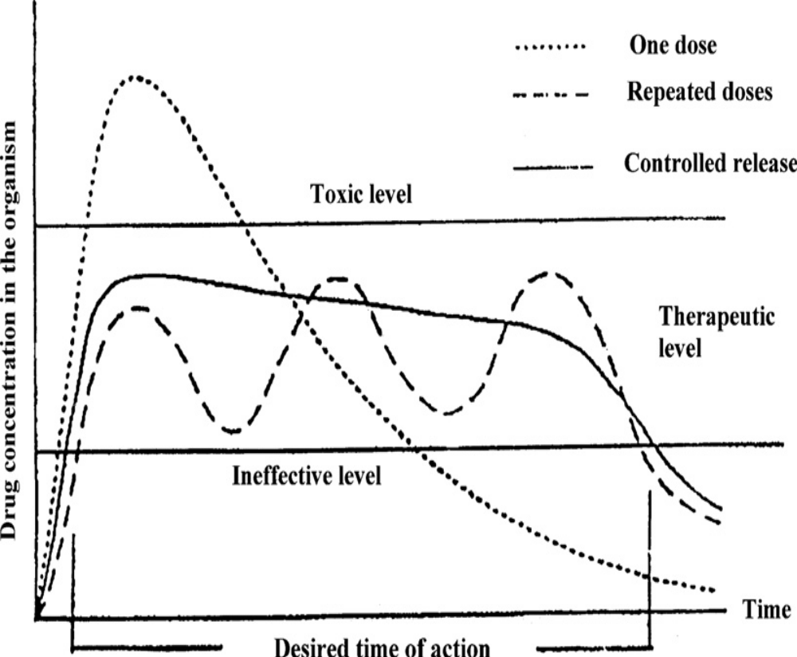
To maintain an ideal pharmacokinetic profile
Why control drug delivery?
Goals:
  Deploy to a target site to limit side effects
  Shepard drugs through specific areas of the body without degradation
  Maintain a therapeutic drug level for prolonged periods of time
  Predictable controllable release rates
  Reduce dosing frequent and increase patient compliance
Plot of drug concentration versus time for different release methods

Slide 7
In an ideal case scenario, such a profile can be achieved by use of the polymer matrix as drug releasing device which :
Releases the drug in controlled and sustained manner to maintain the therapeutic level
In addition, the polymeric materials provide the most important avenues for research:
Primarily because of their ease of processing
Ability of researchers to control their physical and chemical properties

Slide 8
Reservoir
Monolithic
Hydrogels
Polymer based drug delivery devices
Osmotically controlled devices
Beads
Enteric coating &
tablets
Microspheres & Nanospheres
Prodrug devices

Slide 9
Among these :
Hydrogels, specially based on the polysaccharides:
Attracted considerable attention
Act as a smart candidate
For the control release of therapeutic agents
To specific sites in the GI tract

Slide 10
Hydrogels
Hydrogels are cross-linked, hydrophilic, 3-D polymer networks
Swell quickly by imbibing a large amount of water (> 20% of their dry mass)
or de-swell in response to changes in their external environment.
The volume phase transitions as a response to different stimuli
Make these materials interesting objects of scientific observations
Useful materials for use in drug delivery systems.
mer
mer
mer
mer
mer
mer
mer
mer
Add water
mer
mer
mer
mer
mer
mer
mer
mer

Slide 11
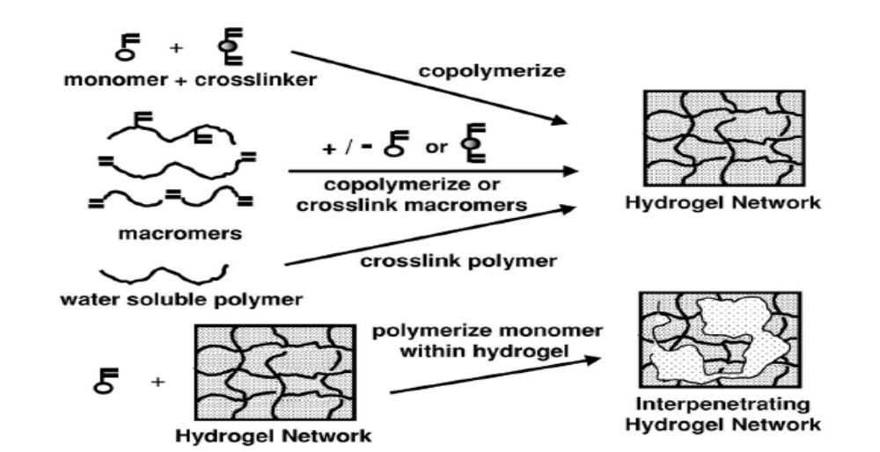
Preparation of hydrogels
Bulk Polymerization 2. Solution Polymerization 3. Suspension Polymerization
Schematic methods for formation of crosslinked polymers

Slide 12
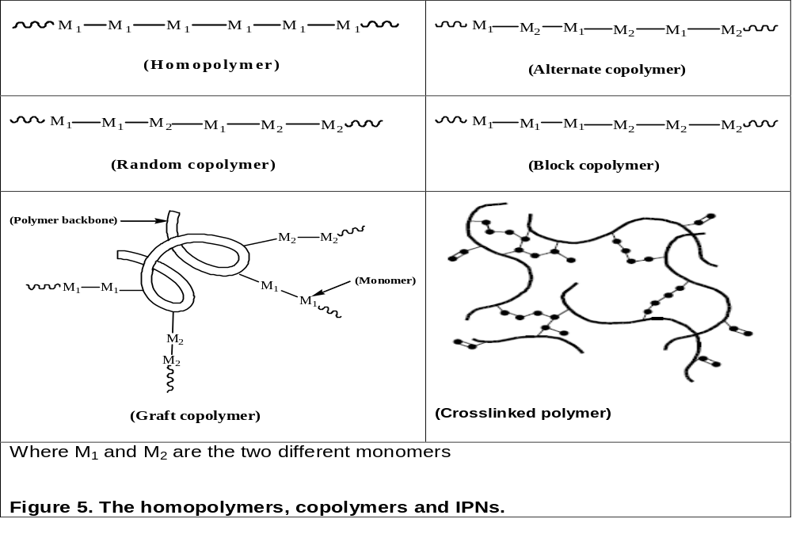

Slide 13
The goal of oral insulin delivery devices is to design:
pH responsive hydrogels
To protect the sensitive drug from
Proteolytic degradation in the acidic environment (stomach) and
Upper portion of the small intestine before releasing in the small intestine

Slide 14
Polysaccharide based hydrogels
Polysaccharide-based formulations are non-toxic, safe, biocompatible, biodegradable, abundant and colon specific.
Polysaccharide based hydrogels:
Enhance the intestinal absorption of insulin
Increase the relative pharmacological bioavailability of insulin
Psyllium is medicinally important natural polysaccharide and hydrogels developed from it will have all the properties.

Slide 15
Psyllium
Derived from the dried, ripe seeds of Plantago psyllium
A white fibrous hydrophilic material which forms the
colorless mucilaginous gel by absorbing water.
Chemically, it is composed of hemicellulose which consists of
xylan backbone linked with arabinose, rhamnose and
galacturonic acids units collectively known as arabinoxylans.
Arabinoxylans have β-1,4-linked D-xylopyranose units joined in
linear fashion and side branches of α-L-arabinofuranose residues.
Furanose conformations of side branches are the sites of water
absorption due to their flexible nature.

Slide 16
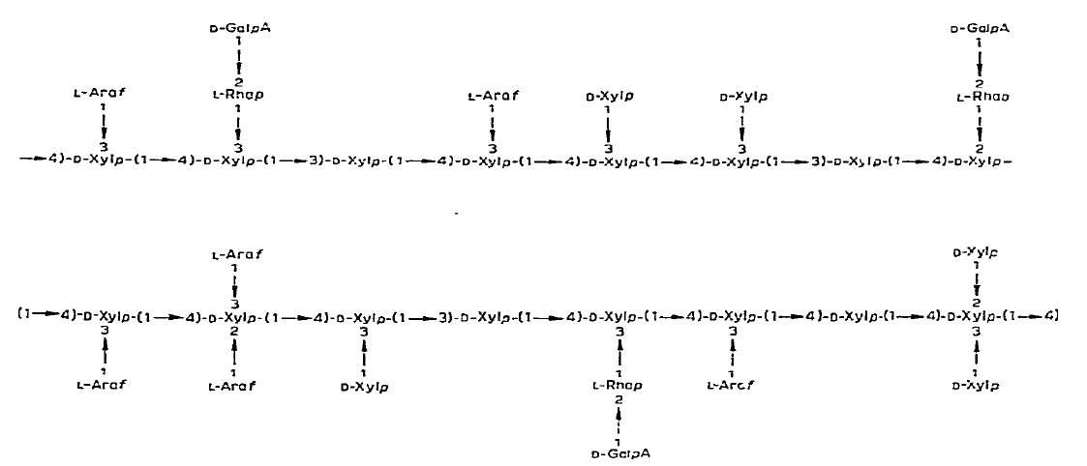
Main structural features of the mucilage from Plantago ovata Forsk.

Slide 18
Psyllium as therapeutic agent
Constipation
Diarrhea
Irritable bowel
syndrome
Ulcerative
colitis
Colon cancer
Diabetes
Cholesterol
lowering

Slide 19
Psyllium and Diabetes
Psyllium has been proposed as a possible treatment for high blood sugar level and viscous form of psyllium have shown improved blood control by:
Trapping the ingested carbohydrates inside the viscous gel formed after digestion
As a result sugar are absorbed into the blood stream more slowly
It increases the viscosity of intestinal contents
Therefore decrease the rate of absorption of glucose, bile acids and other nutrients
Decreases postprandial glucose concentrations

Slide 20
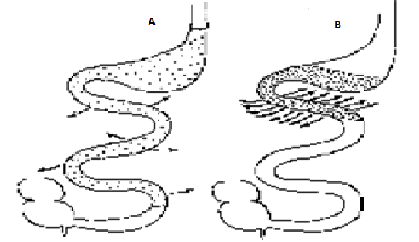
Mechanism of action of gel forming fiber is related to:
Ability to increase the viscosity of the gastrointestinal contents
Thus, interfere with motility and absorption
Improves glucose tolerance in diabetes, due to
Retarded gastric emptying and increased intestinal transit
Schematic representation of stomach and small intestine showing:
(A)slow digestion and absorption of 'fibre rich‘ diet and
(B) rapid digestion and absorption of energy-dense food from low fibre diets

Slide 21

Insulin as a model drug
Insulin is a hormone that :
Regulates the amount of glucose (sugar) in the blood
Required for the body to function normally
Without insulin, the blood glucose builds up in blood
Cells are starved of their energy source.

Slide 22
Keeping in view, the pharmacological importance of psyllium polysaccharides to reduce glucose absorption and drug delivery devices based on hydrogels, psyllium, if suitably tailored to prepare the hydrogels, can act as the double potential candidates to develop novel drug delivery systems.

Slide 23
The main objectives of the present study
Modification of natural polymers is important to improve their chemical and physical properties.
  To use psyllium, a medicinally important polysaccharide:
  For developing the novel pH responsive hydrogels for the use in insulin delivery
  To synthesize psyllium and vinylic monomers (acrylamide, methacrylamide) based hydrogels by chemical induced crosslinked polymerization
  To characterize these polymers/hydrogels by different physical techniques such as SEMs, FTIR and TGA for evaluation of structural aspects.
  To study the swelling kinetics of the hydrogels as a function of , pH, for the evaluation of swelling mechanism and diffusion coefficients for the swelling of the hydrogels.
  To study the in vitro release dynamics of model drug insulin, from the drug loaded hydrogels in different release medium, for the evaluation of the release mechanism and diffusion coefficients.

Slide 24
Materials and Method
Plantago psyllium (Sidpur Sat Isabgol factory, India)
Acrylamide, Methacrylamide (Merck Schuchardt, Hohenbrunn, Germany)
Sodium potassium tartrate and Folin’s reagent(Merck-Mumbai-India)
Ammonium persulphate, Copper sulphate and N-N’-methylenebisacrylamide (S.D Fine, Mumbai-India)
Insulin (Torrent Pharmaceuticals-Mehsana, Gujrat-India)
MONOMER (CH₂=CXY) | X | Y | POLYMER -(CH₂-CXY-)n
Acrylamide( AAm) |  | H | Poly(AAm)
Methacrylamide(MAAm) |  | CH₃ | Poly(MAAm)

Slide 25
Synthesis of Hydrogels
Graft copolymerization method
STEP-1
By free radical polymerization.
STEP-2
Psyllium
Monomer
(AAm/MAAm)
Water
Crosslinker
(NN’-MBA)
Initiator
(APS)
Stirred
Homogenous
Solution-1
Add in solution 1
Homogenous
Solution-2
Synthesis
Kept at 65°C temperature for 2h
in a reaction system.
Hydrogels thus formed
Stirred
Psy-cl-poly(AAm) hydrogels
Psy-cl-poly(AAm-co-MAAm) hydrogel
2h with distilled water and
2h with ethanol and then
dried in oven at 40°C

Slide 26
Release dynamics of Insulin from drug loaded hydrogels
Preparation of
calibration curves
Drug loading to
polymer matrix
Drug release
from
polymer matrix
Insulin
Swelling equilibrium
method at 37ºC
for 24hrs
Distilled water
λ_{max} 768nm
pH 2.2 buffer
λ_{max} 753 nm
pH 7.4 buffer
λ_{max} 758nm

Slide 27

Mechanism of swelling and drug release
Based on the relative rate of diffusion of water into polymer matrix and rate of polymer chain relaxation, swelling and the drug release profiles classified into three types of diffusion mechanisms:
Normal Fickian diffusion is characterized by n < 0.5,
Case II diffusion by n > 1.0.
Non-Fickian or anomalous diffusion indicates value of n between 0.5 and 1.0
On the basis of power law expression given by Ritger and Peppas shown in figure :

Slide 28
Mechanism for the swelling and release dynamics of drug from hydrogels
Case I or
Simple Fickian diffusion
Case II diffusion
Non-Fickian or Anomalous diffusion
It occurs when the rate of diffusion is much less than that of relaxation
It occurs when diffusion is very rapid compared with the relaxation process
It occurs when the relaxation and diffusion rates are comparable

Slide 29
Mechanism of Polymerization

Slide 32
Characterization
All psyllium crosslinked hydrogels synthesized at optimum reaction parameters were characterized by using:
Scanning electron micrography (SEM)
Energy dispersion X-ray analysis (EDAX)
Fourier transform infrared spectroscopy (FTIR)
Thermogravimetric analysis (TGA)
Swelling studies

Slide 33
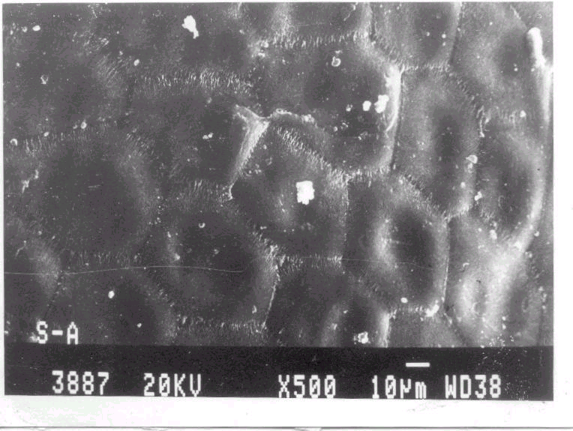
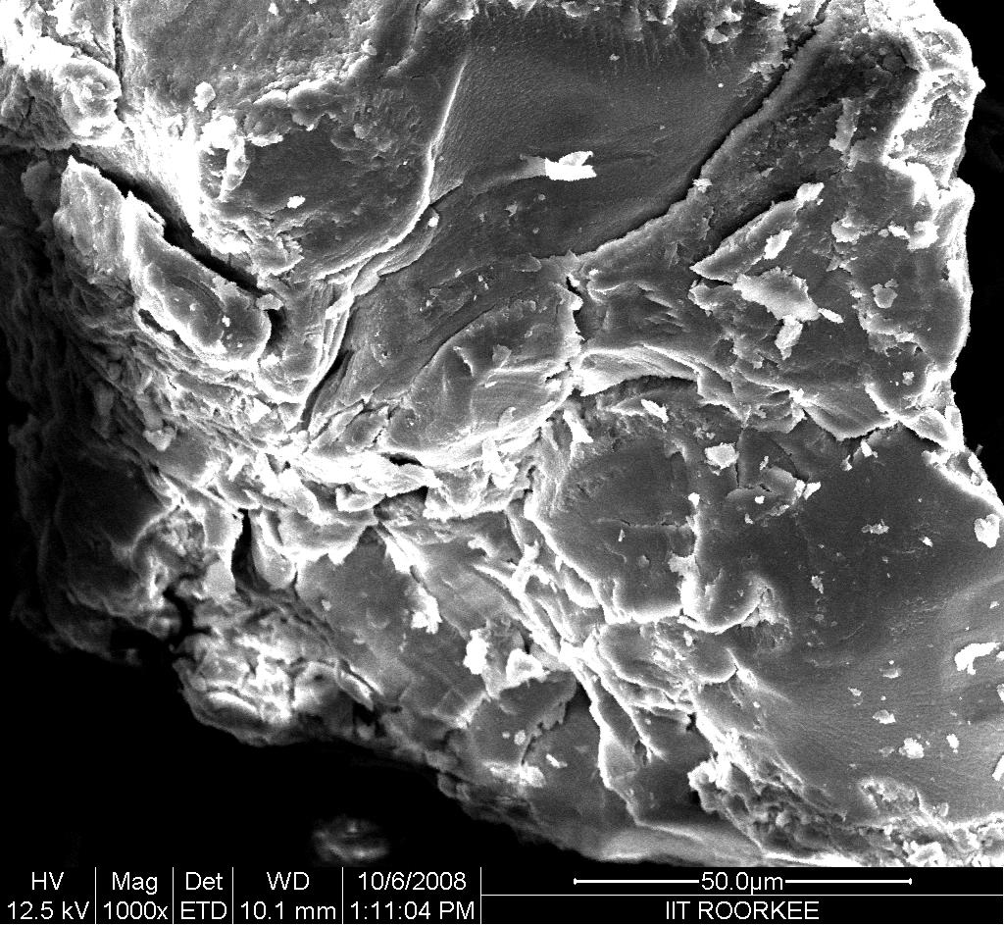
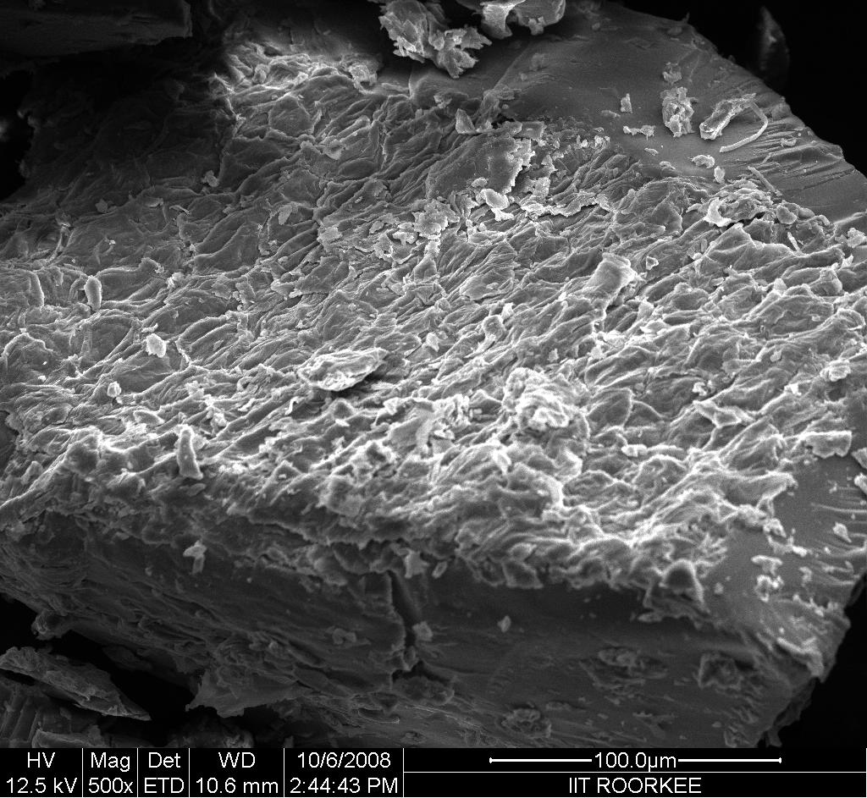
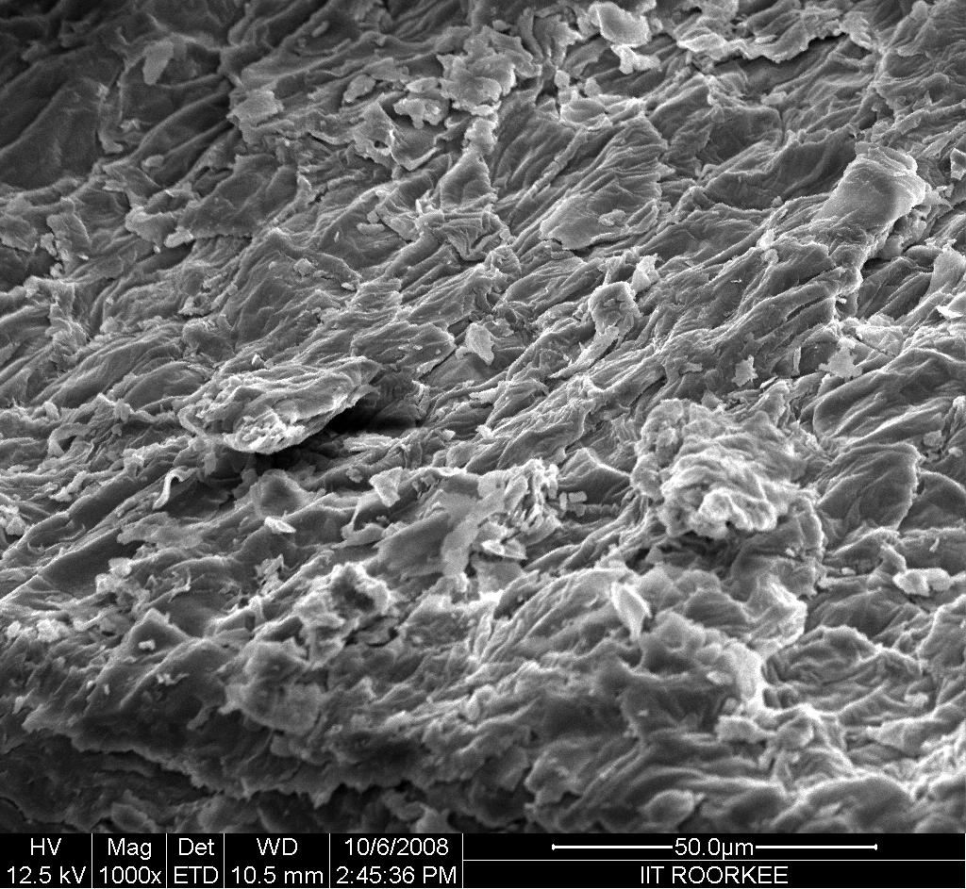
SEMS Analysis
To investigate the surface morphology of crosslinked hydrogels prepared by chemical method SEM’s were taken at different magnification reveals that
Psyllium has homogeneous surface
Crosslinked polymer show a structure heterogeneity-porous structure-regions for water permeation and interaction sites of external stimuli with hydrophilic group of polymers
Psyllium
Psy-cl-poly(AAm) hydrogels
Psy-cl-poly(Aam-co-MAAm) hydrogels

Slide 34
EDAX Analysis
To investigate the elemental composition of psyllium and crosslinked polymeric hydrogels EDAX were taken
Table: Results of EDAX for elemental composition (Wt %) of psyllium and crosslinked hydrogels prepared by chemical method.
Polymers | C | O | N | Na | Ca | K | Cl
Psyllium | 45.66 | 47.79 | -
Psy-cl-poly(AAm) hydrogels | 45.52 | 42.44 | 12.03 | - | - | - | -
Psy-cl-poly(AAm-co-MAAm) hydrogels | 47.22 | 44.13 | 8.65 | - | - | - | -

Slide 35
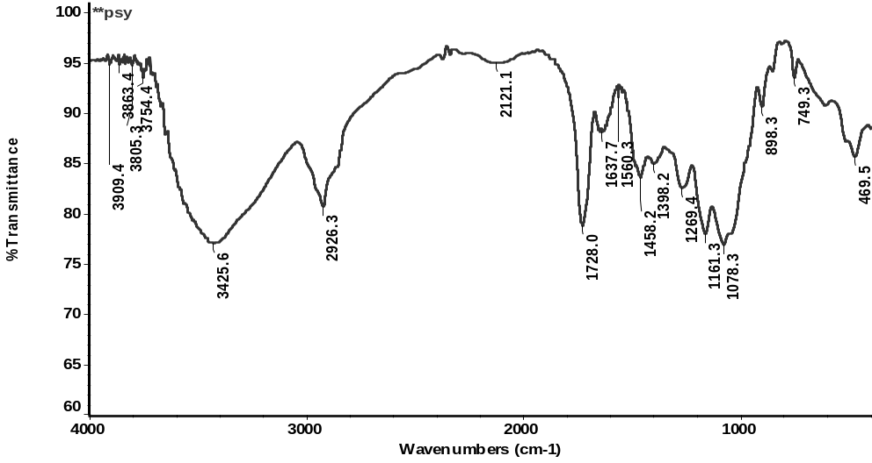
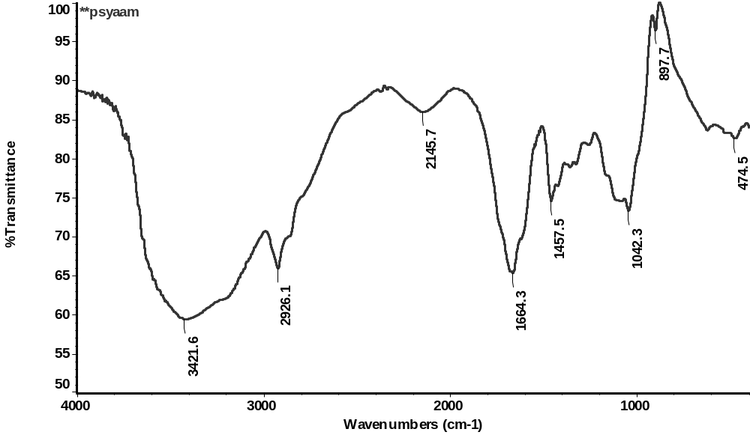
FTIR Spectra
FTIR spectra of psyllium, psy-cl-poly(AAm) polymers were recorded in KBr pellets on Nicolet 5700 FTIR (THERMO).
The absorption bands at:
3425.6 cm⁻¹ = hydroxyl groups, 1200-1030 cm⁻¹ due to C–O and C–O–C stretching characteristic peaks of natural polysaccharides, band at 930-820 cm⁻¹ and 785-730 cm⁻¹ vibrational mode of pyranose ring of polysaccharides.
Besides the absorption peaks on psyllium, , the bands at 1664.3 cm⁻¹ , 1611cm⁻¹ and 1353.4cm⁻¹ due to C=O stretching(Amide-I), N-H in-plane bending(Amide-II) and C-N stretching vibrations(Amide-III) respectively.
Psyllium
Psy-cl-poly(AAm) polymer

Slide 36
TGA Analysis
Psyllium
The primary thermograms (TGA, DTA and DTG) of psyllium and crosslinked polymers were taken. These thermograms were obtained in the range 20-800ºC under air atmosphere at 10ºC/min heating rate.
Psy-cl-poly(AAm)hydrogel
Psy-cl-poly(AAm-co-MAAm) hydrogels

Slide 37
Thermo Gravimetric Analysis
Table: Thermo gravimetric analysis of Psyllium and crosslinked hydrogels prepared by chemical method.
Sample | IDT (ºC) | FDT (ºC) | DT(⁰C) at every 10% weight loss
 |  |  | 10 | 20 | 30 | 40 | 50 | 60 | 70 | 80 | 90 | 100 | Residue left (%)
Psyllium | 220 | 548 | 192 | 278 | 294 | 298 | 301 | 306 | 369 | 424 | 460 | 548 | 1.80
Psy-cl-poly(AAm) | 216 | 622 | 90 | 238 | 269 | 325 | 377 | 451 | 503 | 542 | 581 | 622 | 0.97
Psy-cl-poly(AAm-co-MAAm) hydrogels | 225 | 607 | 115 | 246 | 272 | 313 | 370 | 438 | 499 | 538 | 573 | 607 | 0.54

Slide 38
Since the pH change occurs at many specific or physiological sites in the body, it is one of the important parameters in the design of drug delivery systems. Utilization of pH changes within the GI tract is of special interest for the controlled drug delivery.
To understand the effect of pH on water uptake by the hydrogels, the most common approach used is the study of gel swelling.
Swelling studies were carried out in distilled water, pH 2.2 buffer and pH 7.4 buffer for 24 h at 37 ºC.

Slide 39
Swelling as a function of pH
Swelling has been observed maximum in pH7.4 buffer as compared to pH2.2 buffer because in basic medium–COO⁻ groups ionize and charged carboxylate groups repel each other and expand the polymer networks. Non-Fickian diffusion has been observed

Slide 40
Table : Results of diffusion exponent ‘n’, gel characteristic constant ‘k’ and various diffusion coefficients for the swelling kinetics of psy-cl-poly(AAm) and psy-cl-poly(Aam-co-MAAm) hydrogels in distilled water at 37 ºC.
Drug in releasing medium | Diffusion exponent ‘n’ | Gel characteristic constant ‘k’×10² | Diffusion coefficients (cm²/min)
 |  |  | Initial D_{i}×10⁴ | Average D_{A}×10⁴ | Late Time D_{L}×10⁴
Psy-cl-poly(AAm) based hydrogels
Distilled Water | 0.66 | 1.15 | 4.74 | 7.41 | 0.69
pH 2.2 buffer | 0.54 | 2.75 | 8.51 | 12.83 | 1.35
pH 7.4 buffer | 0.61 | 1.52 | 6.59 | 10.89 | 1.01
Psy-cl-poly(AAm-co-MAAm) based hydrogels
Distilled Water | 0.69 | 0.74 | 1.74 | 3.87 | 0.32
pH 2.2 buffer | 0.70 | 0.68 | 2.36 | 5.16 | 0.38
pH 7.4 buffer | 0.65 | 0.94 | 1.72 | 4.07 | 0.31

Slide 41
In designing a device for oral delivery of sensitive peptide drug such as insulin, it is important to protect the drug in the harsh environment of the stomach and upper GI tract and release the drug into the distal portions of the intestine. Therefore, in an effective carrier the release rates must be significantly greater in neutral or basic conditions than acidic conditions.

Slide 42
In vitro release dynamics of Insulin from Psyllium crosslinked hydrogels
The release of water soluble drug entrapped in a hydrogels occurs :
Water penetrates into the network
Swell the polymer and dissolve the drug
Followed by diffusion along the aqueous pathways to the surface of the device
The release of the drug is closely related to :
Swelling characteristics of the hydrogels which in turn
Key function of chemical architecture of the hydrogels

Slide 43
Release profile of Insulin
The release of insulin has been observed more in pH7.4 buffer as compared to pH 2.2 buffer. This observation may be explained on the basis of swelling of the hydrogels which has also been observed higher in pH 7.4 buffer.

Slide 44
The release of insulin in pH7.4 and pH2.2 buffer occurred through a non-Fickian and Fickian diffusion mechanisms.
The values of initial and average diffusion coefficients (i.e. earlier stages diffusion coefficients) have been observed higher than the late diffusion coefficients.
This may be due to the higher concentration gradient of the insulin in the earlier stages of diffusion than late stages of diffusion.
It means after maintaining the certain concentration, the release of drug from the polymer matrix occurred slowly and this is very important observation for designing the controlled drug delivery systems.

Slide 45
Table : Results of diffusion exponent ‘n’, gel characteristic constant ‘k’ and various diffusion coefficients for the release of model drug (Insulin) from drug loaded hydrogels in different medium at 37ºC.
Drug in releasing medium | Diffusion exponent ‘n’ | Gel characteristic constant ‘k’×10² | Diffusion coefficients (cm²/min)
 |  |  | Initial D_{i}×10⁴ | Average D_{A}×10⁴ | Late Time D_{L}×10⁴
Psy-cl-poly(AAm) based hydrogels
Distilled Water | 0.81 | 0.87 | 18.0 | 16.95 | 2.25
pH 2.2 buffer | 0.38 | 8.39 | 7.47 | 19.88 | 1.60
pH 7.4 buffer | 0.60 | 2.73 | 19.69 | 20.44 | 3.19
Psy-cl-poly(AAm-co-MAAm) based hydrogels
Distilled Water | 0.60 | 3.29 | 8.33 | 7.61 | 1.69
pH 2.2 buffer | 0.40 | 10.69 | 5.82 | 12.75 | 2.01
pH 7.4 buffer | 0.57 | 3.46 | 7.83 | 7.96 | 1.34

Slide 46
Conclusion
From the foregone discussion it can be concluded that :
Drug delivery system developed from the modification of the psyllium have the double potential
Here double potential of these delivery systems is due to :
Therapeutic importance of psyllium to cure the diabetes and
Release of curative agents from drug loaded hydrogels on the other hand
This will release the insulin in the colon in a controlled and sustained manner,
Polymer degradation in the colon will release the psyllium, which itself has been proposed as a glucose lowering agent
Degradation of the polymer matrix and release of drug may exert the synergic effect

Slide 47
It is further it can be concluded that the swelling of the Crosslinked hydrogels:
Higher in pH 7.4 buffer as compared to pH 2.2 buffer
Hydrogels have been found pH responsive
Thus could be exploited for developing the site specific drug delivery systems.
Further reading:
B. Singh, N. Chauhan / International Journal of Diabetes Mellitus 2 (2010) 32–37
B. Singh, N. Chauhan / Food Hydrocolloids 23 (2009) 928–935
Thank You

