Slide 1
NV centers in diamond: from quantum coherence to nanoscale MRI
Nir Bar-Gill
Hebrew University, Jerusalem, Israel
Quantum Conference 2016, London, March 14th 2016

Slide 2
Outline
Introduction to NV centers in diamond
Quantum information processing – dynamical decoupling for better qubits
Noise spectroscopy of shallow NVs
Nanoscale NMR
Summary and outlook

Slide 3
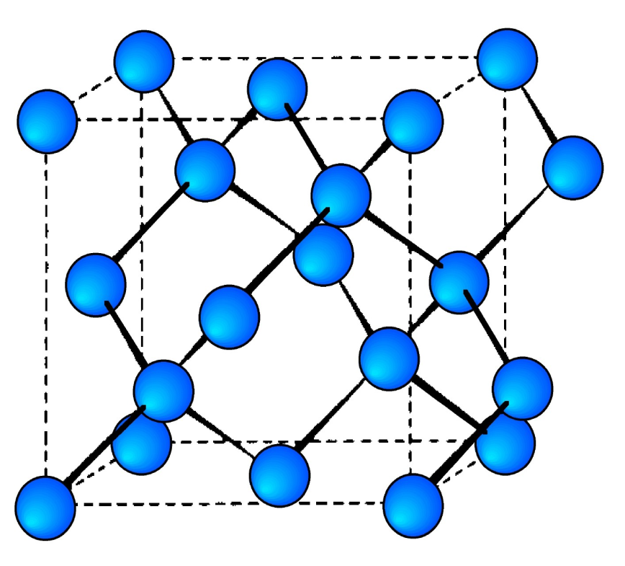
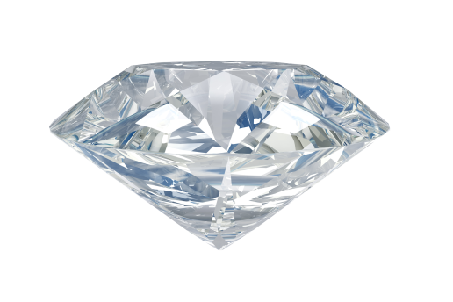
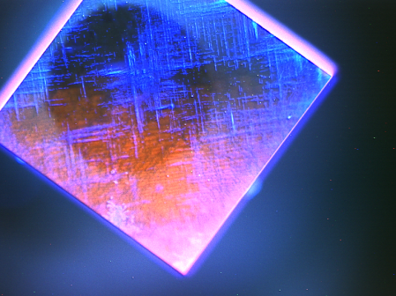
NV Physical Structure
Staggered face-centered-cubic lattice of C
Nearest-neighbor pair of substitutional Nitrogen
and lattice Vacancy (NV)
Recent advances in diamond growth and implantation allow control of defect concentrations
V
N

Slide 4
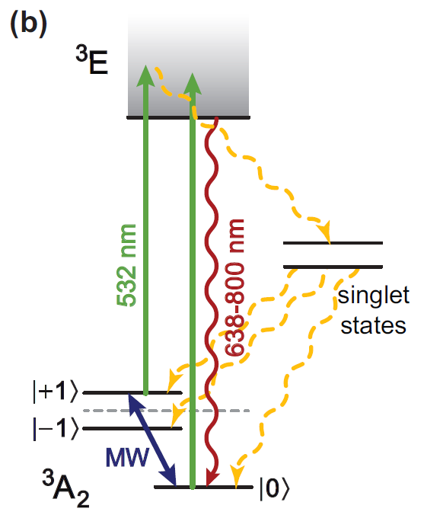

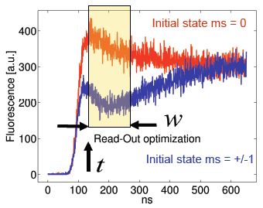
NV⁻ electronic structure
532 nm light pumps into the state
State read out from a fluorescence measurement before optical pumping occurs
Coherent spin manipulation with microwave fields at ~3GHz
Zeeman shift allows magnetometry along NV axis
qubit

Slide 5
NV Spin Decoherence
NV spin decoherence is due to fluctuating dipolar fields from N electron and ¹³C nuclear spins in environment
Focus on N-induced decoherence
N
NV spin environment:
N
V
¹³C
¹³C nuclear spin impurities
N
Substitutional Nitrogen paramagnetic impurities
N
¹³C

Slide 6
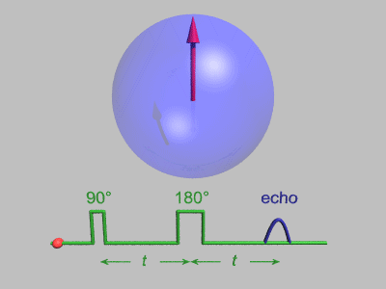
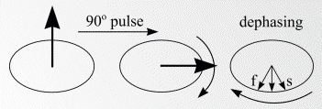
Fighting decoherence:
Hahn echo and dynamical decoupling
Efficient for slow noise
Use more 180° pulses to suppress faster noise – increase T₂

Slide 7
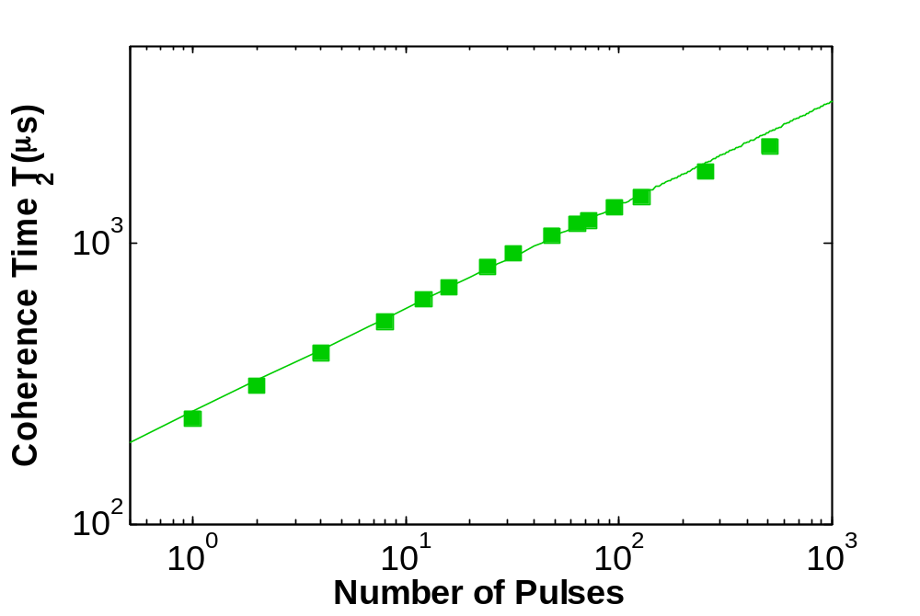
Enhanced coherence time through dynamic decoupling
N = 512
T₂ = 2.2 ms
N = 1
T₂ = 250 μs
L. M. Pham, N. Bar-Gill et. al, PRB 86, 045214 (2012)

Slide 8
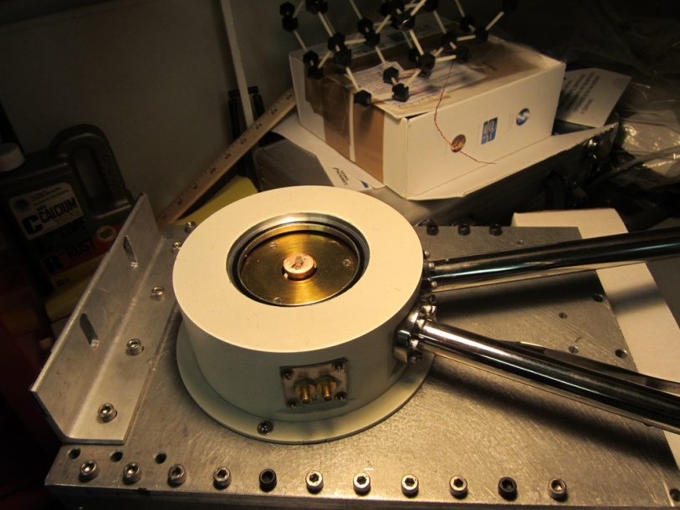
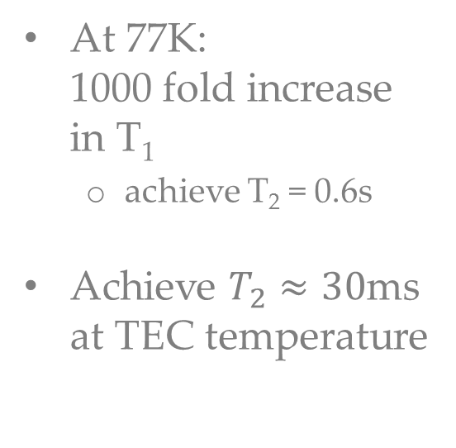
Low temperature:
Increase T₂ by a factor of 1000
At 77K:
1000 fold increase in T₁
  achieve T₂ = 0.6s
Achieve $T_{2}≈30$ms at TEC temperature
Nir Bar-Gill et. al., Nat. Commun. 4, 1743 (2013)

Slide 9
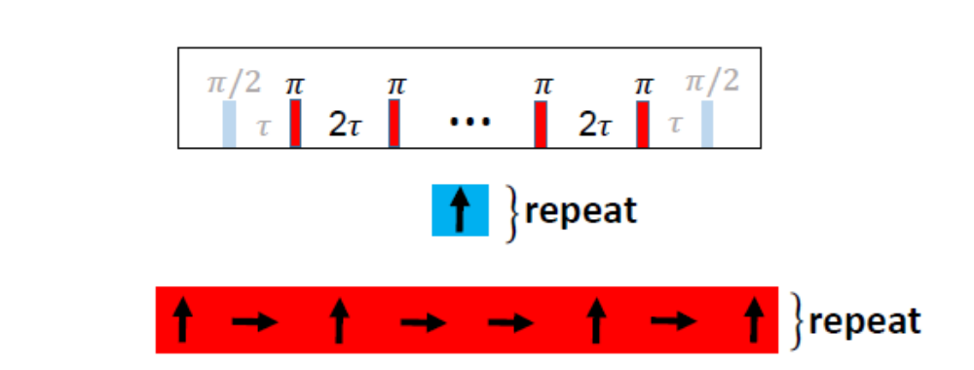
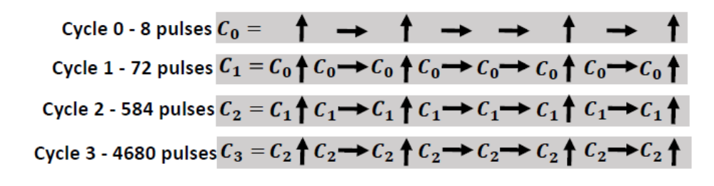
Optimized dynamical decoupling for arbitrary states
Modified control sequences:
CPMG:
XY8:
Concatenated XY8:
D. Farfurnik et. al., PRB 92, 060301(R) (2015)

Slide 10
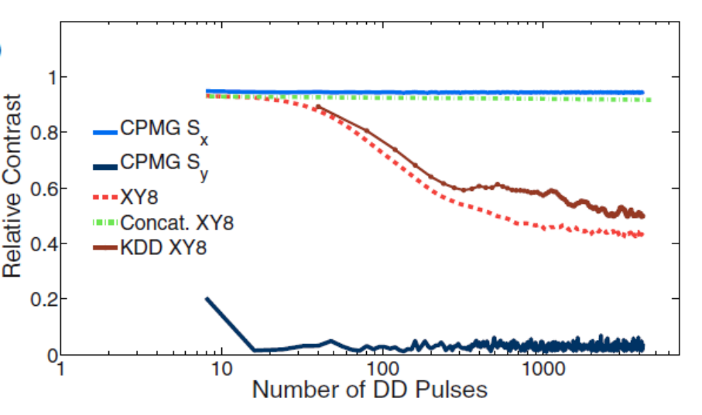
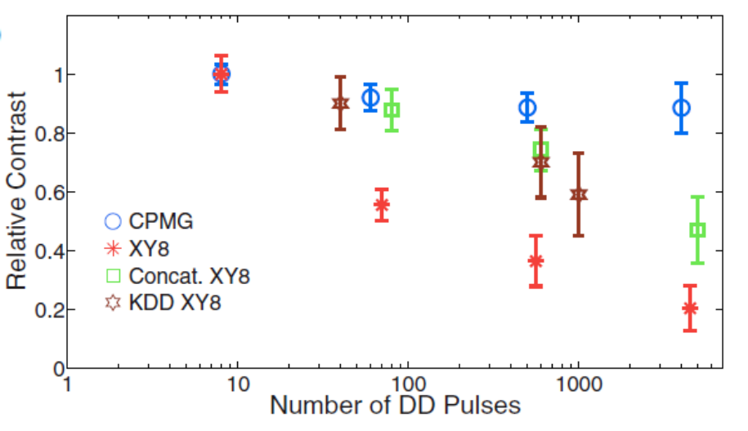
Optimized dynamical decoupling for arbitrary states
Fidelity of quantum state (contrast):
simulation
experiment

Slide 11
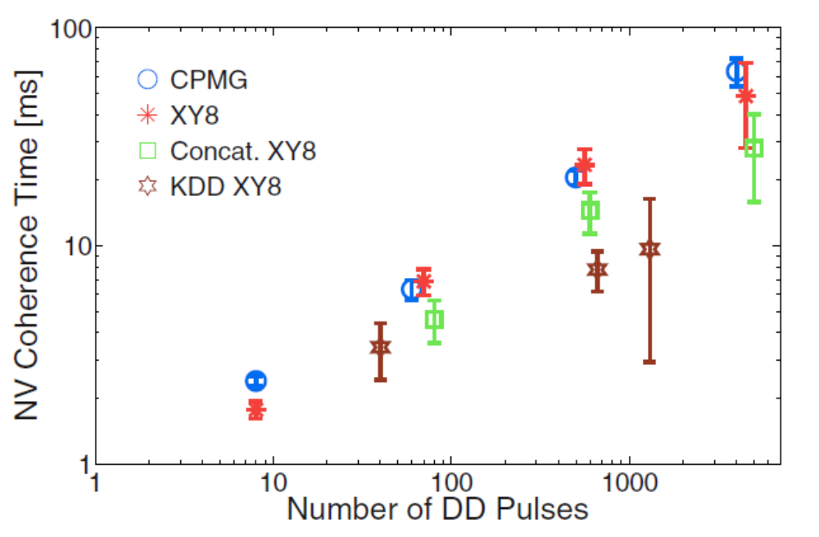
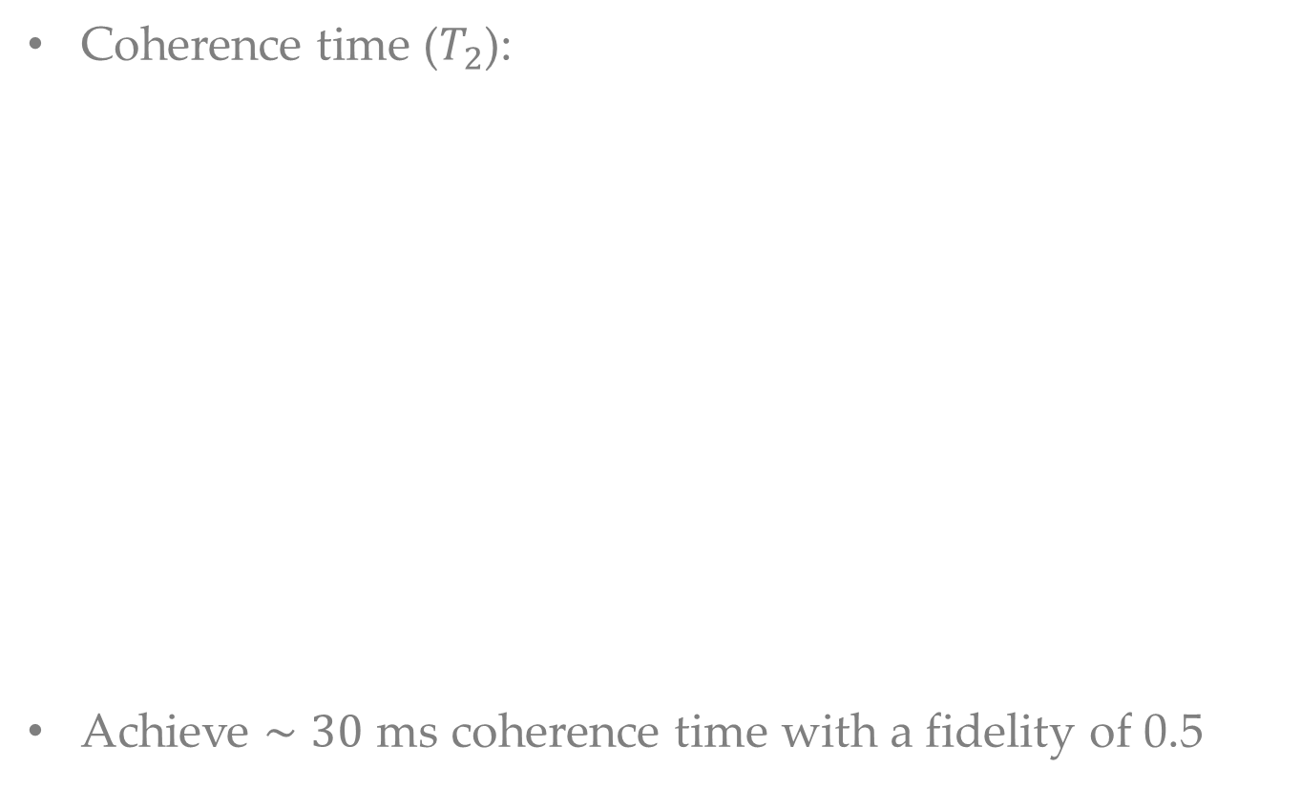
Optimized dynamical decoupling for arbitrary states
Coherence time ($T_{2}$):
Achieve $∼30$ ms coherence time with a fidelity of 0.5

Slide 12
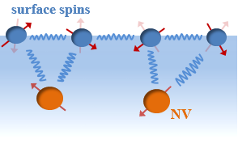
Noise experienced by shallow NVs
Study noise experienced by shallow NVs as a function of depth, temperature, surface coating, magnetic field
Related recent work
  Degen group
  Rosskopf et. al., PRL 112, 147602
  Jayich group
  Myers et. al., PRL 113, 027602
Y. Romach et. al., PRL 114, 017601 (2015)

Slide 13
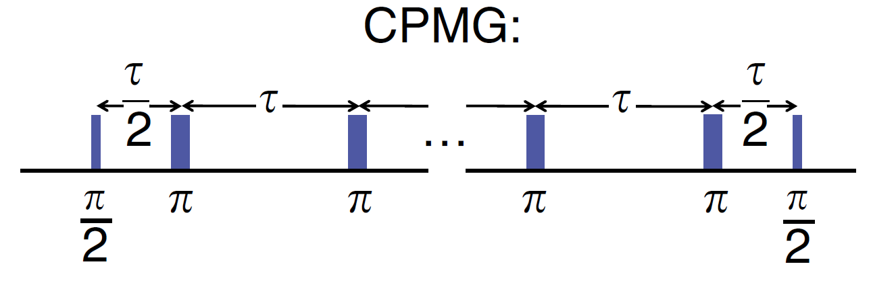
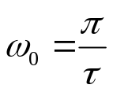
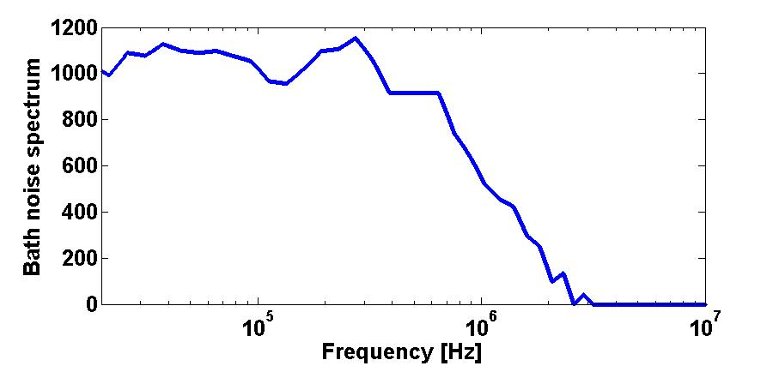
Probing the spin-bath in Bulk
Dynamical decoupling pulse sequences (CPMG) are periodic in time
Act as a “lock-in” detector
In bulk, extract Lorentzian spectrum
N
V
N
N
¹³C
N. Bar-Gill et. al, Nat. Commun. 3, 858 (2012)
Notes:
13

Slide 14
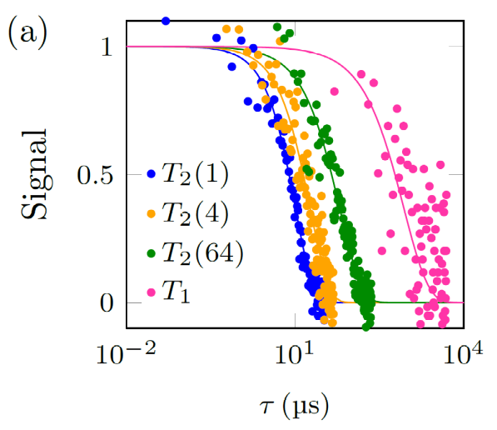
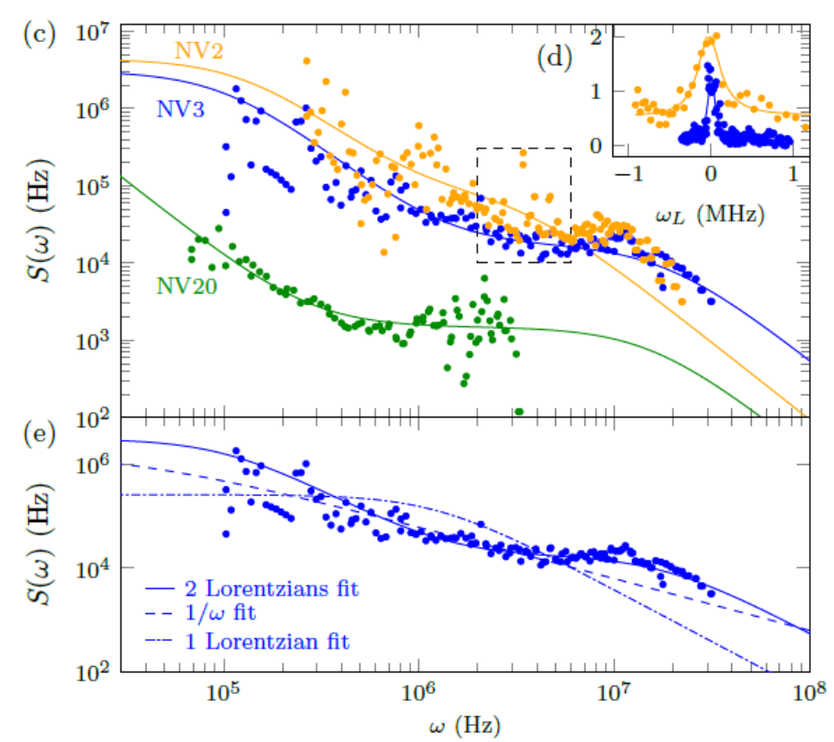
Shallow NV noise spectrum
Use decoherence measurements on several NVs to extract noise spectrum and compare to commonly encountered spectra (Lorentzian, 1/f)
Best fit to a
double-Loretzian
  2 distinct noise sources
  (fast and slow)

Slide 15
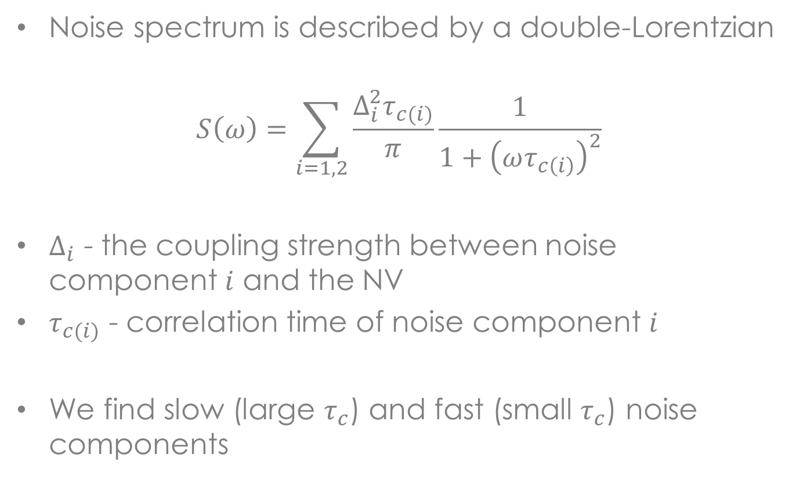
Two noise sources
Noise spectrum is described by a double-Lorentzian
$$S\left(ω\right)=\sum_{i=1,2}{\frac{Δ_{i}^{2}τ_{c(i)}}{π}\frac{1}{1+{\left(ωτ_{c\left(i\right)}\right)}^{2}}}$$
$Δ_{i}$ - the coupling strength between noise component $i$ and the NV
$τ_{c(i)}$ - correlation time of noise component $i$
We find slow (large $τ_{c}$) and fast (small $τ_{c}$) noise components

Slide 16
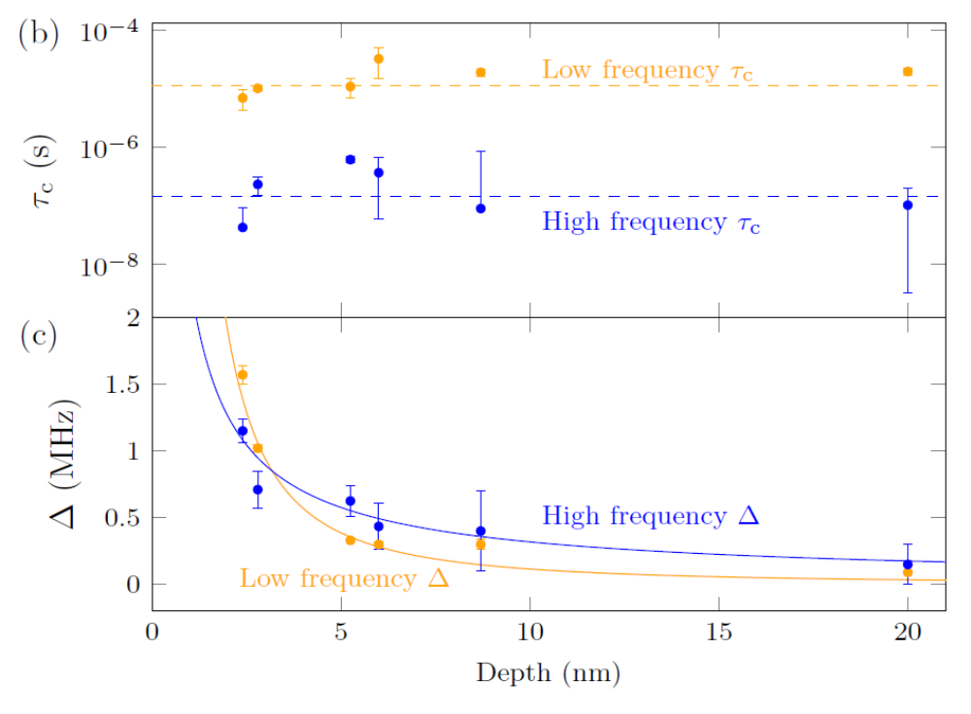
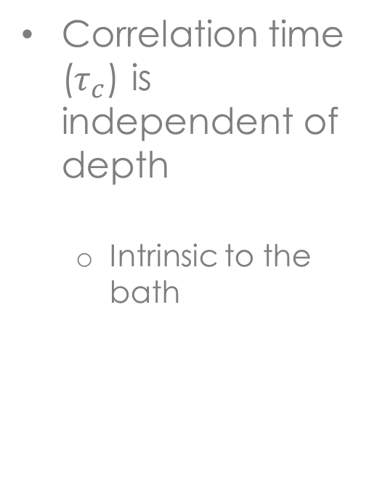
Noise vs. NV depth
Correlation time ($τ_{c}$) is independent of depth
  Intrinsic to the bath

Slide 17
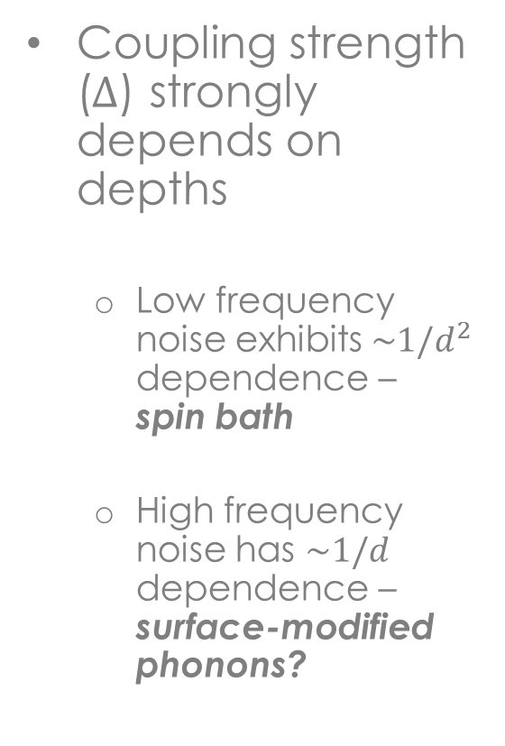
Noise vs. NV depth
Coupling strength ($Δ$) strongly depends on depths
  Low frequency noise exhibits$\sim 1/d^{2}$ dependence – spin bath
  High frequency noise has $\sim 1/d$ dependence – surface-modified phonons?

Slide 18
Surface noise analysis
Identify 2 distinct noise sources
  Slow – surface spins controlled by spin-spin interactions
  Fast – surface modified phonons (?)
Additional studies still needed
  Various surface terminations/coatings (N- termination)
  Theoretical analysis of modified phononic behavior near diamond surface
  Nanoscale structures

Slide 19
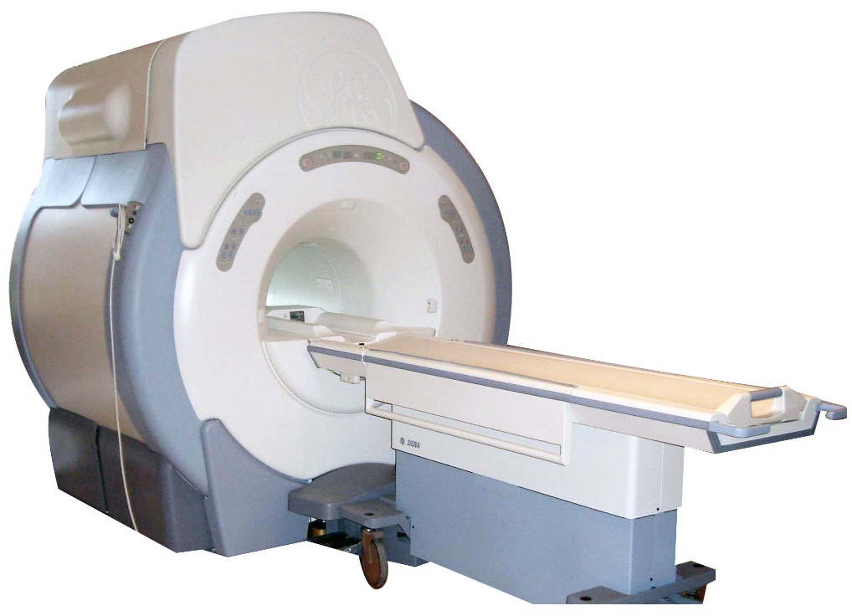
NMR Spectroscopy
Perform spectroscopy on nuclear spin species to extract physical, chemical and biological properties (e.g., structure, dynamics, chemical environment, etc.) of atoms and molecules
Conventional NMR
Inductive detection
Macro-scale sample volume
Thermal spin polarization

Slide 20
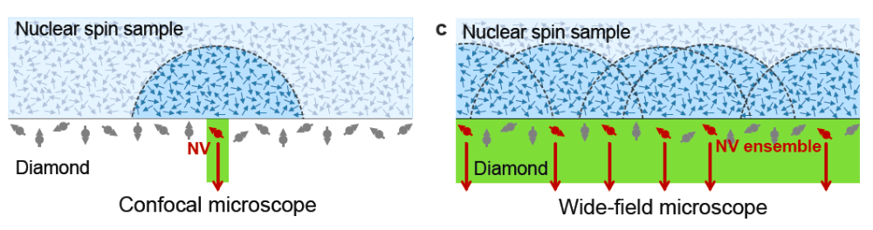
NMR Spectroscopy
NV Diamond NMR
Optical detection
Nano-, micro-scale sample volume
Statistical spin polarization
S. DeVience et. al., Nat. Nanotech.,10, 129-134 (2015)

Slide 21
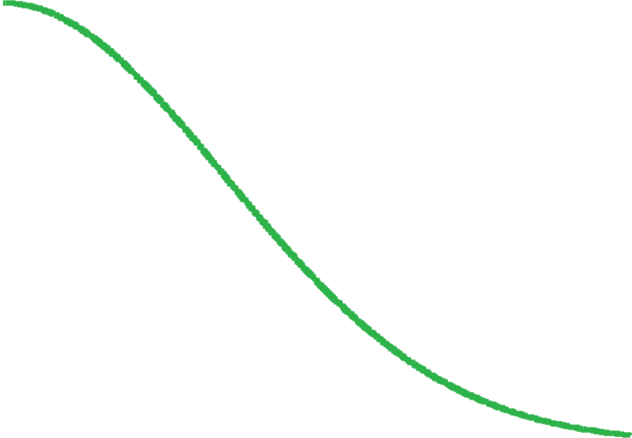
NV Diamond NMR detection scheme
τ
τ
τ
τ
τ
τ
τ
τ
τ
2
2
XY8-n
π
π
( )
( )
( )
( )
π
π
( )
( )
( )
( )
( )
π
π
π
π
π
( )
2
x
y
x
y
y
x
y
π
2
x
x
x
x n
NV coherence
Free precession time τ

Slide 22


NV Diamond NMR detection scheme
τ
τ
τ
τ
τ
τ
τ
τ
τ
2
2
XY8-n
π
π
( )
( )
( )
( )
π
π
( )
( )
( )
( )
( )
π
π
π
π
π
( )
2
x
y
x
y
y
x
y
π
2
x
x
x
x n
$$f_{ac}^{−1}≪τ$$
$$\left(Δφ\right)≈0$$
In the presence of a fluctuating magnetic field with characteristic frequency f_{ac}
NV coherence
Free precession time τ

Slide 23

NV Diamond NMR detection scheme
τ
τ
τ
τ
τ
τ
τ
τ
τ
2
2
XY8-n
π
π
( )
( )
( )
( )
π
π
( )
( )
( )
( )
( )
π
π
π
π
π
( )
2
x
y
x
y
y
x
y
π
2
x
x
x
x n
$$f_{ac}^{−1}≫τ$$
$$\left(Δφ\right)≈0$$
In the presence of a fluctuating magnetic field with characteristic frequency f_{ac}
NV coherence
Free precession time τ

Slide 24
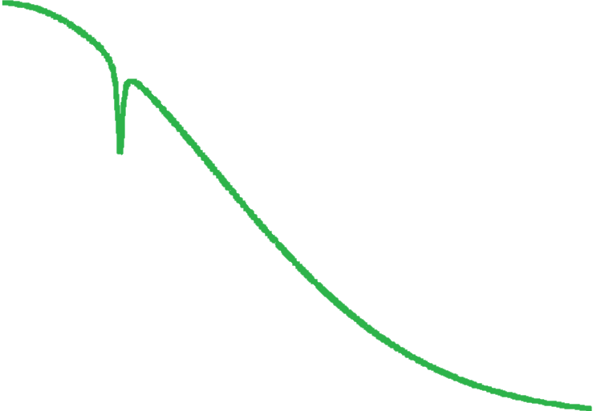


NV Diamond NMR detection scheme
τ
τ
τ
τ
τ
τ
τ
τ
τ
2
2
XY8-n
π
π
( )
( )
( )
( )
π
π
( )
( )
( )
( )
( )
π
π
π
π
π
( )
2
x
y
x
y
y
x
y
π
2
x
x
x
x n
τ₀ = 1/(2f_{ac})
$$f_{ac}^{−1}≃2τ$$
$$\left(Δφ\right)≠0$$
In the presence of a fluctuating magnetic field with characteristic frequency f_{ac}
NV coherence
Free precession time τ

Slide 25
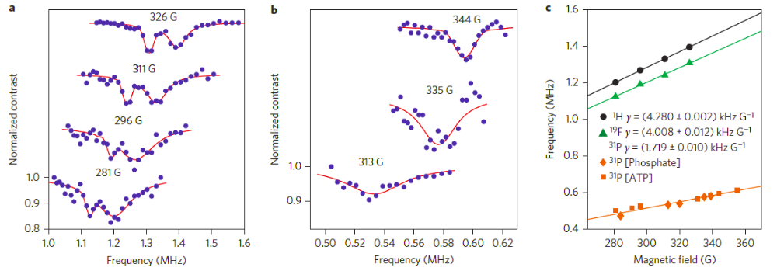
Multi-species NMR
Spectrally identify three spin species (proton, fluorine and phosphorous) using high-order pulse sequences

Slide 26
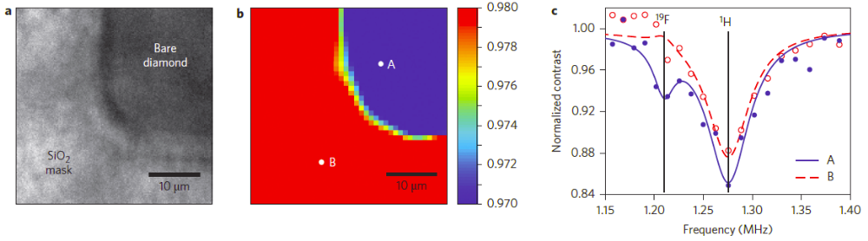
MRI of fluorine
Partially coat diamond with SiO2, and then introduce fluorine
Image optically
on a CCD

Slide 27
Summary and outlook
NVs present a promising new platform for spin physics research and applications
  Nanoscale magnetic imaging
  Quantum information and computing
  Integrated spintronic and photonic devices
Outlook
  Magnetic sensing of various samples (thin layer magnets, bio, …)
  Improved sensitivity at low temperatures
  Improved sensitivity and coherence time through surface termination
  Interaction dominated quantum dynamics in spin ensembles
  Quantum thermodynamics
Notes:
27

Slide 28
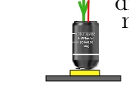
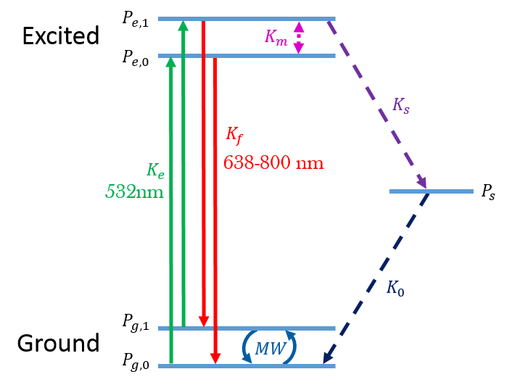
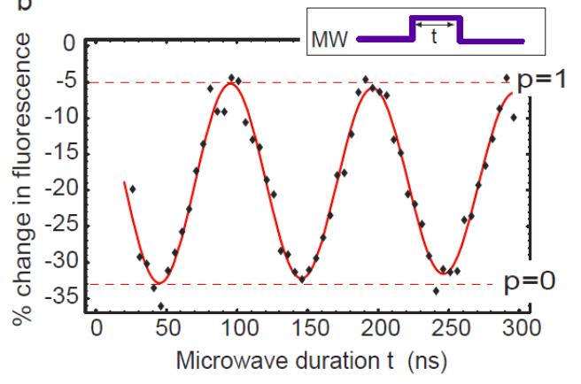
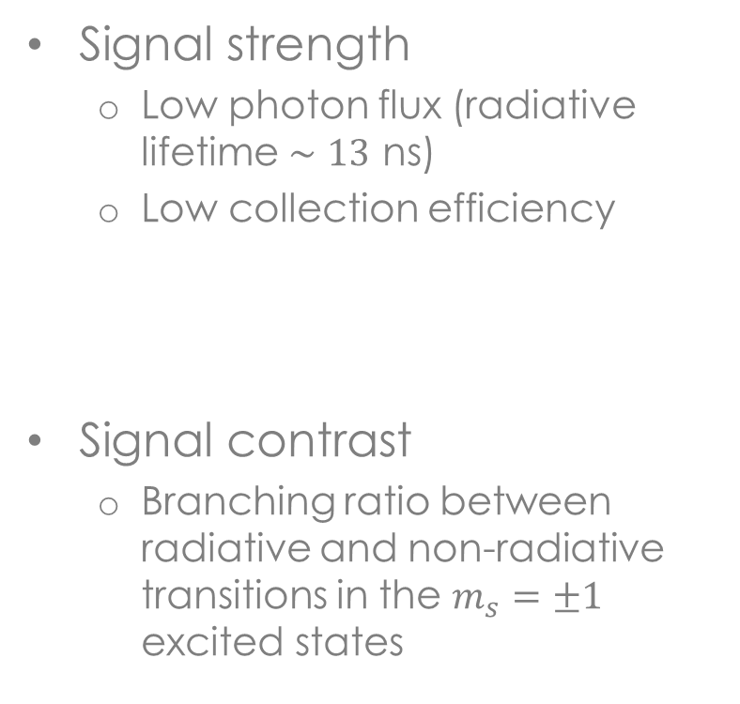
Optical readout: not perfect…
Signal strength
  Low photon flux (radiative lifetime $∼13$ ns)
  Low collection efficiency
Signal contrast
  Branching ratio between radiative and non-radiative transitions in the $m_{s}=±1$ excited states
L. Childress, PhD thesis (2007)

Slide 29
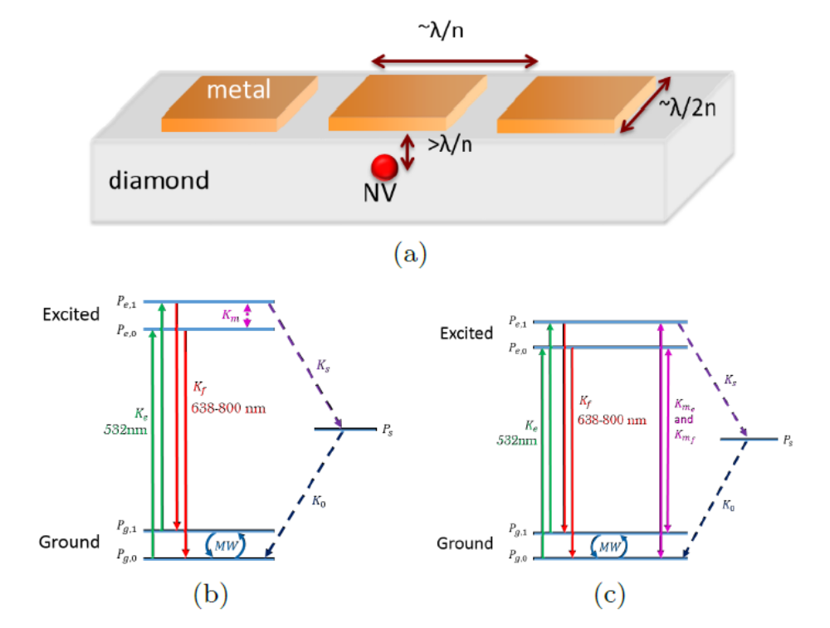
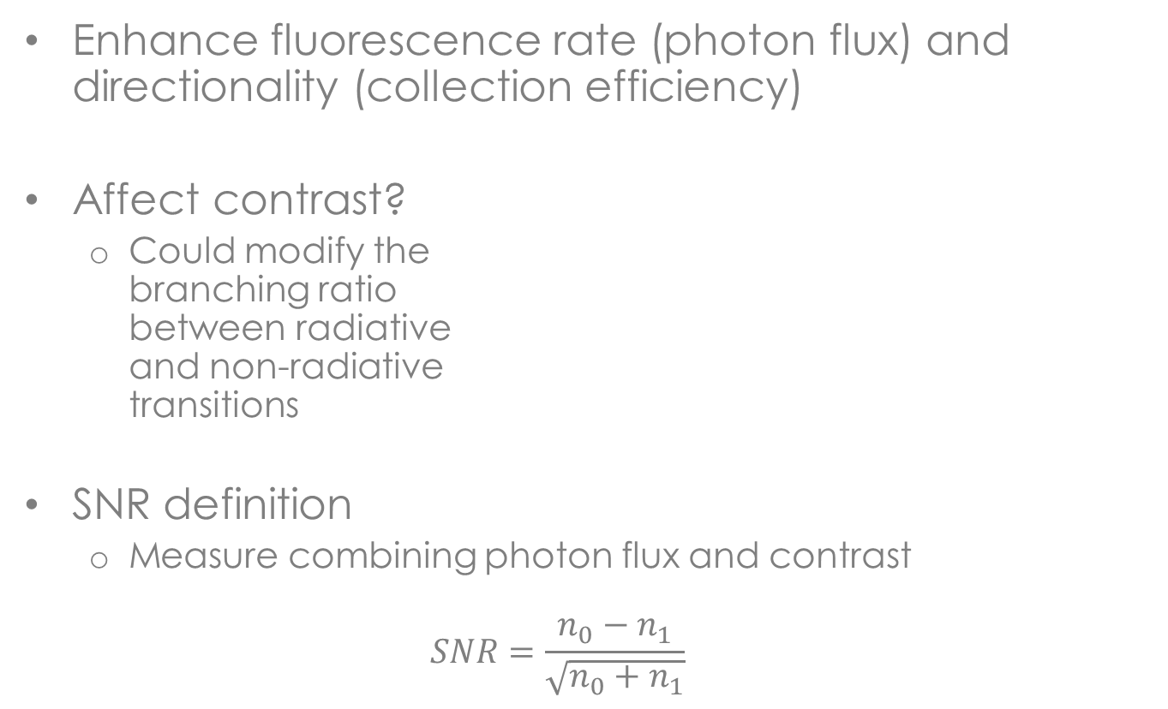

Purcell enhancement for improved spin readout
Enhance fluorescence rate (photon flux) and directionality (collection efficiency)
Affect contrast?
  Could modify the
  branching ratio
  between radiative
  and non-radiative
  transitions
SNR definition
  Measure combining photon flux and contrast
  $$SNR=\frac{n_{0}−n_{1}}{\sqrt{n_{0}+n_{1}}}$$
$$<λ/n$$
S. Wolf et. al., PRB 92, 235410 (2015)

Slide 30
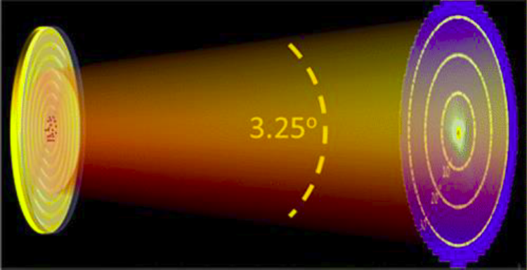
Plasmonic nano-antenna
Demonstrated for quantum dots (Ronen Rapaport)
Achieve directional emission and enhanced collection efficiency
  Metallic dielectric bullseye structure
  Collection efficiency of 30% with NA=0.55
Livneh et. al., ACS Photonics 2, 1669 (2015)

Slide 31
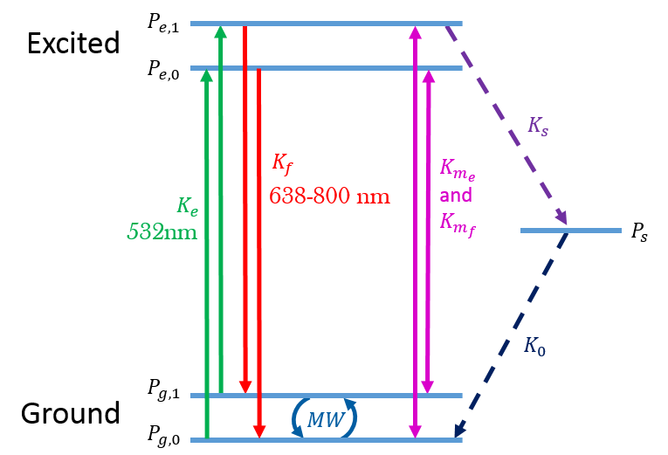
Different spin-mixing terms
It is known that spin mixing occurs in the presence of optical excitation
The physics mechanism is unclear
  Radiative
  Non-radiative
Radiative
Non-radiative

Slide 32
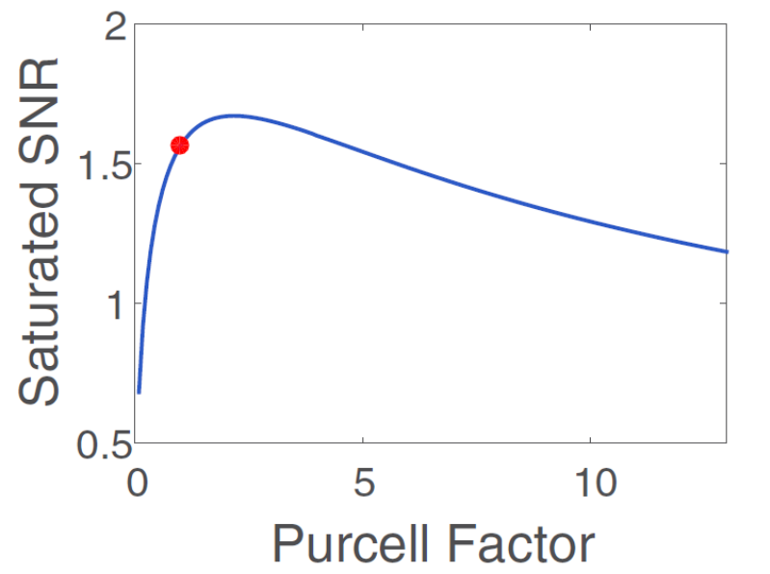
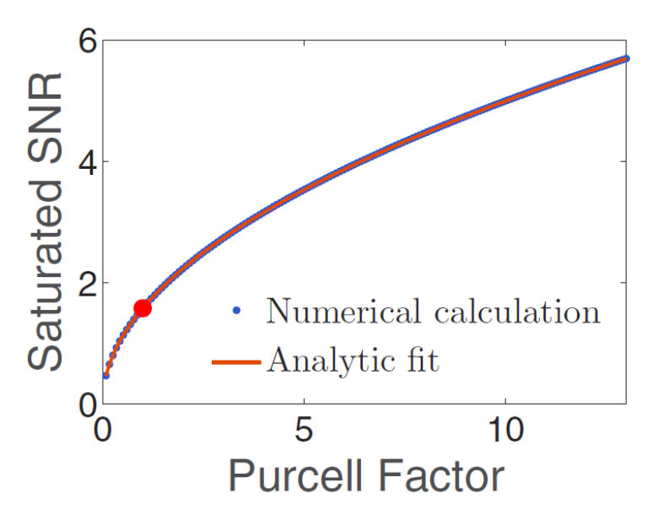
SNR vs. Purcell factor
The effect of Purcell enhancement on the SNR strongly depends on the nature of the spin mixing
  For non-radiatve mixing, and enhanced collection, could reach single-shot readout at PF<10
  Could be used to identify the underlying mechanism
Radiative
Non-radiative

Slide 33
Summary
NVs present a promising platform for quantum information processing and quantum sensing
  Advantage – optical initialization and readout of quantum state
  Disadvantage – Weak coupling to optical degree of freedom and low photon flux
Purcell enhancement of optical readout
  Could improve photon flux and collection efficiency
  Performance dependent on physical mechanism of spin-mixing transitions
  Experimental studies under way…
Notes:
33

