Slide 1

Control of Protease Activity in S. pombe using Gene Silencing Approach
Nipunjot Kaur Soni-Bains
Asst. Professor & Head
Department of Biotechnology
GSS DGS Khalsa College, Patiala
Punjab, India
+91-9417874659, nipunjotsoni@gmail.com

Slide 2
INTRODUCTION
Thousands of genes have been identified and cloned using recombinant DNA technology.
The expression and the production of proteins of interest are important for both basic research, and practical applications.
Hence, the demand for foreign-gene expression systems is increasing rapidly.
Many kinds of foreign-gene expression systems have been developed using different cells as host,like
Escherichia coli, Bacillus,
Streptomyces, Aspergillus,
Yeast, Insect cells,
Plant cells, Mammalian cells.
Each system has its own merits and demerits, so we need to make a choice based on the gene of interest, the amount to be produced, the purpose and final aim.

Slide 3
Prokaryotic cells are commonly used as a host as their manipulation is easy and the production cost is low
Expression of higher eukaryotic genes sometimes results in an inactive product without proper folding and/or post-translational modification
Such problems can be solved using higher eukaryotic cells like animal and plant cells as hosts,
But the manipulation is not easy and the production level is low.
Yeast : a good host for eukaryotic protein production
Eukaryote;
Molecular-biological research is well developed;
Genetic manipulation is easy;
Has been used in the fermentation industry for a long time;
A culture method for it has been established;
It is free from endotoxins, hence is safe to use.

Slide 4
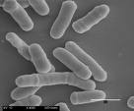

Amongst yeast
fission yeast Schizosaccharomyces pombe is an attractive host model for high-level protein production and functional analysis of eukaryotic proteins:
it shares many molecular, genetic and biochemical features with higher eukaryotes.
distinguishable from other yeasts through its ability to
proliferate by fission rather than budding.
Many of S. pombe cellular processes such as
mRNA splicing,
post-translational modification,
cell-division and cell cycle control,
are closely related to higher eukaryotes.
S. pombe has a developed Golgi apparatus and galactosyl transferase that is not found in other yeast cells.

Slide 5
The fission yeast is therefore an ideal host for high-level production of eukaryotic proteins.
many types of human proteins have been successfully expressed in S. pombe.
e.g. human antithrombin III,
human papillomavirus E7 protein,
and human D2s dopamine receptor
as well as many types of heterologous proteins
The major hurdles in effective production and purification of heterologous proteins from S. pombe is proteolytic degradation of the recombinant gene products by host-specific proteases.
The problem becomes significant when the recombinant protein under production, is secretory and proteolytically sensitive in nature.
In order to overcome this limitation, a number of attempts have been made,
control of cultivation conditions like culture pH, temperature and time;
changing medium contents, e.g. nitrogen and carbon sources
addition of protease inhibitors, peptone, or specific amino acids

Slide 6
These methods have their own limitations.
Controlling growth conditions or adding protease inhibitors might also inhibit cell growth or reduce cell density,
both are essential for high productivity of recombinant proteins during industrial production processes.
Cultivation time cannot be shortened freely in some cases,
e.g. in high cell density fed-batch culturing processes, where the cells must be grown for an extended period
Consequently, Genetic manipulation of the host strain becomes a potent method
Giga-Hama et. al disrupted S. pombe protease genes using specialized vectors for the purpose.
We tried gene Silencing approach for reducing the activity o protease using RNA interference by SiRNA.
RNA interference : A potent tool for gene silencing
RNA interference (RNAi) is a process of post-transcriptional gene silencing (PTGS) by which double stranded RNA (dsRNA) causes sequence-specific degradation of mRNA sequences.

Slide 7
RNA interference : Two Phase Process
Initiation
Small regulatory RNAs are generated via processing of longer double-stranded RNA (dsRNA) precursors by an RNaseIII-like enzyme termed Dicer.
Execution
Loading of small RNAs into large multiprotein complex RISC
Silencing of target gene
Degradation or inhibition of translation
Three major classes of small RNAs are there:
Small interfering RNAs or siRNAs
Micro RNAs or miRNAs
Small heterochromatic RNAs
Both miRNAs and siRNAs silence at the post-transcriptional level by virtue of their sequence complementarity to target mRNAs.

Slide 8
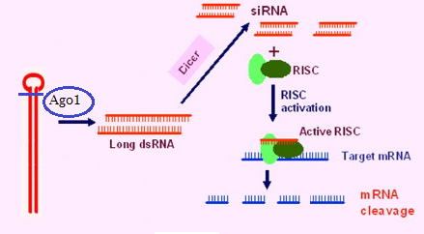
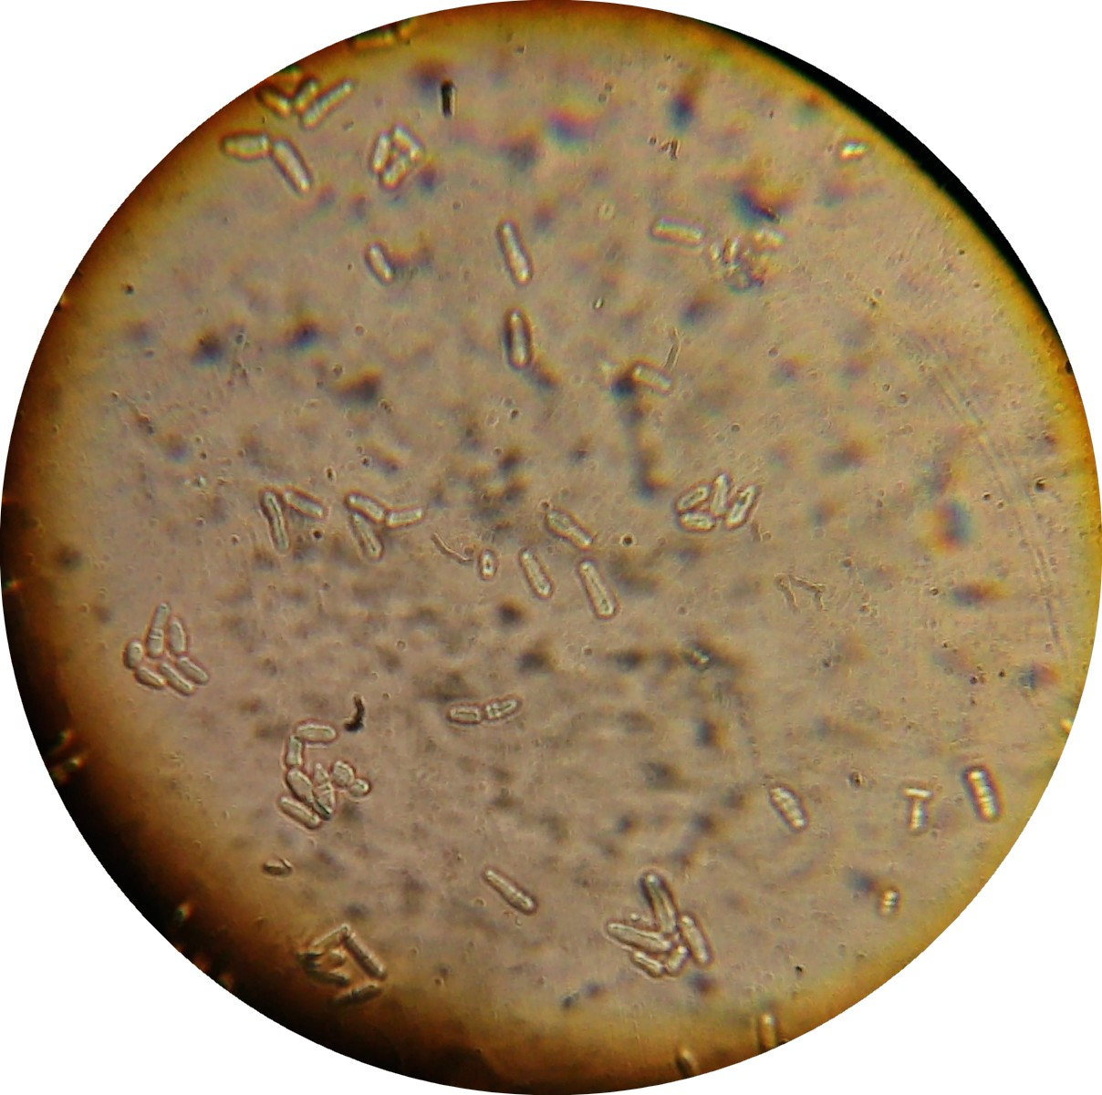
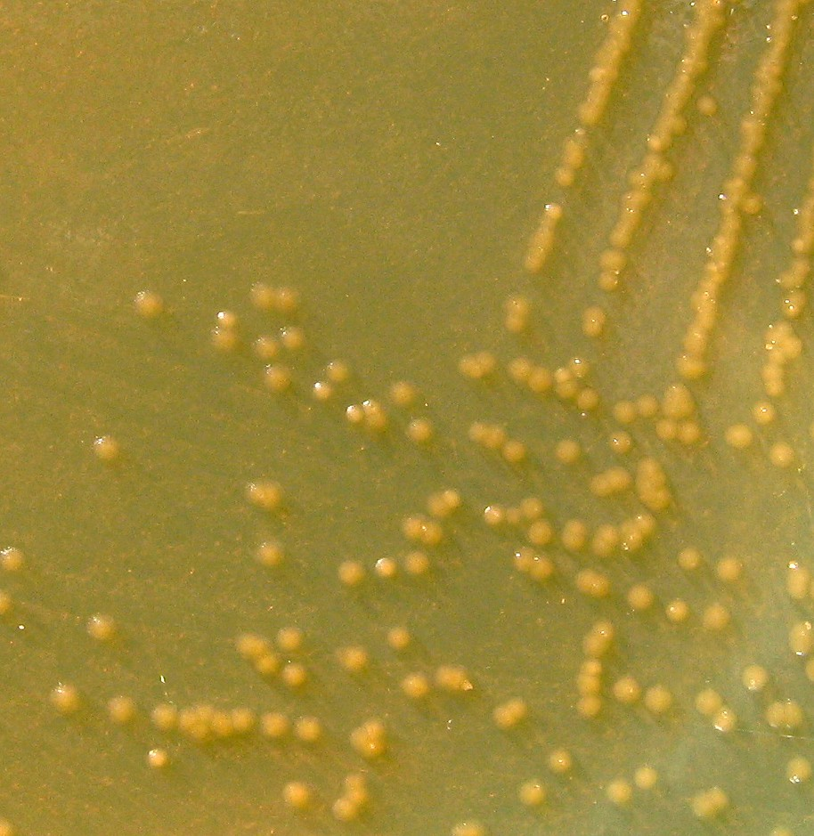
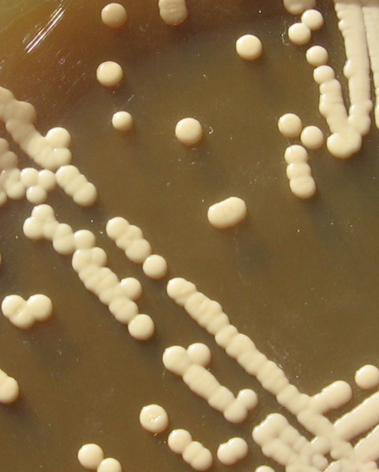
It is evident from literature (Volpe et al) that S. pombe has all the machinery required for RNA interference, so it can be used as a model system to express siRNAs against the proteases which are responsible for degradation of protein of interest.
Keeping all these things in mind this study was aimed to control protein activity by generating siRNAs to silence protease which is acting upon model protein.
Proposed pathway for processing of Gene silencing trigger into classical pathway (Elbashir et al., 2001).
Following S. pombe expression system was used in the study,
which was provided free of cost by yeast Genetic Resource Center of Japan
Expression vectors: pREP1 (LEU2marker; strong nmt1 promoter);
pREP2 (URA4 marker; strong nmt1 promoter)
Escherichia coli DH5α MTCC1652 was used for amplification and preservation of Expression vectors

Slide 9
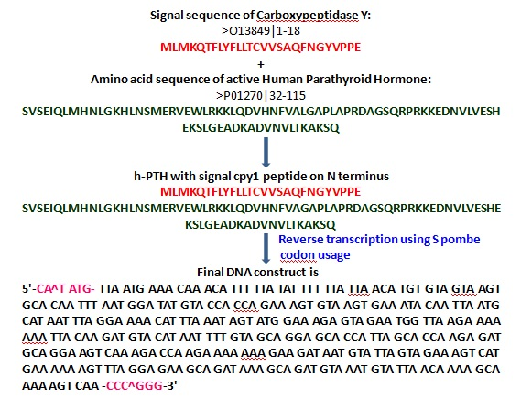
Designing of DNA construct for secretary production of human Parathyroid Hormone (hPTH) and its Synthesis
Human Parathyroid hormone having a chain of 115 AAs was selected as a model protein to check the effect of Protease silencing on production of heterologous proteins in S. pombe. DNA construct of hPTH cDNA was designed for insertion in pREP1 vector having nmt1 strong promoter .
It is designed for secretory production of Human Parathyroid hormone by linking cpy1 (carboxypeptidase Y) secretory signal sequence at 5’ terminus of cDNA sequence of Human Parathyroid hormone.
With the help of various bioinformatics tools the human Parathyroid Hormone (hPTH) gene has been designed in the following steps for cloning and expression in pREP1 vector.

Slide 10
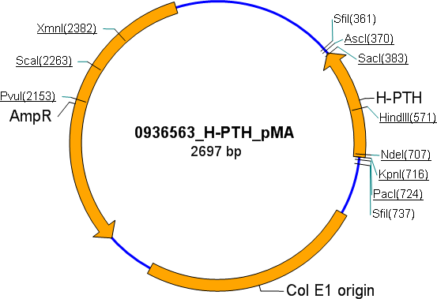
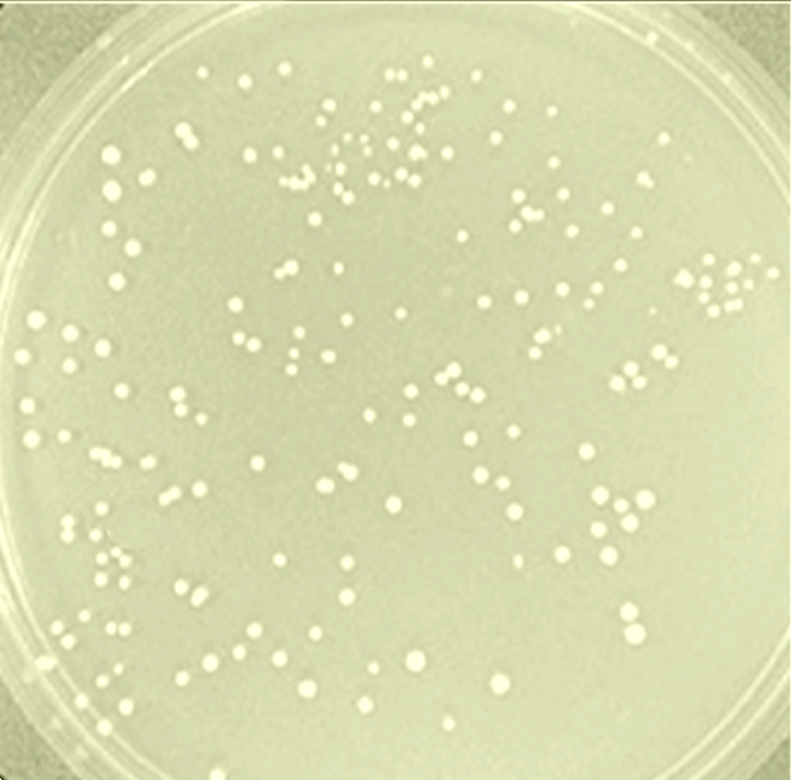
The designed hPTH gene construct sequence was commercially synthesized by GENEART, Germany which supplied it in the vector H-PTH _pMA as shown in Fig.5.
Fig. 5: H-PTH_pMA vector (supplied by GENEART, Germany).
This vector H-PTH_pMA was used to transform in E.Coli DH5α with the standard CaCl₂ method (Sambrook et al., 1989) and colonies were selected on the ampiciline LB agar plates (Fig.6).
Fig.6 Transformed E.Coli DH5α on LB Ampicillin plates

Slide 11
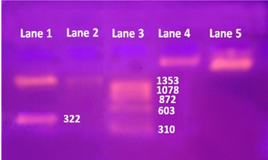
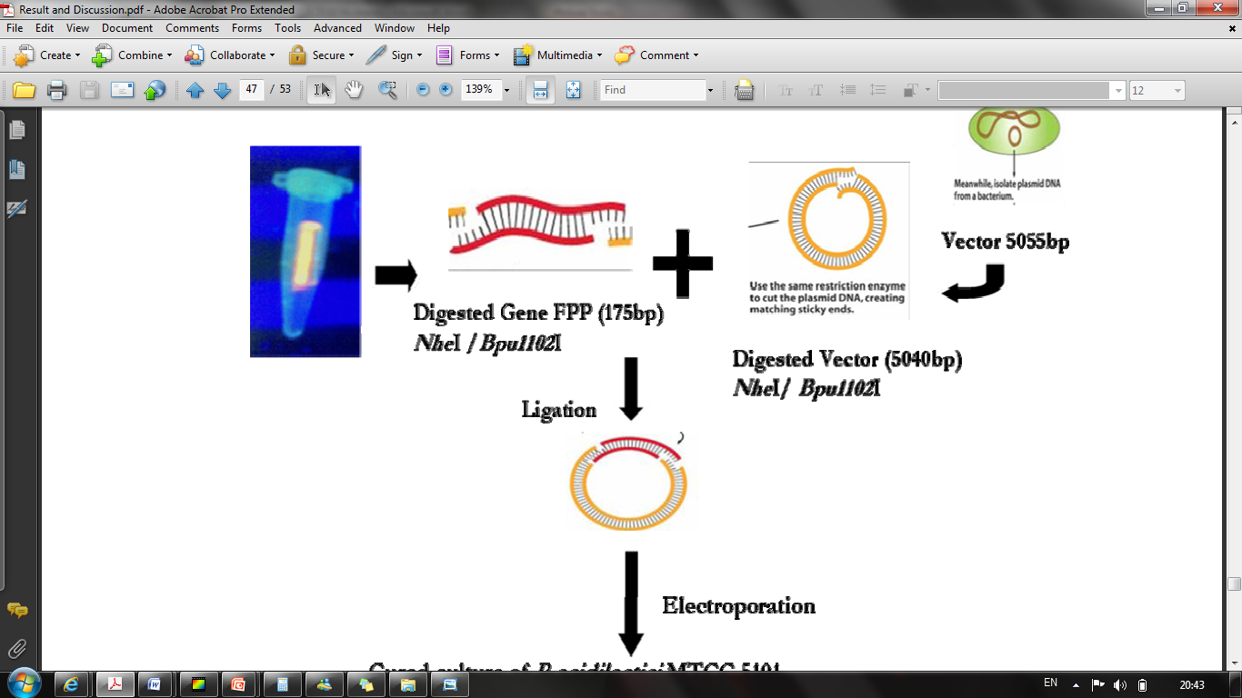
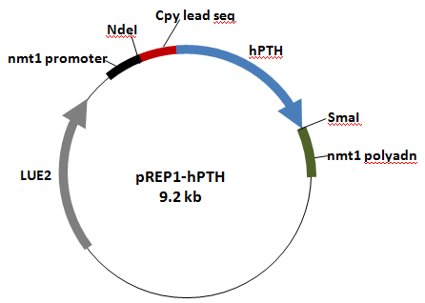
Cloning of hPTH gene Construct into Rep1 plasmid
Both Rep1 and H-PTH _pMA vector was digested with Nde1 and Sma1 restriction enzymes sequentially to generate sticky ends.
The digested products were then purified on 1.5% low melting agarose along with standard molecular weight marker to confirm that the restriction digestion is complete.
Ligation of Nde1/Sma1 digested Rep1 vector and hPTH gene Constuct
hPTH gene and digested pRep1 vector from agarose gel slices were extracted using a DNA gel extraction kit (Qiagen MinElute or QIAquick gel extraction kit) and Ligation reaction was carried out as per Sambrook et al., 1989 (Fig. 8).
Lane1: Digested H-pth_pMA vector with bands of 322 bases hPTH construct and a linear H-PTH_pMA (appr. 2kb) left out after digestion of hPTH construct ; Lane2: Undigested H-pth_pMA vector; Lane3: ΦX Hae III digest marker; Lane4: digested Rep1 vector; Lane5: Undigested Rep1 vector.
hPTH gene digested with Nde1 and Sma1
Gel elution
Bands cut out from gel for elution
Ligation
Rep1 digested with Nde1 and Sma1
The hPTH gene sequence was added immediately next to nmt1 promoter and was followed by nmt1 polyadenylation sequence at its 3’ terminus. Total size of pRep1-hPTH became 9.2 kb (8.9kb vector + 322bases hPTH gene construct) as shown in Fig. 9.
Plasmid Map of pRep1 vector carrying hPTH gene.

Slide 12
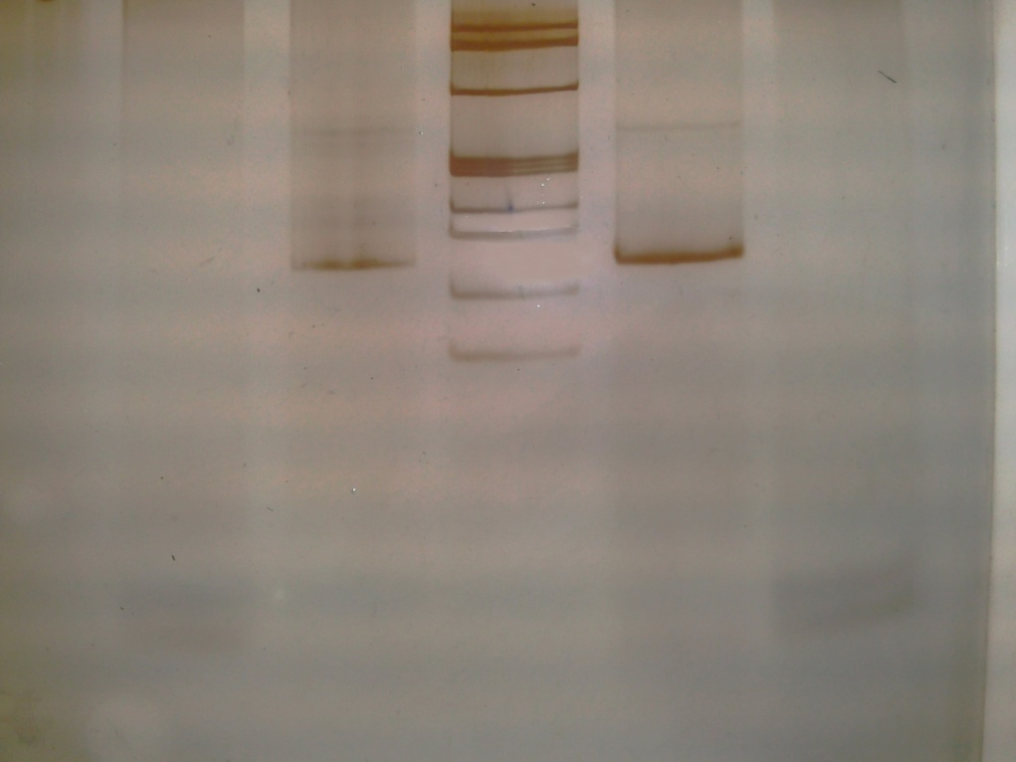
Confirmation of ligation of Nde1/Sma1 digested Rep1 vector and hPTH gene Constuct
Ligation of hPTH gene construct to Rep1 vector was confirmed through PCR (polymerase chain reaction).
Primers for hPTH DNA were designed using http://tools.invitrogen.com/
Lane 1
Lane 2
Lane 3
PCR was run as per the optimized thermal profile to amplify the hPTH DNA from both hPTH-pMA and hPTH-pRep1. A 152bp DNA was amplified from both which confirmed the ligation of hPTH gene to pRep1 vector
200 bp
152 bp
100 bp
Vector hPTH-pRep1 was introduced into into S.pombe FY!@*%$ cells by Lithium Acetate Method (Okazaki et. al. 1990)
Lane: A 152 bp PCR product from hPTH-pMA; Lane: B Ø×175 Marker from Genei; Lane: C 152 bp PCR product from hPTH-pRep1.
Transformants were selected on the basis of nutritional Auxotrophy.
Good transformation efficiency (88.4%) was observed.

Slide 13
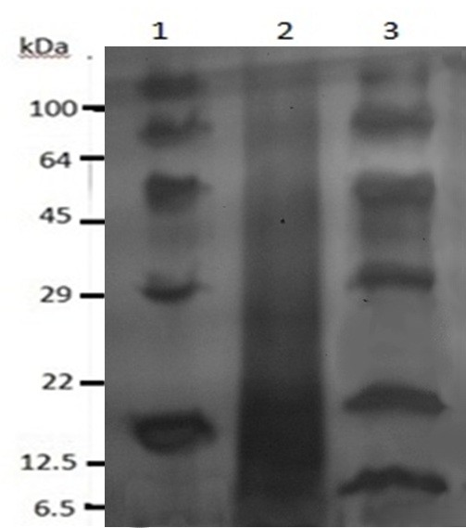
Protein Expression
To check secretory expression of hPTH, the extracellular proteins from both untransformed S. pombe and Transformed S. pombe Spv1 were concentrated using TCA precipitation (Hirose et al., 2000) method. Samples were then analyzed by 15% SDS-PAGE electrophoresis (Sambrook et al., 1989).
A clear band of approximately 9KD appeared in concentrated extracellular protein preparation from transformed S. pombe cells (Fig. 13).
This result depicts successful secretory expression of hPTH from transformed S pombe cells.
After 36 hours of growth the amount of Total Extracellular protein and hPTH secreted were found to be 767 mg/L and 160 mg/L respectively.
The reason for low level of expression was probably due to proteolytic degradation of the secreted protein by extracellular proteases of the host.
Fig.13: SDS-PAGE Profile. lane1: Extracellular protein from host S. pombe ; Lane 3: extracellular protein from Spv1 (S. pombe transformed with Rep1-hPTH).

Slide 14
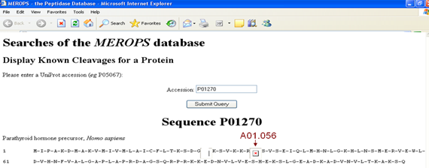

Designing of DNA construct for silencing of yps1 proteases and its Synthesis
The main problem for less expression of hPTH is its proteolytic cleavage by host proteases. The protease responsible for cutting human Parathyroid Hormone was predicted as "aspartic protease, yapsin Yps1" by CutDB tool, it showed one cleavage by A0.056 (Fig.14).
Fig.14: Results of CutDB protease cleavage event database.
A01.056 corresponds to Yps1 protein of Schizosaccharomyces pombe. Yps1 is an aspartic protease of yapsin family (Fig.15).
Fig.15: MEROPS ID database.

Slide 15
To control the protease degradation of Human Parathyroid hormone by Yps1 a gene silencing construct was designed against yps1.
The 653-bp Yps1 ORF was cloned as an inverted repeat, with the sense and antisense arms of the repeat separated by a 53-bp spacer containing the first intron of the rad9 gene. The intron was included, because intron-containing hairpin RNAs induce PTGS in plants with nearly 100% efficiency (Smith et al. 2000).
The construct used here, when spliced, is presumed to leave a loop of 14 unpaired nucleotides (nt). dsRNA hairpin so generated triggers classical RNAi in S. pombe.
Removal of loop by Ago1 leads to generation of exogenous dsRNAs which are further cut into small interfering RNAs by Dicer.
si-RNAs so generated will guide degradation of target mRNAs via base pairing with complementary sequences and are the hallmark of the ‘classical’ RNAi pathway.

Slide 16
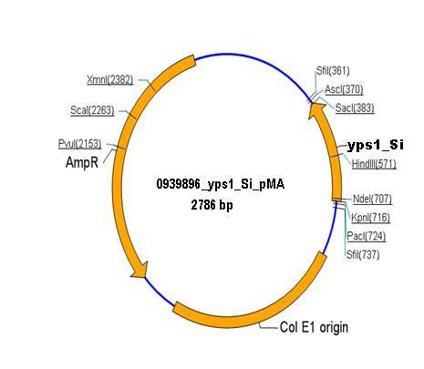
The designed construct was synthesized from GeneArt Germany and was received in a 2.7 kb yps1_Si_pMA vector (Fig. 17).
Fig. 17: H-PTH_pMA vector (supplied by GENEART, Germany).
Cloning of yps1-silencing Cassette into Rep2 plasmid
Rep2 and vector Yps1-Si_pMA was double digested with SalI and BamHI restriction enzymes to generate sticky ends.
The digested products were then purified on 1% low melting agarose along with standard molecular weight marker to confirm that the restriction digestion is complete.

Slide 17
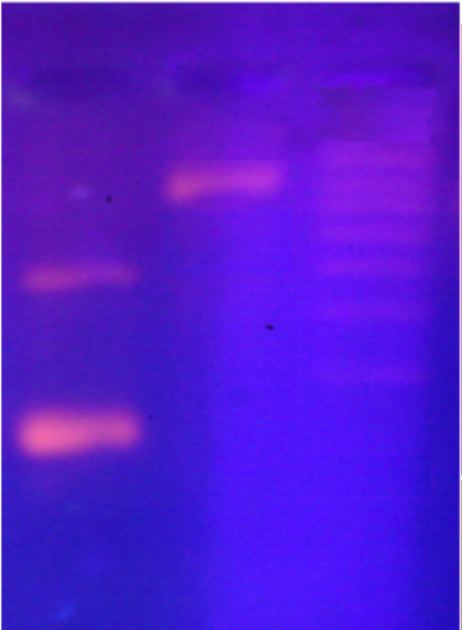
Confirmation of restriction Digestion and purification of Digested Rep2 vector and Yps1-silencing Cassette
As evident from Fig. 18, a clear band of 653 bases yps1 silencing cassette and a linear Yps1-Si_pMA left out is clearly visible in Lane 1. In lane 2 there is a single band of digested 8.9kb Rep2 vector.
Lane 1
Lane 2
Lane 3
10000
8000
4000
3000
2000
1000
653bp
Fig.18: Lane1: Digested Yps1-Si_pMA vector ; Lane2: Digested Rep2 vector; Lane3: 1kb marker.

Slide 18
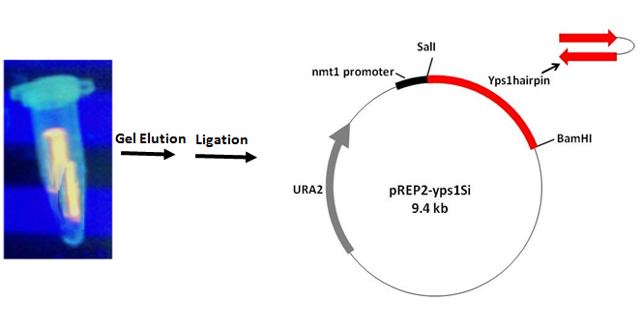
Ligation of Nde1/Sma1 digested Rep2 vector and Yps1-silencing Cassette
Yps1 silencing cassette and digested pRep2 vector were extracted from agarose gel slices using a DNA gel extraction kit and Ligation reaction was carried out to get 9.6 kb Rep2-yps1Si vector (Fig. 19).
Fig.19: Ligation Yps1 silencing cassette with pRep2 vector and resulting pRep2-yps1Si vector.

Slide 19
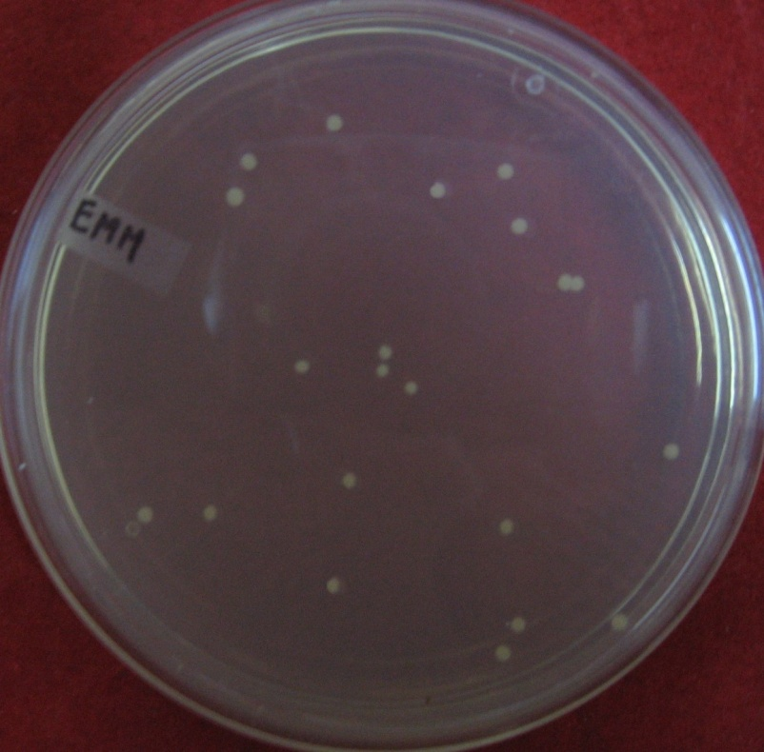
Transformation of Schizosachharomyces pombe FY12854 with Rep2-yps1Si
Rep2-yps1Si vector was introduced into Spv1 cells by Lithium Acetate method (Okazaki et. al., 1990).
Good transformation efficiency (89.1%) was observed.
These results testify that the Rep2-yps1Si vector was successfully introduced into Spv1 and able to reproduce itself in the host cells, and thereby transformed the cells to become able to grow on EMM plates lacking both Leucine and Uracil (Fig. 20).
Fig. 20: S. pombe FY12854 transformed with hPTH-pRep1 and Rep2-yps1Si (Spv2) on EMM plates.

Slide 20
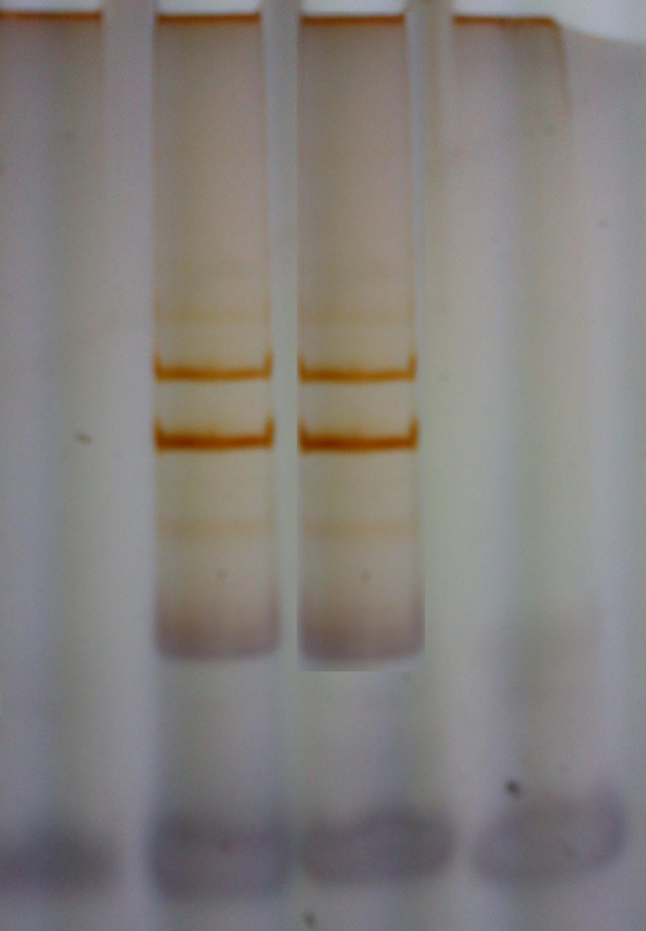
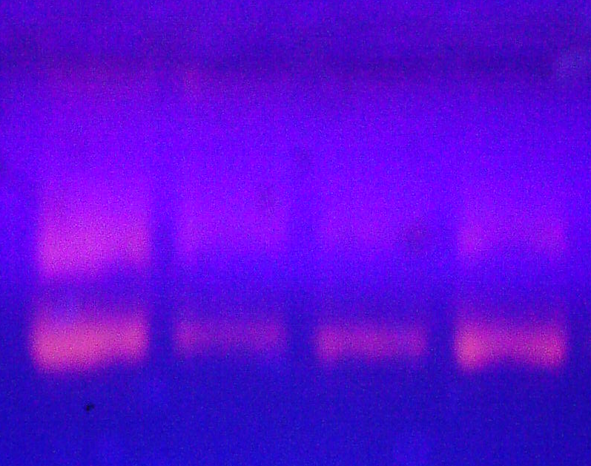
Quantitaion of % silencing of yps1 protease
Total RNA isolated from Spv1 and Spv2 were quantified from the OD obtained at 260 nm, a good conc. Of 1040 µg/ml and 2560 µg/ml was obtained respectively from Spv1 and Spv2 (Table).
Table : Absorbance ratio of total RNA samples from Spv1 and Spv2.
Sample | λ260 | λ 280 | λ260/λ280 | Conc. (µg/ml)
Spv1 | 0.026 | 0.014 | 1.857 | 1040
Spv2 | 0.064 | 0.036 | 1.722 | 2560
The quality of isolated RNA samples was checked on 10 % denaturing PAGE and on 2% Agarose, Two clear bands of 28S and 18S were obtained (Fig 21 & 22).
Fig. 21: 10% Denaturing PAGE Fig. 22: 2% Agarose

Slide 21
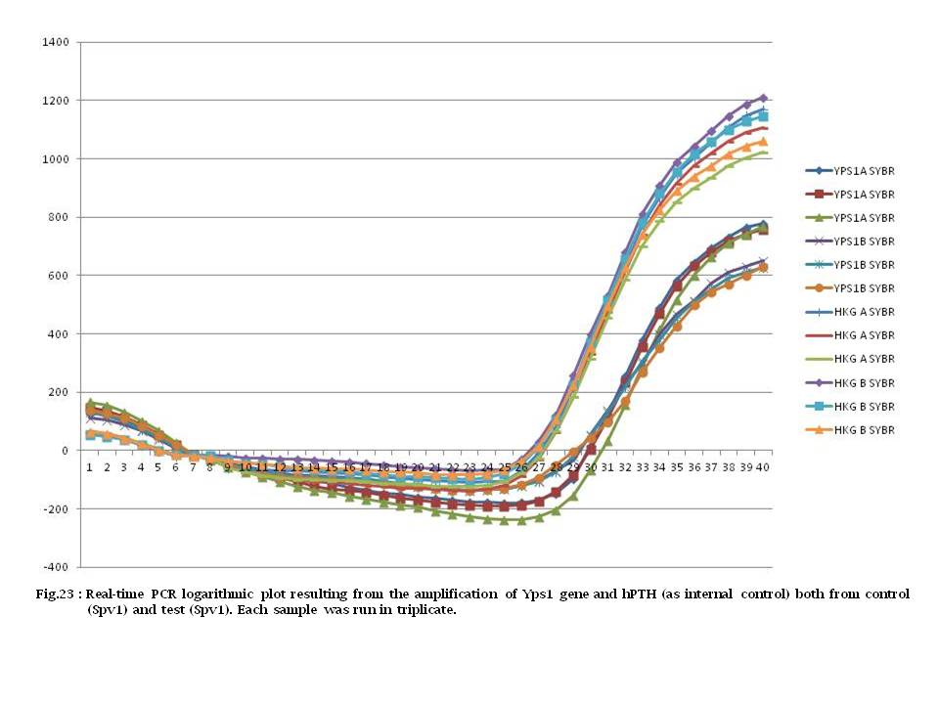
The mRNA level of Yps1 in Spv1 and Spv2 was determined by analyzing the Relative Gene Expression using Real Time Quantitative PCR and 2^{-ΔΔC}T method. A 152 bp DNA fragment of Yps1 mRNA was amplified by RT—PCR in Realplex2 using the SYBR Green PCR Kit (Fig23).

Slide 22
The fold change in expression of the Yps1 gene normalized to internal control was analyzed using C_{T} values provided from Real-Time PCR on spreadsheet program of Microsoft Excel. As shown in Table there was approximately three fold decrease in Yps1 expression level in Spv2 strain as compared to Spv1 (Fig. 22 ).
Table: Spreadsheet of data analysis using the 2^{-ΔΔC}T method.
S No. | Gene | Primer | Ct | Mean Ct | ΔCt | mean ΔCt | ΔΔCt | 2^-ΔΔCt | 1.8^-ΔΔCt
1 | Yps1Control | P1 | 29.09 | 29.07 | 0.21
2 | Yps1Control | P1 | 28.97 | 29.07 | 1.16 | 0.92±0.09 | 0 | 1 | 1
3 | Yps1Control | P1 | 29.15 | 29.07 | 1.39
4 | Yps1 Test | P1 | 31.12 | 31.12 | 2.94
5 | Yps1 Test | P1 | 30.83 | 31.12 | 1.95 | 2.52±0.29 | 1.6 | 0.32988 | 0.390449
6 | Yps1 Test | P1 | 31.41 | 31.12 | 2.67
7 | Int Control | P2 | 28.88 | 28.15
8 | Int Control | P2 | 27.81 | 28.15
9 | Int Control | P2 | 27.76 | 28.15
10 | Int Control | P2 | 28.18 | 28.6
11 | Int Control | P2 | 28.88 | 28.6
12 | Int Control | P2 | 28.74 | 28.6
68% decrease in Yps1 expression level.
Fig.22 : The expression of yps1 is repressed in the Test (Spv2) relative to Control (Spv1)

Slide 23
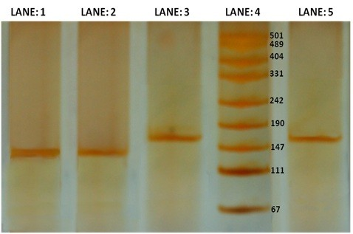
The RT-PCR products were analysed on 12% PAGE (Fig. 23). A lighter band resulting from lowering in amount of Yps1 mRNA is obtained from the Spv2 tranformant harbouring gene silencing cassette as compared to Spv1 normal strain.
The bands of 152 bases DNA product of internal control gene from both Spv1 and Spv2 strains were of same intensity showing no effect of gene silencing cassette on it.
Fig. 23: RT-PCR product, Lane 1: Yps1 product from Spv1; Lane 2: Yps1 product from Spv2; Lane 3: hPTH product from Spv1; Lane 4: DNA Ladder; Lane 5: hPTH product from Spv2.

Slide 24
    Monitoring the effect of gene silencing cassette on cell growth
The effect of yps1 gene silencing cassette on S. pombe cell growth was monitored by comparing the growth curves of both Spv1 and Spv2.
As evident in Fig.. the growth pattern of both Spv1 and Spv2 was same which proves the gene silencing cassette has no off target effect hence it is not hampering any vital activity of the strain so showing no effect on its growth.
Fig. 24: Cell growth Pattern of Spv1 and Spv2

Slide 25
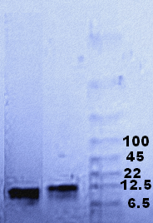
    Comparison of hPTH expression after silencing of yps1 protease
To reduce the proteolytic cleavage a gene silencing cassette was designed against Yps1 and introduced into the host carrying hPTH production gene. A tentative decrease of 70% Yps1expression was noticed in the recombinant Spv2.
To check weather this decrease in protease expression has any effect on production of hPTH, extracellular broth of both Spv1 and Spv2 was compared for secreted amount of hPTH. Extracellular broth was concentrated using TCA Precipitation method and samples were analyzed by 15% SDS-PAGE electrophoresis.
As evident from Fig. 25 there was a marked difference in amounts of hPTH produced in Lane 3 extracellular proteins from Spv2 show a broader band of hPTH as compared to hPTH band from Spv1 in Lane 2, both the bands are synchronous in position with standard hPTH in Lane 1.
Fig. 25: Silver stained SDS-Page profile of hPTH; Lane 1: Extracellular proteins from Spv2; Lane 2: Extracellular proteins from Spv1.Lane 3:Standard protein marker

Slide 26
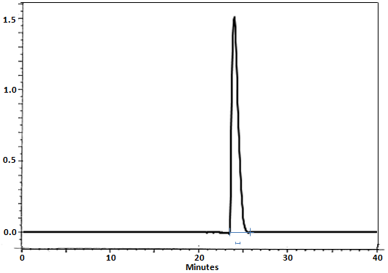
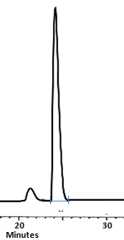
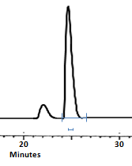
24.692
24.847
24.586
Standard 1 (1.0µg/ml)
Sample from Spv 1
Sample from Spv 2
Area18539506
Area 2986186
Area 17639496
As evident from HPLC graphs both the samples were eluted at the same time as that of standard and there is a tentative difference of about 8 times in area under hPTH peak of Spv1 with respect to area under hPTH peak of Spv2.
The conc. of hPTH from Spv1 was calculated to be 0.16 µg/ml and that of hPTH from Spv2 was 0.95 µg/ml, which shows there is approximately 8 fold increase in concentration of hPTH after silencing the expression of Yps1 protease.

Slide 27

The ultimate goal of this study was to develop a S. pombe host strain useful for effective production of distinct protease sensitive heterologous proteins by reducing the effect of selective proteases which are acting on the heterologous protein in particular.
Here the particular protease is knocked down instead of being completely knocked out, so that the actual function of the protease in the cell is not disturbed and there is no effect of Yps1 silencing on growth rate of Spv2 strain, but its concentration is reduced to such an extent that its digestive effect on heterologous hPTH is reduced resulting in 8 fold increase in concentration of secreted hPTH.
Here we succeeded to develop a custom designed protease-deficient S. pombe host strain useful for effective production of hPTH by reducing the effect of selective protease which is acting on the hPTH protein forming a proof of our concept for this novel approach for specific silencing of protease as applied to enhanced protein production by S. pombe.

Slide 28
Acknowledgements
I Acknowledge University Grants Commissions, India for providing Contingency grant under Faculty Improvement Pragrame to carry out this work.
Highly thankful to Dr, Praveen P Balgir for her valuable guidance.
Again thankful to UGC, India for providing 100% travel assistance to attend the conference
Publications
“RNAi Mediated Silencing of Host Specific Protease in Fission Yeast Schizosaccharomyces Pombe.” Nipunjot Kaur Soni-Bains and Praveen Pal Balgir in International Journal of Chemical And Pharmaceutical Analysis, 2(2):135-140, 2015.
“Heterologous production of hPTH in fission yeast Schizosaccharomyces pombe.” Nipunjot K. Soni1 and Praveen P. Balgir in European Journal of Experimental Biology, 3(1):298-302, 2013.
“Designing and validation of Vector construct for secretory production of hPTH in S pombe.” Praveen P. Balgir and Nipunjot Kaur Soni in Jounnal Punjab Academy of Sciences, Volume 5&6, No. 1&2 Jan-Dec 2008-2009.

Slide 29
THANK YOU

