Slide 1
About OMICS Group
OMICS Group International is an amalgamation of Open Access publications and worldwide international science conferences and events. Established in the year 2007 with the sole aim of making the information on Sciences and technology ‘Open Access’, OMICS Group publishes 400 online open access scholarly journals in all aspects of Science, Engineering, Management and Technology journals. OMICS Group has been instrumental in taking the knowledge on Science & technology to the doorsteps of ordinary men and women. Research Scholars, Students, Libraries, Educational Institutions, Research centers and the industry are main stakeholders that benefitted greatly from this knowledge dissemination. OMICS Group also organizes 300 International conferences annually across the globe, where knowledge transfer takes place through debates, round table discussions, poster presentations, workshops, symposia and exhibitions.

Slide 2
About OMICS Group Conferences
OMICS Group International is a pioneer and leading science event organizer, which publishes around 400 open access journals and conducts over 300 Medical, Clinical, Engineering, Life Sciences, Phrama scientific conferences all over the globe annually with the support of more than 1000 scientific associations and 30,000 editorial board members and 3.5 million followers to its credit.
OMICS Group has organized 500 conferences, workshops and national symposiums across the major cities including San Francisco, Las Vegas, San Antonio, Omaha, Orlando, Raleigh, Santa Clara, Chicago, Philadelphia, Baltimore, United Kingdom, Valencia, Dubai, Beijing, Hyderabad, Bengaluru and Mumbai.

Slide 3
Bridging the Gap Between Cosmetologist, Dermatologist & The Medical & Research Community
Nina Turnage, Cosmetologist, Researcher

Slide 4
OBJECTIVE
THE FUTURE OF COSMETIC R&D LIES IN THE HANDS OF PRACTICING COSMETOLOGISTS AND ESTABLISHING RELATIONSHIPS WITH OTHERS IN THE MEDICAL PROFESSION, CHEMISTS AND THE NATURE OF SCIENCE THAT BRINGS US TOGETHER

Slide 5
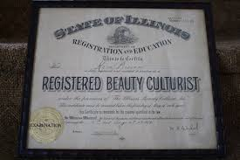
BEAUTY CULTURIST

Slide 6

Willful Knowledge
Less Diversion & Competition
Respect and High Regard

Slide 7
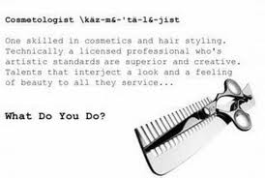

Slide 8
WHAT DOES IT MEAN TO BE A COSMETOLOGIST?
English definition of “-ologist”
-ologist
suffix /-ɒl.ə.dʒɪst/ /-ɑː.lə-/
› used to form nouns ; an expert in a particular area of scientific study :

Slide 9
WHAT’S HOLDING US BACK?
LACK OF, FEAR OR DIS-INTEREST IN SCIENCE
NO SPECIALIZED TRAINING
TOO MUCH FOCUS ON CREATIVITY
TECHNOLOGY?
NO DIALOGUE – NO INTEREST
NO MOTIVATION – NO SUPPORT
EXECUTIVE TAKEOVER

Slide 10
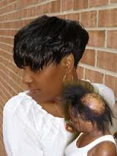
THE NEW NORMAL

Slide 11
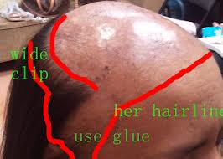
WHAT IF WE ACTED QUICKER?

Slide 12
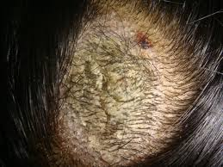
THERE’S STILL HOPE – DO SOMETHING NOW!

Slide 13
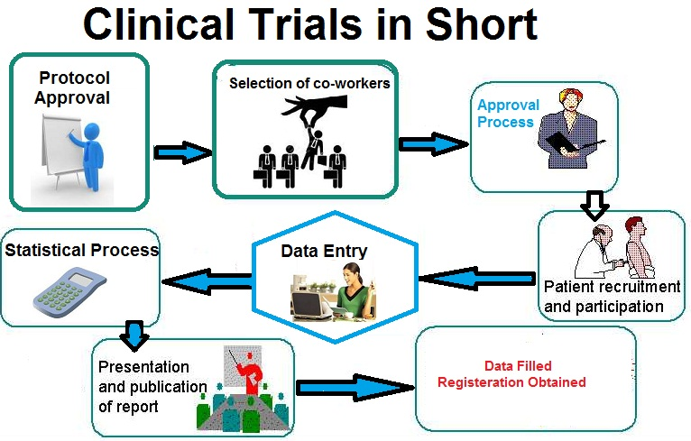
MORE THAN THE END USER

Slide 14
WE CONTROL THE PRODUCT CYCLE
DIRECT ABILITY TO INFLUENCE OUR CLIENTS
SUPERIOR PRODUCTS – FORCING COMPETITION FOR R&D
INCREASED SALES
HIGHER INDUSTRY STANDARDS
SATISFIED CLIENTS & CONSUMERS

Slide 15
LET’S STRENGTHEN THE INDUSTRY
MORE DIALOGUE BETWEEN COSMOS, DERMS, R&D
SUPERIOR PRODUCTS
RIGOUROUS SALON TESTING
RIGOUROUS LABORATORY TESTING
MARKET RESEARCH

Slide 16
BRIDGING THE GAP
CLINICAL TRIALS
CROSS TRAINING
CASE STUDIES
QUALIFIED DATABASE
MORE DIALOGUE MORE INTEREST
CALL TO ACTION – RAISE THE BAR
MARKET RESEARCH
COSMO ENDORSEMENTS/SUBSTANTIATION

Slide 17
LACK OF SCIENCE HAS LED TO. . .
SELF-INDUCED TRACTION ALOPECIA IS ON THE RISE
LACK OF CONCERN FROM CLIENTS AND COSMETOLOGISTS
USE OF MORE CREATIVITY RATHER THAN SCIENTIFIC APPROACH TO TREAT CLIENT
SOCIETY SAYS COVER IT UP AND ACHIEVE IT WITH ENHANCEMENTS

Slide 18

LET’S INSPIRE FUTURE PROFESSIONALS

Slide 19

WHAT BETTER WAY TO INCREASE GIRLS INTEREST IN SCIENCE THAN THROUGH COSMETOLOGY

Slide 20


WHAT’S THE FUTURE
COSMETIC
CHEMISTS

Slide 21

COSMETIC CHEMIST
LABORARTORY TESTER
PRODUCT DEVELOPER
MARKET RESEARCHER
TECHNICAL WRITER
COSMETIC EXECUTIVE

Slide 22
LET’S RAISE INDUSTRY STANDARDS
CROSS TRAINING
REGULATION
CERTIFICATIONS
INTERNSHIPS
EDUCATION
INITIATIVES

Slide 23
Lets Meet again at Cosmetology-2015
4th International Conference and Expo
On
Cosmetology & Trichology
June 22-24, 2015 Boston, USA
Theme: Cosmetology and Trichology: Tracking and Tackling its Consequences
Website: http://cosmetology-trichology.conferenceseries.com/

