Slide 1
About OMICS Group
OMICS Group International is an amalgamation of Open Access publications and worldwide international science conferences and events. Established in the year 2007 with the sole aim of making the information on Sciences and technology ‘Open Access’, OMICS Group publishes 400 online open access scholarly journals in all aspects of Science, Engineering, Management and Technology journals. OMICS Group has been instrumental in taking the knowledge on Science & technology to the doorsteps of ordinary men and women. Research Scholars, Students, Libraries, Educational Institutions, Research centers and the industry are main stakeholders that benefitted greatly from this knowledge dissemination. OMICS Group also organizes 300 International conferences annually across the globe, where knowledge transfer takes place through debates, round table discussions, poster presentations, workshops, symposia and exhibitions.

Slide 2
About OMICS Group Conferences
OMICS Group International is a pioneer and leading science event organizer, which publishes around 400 open access journals and conducts over 300 Medical, Clinical, Engineering, Life Sciences, Pharma scientific conferences all over the globe annually with the support of more than 1000 scientific associations and 30,000 editorial board members and 3.5 million followers to its credit.
OMICS Group has organized 500 conferences, workshops and national symposiums across the major cities including San Francisco, Las Vegas, San Antonio, Omaha, Orlando, Raleigh, Santa Clara, Chicago, Philadelphia, Baltimore, United Kingdom, Valencia, Dubai, Beijing, Hyderabad, Bengaluru and Mumbai.

Slide 3
Aptamer Based E-coli Detection in Waste Waters by SWCNTs Modified Biosensor System
Nimet Yildirim ^{1, 2}, Jinyoung Lee ³, Hanchul Cho ³, HeaYeon Lee ³, Ahmed Busnaina ³, April Z. Gu^{*2}
¹Bioengineering PhD Program, Northeastern University, Boston, USA ²Department of Civil and Environmental Engineering, Northeastern University, Boston, USA ³The NSF Nanoscale Science and Engineering Center for High-rate Nanomanufacturing (CHN), Northeastern University, Boston, MA 02151, USA

Slide 4
Motivation
  E. coli is appropriate indicator for monitoring potential enteric pathogens in waters.
  A microbiological indicator for fecal contamination in water and foods.
  For drinking water, E.coli must be less than 1 CFU/100 mL (EPA).
  With traditional detection methods (like colony counting), detection takes more than 24 hours.
  PCR techniques needed extra DNA extraction steps.
  ELISA used antibodies, not stable for long time.
  Over the past decade, many biosensor systems have been developed for sensitive and reliable detection protocol.
1. Dufour, A.P. (1977) Escherichia coli : the fecal coliform. In Bacterial Indicators/health Hazards Associated with Water (eds A.W. Hoadley and B.J. Dutka), pp. 48–58, American Society for Testing and Materials, PA.
2. Bej, A.K., R. Steffan, J. DiCesare, L. Haff, and R.M. Atlas. 1990. Detection of coliform bacteria in water by polymerase chain reaction and gene probes. Appl. Environ. Microbiol. 56: 307-314.

Slide 5
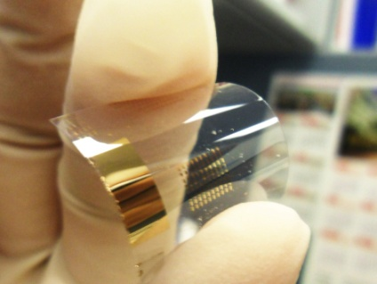
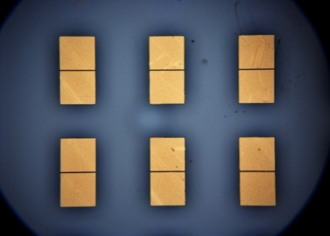
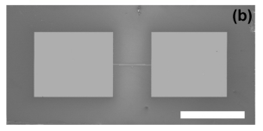
Introduction
SWCNTs Modified Biosensor System
The flexible biosensor was fabricated by directed assembly using reusable template.
Flexible template: polyethylene-naphthalate (PEN) film.
A plain gold templates were fabricated as two electrode system.
The device was immersed into SWNTs suspension (0.001 wt%, 90 semiconducting SWNTs).
DC power supplier was used to apply the potential (2~2.5V) between the two electrodes.
Negatively charged SWNTs were attracted onto positive conductive patterns in template.
Yang Zhang et al 2013 Nanotechnology 24

Slide 6
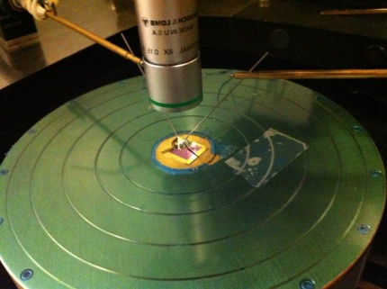
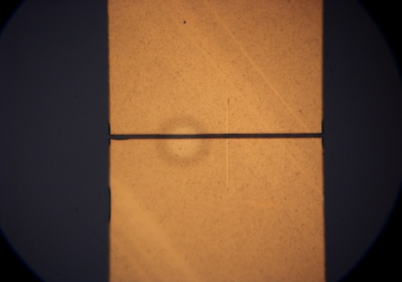
IV Measurement Procedure
Conductance and resistance changes were measured between two gold electrodes.
IV measurement was conducted before and after each experiment.

Slide 7
Introduction cont’d
Aptamers
Aptamers are single-stranded DNA, RNA, or modified nucleic acids.
Specifically recognize target molecules.
Obtained from a combinatorial library via an in vitro selection process known as the systematic evolution of ligands by exponential enrichment (SELEX) method.
There are several advantages of aptamers over antibodies;
much smaller than antibodies,
more easily modified at terminal sites with several functional groups,
more stable than antibodies.

Slide 8
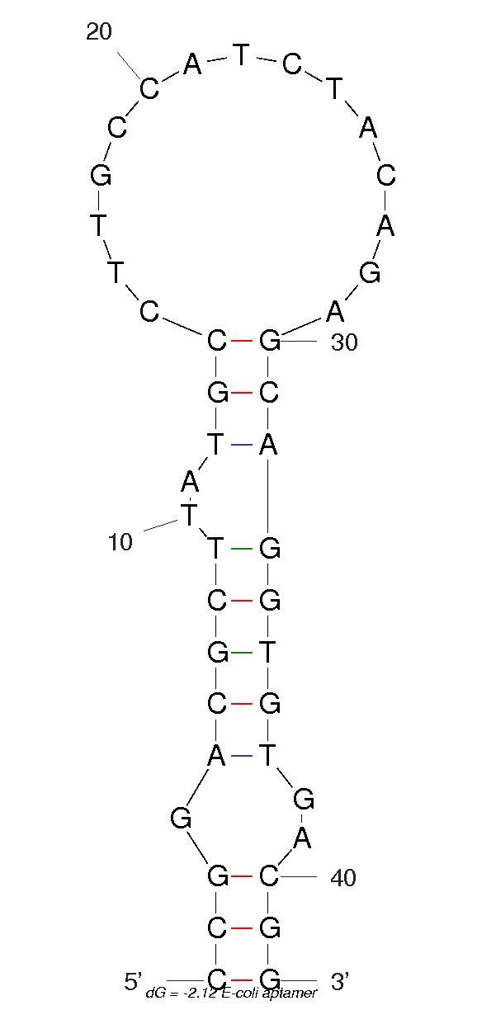
E-coli Aptamer
DNA aptamer for E-coli; can specifically distinguish the pathogen E. coli O157:H7 from other pathogens (Bruno et al. 2010).
DNA library was first incubated with the E. coli K12 strain and the DNAs binding to the strain were discarded.
The precluded DNAs were then used for the selection of O157:H7-specific aptamers.
After 6 rounds of the subtractive cell-SELEX process, the selected aptamer was found to specifically bind to the O157:H7 serotype, but not to the K12 strain.
Bruno, J.G.; Carrillo, M.P.; Phillips, T.; Andrews, C.J. A novel screening method for competitive FRET-aptamers applied to E. coli assay development. J. Fluoresc. 2010, 20, 1211–1223.

Slide 9
Biosensor Systems for E-coli Detection
Detection method | Recognition element/target | Detection range | Detection time | Enrichment or DNA-protein extraction | Regeneration | Ref.
DNA aptamer-based impedance biosensor | DNA-aptamer/ E. coli outer membrane proteins | 1×10⁻⁷ to 2×10⁻⁶ M | 90 minutes | E. coli OMPs extraction | 15- 45% of regeneration | (Queirós et al. 2013)
DPV based electrochemical biosensor | DNA-aptamer/ E-coli surface lipopolysaccharide | 2 x 10² to 2 x 10⁷ CFUml¹ | 3.5 hours | NO | NO | (Luo et al. 2012)
Real-time PCR | DNA template of the RNA-aptamer/ E-coli surface protein | 10¹ to 10⁷ CFUml¹ | 60 minutes incubation + 40 minutes detection | DNA extraction | NO | (Lee et al. 2009)
DNA aptamer-based colorimetric detection | DNA aptamer/ whole E-coli cell | 10⁴ to 10⁸ CFUml¹ | 2 hours | NO | NO | (Su et al. 2012)
DNA aptamer-based colorimetric detection | DNA aptamer/ whole E-coli cell | 10⁵ to 10⁸ CFUml¹ | 20 minutes | NO | NO | (Wu et al. 2012)
Antibody modified microfluidic chip and real-time qPCR | Antibody/ whole E-coli cell | 10¹ to 10⁶ CFUml¹ | Incubation + 74 minutes detection | DNA extraction | NO | (Dharmasiri et al. 2010)
Label free polyaniline based impedimetric biosensor | antibody | 10² to 10⁷ CFUml¹ | 10 minutes binding + few minutes detection | NO | NO | (Chowdhury et al. 2012)

Slide 10
Aspects of Improvement
Using E-coli specific DNA aptamer with high specificity and affinity without any reactivity loses in the harsh conditions
DNA-aptamer directly binds to the surface lipopolysaccarides, so eliminate protein extraction step.
SWCNTs modified biosensor system with using features of the electrochemical systems such as; low voltage need, small, cost effective and easy to use equipment.
Improve sensitivity to detect the U.S. EPA allowable levels of E. coli and less than 1cells/ml infectious dose.

Slide 11
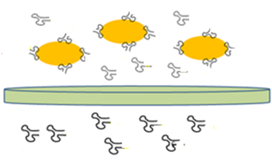
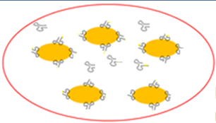
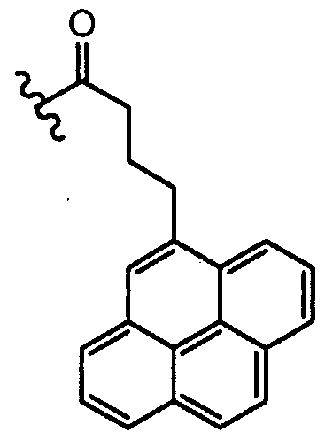


Detection Procedure
Filtration of the mixture with 0.22 μm pore size filter
Mixing E-coli cells and aptamer
Pumping to the sample cell
Hybridization of the aptamer and probe DNA
I-V Measurement
pyrene-butyric acid
Probe-DNA immobilization onto the SWCTs surface
Regeneration with 0.5 % SDS

Slide 12
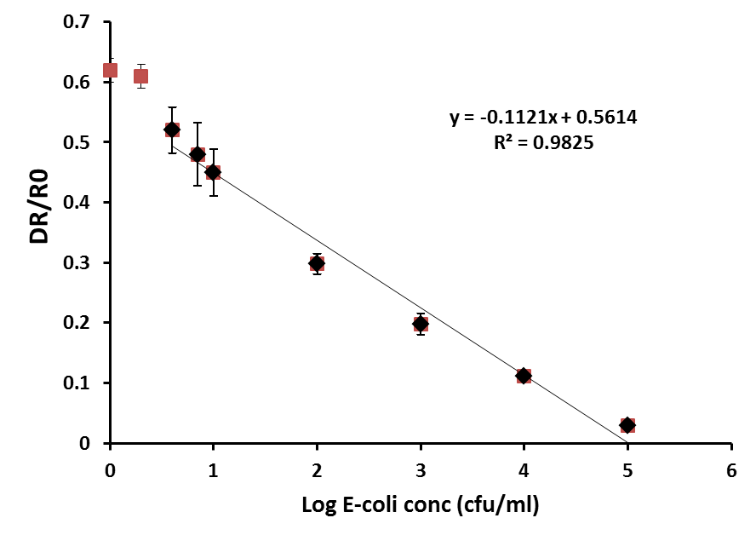
Dose-response Measurements of the Sensor
Each data value is the average of three independent experimental results.
The linear range between 4 cfu/ml and 10⁵ cfu/ml since we got negligible signal with the E-coli concentration smaller than 4 cfu/ml.

Slide 13
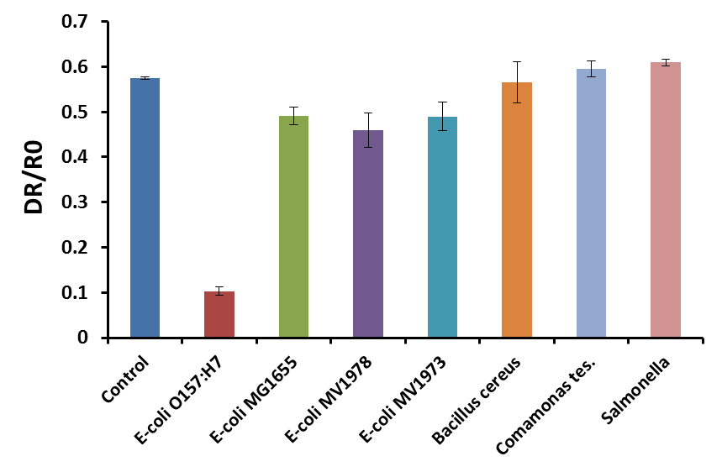
Assessment of Sensor Specificity
All bacteria strains were applied at 2000 cfu/ml.
Still have 10 % to 15 % of signal decrease with other pathogens.
May come from just non-specific binding to the pathogens or loosing aptamers during filtration

Slide 14
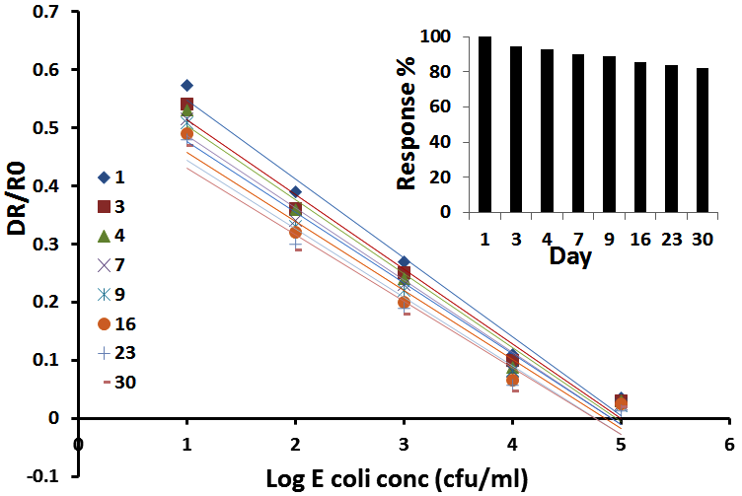
Regeneration and Sensor Stability
The sensor system is stable over 80 % with E-coli detection in30 days period.

Slide 15
Analysis of Spiked Wastewater Treatment Effluent Samples
 | Spiked (cfu/ml) | Found (cfu/ml) | cv % | Recovery %
plant 1 | 10 | 8.7 | 3.2 | 87.7
 | 10⁴ | 9255.1 | 18.1 | 92.5
plant 1 | 10 | 9.8 | 9.9 | 98.0
 | 10⁴ | 10158.5 | 17.2 | 101.5
tap water | 10 | 9.2 | 2.6 | 92.7
 | 10⁴ | 8687.7 | 5.5 | 86.8
Two duplicate experiments were performed for all samples.
The recovery of all measured samples was between 93 and 118 %, and the parallel tests showed that the relativity coefficient was within 4.3-21.8 %.

Slide 16
Conclusion
An aptamer-based biosensor for rapid and selective E-coli detection was developed with using a SWCNTs modified system.
Low detection limit; 4 CFU/ml.
When compare with the present studies, the new system is cost-effective, rapid (less than one hour), easy to use and reusable.
The system is selective for E-coli O157:H7 .
The biosensor evaluated in spiked wastewater samples.

Slide 17



Questions ??
APRIL Z. GU
Associate Professor and College of Engineering Faculty Scholar
Department of Civil and Environmental Engineering
471 Snell Engineering Center
360 Huntington Ave.
Boston, MA 02115
Thank you

Slide 18
Let Us Meet Again
We welcome you all to our future conferences of OMICS Group International
Please Visit:
www.omicsgroup.com
www.conferenceseries.com
www.pharmaceuticalconferences.com

