Slide 1



Exact data mining from inexact data
Nick Freris Cyberphysical Systems Laboratory New York University Abu Dhabi
https://wp.nyu.edu/cpslab
Plenary talk
4th International Conference on Big Data Analysis and Data Mining
September 7, 2017

Slide 2

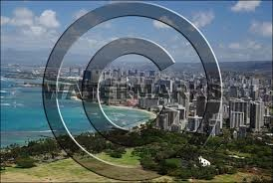
Motivation
Information retrieval is a huge industry..
§ Biology, finance, engineering, marketing, vision/graphics, video, audio, etc.
..but data are hardly ever maintained in original form
Compression Security/Privacy
Original
Quantized
Watermarking

Slide 3
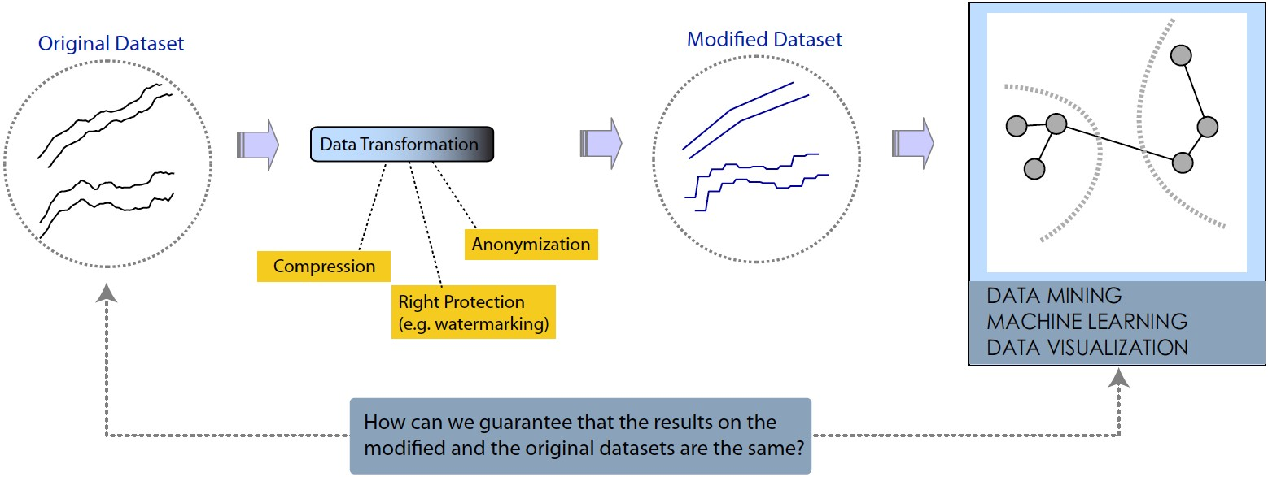
Exact data mining from inexact data
…with provable guarantees!

Slide 4
Outline
Optimal distance estimation between compressed data series
NN, MST, HC-preserving watermarking
K-means preserving compression

Slide 5
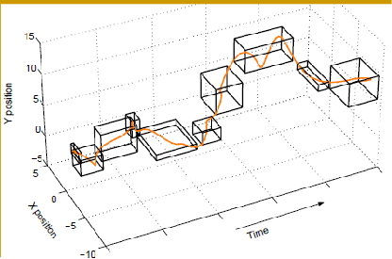
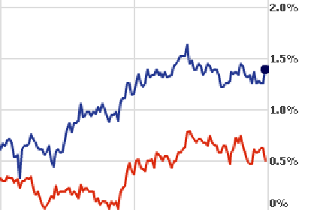
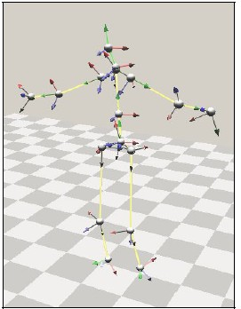
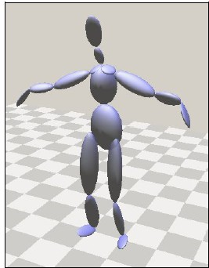
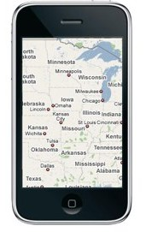
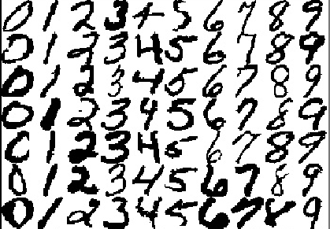
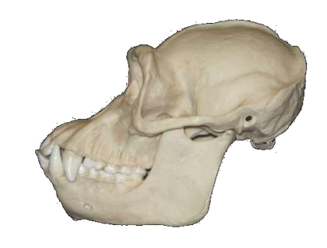
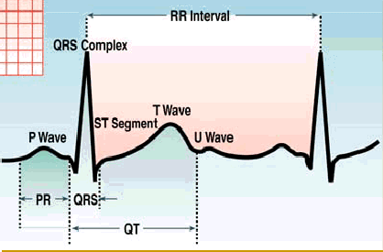

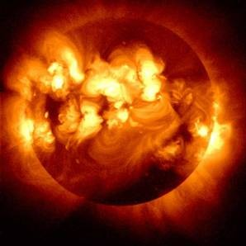
Datasets
Microsoft
Yahoo
Financial
Motion/Video
Mobility
Handwriting
Images/Shapes
Medical
1986 2006
4 / 30
Astronomical

Slide 6
Optimal distance estimation between compressed data series

Slide 7
Compressive Mining
Compression is ubiquitous
  Save storage space / transmission bandwidth
  Faster processing / data analysis
  Denoising
Most mining operations are distance-based
  Clustering / Classification
  Anomaly detection
  Similarity search (k-NN)
  Visualization
Now we can do all this very efficiently directly on the compressed data!
5 / 30

Slide 8


Similarity search
Distance
query
D = 7.3
k-NN:
D = 10.2
Objective: Compare the query with all sequences in DB and return the k most similar sequences to the query.
D = 11.8
D = 17
D = 22
5 / 30

Slide 9








Speed-up
simplified DB
Candidate Superset
original DB
Final Answer set
Verify against original DB
Upper / lower bounds on distance
keyword 1
simplified query
keyword 2
keyword 3
…
keyword
5 / 30

Slide 10
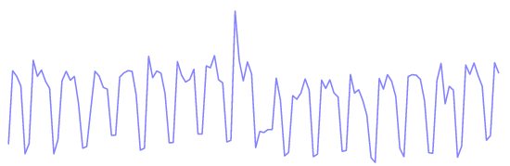
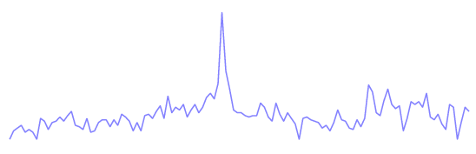
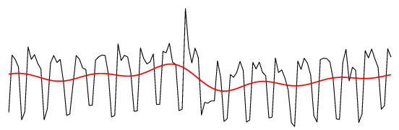
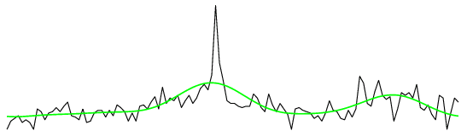
Compression
x(n)
X(f)
Discard frequencies
0.4326
2.0981
1.9728
1.6851
2.8316
1.6407
0.4515
0.4892
0.1619
0.0128
0.1739
0.5518
0.0365
2.1467
2.0103
2.1243
3.1910
3.2503
3.1547
2.3223
2.6167
1.2805
1.9949
3.6184
2.9266
3.7846
5.0386
3.4449
2.0039
2.5751
2.1752
65.0630
0.4721 +20.2755i
4.6455 - 0.7204i
approximate distance using kept DFT coefs.
-11.6083 - 5.8807i
1.0588 - 3.9980i
0.3014 + 3.4492i
-1.3769 + 3.3947i
0.5637 + 3.4632i
-2.7711 + 0.3124i
-3.6572 - 1.4000i
0.1078 - 6.0011i
-1.9892 + 2.8143i
-2.6120 + 3.4182i
-3.9104 - 0.4136i
-1.2362 + 3.5155i
-2.2397 - 0.6038i
-2.7173
-2.2397 + 0.6038i
-1.2362 - 3.5155i
-3.9104 + 0.4136i
-2.6120 - 3.4182i
-1.9892 - 2.8143i
0.1078 + 6.0011i
-3.6572 + 1.4000i
-2.7711 - 0.3124i
0.5637 - 3.4632i
-1.3769 - 3.3947i
0.3014 - 3.4492i
1.0588 + 3.9980i
11.5517
First 5 Coefficients +symmetric ones
7.9234
-11.6083 + 5.8807i
4.6455 + 0.7204i
2.8652
0.4721 -20.2755i
6 / 30

Slide 11
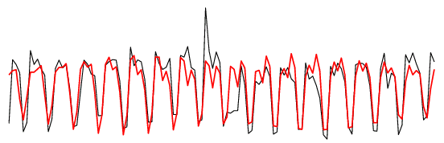
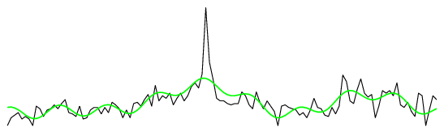
Compression
x(n)
X(f)
Discard frequencies
0.4326
2.0981
1.9728
1.6851
2.8316
1.6407
0.4515
0.4892
0.1619
0.0128
0.1739
0.5518
0.0365
2.1467
2.0103
2.1243
3.1910
3.2503
3.1547
2.3223
2.6167
1.2805
1.9949
3.6184
2.9266
65.0630
0.4721 +20.2755i
4.6455 - 0.7204i
-11.6083 - 5.8807i
approximate distance using kept DFT coefs.
1.0588 - 3.9980i
0.3014 + 3.4492i
-1.3769 + 3.3947i
0.5637 + 3.4632i
-2.7711 + 0.3124i
-3.6572 - 1.4000i
11.5517
0.1078 - 6.0011i
-1.9892 + 2.8143i
-2.6120 + 3.4182i
-3.9104 - 0.4136i
-1.2362 + 3.5155i
-2.2397 - 0.6038i
-2.7173
-2.2397 + 0.6038i
-1.2362 - 3.5155i
-3.9104 + 0.4136i
-2.6120 - 3.4182i
-1.9892 - 2.8143i
0.1078 + 6.0011i
Best 5 Coefficients + symmetric ones
-3.6572 + 1.4000i
11.1624
-2.7711 - 0.3124i
3.7846
5.0386
3.4449
2.0039
2.5751
2.1752
2.8652
0.5637 - 3.4632i
-1.3769 - 3.3947i
0.3014 - 3.4492i
1.0588 + 3.9980i
-11.6083 + 5.8807i
4.6455 + 0.7204i
0.4721 -20.2755i
6 / 30

Slide 12
Compression
x(n)
X(f)
Discard frequencies
0.4326
2.0981
1.9728
1.6851
2.8316
65.0630
0.4721 +20.2755i
4.6455 - 0.7204i
-11.6083 - 5.8807i
approximate distance using kept DFT coefs.
1.0588 - 3.9980i
0.3014 + 3.4492i
-1.3769 + 3.3947i
0.5637 + 3.4632i
-2.7711 + 0.3124i
-3.6572 - 1.4000i
1.6407
0.4515
0.4892
0.1619
0.0128
0.1739
0.5518
0.0365
2.1467
11.5517
0.1078 - 6.0011i
-1.9892 + 2.8143i
-2.6120 + 3.4182i
-3.9104 - 0.4136i
-1.2362 + 3.5155i
-2.2397 - 0.6038i
-2.7173
-2.2397 + 0.6038i
-1.2362 - 3.5155i
-3.9104 + 0.4136i
-2.6120 - 3.4182i
-1.9892 - 2.8143i
0.1078 + 6.0011i
2.0103
2.1243
3.1910
3.2503
icients + symmetric ones ^{3.1547}
2.3223
Works on any orthonormal transformation:
DFT, Wavelet, Chebyshev, etc.
Best 5 Coeff
2.6167
1.2805
1.9949
3.6184
2.9266
-3.6572 + 1.4000i
11.1624
-2.7711 - 0.3124i
3.7846
5.0386
3.4449
2.0039
2.5751
2.1752
2.8652
0.5637 - 3.4632i
-1.3769 - 3.3947i
0.3014 - 3.4492i
1.0588 + 3.9980i
-11.6083 + 5.8807i
4.6455 + 0.7204i
0.4721 -20.2755i
6 / 30

Slide 13
Objective
Calculate the tightest possible upper/lower bounds using the coefficients with the highest energy
This will result in better pruning of the search space
➞ faster search

Slide 14
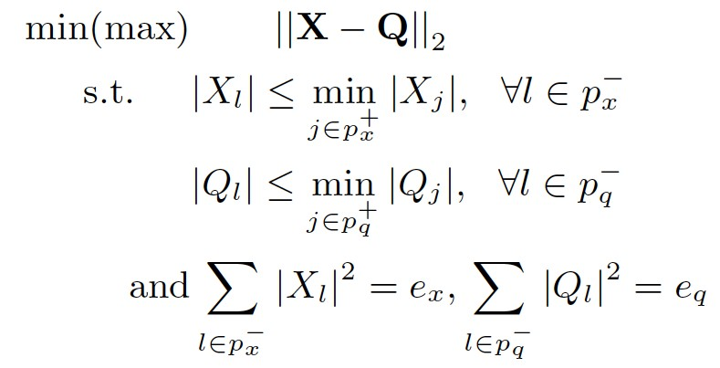


Mathematically…
Upper-Lower bound
Discared <= high-energy
Distortion energy

Slide 15
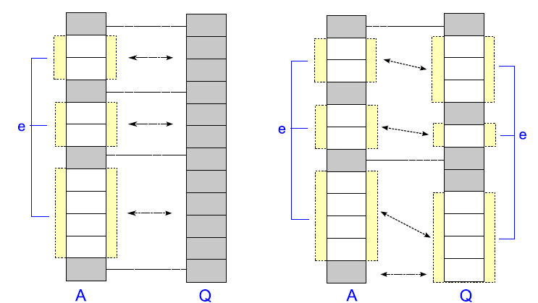
Solution
Exact solution using our double waterfilling algorithm
waterfilling
double waterfilling

Slide 16

Waterfilling
minPower
X
Q
Available Energy
10 / 30

Slide 17
Waterfilling
minPower
X
Q
Available Energy
10 / 30

Slide 18
Waterfilling
minPower
X
Q
Available Energy
10 / 30

Slide 19
Waterfilling
minPower
X
Q
Available Energy
10 / 30

Slide 20
Waterfilling
minPower
X
Q
Available Energy
10 / 30

Slide 21
Waterfilling
minPower
X
Q
Available Energy
10 / 30

Slide 22
Waterfilling
minPower
X
Q
Available Energy
10 / 30

Slide 23
Waterfilling
minPower
X
Q
Available Energy
10 / 30

Slide 24
Waterfilling
minPower
X
Q
Available Energy
10 / 30

Slide 25
Waterfilling
minPower
X
Q
Available Energy
10 / 30

Slide 26
Waterfilling
minPower
X
Q
Available Energy
10 / 30

Slide 27
Waterfilling
* X
10 / 30

Slide 28
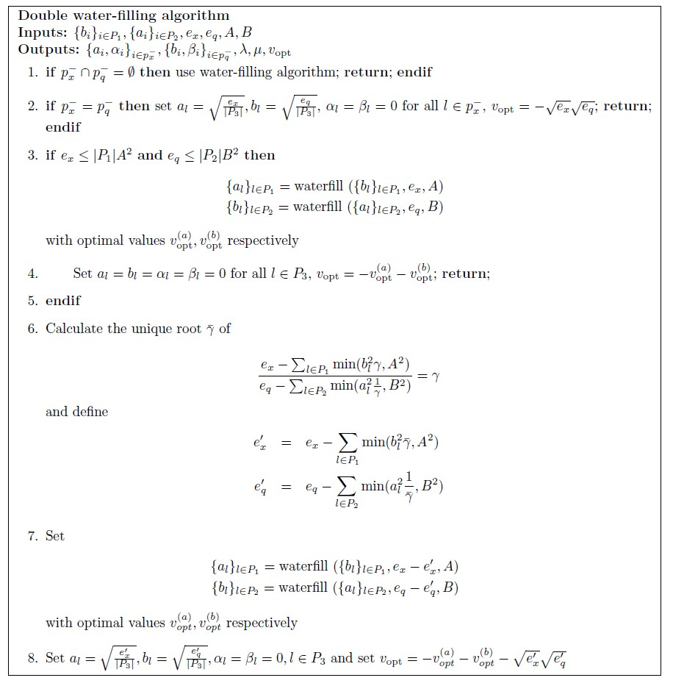

Double Waterfilling algorithm
Water-fill for the two vectors
separately..
..using the optimal energy allocation
Exact solution
Complexity: O(n)
10 / 30

Slide 29
Correctness
Theorem (VFK’13): The computation of lower and upper bounds can be solved exactly using double waterfilling. The lower and upper bounds are optimally tight; no tighter bounds can be provided.
10 / 30

Slide 30

Experiments
Unica: IBM web traffic for year of 2010
  Marketing/Adwords recommendation
Weblog queries (1TB of data per month)
  GBS: Scheduling advertising campaigns / pricing
BUSINESS DYNAMICS IBM
YIN YANG OF FINANCIAL DISRUPTION
EINSURANCE CUSTOMER EXPERIENCE.
IBM GLOBAL BUSINESS ANDREW STEVENS
BUSINESS CONSULTING
GLENN FINCH IBM
AMERICA MEDIA PLAYER INDUSTRY
STRATEGIE ENTREPRISE RENTABILIT
11 / 30

Slide 31
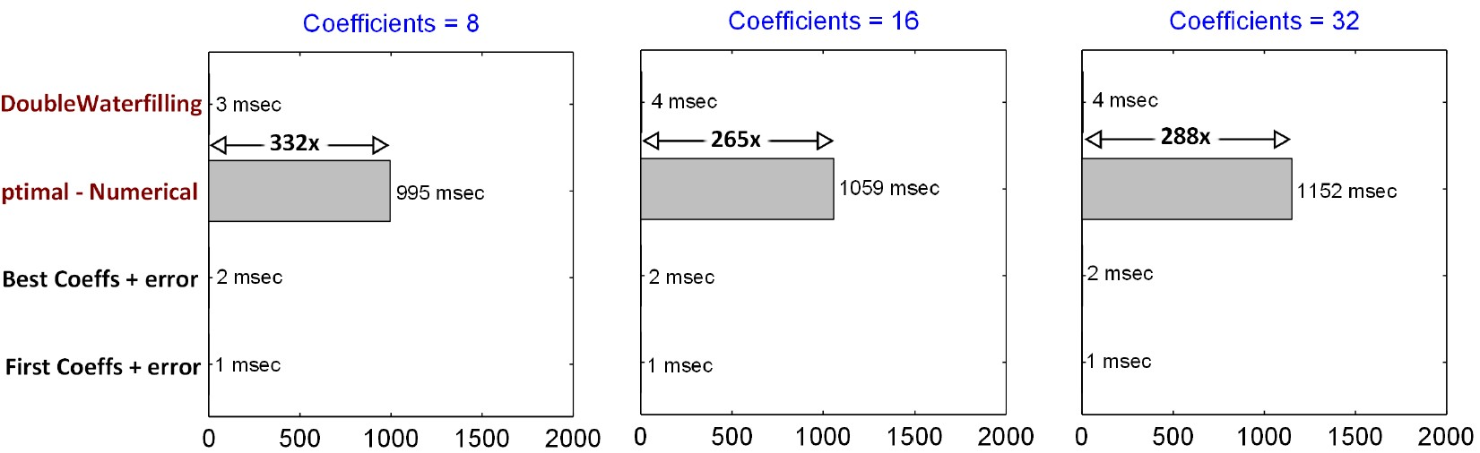
Experiments
our analytic solution is 300x faster than numerical solver
11 / 30

Slide 32
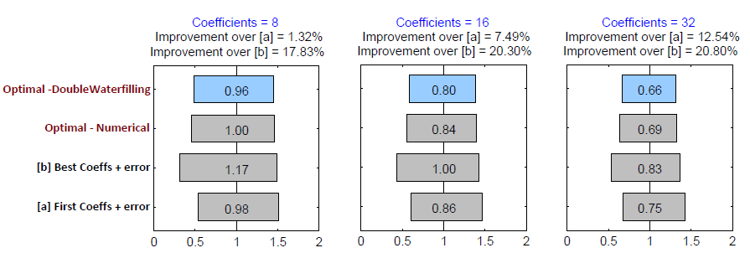
Experiments
LB/UB are 20% tighter than state-of-art
11 / 30

Slide 33
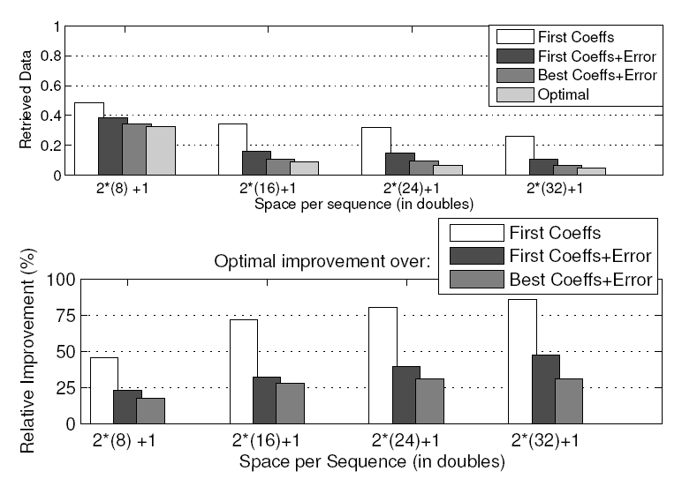
Experiments
(10-20%) improvement in distance estimation significantly reduces the search space for k-NN
We retrieve
20%-80% fewer sequences than other approaches
11 / 30

Slide 34

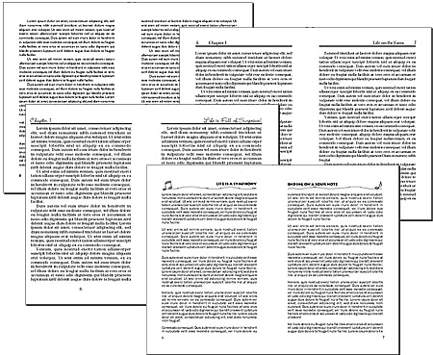

Extensions
Dynamic Time Warping
Halloween
Christmas
Cosine Similarity (text documents): cos(x,y) = 1 - L₂(x,y)²/2
Correlation (financial analysis):
corr(x,y) = 1 - L₂(x,y)²/2 (for normalized signals x,y)
Dynamic Time Warping (flexible similarity metric)
12 / 30

Slide 35
NN preserving watermarking

Slide 36
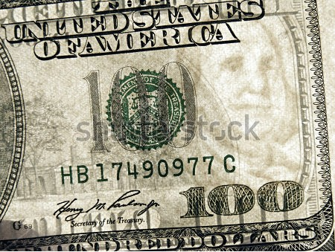

Watermarking
Seal of ownership
Original
Perceptible
Imperceptible
Watermarked

Slide 37
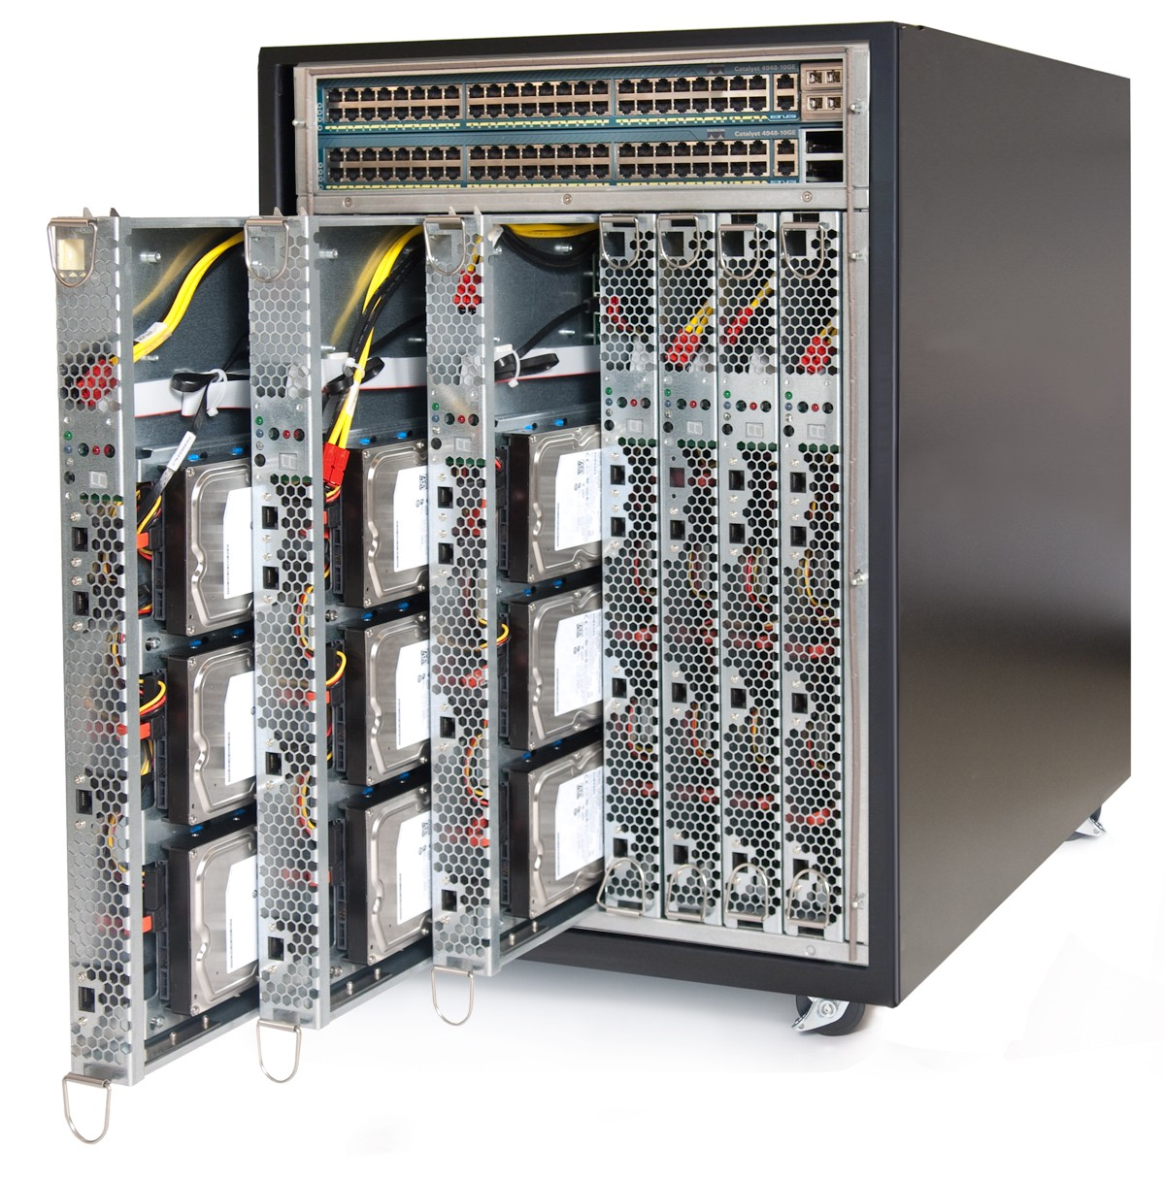



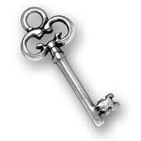
Applications
Cloud Services – Identify Leak
Companies
13 / 30

Slide 38





Applications
Data sharing with another institute
  Means to prove data ownership
Recipient will be able to mine the same results
Medical Centers
Medication
Patient 1
Patient 2
Rights Protection
Yes Age>55
No
Yes
suspected illness
13 / 30

Slide 39

Goal
Right-protect dataset via watermarking
Guarantee dataset‘utility’post-watermarking
Rights Protection
Provably preserve the mining outcome
k-NN, HC, visualization, etc.
Original Data
Transformed Data
Data Mining
14 / 30

Slide 40
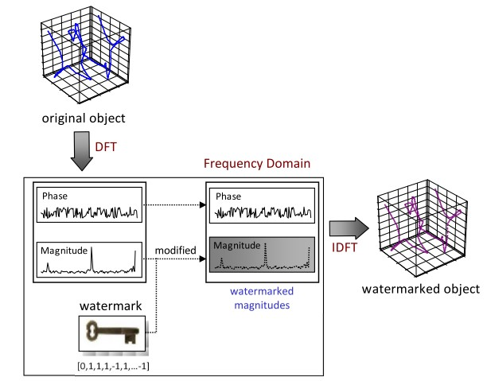
Rights-Protection via Watermarking
14 / 30

Slide 41
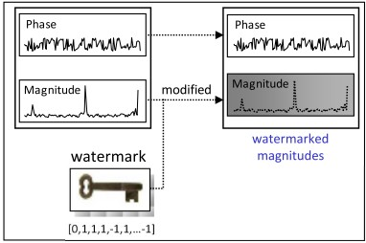

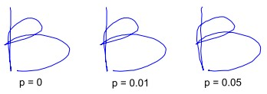
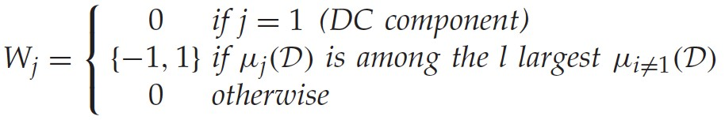

Rights-Protection via Watermarking
Choose watermarking power p
Watermark only magnitudes:
14 / 30

Slide 42

Detecting the watermark
Compute correlation between watermarked data 𝑫" and watermark W
For watermark

Slide 43
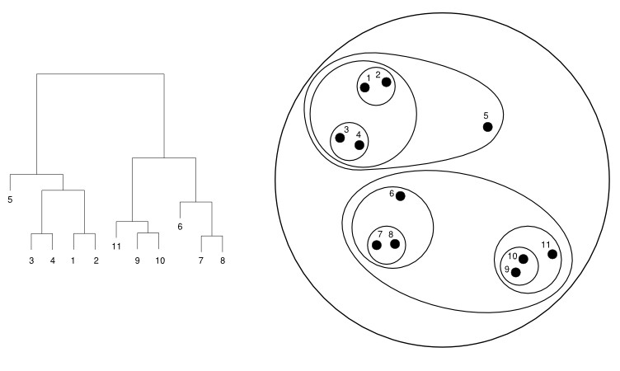
Hierarchical clustering (HC)
Merge objects bottom up
  until only one cluster remains
Various variants
  single linkage, complete linkage, avg. linkage

Slide 44
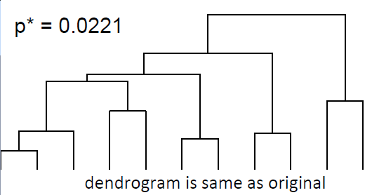
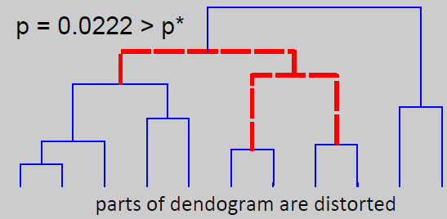
HC preserving Rights-Protection
Can we preserve hierarchical clustering?
What is the maximal embedding power p*?

Slide 45
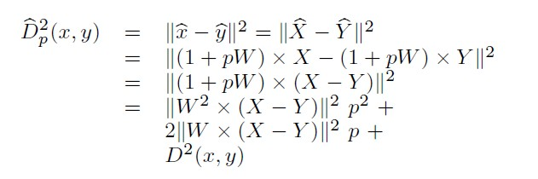
Distance between rights-protected data
Distance is a quadratic in p

Slide 46
Computing p*
A
B
Distance
D_{p}(A,B)
C
D_{p}(B,C)
power p
Maximal power p* that preserves the original order of distances

Slide 47
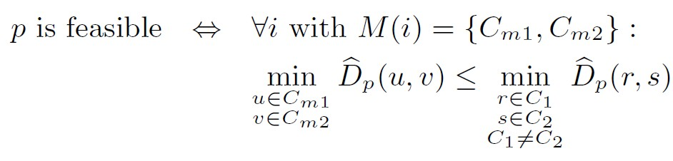
Exhaustive search
Distance
D _{p}(x,z)
_{D}2
2
_{p}(x,u)
_{D}2
_{p}(x,y)
remove this power range because of z
remove this power range because of z
^{p}min
^{p}max
Power
20 / 30

Slide 48

Extensions
NN-search
Minimum Spanning Tree (MST)

Slide 49
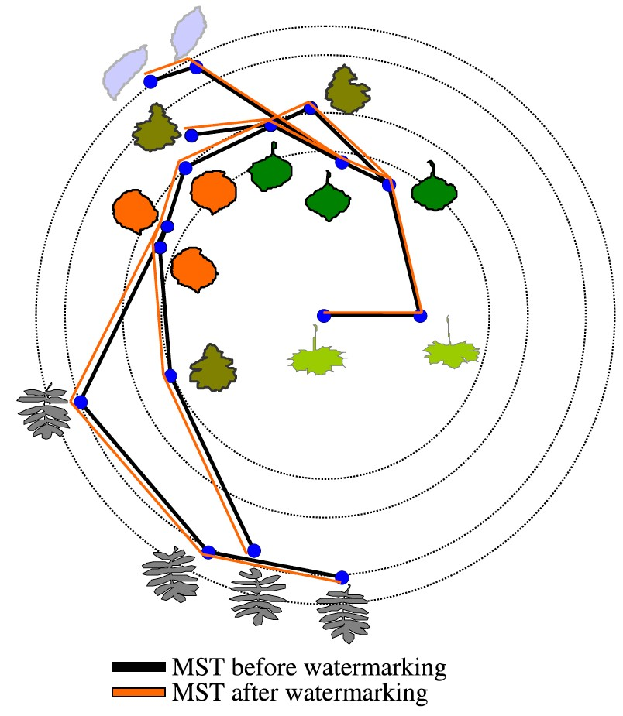
Example: MST preservation

Slide 50
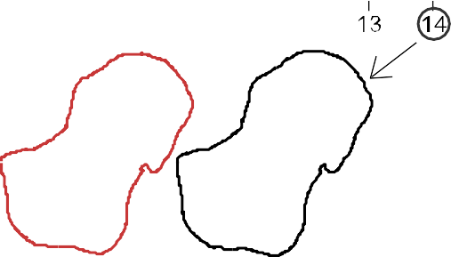
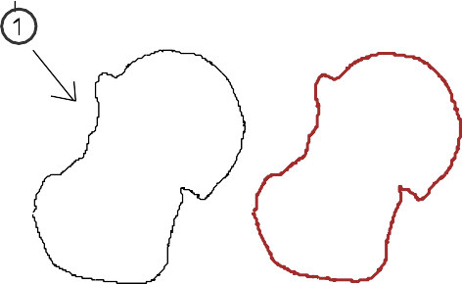
Example: HC preservation
dendrogram on
dendrogram on
original data
rights-protected data
watermarked
original
original
Exact Data Mining from Inexact Data
watermarked
22 / 30

Slide 51
Can we do better?
Too many comparisons
  Prune the search space

Slide 52

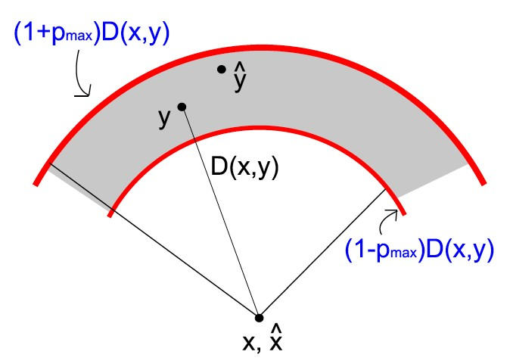
A restricted isometry property (RIP)
(1 — p)D(x, y)  D_{p}(xˆ, yˆ)  (1 + p)D(x, y)
Tight bound between watermarked and non-watermarked distances, for a given embedding power p

Slide 53
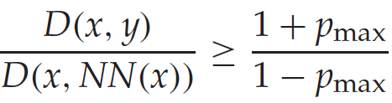
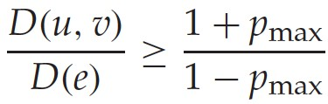
Pruning
Pruning test
NN
MST

Slide 54
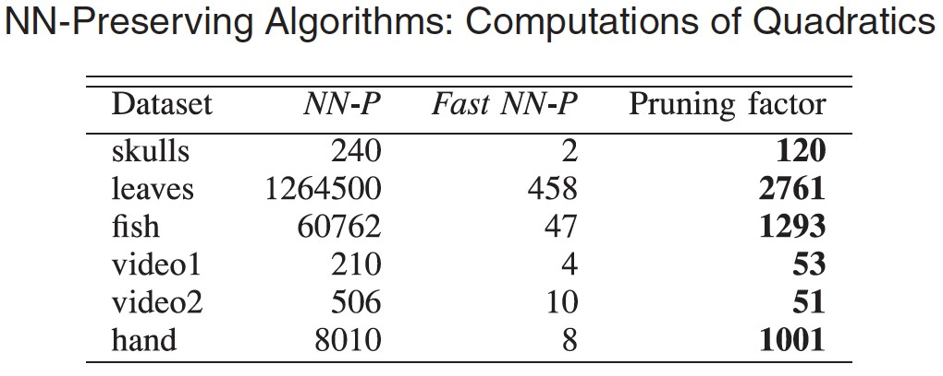
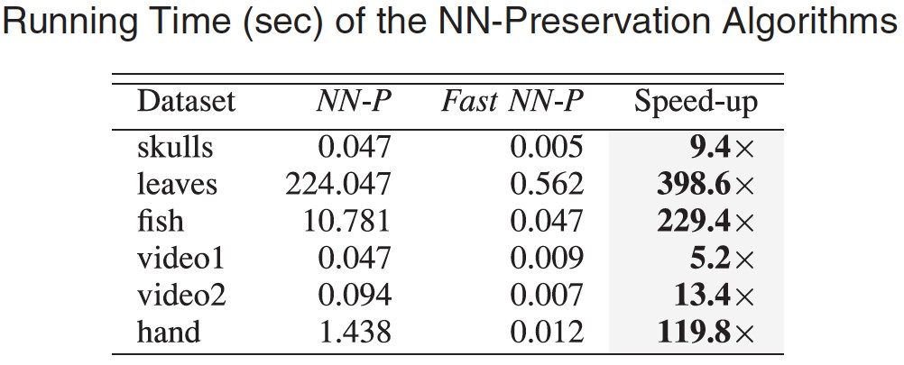
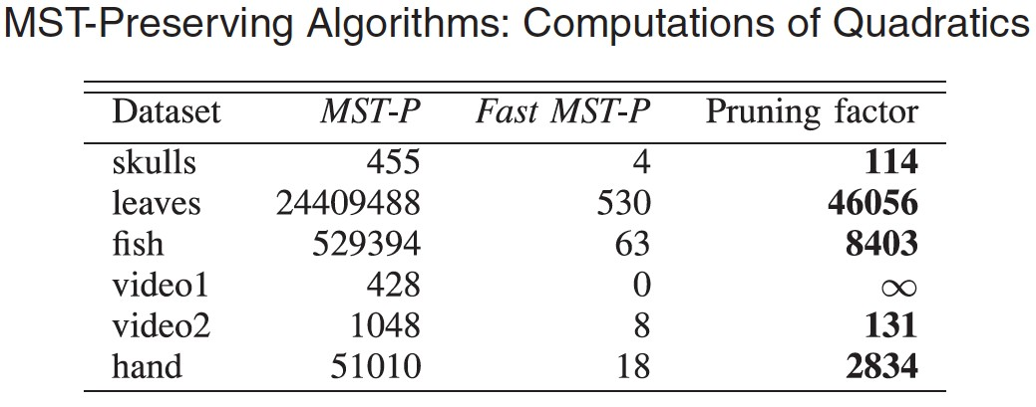
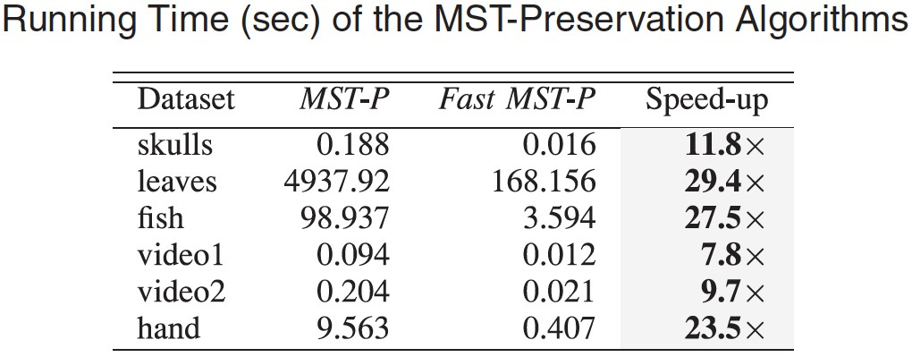
Immense speed-up
Substantially reduce the search space
26 / 30

Slide 55
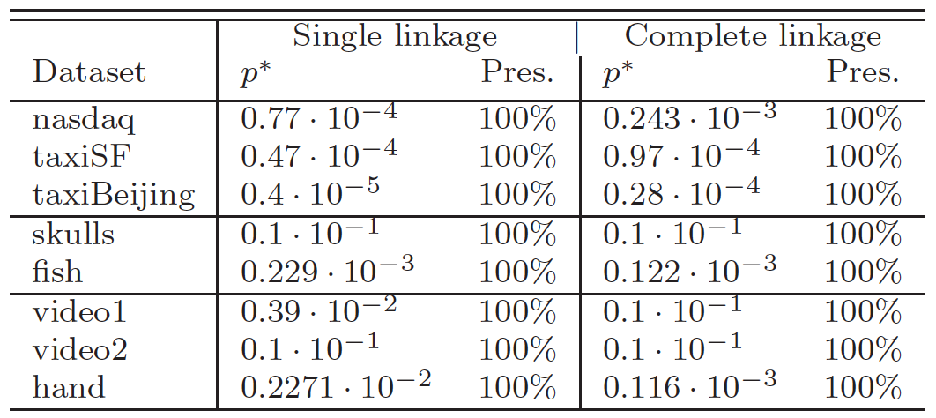
100% HC preservation
...with imperceptible watermark for p*
26 / 30

Slide 56
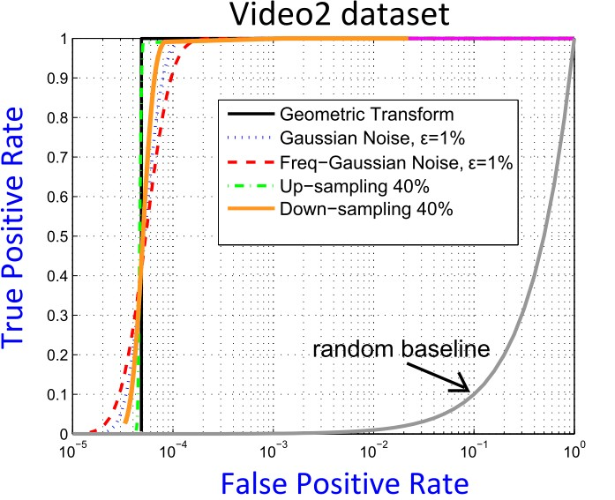
Resilience to attacks
We can withstand a variety of malicious attacks
  Geometric Attacks: Translation/Rotation/Scaling
  Noise addition
  Data Resampling (upsampling/downsampling)
26 / 30

Slide 57
K-means preserving compression

Slide 58
Multi-bit compression
§ with provable K-means preservation
cluster 1 cluster 2 cluster 3
cluster 1
cluster 2
cluster 3
identical clustering results
K-means
K-means
Original data
Quantized data

Slide 59
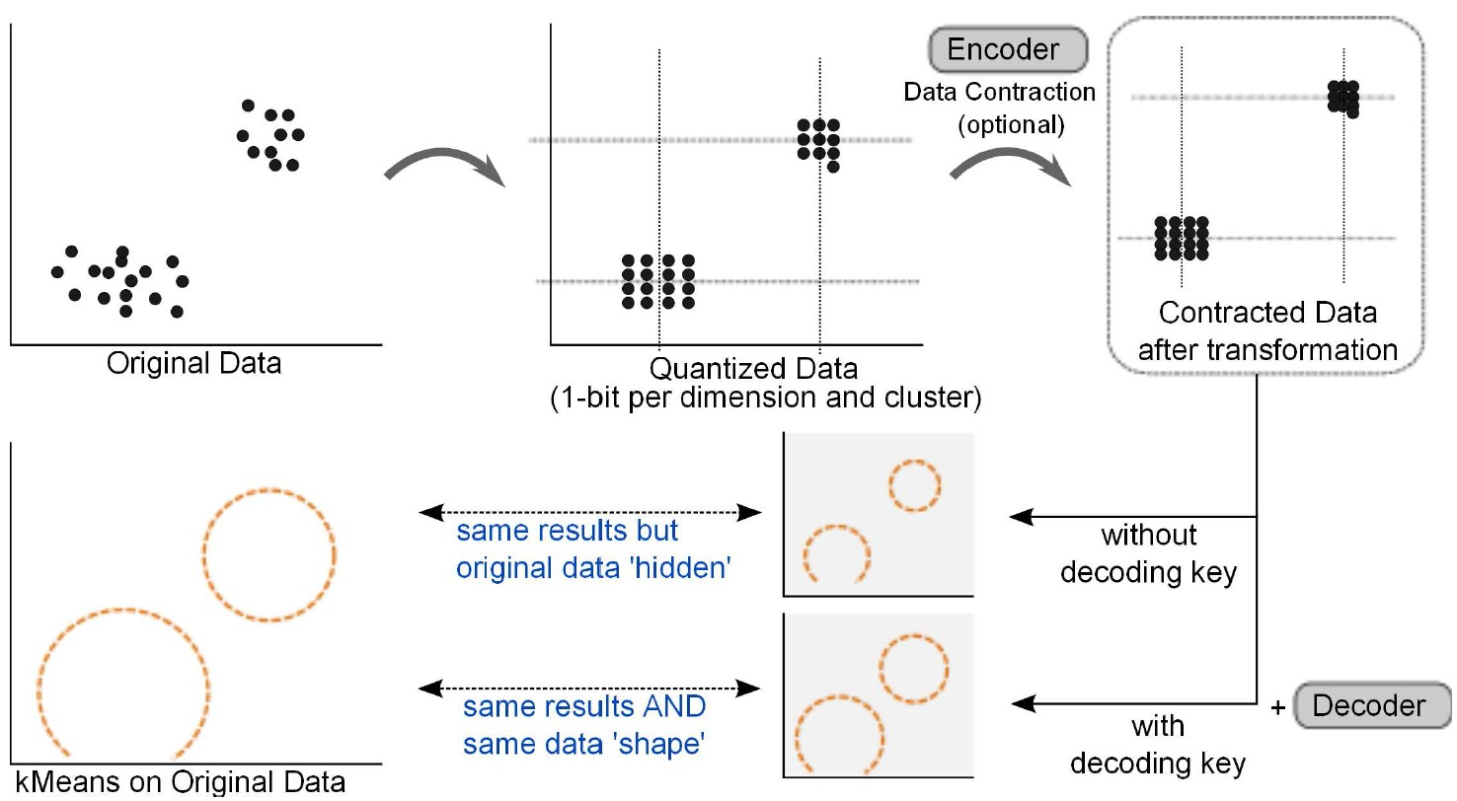
Algorithm
28 / 30

Slide 60
Features
Save storage space
  Faster data processing, reduced bandwidth
Data hiding
  Encoder-decoder scheme
Shape preservation
  High-quality data reconstruction
Tunable compression level
  Good storage/quality trade-off
28 / 30

Slide 61
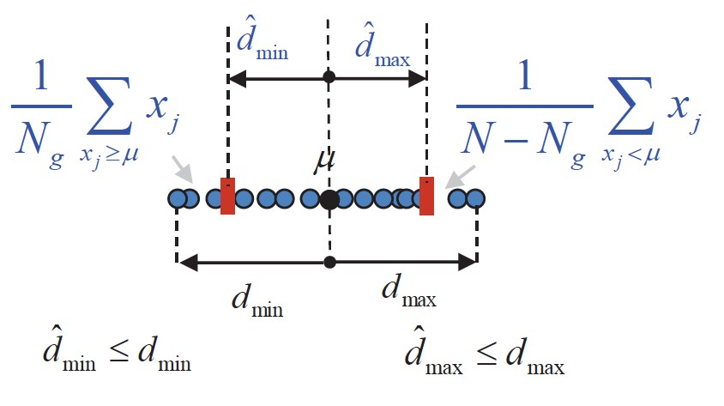

Inside the algo
1-bit MMSE quantization
  Apply per dimension
Extension to multi-bit quantization
Is this enough?
29 / 30

Slide 62


Inside the algo
Need cluster separation
Can achieve it with contraction
  Additionally provides data obfuscation
Exact calculation of contraction factor
29 / 30

Slide 63

100% cluster preservation
…with accurate shape preservation
30 / 30

Slide 64
Conclusions
Optimal distance estimation between compressed data series
NN, MST, HC-preserving watermarking
K-means preserving compression
30 / 30

Slide 65
Conclusions
Provably exact data mining…
…from inexact data
30 / 30

Slide 66
References
M. Vlachos, N. Freris and A. Kyrillidis, “Compressive Mining: Fast and Optimal Data Mining in the Compressed Domain.” International Journal on Very Large Data Bases (VLDBJ), vol. 24(1), pp. 1-24, 2015.
S. Zoumpoulis, M. Vlachos, N. Freris and C. Lucchese, “Right-Protected Data Publishing with Provable Distance-based Mining.” IEEE Transactions on Knowledge and Data Engineering, vol. 99, ISSN 1041-4347, 2013.
N. Freris, M. Vlachos and D. Turaga, “Cluster-Aware Compression with Provable K-means Preservation.” Proceedings of the SIAM International Conference on Data Mining (SDM12), pp. 82- 93, April 2012.
https://wp.nyu.edu/cpslab/publications

Slide 67



CSPLab is hiring!
https://wp.nyu.edu/cpslab

Slide 68

Thank you

