Slide 1


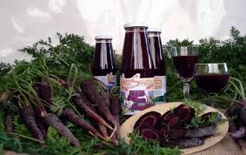
Probiotic beverage from black carrot juice fermented with
Lactobacillus casei and
Lactobacillus paracasei
3rd International Conference and Exhibition on
Probiotics, Functional and Baby Foods,
2014 Italy
Selcuk
University
Nihat AKIN, Talha DEMİRCİ, Hale İnci ÖZTÜRK, Kübra AKTAŞ, Enes DERTLİ
University of Selcuk, Faculty of Agriculture, Department of Food Engineering, Konya TURKEY

Slide 2

Agenda
Introduction
Material and Methods
Result and Discussion
Conclusion
References
The Mevlâna Museum, located in Konya, Turkey

Slide 3
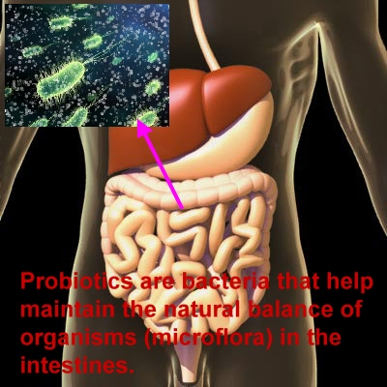
1. INTRODUCTION
Functional foods are defined as the foods that provide nutrients and feed on people, in addition to contribute to cure the diseases and provide several health benefits (Prado et al 2008).
Probiotics are one of the most popular functional foods. Probiotics are defined as live microbial feed supplement that beneficially influence the host by enhancing its gastrointestinal balance(Fuller, 1989; Yoon, 2006).
Notes:
* The second one is Bifidobacterium strains

Slide 4
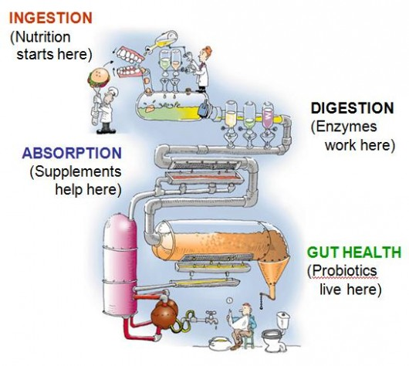
These microorganisms have many health-supporting effects such as easing of lactose intolerance, prevention of intestinal tract infections and colon cancer and good industrial characteristics such as resistance to acid and bile, attachment to the epithelial cells and colonization in the human intestine (Jack,Tagg and Ray, 1995; Prado et al. 2008).
They show antagonistic effect to food-borne pathogens. One of the most commonly used bacteria for commercial probiotic applications are species of Lactobacillus (Sheehan et al., 2007).

Slide 5
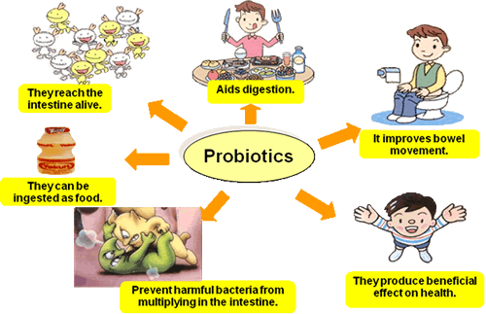
Probiotics have ordinarily been added to fermented milk products, especially yoghurts but there are several disadvantages related to their consumption like lactose intolerance, the cholesterol content and/or allergic to milk proteins (Heenan, Adams, Hosken, & Fleet, 2004; Yoon, Woodams, & Hang, 2006; Kun et al.2008).
However, there is relative little published information on the survival of probiotics in non-fermented food matrices, whereas the stability of probiotics in yoghurts has been widely studied (Kailasapathy & Rybka, 1997).
In recent years, consumer interest to non-dairy probiotic products such as fruit and berry juices, cereal-based products has increased (Shah, 2001) and there is a little publish about probiotic stability in non-fermented foods and beverages.

Slide 6
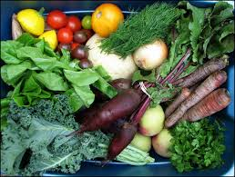
There are a wide variety of traditional non-dairy fermented beverages produced around the world lately. Fruits and vegetables have been showed as appropriate for probiotic products and fruits and vegetables do not contain any dairy allergens that might prevent usage by part of the population (Luckow and Delahunty, 2004). Also they have several functional food components such as minerals, vitamins, dietary fibers, and antioxidants (phytochemicals).
In recent years studies about non-dairy probiotic beverages such as tomato, cabbage, blackcurrant, orange, beetroot and carrot juices have been performed in conjuction with different probiotic strains and obtained appealing results.

Slide 7
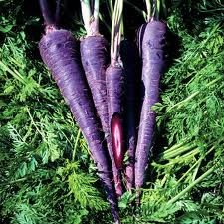
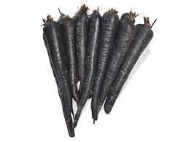
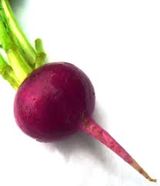
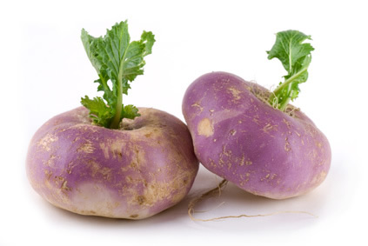
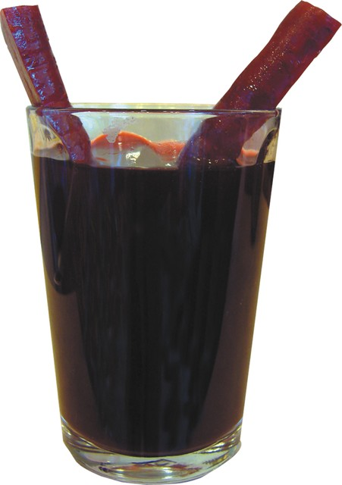
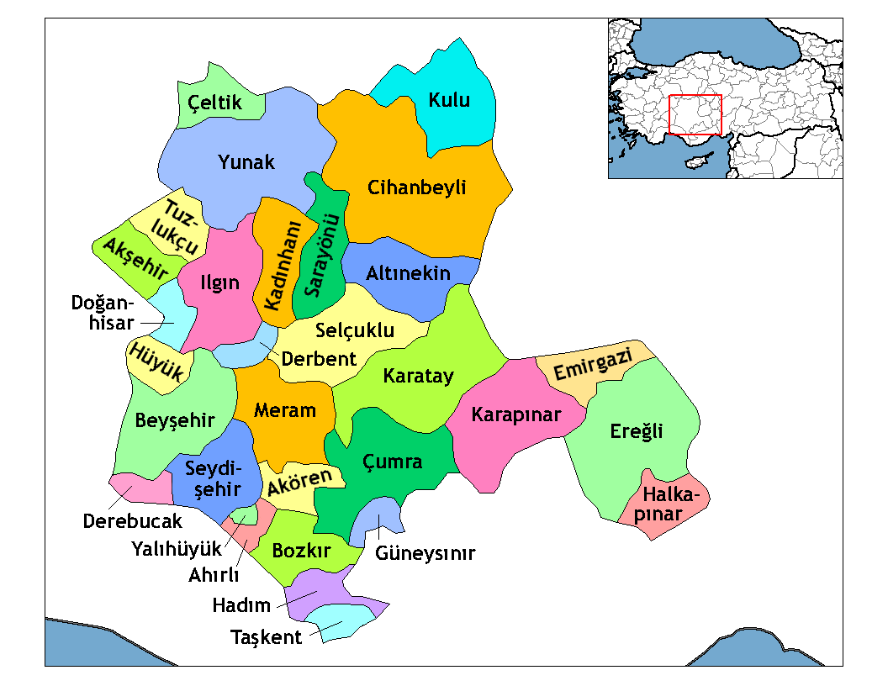
Black carrots are a good source of anthocyanin pigments.
The anthocyanin content of black carrots was reported to be 1750 mg kg⁻¹ fresh weight (Mazza & Miniati, 1993).
Black carrots also contain high amounts of acylated anthocyanins.
Moreover, black carrot anthocyanins provide an excellent bright strawberry red shade at acidic pH values; therefore, black carrot juice can be a good choice for colouring fruit juices and nectars, soft drinks, cans, jellies and confectionery (Downham & Collins, 2000; Kırca et al.,2006).
Black carrots (BCs) are mostly grown in Turkey, Afghanistan, Egypt, Pakistan and India.
Ereğli district in Konya is the major production area for BCs. BCs grown in Turkey were often processed into juice, concentrate and shalgam, i.e. a traditional lactic acid fermented beverage (Turkyilmaz ve ark.,2012).
Black carrot
Red beet
Swede turnip
Notes:
Shalgam: Our traditional juice. törnip

Slide 8

The aim of the present study was to determine the survivability of L. casei and L. paracasei on black carrot juices throughout refrigerated storage for 42 days and therefore to assess suitability of black carrot as a raw material for production probiotic beverages.

Slide 9
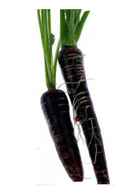

2. MATERIAL AND METHODS
Raw Material
Black carrots were provided by black carrot producers in Ereğli District, Konya as a concentrate, it was diluted 1:10.
A strain of L. casei NRRL B-442 and L. paracasei NRRL B-442 were obtained from ARS Culture Bacterial Collection (NRRL Culture Collection, United States Department of Agriculture, Peoria П,USA)

Slide 10
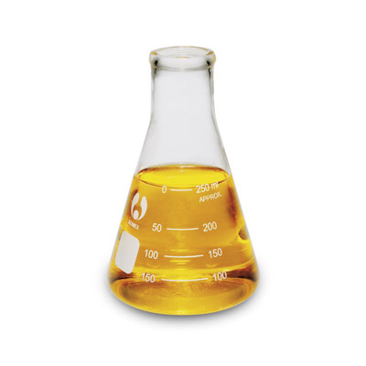
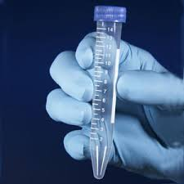
b. Microorganisms, inoculum preparation and juice fermentation
Pasteurization were applied to freshly prepared black carrot juices at 80°C for 20 min. for the purpose of decrease microbial population to below the detection limit.
A strain of L. casei NRRL B-442 and L. paracasei NRRL B-442 was statically activated for 12 h at 37°C in 25 ml erlenmayer flasks containing 100 ml of MRS Broth (de Man, Rogosa, & Sharpe, 1960).
Stock cultures were prepared and stored frozen (-20 ^{O}C).
Notes:
ARS: Agricultural Researh Service

Slide 11
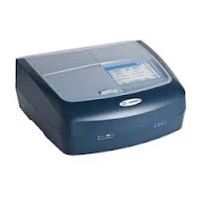

The growth of L. casei and L. paracasei was quantified by measuring the optical density at 590 nm. The absorbance was recorded for the fresh juice inoculated with L.casei (initial absorbance) and after 24 h of fermentation (final absorbance).
The procedure consisted of diluting with distilled water an aliquot of the juice containing microbial cells and reading the absorbance at 590 nm against water.
The difference between final and initial absorbance corresponded to the growth of the microorganisms during the fermentation.
Growth was expressed as dry mass concentration (g/L) calculated using the calibration curve given in Eq. (1), built using L.casei dry cells.
590 nm
Spectrophotometer
Sample solution
L. casei (g/L) = ABS(590 nm) Eq. 1

Slide 12
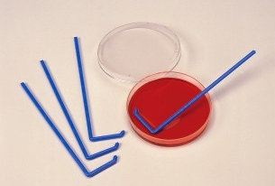
Serial dilutions were prepared for microbial counts. These diluted samples were inoculated on plates containing MRS Agar, plating on the surface with the aid of a Handle Drigalsky.
The plates were incubated at 37°C for 72 h. Typical colonies are round, white creamy with diameters ranging from 0,9 to 1,3 mm (Vinderola and Reinheimer, 2000).
For stability assay, black carrot juice was fermented at 30°C for 48 h. After fermentation the bottles were stored under refrigeration temperature for 42 days. Each seven days, a bottle of each sample was analysed (pH, microbial viability and color).

Slide 13
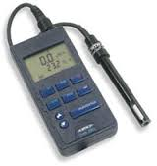
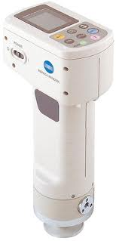
c. pH Analysis
pH values of the black carrot juice was determined by WTW pH meter (İnolab Ph720, Weilheim, Germany).
d. Color Analysis
Color analysis of samples was determined using CR400 chroma meter (Konica Minolta, Inc., Osaka, Japan). The chroma meter was standardized by using the illuminant D65 and measurements were made through an 8 mm viewing area (Minolta, 1998). The instrument measured lightness (L*), redness (a*) and yellowness (b*).

Slide 14
d. Sugar Determination
The sugars were analysed by high performance liquid chromatography in a Shimadzu HPLC equipped with LC-10ADvp pump, RID 10A dedector, CTO-10ACvp column oven and DGU-14A degasser. Seperation was applied Aminex by HPX-87C carbohydrate column (300*7.8mm) at 80°C. Injection volume was 20 μL and flow velocity 0,6 ml/min. Sample preparation was carried out according to Veberic and Stampar (2005) with some modification.
d. Statistical Analysis
JMP 5.0 (SAS Institute Inc., Cary, NC, USA) software was used to perform the statistical analysis according to one-way analysis of variance (ANOVA). Means that were statistically different from each other were compared by using Student’s t comparison tests at %5 confidence interval.
Notes:
Numune 0.45mm filtreden geçirilerek 20 mikrolitre si HPLC ye enjekte edildi.
Sample was filtered from 0,45mm membran filter

Slide 15

3. RESULT AND DISCUSSION
Name | Fermentation and Storage Time (days) | pH values | L* values | a* values | b* values
Lactobacillus casei | 0 | 3,78ª | 8,10ª | 23,37^{ab} | -5,78ª
 | 1 | 3,74^{b} | 8,98ª | 22,18^{ab} | -4,81ª
 | 2 | 3,74^{b} | 9,43ª | 25,22^{ab} | -4,21ª
 | 7 | 3,67^{c} | 8,33ª | 18,77^{b} | -5,97ª
 | 14 | 3,64^{d} | 9,19ª | 27,53ª | -4,78ª
 | 21 | 3,63^{d} | 9,16ª | 19,60^{b} | -5,67ª
 | 28 | 3,64^{d} | 9,44ª | 22,45^{ab} | -5,13ª
 | 35 | 3,64^{d} | 9,38ª | 24,22^{ab} | -3,59ª
 | 42 | 3,65^{d} | 8,70ª | 20,89^{ab} | -4,50ª
Name | Fermentation and Storage Time (days) | pH values | L* values | a* values | b* values
Lactobacillus paracasei | 0 | 3,78ª | 7,88^{c} | 21,43^{cd} | -6,45^{d}
 | 1 | 3,75^{b} | 7,95^{c} | 15,25^{f} | -6,73^{d}
 | 2 | 3,74ª | 10,56ª | 28,78ª | -2,45ª
 | 7 | 3,74^{b} | 8,37^{c} | 16,20^{ef} | -6,35^{d}
 | 14 | 3,72^{c} | 9,94^{ab} | 26,64^{ab} | -3,11^{ab}
 | 21 | 3,71^{cd} | 10,02^{ab} | 19,14de | -5,51^{cd}
 | 28 | 3,69^{d} | 9,62^{b} | 23,06^{c} | -4,34^{bc}
 | 35 | 3,69^{d} | 9,49^{b} | 23,86^{bc} | -4,21^{abc}
 | 42 | 3,69^{d} | 8,16^{c} | 17,54^{ef} | -5,83^{cd}
Notes:
After 14th day, results are not significantly important.

Slide 16

3. RESULT AND DISCUSSION
pH Analysis
No pH adjustment was done at the beginning of the fermentation.
At the beginning of the fermentation, pH values for L. casei and L. paracasei were measured as 3,78. It was measured as 3,65 and 3,69 for L. casei and L. paracasei , respectively, after the storage.
Statistically significant reduction was not determined, after 21st day of storage for L. paracasei and 14th day of storage for L. casei .

Slide 17

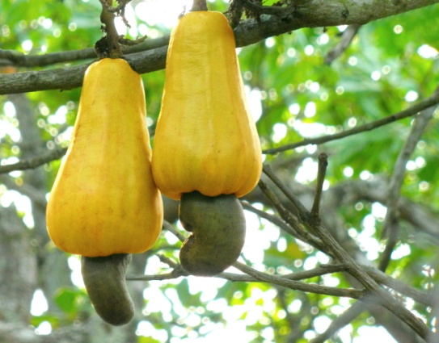
pH reduction which would affect to viability of L. casei and L. paracasei too much was not observed.
In a study about fermented cashew apple juice, it was explained that initial pH value was approximately 4,3 and it decreased to about 3,8 at the end of the storage, and viable cell population of L. casei remained around 8,5 log CFU/ml in these pH conditions after the storage.
In our study, reduction of pH did not affect unfavourably viability as well, after 42 days viability remained approximately 7,5 log CFU/ml.
Cashew apple

Slide 18

In a study of Yoon et al. (2004), they expressed that probiotic cultures, including L. casei, maintained their viability in low pH such as tomato juice’s pH after 72 hour of fermentation at 30 ^{O}C

Slide 19
b. Color analysis “L”, “a”, “b”
“L” (lightness) value increased during fermentation, it had fluctuated during storage after the fermentation, however, it was determined that this value declined by the end of the storage compared to the beginning of the storage. In a research about viability of L. casei in cashew apple juice, it was determined that “L” value decreased during the storage , authors associated this reduction with increase of biomass during the storage.

Slide 20
“a” (redness) value had fluctuated, too. But a decrease was determined last of the storage compared to at the beginning of the storage. In the study about viability of L. casei in cashew apple juice, it was explained that “a” value decreased during the storage, as well.
Reduction of a value of L. casei were observed no statistically significant but reduction of “a” value of L. paracasei were observed statistically significant. However, in a study about storage of açai, acerola, pomegranate and apple, was reported that “a” values of samples decreased any without probiotic culture.
It was observed that “b” (yellowness) value for both L. casei and L. paracasei, more decreased than at the beginning of the storage.
Negative values was observed in “b” value.This showed that Blue was more dominant than yellow in black carrot juice.

Slide 21
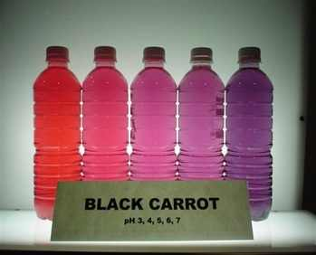
Again, it was found significant for L.paracasei whereas it was not statistically important for L.casei.
As it known to all, black carrot is one of the widely used natural colorant.
Even if black carrot juice colour diluted 1\10 rate , it was so intensive, decreases of “a” and “b” values in black carrot juice were not absolutely distinctive as visual during storage.
From this point of view (during fermantation and storage ) it could be said comfortly that adding L.casei and L.paracasei did not change black carrot juice characteristic colour.
Notes:
Trivial: Önemsiz

Slide 22
c. Viability
Count of L. casei which was 6,5 log CFU/ml, increased to about 8 log CFU/ml after 48 hour of fermentation. At the same time, L. paracasei was 7.4 log CFU/ml at the beginning of the fermentation while it was 8,4 log CFU/ml after fermentation.
Raises of both L. casei and L. paracasei’s numbers which were 1,5-2 log CFU/ml after fermentation, were expected increases. After these raises, it was anticipated that number of probiotic bacteria which reached 8-8,5 log CFU/ml remained upper than
6 log CFU/ml by the end of the end of the storage at 4^{O}C. And it occured as it expected to be. Falls of numbers belonging to both two bacteria were observed after 21st day, however, number of bacteria remained in the range of 7,5 log CFU/ml after 42^{sd} day.
Notes:
Viable count is more than 10^7. We can say black carrot stimulate bacterial growth and it has prebiotic effect on used bacteria
Generally, probiotic level is 10^6 or ^7. That’s why this level more than this level. So we can say this juice is probiotic fruit juice BAKTERİ: PROBİOTİC

Slide 23
In a study conducted by Yoon et al. (2005), 4 type of bacteria were inoculated into beet juice and their viabilities were examined during fermentation and storage time (28 days). While number of L. acidophilus was falling to 16x10⁴ CFU/ml, number of L. delbrueckii remained approximately 9x10⁶ CFU/ml. On the other hand, it was reported that L. casei and L. paracasei stayed alive such high rate as 7,2x10⁷ and 7,7x10⁷ CFU/ml, respectively.
In another study about tomato juice performed by Yoon et al. (2004), it was notified that L. casei kept its viability about 1,7x10⁸ CFU/ml after the storage for 4 weeks. When it comes to another research about probiotic cashew, initial number of L. casei was 7,5 log CFU/ml in the fermentation and then it rose up around 8,5 log CFU/ml after the fermentation. It increased by the time 21st day and had declined after that day, and remained about 8,6 log CFU/ml on 42^{sd} day.

Slide 24
d. Sugar analysis
Notes:
Başlangıçtaki değerler: Sucrose:41
Glucose: 2,9
Fructose: 4,8

Slide 25
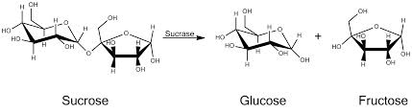
In our study, it is seemed that the amount of sucrose decreased at the end of the fermentation and this falling was found to be more for L. paracasei. Glucose and fructose contents rose up due to decomposition of sucrose after fermentation, too. This increase was still more for L. paracasei. Reduction of sucrose and increment of glucose and fructose was an expected result. It indicated that probiotic bacteria used sugar resources to maintain their activity.
Costa et all. (2013) performed sugar analysis in pineapple which was added with L. casei. Sucrose decreased during the fermentation while glucose and fructose were increasing. As a conclusion, they observed that sucrose reduced from 45 g/L to 32 g/L during the fermentation. In addition glucose and fructose contents which were approximately 4 g/L rose up to 6,5 g/L.

Slide 26
e. Biomass determination
Biomass analysis was performed only for fermentation.
It increased as expected during the fermentation. Biomass increase of black carrot juice enriched L.casei was higher than that of L. paracasei. This situation showed parallelism with increase of viable count and decrease of pH. Because augmentation of increase of viable count in black carrot juice fermented with L.casei was high compared to that of L.paracasei. Also decrease of pH was determined high in black carrot juice with L.casei than that of L.paracasei.
Notes:
Augmentation: growth

Slide 27



4. CONCLUSION
L. casei and L. paracasei were found capable of utilizing black carrot juice for synthesis and lactic acid production without pH adjustment.
Good viable cell counts were obtained in a fermentation time (48h.) and microbial viability was maintained within the acceptable range for 42 days and the characteristic color of the juice was preserved along fermentation and storage.
Thus black carrot juice could be used as a raw material for fermentation of probiotic cultures and could consumed as a good healthy alternative functional beverage for consumers.

Slide 28
5. REFERENCES
Kyung Young Yoon, Edward E. Woodams, Yong D. Hang*, Fermentation of beet juice by beneficial lactic acid bacteria, Lebensm.-Wiss. u.-Technol. 38 (2005) 73–75.
Clarice Maria de Arau´ jo Chagas Vergara a, Talita Lopes Honorato b, Geraldo Arraes Maia, Sueli Rodrigues, Prebiotic effect of fermented cashew apple (Anacardium occidentale L) juice, LWT - Food Science and Technology, LWT - Food Science and Technology 43 (2010) 141–145.
Sawaminee Nualkaekul a, Ivan Salmeron b, Dimitris Charalampopoulos, Investigation of the factors influencing the survival of Bifidobacterium longum in model acidic solutions and fruit juices, 129 (2011) 1037–1044.
Mayra Garcia Maia Costa, Thatyane Vidal Fonteles, Ana Laura Tibério de Jesus, Sueli Rodrigues, Sonicated pineapple juice as substrate for L. casei cultivation for probiotic beverage development: Process optimisation and product stability, Food Chemistry, 139 (2013) 261–266.
Kyung Young Yoon, Edward E. Woodams, Yong D. Hang, Production of probiotic cabbage juice by lactic acid bacteria, Bioresource Technology 97 (2006) 1427–1430,
Fla´vera C. Prado a, Jose L. Parada a, Ashok Pandey b, Carlos R. Soccol, Trends in non-dairy probiotic beverages, Food Research International 41 (2008) 111–123
Ana Lúcia F. Pereira, Tatiane C. Maciel, Sueli Rodrigues, Probiotic beverage from cashew apple juice fermented with Lactobacillus casei, Food Research International, 44 (2011) 1276–1283
Kyung Young Yoon, Edward E. Woodams1 and Yong D Hang, Probiotication of Tomato Juice by Lactic Acid Bacteria, 2004, The Journal of Microbiology, December 2004, p.315-318

Slide 29


