Slide 1
Fungi in the oral cavity: the opportunistic foes
Dr. Nihal Bandara BDS Hons (Sri Lanka), Ph.D. (Hong Kong)
The School of Dentistry
The University of Queensland
Australia

Slide 2
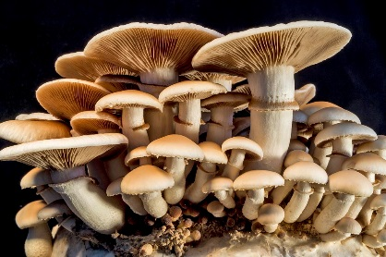
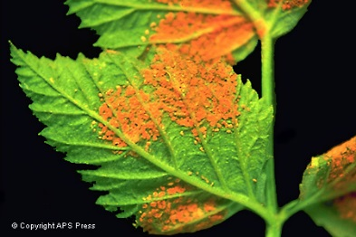
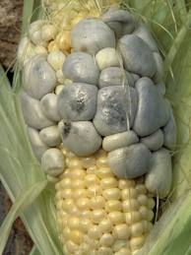
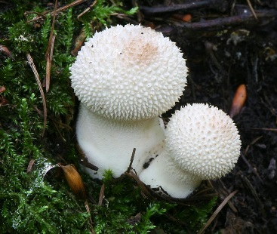
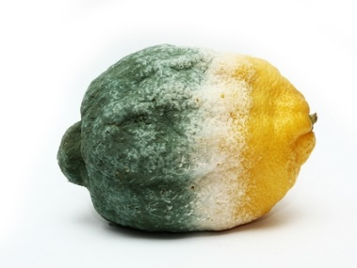
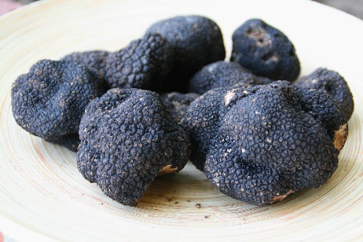
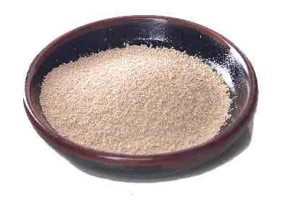
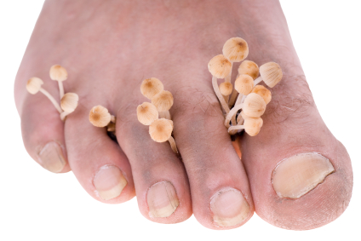
Fungi
A separate kingdom
Neither a plant nor an animal
Includes
  mushrooms, rusts, smuts, puffballs, truffles, morels, molds, and yeasts,
A variety of sizes
  Microscopic single-celled organisms e.g. yeast
  Multicellular macroscopic organisms.
Human feet harbours over 200 species of fungi more than any other body sites .
-Human Genome Research Institute in Bethesda, Maryland, USA

Slide 3
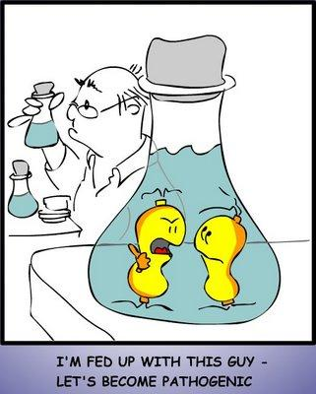
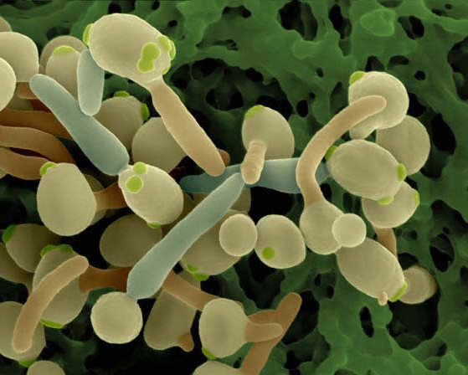
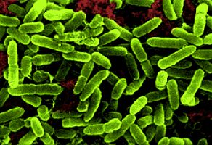
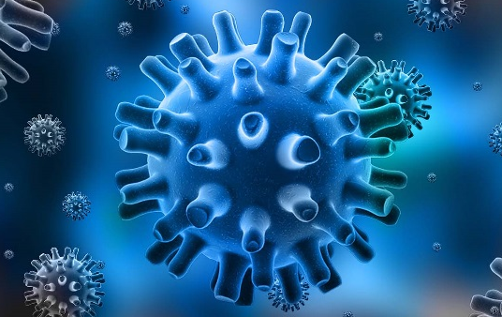
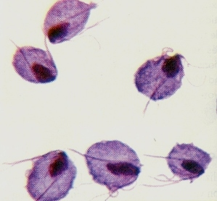
Opportunistic pathogens
Microorganisms
  Do not cause disease in a healthy host
  Take advantage of a host with a weakened immune system
  E.g. some bacteria, viruses, fungi and protozoa

Slide 4
What are the opportunities?
Physiological factors
e.g. elderly, pregnancy and infancy
Local factors
e.g. mucosal irritations, poor dental hygiene, localized radiotherapy, xerostomia
Medications
e.g. broad spectrum antimicrobial therapy, cytotoxic drugs, immunosuppressive drugs, Steroid inhalers and systemic steroids
Nutritional factors
e.g. Iron, folate, vitamin B12 deficiencies, malnutrition
Systemic disorders
e.g. Diabetes, hypothyroidism, Addison’s disease
Immune defects
e.g. HIV infection, AIDS, thymic aplasia
Malignancies
e.g. acute leukaemia, agranulocytosis
Xerostomia due to irradiation, sjögren’s syndrome, drug therapy
Samaranayake et al 2009

Slide 5
Oral fungal infections
Infection | Pathogen
Candidiasis | Candida albicans, C. tropicalis, C. glabrata, C. parapsilosis, C. krusei, C. kyfer, C. dubliniensis
Aspergillosis | Aspergillus fumigatus
Cryptococcosis | Cryptococcus neoformans
Histoplasmosis | Histoplasma capsulatum
Blastomycosis | Blastomyces dermatitidis
Zygomycosis | Orders Mucorales and Entomophthorales
Coccidioidomycosis | Coccidioides immitis
Paracoccidiomycosis | Paracoccidioides brasiliensis
Penicilliosis | Penicillium marneffei
Sporotrichosis | Sporothrix schenckii
Geotrichosis | Geotrichum candidum
Krishnan PA. Indian J Dent Res. 2012 Sep-Oct;23(5):650-9.

Slide 6
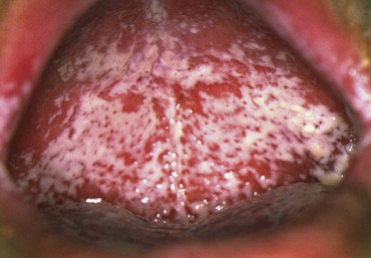
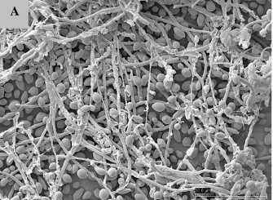
Candidiasis
Pseudomembranous candidiasis (Thrush)
Chronic/acute
White/Yellow plaques in mucosal surfaces
Confluent or discrete
Readily removable leaving raw underlying surface
http://pocketdentistry.com/
Koban et al. New J. Phys. 12 (2010) 073039

Slide 7
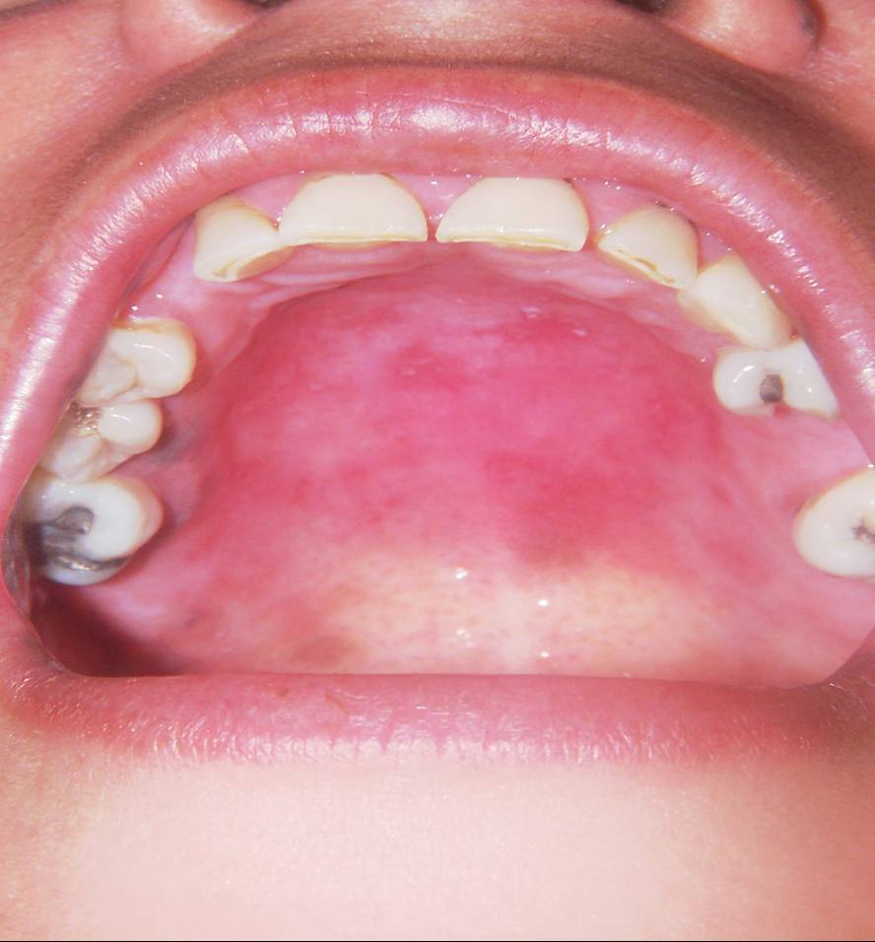
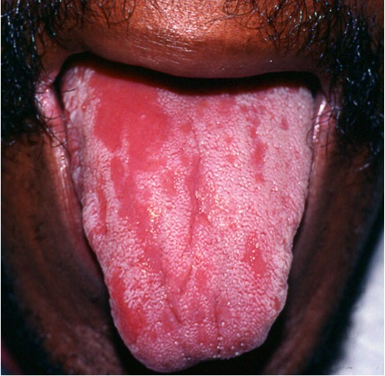
Erythematous candidiasis
Also called atrophic candidiasis
Appears as erythematous patches in the mucosa
Could be chronic or acute
Commonly seen in the palate, dorsal tongue
Tongue depapillation
Mainly associated with broad spectrum antibiotics or corticosteroids
http://www.hivdent.org/
http://hiv.uw.edu/oral/case1/discussion.html

Slide 8
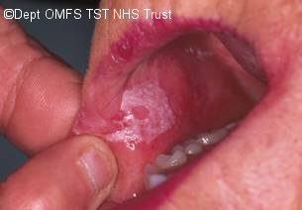
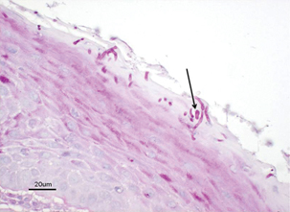
Chronic hyperplastic candidiasis
Also called candidal leukoplakia
White plaque present in the commissural region
Buccal commissural area, plate and tongue
Associated with dysplasia (15%) Samaranayake LP 1990
Biopsy and histopathology is necessary
http://www.tauntonmaxfax.net/html/prof_oralmed_candidalinfections_t.htm
Williams et al. Journal of Oral Microbiology 2011, 3: 5771

Slide 9
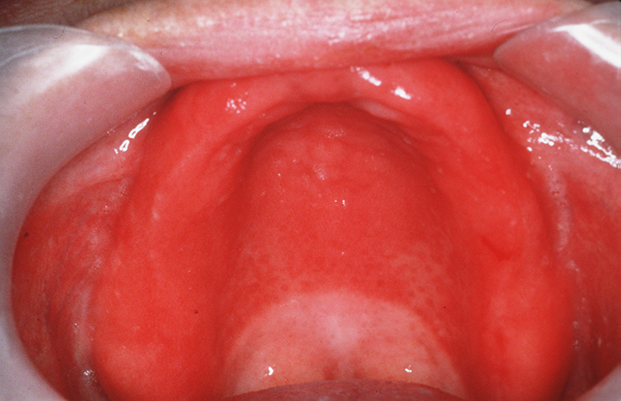
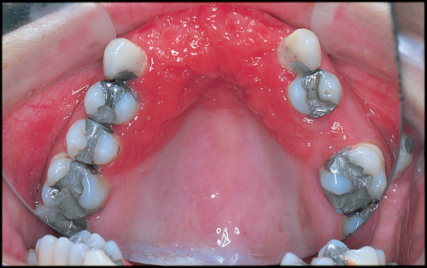
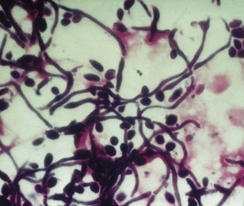
Candida associated lesions
Denture associated stomatitis
A chronic inflammatory condition in denture bearing mucosa
Erythematous lesions
Denture provides ideal environment for Candida growth
          Attachment sites
          Act as a shield for saliva and local immunity
Denture hygiene is critical
http://www.studentistry.com/denture-stomatitis-classification-causes-management/
Davenport et al. British Dental Journal 189, 414 - 424 (2000)
http://pocketdentistry.com/

Slide 10
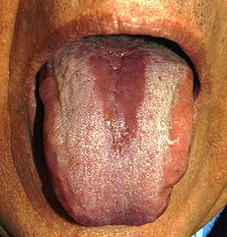
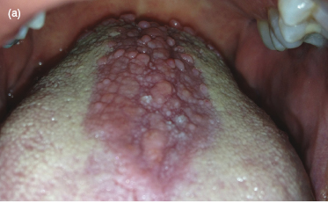
Median rhomboid glossitis
Uncommon condition
Men are affected more
Rhomboid shape hypertrophic or atrophic plaque in the mid dorsal tongue
Association of Candida with median rhomboid glossitis is controversial
https://en.wikipedia.org/wiki/Median_rhomboid_glossitis
http://pocketdentistry.com/3-common-oral-soft-tissue-lesions/

Slide 11
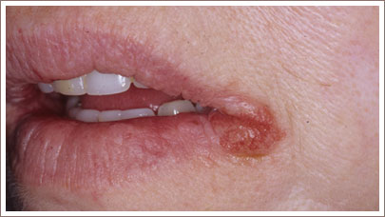
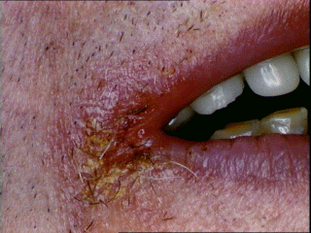
Angular Cheilitis
Mixed bacteria fungal infections
Corners of the mouth is affected
Staphylococci and streptococci are often associated with
Erythematous fissuring in the angle of mouth
Accompanied by a pseudomembranous covering
Can affect anterior nostril regain too
Predisposing factors: facial wrinkling, reduced occlusal vertical dimension, nutritional deficiencies ( e.g. Thiamine, Riboflavin, Iron and Folic acid)
http://www.crutchfielddermatology.com/caseofthemonth/studies/l_2007_008.asp
Hunt 2013 http://www.microbiologybook.org/lecture/hiv3.htm

Slide 12
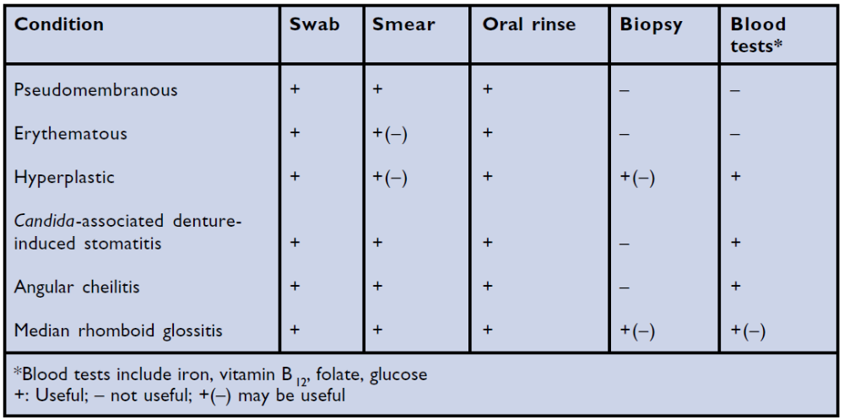
Diagnosis of Candida infections
Characteristic clinical appearance and symptoms e.g. burning sensation
Laboratory assays e.g. exfoliative cytology, fungal culture, mucosal biopsy, salivary assays
Differential diagnoses: thermal and traumatic lesions, syphilis, white keratotic lesions, erosive lichen planus, lichenoid reactions, lupus erythematosis, erythema multiforme, pernicious anaemia, and epithelial dysplasia
McIntyre 2001 Dental update;28:132-139

Slide 13
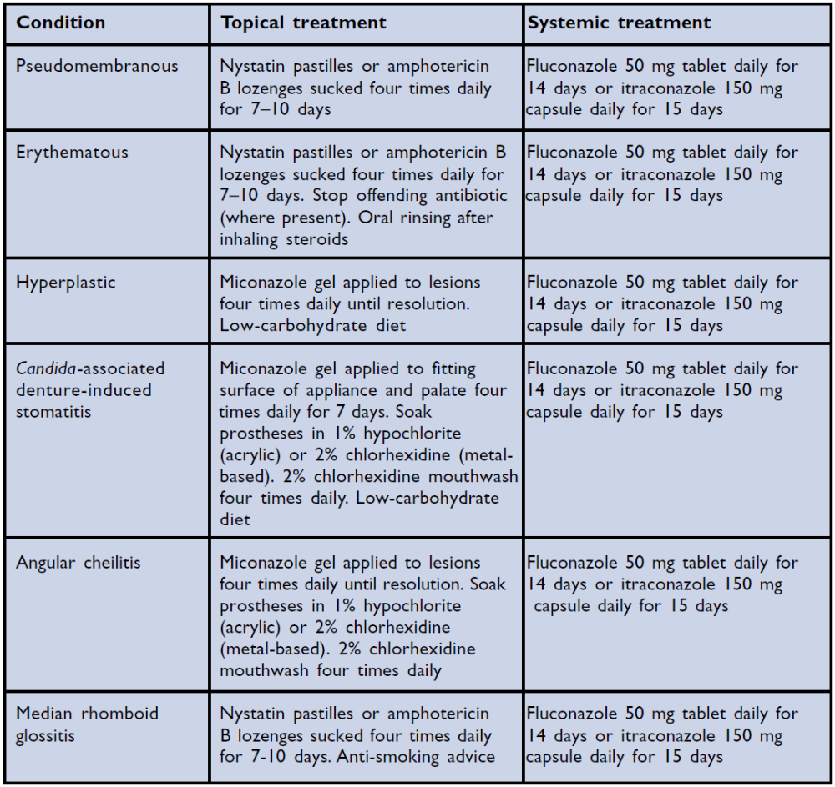
Treatment of oral Candida infections
Correction of the underlying predisposing factors and habits
Pharmacotherapy
McIntyre 2001 Dental update;28:132-139

Slide 14
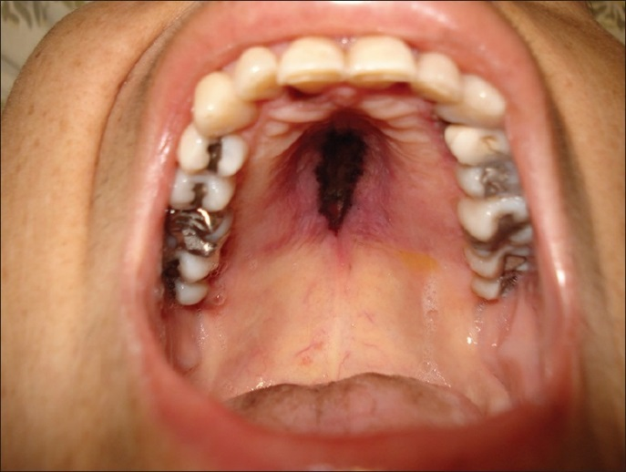
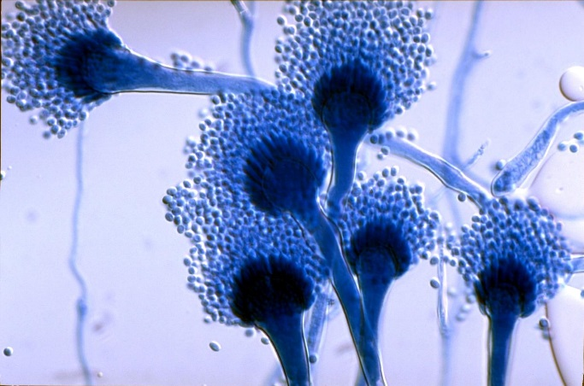
Uncommon oral fungal infections
Aspergillosis
Second commonest fungal infection in human
Commonly seen with high dose of corticosteroid use, organ and marrow transplantation, increase use of immunosuppression against autoimmune diseases
Lungs are commonly affected
Also invade blood vessels causing thrombosis and infarctions
Less commonly affect maxillary sinuses
Oral lesions are typically black or yellow necrotic soft tissues
Krishnan PA. Indian J Dent Res. 2012 Sep-Oct;23(5):650-9.
Aspergillus fumigatus

Slide 15
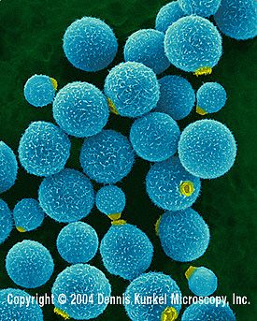
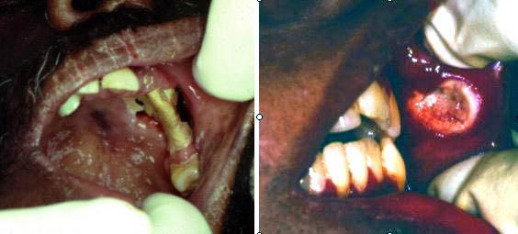
Cryptococcosis
Primarily affects lungs and can lead to meningitis
Caused by Cryptococcus neoformans, usually isolated in pigeon’s and other birds’ droppings
Cutaneous lesions : Face, neck and scalp
Oral lesions are rare; resembles superficial ulcerations, granulomas, nodules or indurated ulceration similar to carcinoma
Cryptococcus neoformans
Nonspecific chronic ulceration of the buccal mucosa due to cryptococcosis
Necrosis of alveolar bone and palatal mucosa
Crispian Scully et al http://emedicine.medscape.com/

Slide 16
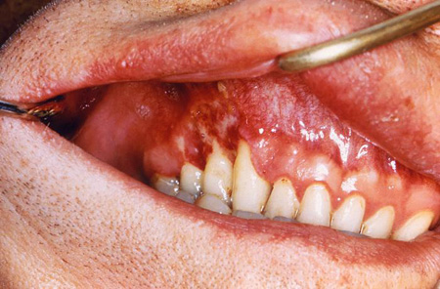
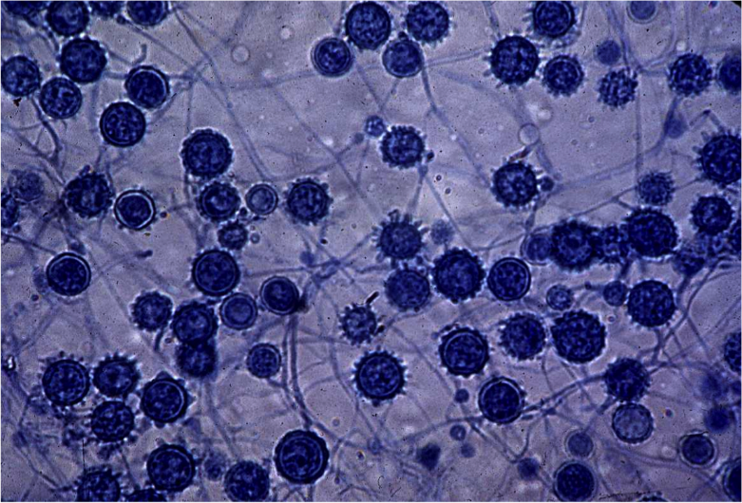
Histoplasmosis
Caused by Histoplasma capsulatum; a dimorphic fungi
Two forms; pulmonary and mucocutaneous
Mucocutaneous form cause ulcerative/erosive lesions on tongue, plate and buccal mucosa
Oral lesions: single ulcers, long term and may or may not be painful
Always misinterpreted as malignant ulcers
Biopsy is mandatory
CDC/Lucille K. Georg
http://www.emedicinehealth.com/histoplasmosis/page4_em.htm
Histoplasma capsulatum

Slide 17
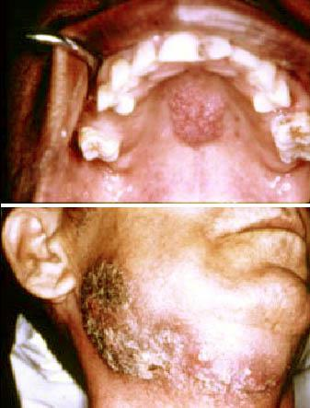
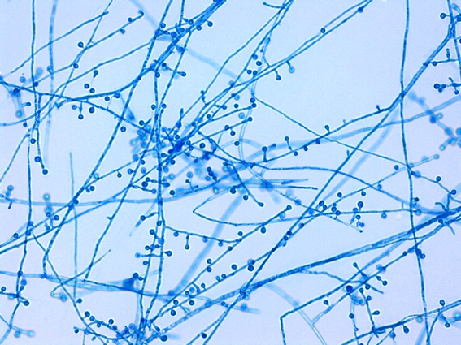
Blastomycosis
Caused by Blastomyces dermatitidis
When inhaled, spores produce disseminated or local respiratory infections
Oral lesions are rare
May produce ulcerated mucosal lesions in the oral cavity
Nonspecific papillary nodular lesion on the hard palate
Extensive ulceration involving the skin of the face and neck.
Crispian Scully http://emedicine.medscape.com/article/1077685-clinical#b4
Blastomyces dermatitidis

Slide 18
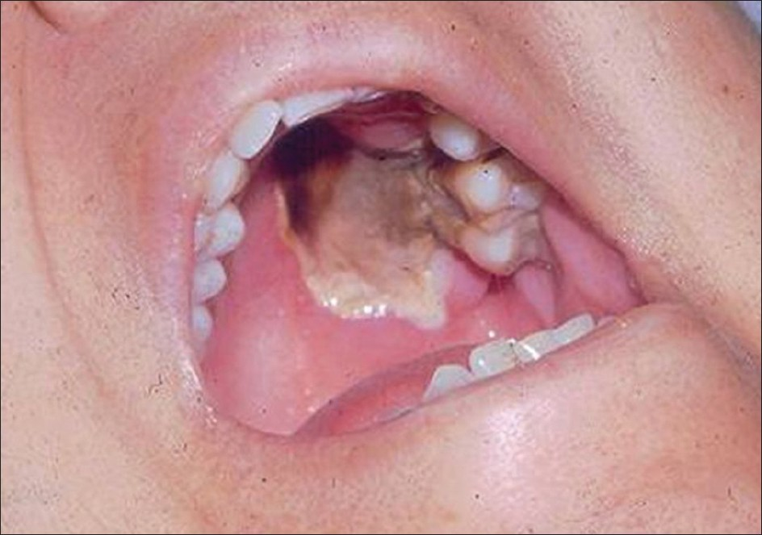
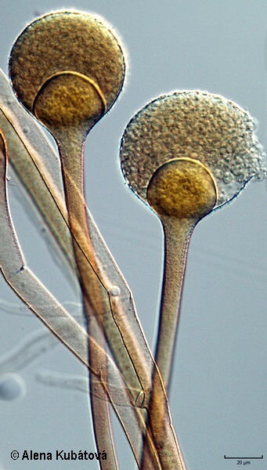
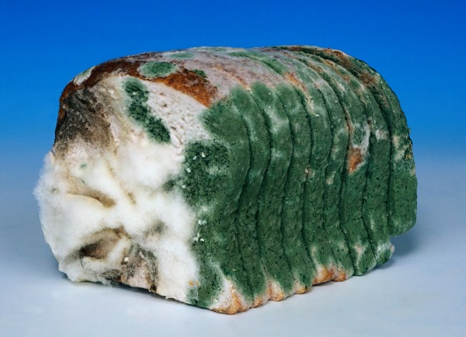
Mucormycosis
Caused by a saprophytic fungi found in soil, bread mold, decaying vegetation etc.
Involvement of the oral cavity is secondary to paranasal sinuses or nasal cavity
Usually present as a palatal necrosis or ulcerations
Extends to adjacent structures causing extensive tissue necrosis and invasion of brain
Organ transplant and poorly controlled diabetic patients are susceptible
Krishnan PA. Indian J Dent Res. 2012 Sep-Oct;23(5):650-9.
Rhizopus oryzae

Slide 19
Diagnosis of deep seated oral fungal infections
Biopsy
Pathologist should be given patients’ medical history e.g. immune suppression
Patients with deep oral fungal infections must be referred to medical specialists for further evaluation
Blastomycosis: smear/culture, Direct immunostaining, DNA probes
Cryptococcosis: microscopy/staining, serology
Histoplasmosis: microscopy/staining, serology, skin tests
Mucormycosis: microscopy/Histology, smear/culture

Slide 20
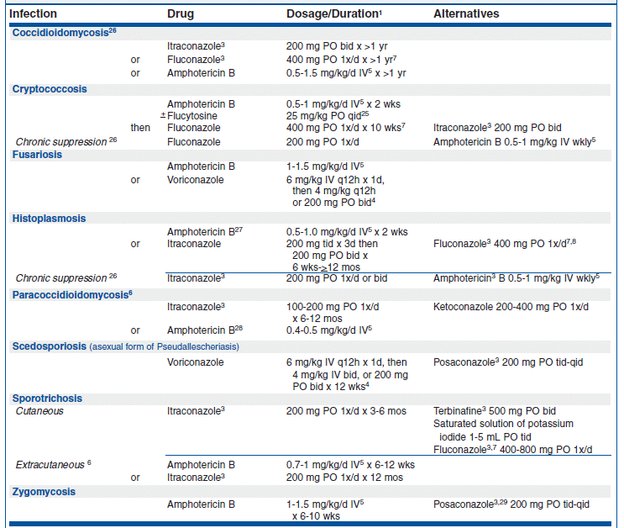
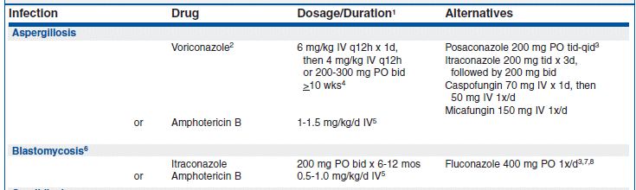
Treatment of Oral fungal infections
Treat Guidel Med Lett. 2009 Dec;7(88):95-102

Slide 21
Thank you

