Slide 1
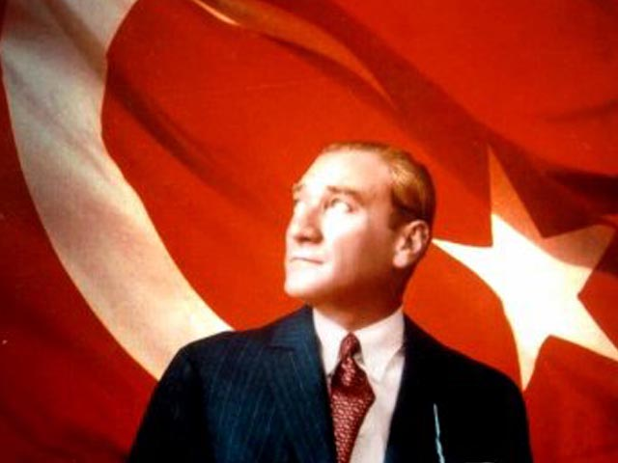
Assessment of Osteoporosis Knowledge and Risk of Sedentary Female Bank Employees
Nurcan YABANCI AYHAN, Nida TOKAC ER, Haci Omer YILMAZ,
Cagdas Salih MERİC, Cahit ERKUL
Ankara University, Nutrition and Dietetics Department
ntokac@ankara.edu.tr

Slide 2
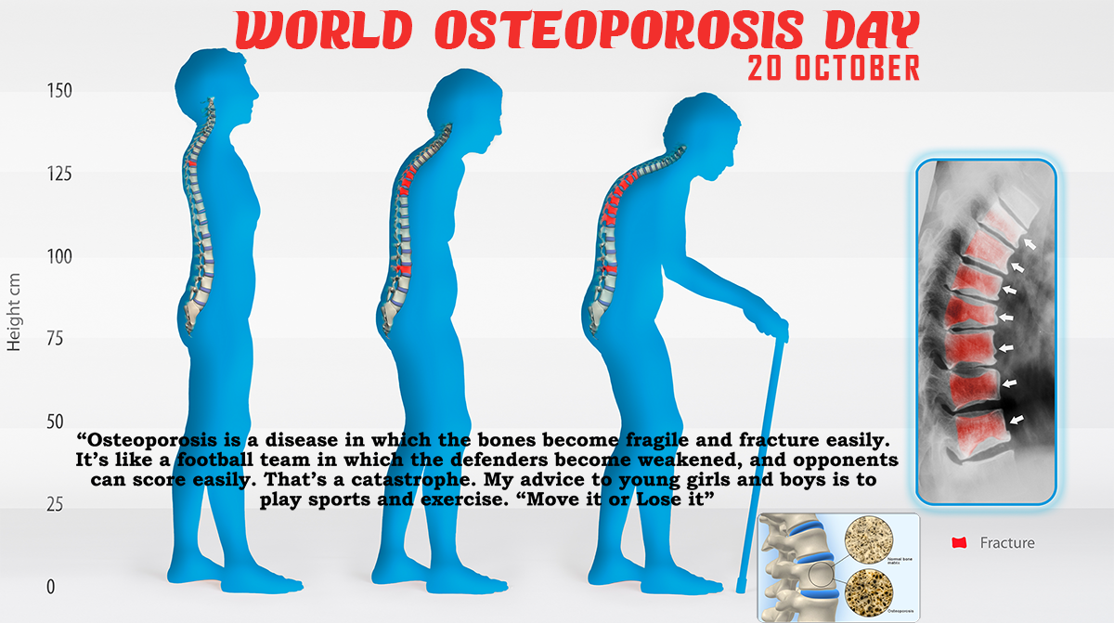

Slide 3
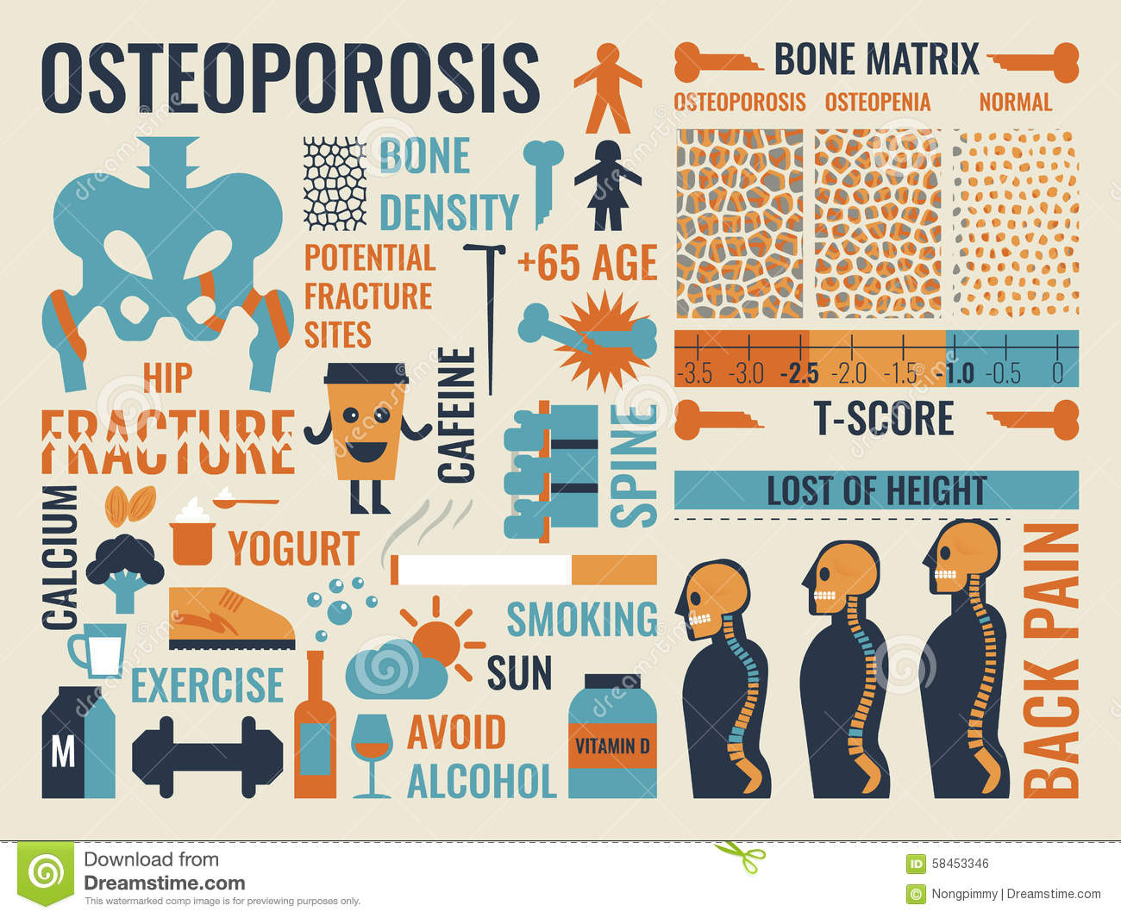
Notes:
Osteoporosis affects the bone matrix and the normal bone remodeling cycle.
Osteoporosis is the effect of osteoclasts breaking down bones faster thanthe osteoblasts can make them. 5 controllable (smoking, exercising regularly, consuming of large amounts of alcohol, eating healthy, getting enough vit D and calcium in diet) and 3 uncontrollable (race, sex, genetics) risk factors for this disease.

Slide 4

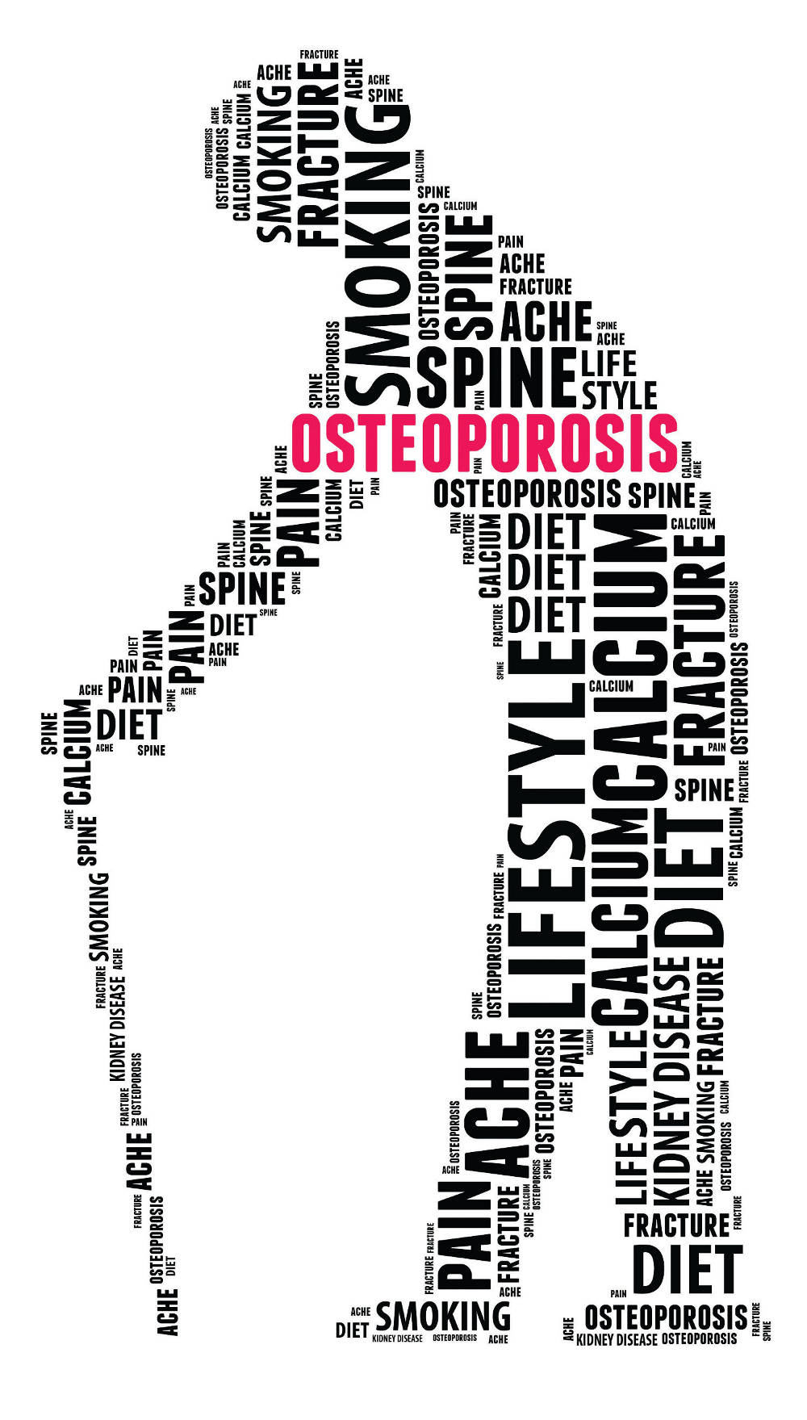
Osteoporosis is a disease characterized by decreased bone density and loss of bone micro architecture quality which in turn lead to an increased risk of fracture
(WHO, 2003).

Slide 5
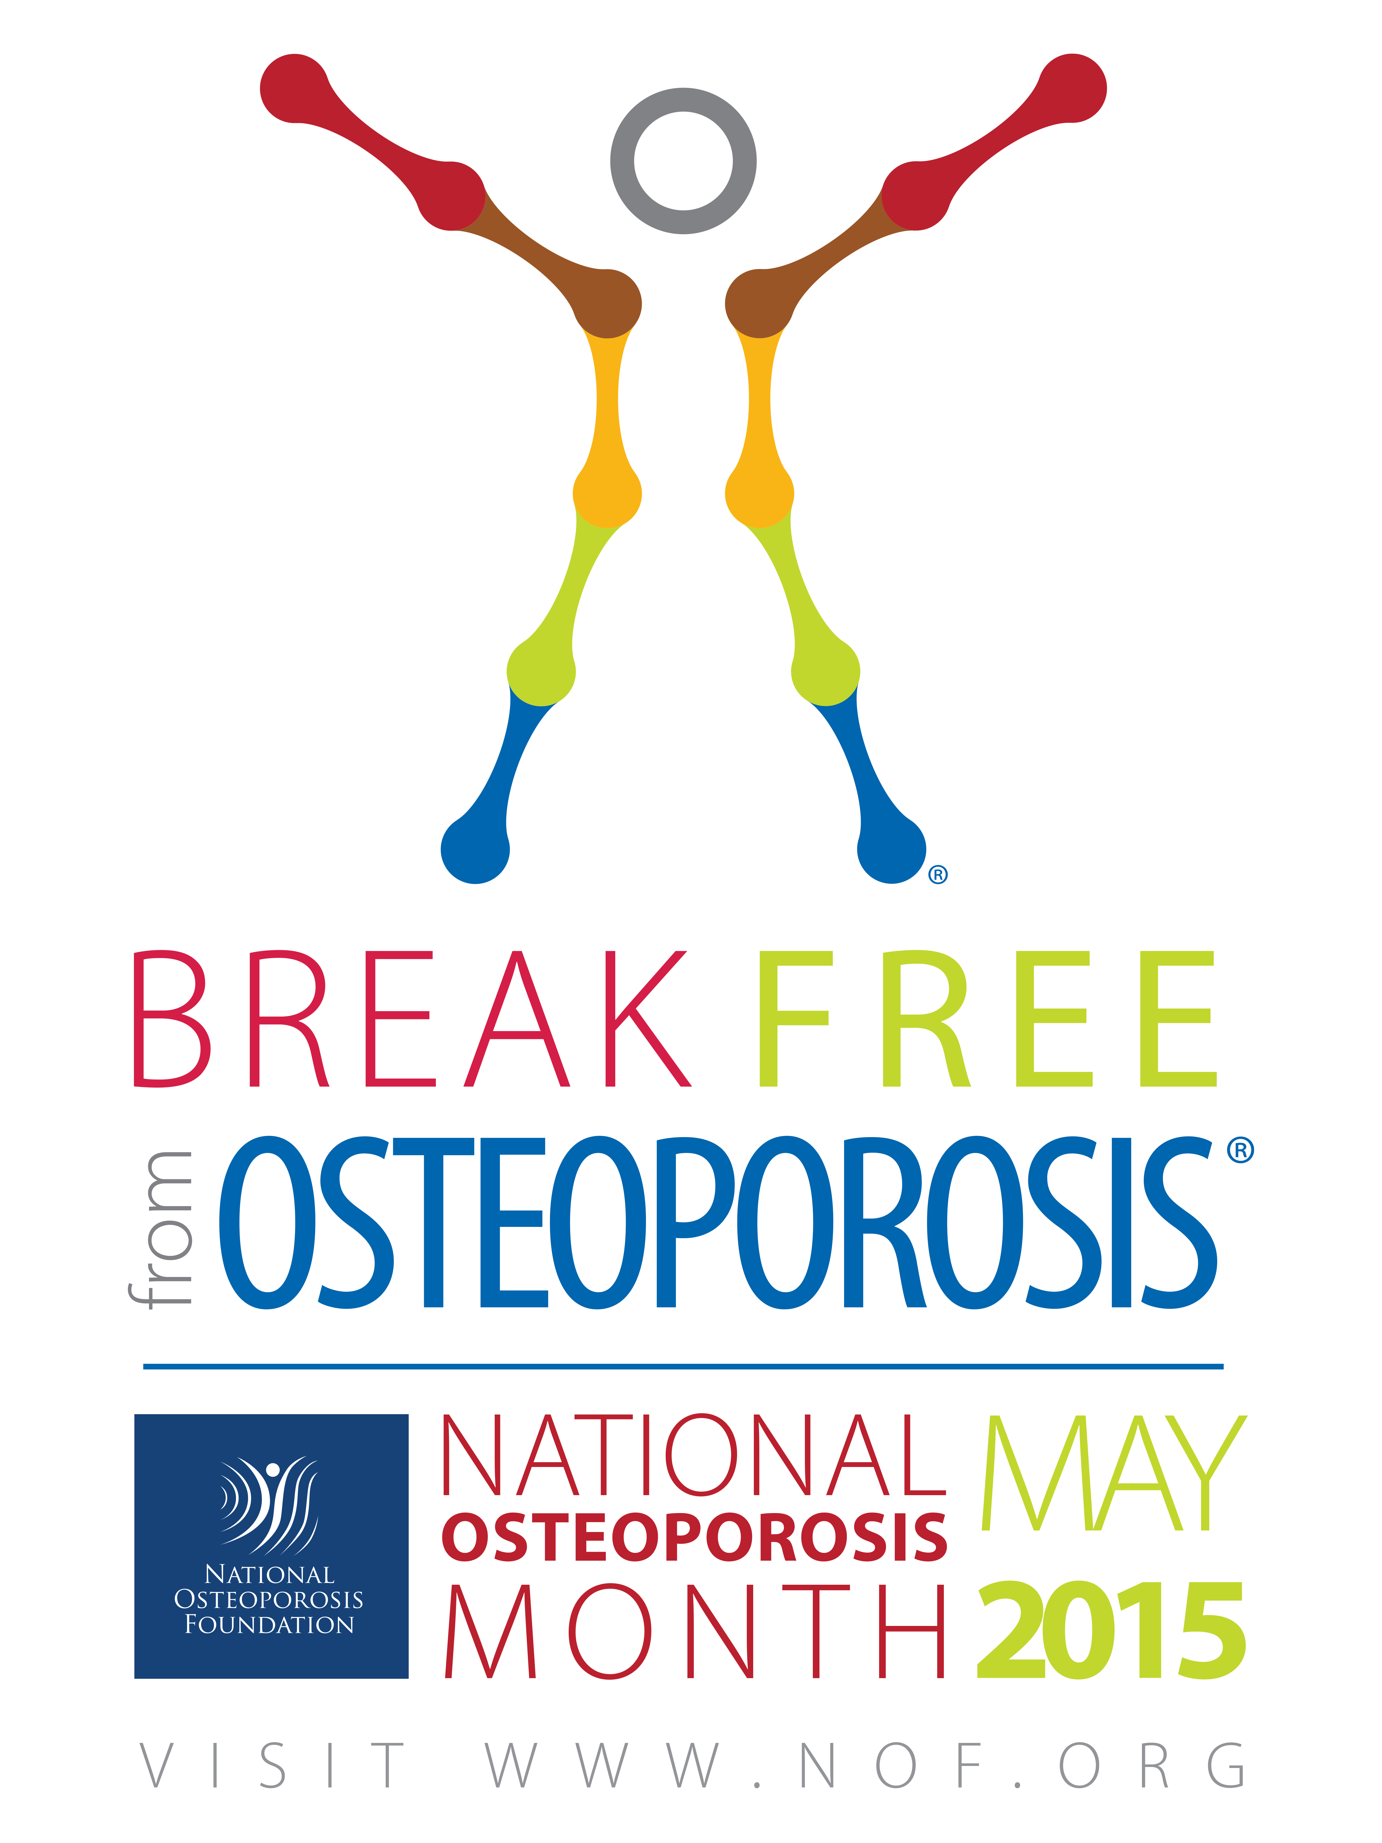
Magnitude of the Problem
It was also reported as the fourth main enemy of the human after heart failure, stroke and cancer, and the most common cause of fractures in the world
(WHO, 2003).

Slide 6
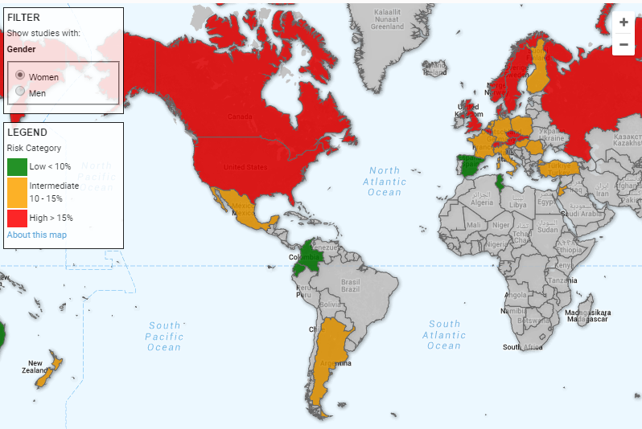
10-year probability of a major osteoporotic fracture risk map
(65-year-old person)
Notes:
International Osteoporosis Foundation (IOF) claims that Ten year probability of a major osteoporotic fracture for a 65-year-old person with a priority fragile fracture with this map.
As it can be seen in map,
-Turkey has a intermediate risk
-Canada, USA, Russia and many European countries have the highest level risk

Slide 7

adad
Changes
Life style
Diet habits
awareness about the disease can helps in prevention
Notes:
Osteoporosis on increase‏ due to the changes in lifestyle and diet habits of people around the world.
It is preventable disease when we identifying factors affecting diet and lifestyle behavior change, then we can make changes easier to maintain bone mass and strength in young people and adults.
Also awareness about the disease can helps in prevention.

Slide 8
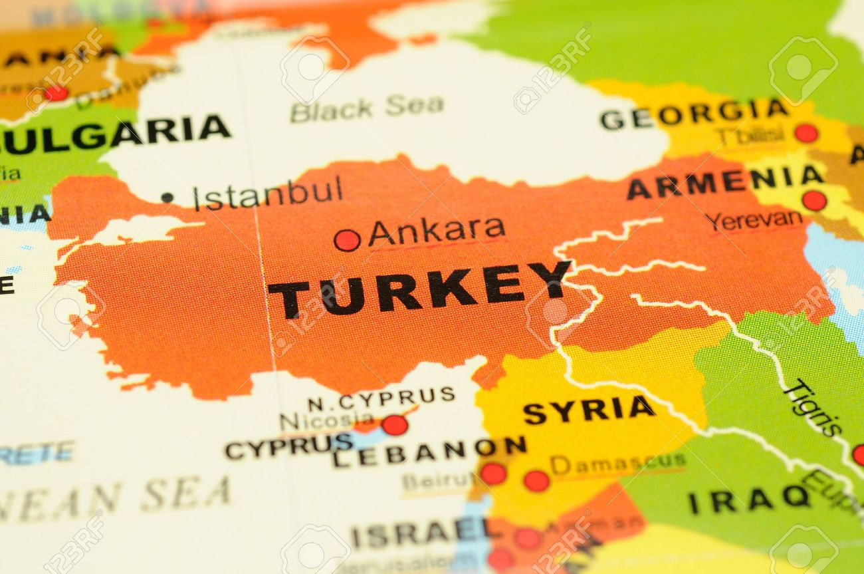
The present study aimed
to determine osteoporosis (OP) knowledge, health believes
among a sample of women working in different branch banks in Ankara, Turkey.

Slide 9
Methods
Study design
Face-to-face survey
Includes:
    Demographic and socioeconomic information
    Anthropometric measurements: height, weight

Slide 10
Study population
Women employees in banks
Ankara, Turkey
200 women employees in banks
Voluntary participation (n=156)

Slide 11
The eligibility recruitment to participate in this study
Turkish
Aged 21-54 years
Not pregnant

Slide 12
Osteoporosis Knowledge Assessment Test
(OKAT)
Developed by Winzenberg et al (2003)
20-item question with statements that can answered with true, false, I don't know
The instrument consisting of 4 subscales addressing:
Understanding (symptoms and risk of fracture) 5 items.
Knowledge risk factors of osteoporosis 7 items.
Knowledge of prevention factors as physical activity and diet relating to osteoporosis 6 items.
Treatment availability 2 items.

Slide 13
One-Minute Osteoporosis Risk Test
(ORT)
Developed by International Osteoporosis Foundation (IOF)
The test includes 19 questions (10 general + 2 for only women/1 for only men + 5 life style)
The answer “yes” was awarded 1 points and “no” 0 point

Slide 14
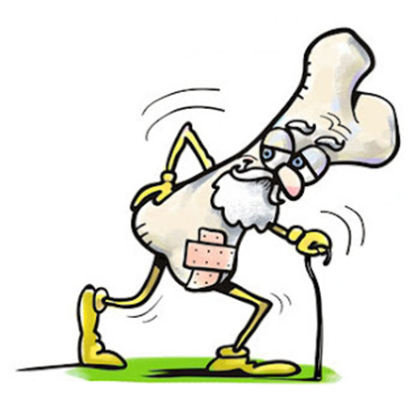
Results

Slide 15
Table 1: Demographics characteristic of subjects (n=156)
Variable | No (%)
Age in years (mean±s.d) | 38.3±8.8
Education
Secondary and lower | 52(33.3%)
University and higher | 104 (66.7%)
Marital Status
Single | 65 (58.4%)
Married | 91 (41.6%)

Slide 16
Table 2: Anthropometric indicators (n=156)
Variable | No (%)
BMI (kg/m²) (Mean±s.d) | 23.6+5.3
< 18.5 | 3 (1.9%)
18.5 - 24.9 | 87 (55.8%)
25 – 29.9 | 45 (28.8%)
>30.0 | 21 (13.5%)

Slide 17
Table 3: Mean OKAT and ORT scores compared with age
Age (years) | OKAT Scores (Mean±s.d) | ORT Scores (Mean±s.d)
20-29 | 11.7±3.1 | 1.5±1.4
30-39 | 10.6±3.3 | 2.6±2.2
40-49 | 11.8±3.1 | 4.8±3.0
50-59 | 12.1±2.6 | 5.6±2.4
 | p<0.14 | p< 0.01

Slide 18
Table 4: Mean OKAT and ORT scores compared with BMI
BMI (kg/m²) | OKAT Scores (Mean±s.d) | ORT Scores (Mean±s.d)
< 18.5 | 9.3±1.1 | 1.6±0.5
18.5 - 24.9 | 11.1±3.1 | 2.8±2.4
25 – 29.9 | 12.4±2.9 | 3.6±2.8
>30.0 | 11±3.3 | 5.5±3.4
 | p< 0.08 | p< 0.01

Slide 19
Conclusion
The more women’s age and body mass index, the more risk of OP (p < 0.01).
The status of education is related to OP risk. Women graduating from high school had more risk compared to upper level educated women (p < 0.05).

Slide 20
Reveals lack of knowledge about osteoporosis prevention.
The majority of women seemed to be unaware of the potential threat of OP, (esp.younger women), to cease progression of OP or carry a step further any preventative interventions.

Slide 21
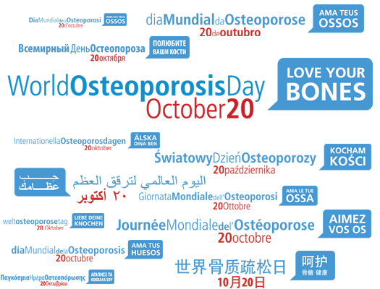
KEMİKLERİNİZİ SEVİN

Slide 22
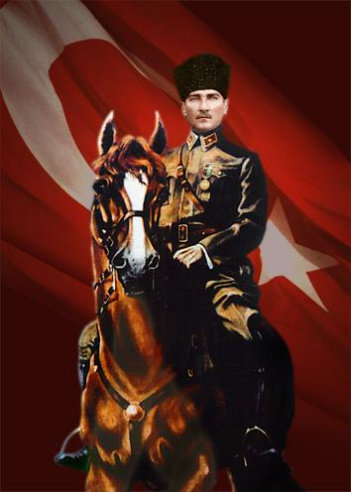
'Peace at Home,
Peace in the World.'
Mustafa Kemal ATATÜRK

