Slide 1
Multi-objective Optimization via Visualization
Nicolas Wesner
(Mazars Actuariat)

Slide 2

Strategic Asset allocation: A Multi-objective optimization problem under uncertainty
Expected return?
Risk ?
Cash ?
Equity ?
Government Bonds ?
Corporate Bonds ?
Real Estate ?
Gold ?
Infrastructures ?
Startups ?
…
Prudential & Regulatory constraints
Liquidity
Time Horizon

Slide 3
Modern Portfolio Theory (Markowitz 1952)
A very simple and intuitive model
“Investor does consider expected return a desirable thing and variance of returns an undesirable thing”
Average (expected) return
Efficient Frontier
Dominated Portfolios
Optimal Allocation
Constraints / Preferences
Other Allocations, Portfolios
Risk (volatility)

Slide 4
In Practice, a much more complex problem
High dimensional, innumerable Decision Space
High computational costs
Asset classes,
Rebalancing frequency,
Trading parameters,…
Traditional mathematical optimization methods can not be used
Mean, variance of past historical returns,
Economic scenario generator
Other statistics or risk metrics (Var, TailVar,…),
Transaction costs,
Stress tests,…
Multiple objective functions (or metrics)
How to integrate the user preferences and constraints ?
Model uncertainty

Slide 5
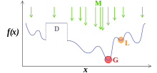
Metaheuristics
Stochastic search algorithms designed to find a “good” solution to an optimization problem
Strategies that guide the search process with aim to efficiently explore the search space
High level of abstraction so they may be usable for a variety of problems
A plethora of methods, often bio or nature-inspired (evolutionary algorithms):
Genetic algorithms,
Ant colony,
Artificial bee colony,
Immune systems,
Simulated annealing
…
Metaheuristics (M) aim to find the global optimum (G) of a complex function f(x) (by example with discontinuities — D —,), moving away from local optima (L).
No convergence proofs
Many parameters, difficult to calibrate
Versatile algorithms, difficult to manipulate

Slide 6
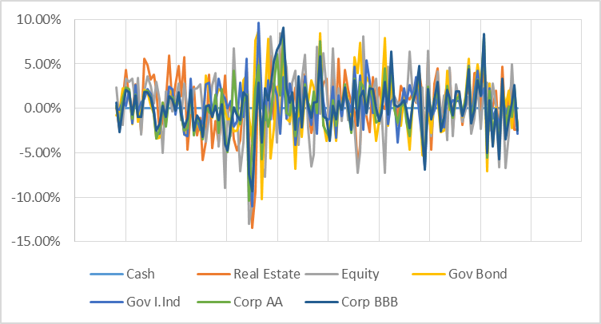
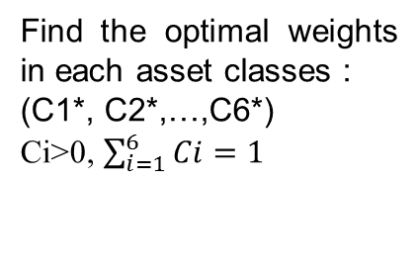
A Real data example: UK Market Data
Decision Space
Objective Space
7 asset classes:
  Equity
  Government Bonds
  Inflation linked Government Bonds
  Corporate AA Bonds
  Corporate BBB Bonds
  Cash
  Real Estate
6 objective functions:
  10 years average monthly returns
  Volatility of monthly returns over 10 years
  3 years average monthly returns
  Volatility of monthly returns over 3 years
  25% Quantile
  Stress Test : « Double Hit Scenario » (EIOPA)
  Historical past monthly returns over a period of 10 years
Fixed mix strategy
FTSE index
UK Gov Bonds 15y
UK Infl ind Gov Bonds 15y
UK House Prices (ONS)
Iboxx £ AA 15+
Iboxx £ BBB 15+
Find the optimal weights in each asset classes :
(C1*, C2*,…,C6*)
Ci>0, $\sum_{i=1}^{6}{Ci=1}$

Slide 7
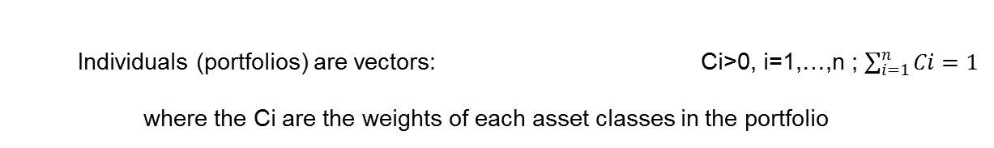
A very simple genetic Algorithm
1. Initial population of individuals:
  (C1, C2,…, Cn)
  Individuals (portfolios) are vectors: Ci>0, i=1,…,n ; $\sum_{i=1}^{n}{Ci=1}$
  where the Ci are the weights of each asset classes in the portfolio
Generation 0
2. Genetic operators are applied to individuals:
  (C1, C2’,…, Cn)
  Crossovers
  (C1, C2,…, Cn)
  (C1’, C2’,…, Cn’)
  (C1’, C2,…, Cn’)
New individuals
Ɛi→ N(μ, σ)
  Mutations
  (C1, C2,…, Cn)
  (C1 +Ɛ1, C2 + Ɛ2,…, Cn + Ɛn)
3. Evaluation of the individuals in the population and selection of the K best:
New generation

Slide 8
AN Interactive Optimization System
parameters
Decision Maker
Genetic algorithm
3
Alternative solutions
Visual Steering
Reduction of the decision space
Visualization of the objective space
Preferred solutions
1
2
Interactive visualization
Potential solutions

Slide 9


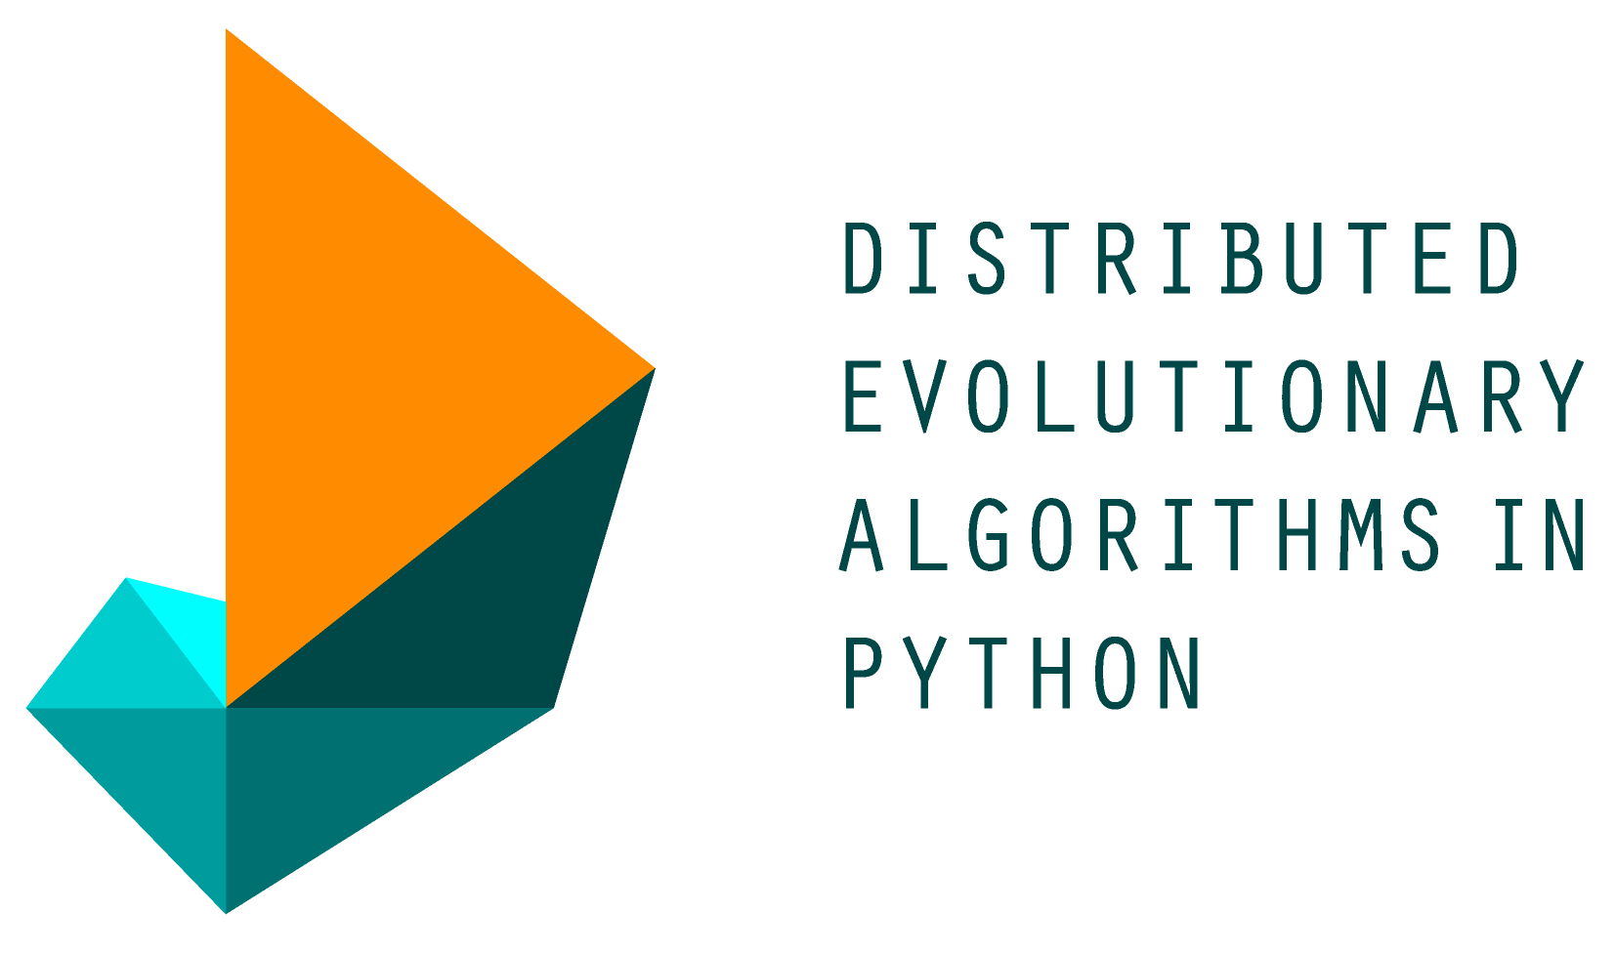
Live demonstration
DEAP

