Slide 1
Ion exchange chromatography in lignocellulosics analysis
Nico Anders
2nd International Conference and Expo on Separation Techniques
28th September 2016, Session: Chromatography as a Separation Technique

Slide 2
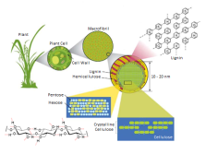
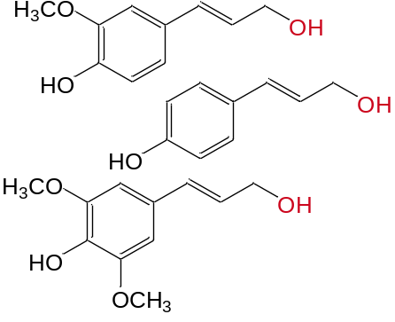
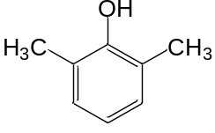
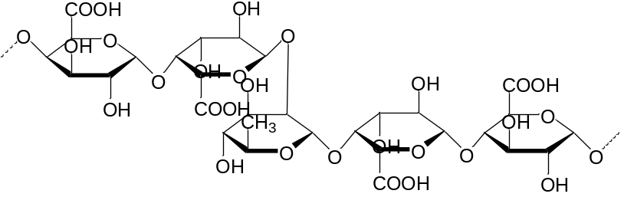
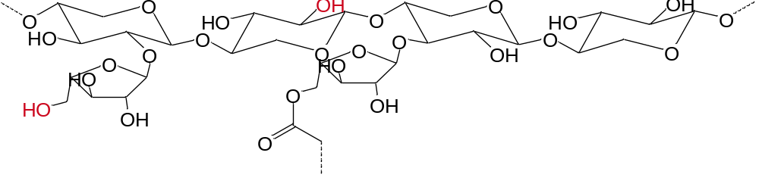
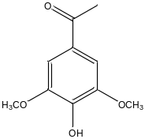

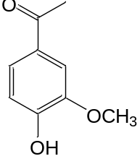

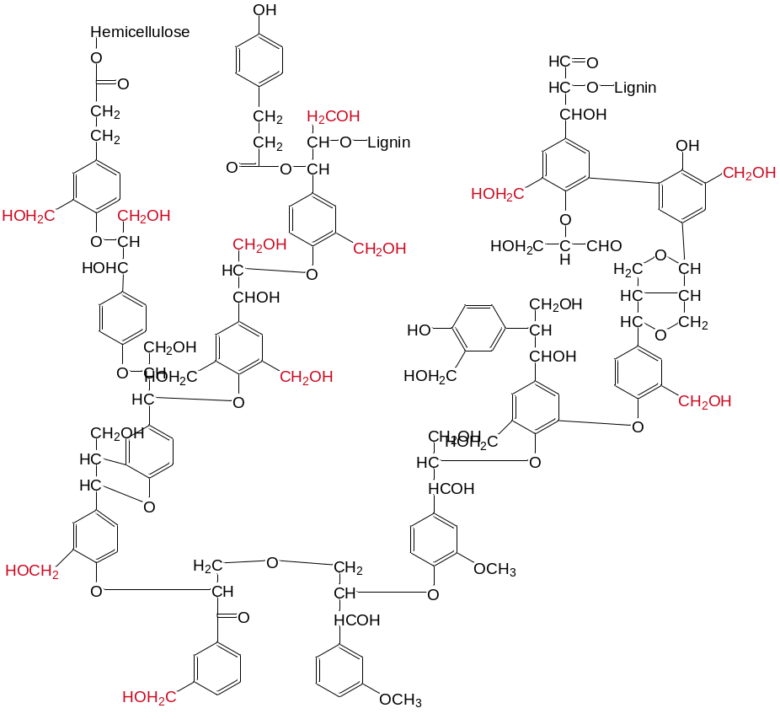
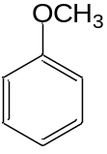
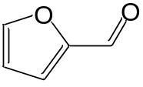
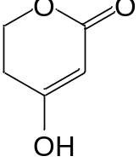

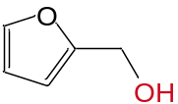
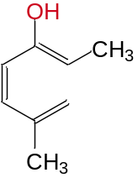

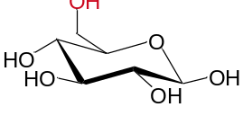
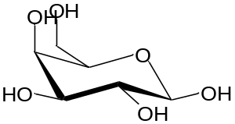
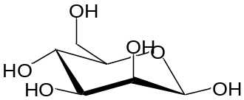
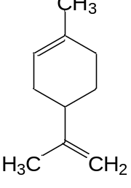
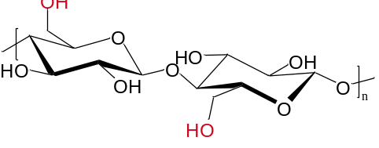
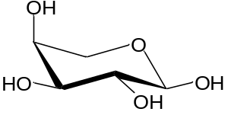
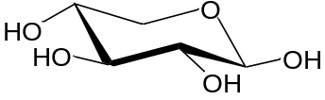
Lignocellulosic biomass
Composition
© Rubin: Nature; 2008, 454, 841-845

Slide 3



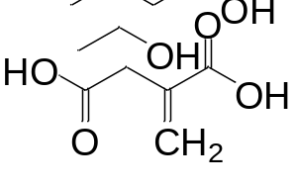


Biorefinery process chain
issues
issues
Degradation products
Sugars
Value added products
issues
Products
Side products
(e. g. ABE)
fermentation media
components
Unhydrolyzed
cellulose
Remaining Lignin,
Hemicellulose
liquid
solid
Pretreatment
solid
Hydrolysis
liquid
Fermentation
issues
issues
Composition
  Cellulose
  Hemi-cellulose
  Lignin
Glucose
Fermentation
inhibitors
→ Lignin, degradation

Slide 4
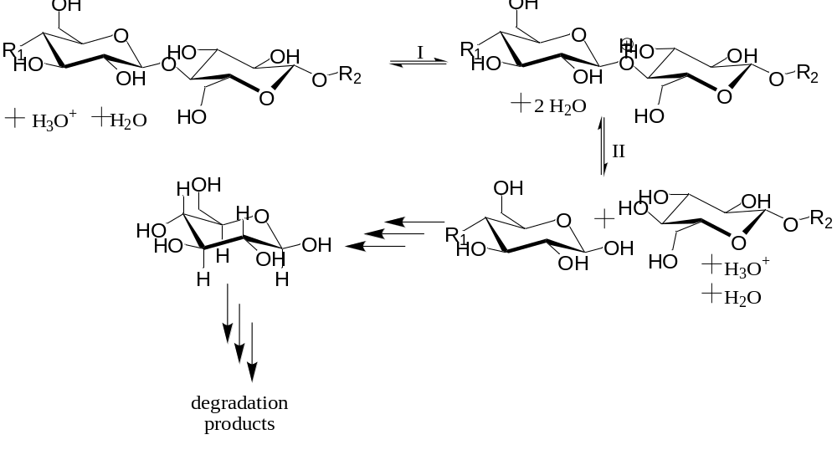
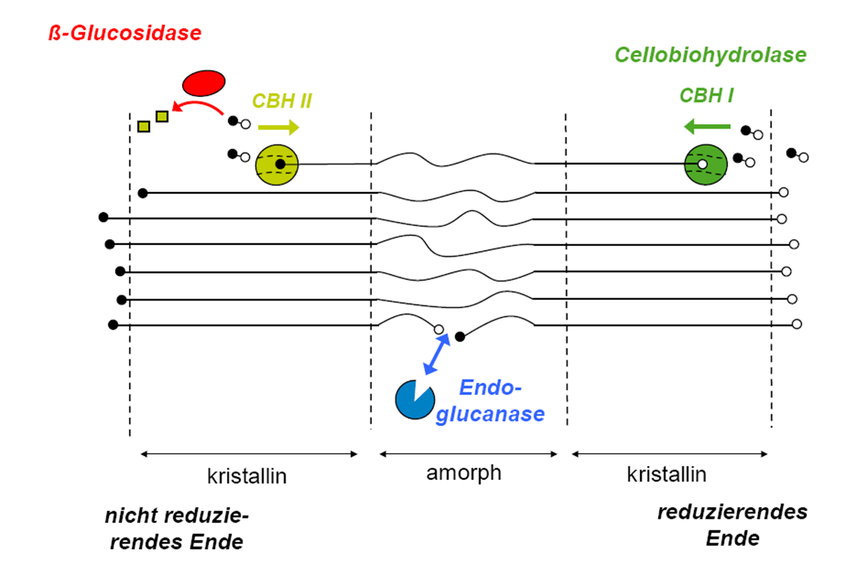
Lignocellulose hydrolysis
Acidic mechanism
acid hydrolysis
enzymatic hydrolysis
crystalline
amorphous
crystalline
non-reducing end
reducing end

Slide 5
Lignocellulose hydrolysis
Enzymatic mechanism
acid hydrolysis
enzymatic hydrolysis
crystalline
amorphous
crystalline
non-reducing end
reducing end

Slide 6
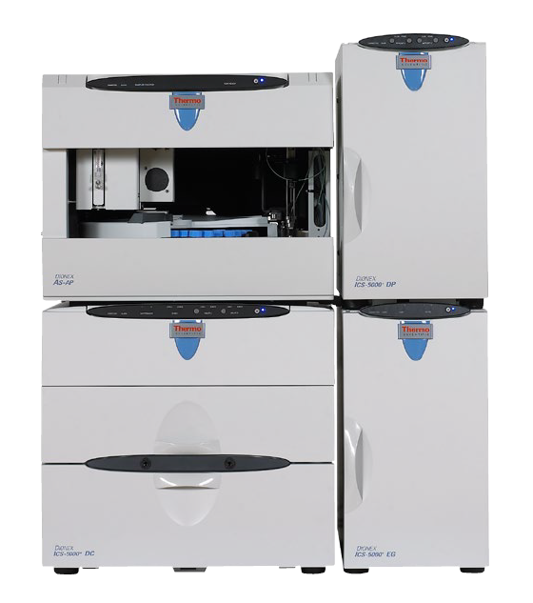
High-performance anion-exchange chromatography with pulsed amperometric detection (HPAEC-PAD)
Flow
(1 mL/min)
R-OH
Deprotonation
of sample molecules
by NaOH
NaOH
⁻O-R
+
+
⁻O-R
Thermo Scientific, Dionex ICS 5000+
+
Separation
due to pK_{a}
+
+
+
⁻O-R
e⁻
PAD
detector
·
⁻O-R
O-R
Detection via oxidation

Slide 7
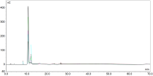

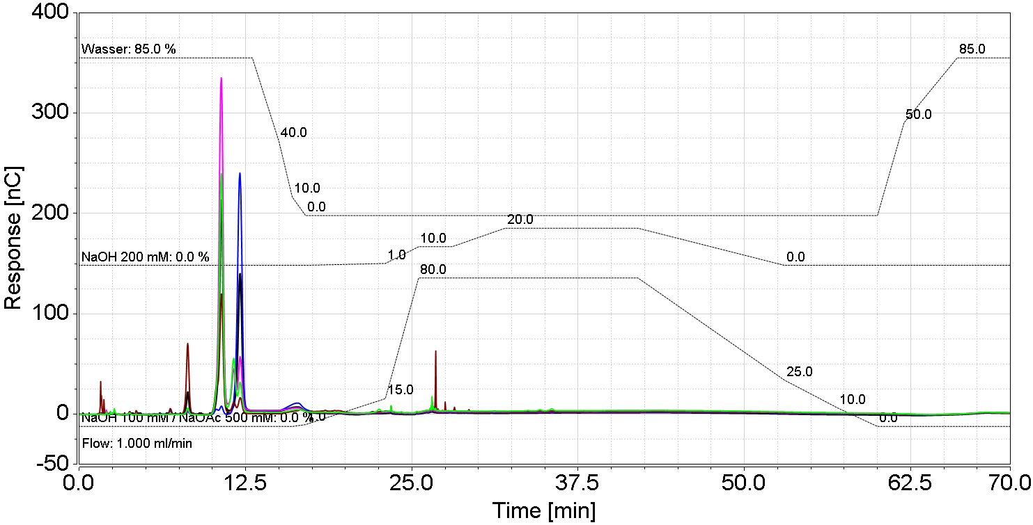
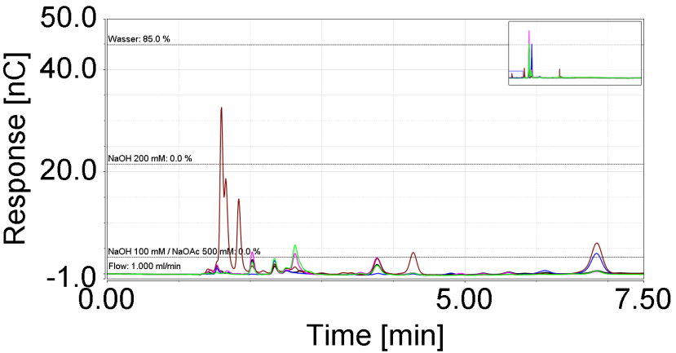
Lignocellulose Analysis using HPAEC-PAD
Chromatograms of various hydrolyzates
Glucose
pK_{a} = 12.28
Barley
Xylan
News paper
Lime
Spruce wood
Xylose
pK_{a} = 12.15
equlibration
5-HMF
pK_{a} = 12.82
oligosaccharides
and sugar acids
monosaccharides
Cellotetraose
pK_{a} = 3.65
alcoholic lignin compounds
phenolic lignin compounds
Galacturonic acid
pK_{a} = 3.48
decreasing pKa value
Anders et al.: Analytical Methods; 2015
Notes:
Wasser → Water

Slide 8
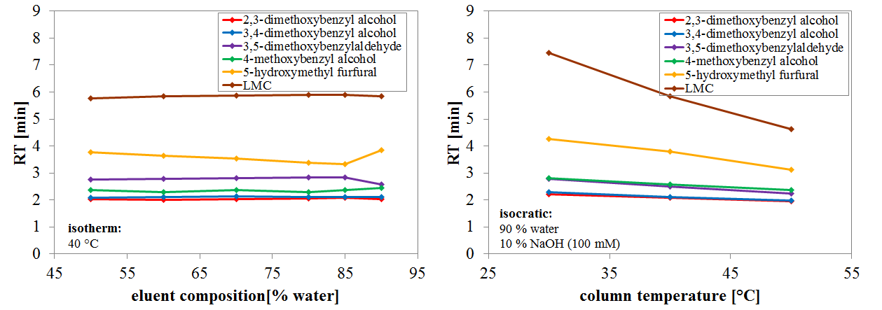
Lignin model compounds
Separation optimization
Documented lignin degradation products were investigated for measurability
Retention behavior depends on column temperature & eluent composition (minor)
      Conditions are given by essential monosaccharide analysis
Anders et al.: Analytical Methods; 2015

Slide 9
HPAEC-PAD
Method Validation
compound | natural polymer | retention time [min] | linearity, R² [-] | sensitivity [(nC*min)/(mg/L)] | LOQ [mg/L] | method standard deviation [mg/L]
Rhamnose | Hemicellulose / Pectin | 6.500 | 0.9993 | 0.16 | 2.34 | 0.33
Arabinose | Hemicellulose | 7.583 | 0.9991 | 0.23 | 4.47 | 0.63
Galactose | Hemicellulose | 9.408 | 0.9992 | 0.30 | 2.91 | 0.41
Glucose | Cellulose / Hemicellulose | 10.383 | 0.9982 | 0.28 | 20.01 | 2.82
Mannose | Hemicellulose | 11.167 | 0.9989 | 0.065 | 4.89 | 0.68
Xylose | Hemicellulose | 11.758 | 0.9990 | 0.26 | 4.41 | 0.62
Fructose |  | 15.525 | 0.9972 | 0.20 | 9.96 | 1.25
Sucrose |  | 12.610 | 0.9982 | 0.31 | 7.83 | 0.76
Cellobiose | Cellulose | 22.825 | 0.9962 | 0.18 | 0.78 | 0.11
Cellotriose | Cellulose | 24.350 | 0.9983 | 0.37 | 1.32 | 0.17
Cellotetraose | Cellulose | 25.417 | 0.9965 | 0.22 | 1.95 | 0.24
Cellopentaose | Cellulose | 26.009 | 0.9948 | 0.18 | 1.14 | 0.14
Cellohexaose | Cellulose | 26.200 | 0.9966 | 0.07 | 1.92 | 0.24
Galacturonic acid | Pectin | 26.833 | 0.9994 | 0.084 | 4.92 | 0.61
Glucuronic acid | Pectin | 27.067 | 0.9951 | 0.0023 | 7.74 | 0.96
5-HMF | Cellulose / Hemicellulose | 3.767 | 0.9978 | 0.20 | 1.26 | 0.18
2,3-dimethoxybenzyl alcohol | Lignin | 2.067 | 0.9989 | 0.20 | 1.05 | 0.15
3,4-dimethoxybenzyl alcohol | Lignin | 2.109 | 0.9913 | 0.0077 | 2.91 | 0.41
4‑methoxybenzyl alcohol | Lignin | 2.705 | 0.9998 | 0.82 | 65.68 | 7.28
3,5-dimethoxybenzaldehyde | Lignin | 2.960 | 0.9989 | 0.20 | 27.69 | 3.49
1-(3,4-dimethoxyphenyl)-2-(2-methoxyphenoxy)-1,3-propanediol | Lignin | 5.908 | 0.9940 | 0.15 | 12.69 | 1.60
2,6-dimethoxyphenol | Lignin | 27.600 | 0.9973 | 5.93 | 0.42 | 0.051
2-methoxyphenol | Lignin | 29.058 | 0.9978 | 0.021 | 4.86 | 0.60
4-allyl-2-methoxyphenol | Lignin | 36.942 | 0.9997 | 0.30 | 0.81 | 0.13
3,5-dimethoxy-4-hydroxybenzaldehyde | Lignin | 42.550 | 0.9955 | 8.36 | 0.42 | 0.05

Slide 10
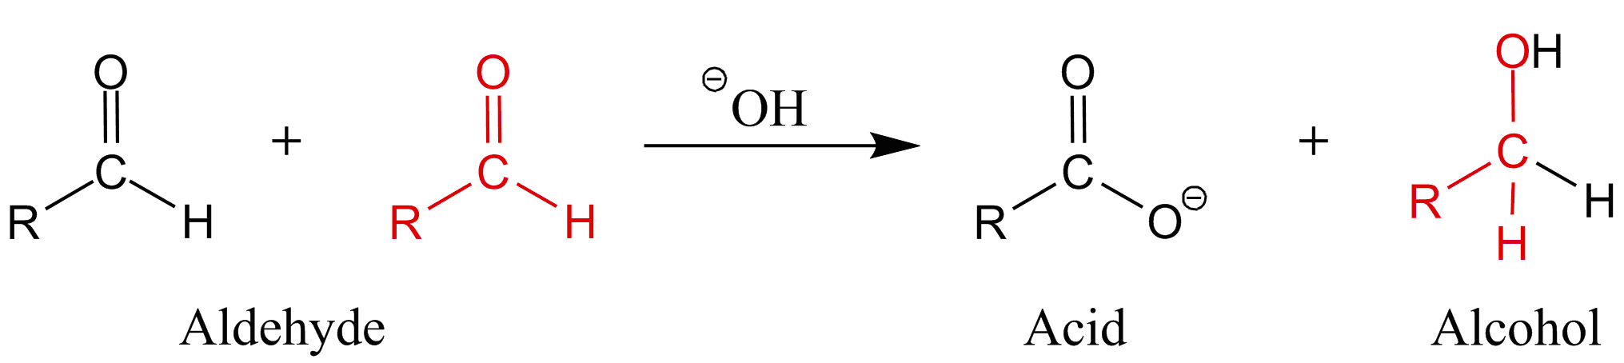
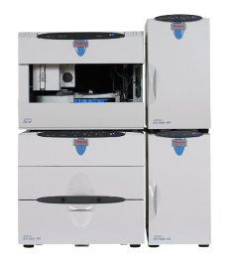
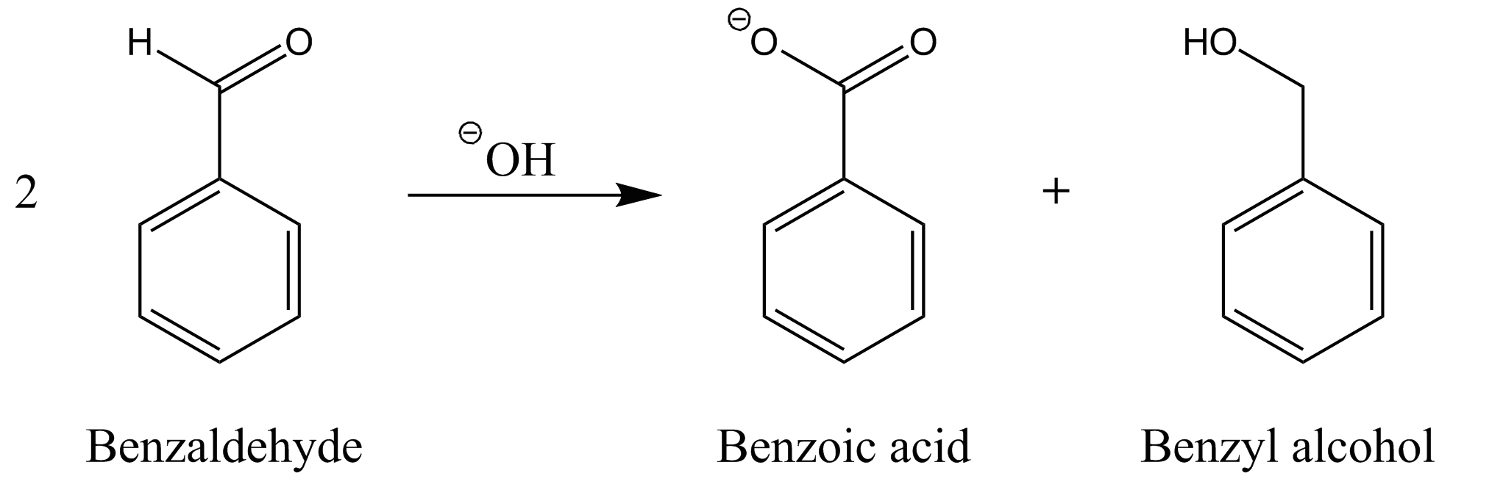
Cannizzaro reaction
Disproportionation of aldehydes
Aldehyde
Acid
Alcohol
Conditions for disproportionation:
  Alkaline conditions (NaOH)
  No hydrogen at α-C-atom
α
α
α
Benzaldehyde
Benzoic acid
Benzyl alcohol

Slide 11
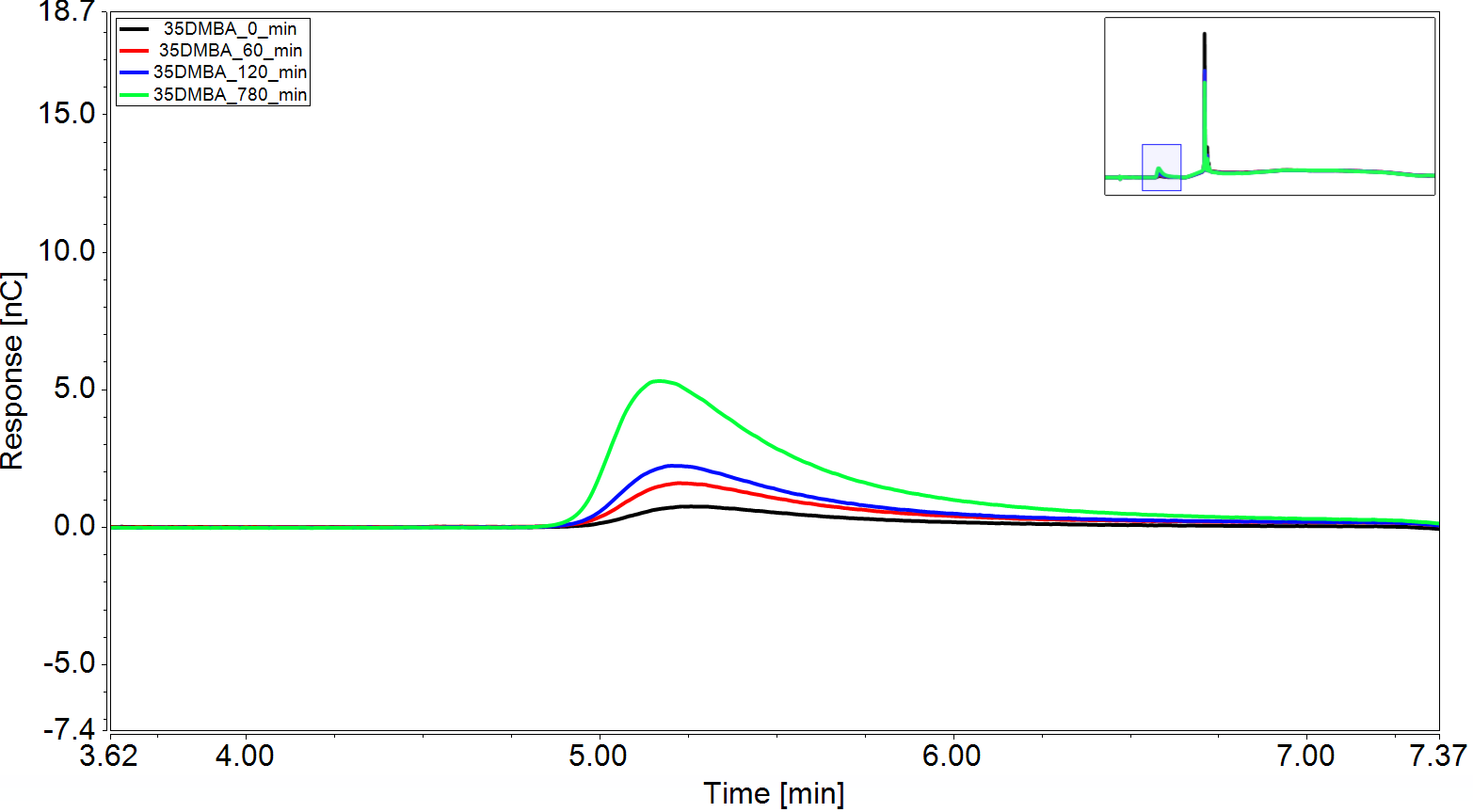
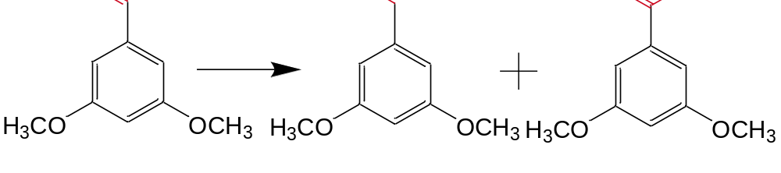
Lignin model compound
3,5-dimethoxybenzylaldehyde
3,5-dimethoxybenzaldehyde 0.1 g/L in NaOH, 40 °C

Slide 12
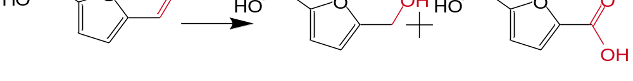
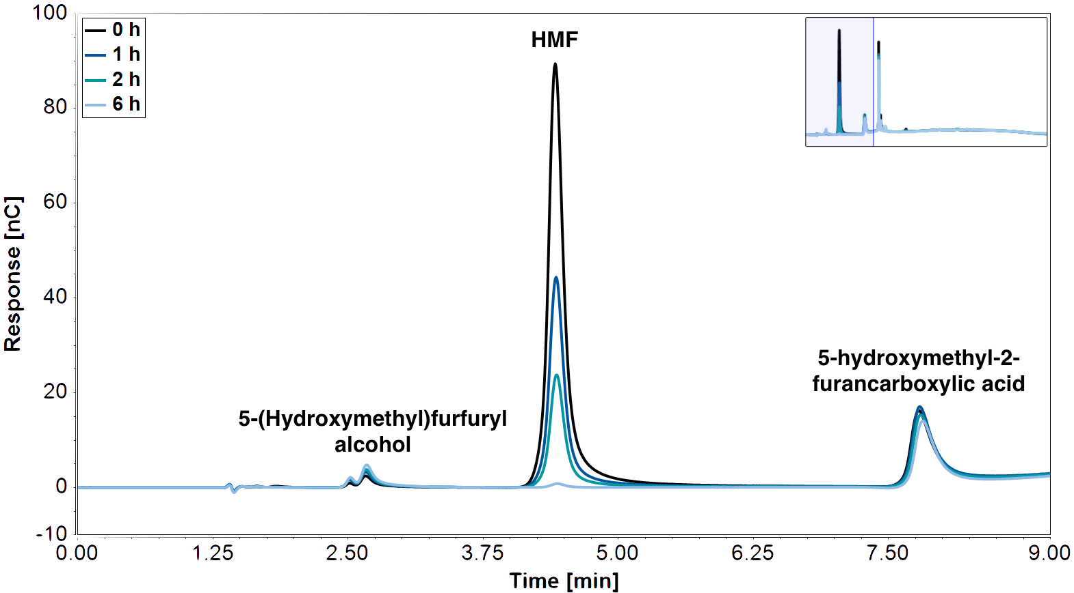
Sugar degradation product
5-hydroxymethylfurfural
5-Hydroxymethyl-2-furaldehyde 0.1 g/L in NaOH, 40 °C,
Polymer formation of HMF
Humins
Kuster et al.: 1990

Slide 13
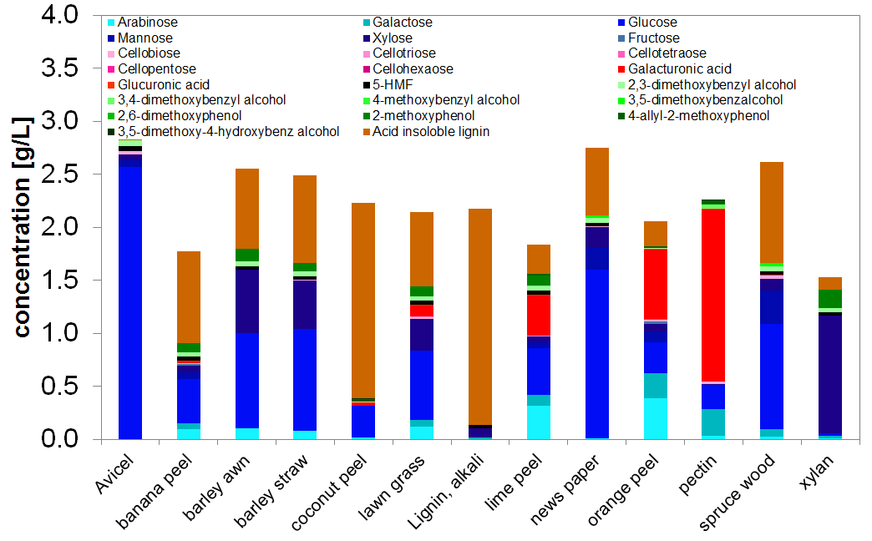
Hydrolyzate characterization using
HPAEC-PAD
Full characterization of hydrolyzates using HPAEC-PAD is possible
Soluble lignin compounds are the minor part
Lignocellulose with high water content is challenging
Anders et al.: Analytical Methods; 2015

Slide 14
Biorefinery process chain
Usage of the HPAEC-PAD method
issues
issues
Degradation products
Sugars
Value added products
issues
Products
Side products
(e. g. ABE)
fermentation media
components
Unhydrolyzed
cellulose
Remaining Lignin,
Hemicellulose
liquid
solid
Pretreatment
solid
Hydrolysis
liquid
Fermentation
issues
issues
Composition
  Cellulose
  Hemi-cellulose
  Lignin
Glucose
Fermentation
inhibitors
→ Lignin, degradation

Slide 15
Summary & outlook
HPAEC-PAD method enables the simultaneous determination of soluble biomass derived compounds from Cellulose, Hemicellulose, Lignin and Pectin
Fermentation inhibitors are mostly aldehydes and alcohols
Cannizzaro reaction takes place allowing an indirect measurement of aldehydes
Soluble lignin is modified by NaOH
Identification of unknown compounds and reactions which occur due to the alkaline media
Implementation of promising raw materials into a bio-refinery process

Slide 16






Slide 17
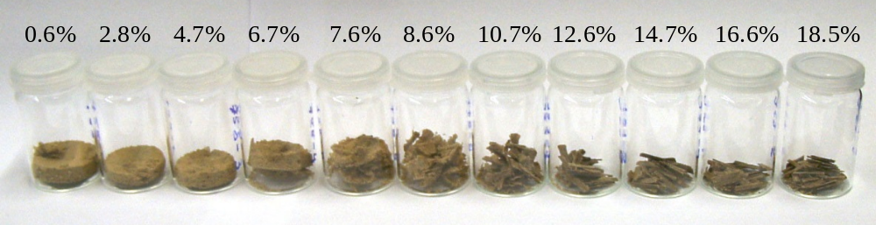
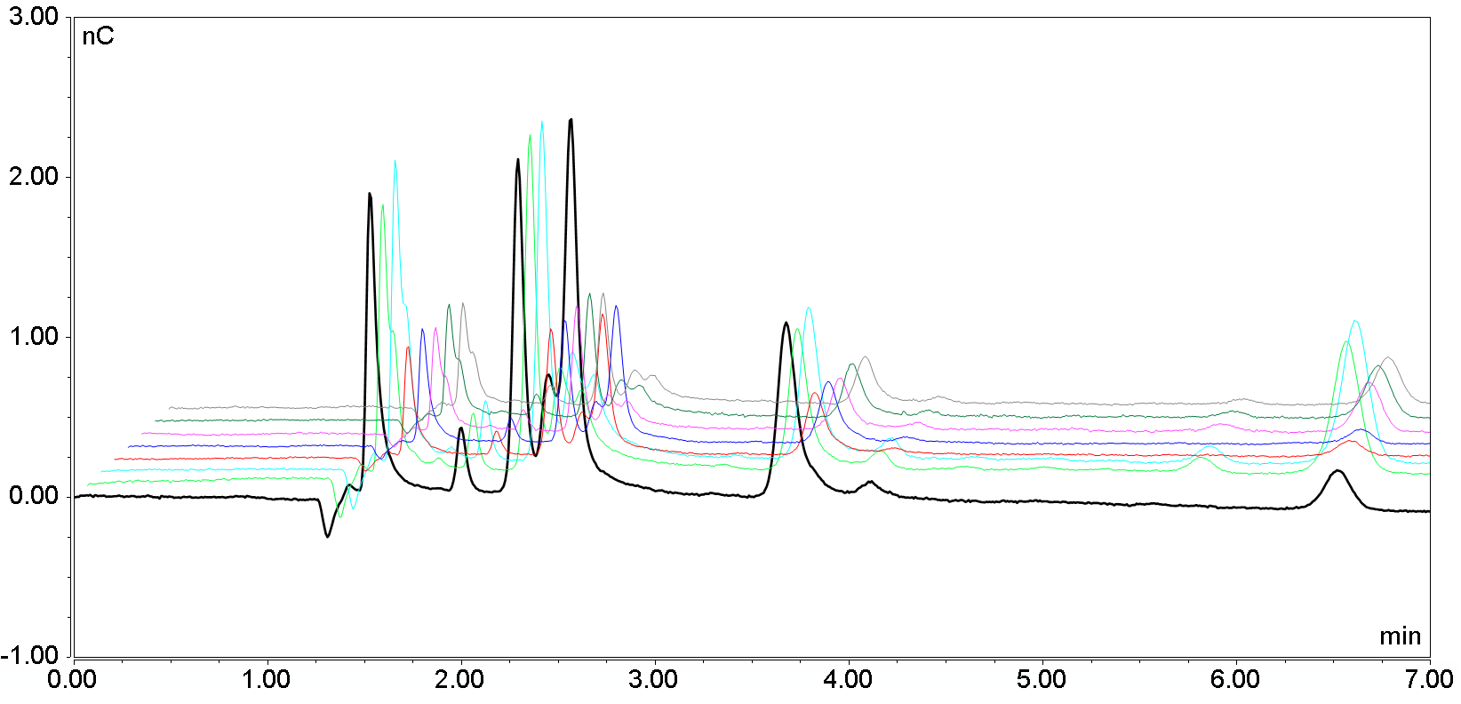
Scientific applications
Characterization of pretreated pulp
Lignin content increases with increasing water content
HMF(Sugar degradation product) increases with increasing water content
      Cellulose affected during pretreatment
*
*
*
*
*
*
*
*
Increasing water/EMIMAc ratio
Viell et al. Biotechnology for Biofuels, 2016

Slide 18

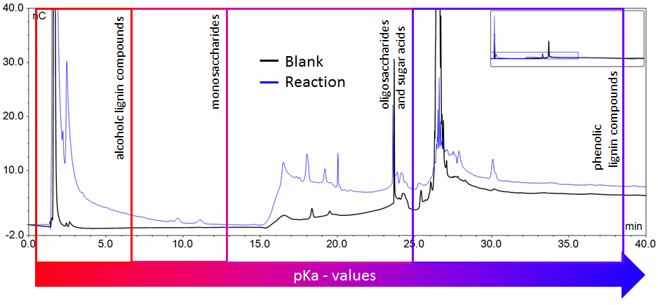
Scientific applications
Can enzymes degrade Lignin?
Lignin bondage cleavage is necessary for any kind of usage
Alcohols and Monosaccharides are measureable
      Degradation occurs
Picart Faiget et al. 2015, submitted

