Slide 1

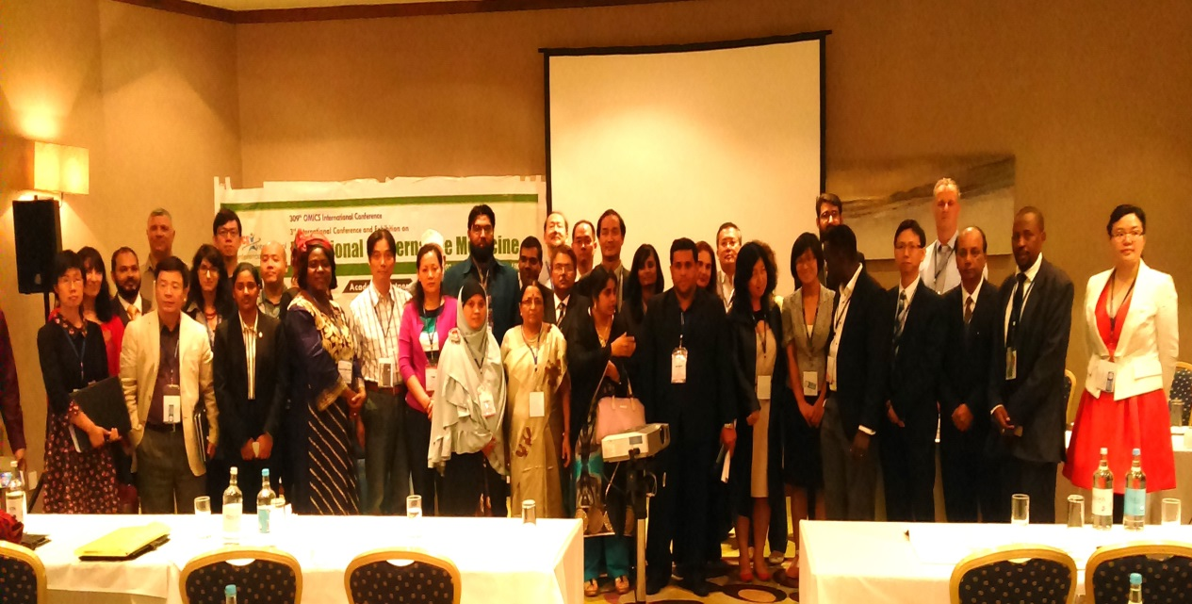
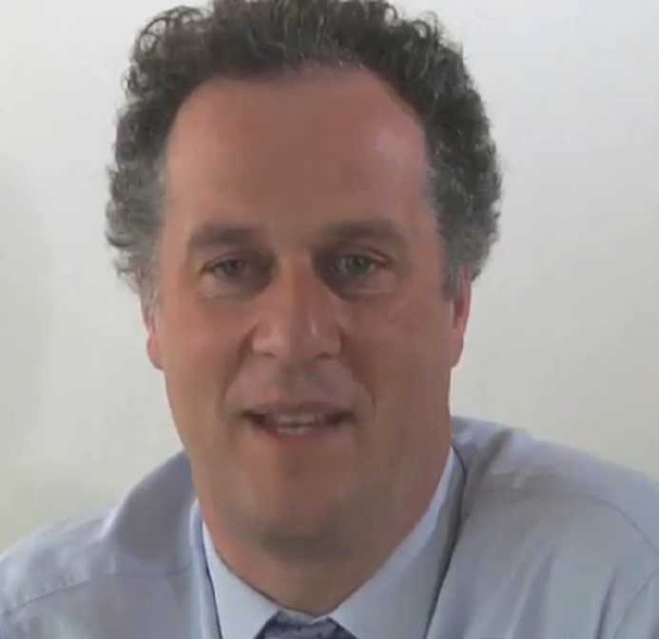
Traditional Medicine-2015
Birmingham, UK
August 03 – 05, 2015
Traditional
Medicine
2015
Nick Pahl

Slide 2
Development of Acupuncture in the UK
Nick Pahl CEO, MPH

Slide 3
Who are we?
The British Acupuncture Council (BAcC) is the leading self-regulatory body for the practice of traditional acupuncture.
Support the European Journal of Oriental Medicine and British Acupuncture Accreditation Board

Slide 4
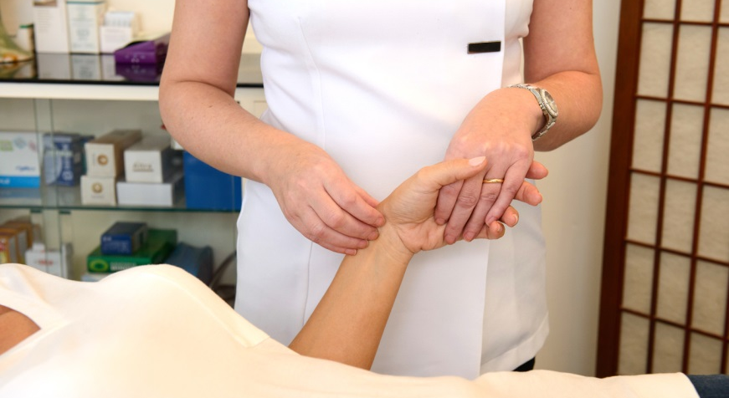
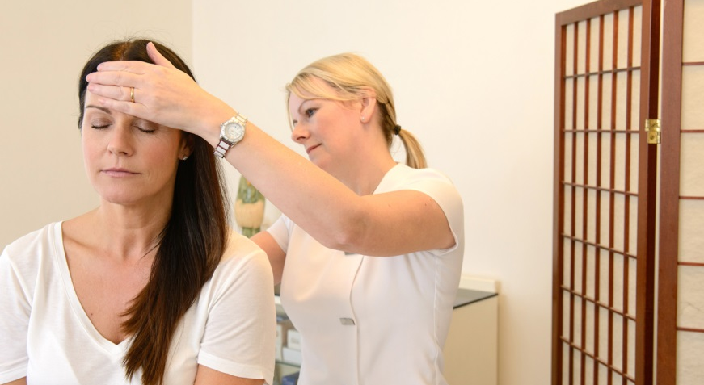
What is Acupuncture?
Complex intervention
Components include: traditional acupuncture diagnosis, selecting points, discussion of condition, lifestyle support
Synergistic and interdependent
Operates with personalised diagnosis and treatment
Addresses root problems as well as symptoms and hence can work preventively
Has a fundamental patient participatory element

Slide 5
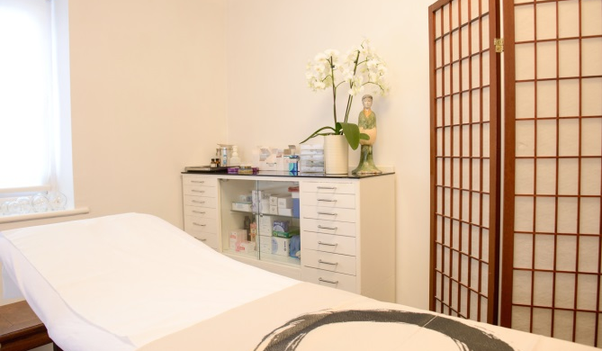
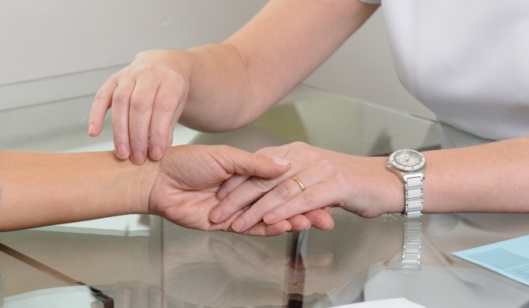
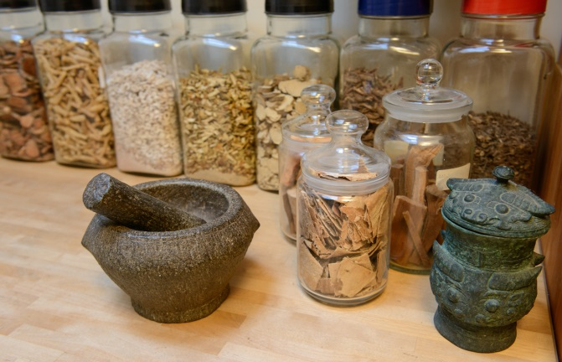
Founders of Acupuncture in the UK
Sydney Rose Neil – led delegation of western acupuncturists to China and set up leading college
JR Worsley - Five Element Acupuncture proponent and set up leading college
Felix Mann – first President of British Medical Acupuncture Society
Ron Bishop, Ken Shifrin, Jasmine Uddin and John Wheeler – leading members of British Acupuncture Council

Slide 6
1980s - development
Acupuncture in Medicine Journal – 1981
Smaller associations formed
Colleges formed and grew
Around 1000 dedicated practitioners
Gateway clinic founded by John Tindell

Slide 7
1990s – institutional development
Formation of British Acupuncture Accreditation Board – 1991
Council of Medical Acupuncture and Related Techniques (ICMART) - 1990
Growth in teaching institutions and University courses
European Journal of Oriental Medicine - 1995
British Acupuncture Council - 1996

Slide 8
2000s - growth
Growth in BAcC membership to 3000
Increase in demand by one third to 4.5m treatments a year
Set backs – Charter application and state regulation
NICE guidance for lower back pain
British Conference of Acupuncture and Oriental Medicine

Slide 9
2010s – maturity?
British Acupuncture Council:
Professional Standards Authority accreditation
Collaboration with National Institute of Health Research
Member of Royal Society of Medicine
Member of Arthritis and Musculoskeletal Alliance
NICE Guidance for headache and SIGN guidance for chronic pain

Slide 10
Regulation in the UK
Local environmental health regulation
Associations for physiotherapists, doctors who do acupuncture
British Acupuncture Accreditation Board
British Acupuncture Council – codes of safe practice etc
Professional Standards Authority Accreditation

Slide 11
Research in the UK
Many Randomised Controlled Trials in the last 20 years
Advancing evidence base in many areas e.g. Osteoarthritis
Mosaic of evidence required rather than hierarchies of evidence - real EBM with individual patient care at heart

Slide 12
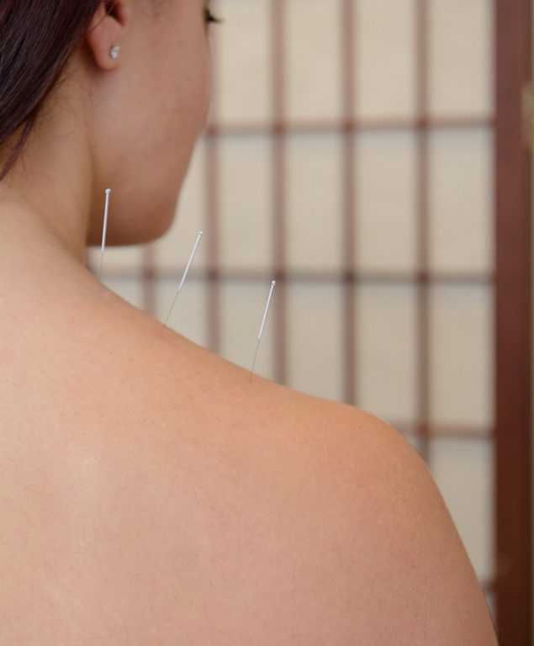
Challenges in the UK
Effective Regulation
Working in partnership with western healthcare in integrated approach
Standards of education and training (WHO standards exist)
Demonstrating research efficacy

Slide 13
Globally
2012, 103 WHO member states use Acupuncture, 23 regulate and 18 reimburse; 39 of 129 WHO member states have degree level training
CAMbrella project mapped practitioners (including acupuncturists) across Europe
International Standards Organisation establishing global benchmarks; WHO planning International Classification of Diseases revision to include acupuncture and Chinese Medicine
Global TCM Market Aus$150bn. TCM visits in China 907million (1999)

Slide 14
WHO strategy for traditional medicine
Traditional medicine in the mainstay of most healthcare –underestimated, although increasingly important to integrate
Strategy aims to support WHO member states to harness the potential of traditional medicine through regulation of products, practitioners and practice. 69 WHO member states have traditional medicine policy (2012, 25 in 1999)
Build knowledge base
Promote universal health coverage of traditional medicine

Slide 15
Opportunities for the future
Integration
Low cost, non drug treatment
Regulation
Support e.g. from Confucius Institute, European Association of Traditional Chinese Medicine

Slide 16
Conclusion
Acupuncture provides a positive example of the development of traditional medicine
In the UK issues relating to evidence, safety, risk and professionalism have been tackled, although to a limited extent
Growth in public demand for acupuncture a sign of success

Slide 17
Thank you.
British Acupuncture Council
63 Jeddo Road
London
W12 9HQ
020 8735 0400

Slide 18

Meet the eminent gathering once again at
Traditional Medicine-2016
London, UK
October 03-05, 2016
Traditional Medicine-2016
Website: http://traditionalmedicine.conferenceseries.com/

