Slide 1

About OMICS Group
OMICS Group International is an amalgamation of Open Access publications and worldwide international science conferences and events. Established in the year 2007 with the sole aim of making the information on Sciences and technology ‘Open Access’, OMICS Group publishes 400 online open access scholarly journals in all aspects of Science, Engineering, Management and Technology journals. OMICS Group has been instrumental in taking the knowledge on Science & technology to the doorsteps of ordinary men and women. Research Scholars, Students, Libraries, Educational Institutions, Research centers and the industry are main stakeholders that benefitted greatly from this knowledge dissemination. OMICS Group also organizes 300 International conferences annually across the globe, where knowledge transfer takes place through debates, round table discussions, poster presentations, workshops, symposia and exhibitions.

Slide 2
About OMICS Group Conferences
OMICS Group International is a pioneer and leading science event organizer, which publishes around 400 open access journals and conducts over 300 Medical, Clinical, Engineering, Life Sciences, Pharma scientific conferences all over the globe annually with the support of more than 1000 scientific associations and 30,000 editorial board members and 3.5 million followers to its credit.
OMICS Group has organized 500 conferences, workshops and national symposiums across the major cities including San Francisco, Las Vegas, San Antonio, Omaha, Orlando, Raleigh, Santa Clara, Chicago, Philadelphia, Baltimore, United Kingdom, Valencia, Dubai, Beijing, Hyderabad, Bengaluru and Mumbai.

Slide 3

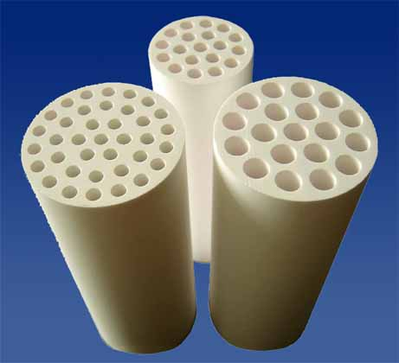
Trial CO₂ extraction ceramic membrane with an integration of a CO₂ laser gas detector
Ngozi Claribelle Nwogu
Robert Gordon University, Aberdeen, UK
3rd International Conference and Exhibition on Mechanical & Aerospace Engineering October 05-07, 2015 San Francisco, USA

Slide 4

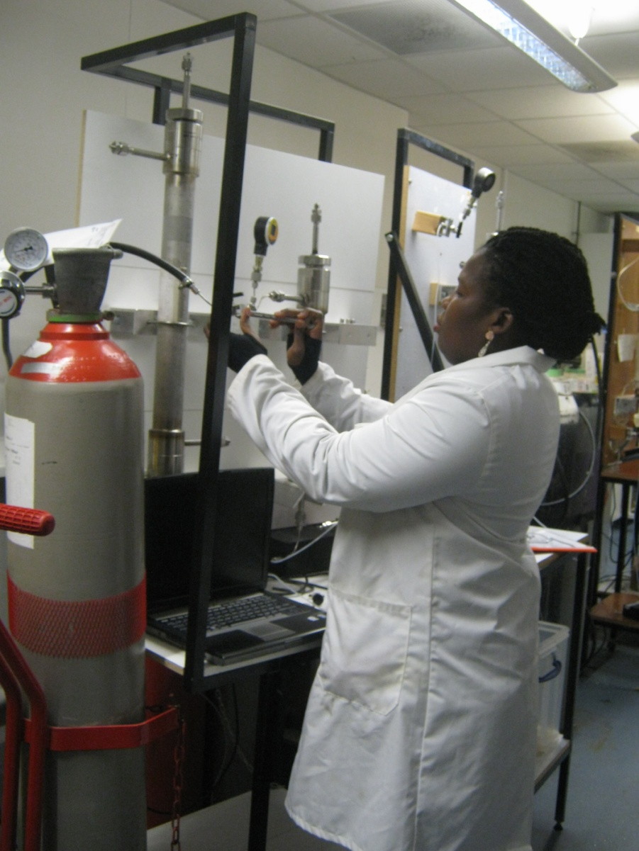
Outline
Introduction
Environmental Pollution
Objectives
Experimental
Methodology
Membrane characterization
Results and Discussions
Conclusion

Slide 5
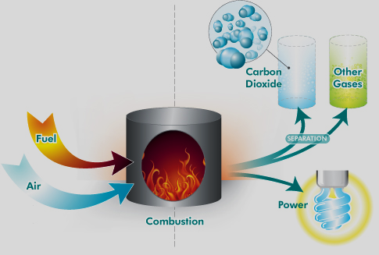
Introduction
Environmental pollution
Coal-fired power plants as large point sources of CO₂ atmospheric emissions
Contaminates the environment with high concentration of pollutants.
Flue gas from fossil fuel power plants emissions has been identified as the main contributor to global warming

Slide 6
The objective
To design a membrane-based system (silica modified) for the removal of CO₂ from flue gas stream.
Detection of CO₂ concentration in gas mixtures by the use of CO₂ laser gas sensor.
Determination of single gas permeance through the modified membrane.

Slide 7
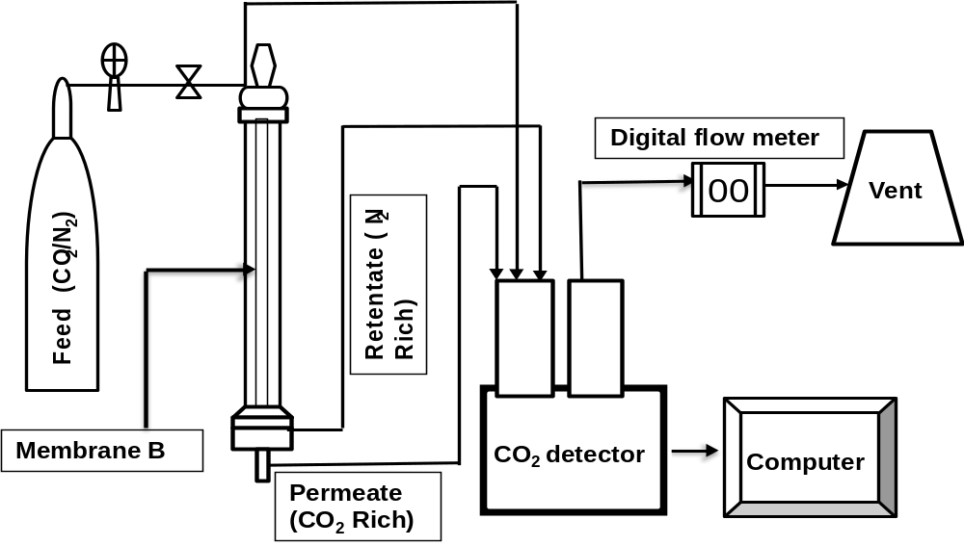
Experimental
Fig. 1: Experimental set up of gas permeation

Slide 8
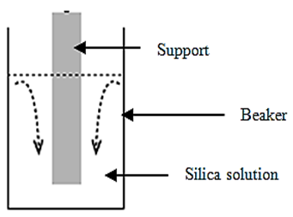
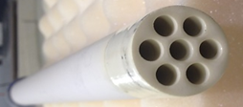
Methodology
Fig. 2: Fresh support
Fig. 3: Sequential dip-coating of the fresh support

Slide 9
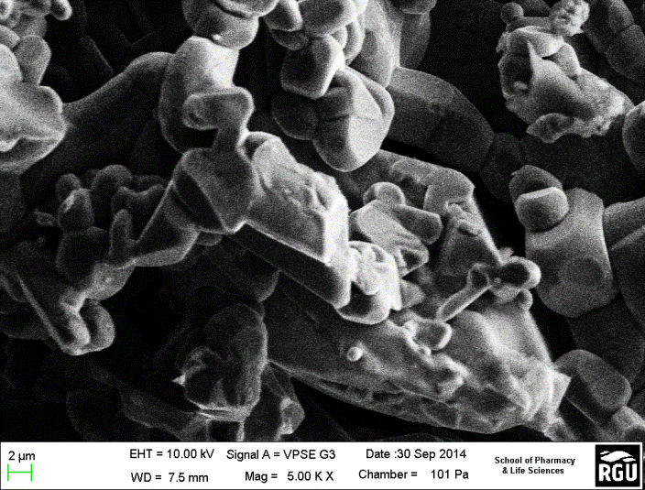
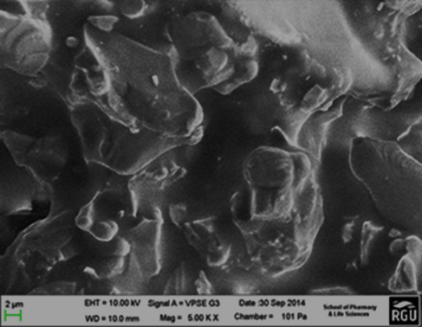
Membrane Characterization
Fig.4: SEM Image of support before modification
Fig. 5: SEM Image of support after modification

Slide 10
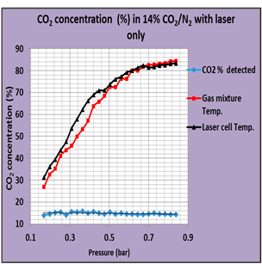
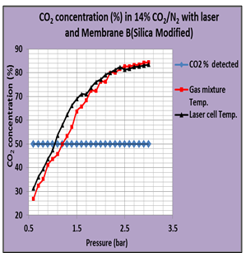
Results and Discussions
Fig 5: CO₂ percentage concentration detection through a modified membrane with integration of CO₂ laser gas sensor
Fig 4: CO₂ percentage concentration detection with CO₂ laser gas sensor only

Slide 11
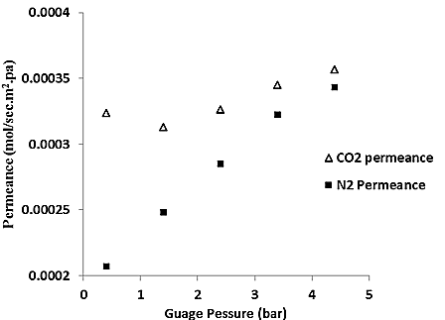
Results and Discussions
Fig. 6: Single gas permeance as a function of feed pressure at room temperature

Slide 12
Conclusion
Fabrication of silica membrane on macro porous alumina supports.
Binary gas permeation experiments were carried out to determine CO₂ concentration using a CO₂ laser gas sensor only and secondly when the laser was connected to the reactor housing a modified support
Results obtained show an appreciable CO₂ extracted from the modified membrane with the integration of the CO₂ laser gas detector from 14% to 50% concentration.
Single permeation experiments indicate that the permeation characteristics of the fabricated membrane are governed by surface adsorptive diffusion flow mechanism
The experiment confirm the usefulness of the CO₂ laser gas detector in membrane performance optimization especially for application in flue gas separation processes

Slide 13


