Slide 1
Creating healthy and appealing restaurant meals
What do guests want?
Neufingerl N¹, Newson RS, PhD¹, van der Maas, R¹, Carlson, L²
& Rosenbloom C, PhD, RDN³
¹ Research and Development, Unilever, the Netherlands
² Research and Development, Unilever, United States of America
³ Division of Nutrition, Georgia State University, USA
Notes:
This slide deck explains the results of an extended set of analyses on the World Menu Report 3– Seductive Nutrition. It is intended to support the scientific manuscript to explain the results and to be used by nutritionists in the countries as part of the roll-out of seductive nutrition.
It begins with an explanation of the need for seductive nutrition from a public health viewpoint and the role of the food service industry in this. Then follows with an introduction to the seductive nutrition framework and an explanation of how this was developed. Following this, the study is outlined (background, design, results and conclusions). Finally, a discussion of the key messages and next steps is presented.
Throughout the deck are also a series of extra slides which are marked with a yellow box, these are only to be shown at the discretion of the UFS roadmap.

Slide 2
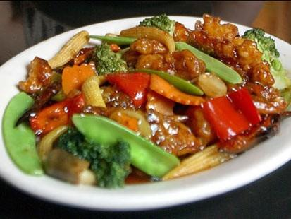
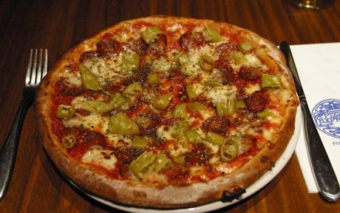
The role of eating out of home
Eating Out of Home is an eating occasion that is commonly associated with treating yourself and indulgence
Each Out of Home meal occasion has been shown to add around 143 calories than equivalent at home meals¹
Rates of Eating out of Home are on the rise²
→ It is therefore unsurprising that more frequent eating Out of Home is associated with increased overweight and obesity³
¹ Todd et al., 2010. The impact of Food away from Home on Adult diet quality. USDA
²Mintel, 2007. Eating out Habits, Leisure Intelligence
³Bezerra et al., 2012, Nutrition Reviews, 65-79
Notes:
Overweight and obesity can be tackled through creating an appropriate energy balance for people through lifestyle modification, such as a healthier diet.
Food eaten Out of Home has a significant impact on caloric intake and diet quality. One study in the USA showed that each additional meal or snack eaten away from home adds an average of 134 calories that day, compared with the same meals or snacks prepared at home. Holding all else constant, one additional meal away from home each week translates to roughly 2 extra pounds each year. The effect of food prepared away from home on daily caloric intake also depends on an individual’s weight status. An away-from-home meal adds an average of 239 calories to daily caloric intake for obese individuals (Body Mass Index (BMI) greater than or equal to 30) versus 88 additional calories for those with a BMI less than 25 [¹ Todd et al., 2010. The impact of Food away from Home on Adult diet quality. USDA].
It is therefore not suprising that an increased frequency of eating out of home has been associated with long-term weight gain [²McCrory et al., 1999. Obesity Research, 7, 564-571]

Slide 3

Key role for food industry
The Food Industry has the power to make a positive impact in this area
17.5m foodservice outlets in the world*
Tens of millions of chefs worldwide
Each chef prepares hundreds of thousands of meals in a lifetime
Small changes can add up to a BIG difference
Small changes to every meal prepared and served can add up to a BIG difference.
¹ Datamonitor
Notes:
As a food industry we have the power to make a positive impact in this area to help create real behaviour change! It’s a big responsibility, but our numbers are big and our reach is wide. In the foodservice industry there are 17.5 million outlets around the world* with more than 500 billion transactions that happen every day. With tens of millions of chefs and cooks in the world preparing meals, each chefs cooks hundreds of thousands of meals in his lifetime… They are responsible for the meals that these thousands of guests enjoy - the impact that an individual chef alone can make is huge.
Small changes to every meal prepared and served can add up to a BIG difference.
Unilever Food Solutions is committed to help chefs to make 200 million meals daily, healthier, tastier and more enjoyable by 2020. Through our products, recipes and services we aim to help influence all those meal occasions. Meals that are enjoyed in restaurants, but also in canteens, hotels and schools.
Seductive nutrition is one of our activities that will contribute to this commitment.

Slide 4
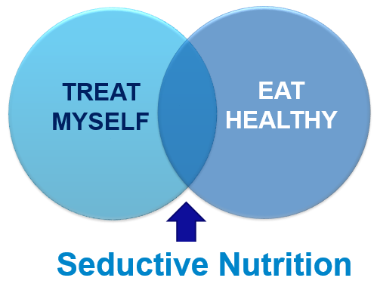
SEDUCTIVE NUTRITION As A solution
A Unilever Food Solutions training program for chefs and operators to help them make small, healthier changes to meals and
still be tasty and appealing.
Developed by chefs and nutritionists and grounded in behaviour change theory.
Notes:
It is all about being seduced by food that tastes wonderful and is also good for you.
Seductive Nutrition is designed to be appealing to guests as it is at the crossroad between “treating myself”, which is what guests want from an out of home eating experience and “eating healthy” which will help them to maintain a balanced lifestyle.
In light of this Unilever Food Solutions, the food service division of Unilever developed a program to help chefs and operators make small changes to restaurant meals that would improve the nutritional profile and still be tasty. This program, called Seductive NutritionTM, was created to seduce dinners with delicious and nutritious foods by making small changes to meals and making them appealing. Small changes can make a large difference at the population level (e.g., reducing obesity) and over time many small changes in dishes can also make a difference at the individual level (e.g., helping individuals to meet daily nutritional recommendations). Given the large number of chefs and operators Unilever Food Solutions can influence, these small, but vital changes can really add up to make a big difference toward the overweight and obesity epidemic.
Additionally, behavioral economists suggest that people do not need more nutrition education to prevent and treat obesity but instead need to be “nudged” to make healthier eating choices (Heshmat, 2011). The concept of nudging was popularized in a book by Thaler & Sunstein (2008) and its appeal is that individuals can be nudged toward behaviors that promote self-interest (such as choosing healthier foods) without taking away freedom of choice. Moreover, Wansink has shown that the environment plays an important role in overeating, therefore, changing the environment to help individuals make healthy choices without relying on individual “will power” could be a realistic public health approach applied to the food service industry (Wansink, Just & Payne, 2009).
The Seductive Nutrition framework is designed as a programme to change the behavior of guests towards choosing healthier menu items. In developing the framework the barriers, triggers and motivators towards healthy out of home eating were discussed and in consultation with operators, chefs and nutrition and consumer experts were turned into a framework for Seductive Nutrition. As individual stages and together as a whole framework, this framework addresses all 5 of the behavior change levers. This enhances the chances of achieving widespread behavior change as it is launched into the public domain.

Slide 5
More consumer insights needed
Consumer study objectives
Current satisfaction with healthy menu items
What do guests want in terms of healthy restaurant meals
  Extent of change
  What items wanted on menu’s
  When healthy meals wanted
Potential barriers to healthy meals
  Price
  Taste
  Satiation
Notes:
To provide appealing healthy changes, an understanding of what guests want and what stops them from choosing healthy items is required.
The need for changes to current restaurant options to improve the level of healthiness is clear for guests and it is evident that programs like Seductive NutritionTM can be a useful means to achieve this. However, to ensure that chefs and operators are able to provide changes that guests will accept and find appealing, an understanding is required of what guests want and what currently stops them from choosing healthy items. To explore this, we conducted an international online cohort study in 10 countries to understand current levels of satisfaction with healthy options, evaluate what guests wanted to see from healthy meals (extent of change toward healthiness, what items should be included to make menu’s healthy and when they want healthier meals) and to evaluate the potential barriers of three important facets of restaurant meals: price, taste and satiation.

Slide 6










methods
Design
30 minute online questionnaire, October & November 2011
Populations Evaluated
10 countries across the globe:
Sampling
Population-representative samples were sourced
500 respondents per country
18-64 years old; 50% female
All respondents ate out of home at least once per week
USA
UK
Poland
Brazil
China
S.Africa
Germany
Russia
Turkey
Indonesia
500
500
500
500
500
500
500
500
500
500
Notes:
The study consisted of an online cohort conducted in the following countries: United Kingdom, United States of America, Germany, Poland, Turkey, Russia, Brazil, South Africa, Indonesia and China. Data was collected during October to November 2011using an online questionnaire which took approximately 30 minutes to complete. This was completed using the participants own computer in their own setting. The questionnaire had to be completed in one sitting and prompting was provided on incomplete answers to reduce the occurrence of missing data. Participants were recruited through an international online panel provider (BrainJuicer), who was registered with the Data Protection Act. Informed consent was provided by all participants and they received a minor standard reimbursement for their time.
Population & Sampling
The study took place in ten countries around the world: America, United Kingdom, Poland, brazil, China, South Africa, Germany, Russia, Turkey and Indonesia. A recruitment target was set for each country of a sample size of 500 adults aged 18-64 with an even gender split. The online participant panels in the ten countries had population representative samples in terms of age and region, but were stratified based on gender to enable cross-country comparability. To ensure the relevant audience for the questionnaire, the following inclusion criteria were applied: must eat out of home at least once a week and must not be employed in the hospitality or marketing industry.

Slide 7

Questionnaire
Background Information
  Age, gender, country
  Children in household
  Eating Out of Home habits
  Allergies and Intolerances
  Eating preferences
Seductive Nutrition Framework Elements
  Guest Needs
  Current satisfaction with healthy Out of Home Meals
  Appeal of small changes to guests
  What small changes consumers want to see
  When guests want to have healthy meals
  Guest Barriers
  Influence of Price, Taste & Satiation
Notes:
A self report questionnaire was developed in consultation with experts in food services, nutrition and consumer science. Questions were developed to elicit information to understand guests reaction to seductive nutrition and associated behaviours. Overall multiple areas were covered.
Most questions were asked with closed responses (e.g., participants had to chose answers from 5-point rating scales rather than open options) to reduce error.

Slide 8
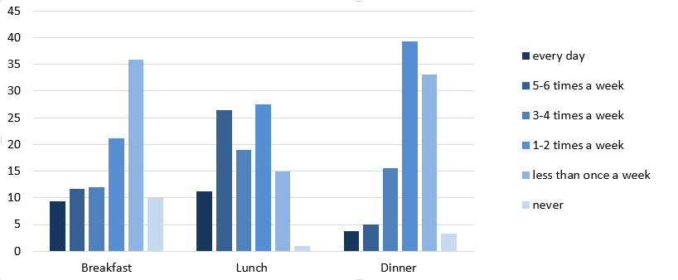
Eating Characteristics
“How often do you Eat out of Home?”
Percentage of the population (%)
Lunch was the key eating Out of Home moment
Additionally:
17% reported experiencing a food allergy or intolerance
3% were vegetarian, 2% were vegan and 6% pescatorian
Notes:
This slide shows the eating out of home characteristics of the sample. Guests were only included in the sample if they ate out of home at least one time per week to ensure we were examining a relevant sample.
Overall, lunch was the most popular meal to be eaten out of the home (on average 3.3 times per week, breakfast 2.1 x per week and dinner 1.7 x per week1).
More interesting habits included:
17% of the sample reported a food allergy or intolerance (lactose 3%, gluten 2%, shell fish 4,4%)
3% of the sample was vegetarian (no meat), 2% were vegan (no meat, no dairy) and 6% were pescatorian (only meat source eaten is fish).
Most respondents were in the category of:
25 to 34 year old: 37%
35-44 year old: 24%
45-54 year old 16%
18-24 year old 14%
55-64 year old 9%

Slide 9

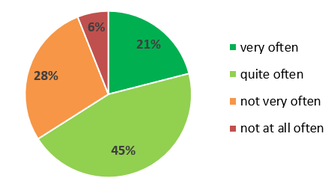
choosing healthy in restaurants
“How often do you Choose a Healthy Option?”
Overall, guests were regularly choosing “healthy” options.
Yet, 67% thought that they ate more healthily at home than Out of Home.
Notes:
Guests were also asked how often they actually choose a healthy option when they ate out of home.
Interestingly, only 6% reported that they chose a healthy dish ‘not at all often’, suggesting that the majority of the guests interviewed were open to choosing healthy options. Almost half of the population (66%) reported that the chose a healthy dish “quite or very often”.
Whilst this is hard to interpret this question as we don’t know whether they do actually choose healthy dishes, as it is a self-report question about past behaviours and it is socially desirable to respond positively, it does show that guests have “healthy options” on the mind and they recognise that they are positive. Good news for Seductive Nutrition!
67% of the sample believed (agree slightly/strongly) that they ate more healthily at home than when eating the equivalent meal out of home, which is in accordance with other external research that has been shown in this area.

Slide 10
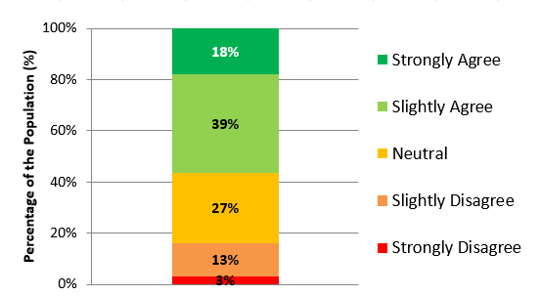
Satisfaction with current options
“I am happy with the current Healthy Options Available…”
Only 18% of respondents are completely satisfied with current healthy options.
82% see room for improvement in healthy options.
Notes:
The graph above shows the responses from participants to the statement: “ I am happy with the current healthy options available”. Participants could respond on a 5-point scale from strongly agree to strongly disagree.
The y-axis of the graph show the percentage of the population that reported each response.
57% agree (strongly/slightly); 43% neutral/disagree.
Satisfaction highest in China (32%) & Indonesia (46%), and lowest in USA & Germany (10%)
Only 18% of the population reported that they “strongly agreed” that they were happy with the current healthy options available, indicating complete satisfaction. Overwhelmingly 82% of the population reported that were not completely satisfied with the current options, this indicating room for improvement (e.g., they rated less than strongly agree).
Therefore we first evaluated amongst the 82% of the total group who were not completely satisfied whether they wanted slightly healthier options in restaurants (e.g., small changes).

Slide 11
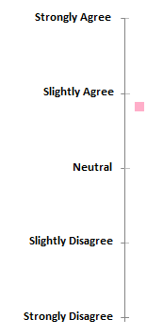
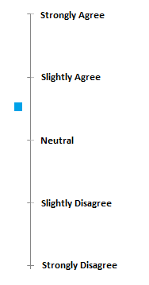

Consumer appeal of small changes
Guests who were not completely satisfied with current healthy options, on average reported they were ‘slightly’ interested in having slightly healthier options when eating out.
“I would prefer slightly healthier options when dining out”
Women and vegetarians had a significantly higher preference for ‘slightly healthier options’ than men and meat eaters, respectively (p <.001).
*Note. Analyses based on ANCOVA controlling for the effect of age and country, Estimated Marginal Means are presented
Notes:
Participants were asked to respond to the statement: “I would prefer to have slightly healthier options when eating out”. They were able to respond on a 5-point scale from strongly agree to strongly disagree. On average participants scored around ‘4’ on the 5-point scale, equivalent to a rating just below “slightly agree”. This indicates that they are somewhat interested in seeing slightly healthier options on the menu.
76% agreed slightly/strongly. (75% men vs 78% women; 97% vegetarians vs 75% meat eaters)
Once we understood what the participants wanted overall, it is of interest for operators and chefs to know what personal factors are associated with wanting slightly healthier options, for example perhaps there are some groups that want this more or less than the average. As such a series of Analysis of Covariances (ANCOVA’s) were conducted, this tests for differences between groups on a certain outcome variable, in this case the outcome was the continuous variable: “wanting slightly healthier options”. All analyses were controlled for the effects of age, gender and country where appropriate.
in this slide we display the means of the ratings for men and women (note, estimated means are shown which are adjusted for the other influences of country and age group as these also varied).
As you can see in the slide women rated slightly higher than men, indicating that although men did want to see small changes in healthy options, women wanted this slightly more.
Gender (women),
country (China & Brazil!!)
age group (35-44)
Being vegetarian
Eating out of home more often
Having children living at home
were all shown to significantly influence wanting slightly healthier options.
We conducted additional ANOVAs and found that being vegetarian compared to being a meat eater, eating more often out of home and having children still living at home were significantly associated with wanting to see slightly healthier options on restaurant menu’s. However, having food allergies or intolerances had no effect on wanting slightly healthier options.

Slide 12
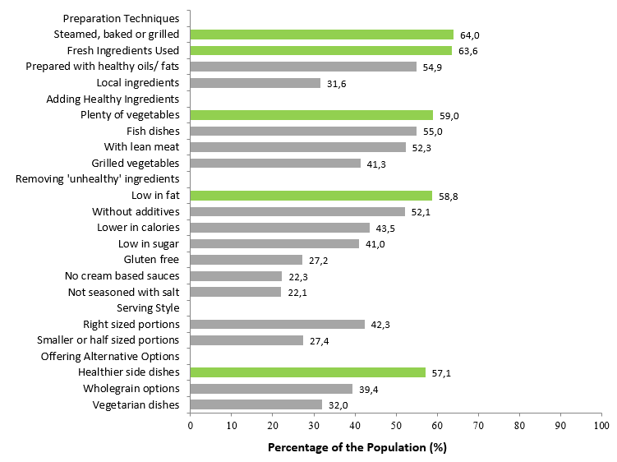
What Small Changes do they want
“What options should restaurants adopt to help provide healthier menu’s?”
Preparation techniques
Adding healthy ingredients
Removing “unhealthy” ingredients
Serving style
Offering alternative options
Notes:
It is clear that consumers who were not completely satisfied with current healthy offerings and want to see small changes in restaurant menu’s. In this slide we provide an overview of what small changes they wanted to see adapted on restaurant menu’s, i.e. what guests feel are missing from current offerings to enhance current menu’s. This is particularly important as here we are only looking at participants who were not completely satisfied with current offerings.
Here participants were asked to indicate what options restaurants should adopt to help provide healthier menu’s. They were able to select as many options as they liked and if none were indicated, this was recorded as “none of these options”. As participants could answer each item no significant difference can be calculated between them, but we can evaluate the rank order of the items to see which were selected by the most people. The numbers shown are global figures.
The top six items that were chosen include:
Steamed, baked or grilled items instead of fried – chosen by 65% of participants
Fresh Ingredients Used – chosen by 63% of participants
Plenty of vegetables (raw or cooked) – chosen by 59% of participants
Dishes that are low in fat – chosen by 58% of participants
Healthier side dishes – chosen by 56% of participants
Dishes that are prepared with healthier oils or fats – chosen by 55% of participants
Women and older adults were more interested in steamed/grilled/baked items and plenty of vegetable than men and younger adults.
There were significant differences in selections based on country. (Without additives was high in Turkey, China and Indonesia.

Slide 13
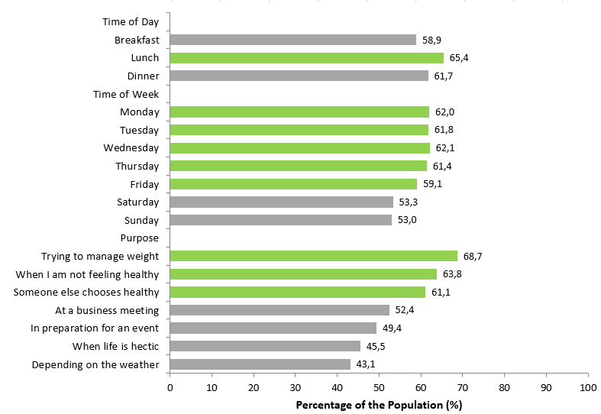
Preferred occasions to choose healthy
“When are you likely to choose a Healthy Option?”
Time of day
Time of week
Purpose
Note. Percentages reflect those participants that recorded that they were likely to choose healthy on these occasions: “very often” or “quite often,
Notes:
For the offering of healthy meals is important to know which moments guests are most likely to choose a healthy option. As such we asked guests at which out of home dining moments they were most likely to choose a healthy dish. This was asked in three categories: time of day of eating (breakfast, lunch and dinner), day of the week (Sunday-Saturday) and occasions (e.g., business meeting vs. for weight loss). Participants were able to respond: ‘not at all often’, ‘not very often’, ‘quite often’ or ‘very often’.
The graph above shows for each item the percentage of the population which reported that they would chose a healthy item on these occasions “quite often” or “very often”.
In summary the most likely occasions that guests were likely to chose a healthy meal were:
Time of Day (lunch, dinner)
Day of the Week (Monday through to Friday)
Occasion (‘trying to manage my weight’, ‘when I am not feeling 100% healthy’ and ‘if a friend were to chose healthy’)
This indicates that operators and chefs need to do more efforts to sell healthy menu’s on weekends and at breakfast when guests are less likely to choose current healthy options.
Note. No statistics are shown here to compare the groups as participants could report on all items.

Slide 14
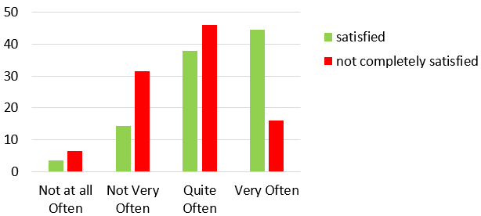
Who chooses healthy options
Guests who were more satisfied with current healthy options were more likely to choose a healthy dish when eating out (p<0,001).
Frequency of choosing a healthy option
Percentage of the population (%)
Guests who eat out more often
  were more likely to choose healthy options
  they were also more likely to choose a healthy option during the weekend (all, p<0,001)
*Note. Analyses based on chi-square test
Notes:
Guests who were more satisfied with healthy options current available at out of home eating locations, were also more likely to actually choose a healthy option when they are eating out. In addition, those who were more satisfied also ate out more often.
Also
females,
vegetarians, and
35-44 year olds were more likely to chose healthier options (p< 0.001)
In order to determine if there was an association, a chi-square analysis was done. The analyses showed a significant association such that the more satisfied people were with current healthy option, more likely they were to choose a healthy meal option.
In order to determine if there was an association between eating out of home frequency per meal occasion and reporting of choosing a healthy meal at each of these occasions, a chi-square analysis was done to compare the association between: 1) frequency of eating out of home, and 2) reporting of choosing a healthy item per meal occasion). The analyses also showed a significant association between eating out of home frequency per meal occasion (breakfast, lunch and dinner) and reporting of choosing a healthy meal at each of these occasions, such that the more often people ate out, the more likely they were to choose a healthy meal option (p<0,001).
Importantly for chefs and operators, this indicates that guests who eat out more are more likely to choose healthy options and those who eat out less regularly are more looking to treat themselves.
Chi-square for breakfast: 240.1, p <.001
Chi-square for lunch: 74.8, p <.001
Chi-square for dinner: 99.5 p <.001

Slide 15
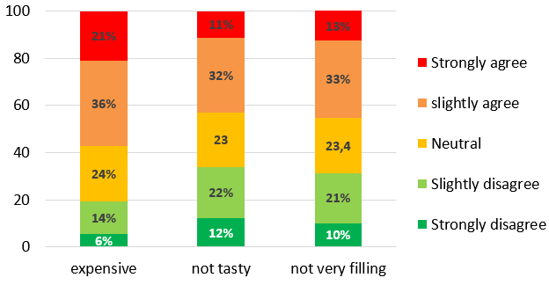
Expense, taste and satiation
“Healthy Options Are…
Percentage of the population (%)
Mostly guests found healthy meals to be expensive, not tasty and not filling.
This was more pronounced in younger (18-24y)
compared to older (55-64 y) adults (p<0.001).
*Note. Analyses based on chi-square test
Notes:
We have learnt that guests want small changes and what factors influence this, however in order to provide guidance to operators, it is also important to know what changes they want to see on restaurant menu’s.
In order to better understand these barriers we asked the participants in the current study to tell us how much they agreed with the following three statements:
57% “healthy options tend to be more expensive”
43% “healthy options on the menu usually don’t sound very tasty”
46% “often the healthy option is not very filling”
Guests could respond on a 5-point scale from: strongly disagree to strongly agree. Guests who reported they strongly agree are more positive in that this means they do not find healthy options to be more expensive, less tasty or less satiating.
The role of price, taste and satiation is important to understand for romancing the menu, as if these elements are not addressed through the romancing the menu wording, they can potentially turn customers away from the healthy options to the less healthy options.
The graph above shows the percentage of the population that responded in each category. As you can see the vast majority of the population thought that healthy dishes did tend to be more expensive, less satiating and more filling. (4% of the population “strongly agreed” to all above elements.) This confirms that the seductive nutrition approach also needs to ensure that the meals sound like good value for money, they appeal in terms of taste, and consumers have the feeling that the dish would fully satiate their appetite.
Compared to older adults, younger adults thought healthy meals were less tasty (46% in adults aged 18-24 compared to 37% in adults aged 55-64: χ2=23.7, p<.001), less satiating (47% in adults aged 18-24 compared to 37% in adults aged 55-64: χ2=22.7, p<.001), and more expensive (59% in adults aged 18-24 compared to 50% in adults aged 55-64: χ2=30.1, p<.001).
There were also significant differeneces between countires

Slide 16
conclusions
Majority of guests not completely satisfied with current healthy options
Small, healthy changes are desired
  steamed/baked/grilled preparation, plenty of vegetables, fresh ingredients, low in fat & healthy oils
  addition of “healthy” rather than removing “unhealthy” ingredients
Lunch, weekdays and frequent guests as key opportunities
  Highlight healthy options
  Otherwise seduce towards slightly healthier option
Healthy options linked to low taste & satiation and high price.
  Appealing descriptions (“romancing the menu”)
  Great recipe, no taste compromise
Chefs and operators should use this information to develop attractive healthier meals, and tailor the manner of selling healthier meals to the occasion and target group.
Notes:
Remarkably, only 18% of guests globally surveyed were satisfied with current healthy options on restaurant menus. This indicates definite room for improvement for operators and chefs in their current menus and overall should act as a wakeup call to the industry. This is particularly important as higher satisfaction with current healthy options was associated with eating out of home more often and every restaurant wants to provide satisfaction to its patrons and potentially increase the number of guests.
Interestingly, the majority of guests were interested in seeing small, healthier changes to the menu. This supports the notion that small changes are an important strategy to making improvements to the healthiness of restaurant menus. Guests are caught at the intersection of wanting to eat healthy but also wanting to treat themselves on the weekend or for special occasions. Small changes can appeal to a guest whereas a total overhaul of a restaurant menu or favorite dish is less appealing to guests. By making small changes to restaurant meals, chefs and food service operators could make a valuable contribution to reducing energy intake and increasing healthiness of food consumption of guest’s throughout the world.
Guests in our study wanted to see changes made to preparation techniques with the most interest in steaming, baking, and grilling foods, along with the use of fresh ingredients prepared using healthier fats and oils. They also wanted to see the addition of healthy ingredients including the use of more vegetables, fish, and lean cuts of meat. These changes point to not only what guests want but what they see missing in today’s restaurant offerings. It is also interesting that the positive changes were more often mentioned than negative changes (i.e., removing ingredients deemed to be unhealthy such as cream-based sauces or high in sodium). This implies that chefs and food service operators have an opportunity to add healthy ingredients and promote healthy food preparation techniques without dwelling on the negatives (low fat or low sodium).
Understanding when guests want healthier meals can help chefs and operators to decide when they need to increase or highlight healthier options. Certain meals (lunch, dinner), days of the week (Monday to Friday) and certain occasions (managing weight, when a friend chooses healthy or when not feeling well) were key triggers for choosing healthy options. This is of note to chefs and operators, as they know that most guests on these occasions are already interested in eating more healthily, but it indicates that extra effort needs to be made on other occasions (e.g., breakfast and on weekends when guests are not as likely to be looking for healthy options). Interestingly choosing these options were strongly related to frequency of eating out, indicating that people who eat out more frequently are more likely to eat more healthily than those who eat out less. It is therefore important for chefs and operators to be aware that they may have different challenges from “regular” from those who are less frequent guests. . In a study on healthy dining, Papies and Veling (2013) found that subtle reminders on health and nutrition on the menu increased the selection of healthier options among dieters. They concluded that expanding the options of tasty, less caloric foods at comparable prices to other offerings of the menu could make restaurants more desirable to the health conscious guest.
Despite the positive comments from diners, we also identified perceived barriers. More than half reported that they thought that current healthy options were too expensive and slightly less than half thought that healthy items would not taste good or be satiating. This indicates strong room for improvement in how chefs and operators develop their menus. This indicates strong room for improvement through Romancing the Menu, chefs and operators need to pay attention to their menu’s to make sure the healthier options in the menu’s do sound tasty, are justified in their expense and describe the dish in enough detail to make it seem satiating.
This can be difficult to achieve for chefs alone, which is why Unilever Food Solutions developed the Seductive NutritionTM service. This is a practical service that teaches and enables chefs and operators to make small, but vital, changes to their top dishes so they become slightly healthier.
This research establishes the needs and barriers of guests, however further research will also help to enhance our knowledge and the ability to provide targeted services. For example, we now know what type of small changes guests want to see, but it is also of interest to determine which type of dishes guests are prepared to see changes on. Do they want their favorite meals made slightly healthier, or do they want their favorite foods to remain unchanged? It is also of use to know more about the best approach to communicating small changes to diners. In the past, many chefs and food service operators have taken a “stealth health” approach. That is, the dish might be healthier but there is no desire to call out the healthy features for fear diners will reject it. However, there is some indication that health and nutrition is a growing trend in the restaurant industry. The National Restaurant Association’s What’s Hot 2013 Chef Survey reveals that health and nutrition are “hot” with diners, especially healthier children’s meals, vegetarian dishes and sustainable sourcing (2013).Transparency on the menu might be the right complement to a stealth approach to health and nutrition in the food service industry. Either way, menu items with appealing descriptions that show no taste compromise are of interest to the vast majority of guests.
Conclusion
The majority of guests were not satisfied with current healthy options, highlighting the need for improvement. Guests wanted to see small, healthy changes and responded clearly about which items they wanted to see included by chefs and operators on menus to make them healthier, if they are not already present on menus. Overall, healthy options were often linked to lower taste and satiation and higher price, as such menus reporting healthy dishes need to be altered to ensure these barriers are overcome. Guests had clear preferences for when they wanted healthier meals. Chefs and operators can use this information to know when to highlight healthier meals, and when more work is needed to sell these dishes. Differences in the needs and wants of guests per socio-demographic and personal factors were present indicating the need to tailor menus and the manner of selling meals locally.

Slide 17
Healthy recipes case studies
In practice

Slide 18



FOODSERVICE IS FACING A GLOBAL CHALLENGE
With over a billion overweight adults and a hundreds of millions of cases of obesity worldwide, the food service industry needs to face up to its responsibilities in tackling the global obesity epidemic.
Guests are looking for healthier options when dining out, but they also want the feeling of indulgence and treating themselves to something that they can’t get at home.
They aren’t expecting to sacrifice taste but are looking for slightly healthier versions of their favourite foods.

Slide 19
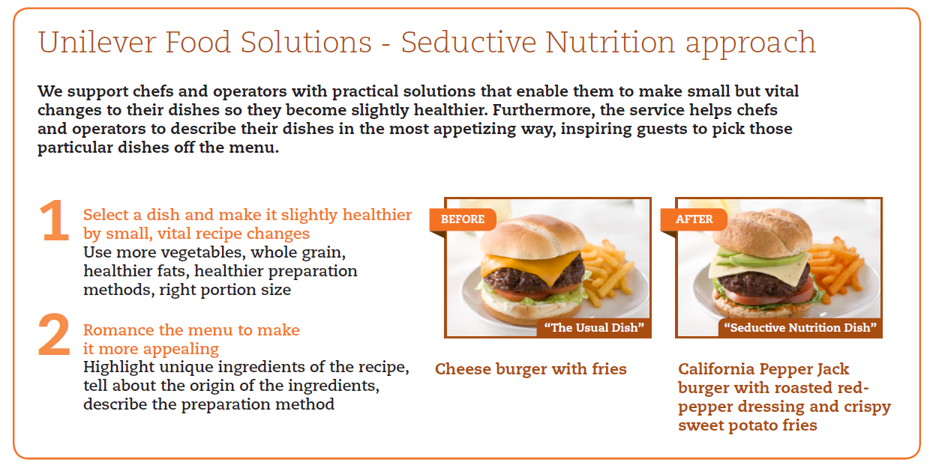
Changes the chef can make
Notes:
*Only show in settings where it is appropriate to disclose more information on Seductive Nutrition*
The Seductive Nutrition Framework was developed with Chefs and Nutritionists. It consists of two stages:
Small Changes – “Select a dish and make it slightly healthier”. Making large changes to menu items to make them more nutritious can be extremely difficult for food service operators to achieve as it can require a complex alteration of the menu items. Moreover, consumers may not find these items appealing as they are too far removed from the original dish or not as appealing as the original item, thus defeating the purpose of the alterations. As such, the first step of the seductive nutrition process is to make “Small Changes” to dishes, rather than large changes or swapping for new dishes. A small change may involve substituting one ingredient in the dish for something healthier (e.g. using margarine in the sauce instead of butter), reducing the amount of an unhealthy item in the dish (e.g., 10% less olive oil in the sauce), or adding more of a healthier item (e.g., adding 100grams more of green beans to a risotto). Small changes can make a large difference at the population level (e.g., x tones of salt removed), and over time many small changes in dishes can also make an influence at the individual level (e.g., helping individuals to meet daily nutritional recommendations). This technique has also been shown to be more effective to promote and sustain a healthier lifestyle in the long term.
Our Unilever Food Solutions service provides practical tools, like calorie calculators, plus advice and ideas to make your menu healthier but attractive to diners. We host workshops in our Chefmanship Centres to demonstrate the positive effect of recipe changes, such as increasing the amount of vegetables, lowering fat and adapting portion sizes. We also show how to maximise the appeal of dishes with enticing menu descriptions.
Romance the Menu – “Make the wording of the menu appealing”.
In order to entice guests to order a dish, it needs to sound appealing and tempting. Using terms such as nutritious and healthy can work for guests who are health oriented, but for the majority of guests this can be a deal breaker. Some simple steps that can be followed include: Focus on ingredients: rather than just listing ingredients, focus on them and make them appealing (e.g., Locally sourced, Alaskan Salmon, Tillamook Cheddar, Farmer’s market produce). Tell a story, share a memory: make the dish appear more exotic and unique by explaining its origin (e.g., we search all over for the best, this recipe comes from, we are proud to support local farmers and food artisans, fresh, real, authentic, signature, natural etc…). Describe preparation - this makes the guest feel it is a specially prepared meal (e.g., thoughtfully prepared, plank Grilled Salmon, bbq grilled vegetables etc…).
A “before” and “after” example is given above to highlight the effect of the seductive nutrition process.

Slide 20
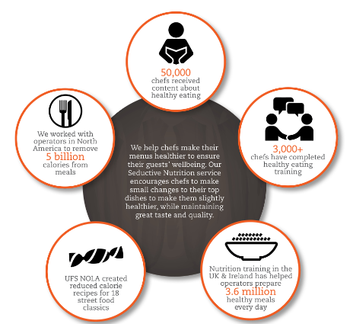



Seductive Nutrition in practice
Active in:
US
UK
South Africa
Israel
Singapore
Philippines
Mexico
With local partnerships
Notes:
Our Seductive Nutrition programme is currently running in 7 countries around the world. Mulit-stakeholder approach is important. We work together with local associations, authorities and industry leaders to increase awareness of the obesity issue and to encourage everyone working in foodservice to take action.
E.g. in Singapore: health promotion board (door overheid gestimuleerd/gesponderd): 500 kcal meals in restaurants, less salt,
50,000 chefs received content about healthy eating (newsletter, info)
3,000+ chefs have completed healthy eating training (workshops)
UK & Ireland: nutrition workshops for chefs in elderly care homes elderly & schools, has helped operators to prepare 3,6 million healthy meals EVERY DAY
In Mexico (NOLA), FoodSolutions created reduced calorie recipes for 18 street food classics
In North America, UFS partnered with the Culinary Institute of America and the American Culinary Federation to educate operators about
the principles of seductive nutrition.
In Singapore with Health Promotion Board

Slide 21
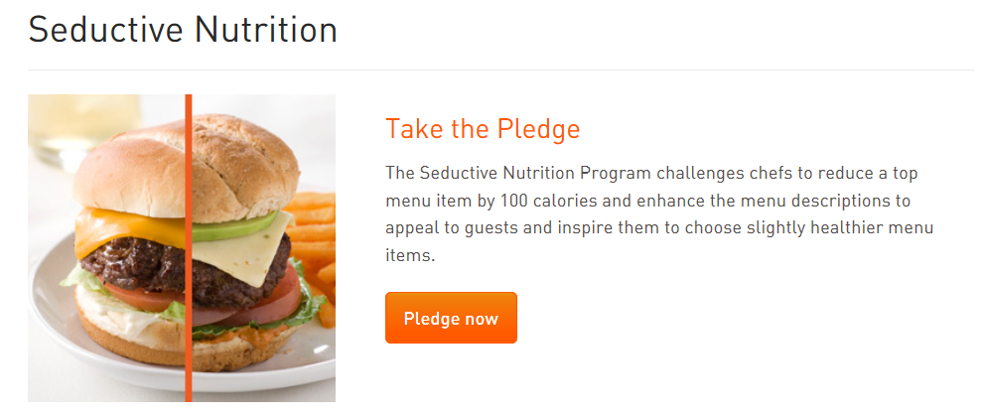
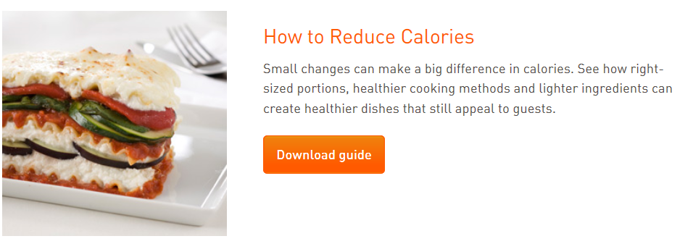

USA: Tools & inspiration for chefs

Slide 22
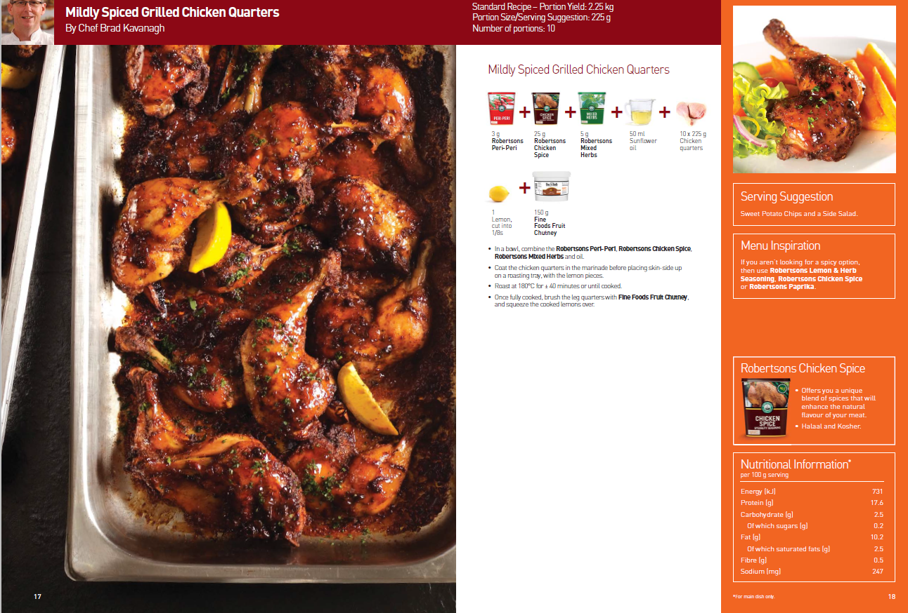
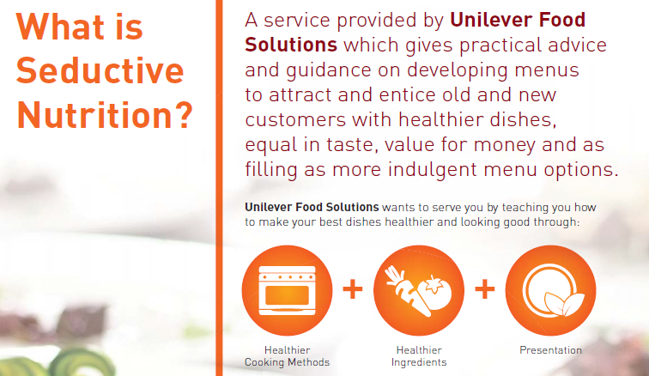
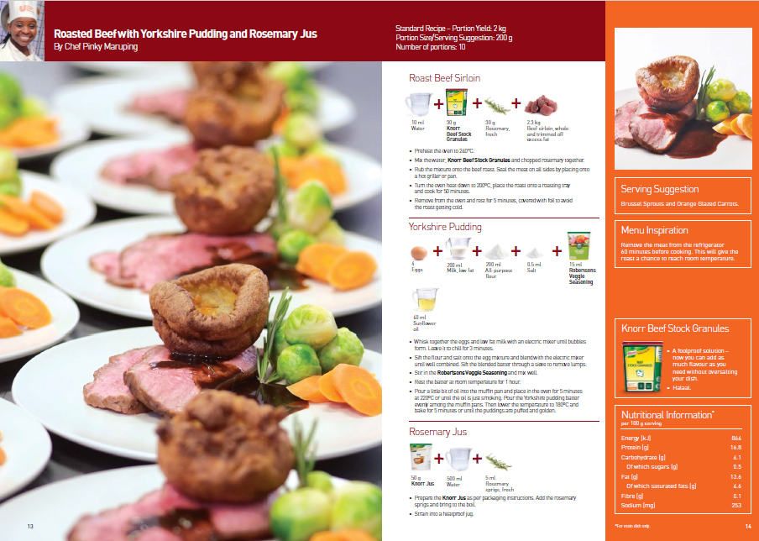
  South Africa: Healthy meals don’t have to be bland
  The recipes explain how operators can make small changes to their dishes that can make a big difference to the health of their guests without compromising on flavour.

Slide 23
Thank you!
http://www.ufs.com/sustainable-living/healthier-eating/seductive-nutrition

