Slide 1

German University in Cairo
Design and Synthesis of Novel Non CYP2D6 mediated Tamoxifen Analogues
Nehal H. Elghazawy, Nermin S. Ahmed, Bianca M. Liederer,
Rolf Hartmann, Ashraf. H. Abadi
Pharmaceutica , March 2016

Slide 2
Breast Cancer
Mortality Rate 12%
Notes:
According to WHO ( International Agency for Research on Cancer) , Breast cancer is one of the major cancers worldwide
In year 2012 , it represented almost 25 % of all cancer cases among females and with mortality rate of 12 % .

Slide 3
Hormonal Therapy
Estrogen Synthesis antaganoist
  Aromatase Inhibitors
Estrogen Receptor antagonist
  Selective Estrogen Receptor Modulators (SERMs)
Notes:
Drugs in hormonal therapy either estrogen synthesis antaganoist such as Aromatase Inhibitors or Estrogen Receptor antagonist such as Selective Estrogen receptor modulators

Slide 4
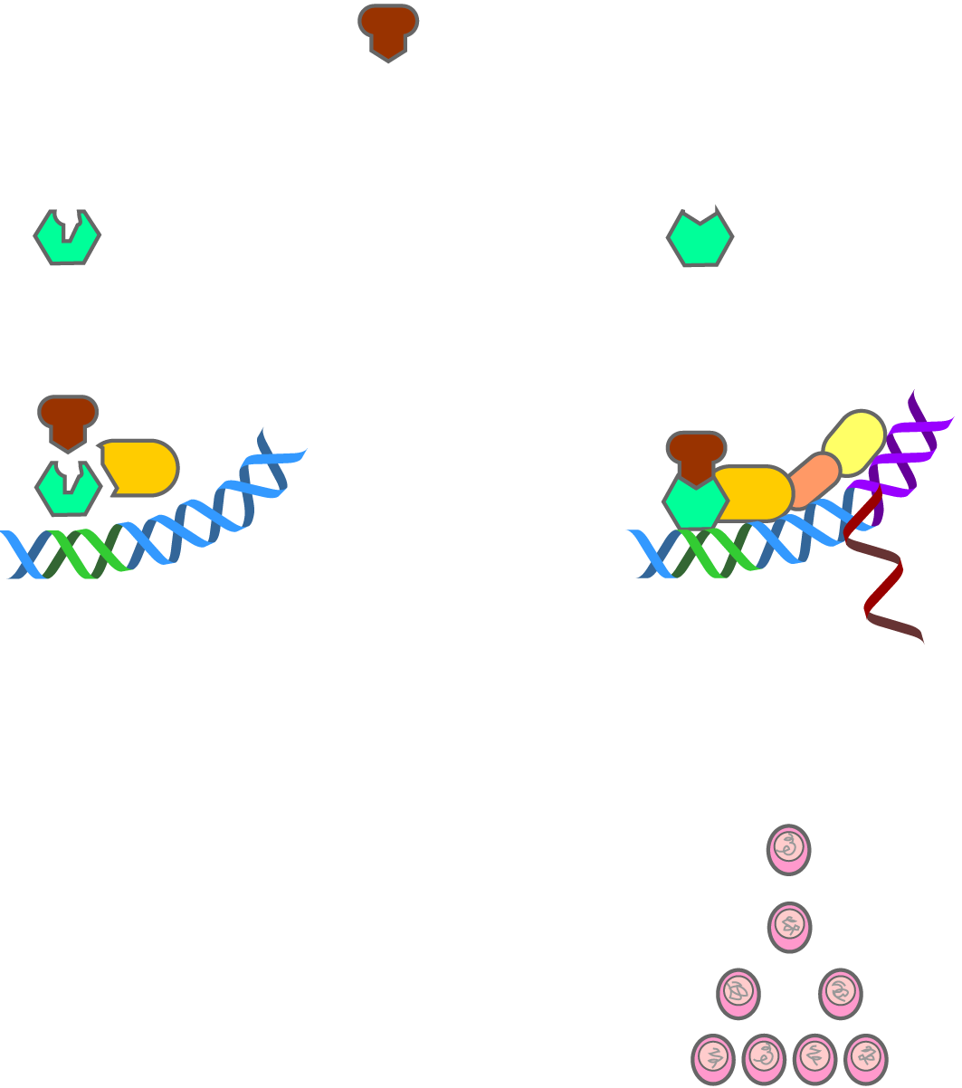
Selective Estrogen Receptor Modulators
(SERMs)
Dual action
SERM
Estrogen receptor in breast cell
Estrogen receptor in uterine cell
Breast receptor not activated
No breast cell proliferation
Uterine receptor activated
Uterine cell proliferation
Notes:
This dual effect can be attributed to one of the following reasons :

Slide 5
SERMs Mode of Action
Differential ERα and ERβ expression
Ratio of co-activator to co-repressor proteins in different cell types
Conformation of the estrogen receptor induced by drug binding

Slide 6
SERMs Chemical Classes
Benzothiophenes
Naphthylenes
Indoles
Benzopyrans
Triphenylethylenes
Notes:
And the most commonly usedSerm is tamoxifen

Slide 7
Tamoxifen
In 1966, (ICI 46,474), at Imperial Chemical Industries (AstraZeneca), as antifertility agent
In 1971, first clinical study took place showing its effect in advanced breast cancer.
In 1973, Nolvadex® ICI brand of tamoxifen
1977, approved by FDA in the treatment breast cancer in postmenopausal women
1998 , approved by FDA for reducing the incidence of breast cancer in women at high risk developing the disease
Global sales of tamoxifen in 2001 were $1 billion
Notes:
was discovered in the fertility program
Nolvadex, the ICI brand of tamoxifen (as its citrate salt), was approved for the treatment of breast cancer by the Committee on the Safety of Medicines in the United Kingdom.

Slide 8
Tamoxifen metabolism
CYP2D6
4-hydroxy tamoxifen
CYP3A4
endoxifen
Notes:
CYP important metabolizing enzyme that is expressed predominately in the liver
This protein localizes to the endoplasmic reticulum and is known to metabolize as many as 25% of commonly prescribed drugs.

Slide 9
CYP2D6 Pharmacogenomics
Poor metabolizers (PM)
Intermediate metabolizers (IM)
Extensive metabolizers (EM)
Ultrarapid metabolizers (UM)
Notes:
most widely studied group of proteins displaying pharmacogenetic variability
100 different CYP2D6 variant alleles have been reported. alleles vary in frequencies based on the ethnic group in consideration.
reduced activity of CYP2D6 enzyme could account for the inter-patient variability in concentration of metabolites of many drugs especially those of tamoxifen
phenotypic classification of CYP2D6 activity
UMs are rare in both Black Africans and Asians,
but are frequently found in North Africa and the Middle East, where whole gene duplication of CYP2D6 is commonly observed

Slide 10
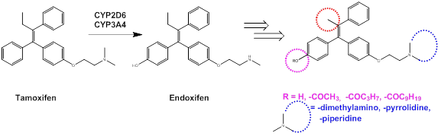
Study Objectives
Notes:
in order to avoid the genetic polymorphism of the CYP2D6 enzyme

Slide 11
Synthetic pathways
a. Zn / TiCl₄
b. THF, reflux, dark, 2.5 h
I
DMF, heat 80 °C, 16 h
TEA /
V - XIII
E/Z
THF, stir 25 °C, 30 min
II-IV
E/Z
Notes:
Using equimolar ratio of the the alkyl halide

Slide 12
Biological Evaluation
All the final and intermediates were tested for their in vitro ability for
MCF-7 cells growth inhibition
Estrogen Receptor Binding
ERα
ERβ
Notes:
The next step was to biologically evaluate our compounds

Slide 13
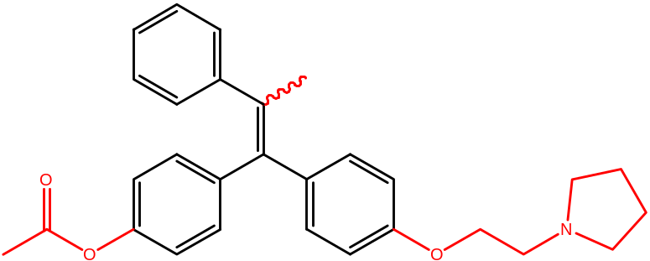
3
8
IC₅₀ (µM) |  |  | ER-α/ER-β selectivity ratio
MCF -7 | ER-α | ER-β | 45:1
<1 | 0.0008 | 0.04
IC₅₀ (µM) |  |  | ER-α/ER-β selectivity ratio
MCF -7 | ER-α | ER-β | 37:1
2.60 | 0.0077 | 0.26
10
IC₅₀ (µM) |  |  | ER-α/ER-β selectivity ratio
MCF -7 | ER-α | ER-β | ND
< 1 | 0.0484 | ND

Slide 14

NCI results
10
Cell Lines | GI₅₀ (µM)
 | Compound 10 | TAM
MCF-7 | <0.005 | 1.58
MDA-MB-468 | 7.26 | 1.99

Slide 15
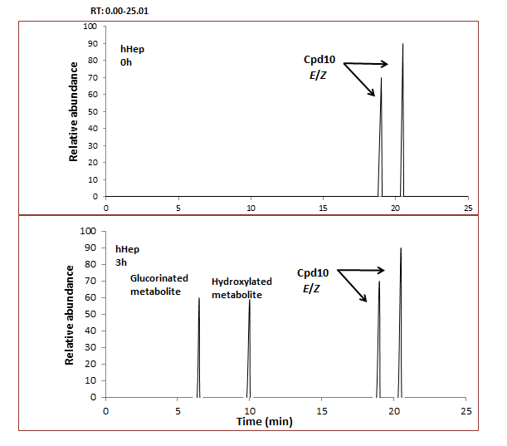
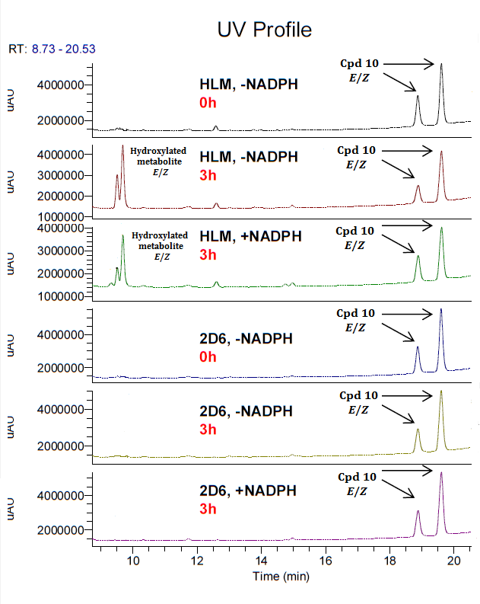
Metabolite Identification

Slide 16
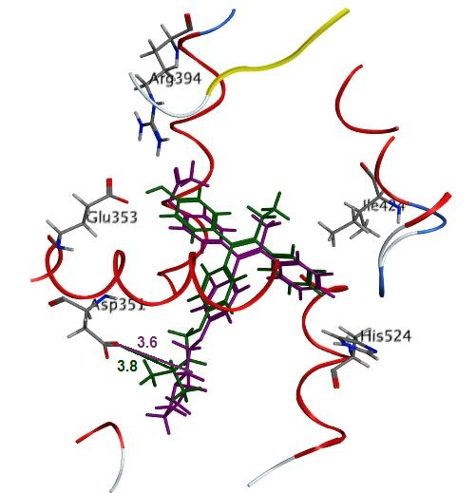
Molecular Modeling
Compound 8 (purple) overlaid with 4- OH Tam( green) in the ER-α ligand binding domain.

Slide 17
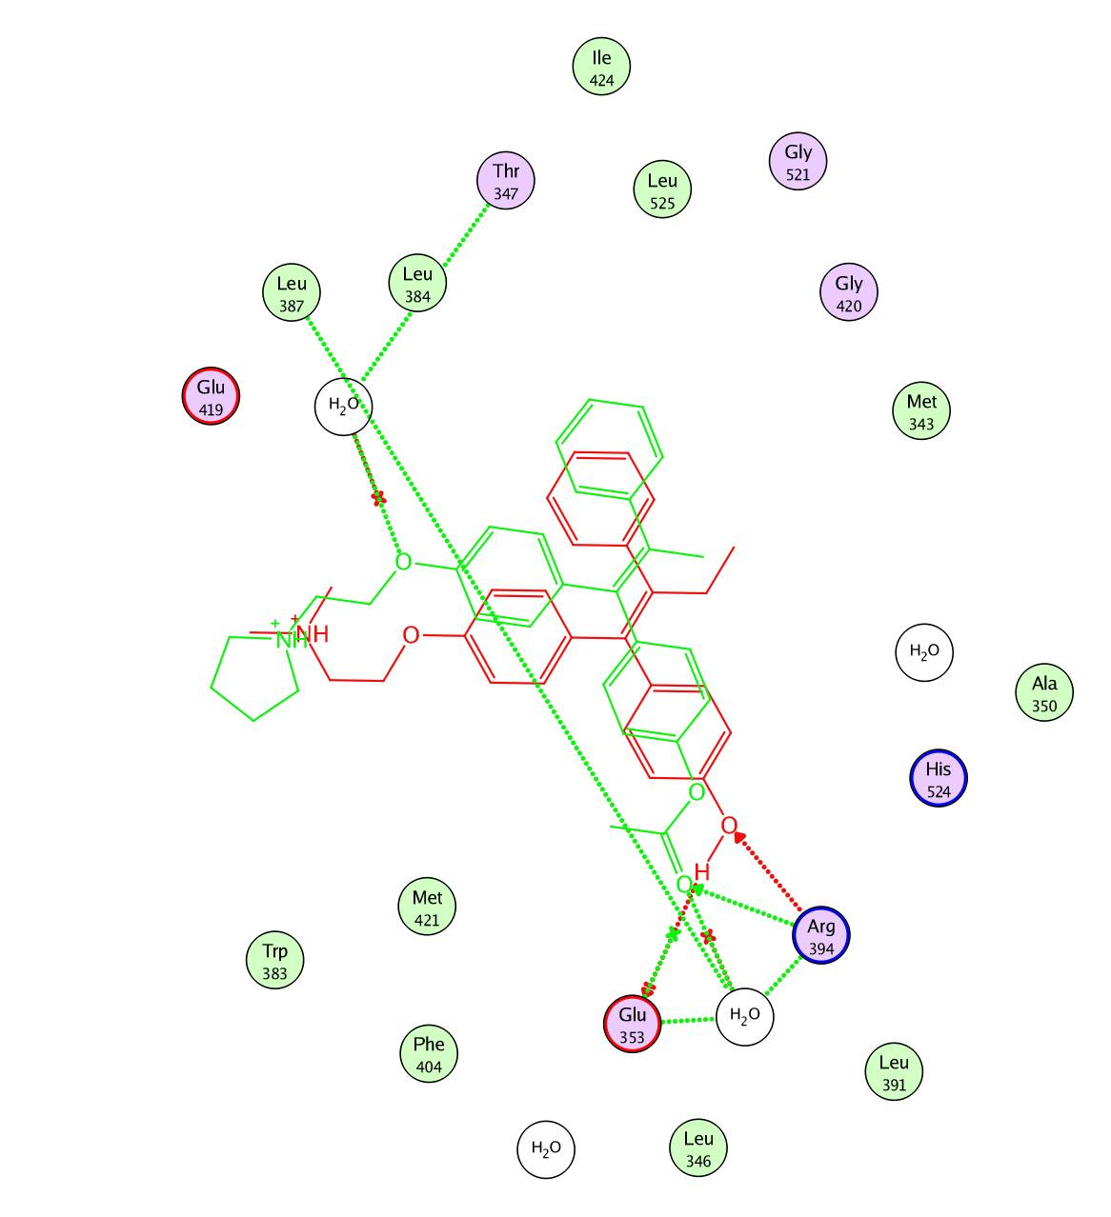
2D interactions of 4- OH TAM (red) and compound 8 (green) in the ER-α ligand binding domain.

Slide 18
Conclusions
Notes:
To wrap up

Slide 19
Conclusion
Novel tamoxifen analogues showed MCF7 cell line growth inhibition with IC₅₀ values between IC₅₀ = < 0.25 - 3.97 μM compared to tamoxifen IC₅₀ = 4.4 μM.
All compounds showed ERα binding affinity (IC₅₀ 7 – 200 nM ) compared to tamoxifen IC₅₀ = 8 nM.
Compound 3 showed 10 times higher ER-α binding compared to TAM and two times more ER-α selectivity.
Moreover, compound 10 exhibited (GI₅₀ 300 times) more potent than that of TAM on MCF-7 cell lines.
Esterified compounds are stable towards CYP2D6 , and are rather metabolized via esterases.

Slide 20
Acknowledgement
Notes:
To wrap up

Slide 21




Prof. Ashraf Abadi Miss Merna Vector
Miss Nehal El Ghazawy Miss Menna Hany
Ms Rasha Rashied Miss Tammy Mostafa
Miss Noran El Sawaf Miss Miriam Albeir
Miss Norhan Khafagi Miss Hoda Allam
Miss Eman Abu El Maaty
Mr. Mohamed Saleh
Prof. Rolf Hartman
Dr. Mathias Engel

