Slide 1
Therapeutic Trial to assess the efficacy and safety of folic acid and/or vitamin B complex on hepatitis C infected patients treated with pegylated interferon and ribavirin.
Nermeen Ashoush
Head of Health Economics Unit, (CDRD)
Lecturer in Clinical Pharmacy & Pharmacy Practice
The British University in Egypt

Slide 2
Introduction

Slide 3
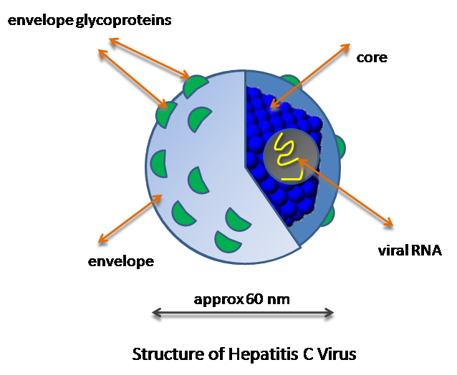
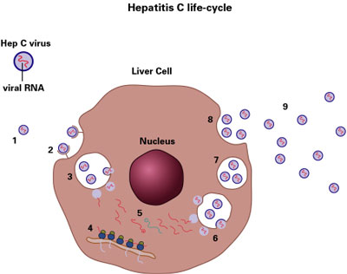
Chronic Hepatitis C Virus (HCV) infection is a global health problem, with more than 185 million people infected worldwide.
HCV is a member of the Flaviviridae family of RNA viruses.
(Messina et al., 2015)

Slide 4
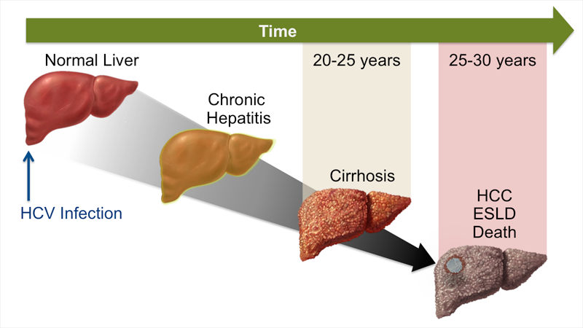
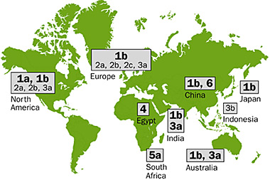
The infection is a common cause of:
Chronic progressive liver disease (e.g., cirrhosis)
Hepatocellular carcinoma
Seven HCV genotypes (genotype 1-7) and 67 subtypes have been identified; their prevalence rates differ by geographical region.
(Vukovic et al., 2015)

Slide 5
Global Distribution of HCV

Slide 6
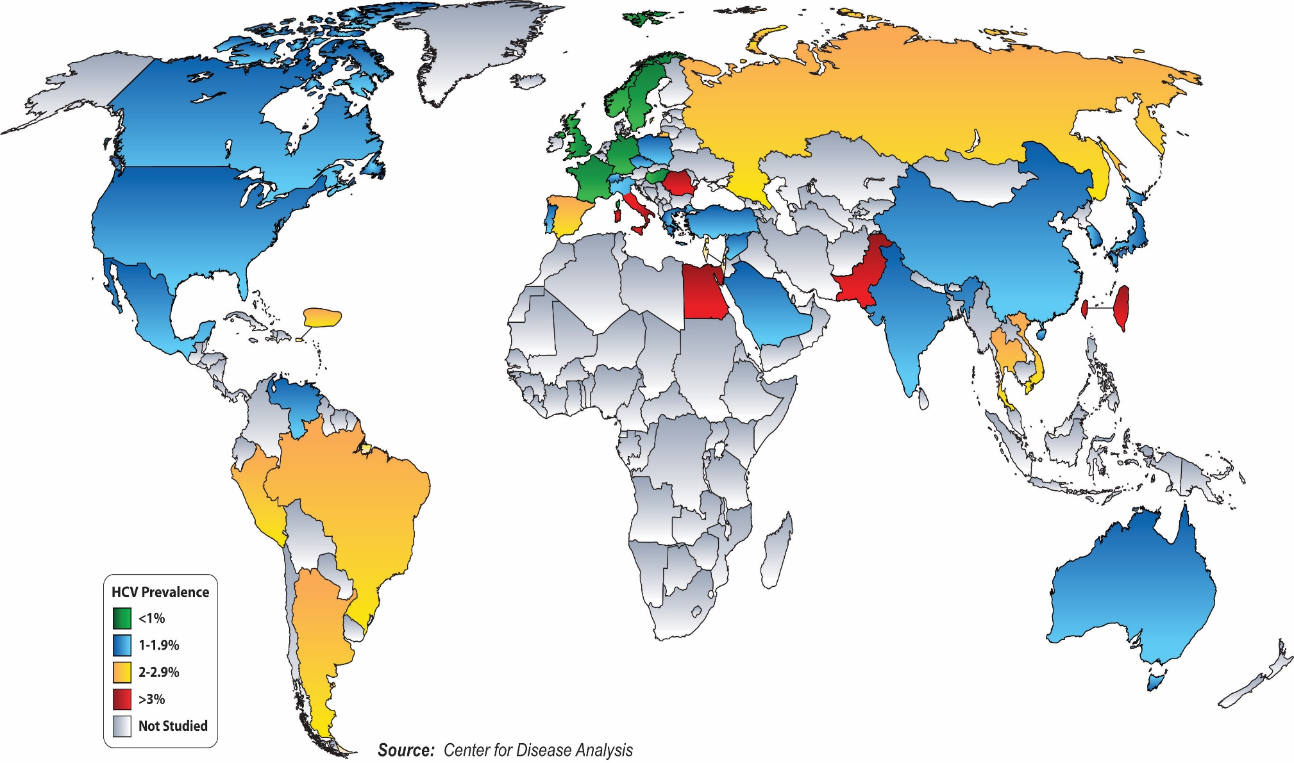

Slide 7
Treatment of HCV

Slide 8
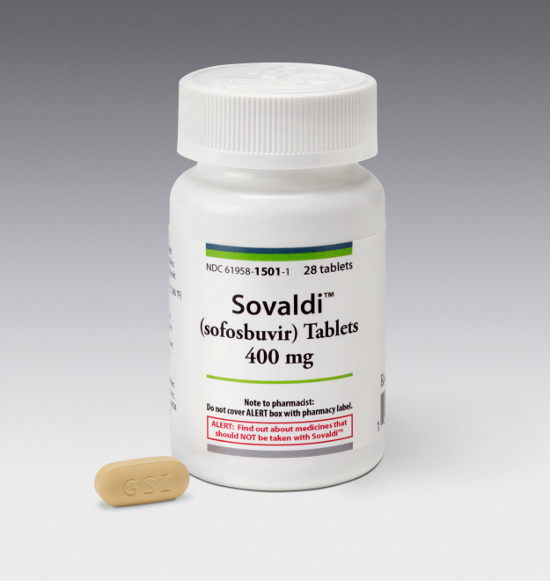
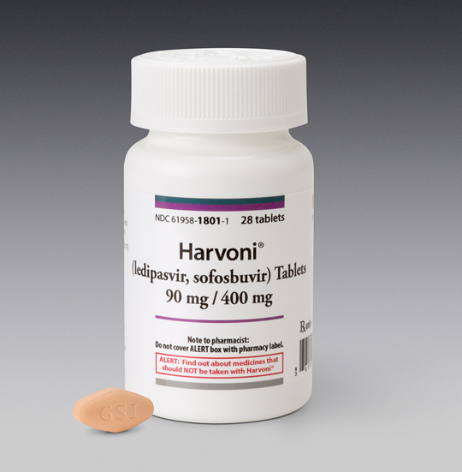
Pegylated interferon (PIFN)
Ribavirin
Direct-acting antivirals:
NS3/4A protease inhibitors (telaprevir, boceprevir, simeprevir)
HCV NS5A inhibitors (daclatasvir, ledipasvir)
HCV NS5B polymerase inhibitors (sofosbuvir)
Host-targeting antivirals
Cyclophilin inhibitors (alisporivir)
MicroRNA-122 antagonists (miravirsen)
(Feeney and Chung, 2014)

Slide 9
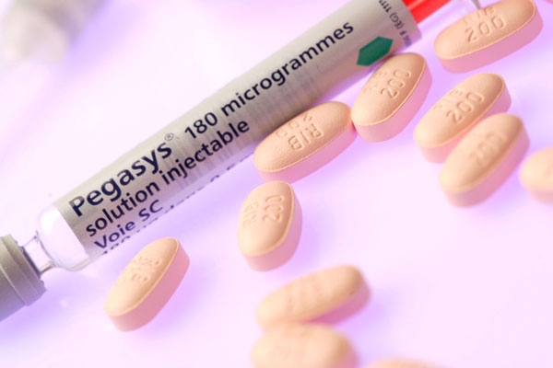
Combination PIFN alpha-2a or alpha-2b and Ribavirin (PIFN/RBV) for 24-48 weeks has been widely used.
Sustained Virology Response (SVR) rates of 43% to 70%.
(Bhatti and Berenson, 2007)

Slide 10
Side effects of PIFN
Hematological (anemia, neutropenia, leucopenia & thrombocytopenia)
Flu like syndrome (Fever, chills, myalgia, headache & weakness)
Depression
Fatigue
Thyroid dysfunction
(Bhatti and Berenson, 2007)

Slide 11
Side effects of RBV
Teratogenicity
Hemolytic anemia
A trade-off between continuing the treatment with optimal dosage versus decreasing dosage to relieve severe anemia
(Alvarez et al., 2006)

Slide 12
Health Related Quality of Life

Slide 13
Health Related Quality of Life
HRQOL
HCV
RBV-induced hemolytic anemia
Adverse effects of IFN
Adherence to antiviral regimen

Slide 14
Vitamin B & Folic Acid

Slide 15
Vitamin B & Folic Acid
HCV + PIFN/RBV Vitamin B_{1, 6, 12} & Folic Acid
Anemia & Depression
Decrease response to antidepressant or even relapse during treatment
(Lin and Yin, 2009)

Slide 16
Role of Vitamin B₁₂ & Folic acid
Vitamin B₁₂ and folic acid are used in a number of important biochemical processes such as:
biosynthesis of amino acids as glycine and methionine
DNA synthesis and repair
B vitamins have antioxidant effect which protect the erythrocyte membrane from RBV induced anemia and promote erythropoiesis.

Slide 17
Vitamin B₁₂ & Folic acid Deficiency
Affect important methylation reactions
Slows down cell division
Rapidly dividing cells as RBC are most severely affected, a serious anemia (megaloblastic) can result. Replacement of the B vitamins corrects hematological abnormalities.
(Eren et al., 2014)

Slide 18
Aim of the work

Slide 19
This study was conducted to:
Monitor efficacy and safety of Folic acid and/or vitamin B complex as a prophylactic treatment to prevent hematological adverse effect during treatment with PIFN/RBV in HCV-infected patients.
Investigate the beneficial effect of Folic acid and/or vitamin B complex supplementation on health related quality of life by conducting a randomized clinical trial.

Slide 20
Materials & Methods

Slide 21
Patients
The study population consisted of treatment-naive patients with chronic hepatitis C (HCV) who were enrolled into a randomized, prospective, single blind, placebo controlled trial conducted at Hepatology and Gastroenterology Units at Ain Shams University Hospitals in the period from September 2012 to
March 2014.

Slide 22
Participating patients were given informed written consent and received a copy of their rights at enrollment and before any study-related procedure.
The study was approved by the Institutional Ethics Committee (FMASU 1669).
All Patients were subjected to the following:
1. Full Medical History
2. General and local Examination
(Proper choosing of HCV patients according to inclusion and exclusion criteria)

Slide 23
Inclusion Criteria:
Elevated serum alanine aminotransferase at least two times above the upper limit of normal (ULN: 40 U/L) during the preceding 6 months.
Detectable anti-HCV antibody status assessed by a second-generation enzyme-linked immunosorbent assay (ELISA) (Roche Diagnostics, NJ, USA).
Detectable HCV RNA by a polymerase chain reaction (PCR) (Cobas Amplicor HCV monitor, Roche Diagnostics).
Infected with HCV-4 [Versant HCV genotype assay (LiPA 2.0; Innogenetics, Eschborn, Germany).

Slide 24
Exclusion Criteria:
Previously treated with IFN-α-based regimen or showed evidence of other liver diseases
Leucocyte count <3000/mm³, neutropenia (<1500 cells/mm³), hemoglobin level <12 g/dl for women and <13 g/dl for men, thrombocytopenia (<90 000 cells/mm³), creatinine concentration 1.5 times above ULN
Organ transplantation, malignant conditions, severe cardiac or pulmonary disease, unstable thyroid dysfunction, severe depression or psychiatric disorder, active substance abuse

Slide 25
Pregnant or Lactation
Hypersensitivity to the drugs tested or therapy with immunomodulatory agents within the last 6 months.
Unreliable, non-compliant patients to therapy or unwilling to apply birth control during therapy.

Slide 26
Methods

Slide 27
Investigations
Blood Picture
Liver function tests (liver enzymes, total bilirubin, prothrombin time)
Kidney function test (creatinine)
Thyroid function test (TSH)
HCV RNA level (PCR)

Slide 28
Health Related Quality Of Life
Health Related Quality Of Life (HRQOL) were assessed by: The Arabic version of the short form-36 health survey version 2 questionnaire.
Physical Component Summary: Physical functioning, role physical, body pain, general health
Mental Component Summary: Vitality, social functioning, role emotional, mental health.

Slide 29
Safety Assessment
Patient report about any adverse events
Clinical and laboratory test results

Slide 30
Study Design

Slide 31
Patients
160 HCV patients divided into 4 groups 40 patients in each group
All the 4 groups received Pegylated-interferon α-2a (Pegasys®, Hoffmann-LaRoche) 180 µg/week & Ribavirin (Ribavirin®, Schering-Plough Corporation) (PIFN/RBV).
Ribavirin dose ranged between 1000 and 1200 mg/day according to body weight (<75 kg, 1000 mg/day ; >75 kg, 1200 mg/day)
Duration of treatment: 48 weeks

Slide 32
Group B: vitamin B complex (Neurobion®, Glaxosmithkline, Egypt)
One tablet x 3/day
Each tablet contains:
Vitamin B₁ 100 mg
Vitamin B₆ 200 mg
Vitamin B₁₂ 200 µg
Group F: folic acid (Folic acid®, NileCo, Egypt)
5 mg x 2/day
Group BF: Vitamin B complex and Folic acid
Group C: A matching placebo tablet and capsule

Slide 33
Blood picture, liver and kidney function tests of patients were followed up:
Before starting treatment (Baseline)
Weekly for the first month
Once/month during 48 weeks of treatment
Treatment was stopped after 48 weeks
Patients were continued to be followed up at week 60 and week 72
Except PT and TSH were followed up less frequently

Slide 34
HCV RNA level (PCR) of patients were followed up:
Before starting treatment
After 4 weeks of treatment
After 12 weeks of treatment Treatment
After 24 weeks of treatment
After 48 weeks of treatment
After 60 weeks of treatment initiation
After 72 weeks of treatment initiation

Slide 35
Measurements & Outcomes

Slide 36
1^{ry} Efficacy Endpoint:
To maintain
Neutrophil count levels >750 cells/mm³,
Hemoglobin levels >10.5 g/dL,
Platelet count above 45,000 platelet/mm³
To prevent adjustment of the PIFN/RBV dose or its temporary suspension

Slide 37
2^{ry} Efficacy Endpoint
To achieve sustained virological response (SVR) deﬁned as undetectable serum HCV RNA (<615 IU/ml) 24 weeks after the completion of treatment. Other on treatment viral kinetics including:
Rapid virological response (RVR) (4 weeks)
Complete early virological response (cEVR) (12 weeks)
Partial EVR (pEVR) (12 weeks)
End-of-treatment response (ETR) (48 weeks)

Slide 38
Results & Interpretation

Slide 39
160 patients with HCV randomly assigned
(138 males & 22 females)
Consented to enroll in the study
17 patients were excluded during treatment
(12 males & 5 females)
Data of only 143 patients who had completed
48 weeks of treatment were analyzed
Retinopathy (N= 1)
Insufficient therapeutic response at WK12 (N=7)
Received epoetin during antiviral therapy (N=9)

Slide 40
Specific Side effects

Slide 41
Frequency of adverse events for PIFN/RBV in addition to Folic acid and/or vitamin B complex
Adverse Events | Week | Group C (N= 35) | Group B (N= 37) | Group F (N= 35) | Group BF (N= 36) | P-value
Flu-like symptoms | Week 1 | 34/35 (97%) | 35/37 (95%) | 34/35 (97%) | 34/36 (94%) | 0.8900
 | Week 4 | 6/35 (17%) | 5/37 (14%) | 4/35 (11%) | 5/36 (14%) | 0.9217
P-value |  | < 0.0001 | < 0.0001 | < 0.0001 | < 0.0001
Neuropsychiatric symptoms | Week 4 | 30/35 (86%) | 28/37 (75%) | 23/35 (66%) | 19/36ª (53%) | 0.0181
 | Week 24 | 29/35 (83%) | 25/37 (68%) | 19/35ª (54%) | 16/36ª (44%) | 0.0057
P-value |  | 1.0 | 0.6067 | 0.4646 | 0.6376
ª significantly different (P< 0.05) compared to control group during the treatment period.

Slide 42
Adverse Events | Week | Group C (N= 35) | Group B (N= 37) | Group F (N= 35) | Group BF (N= 36) | P-value
Ophthalmologic | Week 12 | 1/35 (3%) | 0/37 (0%) | 0/35 (0%) | 0/36 (0%) | 0.3754
Fatigue | Week 4 | 35/35 (100%) | 32/37 (87%) | 30/35 (86%) | 28/36ª (78%) | 0.0421
 | Week 48 | 33/35 (94%) | 29/37^{b} (78%) | 25/35ª (71%) | 19/36ª (53%) | 0.0009
P-value |  | 0.4928 | 0.5426 | 0.2436 | 0.0466
ª significantly different (P< 0.05) compared to control group during the treatment period.
^{b} significantly different (P< 0.05) compared to folic acid plus vitamin B complex group during the treatment period.

Slide 43
Hematological Adverse Events

Slide 44
Blood Picture

Slide 45
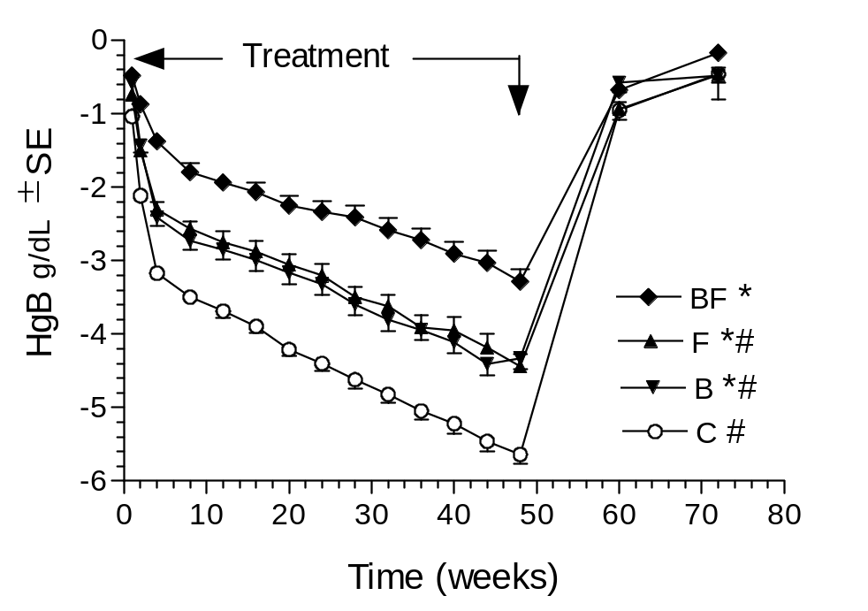
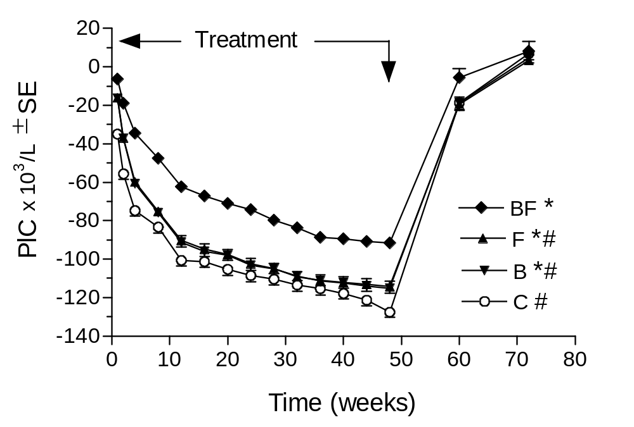
Change in hematological markers throughout the study period
The number of patients in group F and C= 35 while group BF= 36 and group B= 37.
* significantly different (P<0.05) compared to control group during the whole treatment period
# significantly different (P<0.05) compared to BF group during the whole treatment period

Slide 46
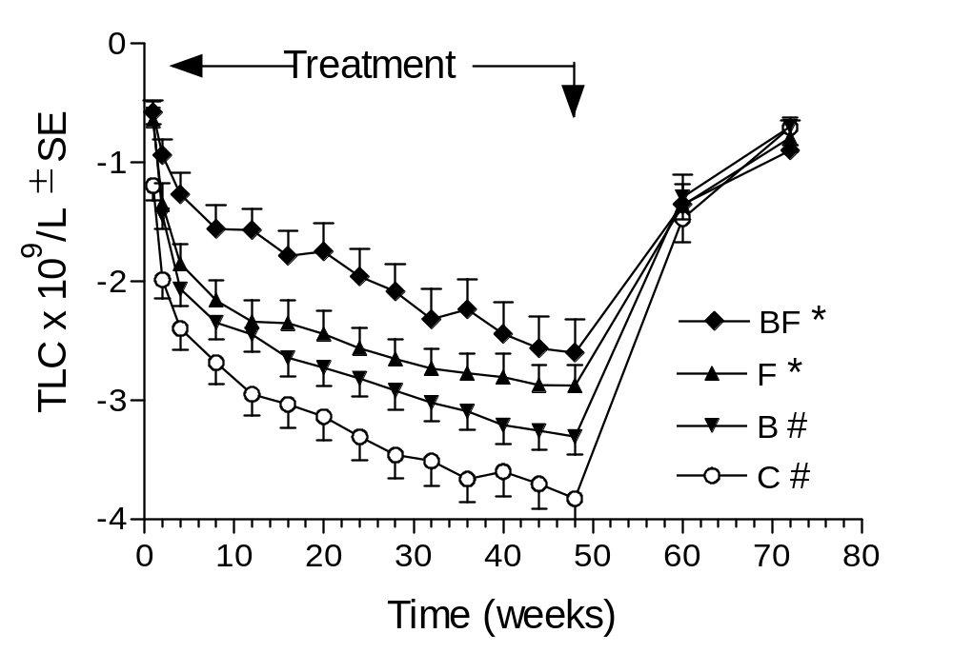
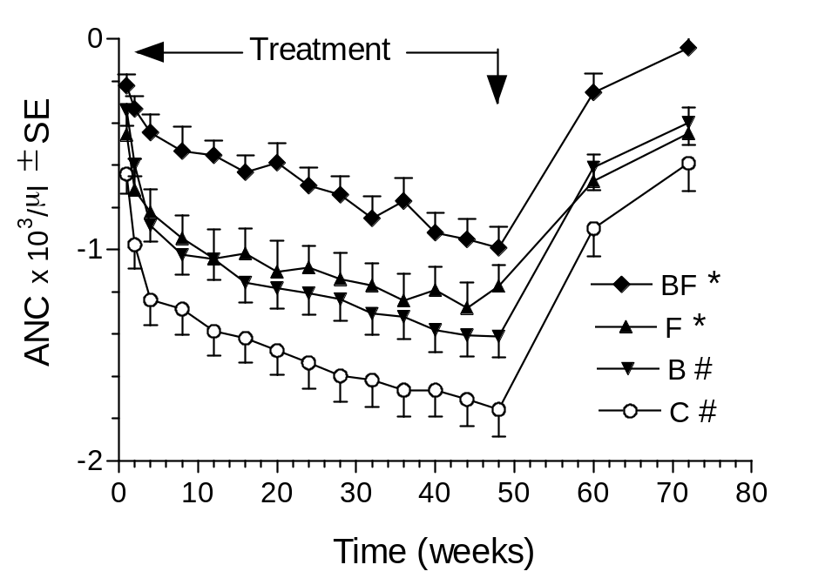
The number of patients in group F and C= 35 while group BF= 36 and group B= 37.
* significantly different (P<0.05) compared to control group during the whole treatment period
# significantly different (P<0.05) compared to BF group during the whole treatment period

Slide 47
Liver Function Test

Slide 48
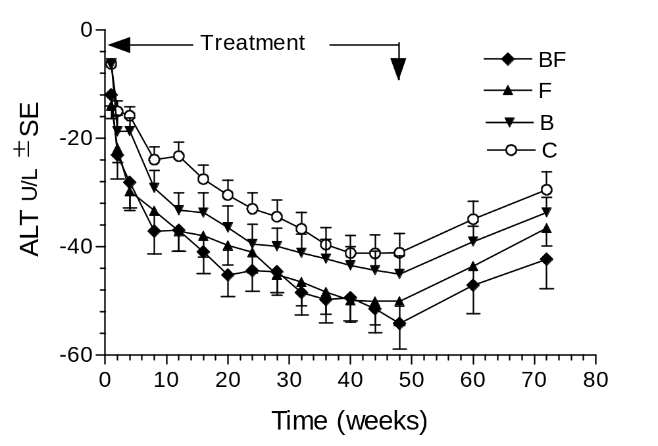
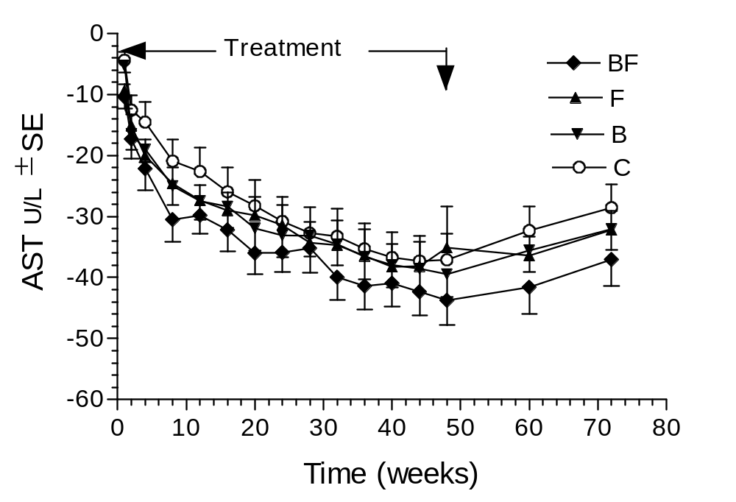
Change in ALT & AST throughout the study period
The number of patients in group F and C= 35 while group BF= 36 and group B= 37.

Slide 49
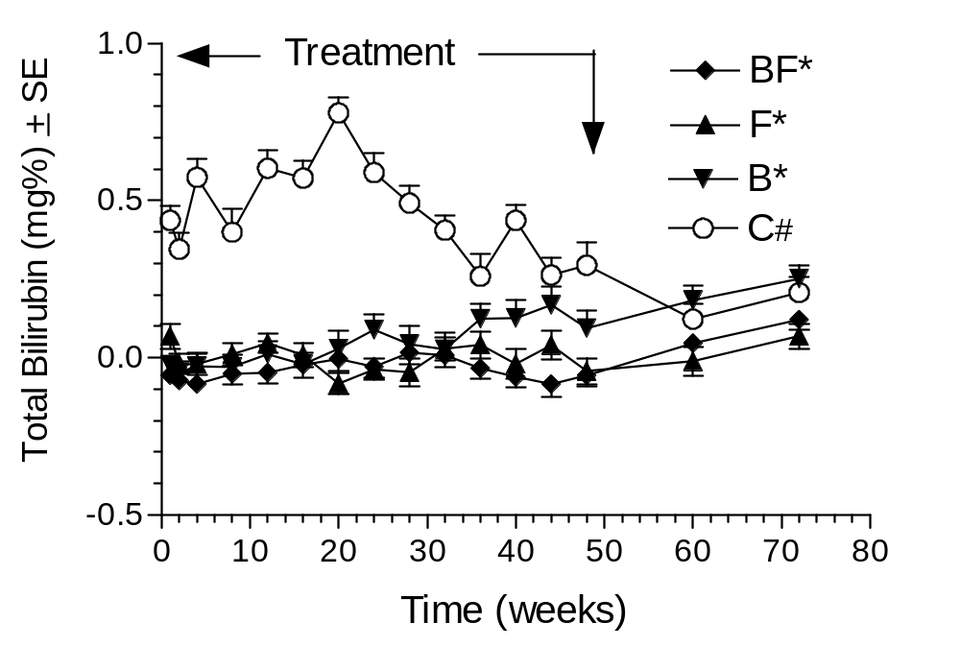
Change in total bilirubin level throughout the study period
The number of patients in group F and C= 35 while group BF= 36 and group B= 37.
* significantly different (P<0.05) compared to control group during the whole treatment period
# significantly different (P<0.05) compared to BF group during the whole treatment period

Slide 50
Prothrombin time before and during 48 weeks of treatment
in the investigated four groups
Groups |  | Group C (N= 35) | Group B (N= 37) | Group F (N= 35) | Group BF (N= 36)
Weeks |  | Mean ± SD | Mean ± SD | Mean ± SD | Mean ± SD
Treatment | Baseline | 12.1 ± 0.5 | 12.1 ± 0.6 | 12.0 ± 0.4 | 12.1 ± 0.4
 | Week 12 | 12.1 ± 0.3 | 12.0 ± 0.6 | 11.9 ± 0.3 | 11.9 ± 0.2
 | Week 24 | 12.0 ± 0.4 | 11.8 ± 0.4 | 12.2 ± 0.5 | 12.1 ± 0.4
 | Week 48 | 12.0 ± 0.2 | 12.0 ± 0.0 | 11.9 ± 0.5 | 12.0 ± 0.1

Slide 51
Kidney function test

Slide 52
Serum creatinine before and during 48 weeks of treatment in the investigated four groups as well as post-treatment
Groups |  | Group C (N = 35) | Group B (N = 37) | Group F (N = 35) | Group BF (N = 36)
Weeks |  | Mean ± SD | Mean ± SD | Mean ± SD | Mean ± SD
Treatment | Baseline | 1.1 ± 0.2 | 1.1 ± 0.2 | 1.1 ± 0.2 | 1.0 ± 0.2
 | Week 12 | 1.0 ± 0.2 | 1.0 ± 0.2 | 0.9 ± 0.1 | 1.0 ± 0.2
 | Week 24 | 1.0 ± 0.2 | 1.0 ± 0.2 | 0.9 ± 0.2 | 0.9 ± 0.1
 | Week 48 | 0.9 ± 0.2 | 0.9 ± 0.2 | 1.0 ± 0.2 | 1.0 ± 0.2
Post-treatment | Week 72 | 1.0 ± 0.2 | 1.0 ± 0.1 | 1.1 ± 0.1 | 1.0 ± 0.2

Slide 53
Thyroid function test

Slide 54
Thyroid stimulating hormone before and during 48 weeks of treatment in the investigated four groups
Groups |  | Group C (N = 35) | Group F (N = 35) | Group B (N = 37) | Group BF (N = 36)
Weeks |  | Mean ± SD | Mean ± SD | Mean ± SD | Mean ± SD
Treatment | Baseline | 2.2 ± 1.3 | 2.6 ± 1.6 | 2.0 ± 1.1 | 2.5 ± 2.0
 | Week 12 | 2.4 ± 1.2 | 2.6 ± 1.3 | 2.1 ± 1.1 | 2.3 ± 1.2
 | Week 24 | 2.7 ± 1.2 | 2.6 ± 1.2 | 2.3 ± 1.2 | 2.4 ± 1.4
 | Week 48 | 3.3 ± 1.4 | 2.5 ± 1.5 | 2.8 ± 1.4 | 2.7 ± 1.5

Slide 55
Virological response rate

Slide 56
Viral kinetics in the investigated four treatment groups
Outcome | Group C (N= 35) | Group B (N= 37) | Group F (N= 35) | Group BF (N= 36) | P value
SVR | 25 (65.7%) | 27 (73%) | 28 (80%) | 31 (86.1%) | 0.4168
RVR | 0 (0%) | 0 (0%) | 0 (0%) | 0 (0%) | 1
cEVR | 7 (20%) | 8 (21.6%) | 6 (17.1%) | 7 (19.4%) | 0.9719
pEVR | 25 (71.4%) | 28 (75.7%) | 23 (65.7%) | 29 (82.9%) | 0.5375
ETR | 25 (71.4%) | 30 (81.1%) | 33 (94.3%) | 33 (91.7%) | 0.0304*
Non responders | 0 (0%) | 0 (0%) | 0 (%) | 0 (0%) | 1
Relapse | 2 (5.7%) | 3 (8.6%) | 3 (8.6%) | 2 (5.7%) | 0.9388

Slide 57
Health Related Quality of Life

Slide 58
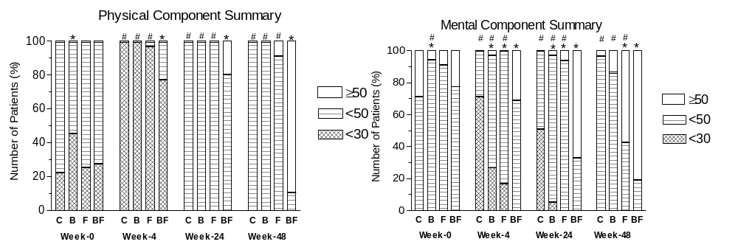
Distribution of the four treatment groups according to their physical component summary and mental component summary for 48 weeks
* P<0.05 compared with group C
# P<0.05 compared with group BF
The number of patients in groups F and C= 35 while group B= 37 and group BF= 36.
Patients with mean score <30 were considered severely affected, from 30-<50 were considered moderately affected and ≥50 were considered with average physical health.

Slide 59
Conclusion
Supplementation of vitamin B complex and folic acid with no serious side effects can reduce hematological adverse effects of PIFN/RBV therapy, but has no effect on SVR in chronic hepatitis C patients.
Abatement of side effects may improve patients’ HRQOL and their adherence to combination antiviral therapy.

Slide 60
Thank You

