Slide 1
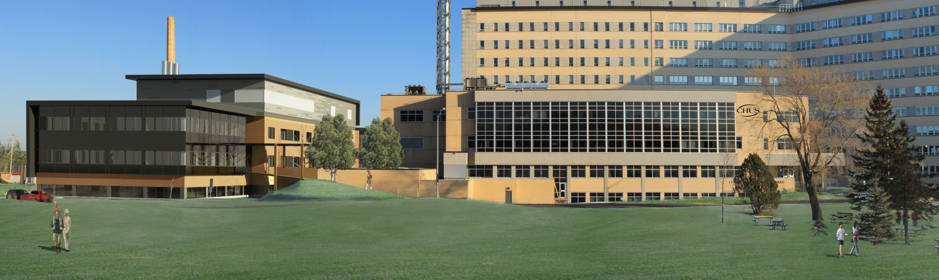
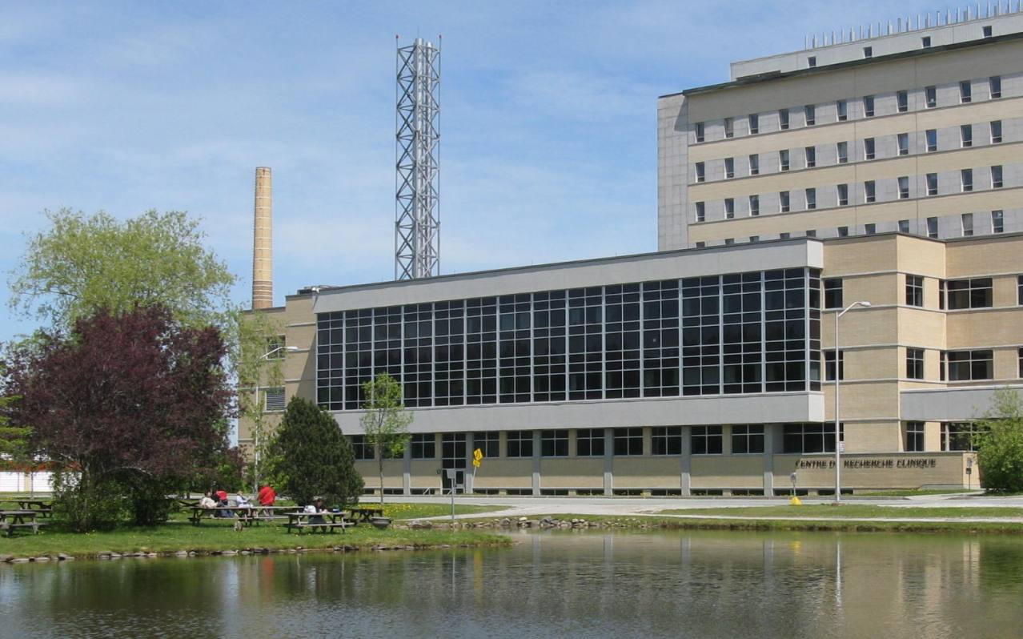
Biological evaluation of ⁶⁴Cu-radiolabeled gastrin-releasing peptide receptors antagonist conjugated to DOTHA₂ a new bifunctional chelator bearing hydroxamic acid arms
Nematallah Mansour
Department of Nuclear Medicine and Radiobiology, FMSS,
Université de Sherbrooke; CIMS, CRCHUS, Sherbrooke
Supervisors: Prof. Brigitte Guérin and Prof. Roger Lecomte
24th June 2015

Slide 2
Contents
Introduction
Hypothesis of the Project
Compound Structure
Experimental Methods
Results
Conclusions

Slide 3
Introduction
Prostate cancer statistics in 2013 (Canada)
Cancer is the leading cause of death in Canada.
Prostate cancer is the 3rd cause of « cancer » death in men.
On average (daily):
  65 Canadian will be diagnosed.
  11 Canadian men will die.
187,600
Cancer cases
25 %
(Prostate Cancer)
- Advisory Committee on Cancer Statistics (2013). Canadian Cancer Statistics 2013. Toronto, ON, Canadian Cancer Society
Notes:
Mortality of prostate cancer

Slide 4


Introduction
Expression of Peptide Receptors
Androgen Receptor
Epidermal Growth Factor
Gastrin Releasing Peptide Receptor
Somatostatin
Cancer Cell
Targets for peptide-based radiopharmaceuticals
- Wenbin et al. Molecular Imaging. ISBN: 978-953-51-0359-2.
- Roesler R, et al. Neuropsychol. 2007;1(2):118-123
Notes:
Highly expressed on prostate cancer cells

Slide 5
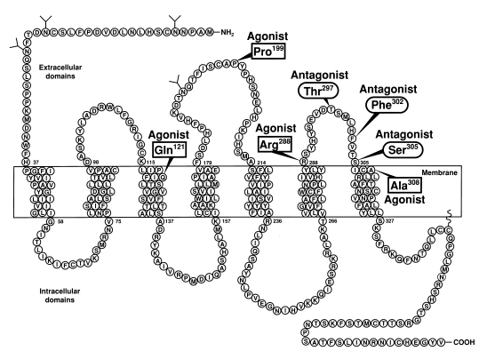
Introduction
Gastrin Releasing Peptide Receptor (GRPR)
They are members of the G-protein coupled receptor superfamily (GPCR). They have 7 transmembrane domains.
GRPR is expressed
on pancreas.
Expression on tumor:
  Prostate (63 – 100%) [Marrone B, et al. The Prostate. 2012; 72:318 -325]
  Bone metastases (50%) [Ananias H, et al. The Prostate. 2009; 69:1101 -1108]
  Lungs, Breast, …
Heppeler A, et al. Current Meicinal Chemistry. 2000;7:971-994
Moody T, et al. Drugs Fut. 1998;23(12):1305

Slide 6
Bombesin peptide (Clinical trial)
Scopinaro et al and De Vincentis et al have shown the usefulness of (^{99m}Tc)- [¹³leu]bombesin in several cancer patients.
  (SPECT imaging, monoenergetic, low resolution)
Hoffman et al used positron emission tomography with 68-Gallium (⁶⁸Ga) -BN to diagnose 13 prostate cancers.
  (PET imaging, high resolution, whole body imaging, progress of the malignancy).
Scopinaro F, Varvarigou AD, Ussof W, et al. Cancer Biother Radiopharm. 17:327-335, 2002.
Hofmann M, Machtens S, Stief C, et al: Eur J Nucl Med Mol Imaging 31:S253, 2004 (abstr 207; suppl 2)

Slide 7
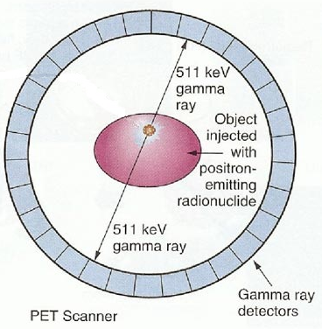
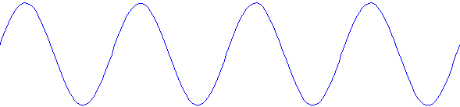
Positron Emission Tomography (PET)
511 keV gamma ray
Positron
Annihilation
Radionuclide Cu-64
Electron
511 keV gamma ray
- RBL 741 Radiation Science, 2014 Bentourkia; Guérin, Lecomte.
- http://www.cellsighttech.com/technology/pet.html

Slide 8
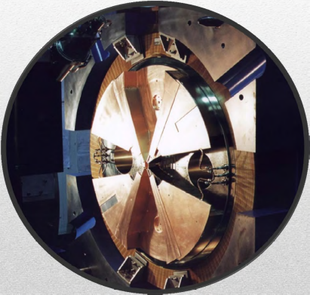
Radionuclide Production (⁶⁴Cu)
Radionuclide: ⁶⁴Cu, Half-life = 12.7 hr, β⁺ = 18% 0.65 MeV, β⁻ = 38.4% 0.573 MeV and Electron Capture = 43%
Production ⁶⁴Ni + p ⁶⁴Cu + n
Cyclotron TR-19 and TR24 (ACSI)
- RBL 741 Radiation Science, 2014 Bentourkia; Guérin, Lecomte.
- Carolyn J, et al.. Cancer Biotherapy and Radiopharmaceuticals. 2009; 24(4), 331-345.

Slide 9
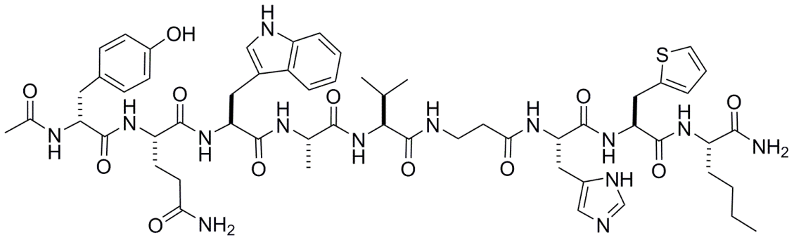

GRPR, tracers for PET imaging
Chelator for metal radiolabelling
Standard peptides
Demobesin 4 : GRPR agonist
  B.A. Nock et al. J. Med. Chem., 48 (2005), pp. 100–110.
Radiometal
Linker
n
Demobesin 1: GRPR antagonist
Wang, LH et al. J Biol Chem 1990; 265:15695–15703
Valence
Guérin B et al. Organic letters, 2010, 12(2)
Ait-Mohand S etal. Bioconjugate chemistry, 2011, 22(8)
Fournier et al. EJNMMI Research 2012, 2:8
Fournier P etal. Bioconjugate chemistry,, 2012 23(8)
Inkster JA et al. Chemistry, 2012, 18(35)
Inkster J et al, Bioorganic & medicinal chemistry letters, 2013, 23(13)
Notes:
Using Demobesin 4 a GRPR agonist as standard peptide, we studied the effect of the radiometal, chelator, linker and valence on the physicochemical, biological and pharmacokinetic properties of the peptides. We also performed a comparative study between GRPR agonist and antagonist
One change at a time to do a fair comparison

Slide 10
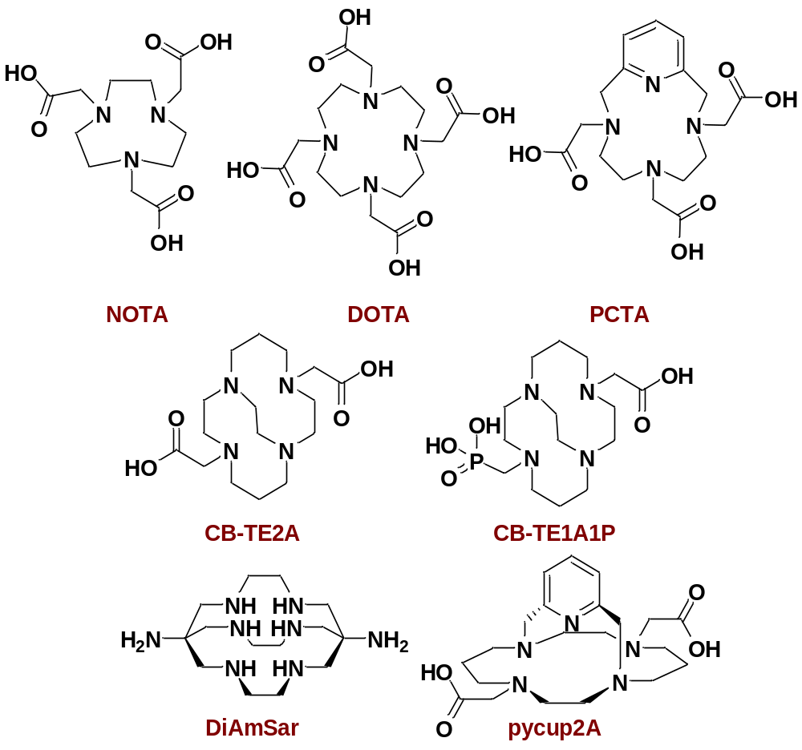
Structures of various BFCs used for ⁶⁴Cu labelling
Notes:
So, our group is interested in bifunctionnal chelators for copper, galium and other radiometals. Of copper’s 5 radioisotopes, copper 64 is the most used in radiopharmaceutical research due to its wide availability. It has a 12.7 hours half-life and emits beta minus, electron capture and low energy positrons, wich is ideal for PET Imaging. Copper is usually carried in the body by means of a bifunctionnal chelator that is also coupled to a bioactive molecule such as a peptide, an antibody or a protein that acts as a transporter. Here are a few of them that have been studied. Most of them bear carboxylic acid pendant arms and form stable copper complexes. However, there always is an interest in developing more BFCs, in order to better modulate the transporter’s kinetics.

Slide 11
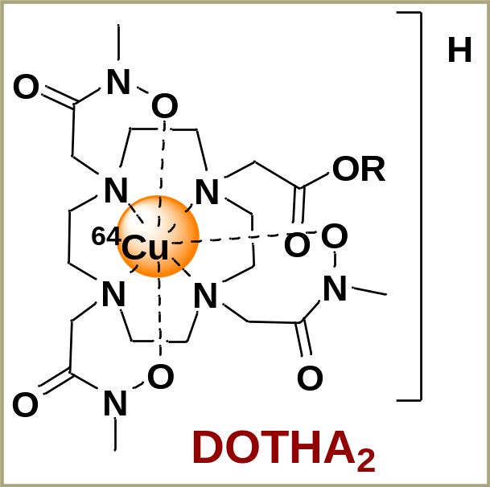
Bifunctional Chelator (BFC) ideal Characteristics
Small size.
Simple chemical preparation
Fast ⁶⁴Cu chelation
Slow ⁶⁴Cu demetallation
Resistance to transchelation
Available conjugation
to a bioactive molecule.
- S. Ait-Mohand, et al. Organic Letters. 2014; 16, 4512-4515
Notes:
To take advantage of the macrocyclic effect, we developed nucleophilic N-methyl-hydroxamate-derived from cyclen macrocycles, named DOTHA₂. Our hypotheses was that these nucleophilic pendant arms would form complexes faster and be more stable. It is the first time such a functional group is studied for the copper 64 labeling of peptide-based biomolecules. So, our two bifunctionnal chelators were synthesized in solution, starting off with their pendant arms in 4 straight forward steps

Slide 12
⁶⁴Cu Radiolabelling Efficiency at room Temperature and pH 5.5
BFC in ammonium acetate buffer
DOTHA₂/NOTHA₂ with different ⁶⁴Cu counterions
Complete complexation in 5 minutes at room temperature.
pH (4.5 – 10 )
Incorporation rate (%)
Incorporation rate (%)
Time (min)
Time (min)
- S. Ait-Mohand, et al. Organic Letters. 2014; 16, 4512-4515
Notes:
As you can see in this comparative study, these complete complexations in five minutes at room temperature are superior to those of the DOTA and NOTA carboxylic acid reference compounds, which take an hour to achieve the same yields. The kinetics were the same using acetate and chloride counterions, which proves the versatility of our chelators. Moreover, we were able to achieve excellent specific activities. Then, the radiolabeling kinetics were challenged in different conditions

Slide 13
Stability under physiological conditions
Condition | Time (h) | ⁶⁴Cu/BFC stability (%)
 |  | NOTA | DOTHA₂ | NOTHA₂
Plasma | 24 | >99 | >99 | >99
In vivo | 4 | >99 | >99 | >99
No decomposition in physiological conditions
- S. Ait-Mohand, et al. Organic Letters. 2014; 16, 4512-4515
Notes:
The stabilities were assessed under physiological conditions, which shows the same full stability for our compounds than for NOTA. Once our chelators’ were proven to be very stable, we got interested in their in vivo behaviour.

Slide 14
Hypothesis of the Project
Radiolabelled peptide antagonist targeting GRPR overexpressed on prostate cancer cells can be used as tools to improve cancer diagnosis by PET (Positron Emission Tomography ) imaging.
The new class of chelator (DOTHA₂) would provide us with fast ⁶⁴Cu radiolabelling, high resistance for transmetalation and improve in vivo stability.

Slide 15
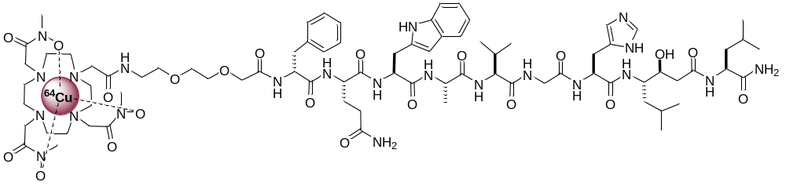
Compound Structure
PEG (linker)
Bombesin Antagonist
[D-Phe⁶-Sta¹³-Leu¹⁴-NH₂]BBN(6-14)
DOTHA2 (chelator)
⁶⁴Cu-DOTHA₂-PEG-Bombesin (Antagonist)
Linares M, et al. J Pept Res. 1999; 53(3):275-83
S. Ait-Mohand, et al. Organic Letters. 2014; 16, 4512-4515
Notes:
Our lab developed new class of chelator for fast labelling

Slide 16
Experimental Methods
In vitro studies
  Competition binding study (PC3 prostate cell line)
  Cellular uptake and Efflux studies (PC3 and LNCaP prostate cell lines)
  Plasma and in vivo stability studies (UPLC, Radio-TLC)
In vivo studies
  Biodistribution studies (normal and tumor bearing mice)
  µPET imaging (tumor bearing mice)

Slide 17
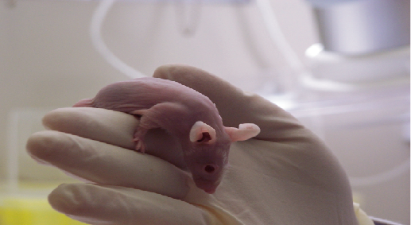
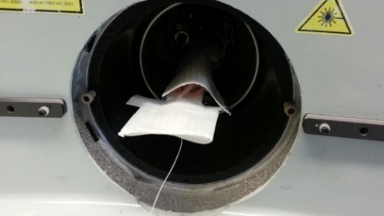
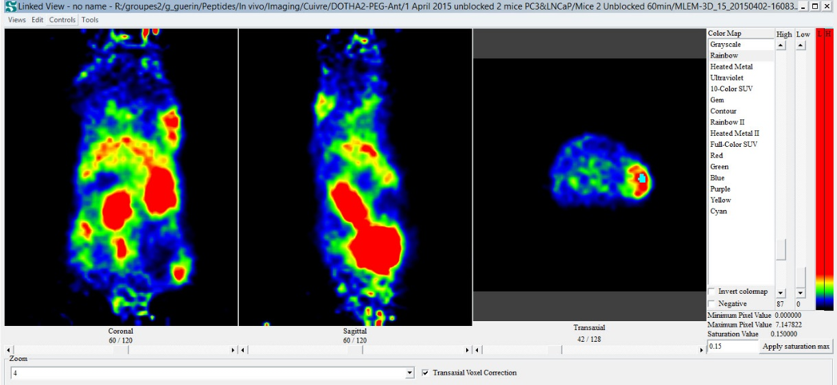
µPET imaging
- 2
0
2
4
Weeks
Cells
Preparation
PC3 & LNCaP
Biodistribution or
2nd PET dynamic scan
Cells inoculated on male athymic nude mice
1st PET dynamic scan
Quantification of the accumulation of the tracer in tumor, kidneys, liver and muscle
Data presented as the percentage of injected dose per gram (%ID/g).
- Fournier P, et al. Bioconjugate Chemistry. 2012; 23, 1687-1693

Slide 18
Results
Radiolabelling and in vitro studies
Efficient labelling >95% in 5 min.
Specific activity > 55 TBq/mmol.
Competition binding study [¹²⁵I]-[Tyr⁴]-BBN
  Ki for GRPR on PC3 (¹²⁵I-BBN): 0.15 nM
  Ki for GRPR on PC3 (Cu/DOTHA2-PEG-RM26): 0.68 ± 0.19 nM

Slide 19
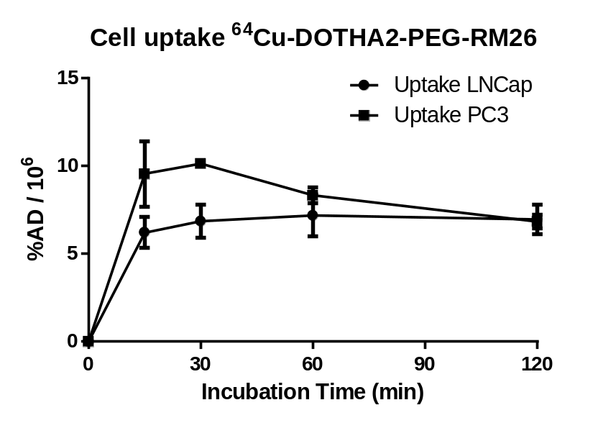
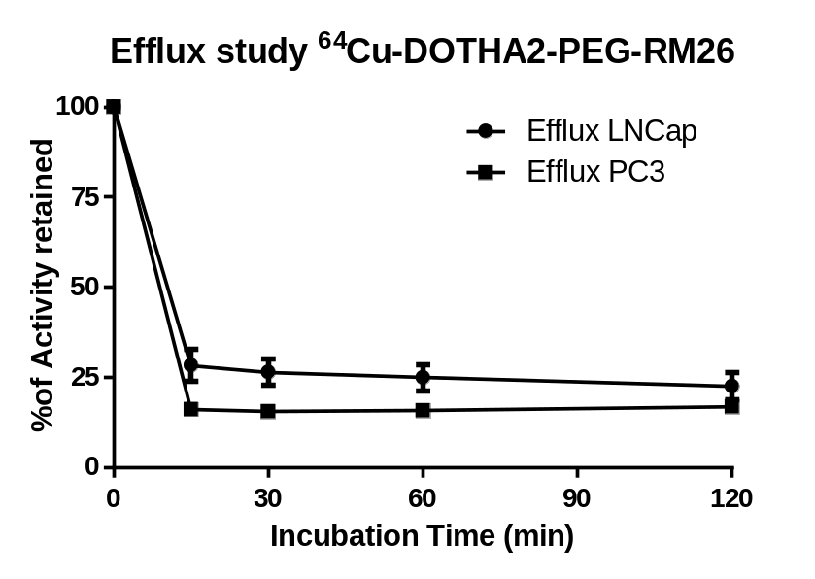
Results
Cellular uptake and efflux studies

Slide 20
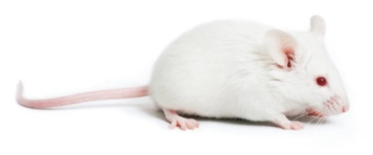
Results
Plasma and in vivo stability studies
Radiolabelled compound injected in fresh mouse plasma (Female balb/c) (Reversed phase-HPLC) to detect ⁶⁴Cu metabolites.
Compound stability in plasma > 95 %, 24 h.
Radiolabelled compound injected in female balb/c and blood collected at different time point (Radio-TLC) to presence of ⁶⁴Cu.
In vivo stability > 95%, 2h.

Slide 21
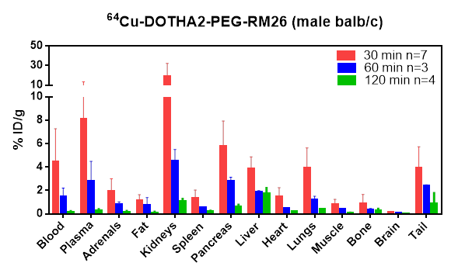
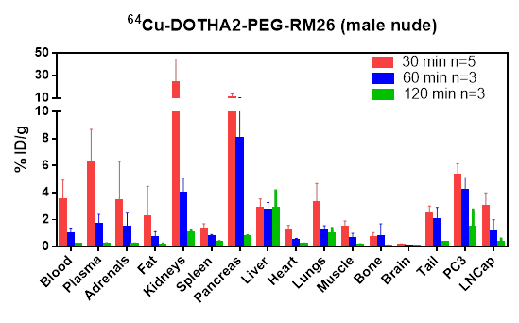
Results
Biodistribution studies

Slide 22
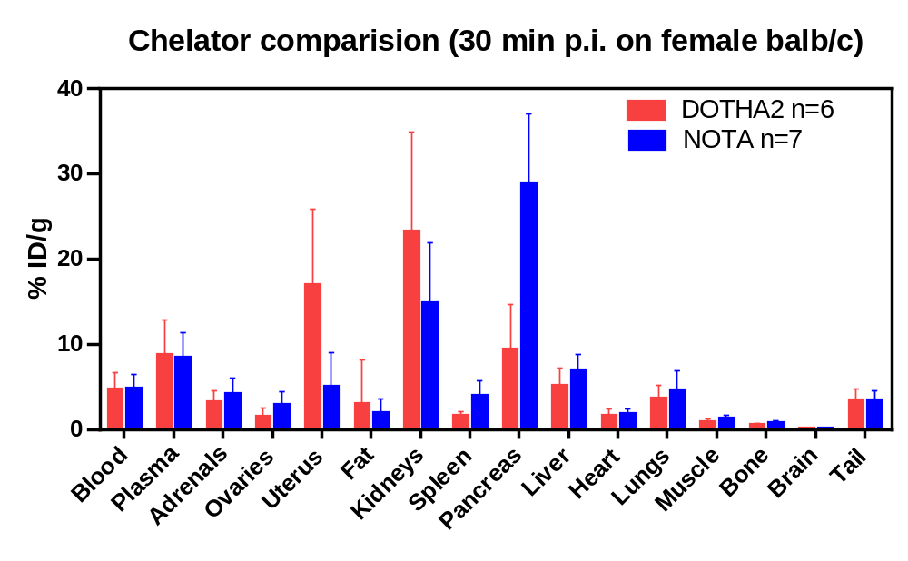

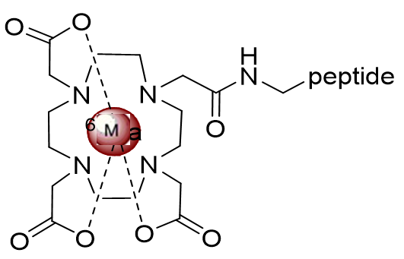
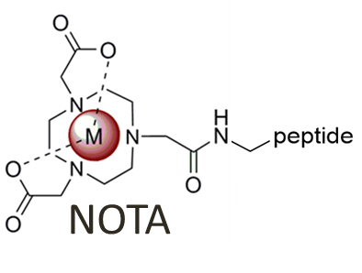
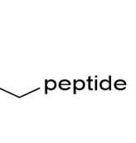

Results
Biodistribution studies
)
DOTHA2

Slide 23
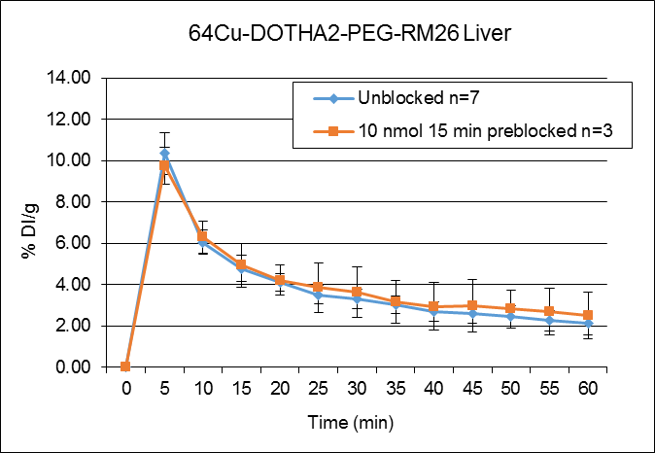
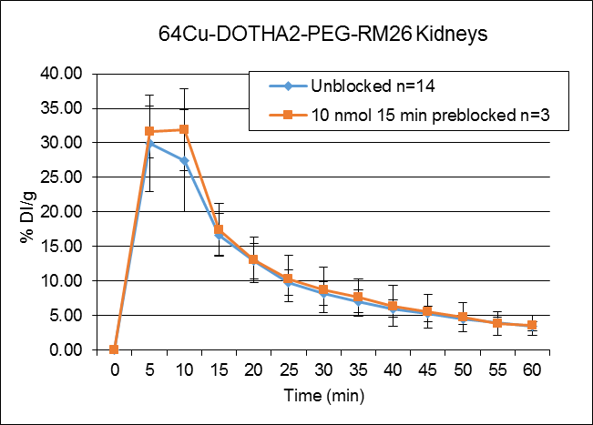
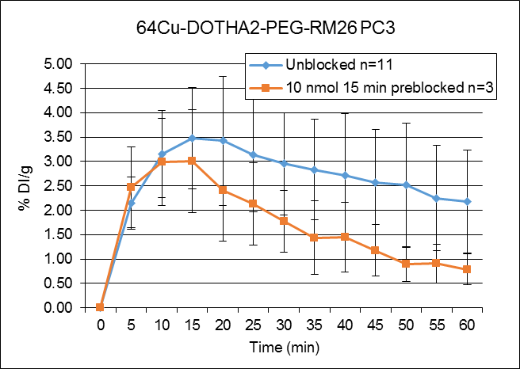
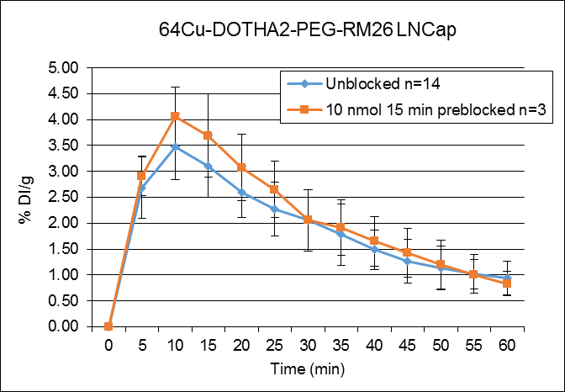
Results µPET imaging

Slide 24
Conclusions
The compound showed high specific activity and high in vitro and in vivo stability.
Biodistribution studies showed specific GRPR uptake (pancreas and tumor), excretions through the liver and mainly the kidneys and low non specific uptake.
μPET imaging studies on tumor bearing mice showed high retention on tumor up to 60 min time point, normal excretion through the liver and fast kidney elimination.

Slide 25







Acknowledgments
Supervisors
Prof. Brigitte Guérin
Prof. Roger Lecomte
Radiochemistry
Samia Aīt-Mohand
Biology
Michel Paquette
Frederic Couture
Véronique Dumulon-Perreault
PET Imaging
Jean-François Beaudoin
Maxime Paillé
Nematallah Mansour has financial support from
King Abdullah International Medical Research Center
Ministry of National Guard, Kingdom of Saudi Arabia
Ministry of Education, Kingdom of Saudi Arabia

Slide 26

Any Questions

Slide 27
Ideal radiotracers
Easy to synthesize.
High affinity for receptors targeting, rapid pharmacokinetics and long retention time.
High ability in detection primary tumors and metastases.
Low immunogenicity.
Rapid chelation process.
Obtain higher specific activity (low receptor density).
Resistance to demetallation (radiometal leaves the tracer) and High in vivo stability.
- http://www.chem.ucla.edu/harding/IGOC/A/amino_acid.html
- Otto C, et al. Seminar in Nuclear Medicine. 2000;30(3):195-208
- Fani M, et al Theranostics. 2012;2(5):481-501

Slide 28
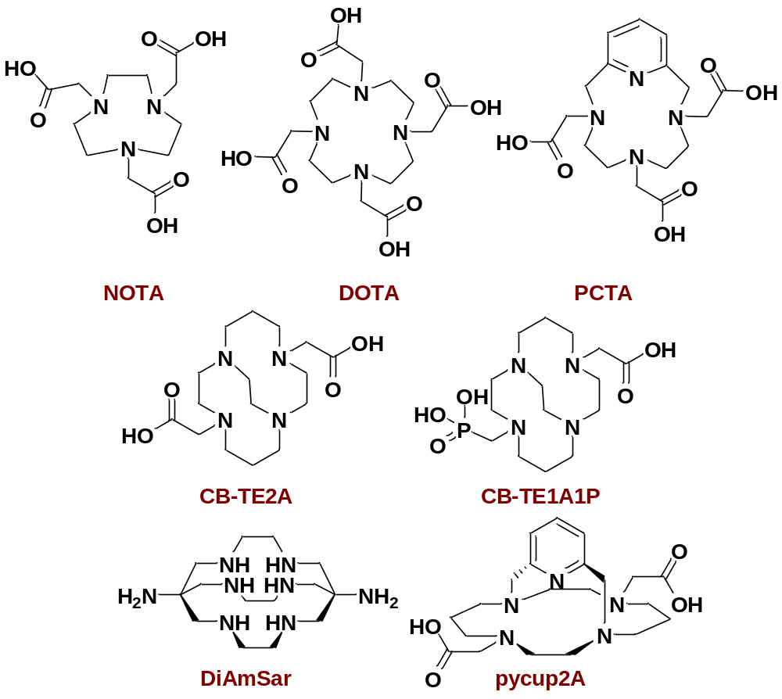
Structures of Various BFCs Used for ⁶⁴Cu Labeling
Bifunctional chelators (BFCs)
⁶⁴Cu T_{½}=12.7h
  39% β⁻
  43% Electron Capture
  17.4% β⁺
β⁺ maximal energy 0.656 MeV
Notes:
So, our group is interested in bifunctionnal chelators for copper, galium and other radiometals. Of copper’s 5 radioisotopes, copper 64 is the most used in radiopharmaceutical research due to its wide availability. It has a 12.7 hours half-life and emits beta minus, electron capture and low energy positrons, wich is ideal for PET Imaging. Copper is usually carried in the body by means of a bifunctionnal chelator that is also coupled to a bioactive molecule such as a peptide, an antibody or a protein that acts as a transporter. Here are a few of them that have been studied. Most of them bear carboxylic acid pendant arms and form stable copper complexes. However, there always is an interest in developing more BFCs, in order to better modulate the transporter’s kinetics.

Slide 29
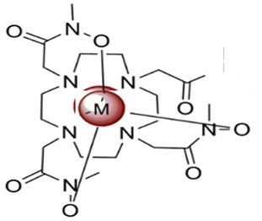
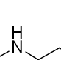
Radiolabelling with ⁶⁴Cu
Ammonium acetate
[⁶⁴Cu]CuCl₂ [⁶⁴Cu]Cu(OAc)₂)
0.1M, pH 5.5
5 min at pH 7 at room temperature.
S. Ait-Mohand, et al. Organic Letters. 2014; 16, 4512-4515

