Slide 1
About OMICS Group
OMICS Group is an amalgamation of Open Access Publications and worldwide international science conferences and events. Established in the year 2007 with the sole aim of making the information on Sciences and technology ‘Open Access’, OMICS Group publishes 500 online open access scholarly journals in all aspects of Science, Engineering, Management and Technology journals. OMICS Group has been instrumental in taking the knowledge on Science & technology to the doorsteps of ordinary men and women. Research Scholars, Students, Libraries, Educational Institutions, Research centers and the industry are main stakeholders that benefitted greatly from this knowledge dissemination. OMICS Group also organizes 500 International conferences annually across the globe, where knowledge transfer takes place through debates, round table discussions, poster presentations, workshops, symposia and exhibitions.

Slide 2
OMICS International Conferences
OMICS International is a pioneer and leading science event organizer, which publishes around 500 open access journals and conducts over 500 Medical, Clinical, Engineering, Life Sciences, Pharma scientific conferences all over the globe annually with the support of more than 1000 scientific associations and 30,000 editorial board members and 3.5 million followers to its credit.
OMICS Group has organized 500 conferences, workshops and national symposiums across the major cities including San Francisco, Las Vegas, San Antonio, Omaha, Orlando, Raleigh, Santa Clara, Chicago, Philadelphia, Baltimore, United Kingdom, Valencia, Dubai, Beijing, Hyderabad, Bengaluru and Mumbai.

Slide 3
Studying the Effect of 5-flurouracil Loaded on Polymer Nanoparticles and Exposed to Ultrasonic Waves in Improving the Tumoricidal Effect in Hepatocellular Carcinoma in Mice
Dr. Nelly M. Dabbour
Pharmacist, MSc. Applied Medical Chemistry
Medical Research Institute
Alexandria University, Egypt

Slide 4
Liver cancer is the fifth most common cancer in men and ninth most common in women, with hepatocellular carcinoma (HCC) accounting for >90% of primary liver cancer cases.
Hepatocellular carcinoma (HCC) is the second most common cause of cancer deaths worldwide (after lung cancer).
The greatest burden of HCC is in the developing world, with cases in eastern and southeastern Asia, and central and western Africa accounting for more than 80% of the total; 50% of all cases occur in China alone.

Slide 5
In Middle Eastern countries, liver cancer is a major concern. In Egypt, liver cancer is the fourth most common cancer and is the second cause of cancer mortality in both sexes.
Hospital-based studies have reported an overall increase in the relative frequency of all liver related cancers (>95% as HCC). The prevalence of HCC is high in the Nile Delta area.

Slide 6
Pathogenesis of HCC is a complex process, it is usually associated with liver damage, and subsequent development of cirrhosis, dysplastic lesions, and eventually invasive carcinoma. Tumors lesions are common in the liver.
Liver is sensitive to chemical carcinogens such as 4-Dimethylaminoazobenzene (DAB, known as butter yellow) which acts as initiator and Phenobarbital (PB) which acts as promoter.

Slide 7
DAB produces liver damage followed by regeneration of parenchymal cells and tumors develop from parenchyma that end up with neoplastic transformation.
PB enhances hepatocytes growth and suppresses apoptotic rate.

Slide 8
Liver cancer rapidly reduces quality of life and typically causes death 6 months to one year from diagnosis. Chemotherapy is a major therapeutic approach for the treatment of localized and metastasized cancers.
5-FU remains one of the most widely used anticancer agents as it shows activity in HCC, as metabolism eliminates 90% of 5-FU, half-life is short ranging from 10 to 20 minutes that necessitates frequent administration of the drug which may lead to severe side effects.

Slide 9
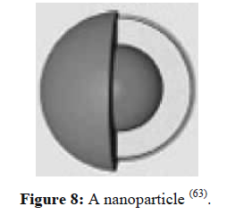

Slide 10
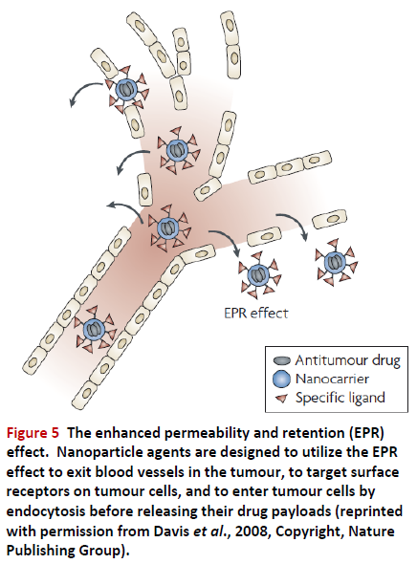

Slide 11
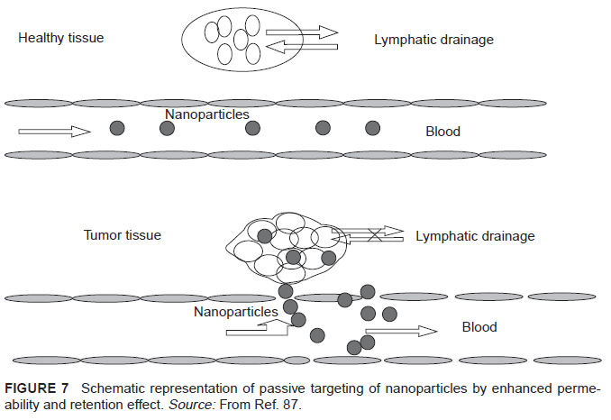

Slide 12
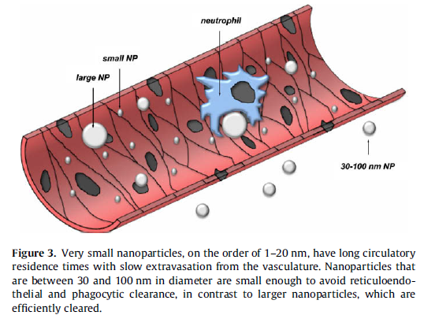

Slide 13
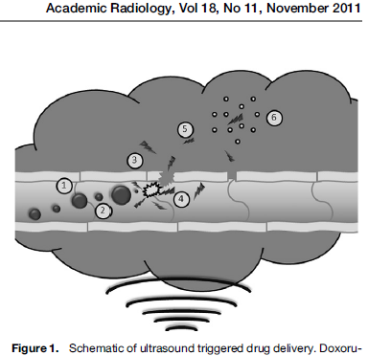

Slide 14
Advantages of Ultrasound:
The technique is non-invasive
Ultrasonic waves can penetrate deep into the interior of the body.
They can be carefully controlled and focused on the tumor site.
Since harmful drug is sequestered until the desired release place and time, the side effects of chemotherapy can be minimized.
Ultrasonic cavitation is producing stress on the cell membrane to allow greater drug uptake than would occur without US.

Slide 15
The study was carried out on three stages:
Preparation and characterization of NPs
Induction of HCC by the administration of DAB and PB
Studying the therapeutic effect of 5-FU loaded BSA NPs on the experimentally induced HCC in mice

Slide 16
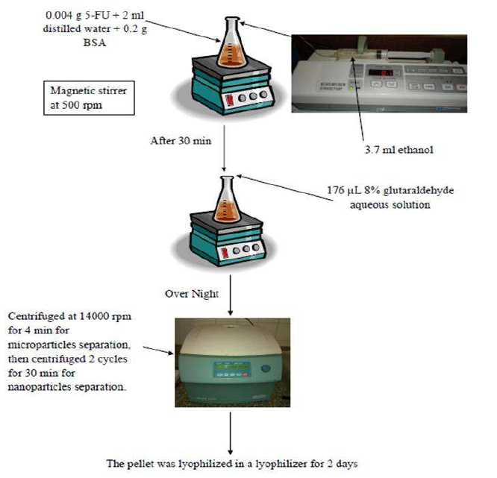
Preparation of 5-FU Loaded BSA NPs

Slide 17
The pellet was redispersed to the original volume (3.5 ml) in phosphate buffered saline (PBS) at pH 7.4 using ultrasonication for 5 min.
For complete liberation of entrapped drug, 50 μl of trypsin solution (1 mg/ml) was added and the resulted solution was incubated at 37°C for 8 h.
Later, total drug concentration was determined spectrophotometrically at 266 nm.

Slide 18
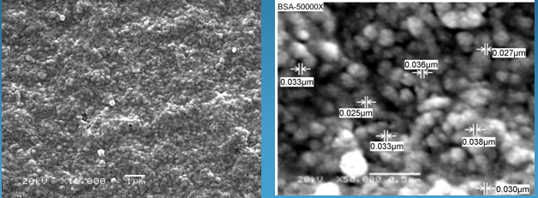
Characterization
Scanning electron microscope (SEM):
Morphology of prepared particles was studied using SEM that indicates the formation of completely spherical particle with smooth surface and low level of agglomeration:
(Mag. x10.000, 20 kV) (Mag. x50.000, 20 kV)

Slide 19
Transmission Electron Microscope (TEM):
TEM examination of blank BSA NPs revealed spherical particle with smooth surface and no agglomeration :
(Mag. x7.500, 80 kV) (Mag. x15.000, 80 kV)

Slide 20
TEM examination of 5-FU loaded BSA NPs revealed spherical particle with smooth surface and low level of agglomeration :
(Mag. x7.500, 80 kV) (Mag. x15.000, 80 kV)

Slide 21
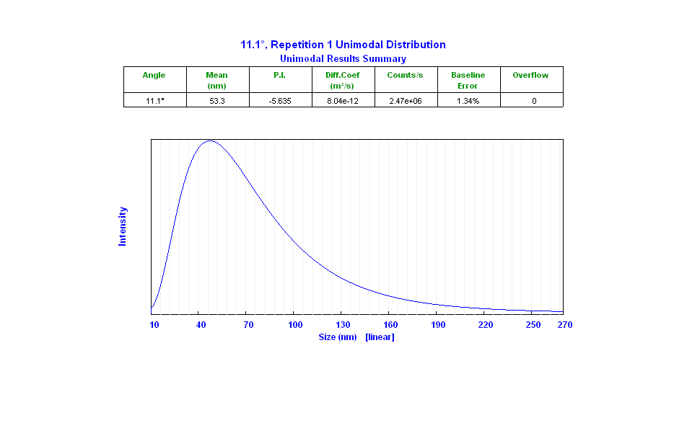
Particle Size Analyzer (PSA):
The particle size distribution of blank BSA NPs was carried out by PSA showed particle size with mean of 53 nm:

Slide 22
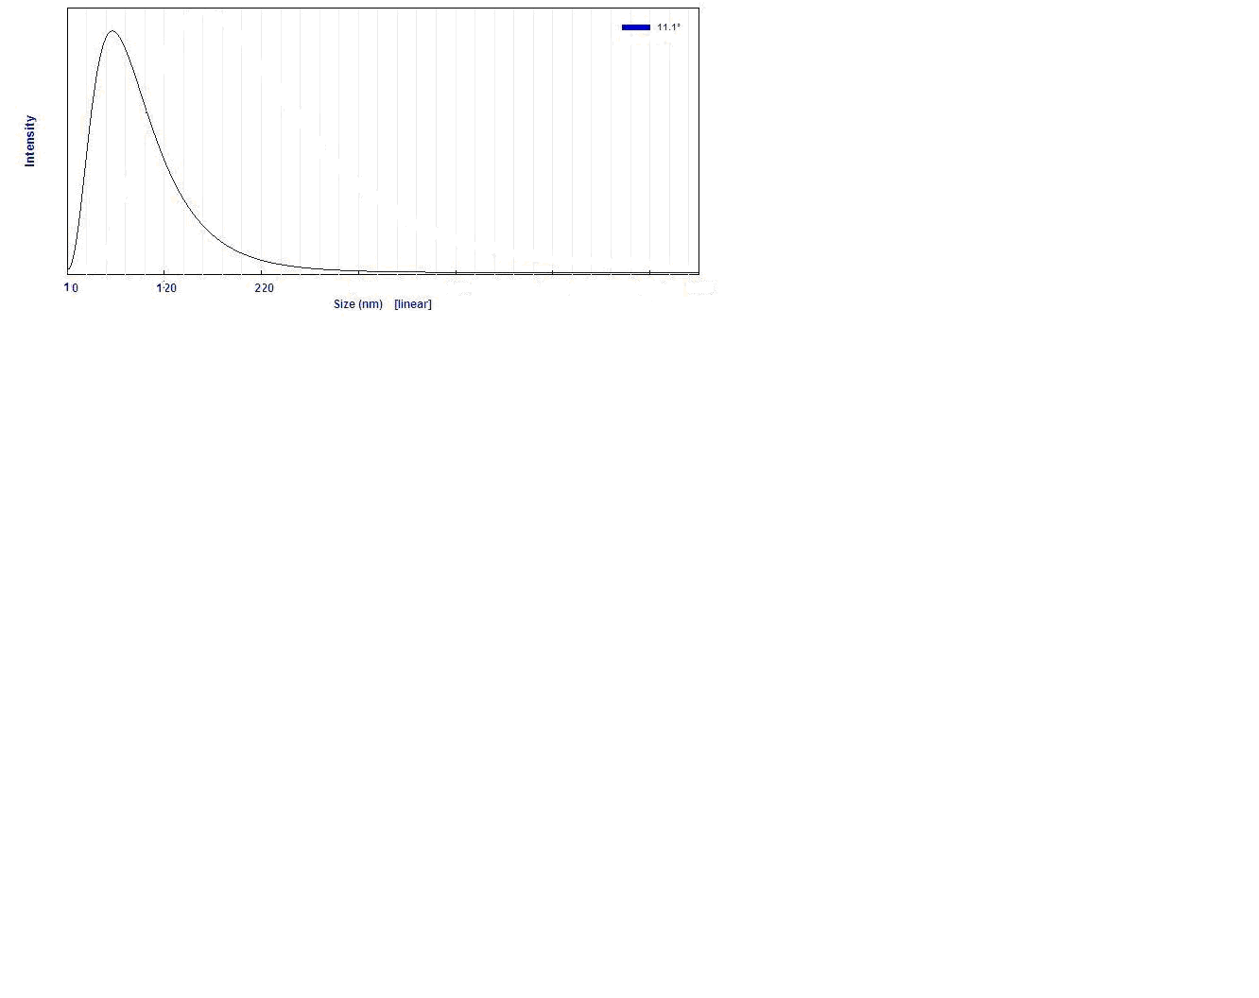
The particle size distribution of 5-FU loaded BSA NPs was carried out by PSA showed particle size with mean of 70 nm:

Slide 23
Determination of DLE and EE:
Amount of entrapped 5-FU in BSA NPs was determined by drug loading efficiency (DLE) which was 19.23% and encapsulation efficacy (EE) which was 62.5%.

Slide 24
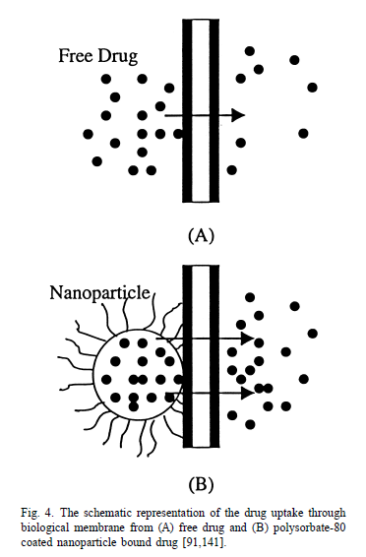
In vitro release profile:
Comparing between release profiles of free drug and nanoparticle suspension confirms that this colloidal drug carrier is capable of releasing drug in a controlled manner with the ability of revealing burst release

Slide 25
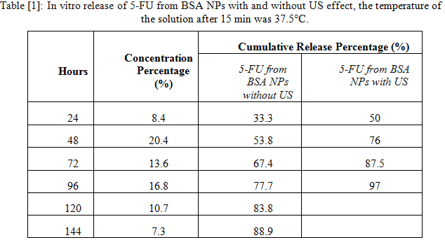
Exposure to US accelerated the release of 5-FU from the NPs, the in vitro drug release of 5-FU under the effect of US reached 50% in the first 24 hrs compared with 33.3% in the absence of US. After 48 hrs the effect reached 76% compared with 53.8%, and then after 72 hrs the effect reached 87.5% compared with 67.4%:

Slide 26
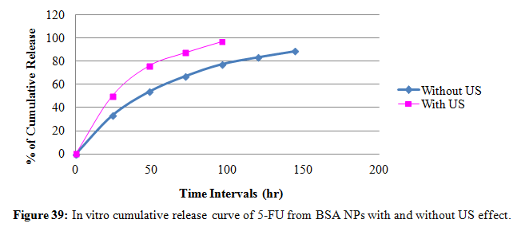
The comparison showed a higher release percentage with the use of US. A maximum release of 5-FU under the effect of US reached 97% after 96 hrs, while maximum release of 88.9 % reached after 144 hrs from NPs in the absence of US irradiation:

Slide 27
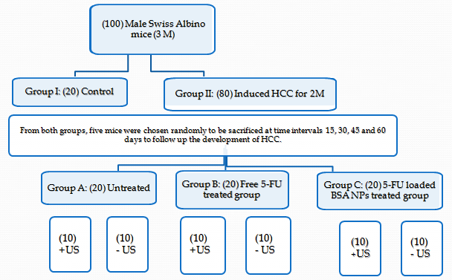
Grouping and Induction of HCC
Our study was carried out on:

Slide 28
After 33 days, animals were sacrificed for biochemical and histopathological parameters:
Biochemical:
Hepatic malondialdehyde (MDA) level
Serum and hepatic ALT activity.
Histopathological:
Histomorphological changes
Histochemistry of alkaline phosphatase (ALP)
Alpha-fetoprotein (AFP) immunohistochemicaly.

Slide 29
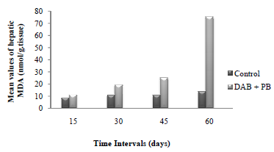
Hepatic MDA Level During HCC Induction
MDA was significantly increased in DAB + PB‏ feeding group of mice at all intervals when compared to the control group.

Slide 30
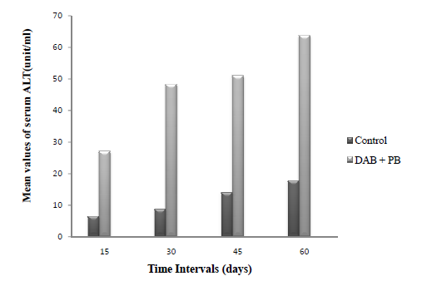
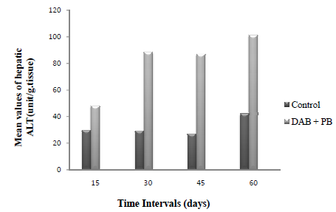
Serum ALT activity:
Hepatic ALT activity:
DAB + PB feeding caused a highly significant progressive increase in serum and hepatic ALT activity at all intervals when compared to the control group.

Slide 31
Treated mice showed improvement mostly after the use of 5-FU loaded BSA NPs and exposed to US.
By measuring the biochemical parameters, hepatic MDA compared with mice bearing the liver nodules showed decreased levels by 9% and 58% after being treated with free 5-FU, and treated with 5-FU loaded BSA NPs respectively.
While compared with mice bearing the liver nodules and exposed to US showed decrease levels by 27% and 75% after being treated with free 5-FU and exposed to US, and being treated with 5-FU loaded BSA NPs and exposed to US respectively.

Slide 32
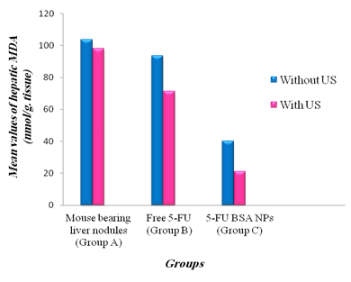
Hepatic MDA level:
Group B showed no significant decrease, while group C caused a highly significant decrease compared to group A.
A significant decrease was obtained when compared group C with B.
Exposing mice to US caused more significant decrease in group C compared to group A. Within the same group, a significant decline in groups B and C.
The best correction in MDA level was obtained in the group received 5-FU loaded BSA and exposed to US.

Slide 33
Serum ALT compared with mice bearing the liver nodules showed decreased levels by 10% and 36% after being treated with free 5-FU, and treated with 5-FU loaded BSA NPs respectively.
While compared with mice bearing the liver nodules and exposed to US, it showed decreased levels by 25% and 50% after being treated with free 5-FU and exposed to US, and being treated with 5-FU loaded BSA NPs and exposed to US respectively.

Slide 34
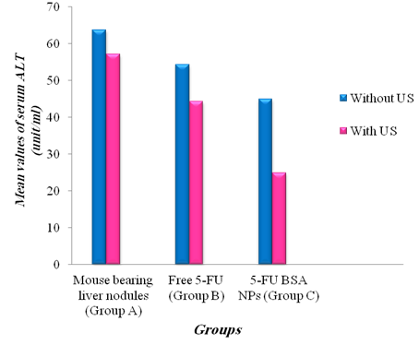
Serum ALT activity:
Group B showed no significant difference, while group C caused a highly significant decrease compared to group A.
A non-significant decrease was obtained when compared group C with B.
Exposing mice to US caused more significant decrease in group C compared to group A. Within the same group, a significant decline in group C only.
The best correction in ALT activity was obtained in the group received 5-FU loaded BSA and exposed to US.

Slide 35
Hepatic ALT compared with mice bearing the liver nodules showed decrease levels by 19% and 30% after being treated with free 5-FU, and treated with 5-FU loaded BSA NPs respectively.
While compared with mice bearing the liver nodules and exposed to US showed decrease levels by 0% and 53% after being treated with free 5-FU and exposed to US, and being treated with 5-FU loaded BSA NPs and exposed to US respectively.

Slide 36
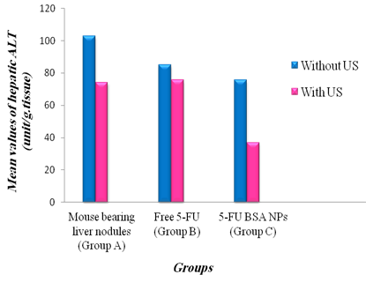
Hepatic ALT activity:
Group B showed a significant decrease, while group C caused a highly significant decrease compared to group A.
A non-significant decrease was obtained when compared group C with B.
Exposing mice to US caused more significant decrease in group C compared to group A. Within the same group, a significant decline in all groups.
The best correction in ALT activity was obtained in the group received 5-FU loaded BSA and exposed to US.

Slide 37
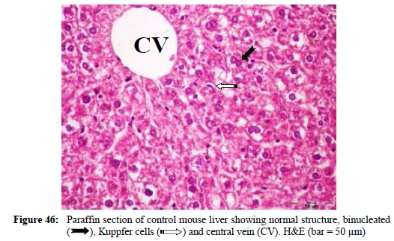
These results were confirmed by the histopathological findings:
H&E:

Slide 38
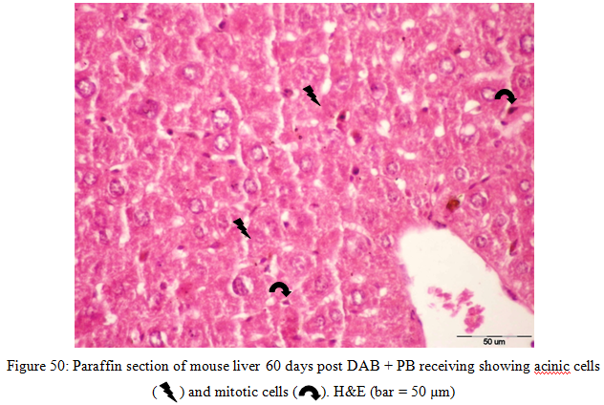

Slide 39
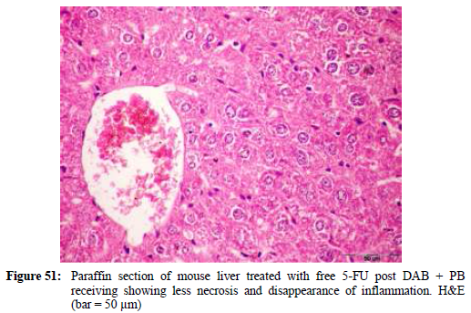
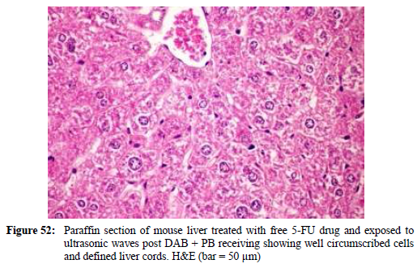

Slide 40
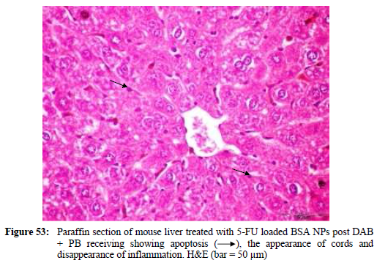
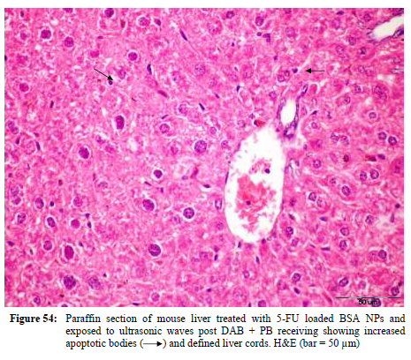

Slide 41
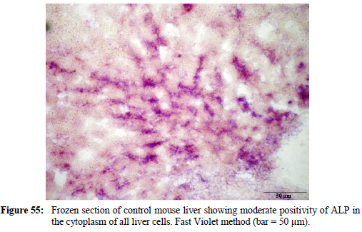
ALP:

Slide 42
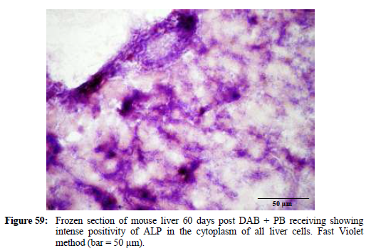

Slide 43
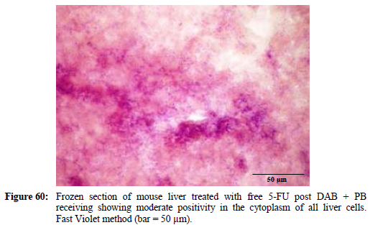
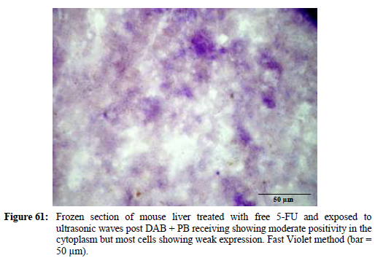

Slide 44
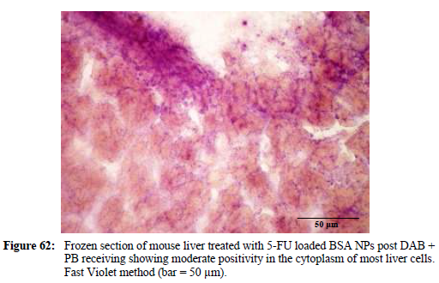
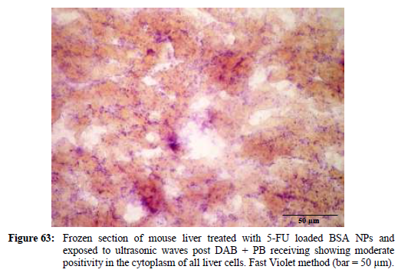

Slide 45
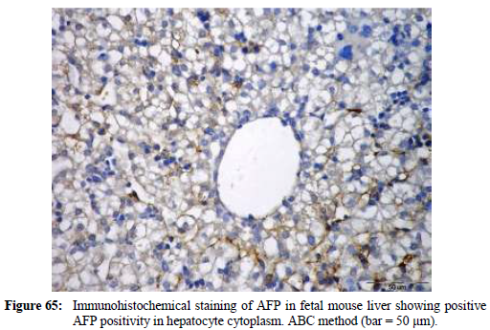
AFP:

Slide 46
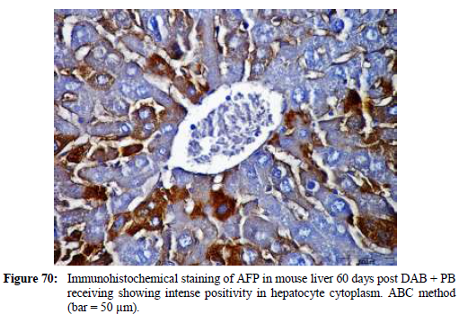
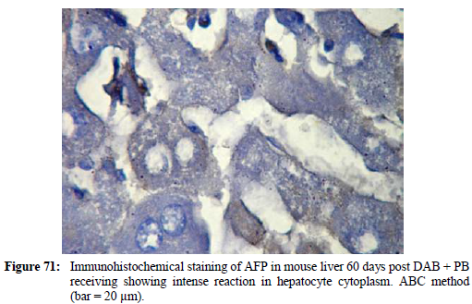

Slide 47
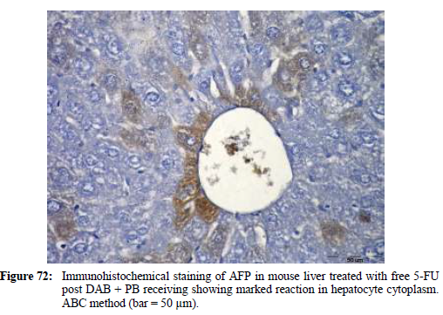
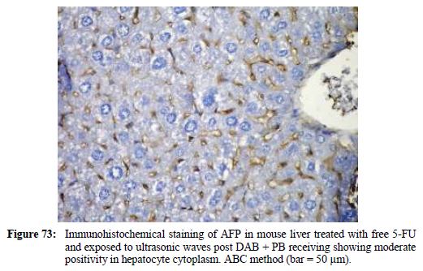

Slide 48
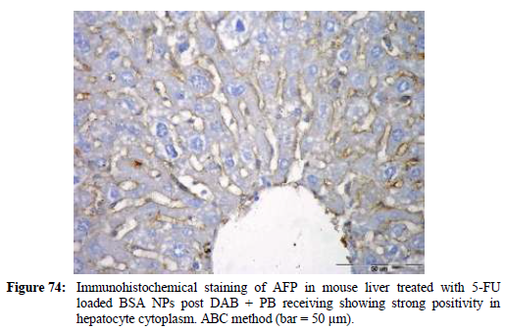
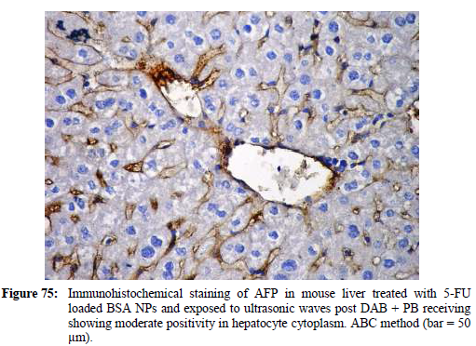

Slide 49
This significant decline in the serum and hepatic biochemical parameters beside the histochemical findings proved that:
The growth inhibitory effect was the best in the use of 5-FU loaded BSA NPs and exposed to US.
There is a good response in liver tissues towards different modalities of treatment being better in the use of 5-FU loaded BSA NPs and exposed to US.

Slide 50
Conclusion
The investigation of BSA NPs containing 5-FU shows that they are promising carriers for delivery system through their enhanced efficacy against cancer cells.
The drug delivery in combined with a local ultrasonic irradiation of the tumor may be developed into a powerful new tool of drug targeting and treatment of cancerous tumors.

Slide 51
Let us meet again..
We welcome you to our future conferences of OMICS International
2nd International Conference and Expo
on
Drug Discovery & Designing
On
October -31 November-02, 2016 at Istanbul, Turkey
http://drug-discovery.pharmaceuticalconferences.com/

Slide 52

Thank You

