Slide 1


Optical Properties and Crystallization kinetic of Tellurite Glass–Ceramics
Presented by
Dr. Nehal Elkhoshkhany,
Ass.Prof., Department of Material Science, Institute of Graduate Studies and Researches, Alexandria University

Slide 2
Outline
Outline
Introduction.
EXPERIMENTAL WORK
Results and discussion.
Conclusion

Slide 3
Introduction.

Slide 4

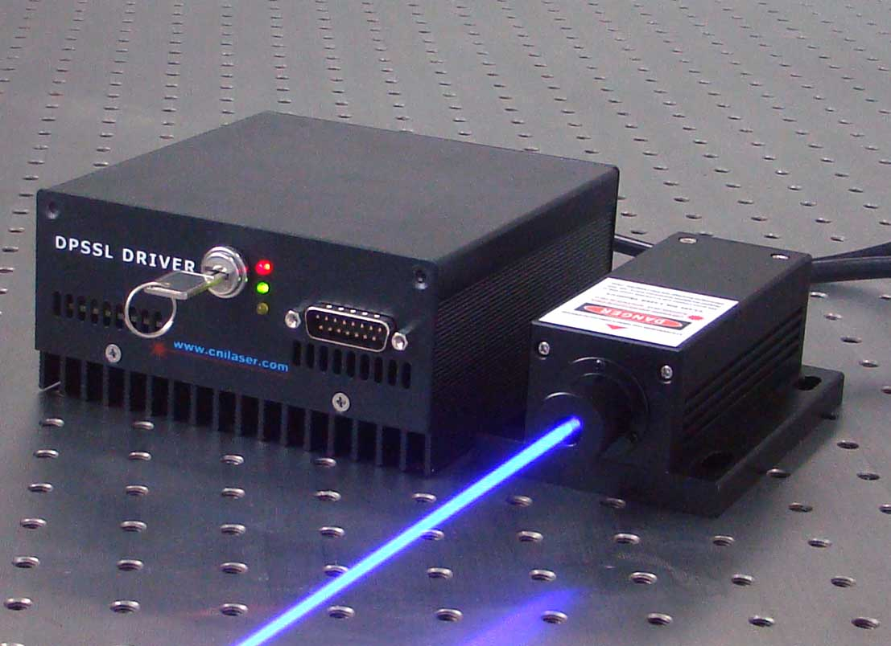
Why we study tellurite glass system ?
The Rare earth-doped tellurite glass systems are very attractive materials. It have attracted a great attention in the last years because of their interesting properties, which made him ideal materials for applications in many important fields like telecommunication technology, laser and optical fiber technology, optical device technology.

Slide 5
Aim
The aim of this research work is to investigate the influence of adding Er₂O₃ from 0 to 2.5 mol % on the Thermal and Optical properties and the network structure of (TeO₂ – Na₂O – ZnO) glasses, using DSC, X-Ray, SEM, and UV-Vis Spectroscopy.

Slide 6
EXPERIMENTAL WORK

Slide 7
Samples preparation
Quaternary tellurite glass systems in the form ((75-x) TeO₂ - 20ZnO-5Na₂Co₃ - xEr₂O₃) glass samples with 0≤ x≤ 2.5 mol %) have been prepared by the melt quenching technique.
Glass type | Chemical composition by mol percent
TZNE0 | 75TeO₂ -20ZnO- 5 Na₂CO₃
TZNE.5 | 74.5TeO₂ -20ZnO- 5 Na₂CO₃ - 0.5Er₂O₃
TZNE1 | 74TeO₂ -20ZnO- 5 Na₂CO₃ –1Er₂O₃
TZNE1.5 | 73.5TeO₂ -20ZnO- 5 Na₂CO₃ –1.5Er₂O₃
TZNE2 | 73TeO₂ -20ZnO- 5 Na₂CO₃ –2Er₂O₃
TZNE2.5 | 72.5TeO₂ -20ZnO- 5 Na₂CO₃ –2.5Er₂O₃

Slide 8
Measurements
X-ray diffraction.
Density measurements & calculation of Molar volume.
Differential Scanning Calorimetry (DSC) have been carried out on the prepared glass systems in the temperature range 300-800 ºC at heating rate 10, 15, 20 ºC/min
Kinetics parameters like activation energy of relaxation structure E_{t} , activation energy of crystallization E_{c} and order of crystallization have been calculated for every glass composition.

Slide 9
Optical absorption studies are carried out on the glassy system in the wavelength range of 300– 600 nm. The cut-off wavelength λ_{c}, optical band gap E_{opt}, Urbach energy ΔE and refractive index n values were calculated from optical absorption data.
glass ceramics were prepared by controlled one step heat treatment method.
The crystal structure was investigated by using X-ray diffraction (XRD) and scanning electron microscopy (SEM).

Slide 10
Results and Discussion.

Slide 11
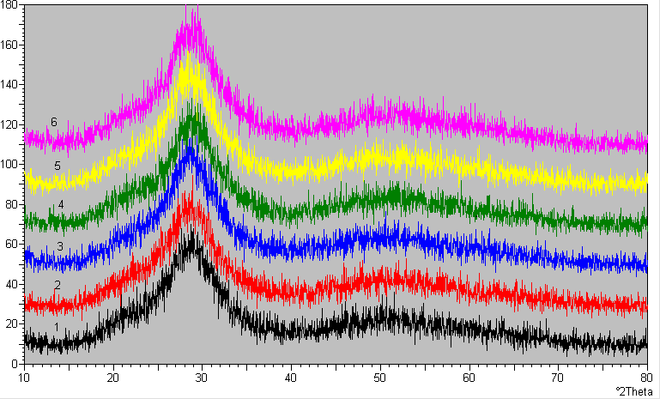
X-ray diffraction of glasses samples.

Slide 12
Density measurements & calculation of Molar volume

Slide 13
Differential Scanning Calorimetry (DSC)
T_{g}
T_{g}
T_{c1}
T_{c1}
T_{c2}
T_{c2}

Slide 14
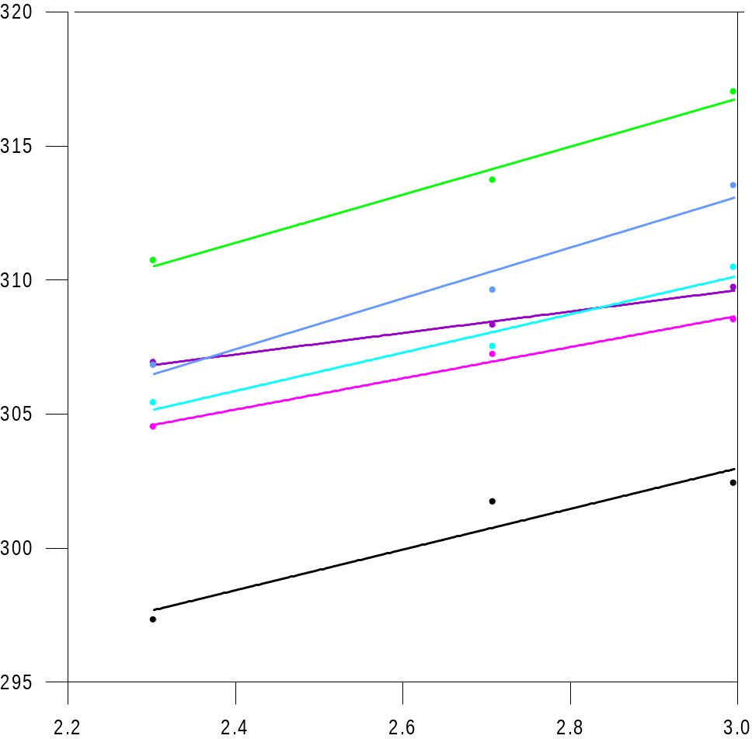
TZNE 0
TZNE 0.5
TZNE 1
TZNE 1.5
TZNE 2
TZNE 2.5
T_{g} (K)
Ln (α)

Slide 15
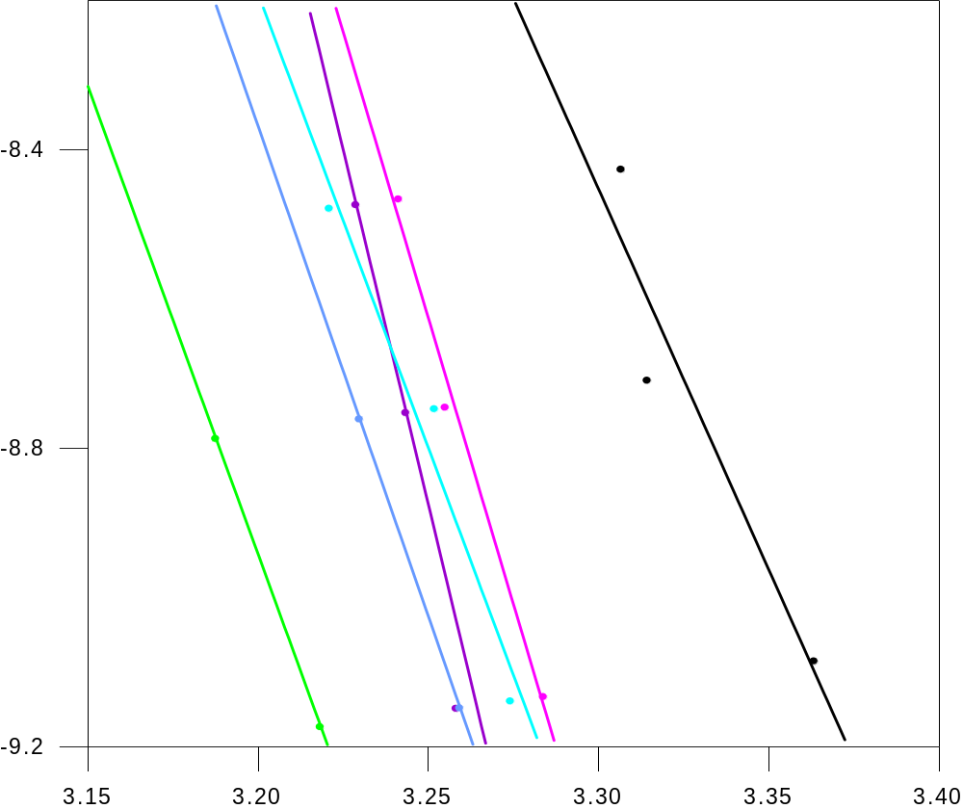
Glass Transition Activation Energy (E_{t})
The formula of [Kissinger’s], The formula of Moynihan C.
Ln(α / T_{g} ²) = (-E_{t} / R T_{g} ) + const. Ln(α ) = (-E_{t} / R T_{g} ) + const.
Glass Transition Activation Energy (E_{t})
The formula of [Kissinger’s], The formula of Moynihan C.
Ln(α / T_{g} ²) = (-E_{t} / R T_{g} ) + const. Ln(α ) = (-E_{t} / R T_{g} ) + const.
Glass Transition Activation Energy (E_{t})
The formula of [Kissinger’s], The formula of Moynihan C.
Ln(α / T_{g} ²) = (-E_{t} / R T_{g} ) + const. Ln(α ) = (-E_{t} / R T_{g} ) + const.
3.2
3.2
3.2
TZNE 0
TZNE 0.5
TZNE 1
TZNE 1.5
TZNE 2
TZNE 2.5
TZNE 0
TZNE 0.5
TZNE 1
TZNE 1.5
TZNE 2
TZNE 2.5
TZNE 0
TZNE 0.5
TZNE 1
TZNE 1.5
TZNE 2
TZNE 2.5
TZNE 0
TZNE 0.5
TZNE 1
TZNE 1.5
TZNE 2
TZNE 2.5
TZNE 0
TZNE 0.5
TZNE 1
TZNE 1.5
TZNE 2
TZNE 2.5
3.0
3.0
3.0
Ln (α/T_{g}²)
Ln (α/T_{g}²)
2.8
2.8
2.8
Ln (α)
Ln (α)
Ln (α)
2.6
2.6
2.6
2.4
2.4
2.4
2.2
2.2
2.2
3.15
3.20
3.25
3.30
3.35
3.40
3.15
3.20
3.25
3.30
3.35
3.40
3.15
3.20
3.25
3.30
3.35
3.40
1000/T_{g}
1000/Tg
1000/T_{g}
1000/Tg
1000/Tg

Slide 16
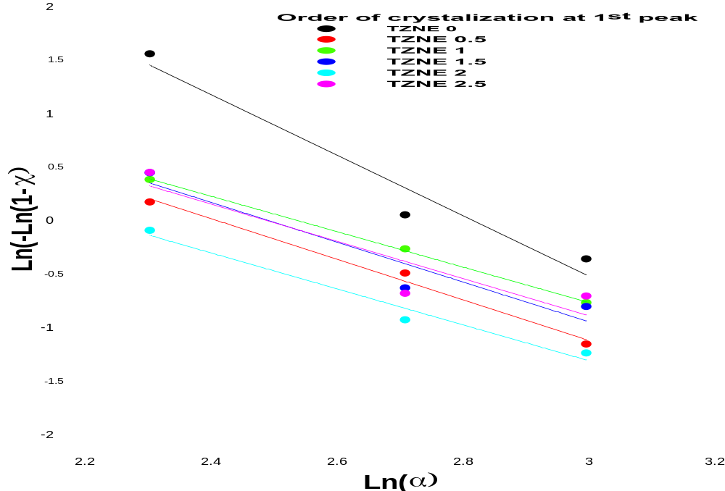
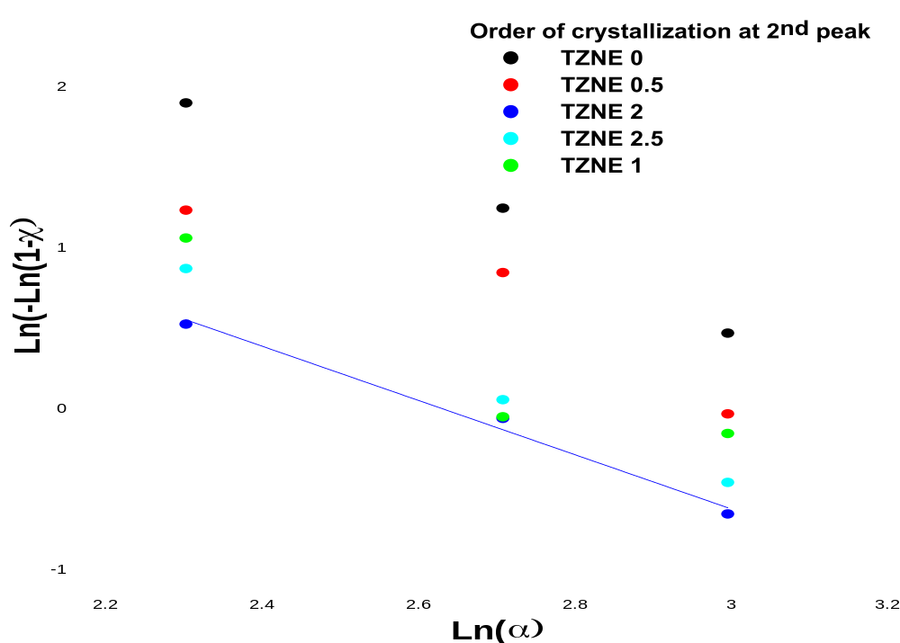
Order of the crystallization reaction (n)
Deduce by using Ozawa method, ln[-ln(1-χ)] = n ln(α)
where χ is (volume fraction crystallized in time (t) obtained from the crystallization exothermic peaks at the same temperature taken at different heating rates.

Slide 17
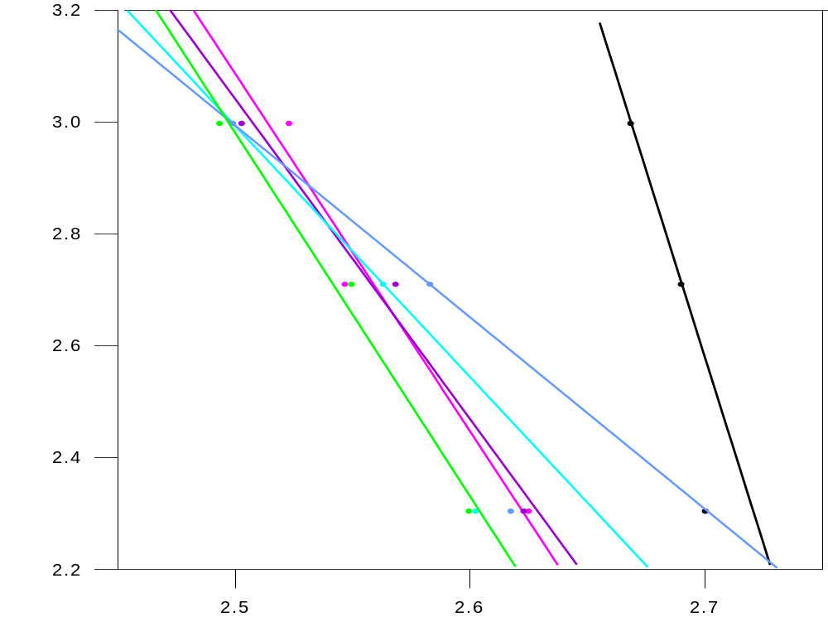
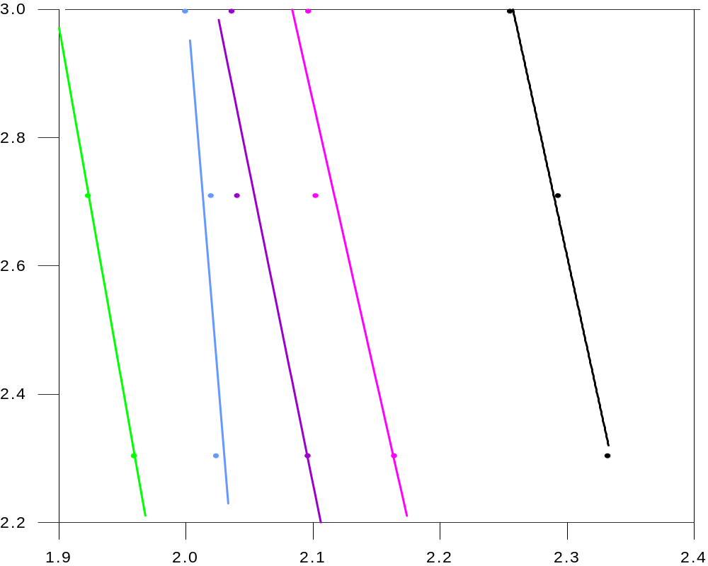
Crystallization Activation Energy (E_{c1})
The Kissinger model The Ozawa-Chen model
ln(α/T²) = (m/n)(E_{c} /RT_{c}) + const ln(α) = (m/n)(E_{c} /RT_{c}) + const
TZNE 0
TZNE 0.5
TZNE 1
TZNE 1.5
TZNE 2
TZNE 2.5
TZNE 0
TZNE 0.5
TZNE 1
TZNE 1.5
TZNE 2
TZNE 2.5
Ln (α/T_{c1}²)
Ln (α)
1000/T_{c1}
1000/T_{c1}

Slide 18
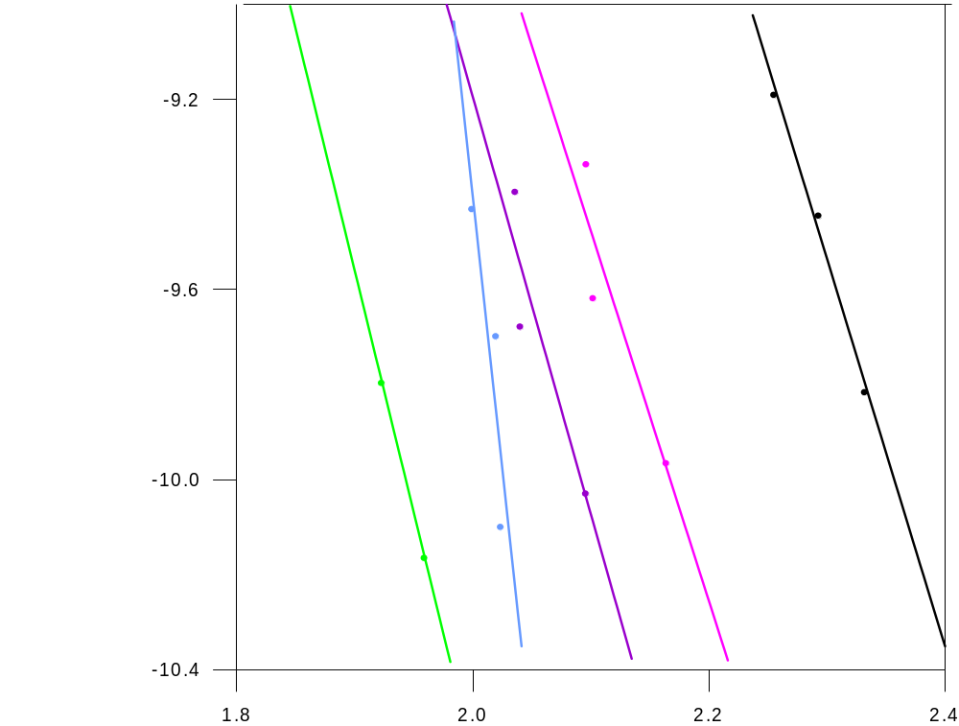
Crystallization Activation Energy (E_{c2})
The Kissinger model The Ozawa-Chen model
ln(α/T²) = (m/n)(E_{c} /RT_{c}) + const ln(α) = (m/n)(E_{c} /RT_{c}) + const
TZNE 0
TZNE 0.5
TZNE 1
TZNE 2
TZNE 2.5
TZNE 0
TZNE 0.5
TZNE 1
TZNE 2
TZNE 2.5
Ln (α/T_{c2}²)
Ln (α)
1000/T_{c2}
1000/T_{c2}

Slide 19
Thermal kinetics parameters of TZNE glasses
Sample | n |  | E_{g} (kJ/mol) | E_{g} (kJ/mol) | E_{c1} (kJ/mol) | E_{c1} (kJ/mol) | E_{c1} (kJ/mol) | E_{c2} (kJ/mol) | E_{c2} (kJ/mol) | E_{c2} (kJ/mol)
 | 1st peak | 2nd peak
TZNE0 | 2.89 | 2.04 | 90 | 85 | 169 | 159 | 117 | 150 | 136 | 111
TZNE0.5 | 1.64 | 1.75 | 132 | 127 | 106 | 93 | 224 | 145 | 129 | 166
TZNE1 | 1.71 | 1.82 | 163 | 158 | 95 | 82 | 216 | 162 | 146 | 524
TZNE1.5 | 1.86 |  | 106 | 101 | 75 | 88 | 255 | - | - | -
TZNE2 | 1.61 | 1.69 | 114 | 109 | 57 | 87 | 179 | 398 | 382 | 540
TZNE2.5 | 1.77 | 1.92 | 110 | 104 | 108 | 97 | 125 | 186.3167 | 169 | 97

Slide 20
glass ceramics were prepared by controlled one step heat treatment method.
According to the DSC results, TZNE0 and TZNE2.5 as cast sample were heat treated at:-
Average Tg +5⁰c for 4h and 22h
Average Onset temperature of 1st crystallization peak
Average crystallization temperature of 2nd crystallization peak
The crystal structure was investigated by using X-ray diffraction (XRD) and scanning electron microscopy (SEM).

Slide 21
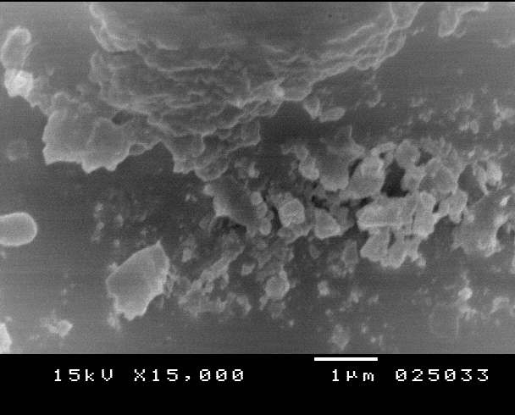
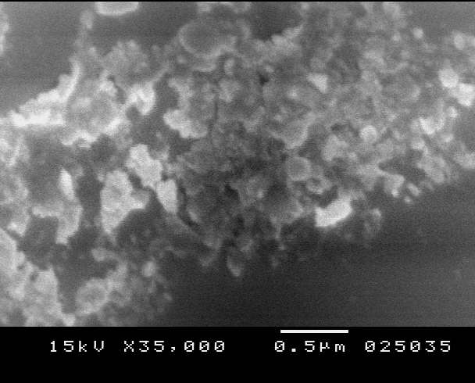
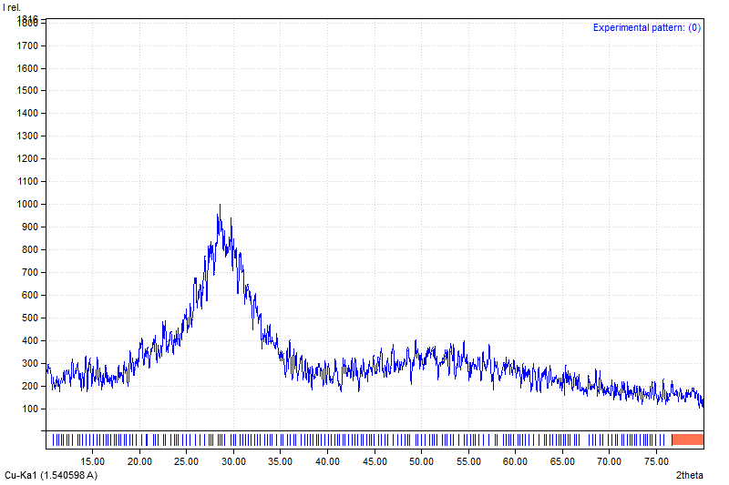
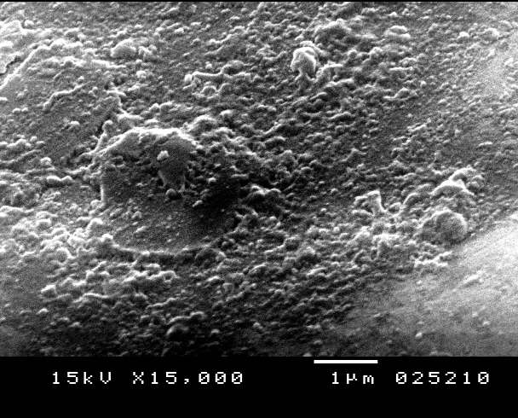
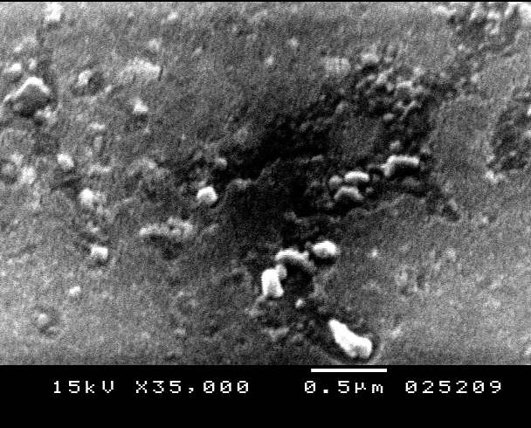
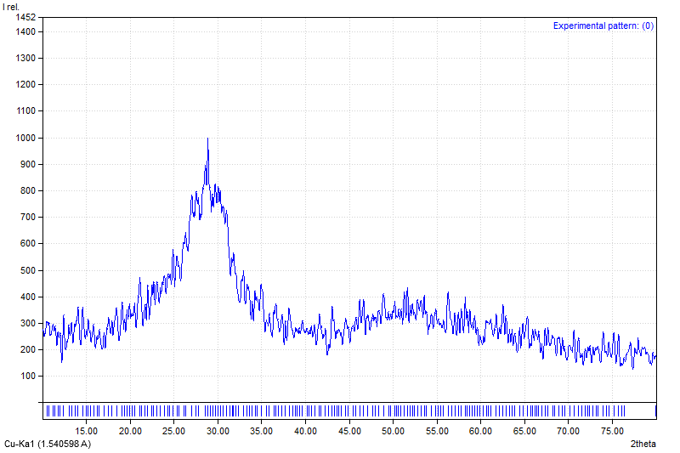
TZNE0.5 heat treated at average Tg +5⁰c for 4h = (311 ⁰c)
TZNE0.5 heat treated at average Tg +5⁰c for 22h
= (311 ⁰c)

Slide 22
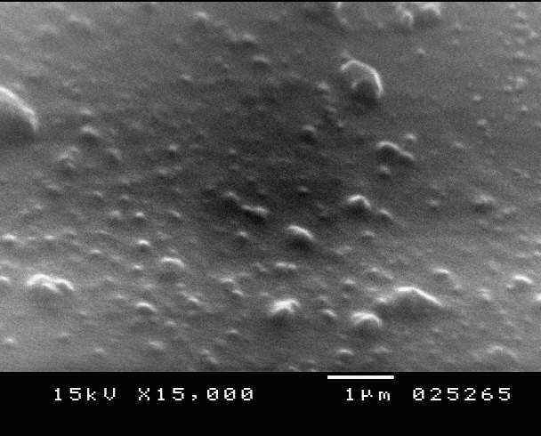
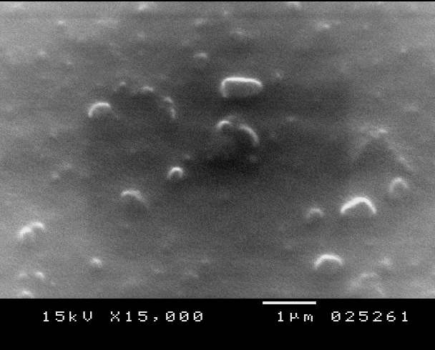
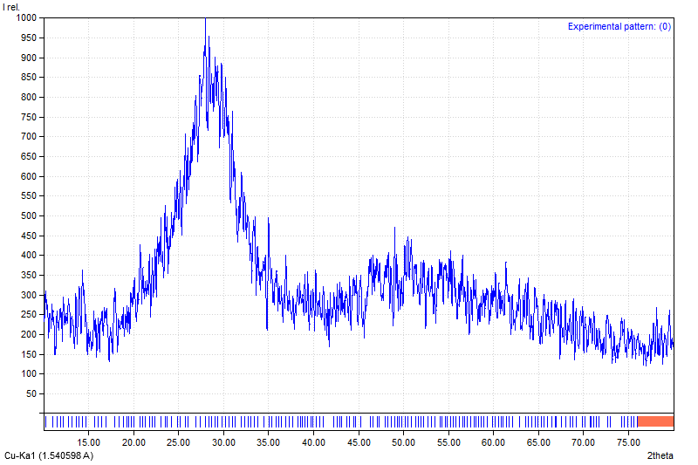
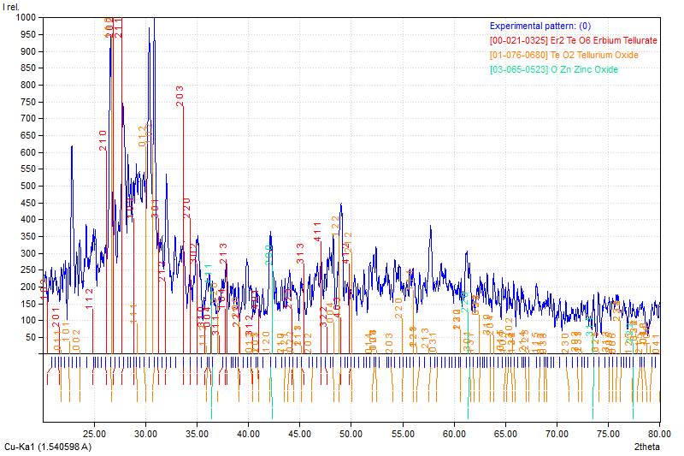
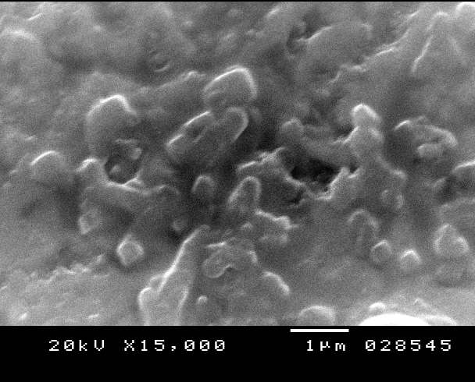
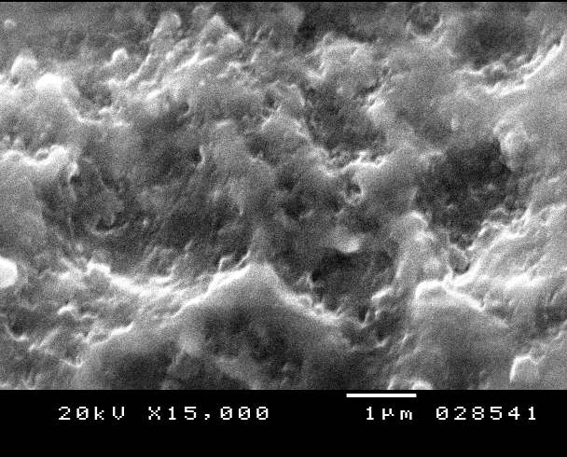
TZNE0.5 heat treated at Average Onset temperature of 1st crystallization peak
For 4h = (350⁰c)
TZNE0.5 heat treated at Average Onset temperature
of 1st crystallization peak For 4h = (350⁰c)

Slide 23
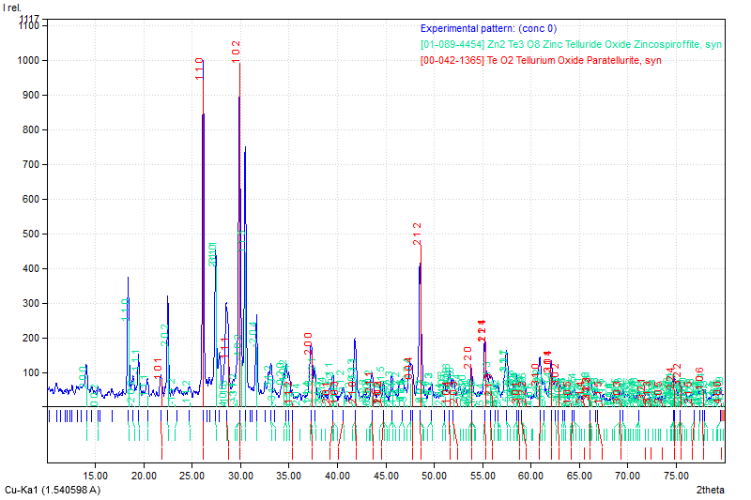
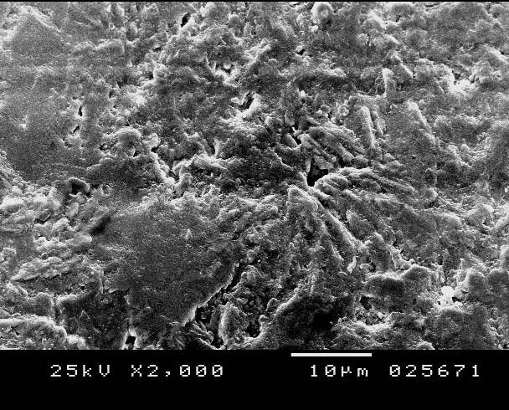
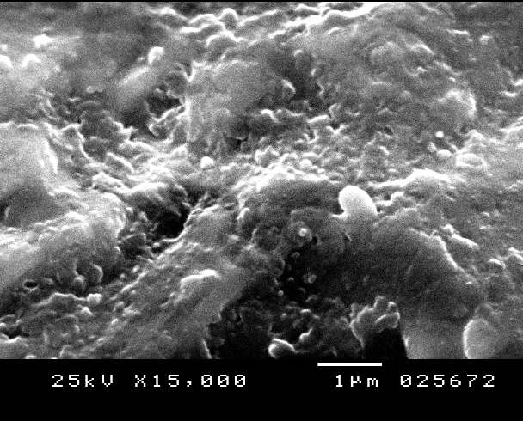
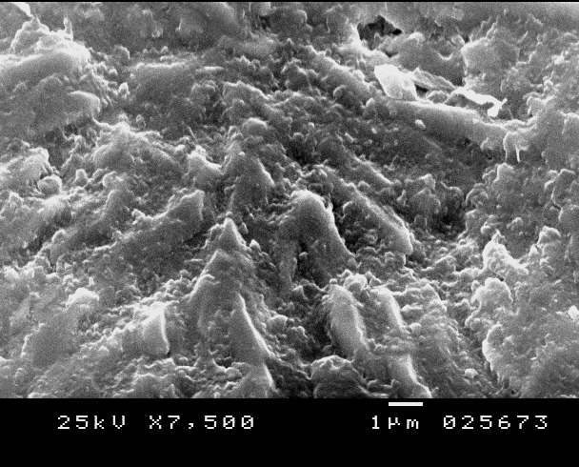
TZNE0.5 heat treated at Average crystallization temperature of 2nd crystallization peak for 4h =(460⁰c)

Slide 24
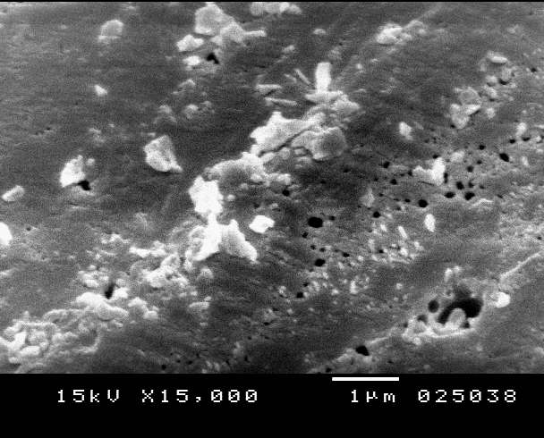
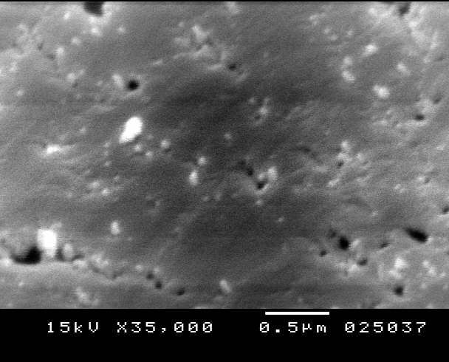
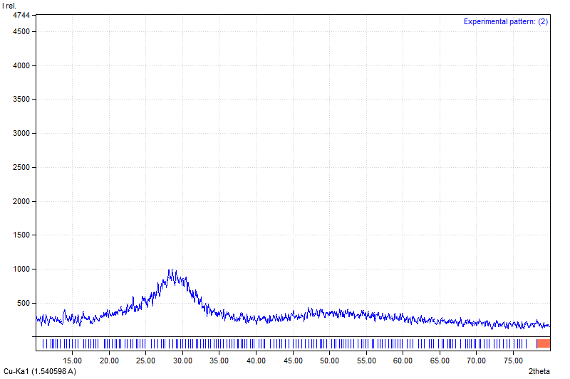
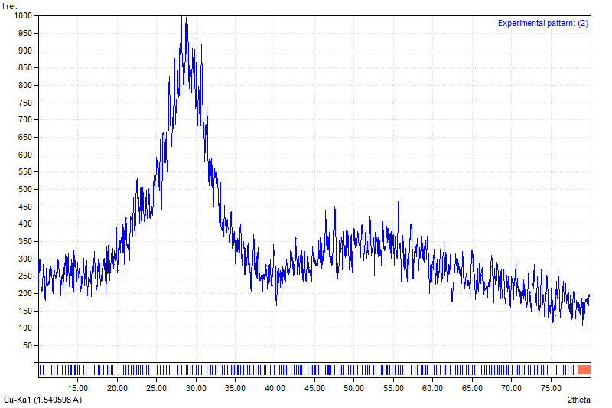
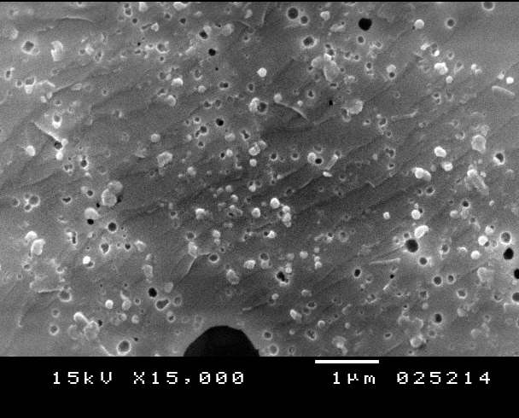
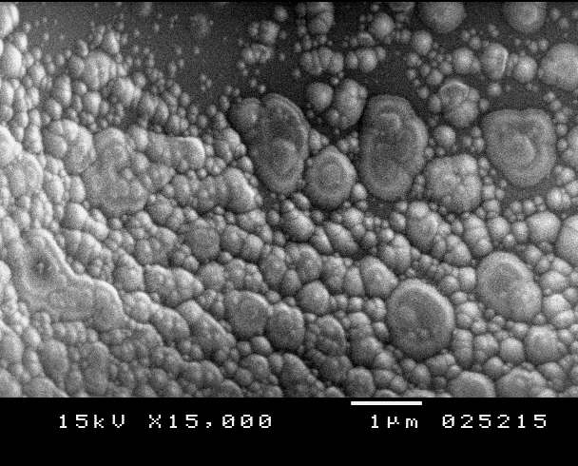
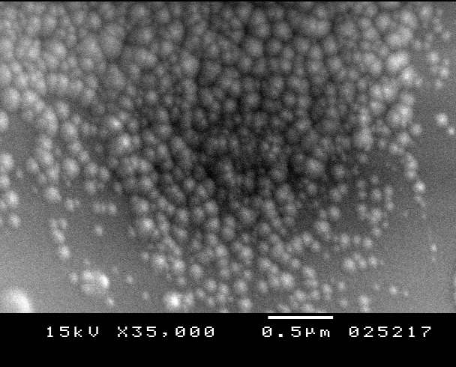
TZNE2.5 heat treated at average
Tg + 5⁰c for 4h = (339 ⁰c)
TZNE2.5 heat treated at average
Tg +5⁰c for 22h = (339 ⁰c)

Slide 25
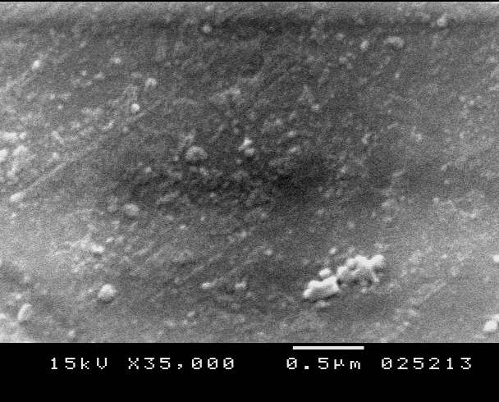
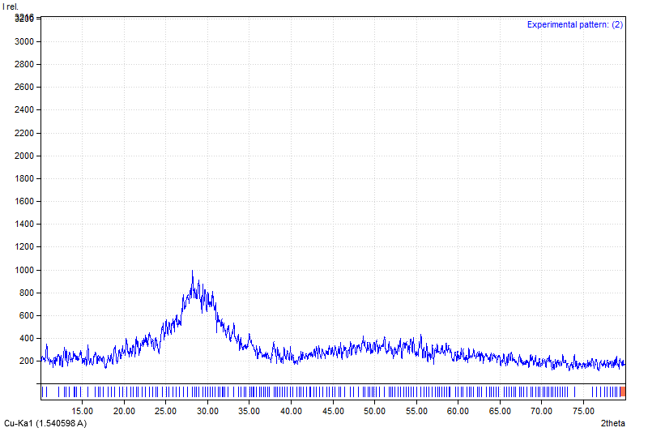
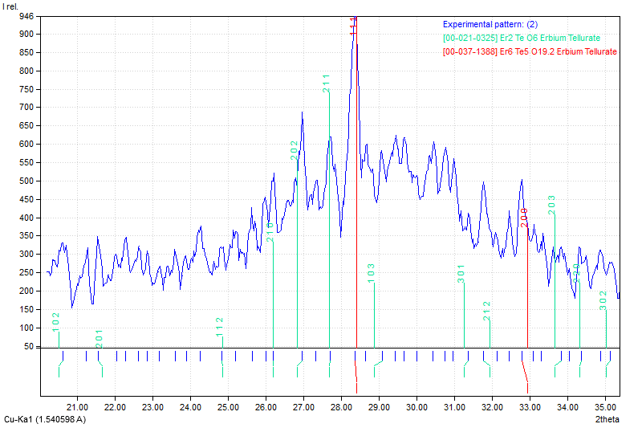
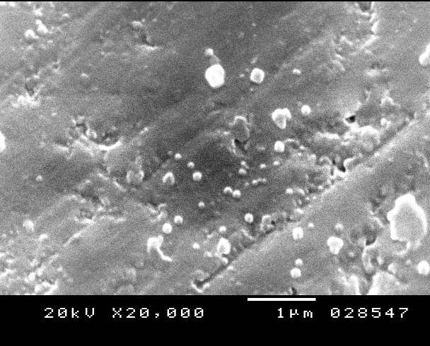
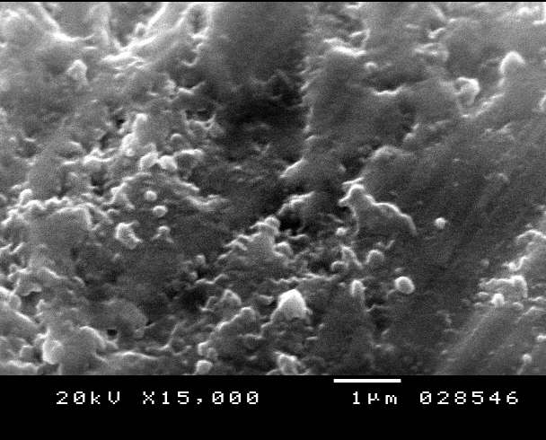
TZNE2.5 heat treated at average Onset temperature of 1st crystallization peak For 4h = (355⁰c)
TZNE2.5 heat treated at average Onset temperature of 1st crystallization peak For 8h = (355⁰c)

Slide 26
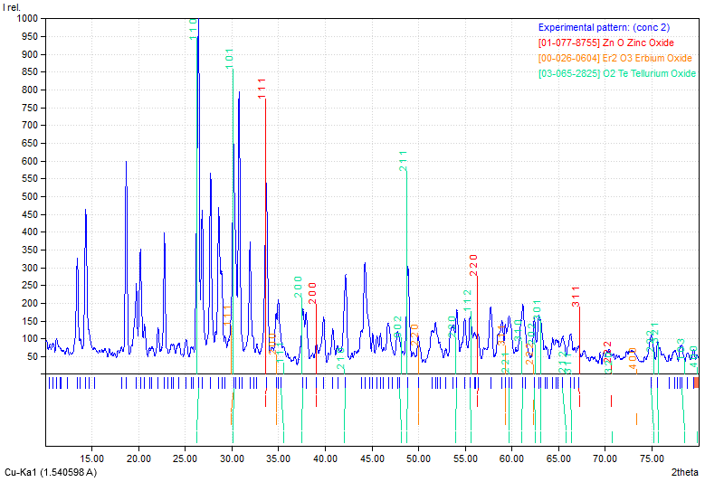
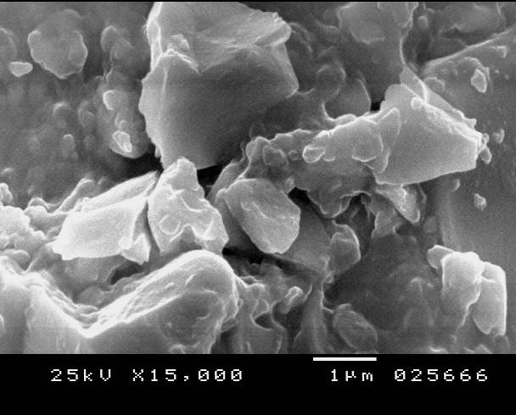
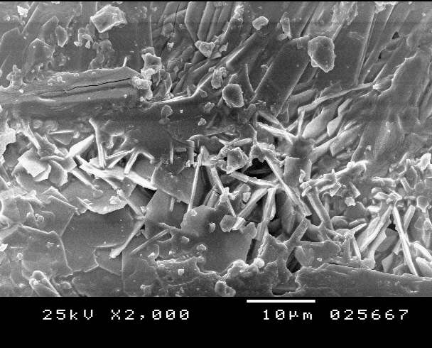
TZNE2.5 heat treated at Average crystallization temperature of 2nd crystallization peak for 4h =(520⁰c)

Slide 27
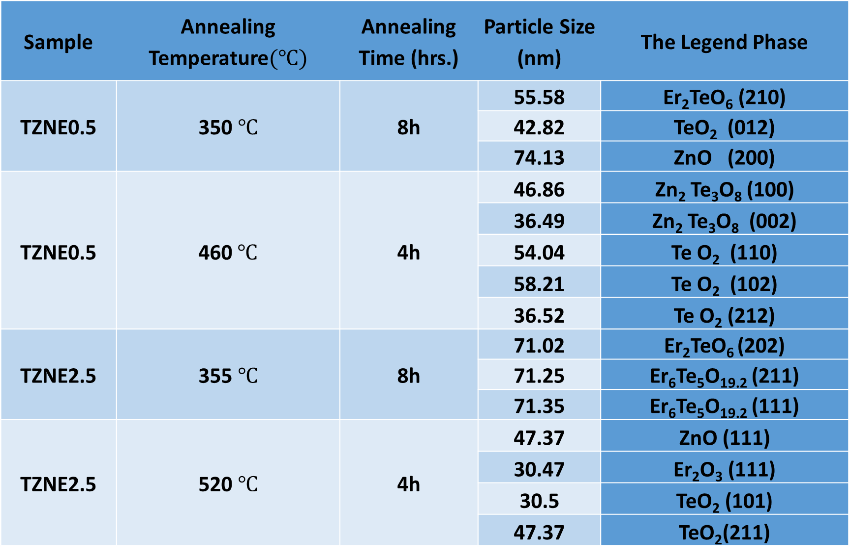
The Legend Phase | Particle Size (nm) | Annealing Time (hrs.) | Annealing Temperature$(℃)$ | Sample
Er₂TeO₆ (210) | 55.58 | 8h | 350 $℃$ | TZNE0.5
TeO₂ (012) | 42.82
ZnO (200) | 74.13
Zn₂ Te₃O₈ (100) | 46.86 | 4h | 460$℃$ | TZNE0.5
Zn₂ Te₃O₈ (002) | 36.49
Te O₂ (110) | 54.04
Te O₂ (102) | 58.21
Te O₂ (212) | 36.52
Er₂TeO₆ (202) | 71.02 | 8h | 355 $℃$ | TZNE2.5
Er₆Te₅O_{19.2} (211) | 71.25
Er₆Te₅O_{19.2} (111) | 71.35
ZnO (111) | 47.37 | 4h | 520 $℃$ | TZNE2.5
Er₂O₃ (111) | 30.47
TeO₂ (101) | 30.5
TeO₂(211) | 47.37

Slide 28
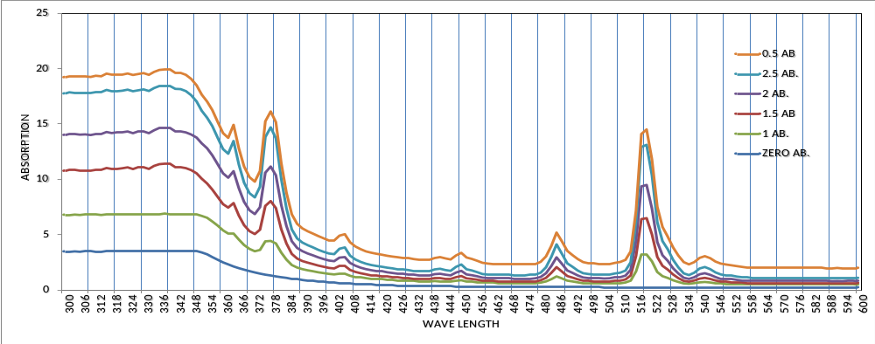
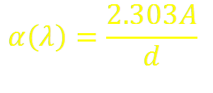
Optical properties UV/VIS absorption spectra
The optical absorption coefficient $α\left(λ\right)$of each curve is calculated by equation:

Slide 29
The Fundamental absorption edge
The (λ_{cutoff}) shifts towards lower wavelength side with increasing Er₂O₃ mol% concentration. This shifting is attributed increase in the number of the bridging oxygen (BO) atoms. glass network to become more rigid than non bridging oxygen

Slide 30
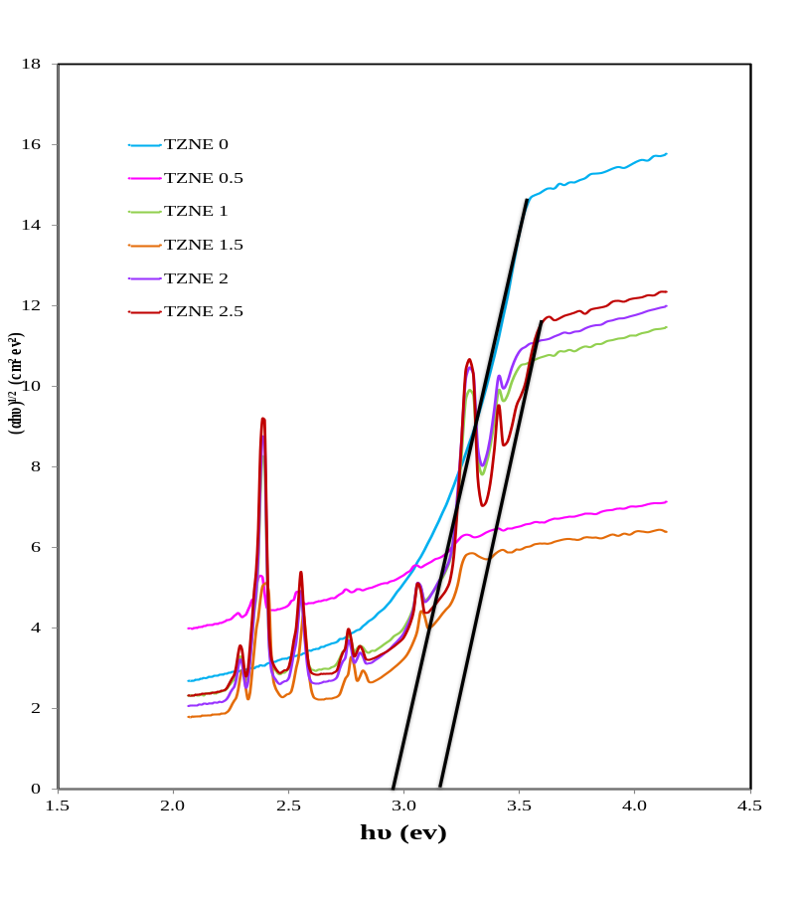
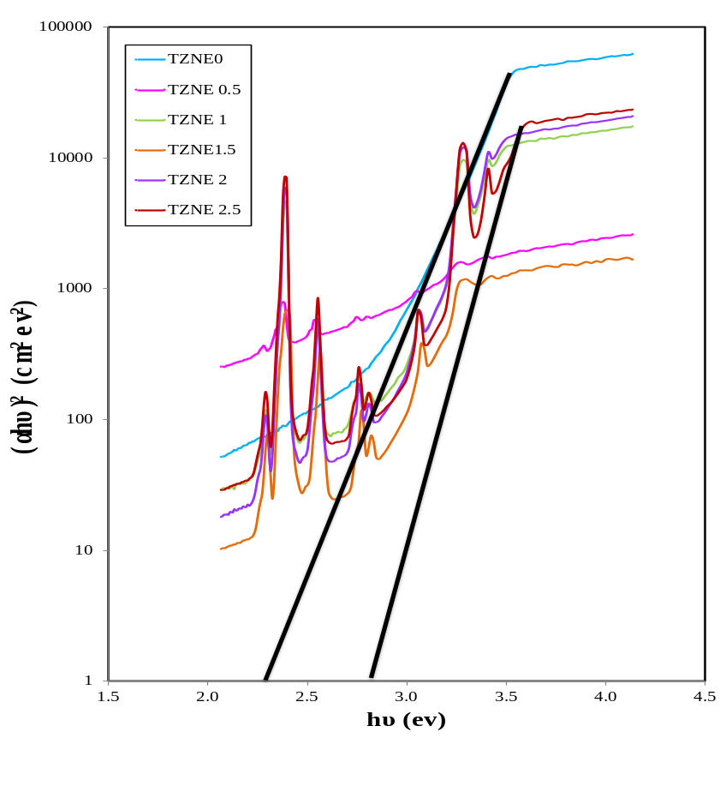
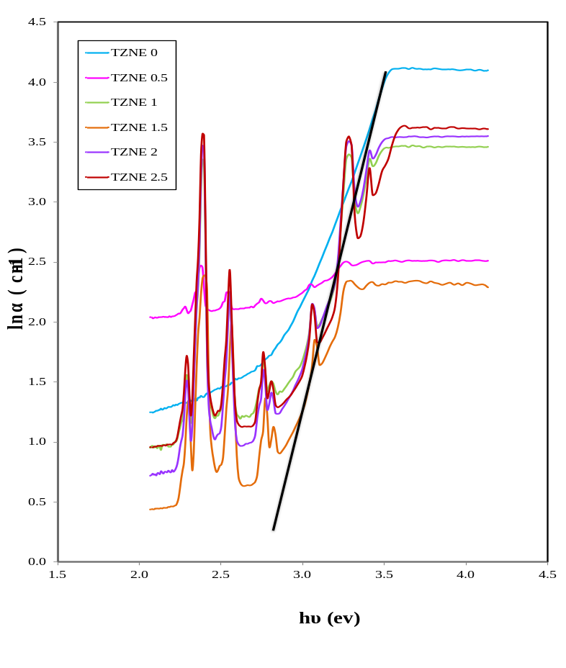

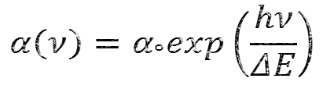
Optical energy band gap and Urbach energy
Where n is equal to 1/2 for direct allowed transitions and 2 for indirect allowed transitions )

Slide 31
