Slide 1


Role of Hydrogeochemistry in the release of arsenic in 24 Parganas districts, West Bengal
Presented By:
Neha Singh
Supervisor:
Prof. Saumitra Mukherjee
School of Environmental Sciences
Jawaharlal Nehru University

Slide 2
Introduction
Groundwater is the major source of freshwater in many parts of the world for meeting the requirements of domestic and agricultural purposes.
Rapid urbanization, excess withdrawal, and improper waste disposal all have an inﬂuence on the availability and quality of groundwater.
Geology of an area, the degree of chemical weathering of various rock types, anthropogenic factors affect the chemistry of groundwater (Giridharan et al. 2008)
The quality of groundwater is also altered by an increase in concentration of chemical species with its movement below the ground surface (Freeze and Cherry 1979)
In Bengal Delta, Bangladesh, and West Bengal, India groundwater arsenic contamination is a crucial water quality problem

Slide 3
West Bengal lies within the Ganga–Brahmaputra delta basin
Arsenic is found in groundwater in inorganic (arsenite and arsenate) and organic form
Numerous studies have reported that arsenic has a geogenic origin, but its source and mechanism of release into groundwater are still not clear
Much work has been carried out focusing the arsenic contamination and its effect on the human health in the study area
Very limited studies have been carried out to determine undergoing processes controlling the quality of groundwater, hydrogeochemistry of the area and the suitability of groundwater for different purposes
In present study, the assessment of hydrogeochemistry of the study area has been carried out to determine the processes controlling the groundwater chemistry
Saturarion Index was also calculated to understand the mineralogy of the subsurface

Slide 4
STUDY AREA
The study area is a part of North 24 Parganas and South 24 Parganas districts
The area lies within the Bengal basin, and is the part of Ganges delta formed by the Ganges-Brahmaputra river system
The region has levees, deltaic plains and swamp areas as major geomorphological features
Intermediate and lower aquifers are reported to be located at shallower depth in North 24 Parganas, while at greater depth in South 24 Parganas
North 24 Parganas is the second most and South 24 Parganas is the sixth most populous district in India
Agriculture is the dominating sector in both the districts
Huge amount of groundwater is extracted for irrigation as rice is the main agricultural product

Slide 5
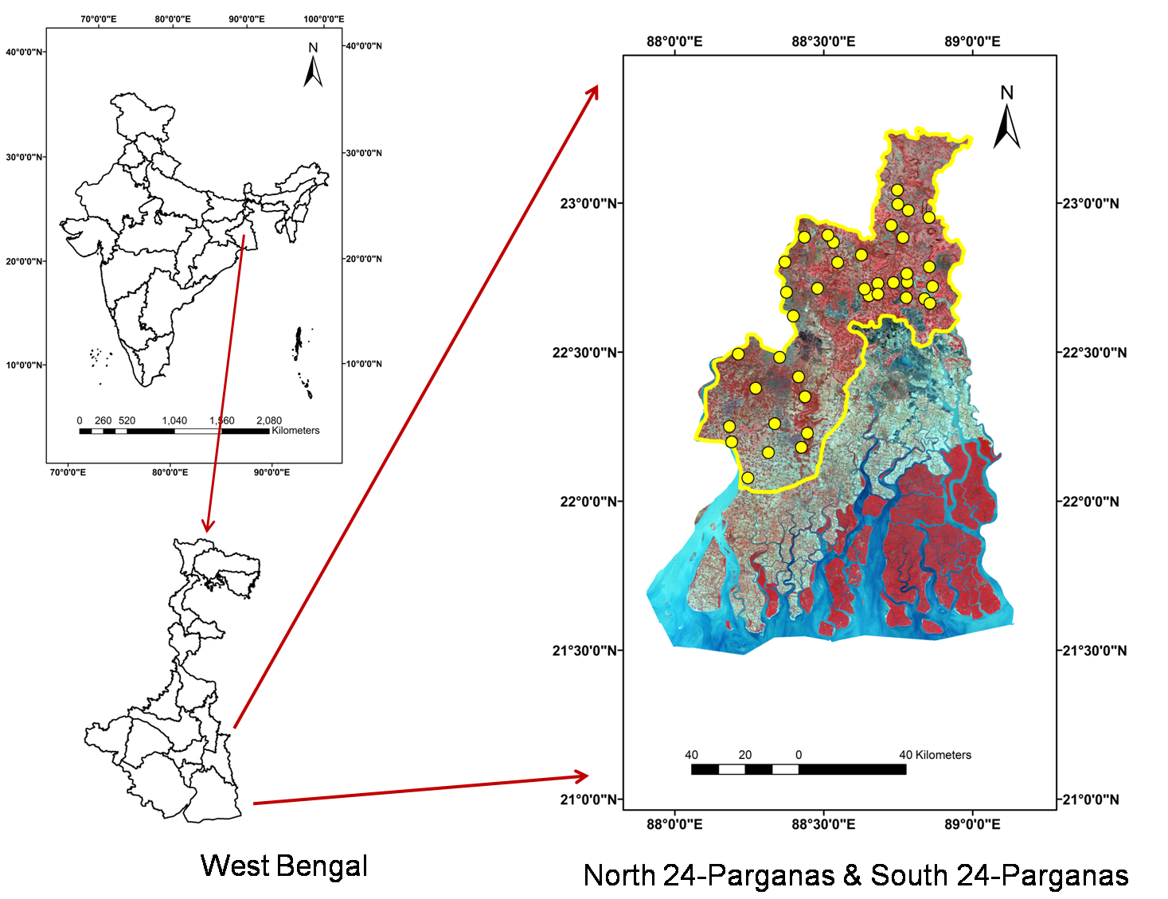

Slide 6
SAMPLING AND SAMPLE ANALYSIS
Based on the surface manifestations of hydrogeomorphological features as inferred from satellite imagery, total 39 groundwater samples were collected
Samples were collected in acid washed polypropylene bottles
pH, EC were measured onsite using respective electrode
Standard protocol given by APHA was used to determine the parameters
Bicarbonate and chloride were analysed using titration method
Phosphate, sulphate, nitrate and fluoride were analysed using spectrophotometer
Sodium, potassium, and calcium were analysed on Flame photometer, while other cations on AAS
Arsenic was analysed using hydride generator on AAS

Slide 7
Results
The result of groundwater quality data has been given in the form of minimum, maximum, and mean.
Chemical data of the groundwater samples were plotted on Schoeller and Durov plot to infer hydrogeochemical facies.
Schoeller diagram (1955) represents variation of major cations and anions in the groundwater samples
Durov diagram provides a better display of hydrochemical types along with the values of TDS and pH
Parameters | Min | Max | Avg
pH | 6.8 | 8.1 | 7.27
EC (μS/cm) | 540 | 1300.0 | 869.23
Na²⁺ (ppm) | 48.5 | 173.70 | 85.27
K⁺ (ppm) | 1 | 8.20 | 3.85
Mg²⁺ (ppm) | 56.79 | 88.61 | 65.39
Ca²⁺ (ppm) | 67.53 | 139.34 | 97.83
Fe²⁺ (ppm) | 0.00 | 15.29 | 2.15
As (ppb) | 0.77 | 69.45 | 15.39
HCO₃⁻(mg/l) | 496.12 | 997.50 | 706.22
Cl⁻ (mg/L) | 4.74 | 457.45 | 112.63
PO₄³⁻(mg/L) | 12.13 | 312.32 | 119.34
NO₃⁻ (mg/L) | 0.00 | 18.00 | 2.36
SO₄²⁻ (mg/L) | 0.01 | 49.12 | 9.74
Dissolved silica (mg/L) | 29.63 | 83.29 | 60.63

Slide 8
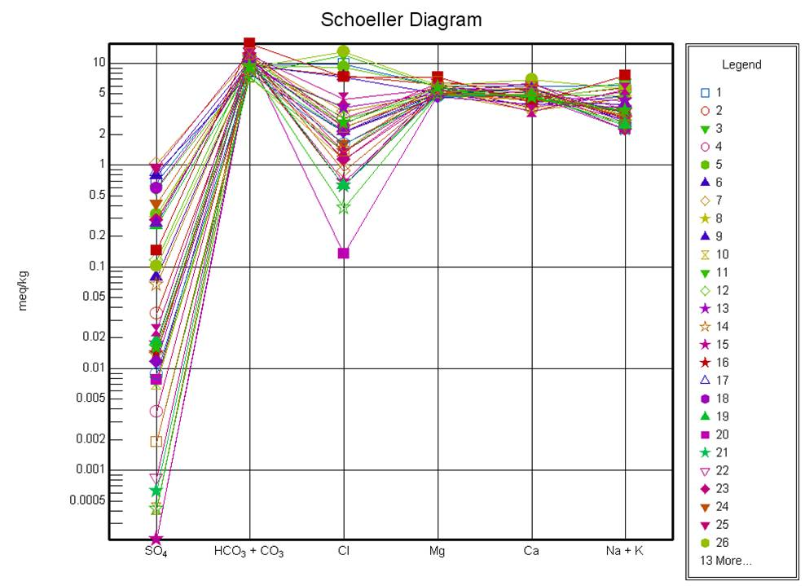

Slide 9
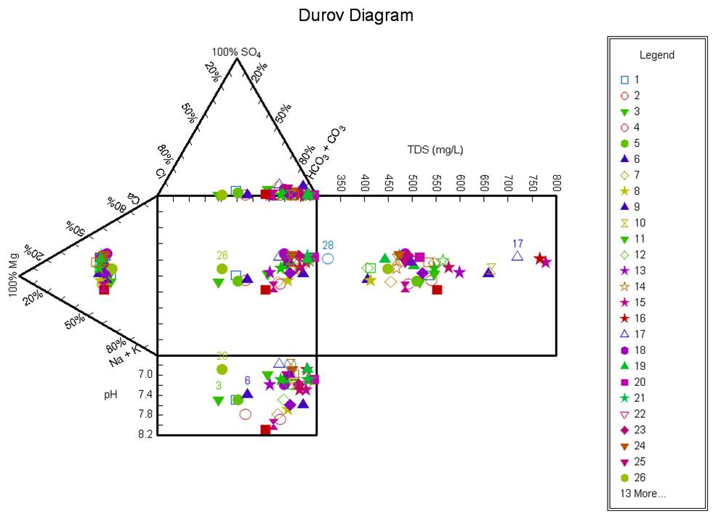

Slide 10
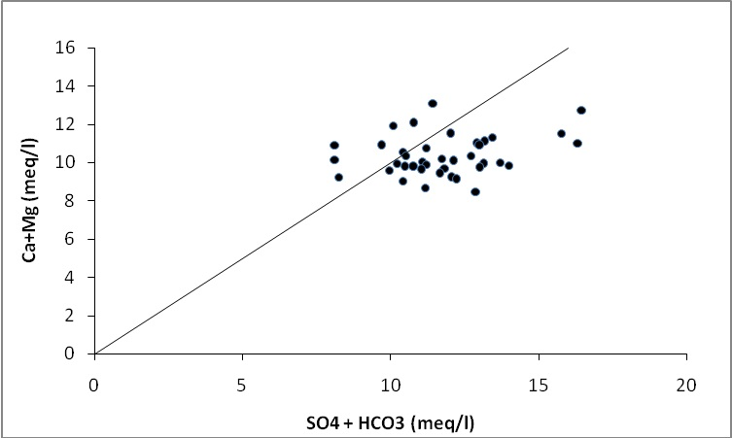
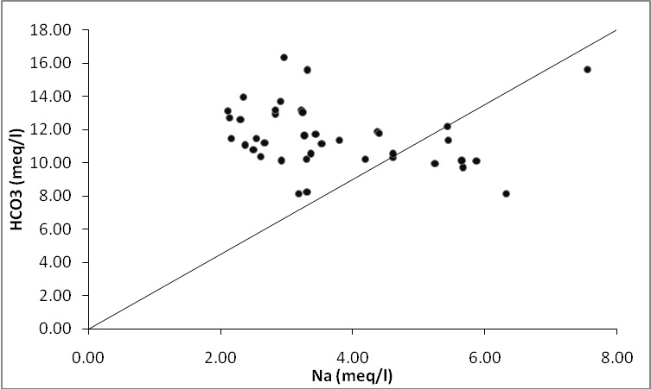
The Schoeller and Durov diagram shows the dominance of bicarbonate, chloride, alkali and alkaline metals.
Thus, it is essential to understand the hydrogeological processes which control the groundwater chemistry.
In the scatter diagram of (Ca+Mg) versus (HCO₃ + SO₄), samples falling above the equiline (1:1), represent carbonate weathering and reverse ion exchange, while below equiline indicate silicate weathering and ion exhange (Datta et al., 1996)
In the plot of HCO₃⁻ versus Na⁺ increased concentration of HCO₃⁻ compared to Na⁺ suggests that silicate weathering is the dominant process in the study area

Slide 11
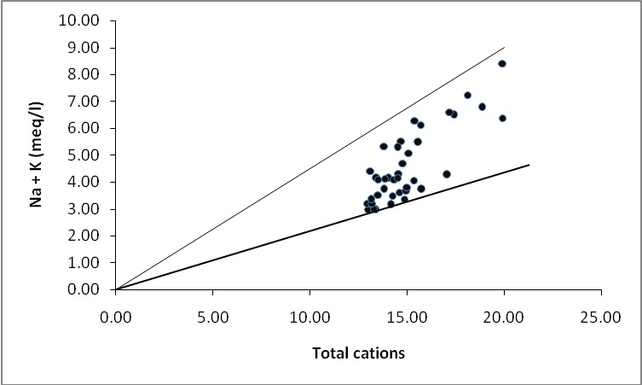
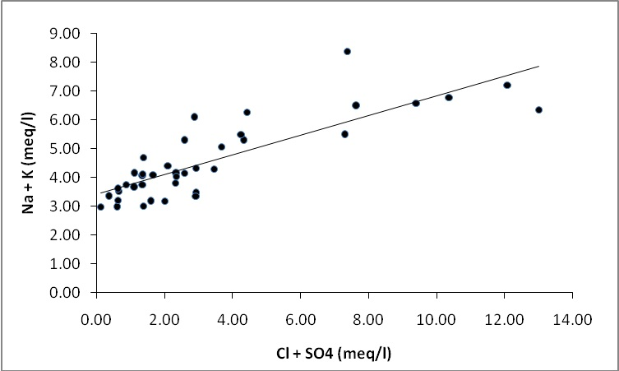
In the scatter plot of Na+K versus total cations, all the samples are present below the equiline and above the Na+K/ 0.50 TC line, it indicates that silicate weathering is more significant and is the main source of cations (Stallard and Edmond 1983)
Increase in alkalies with the simultaneous increase of Cl⁻ +SO₄ indicates a common source of these ions, resulting from dissolution of soil salts (Sarin et al. 1989

Slide 12
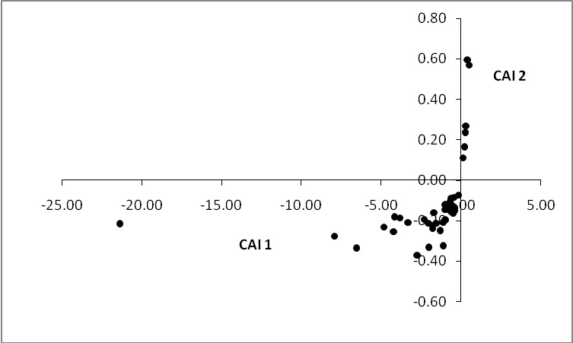
Chloro Alkaline Indices
Changes in chemical composition of groundwater takes place during its travel in the subsurface (Sastri, 1994)
Indices indicate the ion exchange between the groundwater and its host environment during a residence time or travel
Chloro Alkaline Indices (CAI-1) = [Cl – (Na + K)] /Cl
Chloro Alkaline Indices (CAI-2) = [Cl – (Na + K)] /(SO₄ + HCO₃ + CO₃ + NO₃)
Positive index- cation exchange of sodium and potassium from water with magnesium and calcium in the host rock, and vice versa
Most of the samples have negative values for both the indices
Ca and Mg in the water are exchanged with Na and K in the minerals from the host rock

Slide 13
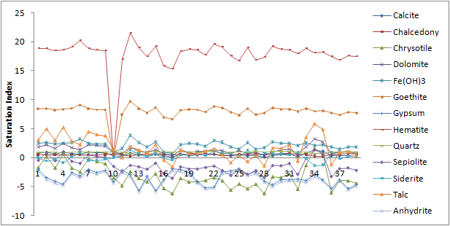
Geochemical Modelling
Saturation index of minerals was calculated by the USGS geochemical code PHREEQC 3.1.2 to evaluate the degree of equilibrium between water and respective minerals
Saturation index is the logarithm of the ratio of ion activity product to the mineral equilibrium constant

Slide 14
Positive saturation index (SI>0) indicates groundwater is oversaturated with respect to particular mineral.
It reflect groundwater discharging from an aquifer containing ample amount of minerals with sufficient resident time.
SI<0 indicates that the groundwater is undersaturated with particular mineral and reflect insufficient amount of mineral and short residence time.
The groundwater in the area is supersaturated with iron containing minerals like Fe(OH)₃, goethite, and hematite.
The water is also saturated with the calcite, chalcedony, dolomite, quartz.
Sepiolite, siderite, chrysotile and talc are oversaturated at some of the places and undersaturated at some sites.
The groundwater is undersaturated with anhydrite and gypsum

Slide 15
Oversaturation of hematite, goethite and Fe(OH)₃ in the study area indicates the abundance of iron minerals in the aquifer.
Groundwater gets sufficient residence time to be in contact with these minerals and their weathering has resulted in abundance of iron in the groundwater.
Calcite, dolomite and siderite are the carbonate minerals, while chalcedony, quartz, sepiolite, chrysotile are the silicate minerals.
Sepiolite is a clay mineral formed of complex magnesium silicate and is frequently found either with gypsum or dolomite (Leguey et al. 2010).
Groundwater is undersaturated with anhydrite and gypsum, and less concentration of sulphate in the groundwater explains the less dissolution of these minerals.
The high concentration of calcium in groundwater may be attributed to the dissolution of calcite and dolomite as carbonate weathering also occurs at some of the places

Slide 16
discussion
Mineral assemblage of kyanite–garnet–staurolite–biotite–tourmaline–chlorite–hornblende–epidote in the subsurface sediments of the 24-Parganas represents highly metamorphosed rocks.
Aquifer of the study area is composed of mainly silicate minerals, thus the silicate weathering plays an important role in this region.
Groundwater in the intermediate aquifer contains calcium, magnesium, bicarbonate as the major ions with elevated concentration of iron, phosphate and arsenic (PHED 1991; Das et al. 1995).
The dissolution of the silicate minerals present in the aquifer determines the chemistry of groundwater and are responsible for increased concentration of cations and bicarbonate in the area

Slide 17
Goethite forms through the weathering of various iron rich minerals in the zone of oxidation within the soil.
Oversaturation of groundwater with goethite indicates that the mineral may have formed in the subsurface because of the aerated zone within the aquifer created by the ﬂuctuation in the water table.
Arsenic was reported to be adsorbed to iron hydroxide coated sand grain margins and to clay minerals (Acharyya et al. 1999) and on the surface of grains coated with Fe oxyhydroxides (Nickson et al. 2000).
Saturation index indicates the presence of iron minerals and iron oxyhydrooxide (FeOOH, Goethite) in abundance in the aquifer.
Thus, weathering of these minerals helps in the release of arsenic into the groundwater resulting in the elevated concentration of arsenic in the groundwater.

Slide 18
References
Acharyya SK, Chackraborty P, Lahiri S, Raymahashay BC, Guha S, Bhowmik A (1999) Arsenic poisoning in the Ganges delta. Nat 401:545
Das D, Chatterjee A, Mandal BK, Samanta G, Chakraborty D, Chanda B (1995) Arsenic in groundwater in six districts of West Bengal, India: The biggest arsenic calamity in the world, Part 2: Arsenic concentration in drinking water, hair, nails, urine, skin-scale and liver tissue (biopsy) of the affected people. Anal 120: 917- 924
Datta PS, Bhattacharya SK, Tyagi SK (1996) 18O studies on recharge of phreatic aquifers and groundwater flow-paths of mixing in the Delhi area. J Hydrol 176: 25–36
Durov SA (1949) Treugolnaja forma graficeskogo vyrazenija rezultatov vodnych analizov I primenenije jejo k klassifikaciji prirodnych vod. Gidrochem.materialy 16: 54
Freeze RA, Cherry JA (1979) Groundwater. New Jersey: Prentice-Hall
Giridharan L, Venugopal T, Jayaprakash M (2008) Evaluation of the seasonal variation on the geochemical parameters and quality assessment of the groundwater in the proximity of River Cooum, Chennai, India. Environ Monit Assess 143: 161–178

Slide 19
Leguey, S, Leon, DRD, Ruiz, AI, Cueva, J (2010) The role of biomineralization in the origin of sepiolite and dolomite. Am J Sci 310: 165-193
Nickson R, McArthur J, Ravenscroft P, Burgess W, Ahmed KM (2000) Mechanism of arsenic poisoning of groundwater in Bangladesh and West Bengal. Appl Geochem 15: 403–413
PHED (1991) National Drinking Water Mission: Submission Project on Arsenic Pollution in groundwater in West Bengal, Final Report by Steering Committee, Arsenic Investigation Project, Government of West Bengal, 57
Sarin MM, Krishnaswamy S, Dilli K, Somayajulu BLK, Moore WS (1989) Major ion chemistry of the Ganga- Brahmaputra river system: Weathering processes and fluxes to the Bay of Bengal. Geochimica et Cosmochimica Acta 53: 997– 1009
Sastri JCV (1994) Groundwater chemical quality in river basins, Hydrogeochemical modeling. Lecture notes—refresher course, School of Earth Sciences. Bharathidasan University, Tiruchirapalli, Tamil Nadu, India
Schoeller H (1955) Geochimie des eauxsouterraines application auxeaux de gisements de petrole; Revue Inst. Petrole et Ann des combustibles liquids 10 (181–213): 219–246

Slide 20
publication
Neha Singh, Ravi Prakash Singh, Saumitra Mukherjee, Kyle McDonald, K.J. Reddy (2014) Hydrogeological processes controlling the release of arsenic in parts of 24 Parganas district, West Bengal. Environmental Earth Sciences, 72 (1); 111-118
Neha Singh, Ravi Prakash Singh, Vikas Kamal, Ratan Sen, Saumitra Mukherjee (2014) Assessment of hydrogeochemistry and the quality of groundwater in 24-Parganas Districts, West Bengal. Environmental Earth Sciences DOI 10.1007/s12665-014-3431-2
Kyle McDonald, K.J. Reddy, Neha Singh, Ravi Prakash Singh, Saumitra Mukherjee (2014) Removal of arsenic from groundwater in West Bengal, India using CuO nanoparticle adsorbent Environmental Earth Sciences. DOI 10.1007/s12665-014-3645-3

Slide 21
Thank You

