Slide 1
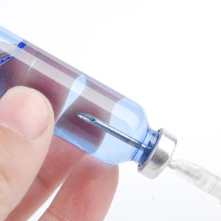
About OMICS Group
OMICS Group is an amalgamation of Open Access Publications and worldwide international science conferences and events. Established in the year 2007 with the sole aim of making the information on Sciences and technology ‘Open Access’, OMICS Group publishes 700+ online open access scholarly journals in all aspects of Science, Engineering, Management and Technology journals. OMICS Group has been instrumental in taking the knowledge on Science & technology to the doorsteps of ordinary men and women. Research Scholars, Students, Libraries, Educational Institutions, Research centers and the industry are main stakeholders that benefitted greatly from this knowledge dissemination. OMICS Group also organizes 1000+ International conferences annually across the globe, where knowledge transfer takes place through debates, round table discussions, poster presentations, workshops, symposia and exhibitions.

Slide 2
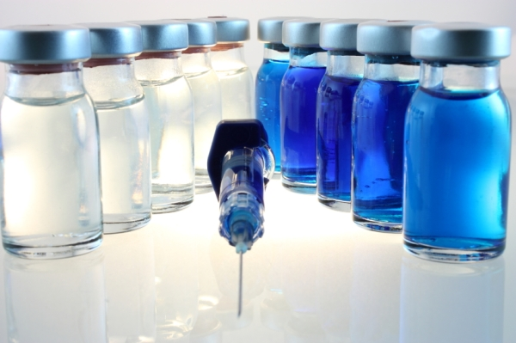
OMICS International Conferences
OMICS International is a pioneer and leading science event organizer, which publishes around 700+ open access journals and conducts over 500 Medical, Clinical, Engineering, Life Sciences, Pharma scientific conferences all over the globe annually with the support of more than 1000 scientific associations and 30,000 editorial board members and 3.5 million followers to its credit.
OMICS Group has organized 1000+ conferences, workshops and national symposiums across the major cities including San Francisco, Las Vegas, San Antonio, Omaha, Orlando, Raleigh, Santa Clara, Chicago, Philadelphia, Baltimore, United Kingdom, Valencia, Dubai, Beijing, Hyderabad, Bengaluru and Mumbai.

Slide 3
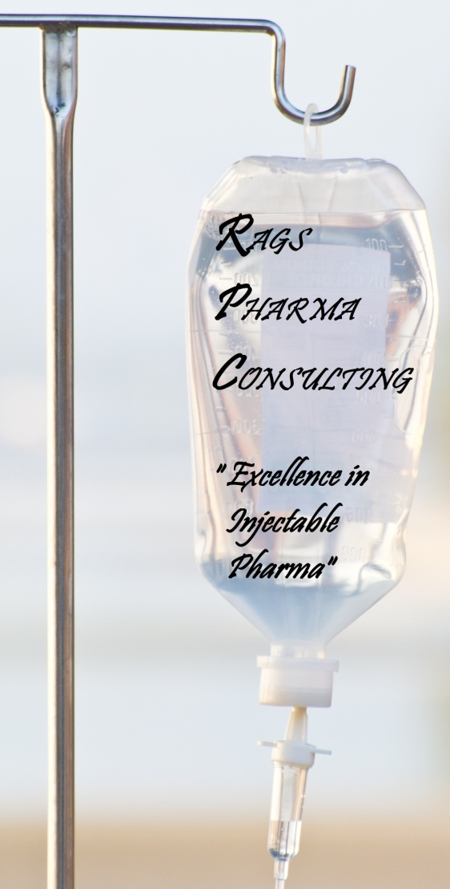
Systematic Approach to Development of Aqueous Drug Formulation and Drug-Device Combination Injectable Products & Challenges
Presented By:
Neervalur V. Raghavan, Ph.D.
President, RAGS PHARMA CONSULTING, LLC
August 19, 2015
Parenterals & Injectables
OMICS Conference
August 17-19, 2015
Chicago IL, USA

Slide 4
LECTURE OUTLINE
Introduction
  Injectable products, Drug-Device Combination products
Physico-Chemical Aspects of Drug molecules
  Solubility profile in aqueous and mixed solvent systems
  pH vs solubility profile in aqueous formulations (buffer, tonicity-adjusting agents, antioxidants, solubilizing agent, preservatives)
  pH rate profile of drug and chromatographic profile, potential for particulate matter

Slide 5
LECTURE OUTLINE
Selection of Parenteral Dosage Forms
  Parenteral product categories –
  Decision Tree for selection of a dosage form for a parenteral drug
  Scientific considerations in selection of a parenteral dosage form
  Preformulation
  Drug Solubility
  Drug Stability

Slide 6
LECTURE OUTLINE
Formulation Optimization
  Approaches to minimize drug degradation
  Formulation considerations in frozen drug development
  Influence of container compatibility and enhanced packaging
  Manufacturing Process Development
    Overview of manufacturing process – process flow diagrams
    Mixing process optimization
    Mixing process scale up
    Considerations in solution filtration
    Sterilization
    Process validation

Slide 7
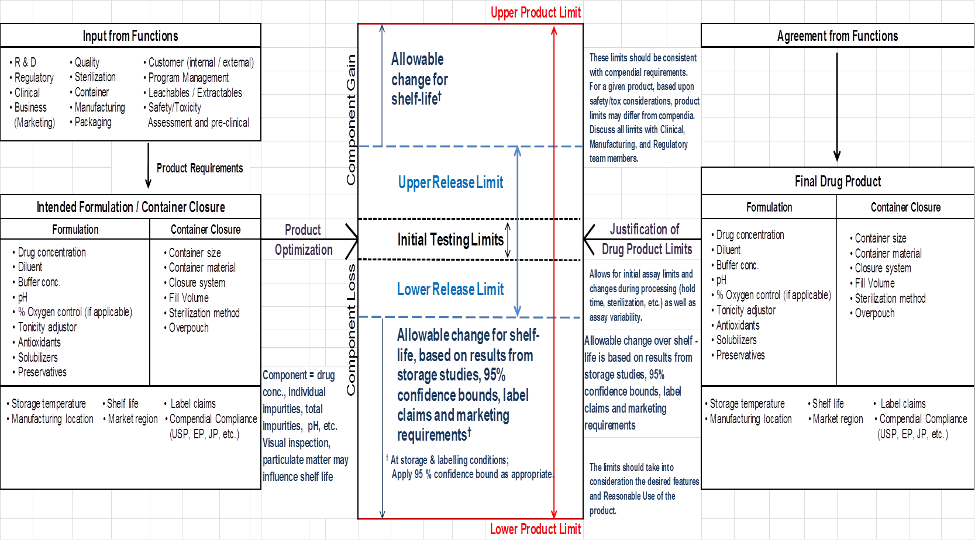
PRODUCT DEVELOPMENT OVERVIEW

Slide 8
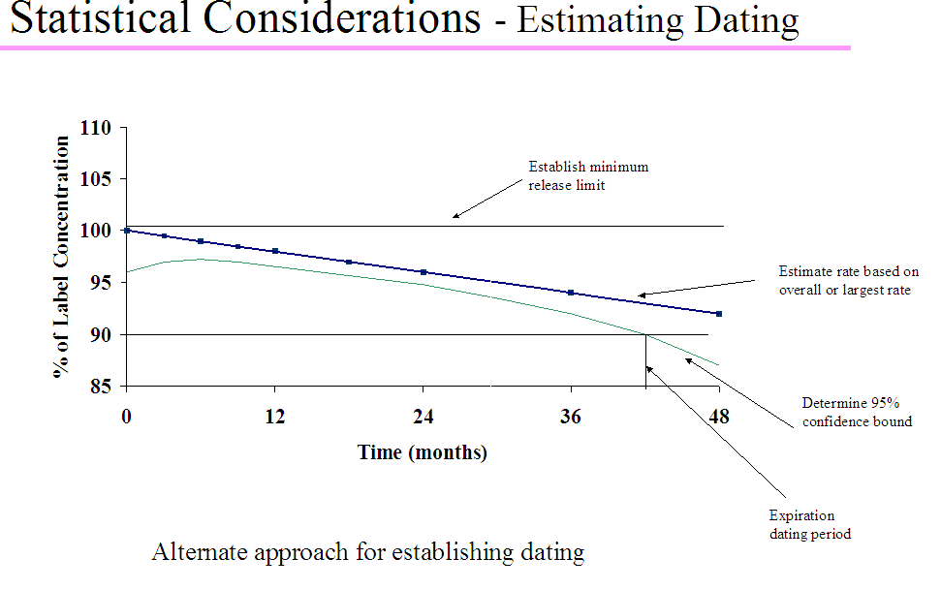
RELEASE & PRODUCT LIMITS
  For attributes known to decrease over time, the lower one-sided 95% confidence bound is compared to acceptance criterion.
  For attributes known to increase over time, the upper one-sided 95% confidence bound is compared to acceptance criterion.
  For attributes that can either increase or decrease over time, two-sided 95% confidence bounds are compared to acceptance criterion.

Slide 9
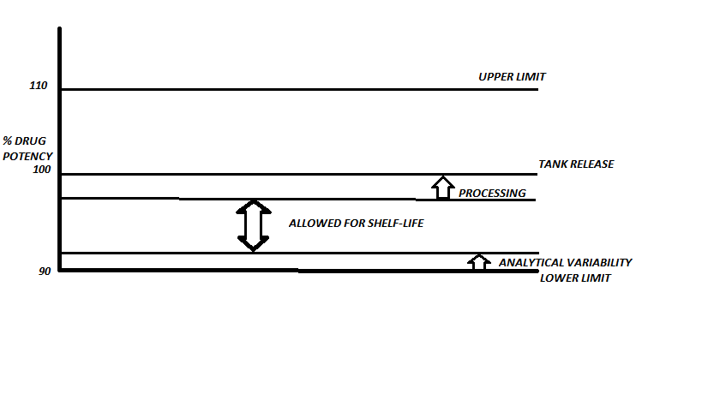
SHELF-LIFE CONSIDERATIONS

Slide 10
Selection of Parenteral Dosage Forms

Slide 11
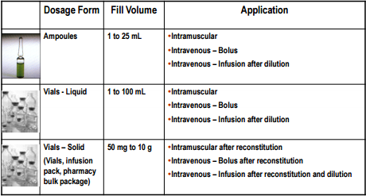
PARENTAL DOSAGE FORMS

Slide 12
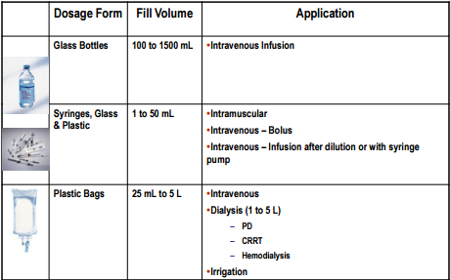
PARENTAL DOSAGE FORMS CONT’D

Slide 13
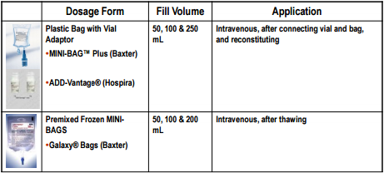
PARENTAL DOSAGE FORMS- ENHANCED PACKAGING

Slide 14
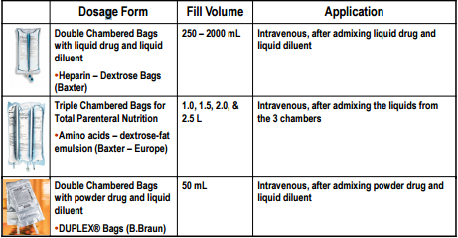
PARENTAL DOSAGE FORMS- ENHANCED PACKAGING CONT’D.

Slide 15
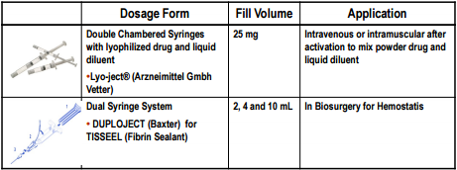
PARENTAL DOSAGE FORMS- ENHANCED PACKAGING CONT’D.

Slide 16
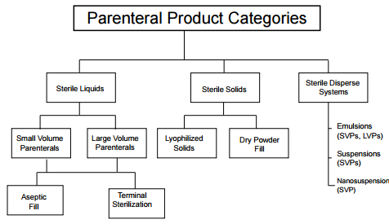
PARENTERAL PRODUCT CATEGORIES

Slide 17
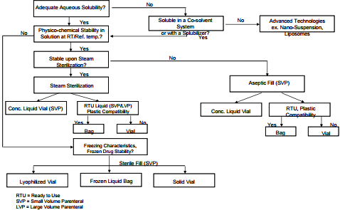
DOSAGE FORM DECISION TREE FOR A NEW PARENTERAL DRUG

Slide 18
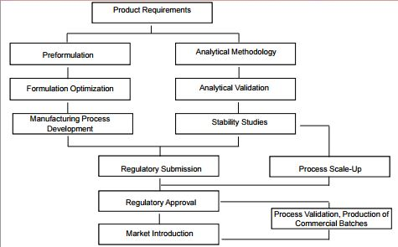
DEVELOPMENT CYCLE FOR A TYPICAL PARENTERAL DRUG PRODUCT

Slide 19
SCIENTIFIC CONSIDERATIONS IN DOSAGE FORM SELECTION
Proposed drug dose & concentration
Type of Administration
  Injection
  Infusion
  Type of compound (e.g., quinolone)
  Aqueous Solubility (pH effects)
  Aqueous stability (pH effects)
  Oxidation
  Light Stability
  Buffer effect
  Container Compatibility
      Absorption
      Leachables
  Drug safety/handling

Slide 20
PREFORMULATION

Slide 21
PREFORMULATION ACTIVITIES FOR PARENTERAL SOLUTIONS
Aqueous Drug Solubility
Aqueous Drug Stability

Slide 22
PREFORMULATION ACTIVITIES FOR PARENTERAL SOLUTIONS
Aqueous Drug Solubility
  pH- solubility profiles
  Solubility-temperature profile-heat of solution
  Co-solvents, other solubilizers
  Partition coefficient

Slide 23
PREFORMULATION OF PARENTERAL SOLUTIONS
pH- Solubility Profiles
  Many drug substances are either acidic or basic in nature and show differences in aqueous solubility as a function of pH depending on their ionization constants
  The relationship between solubility and pH can be defined as follows: pH = pKa + log [Cs ] /[Ca ]
    Where
    pKa = negative logarithm of the ionization constant of the acid
    {Cs } = molar concentration of salt form in water
    [Ca ]= molar concentration of free acid in water
  Experimentally generated pH- solubility profile is essential to ensure solubility of the drug in the formulation at specified dose and formulation pH

Slide 24
PREFORMULATION OF PARENTERAL SOLUTIONS
Co-Solvents
  Examples: Ethanol, Propylene Glycol, Polyethylene Glycol
Acid Solubilizers
  Examples: Hydrochloric acid, lactic acid, methane sulfonic acid
Surfactants
  Examples: Polysorbate 80, Cremaphor®
Complexation Agents
  Examples: Cyclodextrin

Slide 25
PREFORMULATION OF PARENTERAL SOLUTIONS
References on Solubilizers and other Parenteral Excipients
  Excipients and their use in injectable products. Sandeep Nema, R.J. Washkuhn, and R.J. Brendel. PDA Journal of Pharmaceutical Science and Technology. Vol. 51, No. 4. July August 1997
  Solubilizing Excipients in Oral and Injectable Formulations. Robert G. Strickley. Pharmaceutical Research. Vol. 21, No. 2, February 2004
  Compendium of excipients for Parenteral Formulations. Michael F. Powell, Tue Nguyen, and Lisa Baloian. PDA Journal of Pharmaceutical Science and Technology. Vol. 52, No. 5. September – October 1998.

Slide 26
PREFORMULATION ACTIVITIES FOR PARENTERAL SOLUTIONS
Aqueous Drug Stability
  Chemical kinetics
  Degradation pathways
  Identification and monitoring of degradation products

Slide 27
PREFORMULATION ACTIVITIES FOR PARENTERAL SOLUTIONS
Aqueous Drug Stability – Chemical kinetics
  Arrhenius plots
  Micellar effects on kinetics
  Impact of excipients
    Example
  pH- rate profiles

Slide 28
ACCELERATED STUDIES & USE OF ARRHENIUS RELATIONSHIP
Drug degradation rate is a key factor in formulation development
  Many drug degradation reactions are slow and it may take up to several months at room temperature to determine the degradation rate.
  In order to expedite the formulation optimization, degradation studies may be carried out at elevated temperatures and rate constants of room temperature can be estimated through Arrhenius relationship between the reaction rate and temperature.

Slide 29
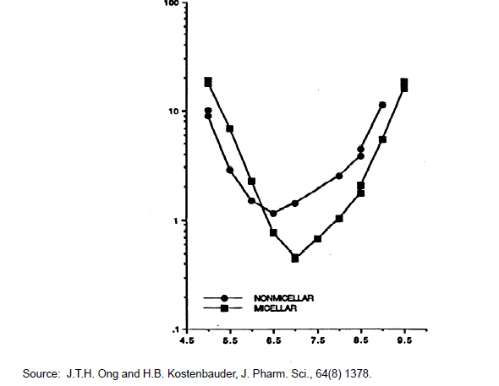
pH – Rate Profiles of Penicillin G in 0.5% (w/v) Non-micellar & 30% Micellar Concentrations

Slide 30
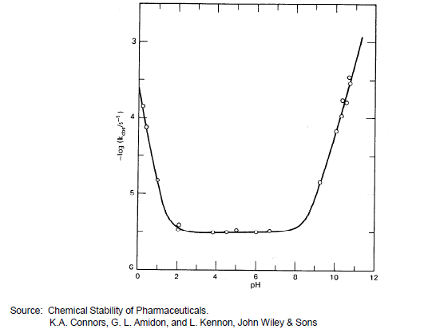
CEPHALOTHIN - pH-Rate Profile for Hydrolysis of ß-lactam Ring in Cephalothin at 30°C

Slide 31
PREFORMULATION ACTIVITIES FOR PARENTERAL
Aqueous Drug Stability – Degradation Pathways
  Hydrolysis
  Polymerization
  Isomerization/epimerization
  Oxidation
  Photolysis

Slide 32
PREFORMULATION OF PARENTERAL SOLUTIONS
References on Drug Degradation Pathways
  Chemical Stability of Pharmaceuticals – A Hand Book for Pharmacists. Chapters 4 and 5. Second Edition. Editors: Kenneth A. Connors, Gordon L. Amidon, and Valentino J. Stella. John Wiley and Sons.
  Pharmaceutical Dosage Forms, Parenteral Medications, Volume 1. Kenneth E. Avis, Leon Lachman, and Herbert A. Lieberman, Editors. Marcel Dekker, Inc.
  Remington: The Science and Practice of Pharmacy. Loyd V. Allen, Editor-Chair. Pharmaceutical Press. 22nd Edition (2012).
  Physical Pharmacy. Alfred martin, James Swarbrick, and Arthur Cammarata. Editors. Lea & Fiebiger.

Slide 33
FORMULATION OPTIMIZATION

Slide 34
FORMULATION OPTIMIZATION OF PARENTERAL SOLUTIONS
Approaches to minimize drug degradation
Formulation considerations in frozen drug development
Influence of container compatibility and enhanced packaging

Slide 35
FORMULATION OPTIMIZATION-
FORMULATION APPROACHES TO MINMIZE DRUG DEGRADATION
Hydrolysis
  Determine the optimum pH for pH- rate profiles
  Calculate change in hydrogen/hydroxyl ion concentration
  Select bugger if needed based on solution pH and buffer pKa
  Estimate the buffer concentration based on change in hydrogen/hydroxide ion concentration and buffer capacity of the buffer
  pKa of Commonly used Buffers for Parenterals
    Acetic acid 4.76
    Citric acid 3.15, 4.78, 6.40
    Phosphoric acid 2.12, 7.21, 12.67

Slide 36
INFLUENCE OF CONTAINER SYSTEM ON FORMULATION
Protection
  Light
  Water Loss
  Oxygen Permeation
  Microbial Ingress

Slide 37
CONTAINER SYSTEM –
DRUG FORMULATION COMPATIBILTY
Container Extractables
  pH Changes” Extractables from the plastic container may migrate into the solution and alter the formulation pH affecting the drug stability
  Excessive Levels of Extractables: Presence of solubilizers in the formulation may result in excessive levels of extractables
  Precipitation: Extractable may precipitate die to formulation pH

Slide 38
CONTAINER SYSTEM –
DRUG FORMULATION COMPATIBILTY
Drug Adsorption/Sorption to the Plastic Container
  Some drugs such as nitroglycerin adsorb to PVC
  Some drugs may sorb into the plastic, particularly during autoclave sterilization (high temperature and pressure)

Slide 39
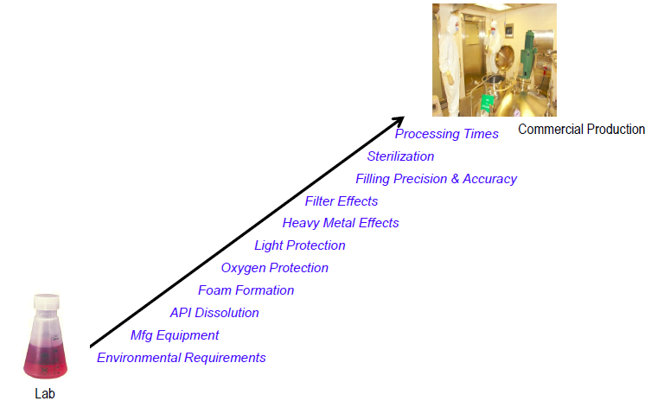
FACTORS IN PROCESS SCALE UP

Slide 40
CONCLUSION
Product Requirements
Product Development with Container & Closure System
TEAM EFFORT SUCCESS

Slide 41
Let us meet again..
We welcome you all to our future conferences of OMICS International
2nd International Conference and Expo
on
Parenterals and Injectables
On
October 24-26, 2016 at Istanbul, Turkey
http://parenterals-injectables.pharmaceuticalconferences.com/

