Slide 1
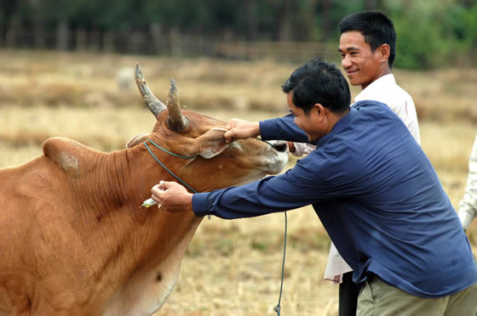
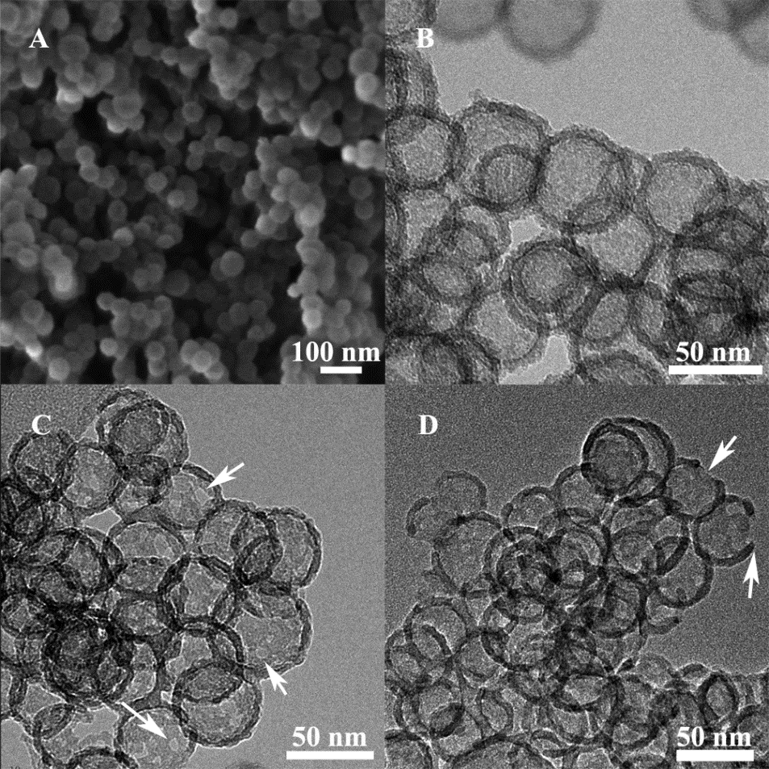
Silica particles as nano-carriers and self adjuvants for delivery of veterinary vaccines
Neena Mitter
n.mitter@uq.edu.au

Slide 2
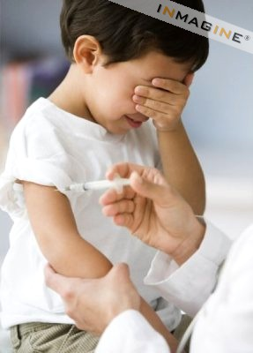
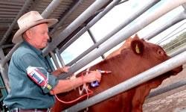
Vaccine development : animal versus human
Potential returns for animal vaccine producers are much less than those for human vaccines
Lower sale prices
Smaller market sizes
Lower investment in research
and development in the
animal vaccine area
Gardasil (papillomavirus and cervical cancer) market size – greater than 1 billion US dollars
FMD (Foot and mouth disease in cattle and Mycoplasma hyopneumoniae in pigs)
Combined market size – 10 -20% of Gardasil

Slide 3
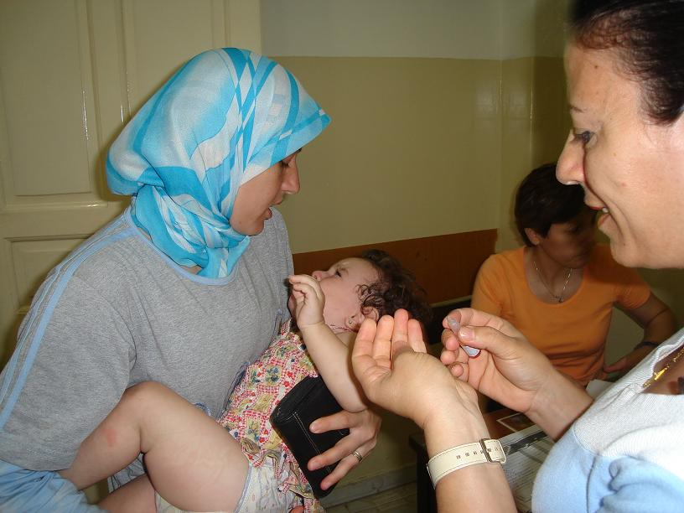
Veterinary vaccines: Major issues
Need for protective immunity
Minimization of side effects
Ease of handling and administration
Cost of production
Delivery
Adjuvants

Slide 4
Nanoparticles as vaccine delivery system and adjuvants
Additional routes of immunization
Enhanced immunogenicity
Minimization of side effects
Improved bioavailability
Improved storability
Targeting of specific tissues
Ease of handling and administration
Low cost of production
Low cost of delivery
Mody, Mitter et al , Nanoscale 2013

Slide 5
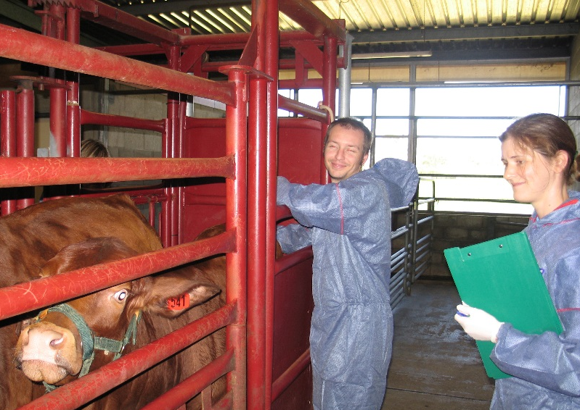
Phase 1: MSN as delivery vehicles–
Silica Nanoparticles: Veterinary Vaccine delivery
Model protein Ovalbumin
Bovine viral diarrhoea virus E2 Protein

Slide 6

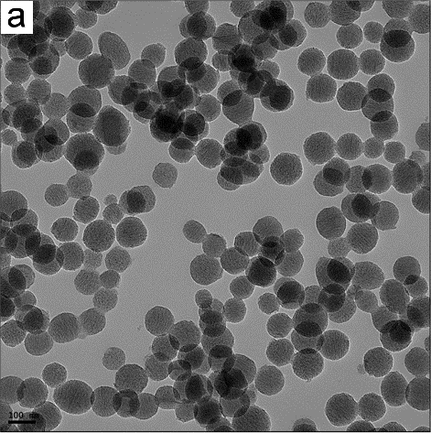
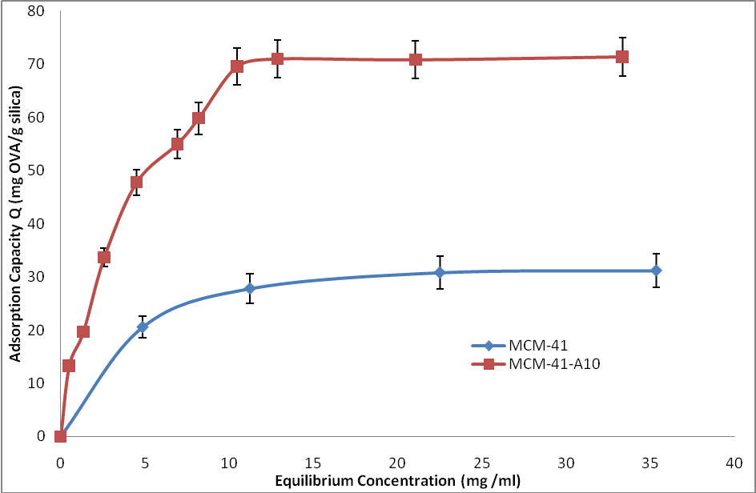
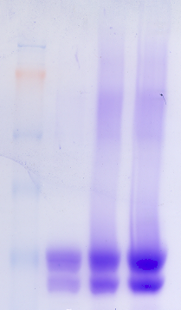
Amino functionalised MCM41(AM-41) for delivery of ovalbumin
Size 90nm
MW
OVA
4
24 hr
148
98
64
50
Mahony, Mitter et al, Small 2013
Notes:
fgfgfh
6

Slide 7
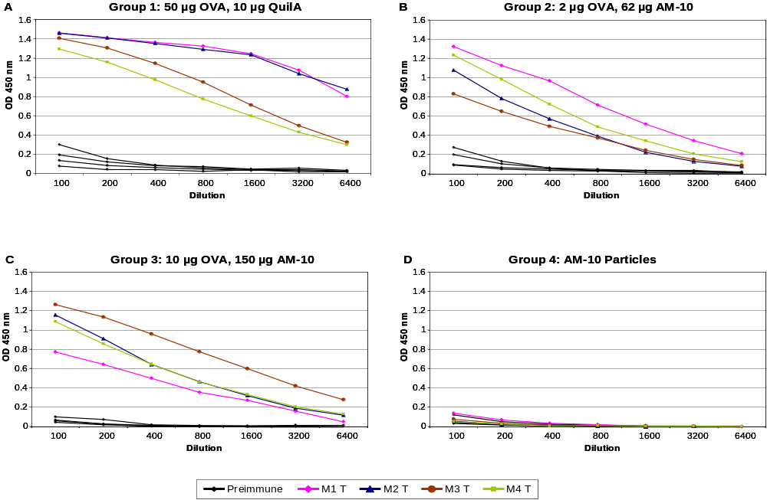
OVA-AM-41 nanoparticles – Antibody response
/AM41
AM41
Mahony, Mitter et al, Small 2013

Slide 8
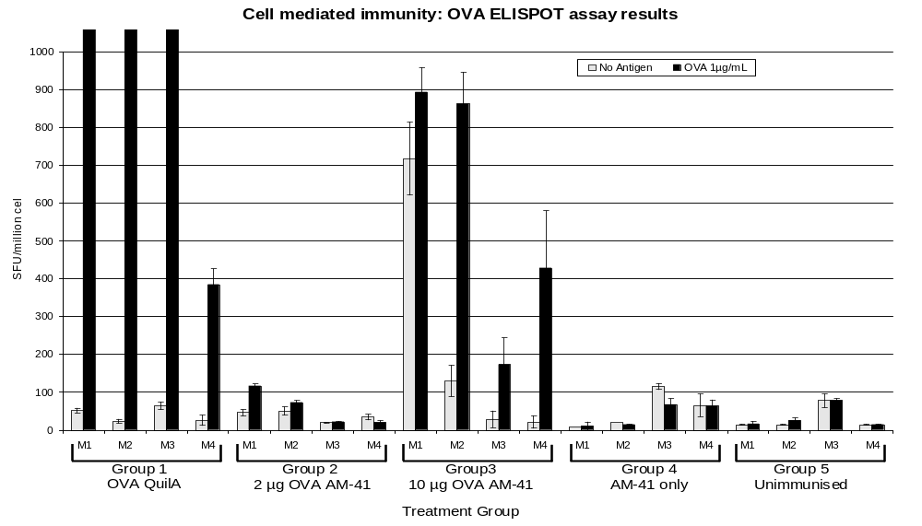
OVA-AM-41 nanoparticles – ELISPOT ASSAY
Detection of antigen specific IFN-γ secretion by ELISPOT assay of splenocytes from immunized mice.
Mahony, Mitter et al, Small 2013

Slide 9
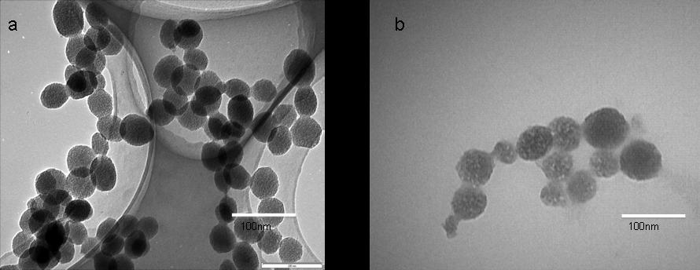
Freeze-drying of OVA loaded AM-41
5% Trehalose and 1% PEG 8000 most suitable for freeze-drying OVA/AM41.
Stored the freeze-dried OVA-AM41 at room temperature (RT) for 2 months.
Freeze-dried samples reconstituted within 30 sec and maintained their physical and chemical characteristics.
(a) AM-41 particles before freeze-drying (b) OVA/AM-41 particles after freeze-drying.
Mody , Mitter et al, International Journal of Pharmaceutics 2014

Slide 10
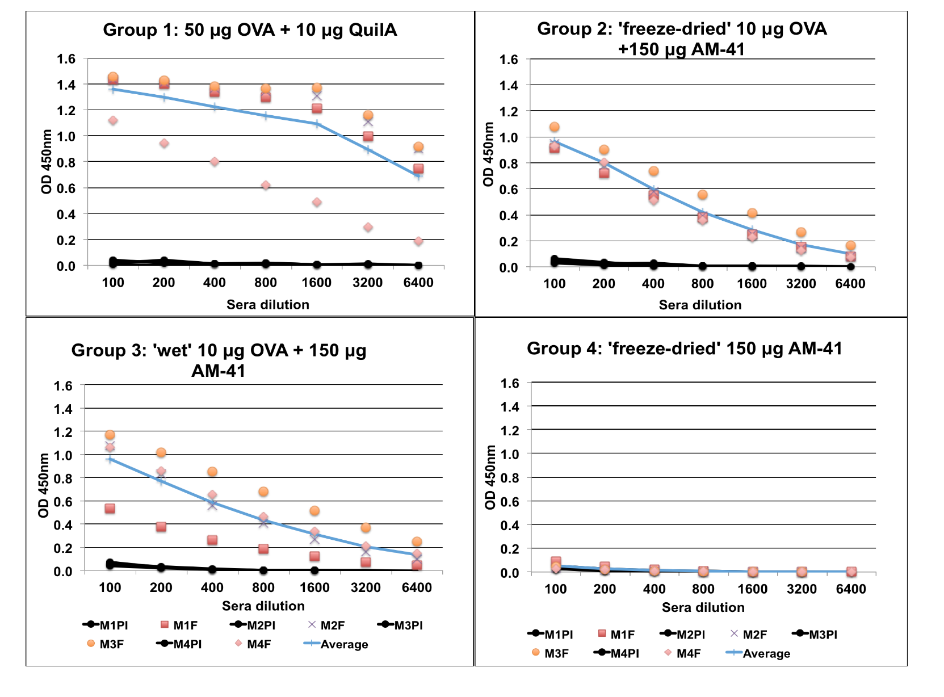
Freeze-dried OVA/AM-41 – Antibody response
Mody , Mitter et al, International Journal of Pharmaceutics 2014

Slide 11
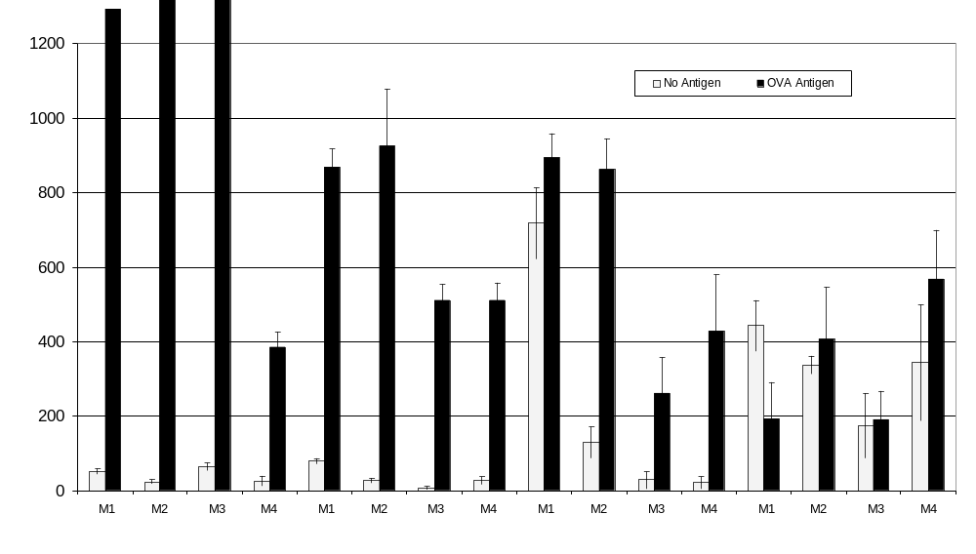
Freeze-dried OVA/AM-41 particles – ELISPOT assay
Spots/million cells
OVA QuilA
OVA AM-41 F/D
OVA AM-41 Wet
AM-41 F/D alone
Detection of antigen specific IFN-γ secretion by ELISPOT assay of splenocytes from immunized mice.
Mody , Mitter et al, IJP 2014

Slide 12
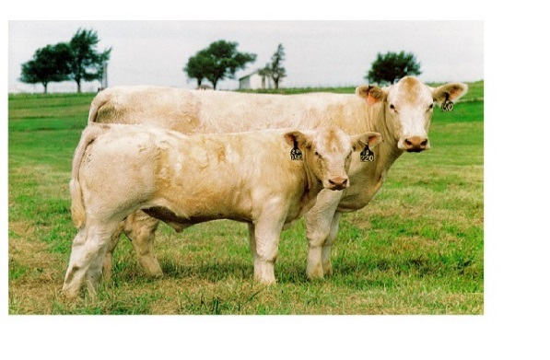

Bovine Viral Diarrhea Virus- BVDV
What can 40 years of vaccinations and 160 currently licensed vaccines do to eradicate a disease?
When you are talking about BVDV apparently not much – it is still thriving
www.bvdvaustralia.com

Slide 13
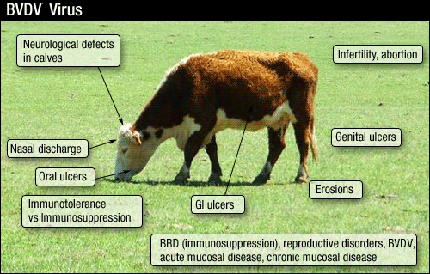
BVDV Infection

Slide 14
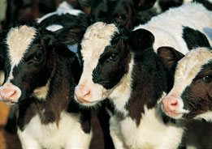

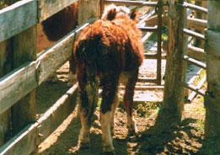
Persistently infected (PI) animals
'Persistently infected' calf with Mucosal Disease
BVDV infection may result in calves of varying birthweight
Severe acute BVDV

Slide 15
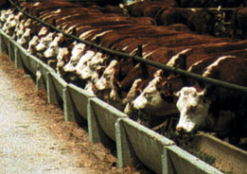
How BVDV is transmitted
Infection of a foetus with BVDV between 0 and 125 days of gestation can result in the birth of a PI animal that carries the virus for life.
PI animals shed and spread the BVDV virus through saliva, nasal secretions, faeces, urine, tears, milk, semen, vaginal discharges, placenta and birth fluid.
It can take as little as 1 hour of direct contact with a PI animal to transmit BVDV to an uninfected animal.

Slide 16
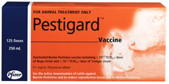
Pestigard® Vaccination Schedule
It uses inactivated forms of two antigenetically different Type 1 strains of BVDV that have been isolated in Australia
Two doses of Pestigard® should be administered 4-6 weeks apart with annual booster there after.
Store at 2 to 8°C
For subcutaneous use only.

Slide 17
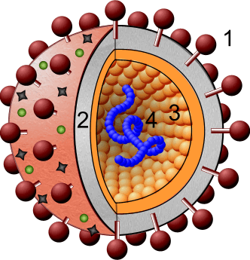
Bovine viral diahorrea virus (BVDV)
Bovine Pestivirus,
Single stranded enveloped RNA, 40-60nm
Genome size - 12.3 kilobase
E2 is a structural protein:
Major immunogenic determinant in infected animals
Involved in virus neutralisation
Ideal candidate for a subunit vaccine

Slide 18
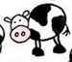
Protein Expression Constructs:
E2-T1 lacks the 93 bp membrane binding domain present in BVDV-E2
optiE2+SUMO (oE2+S) was optimised for E. coli codon usage, coding for an identical
amino acid sequence.
Deletion of the SUMO tag produced optiE2-SUMO (oE2-S).
E2T1, oE2+S and oE2-S were cloned into the bacterial expression vector pET-SUMO.
Cloning Strategy
E2T1
oE2+S
Deletion
oE2-S
SUMO Tag
6-His Tag
E2 native codon
usage
E2 E.coli codon
usage

Slide 19
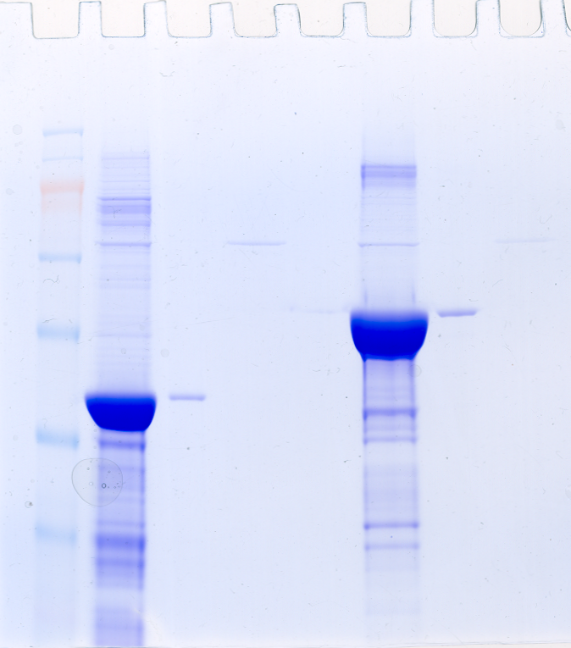
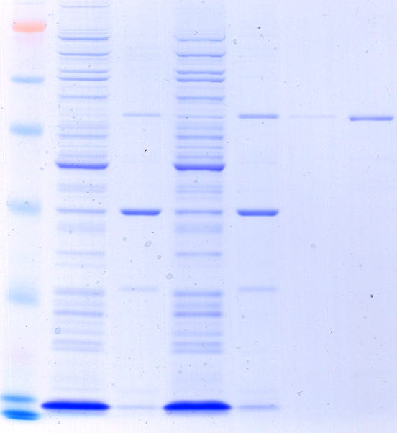
Expression of E2 proteins
BL21 cells, induced with 1mM IPTG.
oE2-S and oE2+S showed maximum expression 4hr post induction.
E2T1 showed maximum expression 2hr post induction.
All constructs produce insoluble proteins.
Solubilisation was achieved in Tris buffer (pH6.8) containing 100mM DTT, 1% SDS.
Dialysis in 50mM Tris, 0.2% Igepal (pH7.0).*
PAGE gel of purified protein
Protein Yield per L culture
optiE2
120
-
160 mg
oE2-S
oE2+S
E2T1
E2T1
1-2 mg
M
160
64
120
51
51kDa
mg protein per L culture
51kDa
80
39
41kDa
40
0
oE2-S
oE2+S
E2T1
* Cavallaro, Mitter et al. 2011, Microbial Cell factories

Slide 20
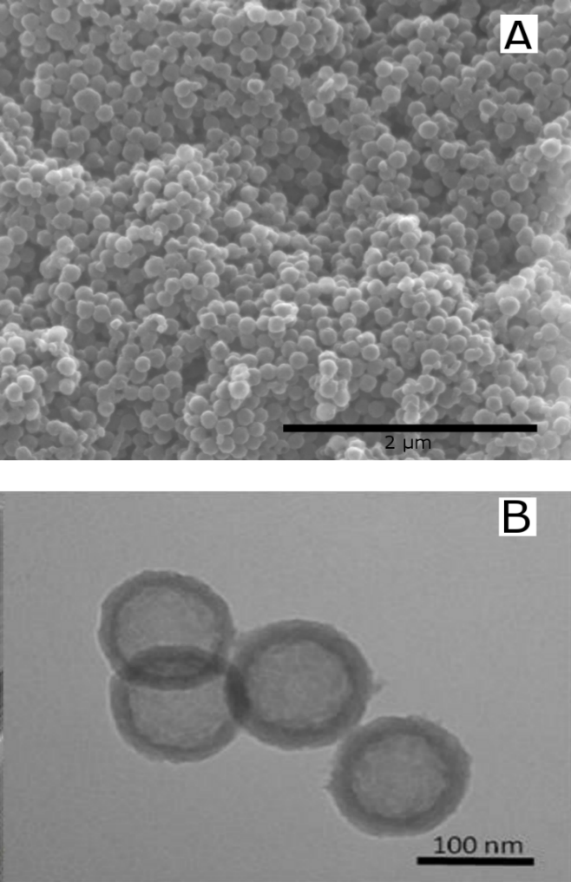
Amino functionalised Hollow Mesoporous Silica (HMSA)
Size 120 nm
Shell Thickness 20 nm
Entrance size 2-3nm
E2 adsorption 80µg/mg of particles
The morphology and microstructure of HMSA observed by (a) SEM and (b) TEM.
Mahony, Mitter et al, Nanoscale 2014

Slide 21
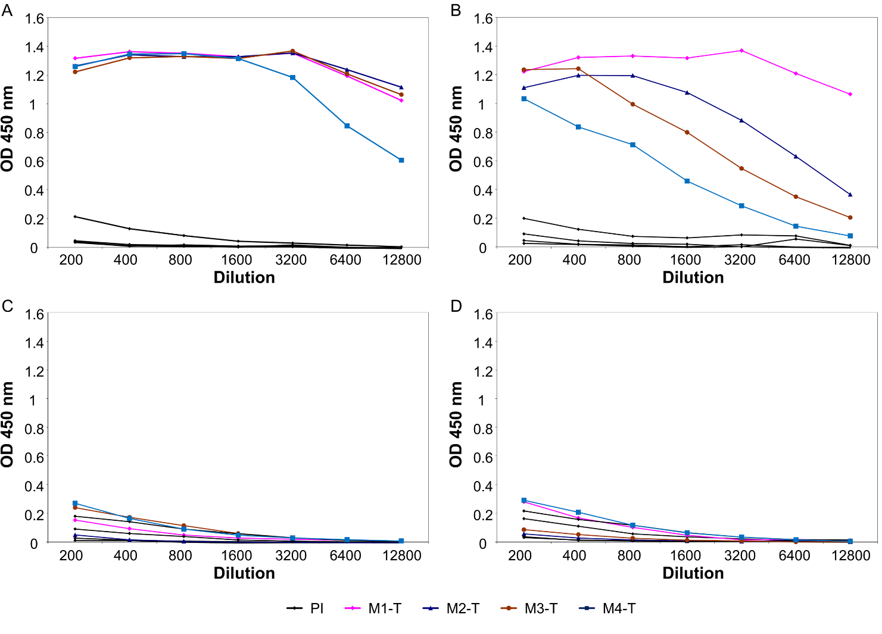
Antibody response in mice for Opti-E2:HMSA nanoparticles after 3 subcutaneous injections
50ug Opti-E2-QuilA
20 ug Opti-E2-HMSA
HMSA only
Unimmunised
Mahony, Mitter et al, Nanoscale 2014

Slide 22
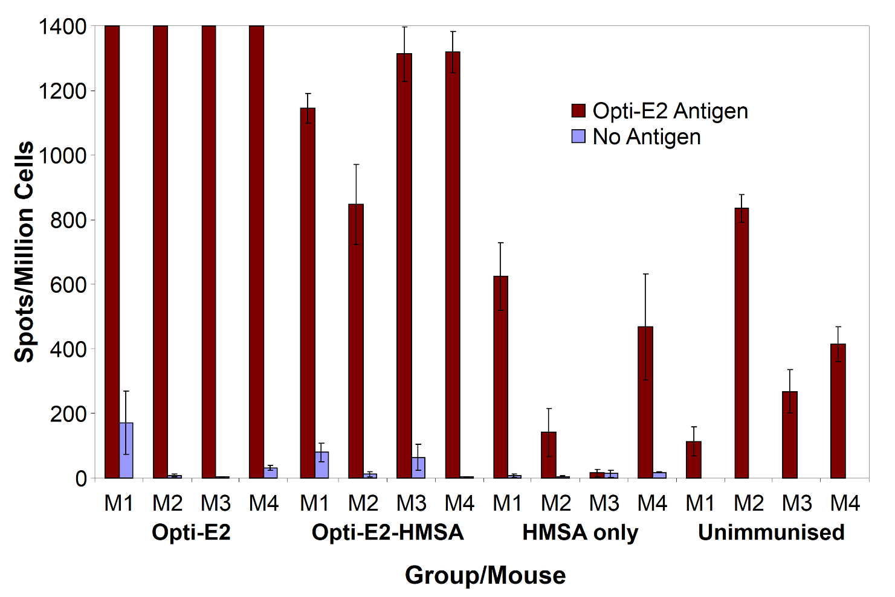
IFN- γ mice for Opti-E2:HMSA nanoparticles after 3 subcutaneous injections
Mahony, Mitter et al, Nanoscale 2014

Slide 23
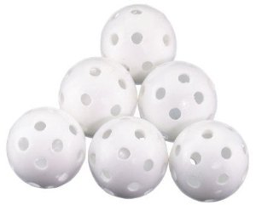

THE NEW GENERATION SILICA VESICLES
Sized for endocytosis (~50 nm)
Large internal cavity for high payload
Tunable entrance size ( 2 - 20nm)
Low cost, scalable manufacture

Slide 24
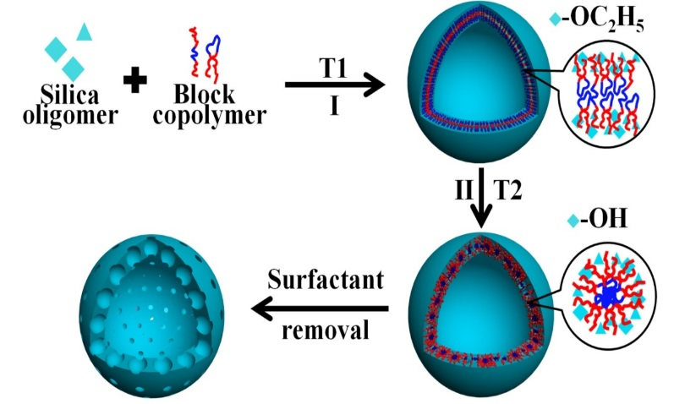
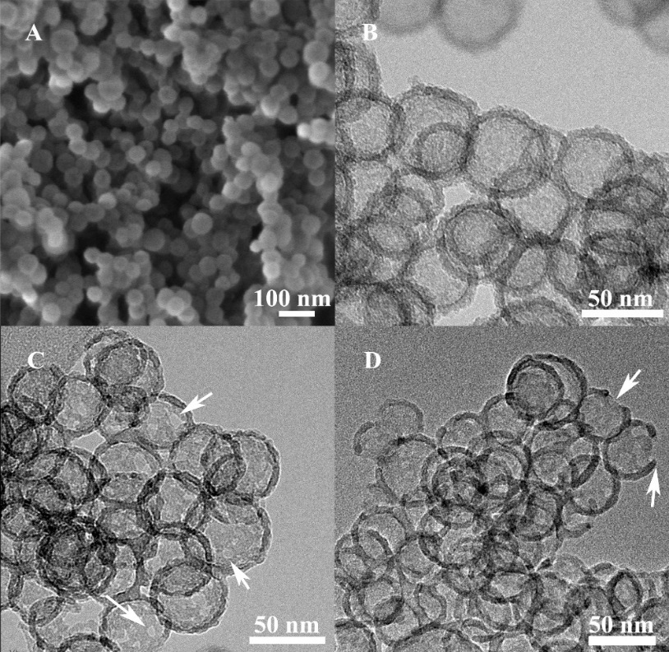
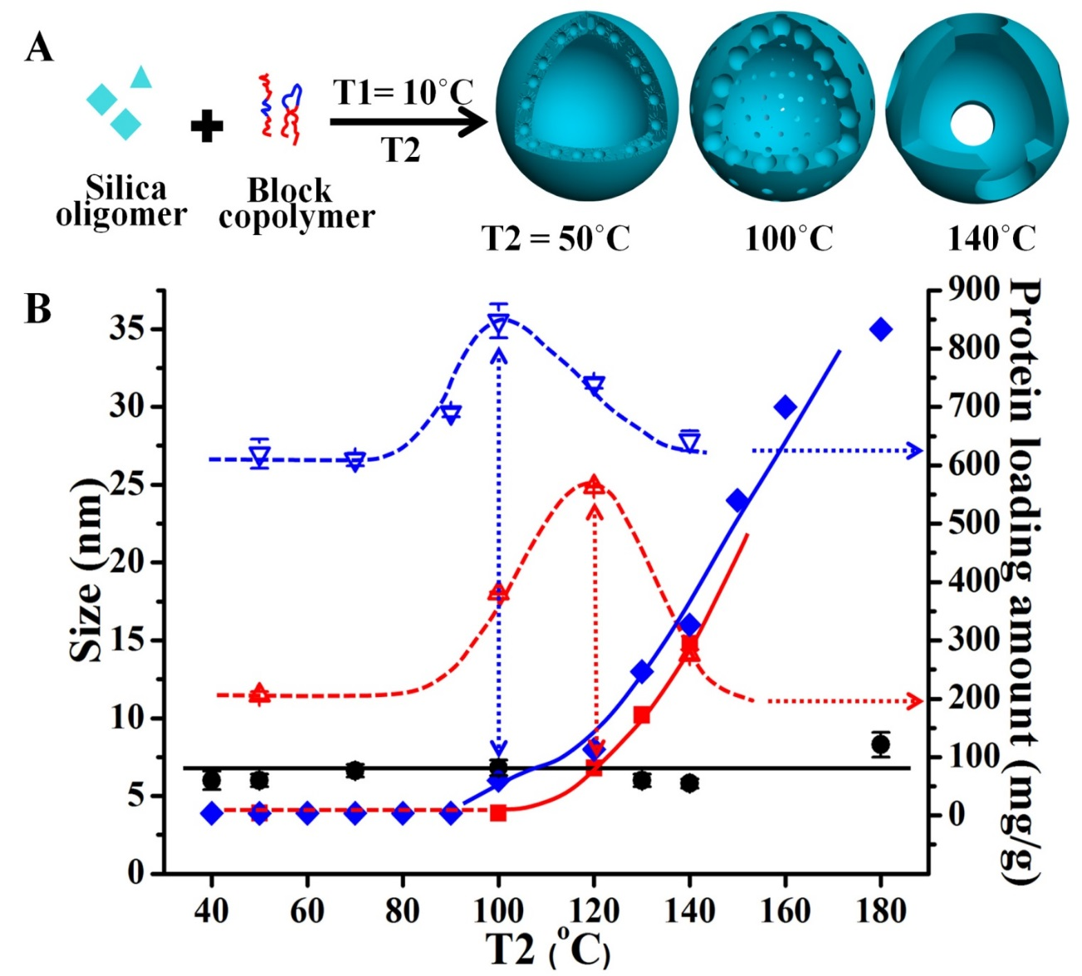
Hollow Silica Vesicles - SVs
T1: Formation of vesicular structure;
T2: fine control over the entrance size.
Mitter, Yu et al. PAT-02125-AU-01, Zhang, Mitter, Yu et al Small 2014

Slide 25
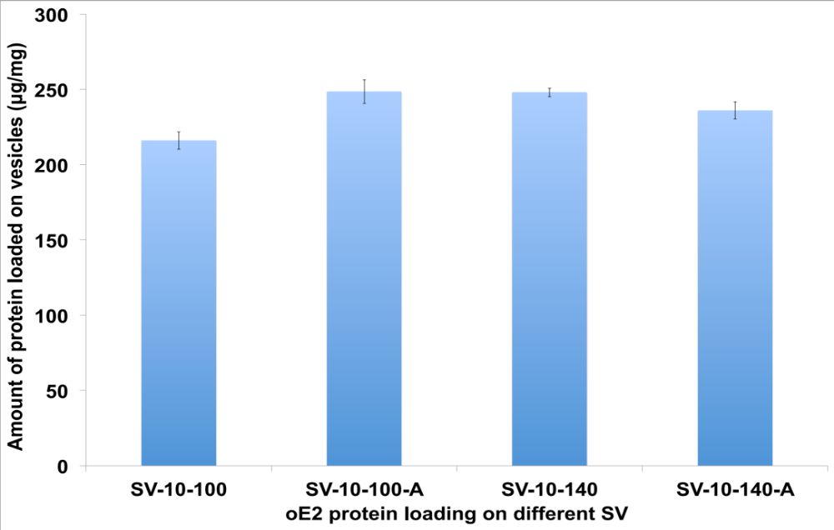
BVDV oE2 Adsorption on SVs
~250ug/mg
Adsorption amount of oE2 protein on the different SVs.
Mody , Mitter et al Biomaterials 2014

Slide 26
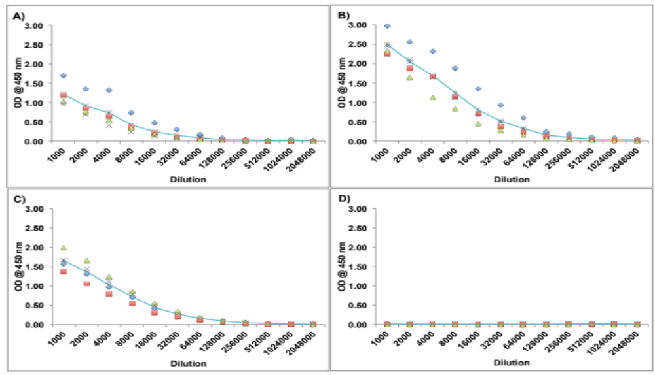
oE2:SV 140 antibody response in mice after 3 injections
oE2+ QuilA
oE2/SV
oE2/ SV + QuilA
Unimmunised
Mody, Mitter et al Biomaterials 2014
Notes:
a) oE2 (50μg) + QuilA (10μg); b) oE2 (50μg) loaded SV-140 (250μg); c) oE2 (50μg) loaded SV-140 (250μg) plus Quil A (10μg); d) SV-140 plus Quil A.
Sera of individual animals were diluted from 1:1000 to 1:2048000.

Slide 27
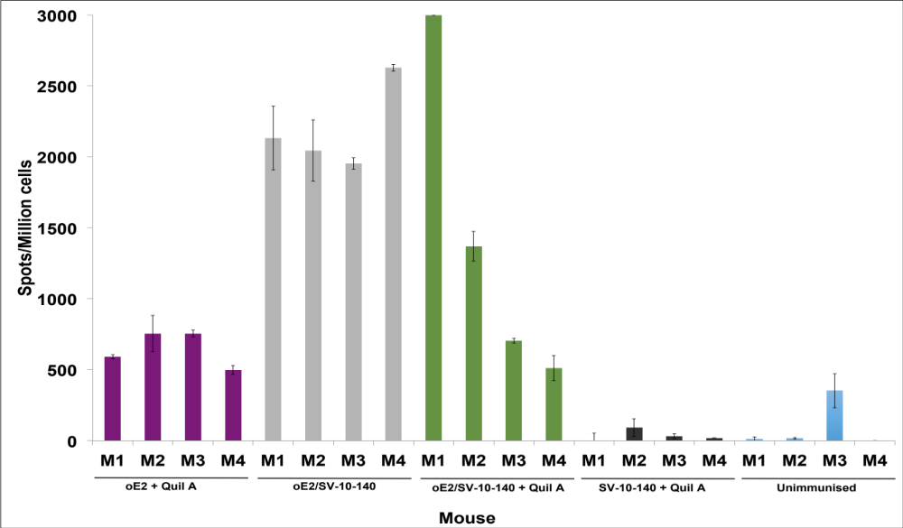
oE2-SV140 : Cell-mediated Response
Detection of antigen specific IFN-γ secretion by ELISPOT assay of murine splenocytes from immunised mice. M1 to M4 are the individual mice in each group.
Mody, Mitter et al Biomaterials 2014

Slide 28
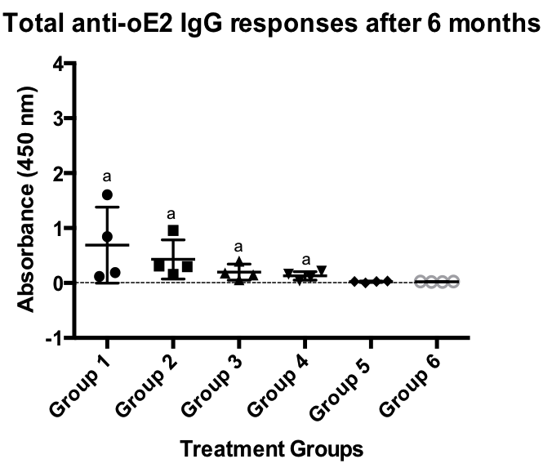
Long term antibody response after 2 injections
Mody, Mitter et al Unpublished

Slide 29
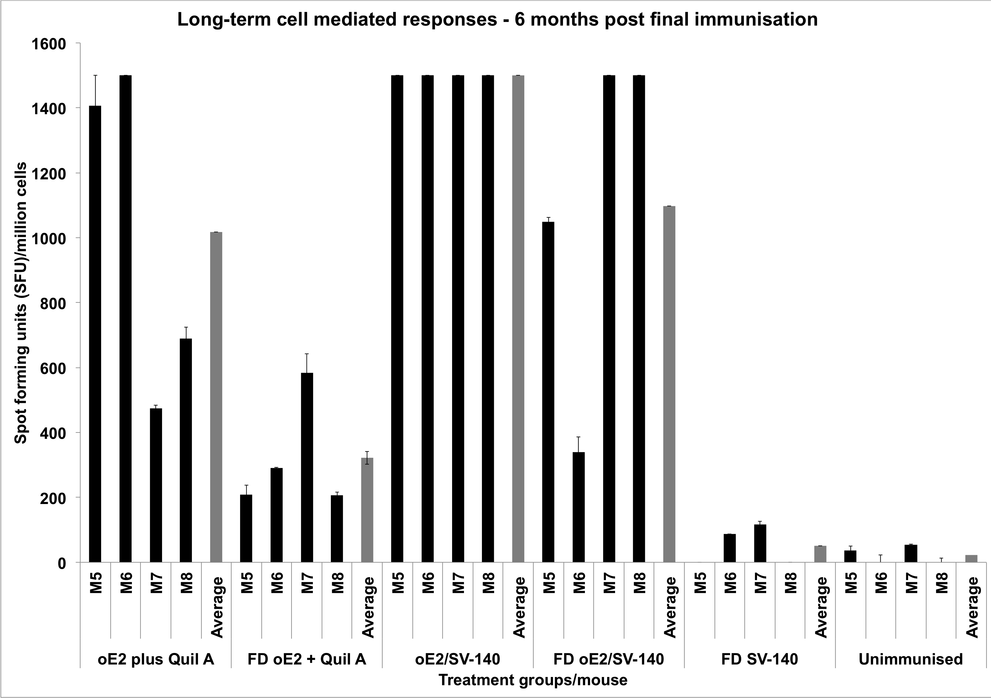
Long term memory response after 2 injections
Mody , Mitter et al Unpublished

Slide 30
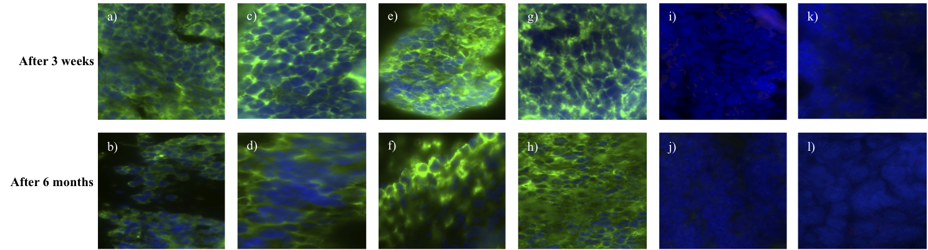
Representative immunohistochemistry analyses to determine the induction of total IgG
oE2:QuilA
oE2:SV140
Controls
Mody, Mitter et al Unpublished

Slide 31
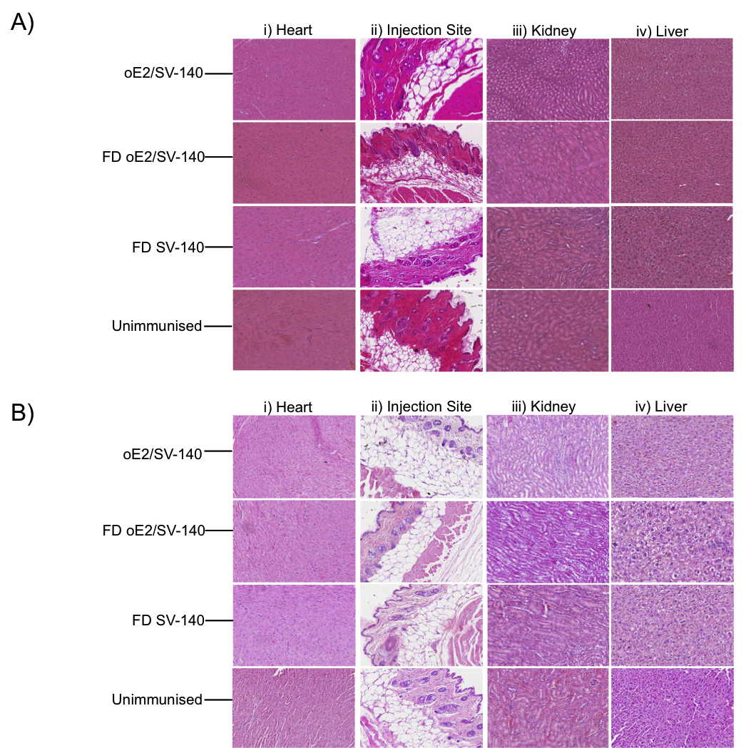
Mody, Mitter et al Unpublished

Slide 32
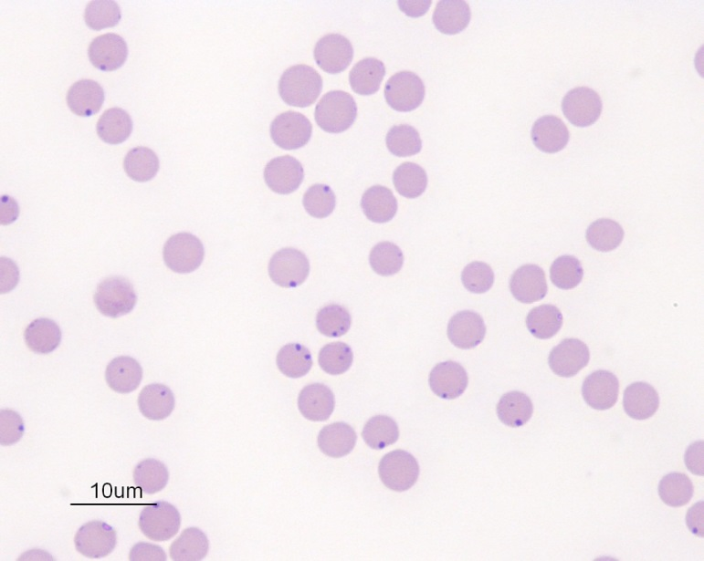
Anaplasma marginale – Cattle tick fever
The most prevalent tick-transmitted rickettsial pathogen in cattle.
Causing worldwide huge economic loss each year. Over $27 million dollars in Queensland annually.
Currently no safe and efficacious vaccines against A. marginale are available.

Slide 33
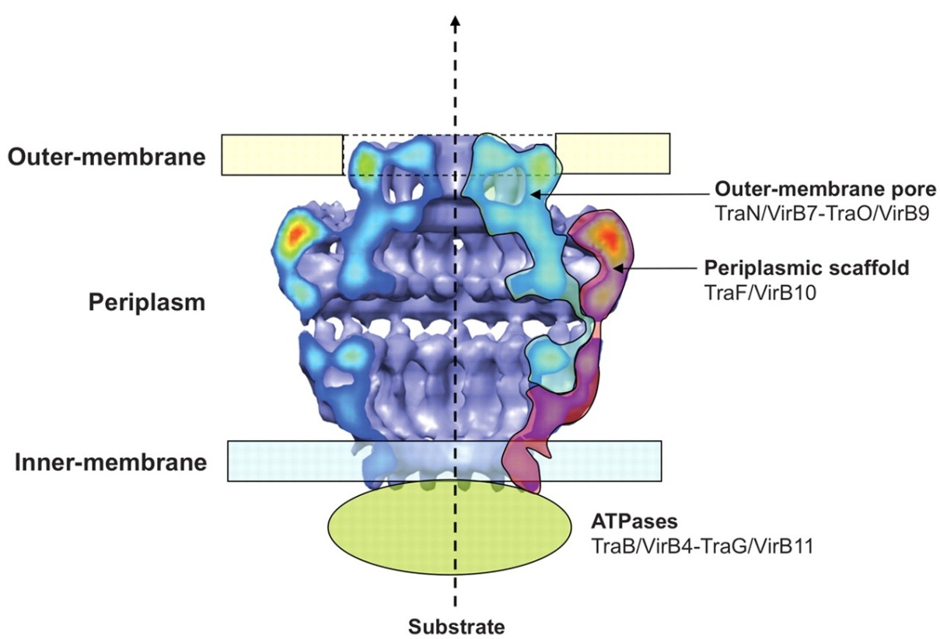
VirB9.1 and VirB9.2
Fronzes, R. et al. Structure of a type IV secretion system core complex. science 323, 266-268 (2009)

Slide 34
Antibody-mediated Immunity
VirB9.1 VirB9.2
SV-100 can achieve same level of adjuvanting effect as Quil A, without any undesirable side effects.
VirB9.1 and VirB9.2 can be used together in the same vaccine formulation.
Zhao, Mahony, Mitter and Middelberg et al Unpublished

Slide 35
Cell-mediated Immunity – VirB9.1
Zhao, Mahony, Mitter and Middelberg et al Unpublished

Slide 36
Cell-mediated Immunity
SV-100 can induce high level of cell-mediated immune response.
Confirmed VirB9.1 or VirB9.2 can be used together as mixed nano-formulation and induce high cell-mediated immunity.
Zhao, Mahony, Mitter and Middelberg et al unpublished

Slide 37
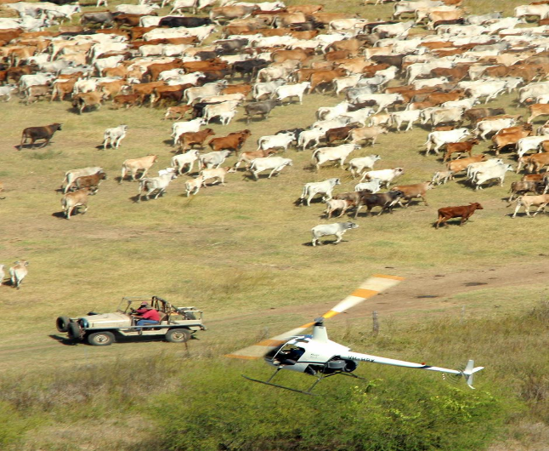
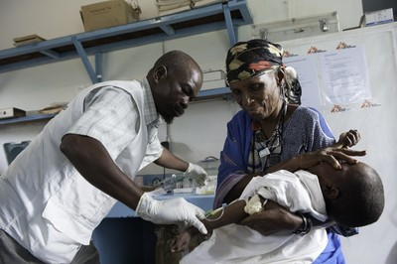
Platform Technology:
Single dose: Novel silica particles, size, functionalization, improved protein loading and slow release
Shelf Stable: Protein-particle interaction, freeze drying or other methods
Translational potential : animal and human health

Slide 38





The Team – Nanovaccines
First Phase:
Neena Mitter
Tim Mahony
Donna Mahony
Tony Cavallaro
Karishma Mody
Prof. Max Lu
Shizhang Qiao
Frances Stahr
Current Phase:
Bing Zhang
Michael Yu
Anton Middelberg
Amir Popat
Jun Zhang
Chunxia Zhao
Nani Wibowo
Liang Zhao
Neena Mitter
Tim Mahony
Donna Mahony
Tony Cavallaro
Karishma Mody
Prof Wendy Brown

Slide 39
