Slide 1
The Obligatory Role of Endogenous Retroviruses in Human Pregnancy: An Overview
Or
Do Viruses Really Cause Pregnancy?
Neal S. Rote, Ph.D.
William H. Weir, M.D. Professor of Reproductive Biology
Professor of Pathology
Case Western Reserve School of Medicine
Vice Chair for Academics and Director, Division of Research
Department of Obstetrics and Gynecology
University Hospitals Case Medical Center
Cleveland, OH

Slide 2
Endogenous Retroviruses (ERV)
In genome of most vertebrates and some invertebrates.
Integrated into DNA of germ cells.
Make up 8% or more of human genome: human ERV (HERV).
Simple retroviruses integrated into human DNA between <10 million and 100 million years ago.
Each specific retrovirus varies from > 100 integration sites to 1 integration site.
The gag, pol, or env regions in most integration sites have been inactivated through genetic modifications (e.g., deletions, mutations).
Selected regions may be expressed.
Major sites of expression: testis and placenta.
Role in development of placenta?

Slide 3
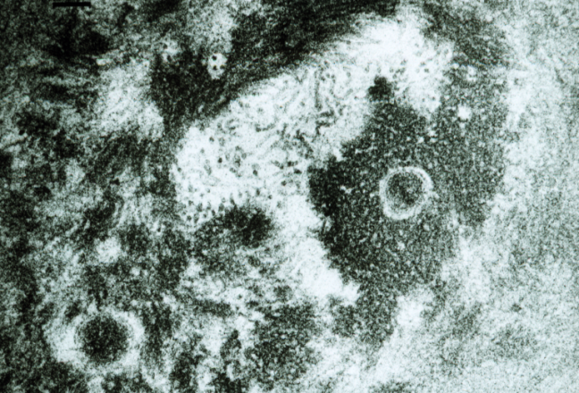
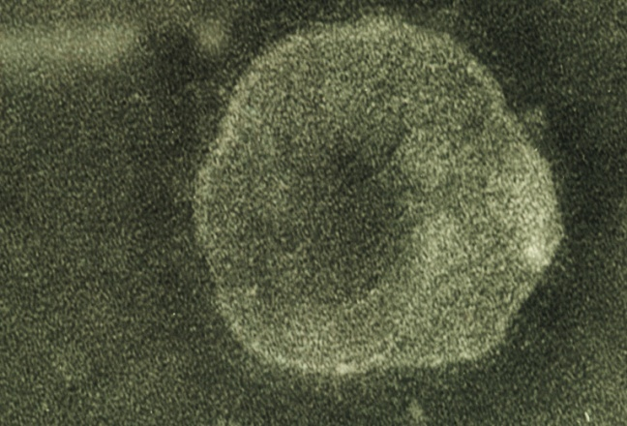
Placental Retrovirus Shedding
Production of viral particles
Along basal membrane of syncytiotrophoblast
Contain reverse transcriptase
Contain randomly packaged RNA
    Lyden TW, Johnson PM, Mwenda JM, Rote NS. Biol Reprod, 51:152-157, 1994.
    Rote NS, Chakrabarti S, Setzer B. Placenta, 25:673-683, 2004..

Slide 4
Human Placental Endogenous Retroviral Elements
5’LTR
gag
pol
env
3’LTR
gag Encodes matrix proteins
pol Encodes viral enzymes
Env Encodes envelope proteins
ORFs in pol, gag, and env
HERV-K family: pol (multiple sites), gag, env (6 different sites)
ORF in env
ERV-3 (HERV-R) (7q11.21)
HERV-W (7q21.2)
HERV-FRD (6p24.1)
HERV-E (clone 4-1)
HERV-R(b)
HERV-T
ERV-9
ORF in gag
ERV-1
HERV-F
HRES-1
ORF in pol
HERV-L
    Rote NS, Chakrabarti S, Setzer B. Placenta, 25:673-683, 2004..

Slide 5
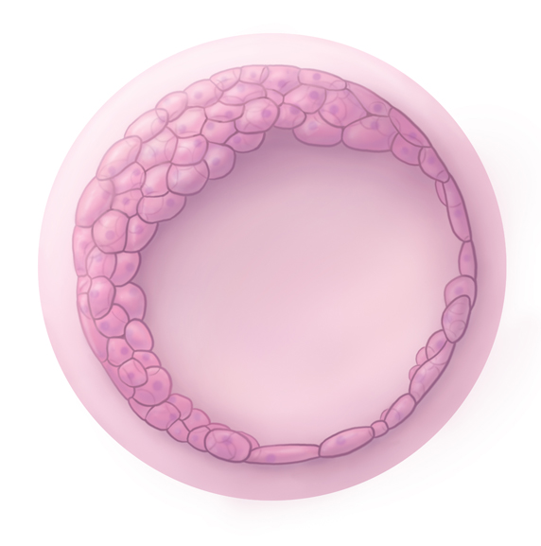
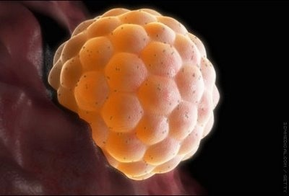
Attachment to Endometrium
Blastocyst
Endometrium
Inner cell mass
Trophectoderm

Slide 6
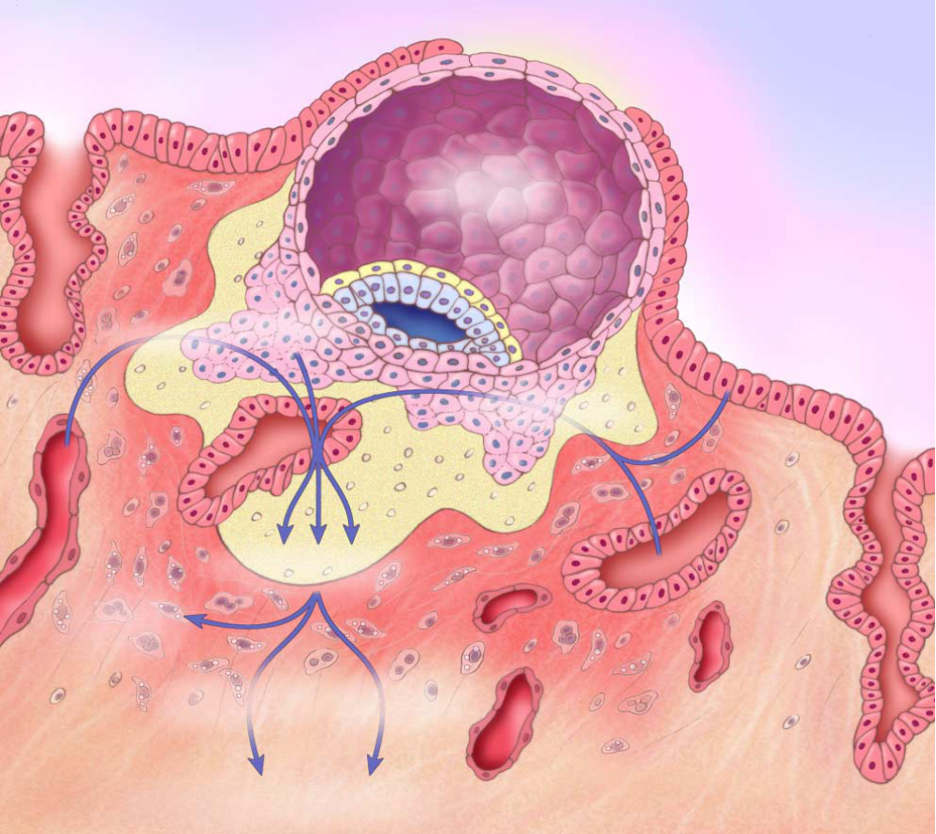
Invasion of Endometrium
9-10 days post-conception
Syncytiotrophoblast
Cytotrophoblast
Blastocyst Cavity
Amniotic Cavity
Growth Factors Cytokines
Low
Oxygen Tension
Endometrial Capillaries
Modified from Norwitz ER, Schust DJ, Fisher SJ. New Eng J Med 345:1400, 2001

Slide 7
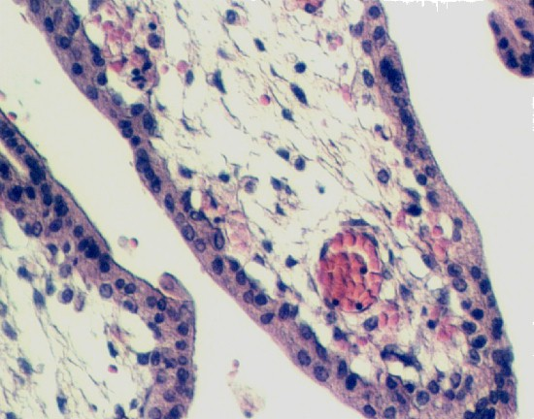
Human Placental Villus
Syncytiotrophoblast
Villous Cytotrophoblast

Slide 8
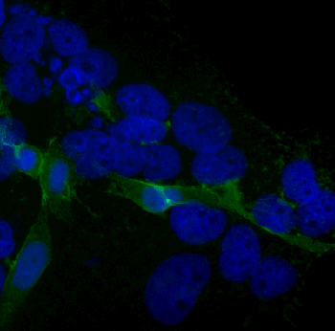
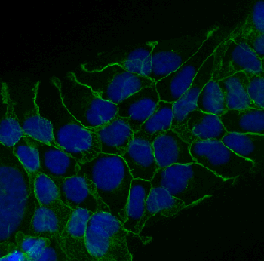
Differentiation of Villous Cytotrophoblast
Intercellular Fusion
Model: BeWo
Undifferentiated
mononuclear BeWo
cAMP or
Forskolin

Slide 9
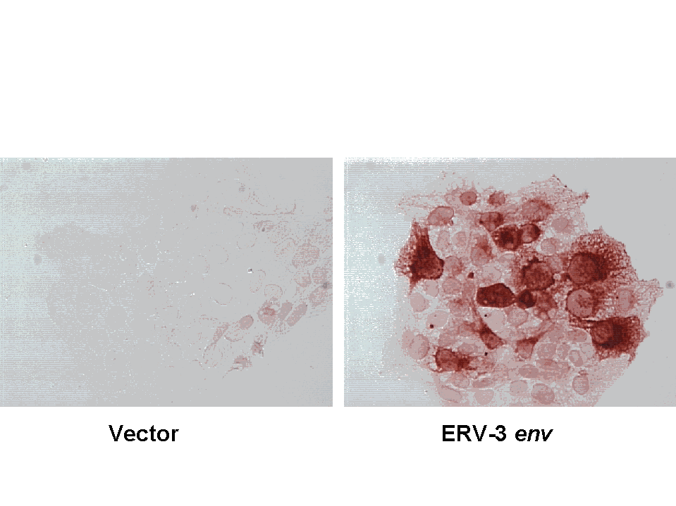
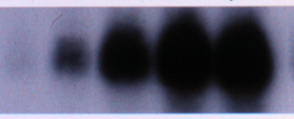
Differentiation of Villous Cytotrophoblast
Secretion of hCG
Undifferentiated
mononuclear BeWo
Immunoperoxidase with
anti-ß-hCG
cAMP or
Forskolin
Hours 0 24 48 72 96
Western blot with
anti-ß-hCG

Slide 10
Other Hallmarks of Human Villous Cytotrophoblast Differentiation
Production of other hormones
Exit from cell cycle
Cytoskeletal rearrangement
Increased resistance to apoptosis

Slide 11
Description of Physiologic Roles for HERVs
ERV3 env initates expression of ß-hCG and G1 arrest.
  Rote NS, Lin L, Xu B. Tropho Res 12:315-26, 1998.
HERV-W Env protein (syncytin-1) is trophoblast fusion protein.
Mi S, Lee X, Li X-P, et al. Nature 403:785-9, 2000.
HERV-FRD protein (syncytin-2) is trophoblast fusion protein.
deParseval N, Lazar V, Casella J-F, Heidmann T. J Virol 77:10414-22, 2003.

Slide 12
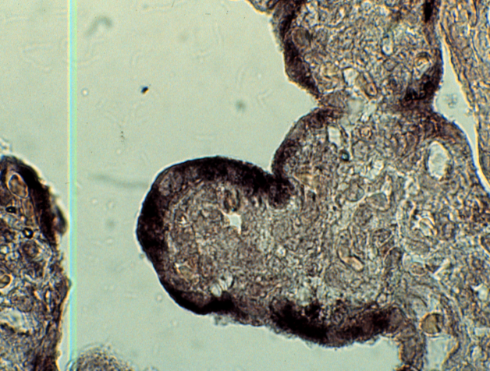
ERV3
Single copy (7q11.21).
ORF in env
ERV3 env sequenced: predicted protein structure.
Expressed in placental syncytiotrophoblast
  (in situ hybridization)
Also expressed in:
testis (not sperm),
fetal adrenal (large cells in cortex),
fetal Rathke’s pouch (developing pituitary),
ovary (progesterone-producing cells), and
sebaceous gland (periphery of lobe).

Slide 13
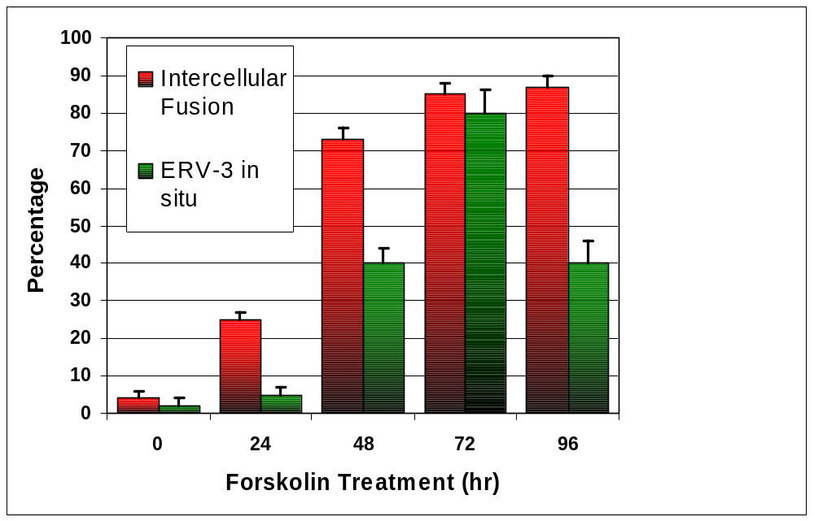
Changes in ERV3 env mRNA and Intercellular Fusion in Forskolin-treated BeWo

Slide 14
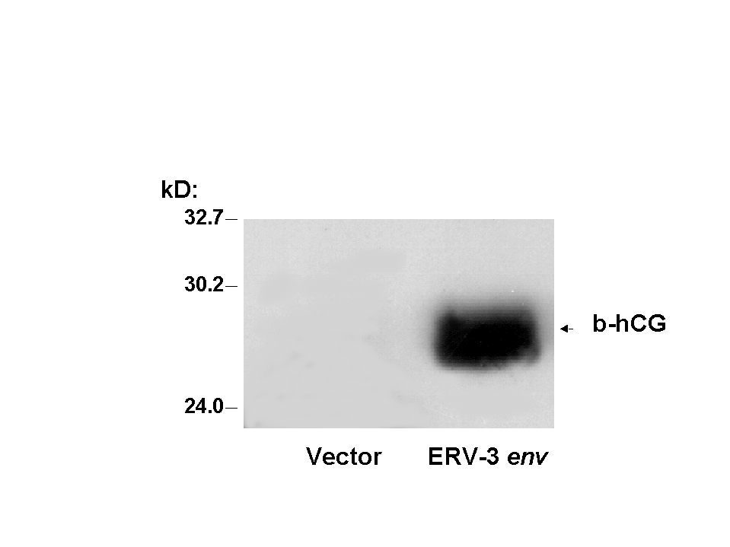
Stable Transfection of BeWo with ERV3 env: Effects on ß-hCG
Immunoperoxidase
Western Blot Analysis
Vector ERV3

Slide 15
ERV3 env “Knockout”?
de Parseval N & Heidmann T, J Virology 72:3442-5, 1998.
ERV3 env polymorphism
Identified homozygous mutation at position 1354: changed arginine at amino acid 183 to a stop signal (opl).
Observed in 1% of healthy individuals (3 in that study).
Therefore, ERV-3 Env “cannot” be relevant because the biologically active regions were deleted in this “knockout”.
L
SU
TM
65 kDa
25 kDa
L
SU
opl mutant (p25)

Slide 16
ERV3 is an “Atypical” ERV
Proteolytic Cleavage Site
p25
MSD/Cyto
L
ERV3
HERV-W
HERV-FRD
SU
TM
L
SU
TM
L
SU
TM
Fusion Peptide
Immunosuppressive Domain
    Rote NS, Chakrabarti S, Setzer B. Placenta, 25:673-683, 2004.

Slide 17
Questions
Where is active site in ERV3 ENV for induction of hCG?
By what mechanism does ERV3 ENV regulate transcription of ß-hCG?
How is expression of ERV3 regulated?

Slide 18
An Atypical Human Endogenous Retrovirus, ERV3 env, Induces Human Chorionic Gonadotropin (𝝱-hCG) in a Model of Placental Trophoblast
Neal S. Rote, Ph.D., Sonia Eiguero, M.D., Chuan Xu, M.D., Huiqing Tan, Lijuan Yi, Sam Mesiano, Ph.D.
Department of Reproductive Biology
Case Western Reserve University School of Medicine
Department of Obstetrics and Gynecology
University Hospitals Case Medical Center
Cleveland, OH, 44106, USA

Slide 21
An Atypical Human Endogenous Retrovirus, ERV3 env, Induces Human Chorionic Gonadotropin (𝝱-hCG) in a Model of Placental Trophoblast
Neal S. Rote, Ph.D., Sonia Eiguero, M.D., Chuan Xu, M.D., Huiqing Tan, Lijuan Yi, Sam Mesiano, Ph.D.
Department of Reproductive Biology
Case Western Reserve University School of Medicine
Department of Obstetrics and Gynecology
University Hospitals Case Medical Center
Cleveland, OH, 44106, USA

Slide 22
Summary of Previous Studies
ERV3 env is expressed in the differentiating villous cytotrophoblast and a model of villous cytrotrophoblast differentiation; BeWo.
Overexpression of ERV3 env results in expression of ß-hCG and apparent G1 arrest, but only a minor increase in intercellular fusion.
A naturally occurring homozygous ERV3 env polymorphism results in a truncated ERV3 ENV; p25.
Question: Does the p25 component contain the active site for induction of ß-hCG?

Slide 23
Model System: BeWo Choriocarcinoma
Undifferentiated
mononuclear BeWo
Immunoperoxidase with
anti-ß-hCG
cAMP or
Forskolin
Hours 0 24 48 72 96
Western blot with
anti-ß-hCG

Slide 24
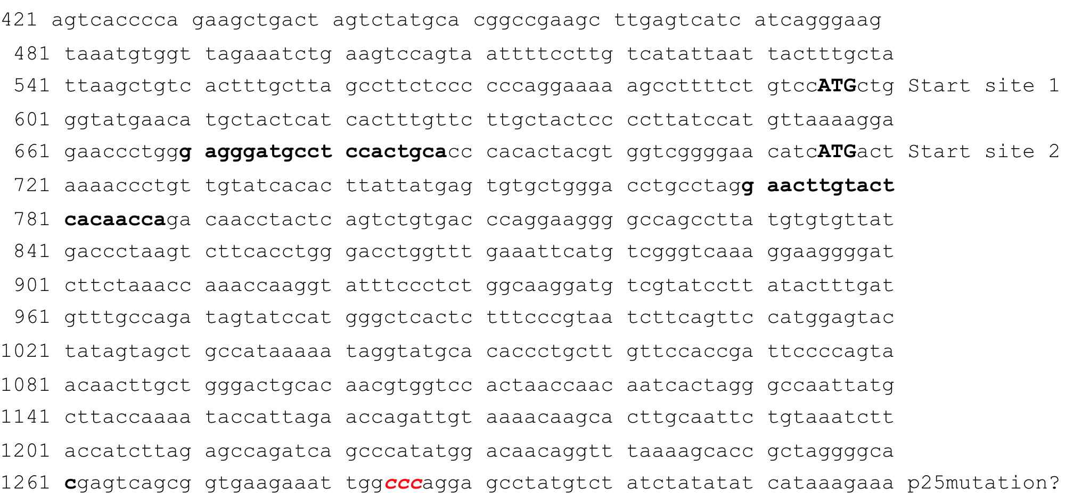
ERV3 env mRNA
siRNA Targets

Slide 25


Effect of siRNA 670 Targeted to ERV3 env
24 hours 48 hours 72 hours
𝝱-Actin
N = No siRNA
S = Scrambled
670 = siRNA 670
𝝱HCG
N S 670 N S 670 N S 670
P < 0.01
P < 0.01
P < 0.01
BeWo transiently tranfected with empty vector (N) or vectors containing a scrambled sequence (S) or siRNA targeted to the ERV3 env.

Slide 26
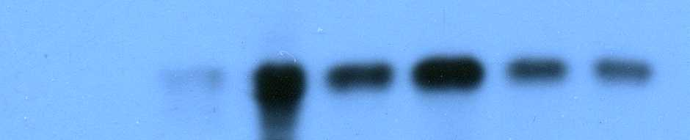
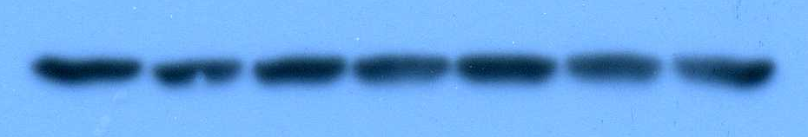
Stable Over-Expression of ERV3 Variants in BeWo
Cont Vector For ERV3 ERV3 p25 p25
ß-hCG
ß-actin
P < 0.05
P < 0.001

Slide 27

Transient Transfection with ERV3 env Inserts
BeWo treated for 48 hours with DMSO (negative control), forskolin (positive control), or vectors containing inserts of TM, p25, or SU regions of ERV3, or the complete ERV3 ORF.
Treatment DMSO - - - - Forskolin
Transfection - TM P25 SU ERV3 -
𝝱-Actin
𝝱-hCG

Slide 28
ERV3 env “Knockout”?
de Parseval N & Heidmann T, J Virology 72:3442-5, 1998.
ERV3 env polymorphism
Identified homozygous mutation at position 1354: converted to a stop signal.
ERV-3 Env “cannot” be relevant because the biologically active regions were deleted in this “knockout”.
L
SU
TM
65 kDa
25 kDa
L
SU
opl mutant (p25)
Conclusion: the truncated ERV3 p25 env encodes the active site for induction of ß-hCG.

