Slide 1


Microbial conversion of biodiesel waste into mcl-PHA using Pseudomonas putida LS46
Dr. Nazim Cicek
Department of Biosystems Engineering
University of Manitoba, Canada
International Conference and Exhibition on Biopolymers and Bioplastics
August 10-12, 2015
San Francisco, California, USA

Slide 2
Presentation Outline
Introduction
Bioplastics
Microbial polyhydroxyalkanoates
Bioprospecting
Isolating PHA-producing strains
Growth Characterization
Growth and PHA accumulation on various carbon sources in flask cultures
Scale up: Bioreactor work
Study of culture conditions
Fed-batch strategies to achieve high cell density cultures
Tailor-made PHAs: Creating high value products
Genetic engineering of strain
Modification of polymers
International Conference and Exhibition on Biopolymers and Bioplastics
August 10-12, 2015
San Francisco, CA

Slide 3
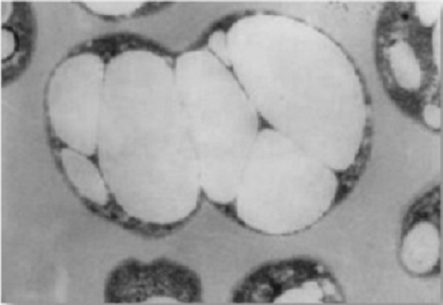
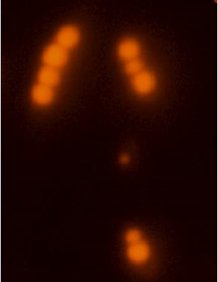
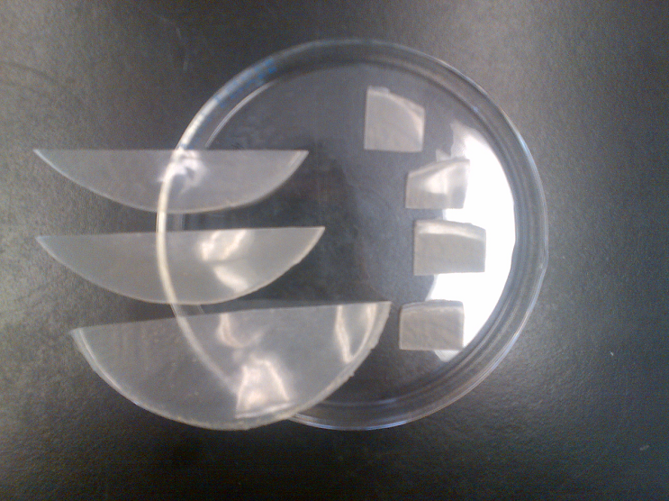
Polyhydroxyalkanoates (PHAs): Biodegradable plastics from bacteria
PHAs are a class of 100% biodegradable polyester polymers (polyesters) that serve as an intracellular energy storage mechanism in a wide range of bacterial species.
Can posses a wide range of properties and can thus be tailored to the application
Can be produced from agro-industrial (renewable) waste streams
These polymers have shown potential value as biopolymers, bioresins, biocomposite materials and fine chemicals
International Conference and Exhibition on Biopolymers and Bioplastics
August 10-12, 2015
San Francisco, CA
Notes:
Fig 1 – microbial mcl-PHA inclusions in cells(note this photo is R. eutropha taken from a review paper (Sudesh et al. 2000)
Middle Fig – stained with nile red and observed under green UV light gives red fluorescence to PHA granules (this is our image)
Fig on the right: PHA from octanoic acid (this is our image)

Slide 4
Microbial Polyhydroxyalkanoates (PHAs)
The monomer composition and molecular weight of the polymer determines the mechanical and thermal properties, and hence the potential application.
Many factors can influence polymer composition:
Bacteria:
C. necator: Class I PHA Synthase
P. putida: Class II PHA synthase
scl-PHAs (R = 1)
mcl-PHAs (R = 1 to 11)
Carbon sources:
Functional side chains
O
Unsaturation; Aromatic
Halogens; Carboxy
Hydroxy; Phenoxy; Epoxy; Methyester, Etc…
O
CH
CH₂
C
R
n
Novel bacteria:
New isolates or genetic modifications
Novel PHAs: scl-mcl-PHA
(Co-polymers)
Figure 1. Pathways for microbial mcl-PHA synthesis.
International Conference and Exhibition on Biopolymers and Bioplastics
August 10-12, 2015
San Francisco, CA
Notes:
Note: make figure look less grainy in the middle

Slide 5
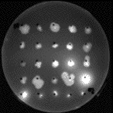
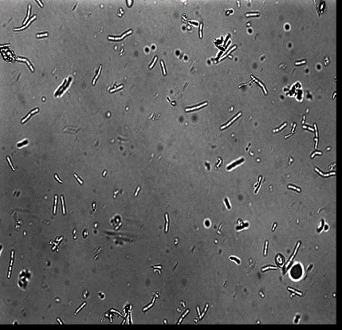
Starting out: Bioprospecting
Method: Enrichment
Medium: Thin slurry, wet cake, or DDGS as a sole carbon source
Inoculum: Hog barn wash
Results:
45 isolates screened. Of these isolates, Pseudomonas putida LS46 showed promising PHA production and was selected for further studies. Although similar to other P. putida strains (F1, KT2440, GB1) it was confirmed to be genetically distinct on the basis of nucleotide sequence of the cpn60 hypervariable region.
International Conference and Exhibition on Biopolymers and Bioplastics
August 10-12, 2015
San Francisco, CA
Notes:
Results: 45 isolates screened on plates containing Nile Red dye were observed under UV light. PHA producers gave bright fluorescence. (stained with nile red and observed under green light gives red fluorescence)
Of these isolates, Pseudomonas putida LS46 showed good PHA production on glucose medium and was selected for further studies. Although similar to other P. putida strains (F1, KT2440, GB1) it was confirmed to be genetically distinct on the basis of nucleotide sequence of the cpn60 hypervariable region.

Slide 6
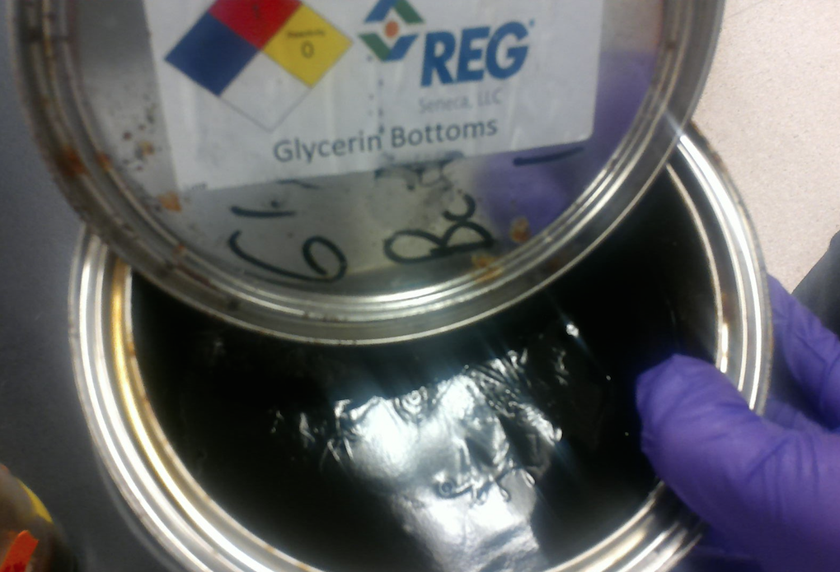
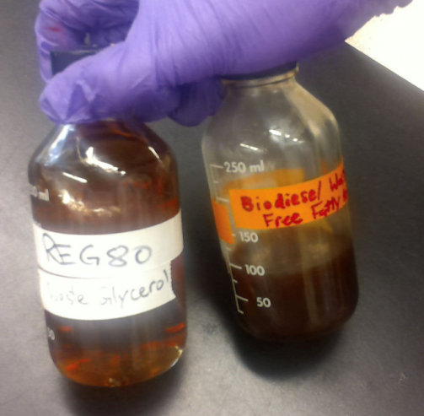
Waste feedstocks for P. putida LS46
Biodiesel production
  116 million gallons/month produced in USA (eia.gov)
  10% (vol/vol) of this is waste (glycerin bottoms)
  Glycerin bottoms contains about 60% glycerol and 40% waste free fatty acids
Waste fryer oil
  100 million gallons produced daily in the USA (Chhertri et al. 2008)
Carbohydrates (incl. glycerol)
  Lots of waste glycerol available
  Supports robust growth, but do not give good PHA yield (Sharma et al. 2012)
Above: Waste glycerine bottoms from Renewable Energy Group in Danville, IL. Left: glycerol and free fatty acids separated from glycerine bottoms
International Conference and Exhibition on Biopolymers and Bioplastics
August 10-12, 2015
San Francisco, CA
Notes:
Data on biodiesel from U.S. Energy Information Agency. Accessed August 1, 2015.
Data on fryer oil courtesy Chhetri et al. 2008.
Ref for carbohydrates/glycerol comment: Sharma et al. 2012

Slide 7
Growth characterization: P. putida LS46
Cell mass, mcl-PHA content, and monomer composition from P. putida LS46 grown on different low cost carbon sources in bench-scale batch culture experiments. Nitrogen limitation was used as a trigger for PHA prodcution
Table 1. Mcl-PHA production by P. putida LS46 grown on different substrates in batch shaker flasks.
Substrate | Biomass | % PHA | Monomer Composition
 |  |  | %C6 | %C8 | %C10 | %C12 | %C14
Glucose | 3.3 | 20.5 | 1.1 | 14.7 | 68.9 | 6.3 | n.d.
Hexanoic Acid | 2.2 | 19.1 | 79.0 | 19.6 | 1.4 | 0.0 | 0.0
Octanoic Acid | 2.5 | 48.9 | 6.5 | 92 | 1.5 | 0.0 | 0.0
Nonanoic Acid | 2.4 | 28.1 | 28.0% C7, 72% C9
Decanoic Acid | 2.5 | 33.7 | 5.2 | 57.4 | 37 | 0.4 | 0.0
Biodiesel Waste Free Fatty Acids | 4.6 | 40.3 | 7.7 | 54.0 | 32.0 | 4.9 | 1.2
Waste Fryer Oil | 2.8 | 35.0 | 6.1 | 54.9 | 27.6 | 4.5 | 3.1
Biodiesel Waste Glycerol | 4.5 | 15.5 | 4 | 32.8 | 57.4 | 2.3 | 0.2
Polymers of different monomer composition synthesized when the bacteria are grown on different carbon sources. The dominant monomer for each substrate is indicated in red (n.d. – not detected).
International Conference and Exhibition on Biopolymers and Bioplastics
August 10-12, 2015
San Francisco, CA
Notes:
Different monomer compositions can be achieved with different substrate = different properties. On most substrates, the PHA synthase seems to show specificity toward C8 and C10 monomers. However, as shown in the Table, this can be changed when the substrate is changed. Dominant monomer is highlighted in red, but other significant differences are observed: production of C12 and C14 from carbohydrates (glucose, glycerol) and also longer chain fatty acids (fryer oil, waste FFAs)
Note that pure alkanoic acids were all added to a concentration of 20 mmol/L. All other substrates were less toxic and were added to concentrations of 10 g/L. More carbon would have given more PHA for most substrates (ie 40 mmol/L octanoic acid gives PHA content up to 75%)
Note that the substrates: glycerol and long-chain fatty acids start to incorporate unsaturated monomers which drastically affects physical properties, but also provides opportunity for chemical modifications
Unsaturated: waste FFA: 0.2% C12:1, C14:1 likely present but not detected
Waste glycerol: 3.3% C12:1, C14:1 not detected
Waste fryer oil: 1.7% C12:1, 0.1% C14:1

Slide 8
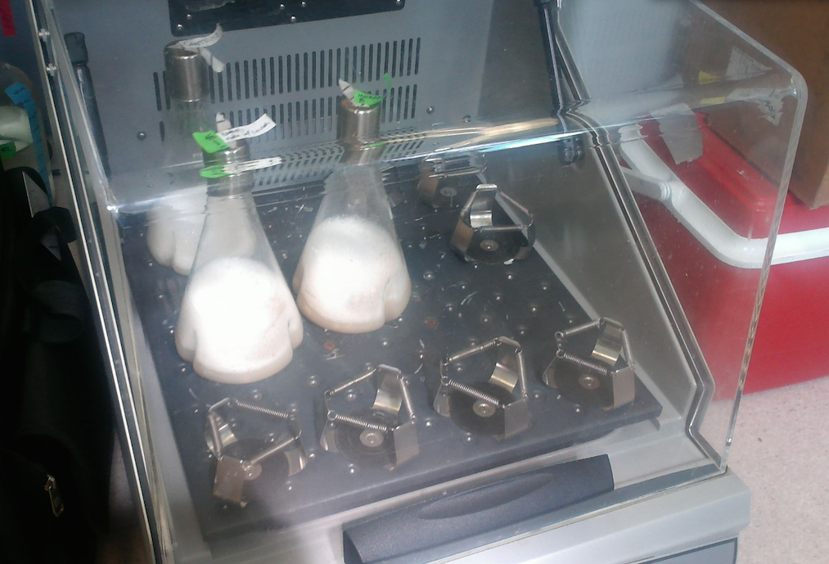
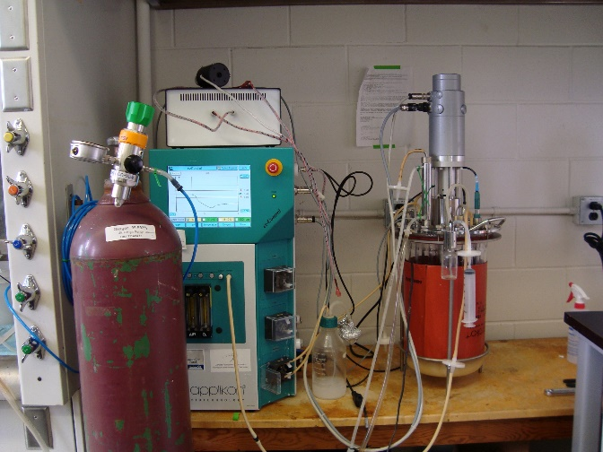
Scale up: effect of culture conditions
Preliminary batch cultures in a stirred tank bioreactor
Starting point: try to obtain similar results to flask cultures
Growth was faster in the bioreactor and PHA content was lower (DO maintained at 40%)
The C/N ratio had to be increased substantially to obtain similar PHA content to flasks
This suggested O₂ limitation was playing a role in inducing PHA synthesis in flasks (when grown on fatty acids)
International Conference and Exhibition on Biopolymers and Bioplastics
August 10-12, 2015
San Francisco, CA
Notes:
DO initially maintained because we assumed that flasks were not oxygen limited – which later proved to be wrong. Most literature suggests maintaining oxygen at 20-40%, so that was our starting point.
To get the 45% PHA that Fu got in flasks with 20 mmol/L octanoic acid, we had to double the octanoic concentration in the reactor to 40 mmol/L (both conditions with 1 g/L NH42SO4) as nitrogen source. This gave about 48% PHA. When we now run oxygen limited, we get 45-50% PHA in the reactor.

Slide 9
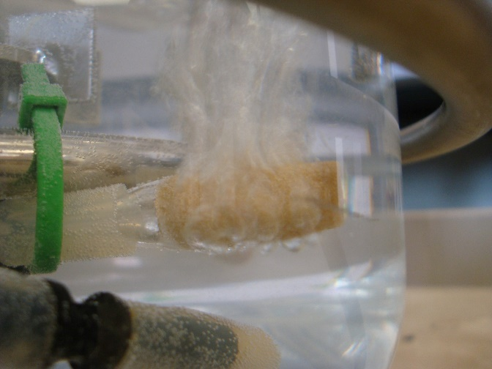
Scale up: effect of culture conditions
Methods:
Several batch trials were conducted with dissolved oxygen maintained at different thresholds to assess the effect on growth and PHA accumulation
    DO conditions tested: 40%, 10%, 1%, and 0%
  Ramsay’s minimal medium with 20 mmol/L octanoic acid
  Constant aeration through microbubblers at constant rate (2 vvm air only)
  Dissolved oxygen maintained with mixing cascade (250-900 rpm)
  pH controlled at 6.5 with 14% NH₄OH and 1 M HCl
Pyrex microbubbler
International Conference and Exhibition on Biopolymers and Bioplastics
August 10-12, 2015
San Francisco, CA
Notes:
Does not include multiple 0% conditions
Why octanoic acid? The real answer is I had no idea what I was doing when I started (didn’t know about the different monomer compositions) and it seemed like a good place to start because Fu/Dr. Sharma reported good PHA production.
The B.S. answer is that it is easy to it is that is is representative of other fatty acid (waste) substrates, but with the added advantage that it is easier to measure than the waste substrates, which is important now that we are looking at carbon balances, contains no impurities, and keeps the fermentation matrix simple.

Slide 10
Results: dissolved oxygen experiments
Figure 2. Growth rate (production of PHA-free biomass) as a function of μ_{max} at indicated dissolved oxygen concentration. Error bars indicate standard deviations of biological replicates
International Conference and Exhibition on Biopolymers and Bioplastics
August 10-12, 2015
San Francisco, CA
Notes:
Not a very surprising result: more oxygen limitation = less growth.
Decline at 1% is likely due to the fact that the controller had trouble maintaining O2 at such a precise level, and at times was at 0%.
MIMS was also used to measure DO at 0%, and for the 6 LPM aeration and 250 rpm mixing we got DO values around 0.05 mg/L. However, the measurements are affected by mass transfer dynamics of the probe as well, just to a lesser exptent than the applikon polarographic probe.

Slide 11
Results: dissolved oxygen experiments
Figure 4. Cell-specific productivity (mg PHA/g cells/hour) at indicated fermenter oxygenation conditions. Error bars indicate standard deviations of biological replicates.
International Conference and Exhibition on Biopolymers and Bioplastics
August 10-12, 2015
San Francisco, CA

Slide 12
DO Experiments: Lessons learned
DO plays a large role in PHA production kinetics with P. putida
  No significant PHA accumulation found until DO below detectable limits with polarographic probe.
  Microaerophilic conditions improved both the PHA yield and rate of PHA production.
Comparing O₂ limitation with N limitation:
  N-limited specific productivity: 102.1 ± 24.1 mg PHA/g cells/hour, no growth during accumulation phase
  O₂ limited cell-specific productivity: 185.5 ± 11.8 mg PHA/g cells/hour, some growth during accumulation phase
  Growth and PHA accumulation can be manipulated by changing hydrodynamic conditions in the bioreactor
    Could be useful in a fed-batch strategy, but also may have application in continuous culture.
International Conference and Exhibition on Biopolymers and Bioplastics
August 10-12, 2015
San Francisco, CA

Slide 13
Pushing forward: fed batch
5 L fed-batch with hydrolysed waste fryer (canola) oil
Exponential feeding of substrate based on predetermined growth rate.
Nitrogen addition tied to pH control with 14% NH4OH
Aeration at 2 vvm (air only) and mixing up cascade up to 1000 rpm
Up to 83g/L biomass and 24 g/L PHA in 24 hours = 1g PHA/L/hr
Figure 5. Fed batch using waste fryer (canola) oil.
International Conference and Exhibition on Biopolymers and Bioplastics
August 10-12, 2015
San Francisco, CA
Notes:
Note: residual biomass = PHA free biomass = total dry cell weight – PHA
Other notes:
carbon always in excess, but quite low at 8 hours.
Nitrogen always measured to be in excess (lowest value 27.4 mg/L free ammonia measured at 10 hours. It is possible that it may have hit zero between time points.
DO hit 0% at 9 hours
exponential growth ended by 12 hours. Stirring was at 1000 rpm from about 8 hours onward – kLa very high so not really sure that 0% = oxygen limitation for the bacteria, but it certainly means a limitation in mass transfer around the probe.
This compares pretty well with some of the most productive fed-batches in literature:
highest biomass= 173 g/L (Lee et al. 2000 but got little PHA and used pure oxygen and pure oleic acid)
Highest biomass without oxygen supplementation: 102 g/L (Davis et al. 2014)
Highest volumetric productivity: PHA
Likely can be improved beucase we backed of the carbon feeding a little prematurely.

Slide 14
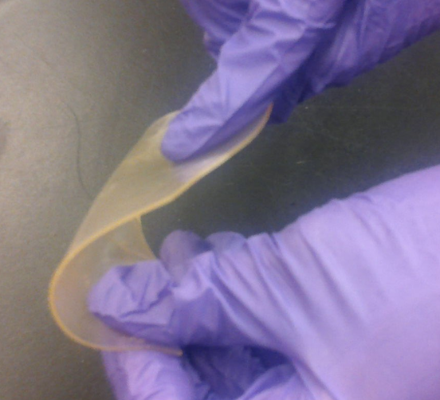
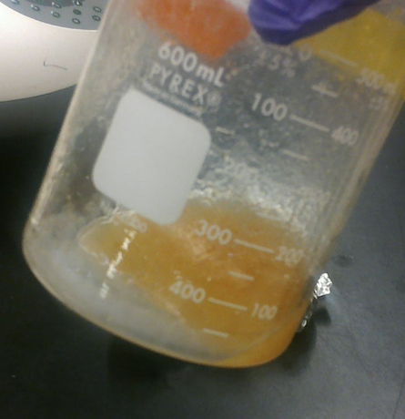
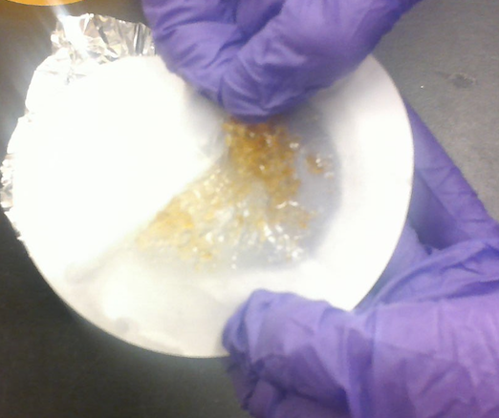
Tailor-made PHAs: Creating value
PHA produced by P. putida grown on a defined substrate such as octanoic acid results in an elastomeric polymer.
PHA from complex substrates, like vegetable oil fatty acids, are amorphous upon extraction due to the incorporation of longer monomer chains and unsaturation into the polymer.
However, the presence of double bonds in PHA presents an opportunity to cross-link or to insert desired chemical modifications (such as chlorination).
Cross-linking can be accelerated thermally, chemically or via irradiation.
Figure 6. A) Octanoic acid PHA (solid). B) PHA derived from biodiesel waste free fatty acid (fluid, sticky, amorphous). C) Cross-linked PHA from biodiesel waste free fatty acids (solid).
(A)
(B)
(C)
International Conference and Exhibition on Biopolymers and Bioplastics
August 10-12, 2015
San Francisco, CA
Notes:
Cross linked PHA is rubbery but still much harder than the PHA un cross linked stuff in the beaker, which is fluid. Chris has shown the melt point to be in excess of 300F.
Chris has used heat at 60C to thermally induce the reaction. UV also reportedly works. The stuff in the picture on this slide cross linked from sitting at room temp in the fume hood for a few weeks (auto-oxidation under ambient conditions).

Slide 15
Tailor-made PHAs: creating value
Table 2. Degree of unsaturation in substrate influences unsaturation in the polymer. Substrates are listed in order of increasing unsaturation (n.d. – not detected).
Substrate | Monomer Composition
 | %C6 | %C8 | %C10 | %C12 | %C12:1 | %C14 | %C14:1
Coconut Oil | 4.8 | 55.5 | 30.6 | 8.4 | n.d. | 0.6 | n.d.
Bacon Fat | 8.3 | 53.1 | 28.0 | 5.4 | 1.6 | 1.9 | 1.6
Waste Fryer Oil | 6.1 | 54.9 | 27.6 | 4.5 | 1.7 | 3.1 | 2.1
Canola Oil | 6.7 | 51.8 | 29.7 | 5.6 | 2.6 | 2.5 | 1.9
Corn Oil | 9.5 | 52.7 | 26.4 | 3.4 | 4.3 | 0.9 | 3.0
Soybean Oil | 10.0 | 52.1 | 25.8 | 3.7 | 4.5 | 0.9 | 3.0
International Conference and Exhibition on Biopolymers and Bioplastics
August 10-12, 2015
San Francisco, CA
Notes:
Soybean and corn oil are high in linoleic acid (C18:2) and result in the highest unsaturation, and are overall very similar in lipid composition.
Coconut oil is the most saturated and has shorter chain fatty acids – which is observed in the PHA monomer composition by higher C12 and no unsaturation.
Note that canola oil and waste fryer oil are basically the same thing (waste fryer oil = used canola oil)

Slide 16
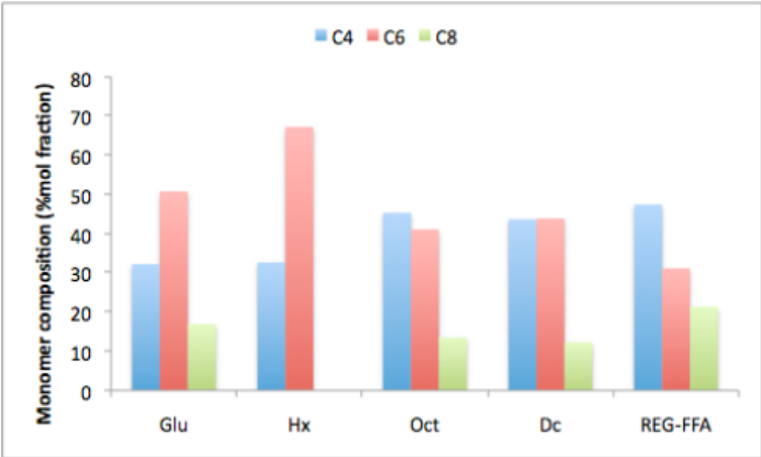
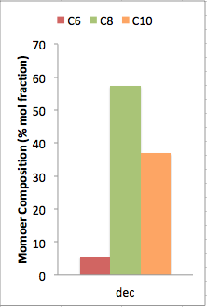
Tailor made PHAs: creating value
Genetic engineering can be used as a strategy to enhance yields and optimize monomer composition.
Cloning and expression of novel phaC genes in P. putida LS46 has allowed synthesis of an scl-co-mcl PHA polymer.
A
B
Figure 7. (A) Novel scl-co-mcl polymers from produced from genetically engineered P. putida LS46 from various substrates. (B) Comparative composition from wild-type strain grown on decanoic acid. (Glu-glucose; Hx-hexanoic acid; Oct-octanoic acid; Dc- decanoic acid; FFA-biodiesel waste free fatty acids; Non – nonanoic acid.
phaC clone
Wild Type
International Conference and Exhibition on Biopolymers and Bioplastics
August 10-12, 2015
San Francisco, CA

Slide 17
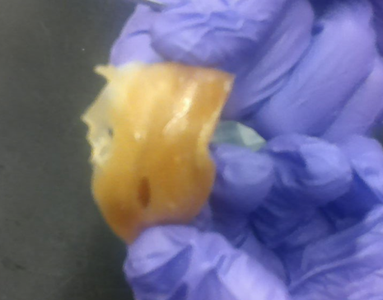
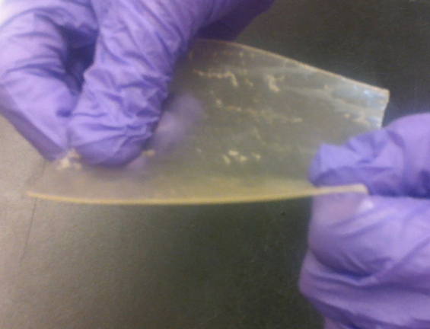
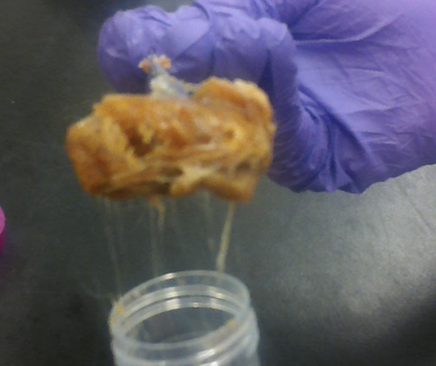
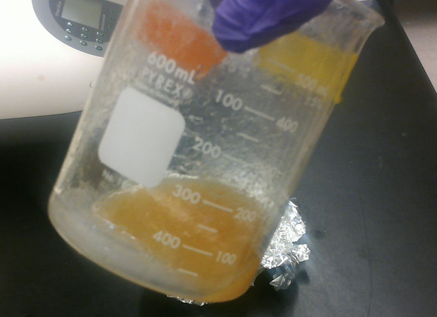
Tailor made PHAs: creating value
Figure 8 A) Scl-co-mcl polymer synthesized from octanoic acid (C4, C6, and C8 monomers) using novel phaC gene in P. putida LS46. B) mcl-PHA polymer synthesized by wild-type LS46 from octanoic acid (predominantly C8, traces of C6 and C10)
A
B
Figure 9. A) Scl-co-mcl polymer synthesized from biodiesel waste free fatty acids. (C4, C6, and C8 monomers) using novel phaC gene in P. putida LS46. B) mcl-PHA polymer synthesized by wild-type LS46 from biodiesel waste free fatty acids.
(C6, C8, C10, C12, C12:1, C14, and C14:1)
A
B
International Conference and Exhibition on Biopolymers and Bioplastics
August 10-12, 2015
San Francisco, CA
Notes:
Note that both these polymer are rather soft, tacky, and rubbery. This is not what we would expect by blending PHB into PHA so this needs further investigation. A very small amount of PHB mixed with PHV can have a drastic effect on the physical properties, so its possible that the nearly 50/50 split between PHB and mcl-PHA is skewed too much toward mcl-PHA. Might be better to clone these phaC genes into a known PHB producer like Ralstonia.

Slide 18
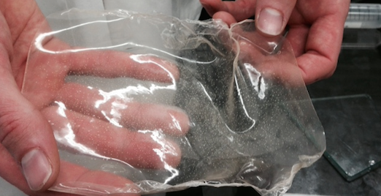
Future work
Improvement on current fed-batch strategies
Investigation of cell retention techniques to establish a continuous or semi-continuous reactor
Testing of PHA polymers synthesized from various carbon sources
  Including novel scl-co-mcl polymers
  Modified polymers with unsaturated moieties
Continued scale-up
International Conference and Exhibition on Biopolymers and Bioplastics
August 10-12, 2015
San Francisco, CA

Slide 19
Acknowledgments
David Levin, Professor, Biosystems Engineering
Richard Sparling, Professor, Microbiology
Parveen Sharma, Research Associate, Biosystems Engineering
Warren Blunt, Ph.D. Student, Biosystems Engineering
Jilagamazhi Fu, Ph.D. Student, Biosystems Engineering
Funders:
Genome Canada
National Sciences and Engineering Research Council (NSERC)
BioFuelNet (BFN) Canada
THANK YOU!
QUESTIONS?
International Conference and Exhibition on Biopolymers and Bioplastics
August 10-12, 2015
San Francisco, CA

Slide 20
References
Bassas, M., Marques, A. M., & Manresa, A. (2008). Study of the crosslinking reaction (natural and UV induced) in polyunsaturated PHA from linseed oil. Biochemical Engineering Journal, 40(2), 275-283.
Chhetri, A. B., Watts, K. C., & Islam, M. R. (2008). Waste cooking oil as an alternate feedstock for biodiesel production. Energies, 1(1), 3-18.
Davis, R., Duane, G., Kenny, S. T., Cerrone, F., Guzik, M. W., Babu, R. P., ... & O'Connor, K. E. (2015). High cell density cultivation of Pseudomonas putida KT2440 using glucose without the need for oxygen enriched air supply. Biotechnology and bioengineering, 112(4), 725-733.
Fu, J., Sharma, U., Sparling, R., Cicek, N., & Levin, D. B. (2014). Evaluation of medium-chain-length polyhydroxyalkanoate production by Pseudomonas putida LS46 using biodiesel by-product streams. Canadian journal of microbiology, 60(7), 461-468.
Lee, S. Y., Wong, H. H., Choi, J. I., Lee, S. H., Lee, S. C., & Han, C. S. (2000). Production of medium‐chain‐length polyhydroxyalkanoates by high‐cell‐density cultivation of Pseudomonas putida under phosphorus limitation. Biotechnology and bioengineering, 68(4), 466-470.
Maclean, H., Sun, Z., Ramsay, J., & Ramsay, B. (2008). Decaying exponential feeding of nonanoic acid for the production of medium-chain-length poly (3-hydroxyalkanoates) by Pseudomonas putida KT2440. Canadian Journal of Chemistry, 86(6), 564-569.
Pratt, S., Werker, A., Morgan-Sagastume, F., & Lant, P. (2012). Microaerophilic conditions support elevated mixed culture polyhydroxyalkanoate (PHA) yields, but result in decreased PHA production rates. Water Science & Technology, 65(2), 243-246.
Sharma, P. K., Fu, J., Cicek, N., Sparling, R., & Levin, D. B. (2012). Kinetics of medium-chain-length polyhydroxyalkanoate production by a novel isolate of Pseudomonas putida LS46. Canadian journal of microbiology, 58(8), 982-989.
International Conference and Exhibition on Biopolymers and Bioplastics
August 10-12, 2015
San Francisco, CA

Slide 21



Slide 22
Pushing forward: fed batch (substrate concentration)
Residual substrate: peak at retention time 11.11 (oleic, largest peak) normalized to benzoic acid internal standard
% AFOS added refers to the cumulative volume substrate added per liquid volume in reactor.
International Conference and Exhibition on Biopolymers and Bioplastics
August 10-12, 2015
San Francisco, CA

Slide 23
Pushing forward: fed batch (NH₃ concentration)
Added 14% NH₄OH to control pH at a setpoint of 6.8
Residual nitrogen is the free ammonia measured by FIA spec.
mL refers to the cumulative volume added.
Low levels detected at 10 hours, but was never measured to be depleted.
Most of the PHA accumulation likely do to oxygen limitation.
International Conference and Exhibition on Biopolymers and Bioplastics
August 10-12, 2015
San Francisco, CA

Slide 24
mcl-PHA film produced from P.putida LS46
International Conference and Exhibition on Biopolymers and Bioplastics
August 10-12, 2015
San Francisco, CA

Slide 25
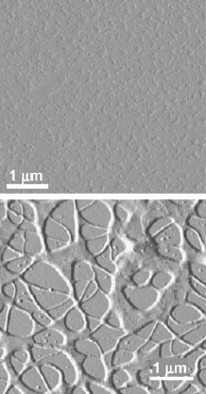
Tailor-made PHAs: Creating value
Figure 8. Polymer synthesized from P. aeruginosa from linseed oil before (top) and after (bottom) UV-irradiation to induce cross linking Source: Bassas et al. 2008)
International Conference and Exhibition on Biopolymers and Bioplastics
August 10-12, 2015
San Francisco, CA

Slide 26
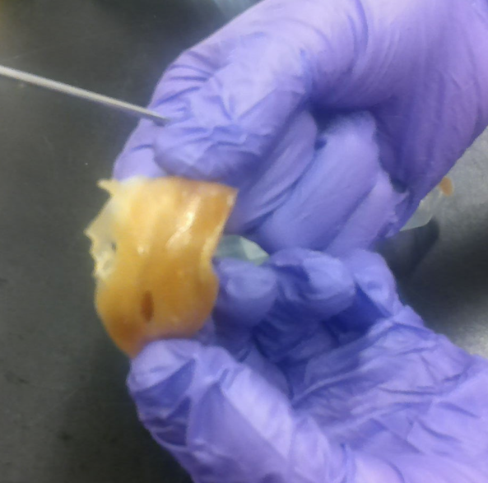
Tailor made PHAs: creating value
Scl-co-mcl PHA produced from genetically engineered P. putida LS46
Figure 8. Scl-co-mcl polymer synthesized from octanoic acid (C4, C6, and C8 monomers
Figure 9. Scl-co-mcl polymer synthesized from biodiesel waste free fatty acids.
International Conference and Exhibition on Biopolymers and Bioplastics
August 10-12, 2015
San Francisco, CA
Notes:
Note that both these polymer are rather soft, tacky, and rubbery. This is not what we would expect by blending PHB into PHA so this needs further investigation. A very small amount of PHB mixed with PHV can have a drastic effect on the physical properties, so its possible that the nearly 50/50 split between PHB and mcl-PHA is skewed too much toward mcl-PHA. Might be better to clone these phaC genes into a known PHB producer like Ralsonia.

