Slide 1

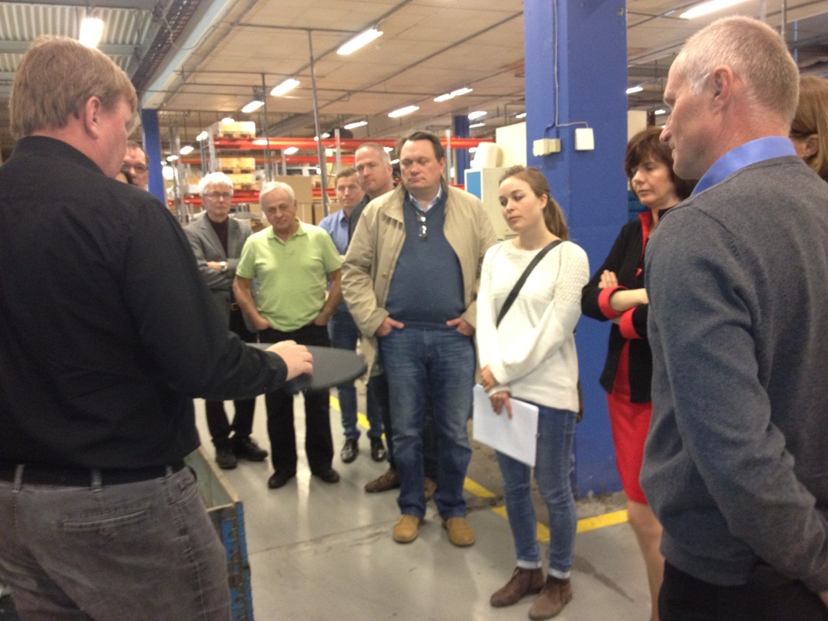
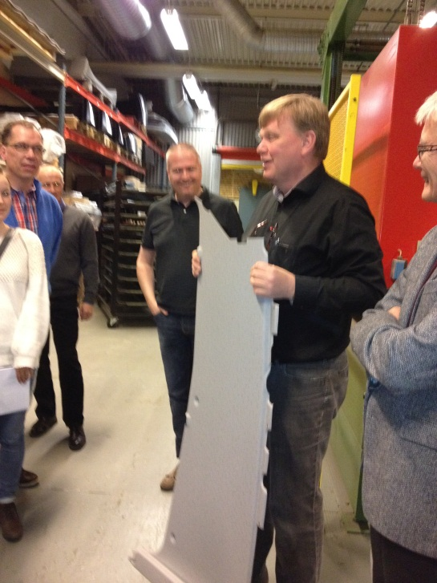
  A part of Sustainable recycling of “green” plastics project
  Recycling of bio/petro blends

Slide 2

Aim of the work
  The aim of this work was to study reprocessing of some commercial blends, evaluation of properties and degradation.
The focus is on highlighting challenges with new bio- petro blends as a new class of materials, identification, compatibility and recyclability.

Slide 3
Work plan
  Choice of materials
  Investigation of the effects of repeated extrusion on material´s degradation
  Thermal and mechanical analysis for determination of miscibility
  Simulation of ”service life & recycling” using combination of repeated extrusion and ageing. Study of the effects on material degradation

Slide 4
Commercial polymer blends used in the study
PLA (Poly Lactic Acid) pure and blends:
  PLA 3051D injection moulding grade from Nature Work
  PLA/HDPE (39%) renewable- RTP2099X115382C from Nature Work
  PLA/PC (32%) renewable- RTP2099X126213 from Nature Work

Slide 5
Processing and ageing of the materials
In-Lab
  PLA Granule, pressed material
  PLA/HDPE Granule, pressed material, extruded 1- 6 times
  PLA/PC Granule, pressed material, extruded 1- 6 times, pressed and aged, extruded and aged, extruded, aged and extruded again, extruded and aged 2 times
At-Industry
  PLA Granule
  PLA/HDPE Granule, extruded 3 times
  PLA/PC Granule, pressed material, extruded 2 times

Slide 6
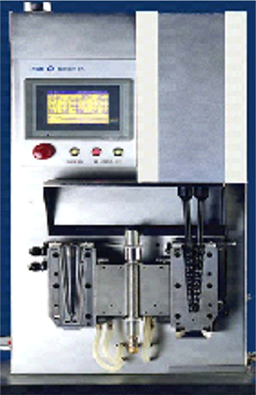
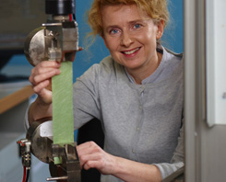
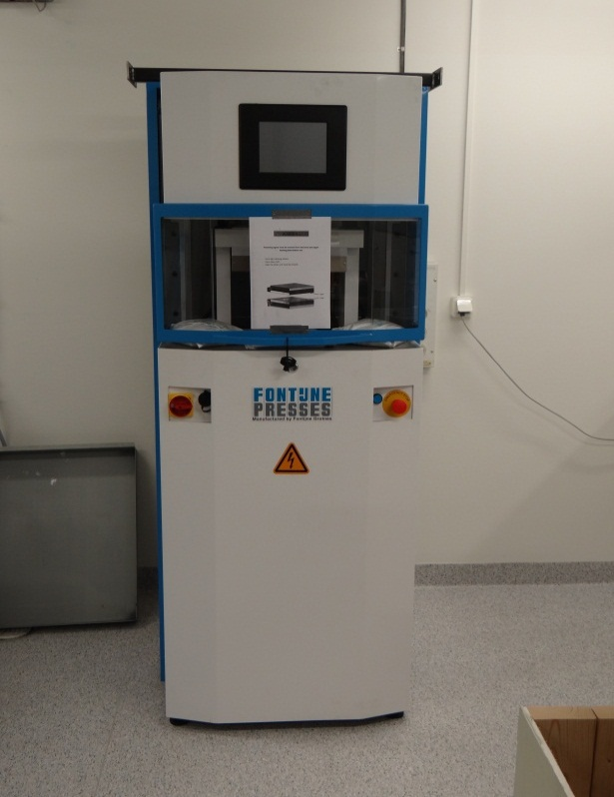
Simulation of pre-consumer recycling ”At Laboratory”
Bio/petro material (with additives)
Extrusion
Material for testing
FTIR
DSC
Mechanical testing
Drying
Notes:
Bearbetning (extruderad och pressad)
Granulat och sex cyklar bearbetad material har granskat i syfte med nedbrytning av materialet under processbetingelse för både PLA/HDPE och PLA/PC.

Slide 7
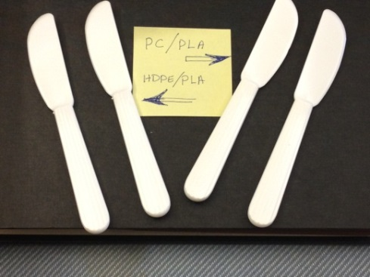
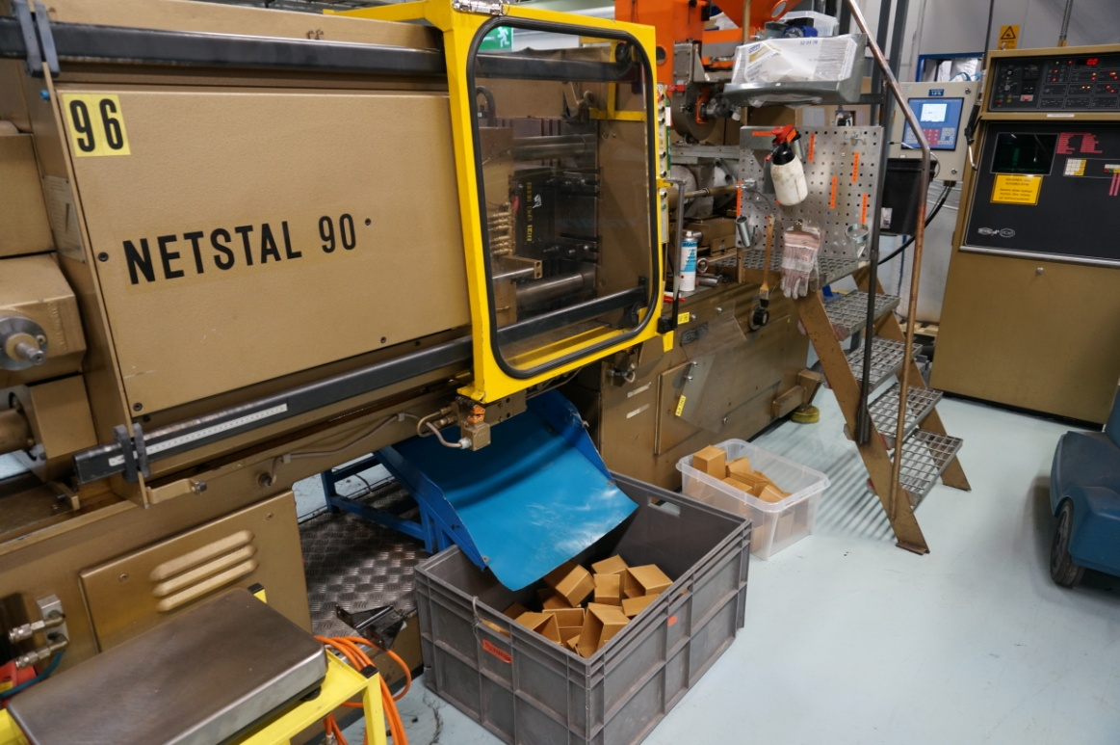
Simulation of pre-consumer recycling ”At industry”
Bio/petro material (with additives)
Extrusion
Material for testing
FTIR
DSC
Mechanical testing
Drying
Notes:
Materialen bearbetads i form av en produkt (kniv) två gånger på industri (Hammarplast) för att simulera återvinning av produktionspill.

Slide 8
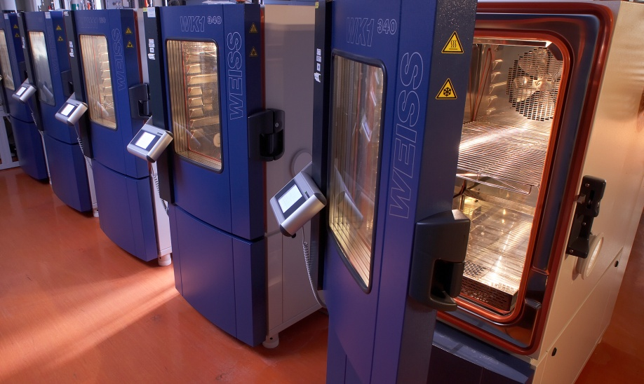
Simulation of post-consumer recycling ”At Laboratory”
”Life cycle”
Material for evaluation
FTIR
DSC
Mechanical testing
Bio/petro material (with additives)
Extrusion
Ageing
Material for evaluation
70 ºC & 50 % RH
Period 7 weeks
Drying
Notes:
Bearbetning och termiskåldring
Materialens livscykel (bearbetning + service life) simuleras med både bearbetning och termisk accelererad åldring i 3 omgångar

Slide 9
Evaluation of simulated pre- and post-consumer recycling
Processing | E-modulus PLA/HDPE [MPa] | E-modulus PLA/PC [MPa]
0 Extrusion ( pressed) | 1417 | 2269
Extrusion 1 time | 1401 | 2250
Extrusion 2 times | 1387 | 2261
Extrusion 3 times | 1441 | 2279
Extrusion 4 times | 1349 | 2265
Extrusion 6 times | 1358 | 2280
Extrusion 1 time +1 ageing | - | 2075
Extrusion 1 time+1 ageing + Extrusion again | - | 2132
Extrusion 1 time+1 ageing + ageing again | - | 1503
E-modulus at tensile insignificantly decreased with the number of extrusions.
Double ageing period caused decrease of E-modulus in PLA/PC

Slide 10
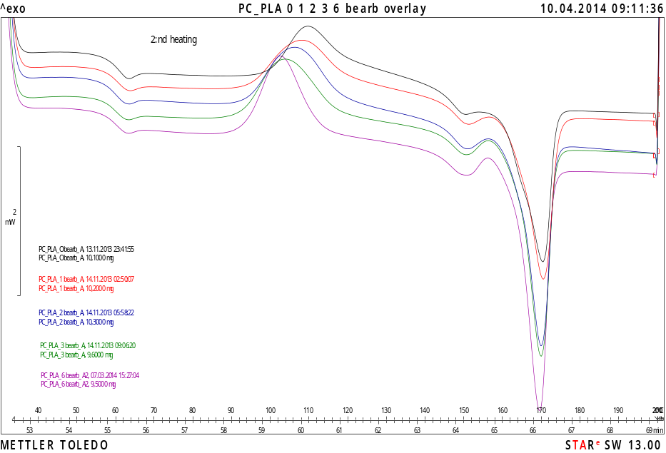
DSC: Tg, Tc and Tm for PLA/PC blend after repeated extrusion
Material | Tg | Tc | Tm
Pressed , non-extruded | 58,8 | 109.6 | 170,1
Extruded 1 time | 58,9 | 107,8 | 170,2
Extruded 2 times | 58,6 | 106,2 | 169,5
Extruded 3 times | 58,7 | 103,6 | 169,7
Extruded 6 times | 58,6 | 102,6 | 169,2
Glass transition temperature for PLA and PC has not changed after repeated extrusion.
Crystallization temperature of PLA has decreased.
Melt temperature has changed slightly.

Slide 11
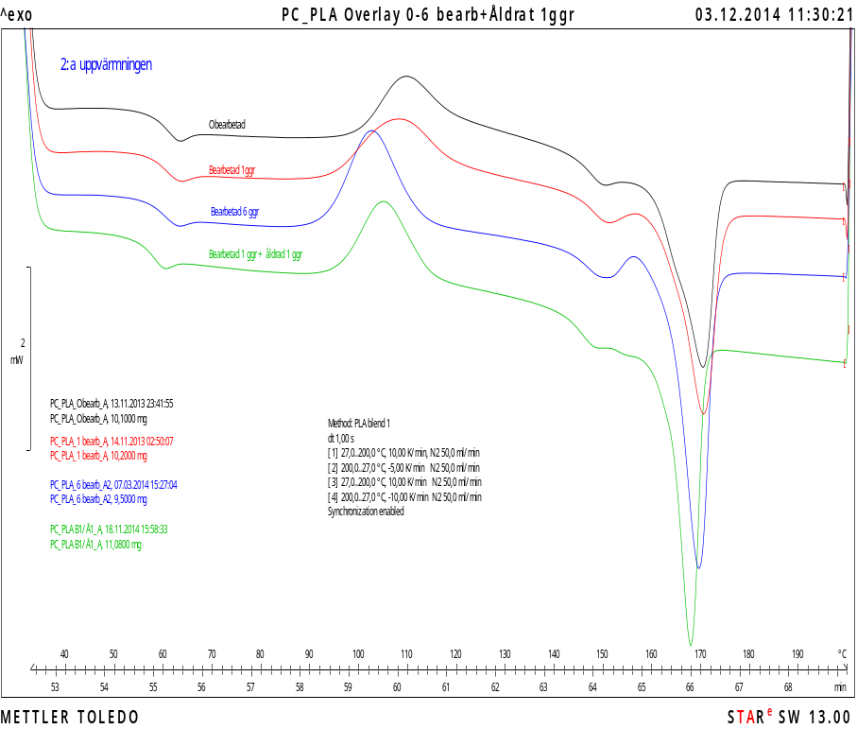
DSC: Tg, Tc and Tm for PLA/PC after
repeated extrusion and combination of extrusion and ageing
Material | Tg | Tc | Tg | Tm
Pressed , non-extruded | 58,8 | 109.6 |  | 170,1
Extruded 1 time | 58,9 | 107,8 |  | 170,2
Extruded 6 times | 58,6 | 102,6 |  | 169,2
Extruded 1 time + ageing | 56,4 | 104,7 | 144,2 | 167,4
Ageing causes degradation of PLA/PC
(lower Tg ,Tc and Tm)

Slide 12
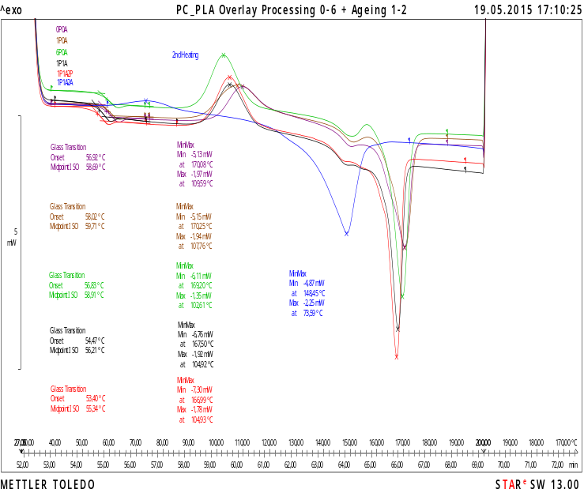
DSC: Tg, Tc and Tm for PLA/PC after
repeated extrusion and combination of extrusion and ageing
Material | Tg | Tc | Tg | Tm
Pressed , non-extruded | 58,8 | 109.6 | 147,3 | 170,1
Extruded 1 time | 58,9 | 107,8 | 147,2 | 170,2
Extruded 6 times | 58,6 | 102,6 | 146,5 | 169,2
Extruded 1 time + ageing | 56,4 | 104,7 | 144,2 | 167,4
Extruded 1 time + ageing + Extruded again | 55,3 | 104,9 | 144,0 | 167,0
Extruded 1 time + ageing + Ageing again | ? | 73,6 | 128 | 148,5
Ageing has a significant effect on degradation of PLA/PC

Slide 13
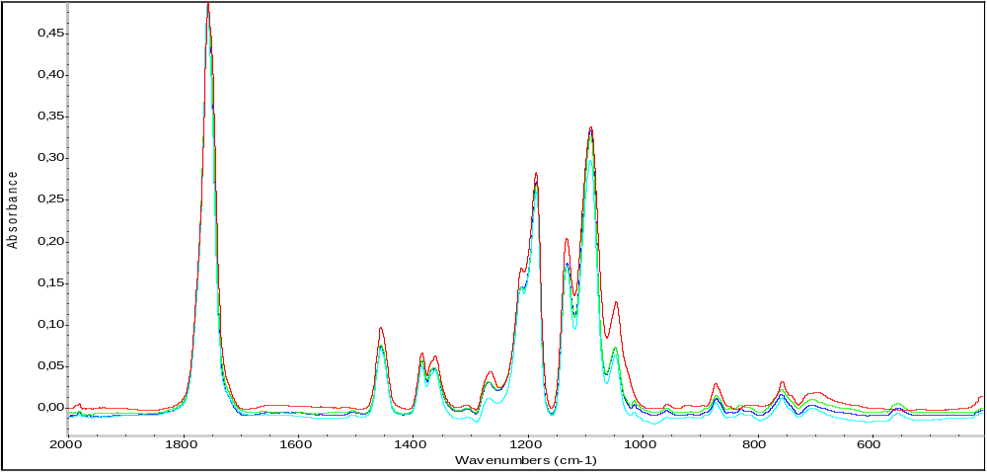
FTIR spectra of PLA and PLA/PC blend after repeated extrusion
Red: Virgin PLA
Light blue: PC-PLA pressed
Blue: PC-PLA Extruded 1 time
Green: PC-PLA Extruded 6 times
No obvious change due to repeated extrusion

Slide 14
Increasing of Bis Phenol A by aging of PC / PLA
Material | Concentration of Bis Phenol A [mg/g]
Non extrusion/granule | 0,13
Extrusion 6 times | 0,61
Extrusion once + ageing + ageing + ageing (B1A3) | 2,3
Concentration of Bis Phenol A increases almost 20 times by combination of extrusion and ageing

Slide 15
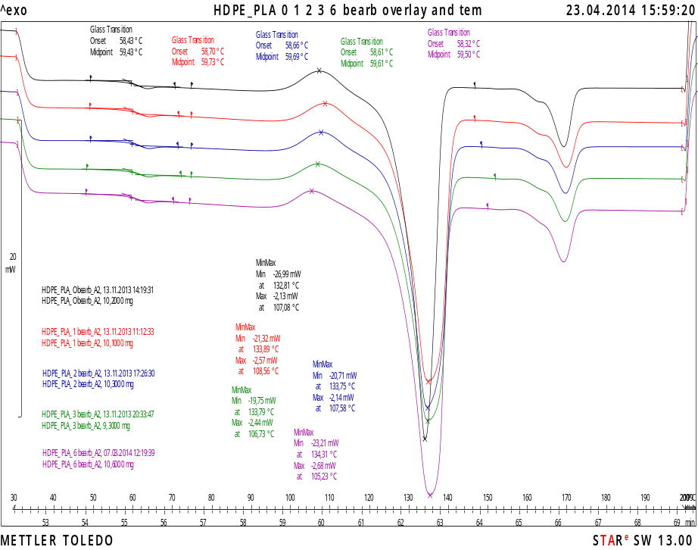
DSC thermogram and changing of Tg, Tc and Tm för PLA/HDPE
Material | Tg1 | Tc | Tm1 | Tm2
Pressed/ Non extruded | 59,4 | 107,1 | 132,8 | 168,8
Extruded 1 time | 59,8 | 108,1 | 133,9 | 169,5
Extruded 2 times | 59,8 | 107,6 | 133,8 | 169,2
Extruded 3 times | 59,9 | 106,7 | 133,8 | 169,2
Extruded 6 times | 59,8 | 105,2 | 134,3 | 168,8
Small effect on crystallization temperature

Slide 16
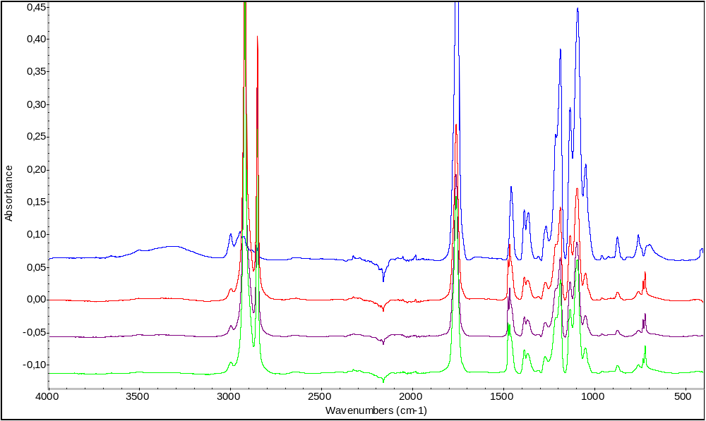
FTIR spectra for PLA and PLA/HDPE blend
Blue: Virgin PLA
Red: HDPE-PLA pressed
Purple: HDPE-PLA Extrud 1 time
Green: HDPE-PLA Extrud 6 times
No obvious change due to repeated extrusion

Slide 17
Acknowledgements
Organizing committee for the opportunity to present our results
MISTRA for the financial support
My co-workers for the fruitful collaboration
Thank you for your kind attention !

