Slide 1
Strategies for Handling Missing Outcomes in Longitudinal Questionnaire Data
Nazanin Nooraee
Post-Doctoral Fellow in Statistics
4th International Conference on Biometrics & Biostatistics
November 16 -18, 2015
San Antonio, USA

Slide 2
Content
Background
Missing data methods for questionnaire
Simulation
Results
Conclusion

Slide 3
Background: Importance of Missing Data Methods
Missingness is a pervasive issue in research
    Mistake in input information: typo,…
    Drop out subjects before completing longitudinal survey,
    Unanswered questions in questionnaire
  Potential source of bias
  Reduction of power due to reduced sample size

Slide 4
Types of Missingness
Missing Completely At Random (MCAR) :
  The probability that an item is missing is related to neither predictors nor other items.
Missing At Random (MAR):
  The probability that an item is missing is related only to the observed data.
Missing Not At Random (MNAR):
  The probability that an item is missing is related to the (unknown) value of the unobserved data and observed data
Notes:
Rubin (1976) and Little (1995) classified unobserved outcomes in three clusters.
The selection of the statistical strategy for analysis should be guided thorough understanding of the underlying reasons for missing data
MCAR: For example: A respondent to a questionnaire accidentally skipped a question or even a whole page because he/she became bored to fill out the questionnaire. (questionnaire not about attention)
MAR: For example: Males are less willing to answer questions about their emotion than females.
MNAR: For example: People, who are depressed, have a higher probability of not answering to a question about depression than people who are not depressed

Slide 5
Methods for Handling Missing Data in Longitudinal Settings
Complete case analysis
Imputation
  Single imputation:
    Mean imputation,
    Individual imputation, …
  Multiple Imputation (MI):
    Joint Modeling, mainly with multivariate normal distribution(MVN)
    Fully Conditional Specification (FCS)
  Ad hoc methods
    Predictive mean matching (PMM)
Maximum likelihood inference
Advanced statistical methods:
  Selection models
  Pattern mixture models
Notes:
Wood et al 2004: Review paper on handling missingness in medical journal
Eekhout et al 2012: Review paper on handling missingness in epidemiological journal
inconsistent results in different analysis because uses different subsets of data set

Slide 6
Advantages and Limitations
Method |  | Advantage | Disadvantages
Complete case analysis |  | Simple to apply | Reduce sample size, information loss, influence on precision and power
 |  | Valid under MCAR | Biased results under MAR and MNAR
Imputation | Single imputation | Unbiased under MCAR and MAR | Underestimate standard error
 | Multiple imputation | Uses all available data | Requires some decisions (each involves uncertainty) apply JM or FCS, which technique of FCS, how many imputed data, how many iterations is sufficient
 |  | Incorporate auxiliary variables | A imputed setting cannot be used for different analysis
 | PMM | Retains the distribution of variables, robust to transformation, less sensitive to mis-specification of the model | Lack of (mathematical) theory
Maximum likelihood |  | For a given data set, always gives the same results | Commonly cannot incorporate auxiliary variables
 |  | Default of mixed models | Cannot handle missing covariates

Slide 7
Applied Statistical Methods in Our Study
Analyze sum score of the items using marginal models
Missing data methods
  Multiple imputation
    At item level
      Logistic regression imputation (LR_{item})
      PMM (PMM_{item})
    At scale level
      Multivariate normal imputation using MCMC, with an addition
      constraint (MCMC_{scale})
      PMM, with an addition constraint (PMM_{scale})
  Maximum likelihood
    All items are missing (ML₁₀)
    At least one item was missing (ML₁)

Slide 8
Combine Advantage of ML and MI: A Hybrid Approach
Suggestion of Von Hipple [1] and White et al. [2]
  Including imputed outcomes adds noise to the parameter estimates in the final analysis
We proposed this approach for questionnaire survey (hybrid approach)
  With all the applied imputation methods
[1] Von Hippel, P. T. (2007). Regression with missing y’s: an improved strategy for analyzing multiply
imputed data. Sociological Methodology, 37(1):83–117.
[2] White, I. R., Royston, P., and Wood, A. M. (2011). Multiple imputation using chained equations:
Issues and guidance for practice. Statistics in Medicine, 30:377–399.

Slide 9
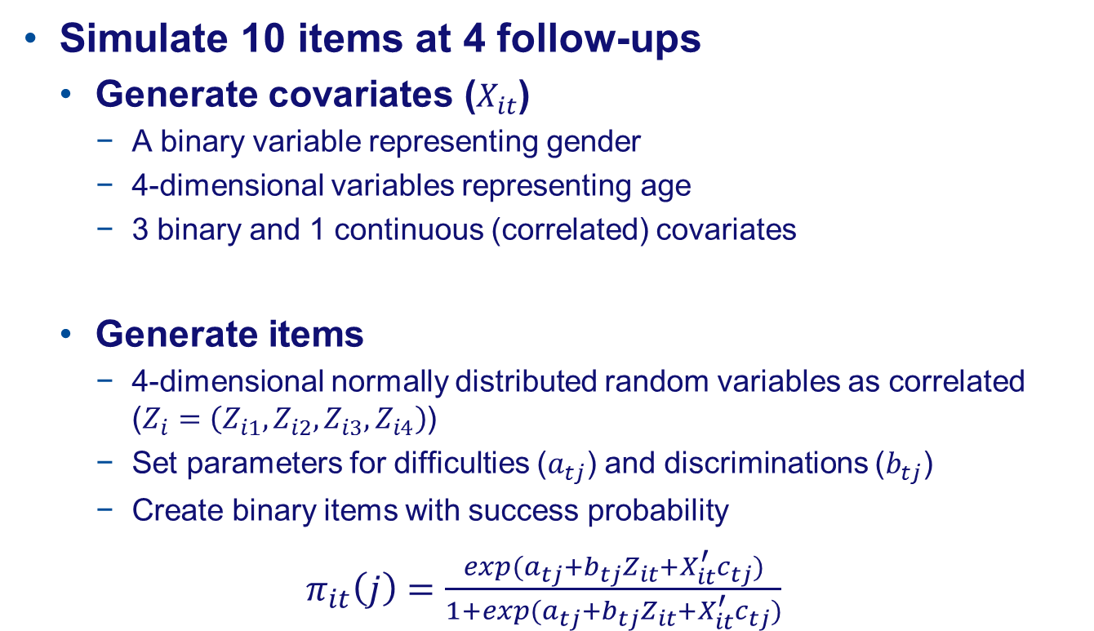
Simulation: Full Data Set
Simulate 10 items at 4 follow-ups
  Generate covariates ($X_{it}$)
    A binary variable representing gender
    4-dimensional variables representing age
    3 binary and 1 continuous (correlated) covariates
  Generate items
    4-dimensional normally distributed random variables as correlated ($Z_{i}=\left(Z_{i1},Z_{i2},Z_{i3},Z_{i4}\right)$)
    Set parameters for difficulties ($a_{tj}$) and discriminations ($b_{tj}$)
    Create binary items with success probability
    $π_{it}\left(j\right)=\frac{exp(a_{tj}+b_{tj}Z_{it}+X_{it}^{′}c_{tj})}{1+exp(a_{tj}+b_{tj}Z_{it}+X_{it}^{′}c_{tj})}$

Slide 10
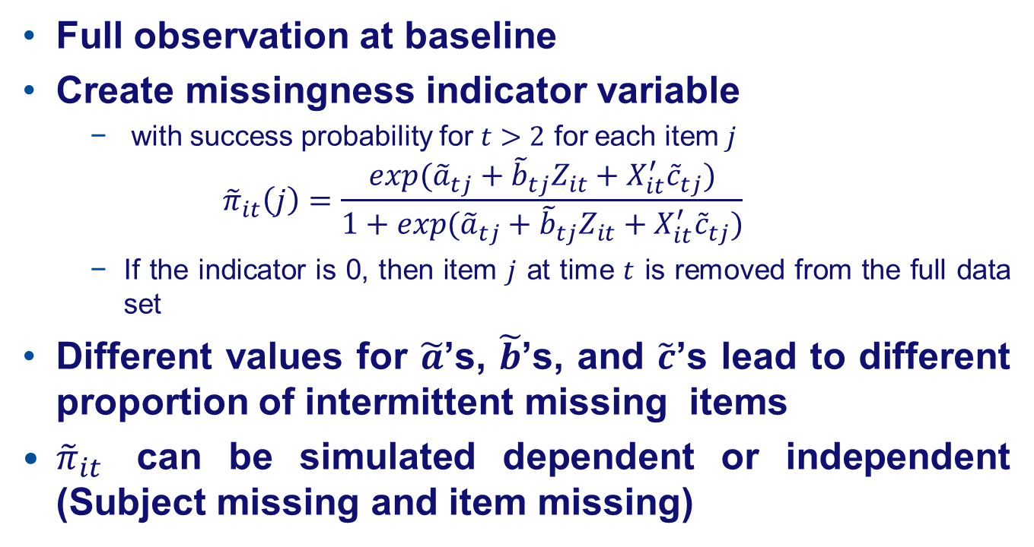
Simulation: Missingness Framework
Full observation at baseline
Create missingness indicator variable
    with success probability for $t>2$ for each item $j$
    $${\tilde{π}}_{it}\left(j\right)=\frac{exp⁡({\tilde{a}}_{tj}+{\tilde{b}}_{tj}Z_{it}+X_{it}^{′}{\tilde{c}}_{tj})}{1+exp⁡({\tilde{a}}_{tj}+{\tilde{b}}_{tj}Z_{it}+X_{it}^{′}{\tilde{c}}_{tj})}$$
    If the indicator is 0, then item $j$ at time $t$ is removed from the full data set
Different values for $\tilde{a}$’s, $\tilde{b}$’s, and $\tilde{c}$’s lead to different proportion of intermittent missing items
${\tilde{π}}_{it}$ can be simulated dependent or independent (Subject missing and item missing)

Slide 11
Simulation
Set up
    Each simulate data set contains 1000 individuals
    Generate small, medium, and large proportions of missing items and subjects (if applicable)
    Each incomplete data set was imputed 10 times
    Repeat each simulation 500 times
Analysis conducted in SAS
    Each data set was analyzed with marginal (population-average) models via Proc MIXED
    Proc MI was applied for multiple imputation
    Proc MIANALYZE for pooling the analysis results from imputed data sets
Comparison criteria: bias and mean square error

Slide 12
Proportion of Missingness
Missingness indicator | Proportion of missingness |  | Unit missing |  |  |  | Item missing
 |  |  | Visit 2 | Visit 3 | Visit 4 |  | Visit 2 | Visit 3 | Visit 4
Independent | Small |  | 0.004 | 0.72 | 1.46 |  | 4.19 | 13.95 | 10.15
 | Medium |  | 0.000 | 1.75 | 8.80 |  | 7.20 | 26.23 | 24.04
Dependent | Medium |  | 4.95 | 23.43 | 23.56 |  | 7.26 | 26.33 | 24.06
 | Large |  | 8.93 | 45.73 | 37.06 |  | 12.75 | 53.12 | 44.03

Slide 13
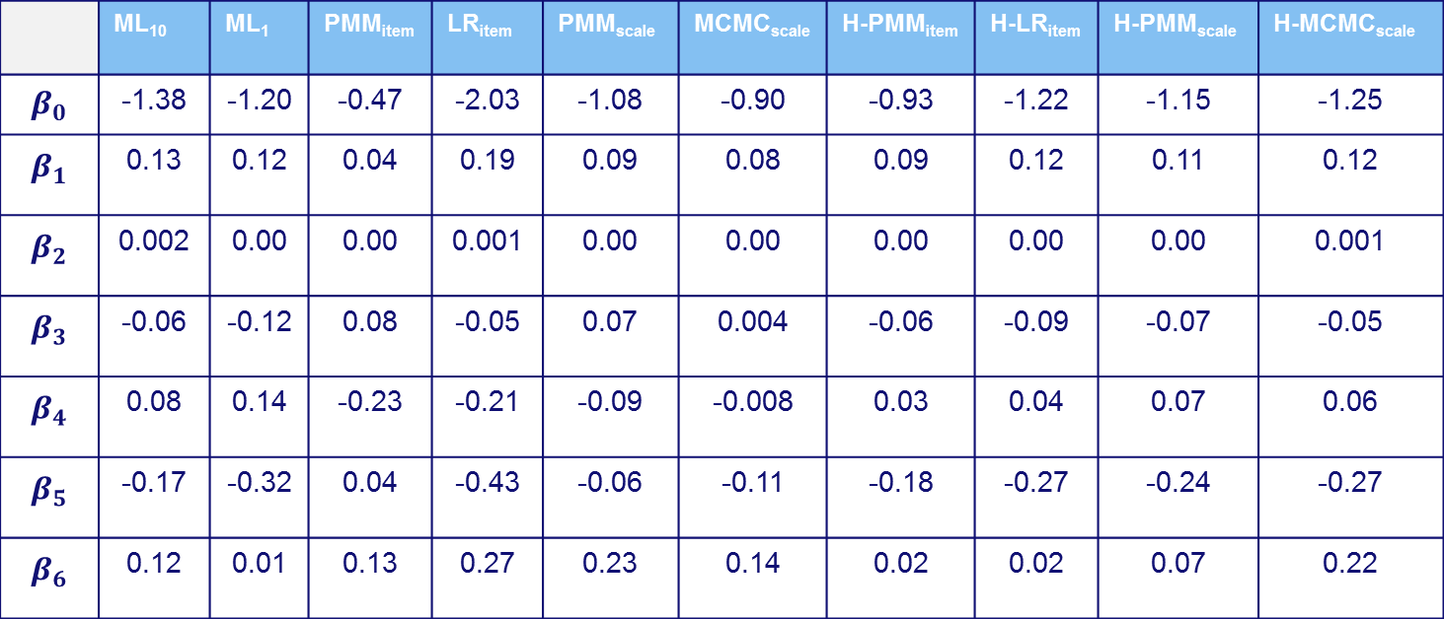
Results: Bias in Fixed Effects
 | ML₁₀ | ML₁ | PMM_{item} | LR_{item} | PMM_{scale} | MCMC_{scale} | H-PMM_{item} | H-LR_{item} | H-PMM_{scale} | H-MCMC_{scale}
$$β_{0}$$ | -1.38 | -1.20 | -0.47 | -2.03 | -1.08 | -0.90 | -0.93 | -1.22 | -1.15 | -1.25
$$β_{1}$$ | 0.13 | 0.12 | 0.04 | 0.19 | 0.09 | 0.08 | 0.09 | 0.12 | 0.11 | 0.12
$$β_{2}$$ | 0.002 | 0.00 | 0.00 | 0.001 | 0.00 | 0.00 | 0.00 | 0.00 | 0.00 | 0.001
$$β_{3}$$ | -0.06 | -0.12 | 0.08 | -0.05 | 0.07 | 0.004 | -0.06 | -0.09 | -0.07 | -0.05
$$β_{4}$$ | 0.08 | 0.14 | -0.23 | -0.21 | -0.09 | -0.008 | 0.03 | 0.04 | 0.07 | 0.06
$$β_{5}$$ | -0.17 | -0.32 | 0.04 | -0.43 | -0.06 | -0.11 | -0.18 | -0.27 | -0.24 | -0.27
$$β_{6}$$ | 0.12 | 0.01 | 0.13 | 0.27 | 0.23 | 0.14 | 0.02 | 0.02 | 0.07 | 0.22

Slide 14
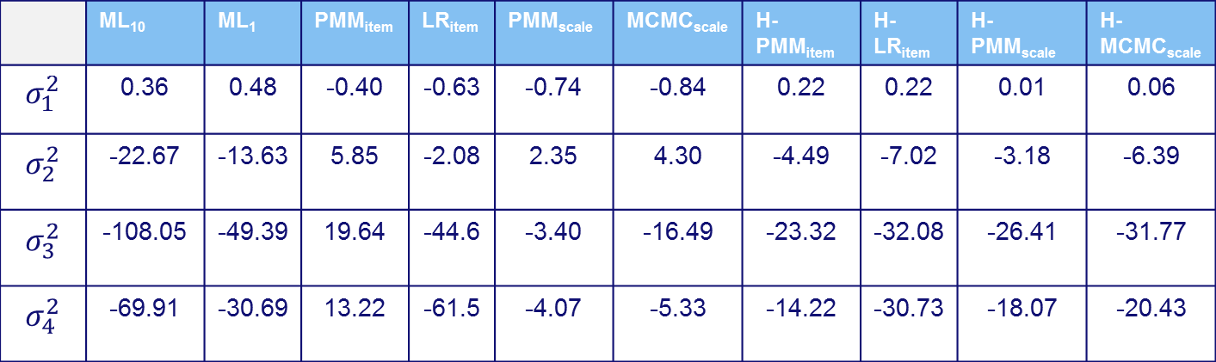
Results: Bias in Variance Components
 | ML₁₀ | ML₁ | PMM_{item} | LR_{item} | PMM_{scale} | MCMC_{scale} | H-PMM_{item} | H-LR_{item} | H-PMM_{scale} | H-MCMC_{scale}
$$σ_{1}^{2}$$ | 0.36 | 0.48 | -0.40 | -0.63 | -0.74 | -0.84 | 0.22 | 0.22 | 0.01 | 0.06
$$σ_{2}^{2}$$ | -22.67 | -13.63 | 5.85 | -2.08 | 2.35 | 4.30 | -4.49 | -7.02 | -3.18 | -6.39
$$σ_{3}^{2}$$ | -108.05 | -49.39 | 19.64 | -44.6 | -3.40 | -16.49 | -23.32 | -32.08 | -26.41 | -31.77
$$σ_{4}^{2}$$ | -69.91 | -30.69 | 13.22 | -61.5 | -4.07 | -5.33 | -14.22 | -30.73 | -18.07 | -20.43

Slide 15
Results: Comparison Biases
Largest bias: Imputation at scales, imputation at item level using logistic regression
“Wilcoxon signed rank” test showed significate bias for most of the parameter estimates
Among four other methods: no clear pattern to choose the best method
  Maximum likelihood provide somewhat smaller biases, for the follow-up times parameters
  For correlation coefficients: ML₁₀ performs best in presence of large proportion of missingness while H-PMM_{item} does best for all other settings.

Slide 16
Results: Comparison MSEs
The hybrid method at item level outperform their original imputation on almost all parameters, though differences are never very large.
H-PMM_{item} performs generally best on almost all fixed effects parameters and on the correlation parameters
When it is outperformed by another method for a specific parameter, the hybrid method is still close to the other method

Slide 17
Conclusion
Results showed that MI at item level outperforms imputation at scale level, (consistent with findings in cross-sectional studies)
Hybrid approach with PMM at item level revealed smaller MSE, however the differences were not substantial

Slide 18


