Slide 1
Challenges facing liposomal delivery of vancomycin for combating bacterial biofilm on abiotic surfaces
Nawal Khalafallah
Department of Pharmaceutics, Faculty of Pharmacy
Alexandria University, Egypt

Slide 2
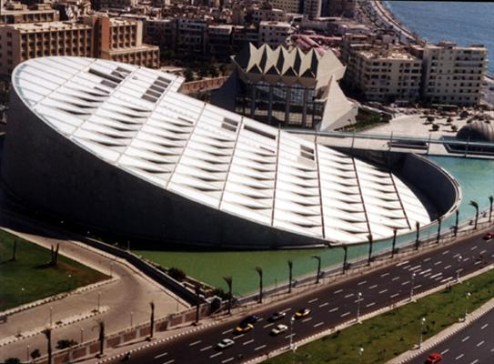

Slide 3
In this talk,
I would like to share with you the experience our group has gained, and the lessons learnt over the past several years in the area of lipid vesicles as drug carriers for improving drug performance.

Slide 4
Focusing on and Aiming to
the area of improving vancomycin performance in combating bacterial biofilms on abiotic surfaces such as indwelling venous catheters and urinary catheters.
Develop an improved technique for combating biofilm formation on abiotic surfaces

Slide 5
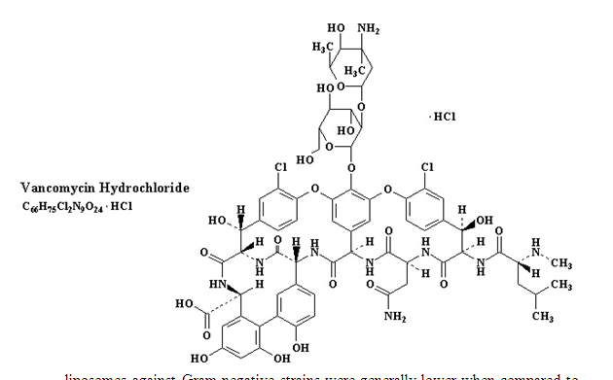
Vancomycin
Molecular weight
1485.7 for the Hcl salt,
Has 6 Pka values ranging from 2.18 to 10.4,
Its solubility in water is 146 mg/ml

Slide 6
Strategies for combating bacterial biofilms
Enhancing antibacterial efficacy using carriers
Preventing initial adhesion of bacteria to abiotic surface
Based on our data, we propose that for VCM, the lipid vesicle systems can combine both strategies

Slide 7
Our data suggest a dual role for vancomycin in vesicles
Enhancing the antibacterial effect.
Hindering the initial step in biofilm formation by adhesion of bacterial cells to the lipid vesicles instead of bacterial adhesion to the abiotic surface.
Photos taken using the phase contrast microscope lend some evidence.

Slide 8
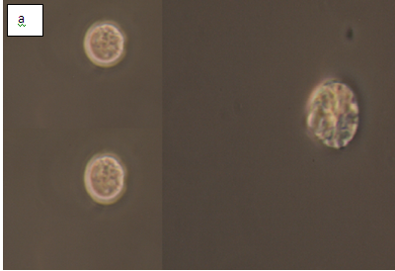

Slide 9
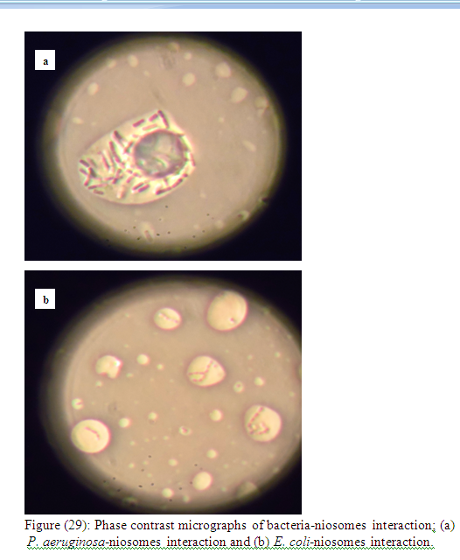

Slide 10
Lipid vesicles as carriers
The use of lipid vesicles to enhance antibacterial effect of bactericides and to deliver them to bacterial biofilms has been reported in many published articles.
The following slides are a few examples of such articles focusing on vancomycin and on lipid vesicles among other carriers

Slide 11
Titles of published articles…..
…that document enhanced antibacterial effect of vancomycin:
Encapsulation in fusogenic liposomes broadens the spectrum of vancomycin against Gram-negative bacteria.
Liposomal encapsulation of vancomycin improves killing of methicillin-resistant Staphylococcus aureus in a murine infection model.

Slide 12
More articles
Preparation of liposomal vancomycin and intracellular killing of meticillin-resistant Staphylococcus aureus (MRSA).,
PEGylated Liposomal Vancomycin: A glimmer of hope for improving treatment outcomes in MRSA pneumonia,

Slide 13
Other carriers
Formulation of Bone Targeting Vancomycin-loaded Liposomes
Vancomycin encapsulation in biodegradable microparticles for bone implantation
Design of vancomycin nanoparticles to increase the intestinal permeability,
Antimicrobial activity of nanoconjugated vancomycin against drug resistant Staphylococcus aureus,

Slide 14
Other antibiotics have also been studied
Apart from vancomycin, the enhanced antimicrobial effect of an antibacterial when incorporated in lipid vesicles has been demonstrated with:
amphotericin B, polymixin B, ofloxacin, some aminoglycosides and macrolides, clarithromycin, ceflazodine & cefepine among others.

Slide 15
Other startegies
Electrospun vancomycin-loaded coating on titanium implants for the prevention of implant-associated infections
Development of a long-lasting ventricular catheter impregnated with a combination of antibiotics

Slide 16
Strategies have also been proposed
…..for preventing bacterial adhesion to surfaces
A review of the biomaterials technologies for infection-resistant surfaces appears in the literature
Preventing initial bacterial adhesion
to abiotic surfaces is part of any successful strategy.

Slide 17
Back to our work: ….….
Two vesicular carriers have been investigated In relation to improving vancomycin efficacy:
Niosomes: Thesis and publication:
H Barakat, M Kassem, L El-Khordagui, N Khalafallah, Vancomycin-eluting niosomes: A new approach to the inhibition of Staphylococcal biofilm on abiotic surfaces. AAPS Pharm Sci Tech, (2014).

Slide 18
The second system studied….
….Vancomycin-loaded propylene glycol liposomes.
One MSc thesis ready for defense
The antibiofilm activity in this case was studied on silicon urinary catheter segments in addition to the use of microtiter plates as a model for abiotic surface.

Slide 19
Study methodology in both systems
Pharmaceutical characterization before and after storage :
Size, PdI, Zeta potential (Malvern zeta sizer)
Entrapment efficiency and release (dialysis)
TEM

Slide 20
Challenges and lessons learnt
Inconsistency in the literature as to the entrapment efficiency value.
A wide range (1 to 60%) of reported entrapment efficiency values appear in relation to vancomycin in liposomes.
One reason we suggest could be the solubility pattern of vancomycin and its degradation in relation to pH

Slide 21
Liposome system
We used water, and not buffer, to prepare the loaded vesicles in both the niosome and the liposome studies
the use of buffer solution, such as phosphate buffered saline, as a hydrating fluid does not support the formation of vancomycin liposomes.

Slide 22
Quoting a reported statement:
"In fact, the presence of vancomycin as the hydrochloride salt did not allow stable phospholipid vesicles to be obtained using the classical thin-layer evaporation method (simple hydration of a lipid film with a buffered solution of the drug)“ end quote

Slide 23
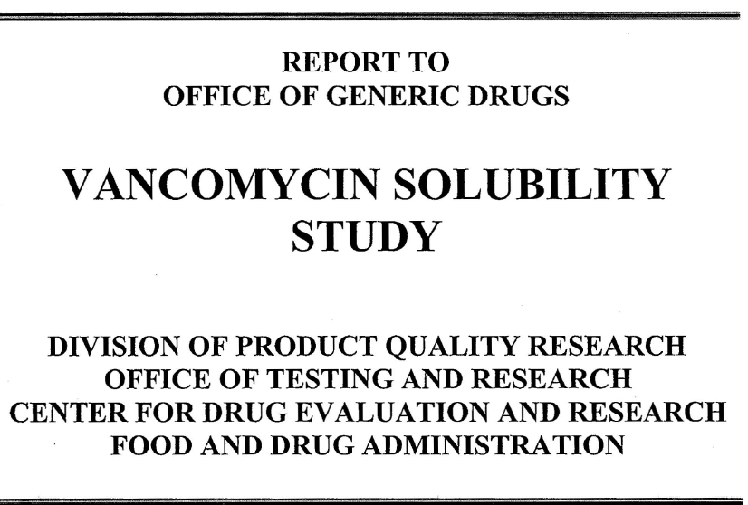

Slide 24
Data from this report
Vancomycin has a solubility greater than 140 mg/mL at pH 1 and 3, and in water.
Vancomycin solubility is reduced significantly, to less than 17.5 mg/mL at pH 4, 5 and 7.5.
The reduction of solubility was associated with enhanced degradation of vancomycin as
observed by multiple peaks in the HPLC chromatograms.

Slide 25
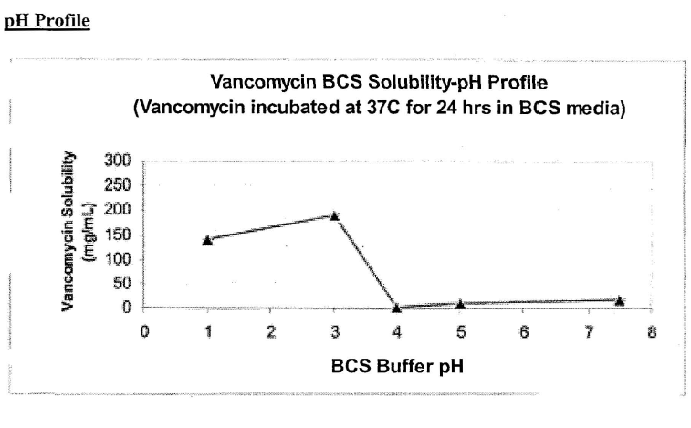

Slide 26
Microbiological characterization
MIC (agar dilution and the broth microdilution methods)
MBIC, MBEC, using microtiter plates and silicon urinary catheter segments as models for abiotic surfaces.
Strains include standard S. aureus and standard S. epidermidis as well as clinical isolates of both strains.

Slide 27
Main microbiological results of our work
Antibacterial efficacy was increased 2-8 times across a range of Staff. Strains and isolates.
MIC, MBIC, MBEC values for vesicular systems were 2-8 times lower than corresponding values for free VCM in both the liposome and niosome systems.

Slide 28
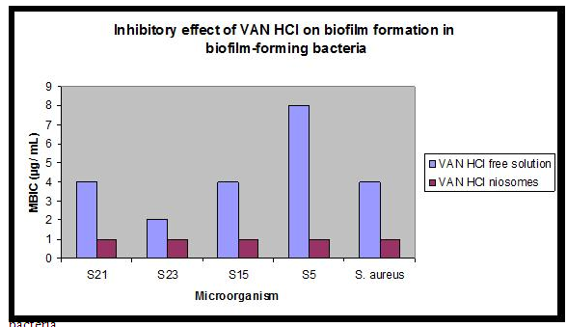

Slide 29
Another study design was also used: Biofilm growth inhibition study design….
Is more challenging and relates to the clinical situation
It tries to assess the ability of the antibiotic system (free vancomycin and vancomycin-loaded vesicles) to stop the growth of a formed biofilm at concentrations lower and higher than the MIC after a limited contact time between antibiotic and biofilm.

Slide 30
We studied this issue with the niosome system as follows:
Biofilm is formed on microtiter plates.
Non-attached bacteria are washed away
Immobilized biofilm is exposed to vancomycin system for 2 h (free and liposomal)
Antibiotic is washed away
Remaining biofilm is allowed to grow overnight
Comparison with controls allows assessment of % growth inhibition

Slide 31
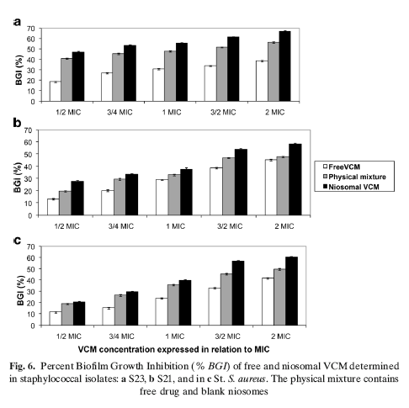

Slide 32
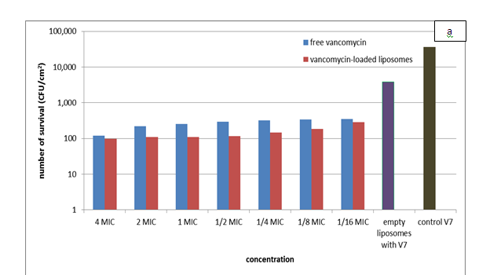

Slide 33
Pretreatment study design
We tried also the effect of pretreatment of catheter segments for 20 minutes with vancomycin system (free and liposomal at 4 MIC) on the formation and growth of a biofilm.

Slide 34
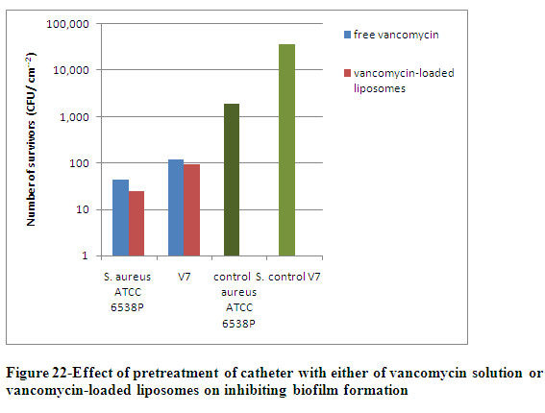

Slide 35
What about empty vesicles?
Empty vesicles showed no antibacterial effect but showed a biofilm-inhibiting effect.
Biofilms grown on catheter segments then subjected to empty liposomes for 2 h showed lower viable bacterial counts compared to broth controls.

Slide 36
Biofilm-inhibiting effect of empty liposomes: Biofilm grown on catheter segments
S. aureus ATCC 6538P:1.9x 10³ CFU/ml
Empty liposomes with S. aureus ATCC 6538P was 3.4x10² CFU/ml
Isolate V7: 3.6x 10⁴ CFU/ml
Empty liposomes with V7 (S.aureus isolate) was 3.8x10³ CFU/ml

Slide 37
Biofilm-inhibiting effect of loaded liposomes: Biofilm grown on catheter segments
S. aureus ATCC 6538P:1.9x 10³ CFU/ml
Empty liposomes with S. aureus ATCC 6538P was 3.4x10² CFU/ml
Free vancomycin at ½ MIC: 2.2x10
Liposomal vancomycin at ½ MIC: 1.8x10

Slide 38
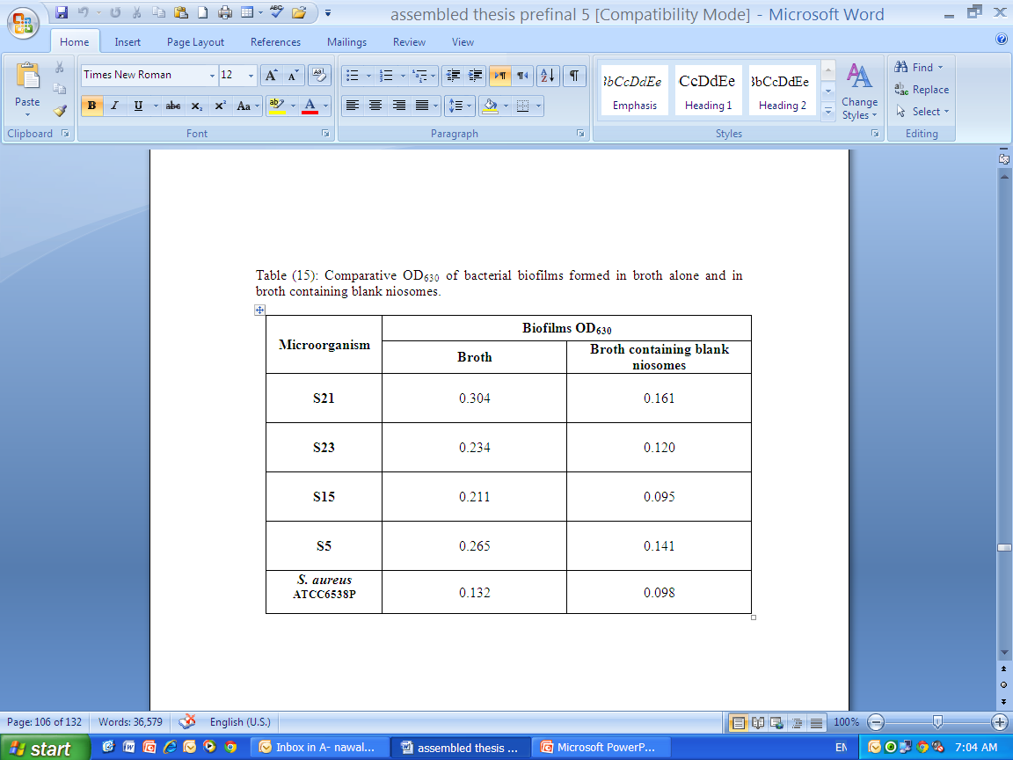
Biofilm-inhibiting effect of empty niosomes: Biofilm grown on microtiter plates

Slide 39
What about a physical mixture between empty vesicles and the drug?
Our data indicated a higher antibacterial/ antibiofilm effect of a physical mixture of empty liposomes and free vancomycin compared to an equal concentration of free vancomycin.
However the effect of vancomycin-loaded vesicles was greater at a lower vancomycin concentration.

Slide 41
Is it feasible to suggest a mixture of empty liposomes with vancomycin
…as a possible technique for combating biofilm formation on abiotic surface?
Generally speaking, such a concept can be found among marketed products.

Slide 42
Myocet®
Supplied to end-user as a three-vial system
Doxorubicin HCl (50 mg)
  Red lyophilized powder
  Lactose and methyl parahydroxybenzoate
Myocet liposomes (1.9 mL)
  White to off-white, opaque and homogeneous suspension
  ~ 180 nm, LUV liposomes
  Egg phosphatidyl choline/cholesterol (1:1), citric acid, sodium chloride, WFI
Buffer (3 mL)
  Clear colorless solution
  Sodium carbonate in WFI

Slide 43
moving from bench to bedside: strategies suggested and studies planned
Two strategies are proposed:
to prepare vancomycin-loaded liposomes
Freeze dry them to allow storage beyond a few months
Reconstitute with sterile water and use the antibiotic-lock technique for indwelling catheters or apply onto urinary catheters before insertion.

Slide 44
Studies required
Repeat Pharmaceutical characterization and antibacterial/ antibiofilm activity after reconstitution of freeze dried loaded vesicles.
Move on to an animal model.

Slide 45
Another suggestion is:
Prepare blank liposomes and store in the liquid state.
Mix with vancomycin vial and again use the antibiotic-lock technique for indwelling catheters or apply onto urinary catheters before insertion. Studies required?
Determine a shelf life for the blank liposomes
Retest in an animal model

Slide 46
Our study group
Labiba Elkhordagui,
Mervat Kassem,
Alyaa Ramadan,
Heba Barakat,
Amr Elhusseiny
Thank you all

