Slide 1
LFA-1/ICAM-1 ligation in T-cells influences both Notch and TGF-β pathways
Navin K. Verma
nkverma@ntu.edu.sg

Slide 2
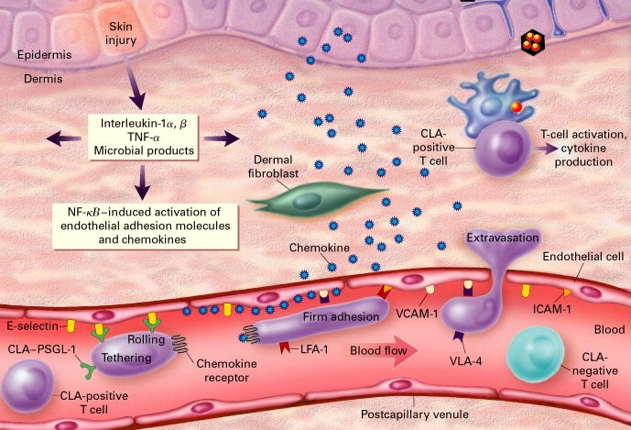
T-cell migration into inflamed tissues
N Engl J Med 1999; 341:1817-28.

Slide 3
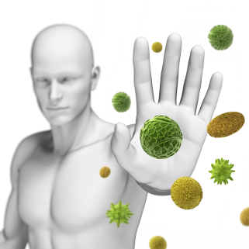

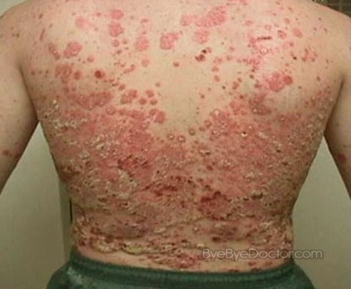

T-cell migration in health and diseases
Regulated T-cell migration
Immune response regulations
Uncontrolled T-cell trafficking
Chronic inflammatory diseases

Slide 4
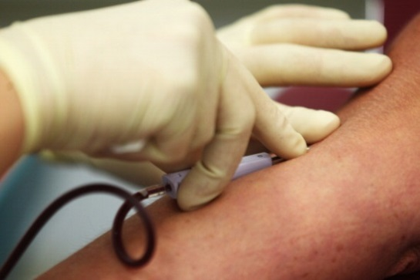
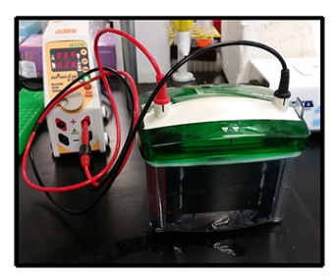
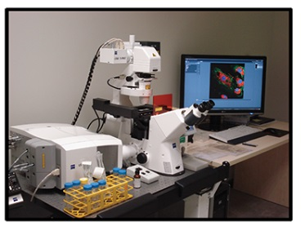
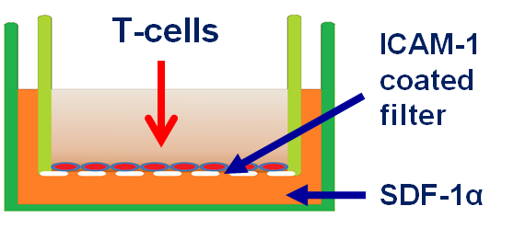
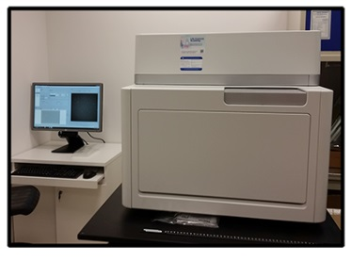
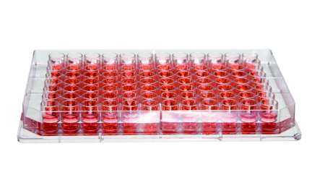
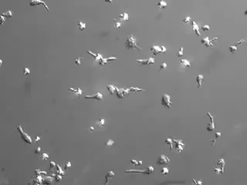
Laboratory model of T-cell migration
Resting T-cells
LFA-1
ICAM-1
Migrating T-cells
Receptor activation
4
Ong et al, 2014, J Biol Chem; Volkov et al, 2001, Nat Immunol
Notes:
4

Slide 5
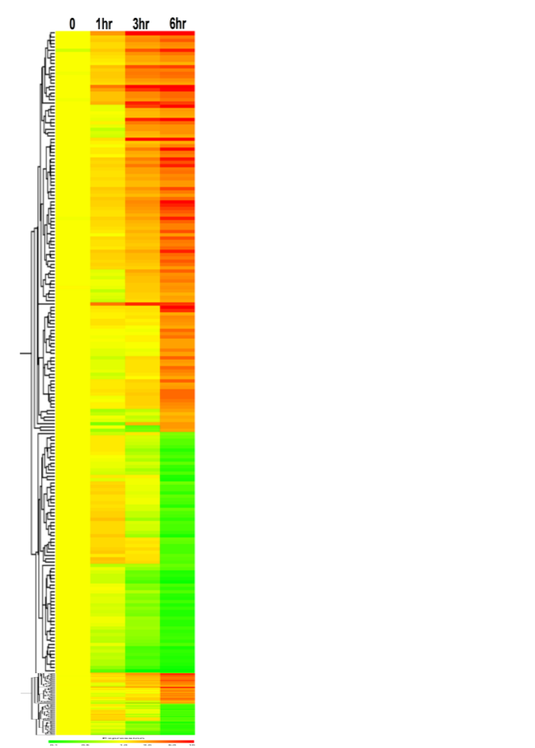
LFA-1/ICAM-1: changes in gene expression
TGF-β pathway
Notch pathway
Verma et al. (2012) J Biol Chem

Slide 6
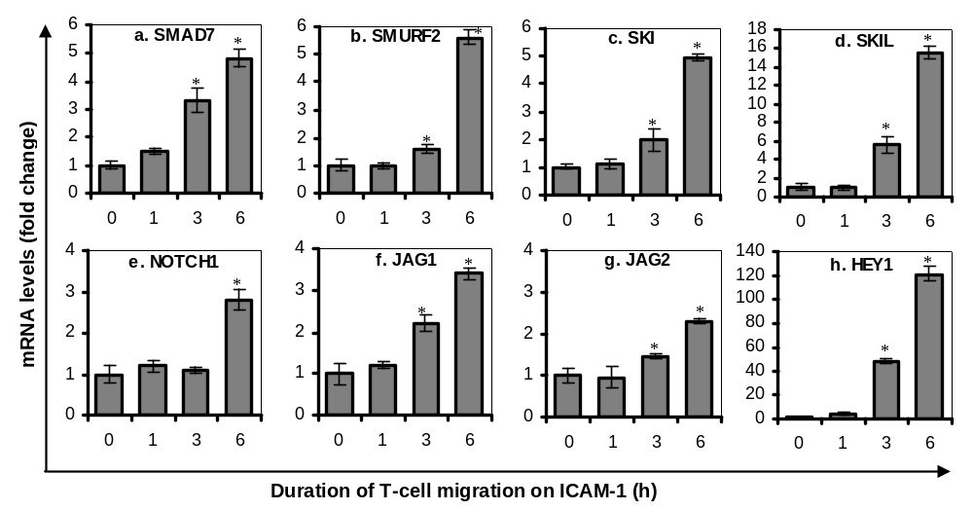
LFA-1/ICAM-1 up-regulates both TGF-β inhibitory molecules and Notch signalling proteins
(verified by RT-qPCR)
TGF-β pathway
Notch pathway
Verma et al. (2012) J Biol Chem

Slide 7
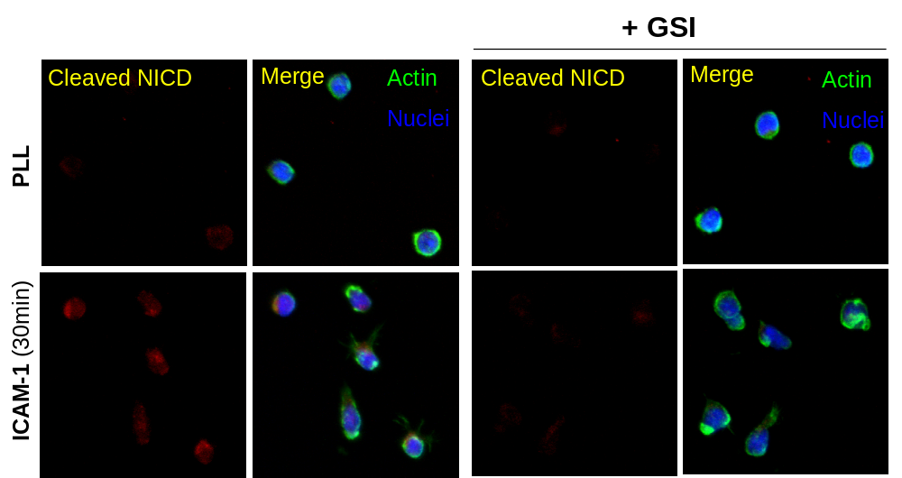
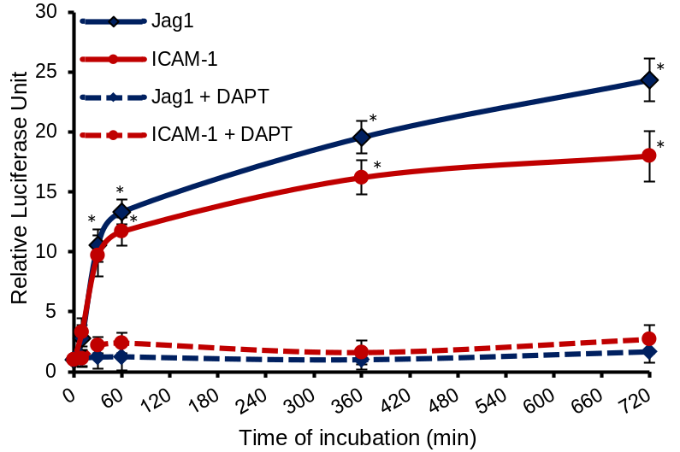
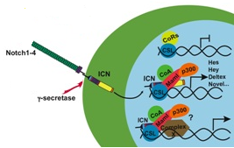
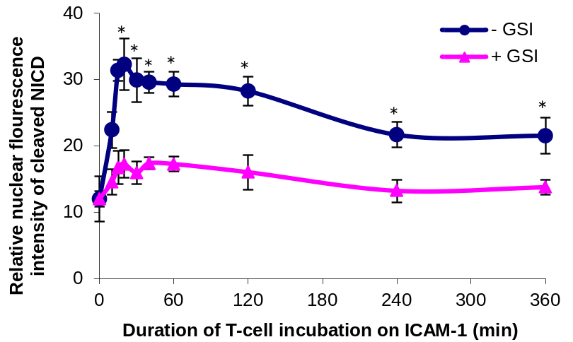
Notch Pathway: LFA-1/ICAM-1 activates Notch signalling
pCBF1-Luc reporter
3
1
2
Unpublished data

Slide 8
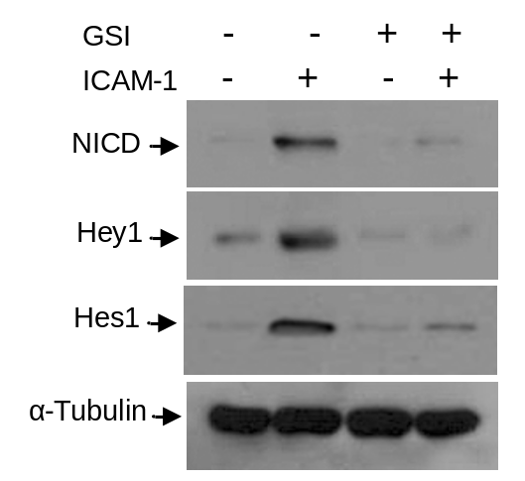
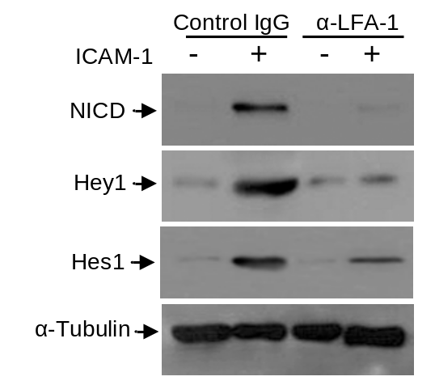
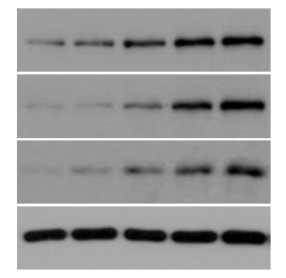
LFA-1/ICAM-1 activates Notch signalling
Time on ICAM-1 (h)
0 1 3 6 12
NICD
Hey1
Hes1
α-Tubulin
3
Unpublished data

Slide 9
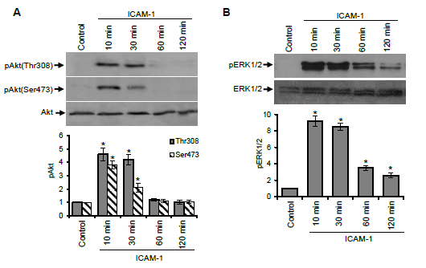
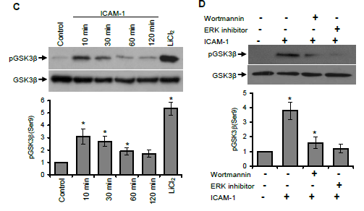
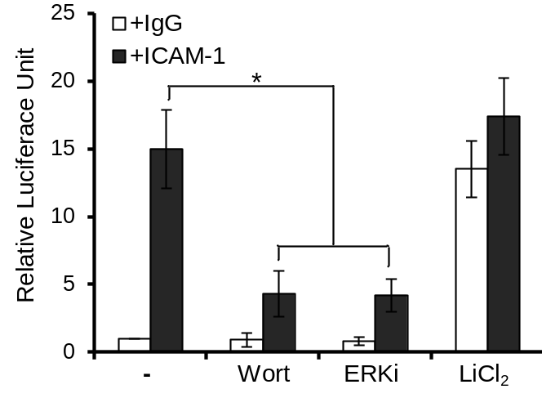
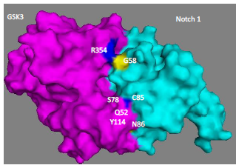
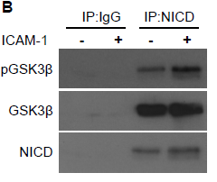
LFA-1 regulates Notch via Akt/ERK/GSK3β signalling axis

Slide 10
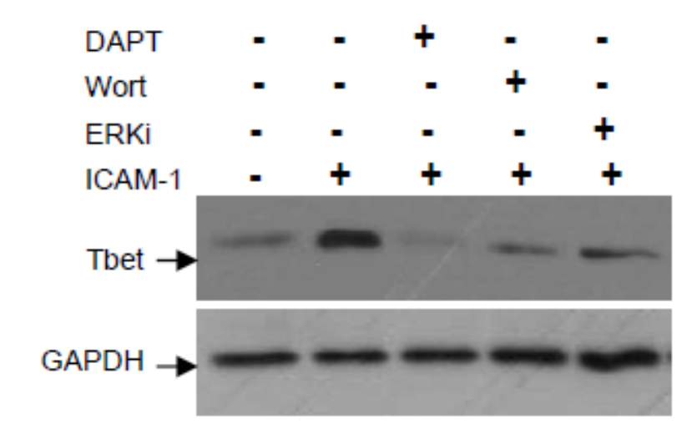
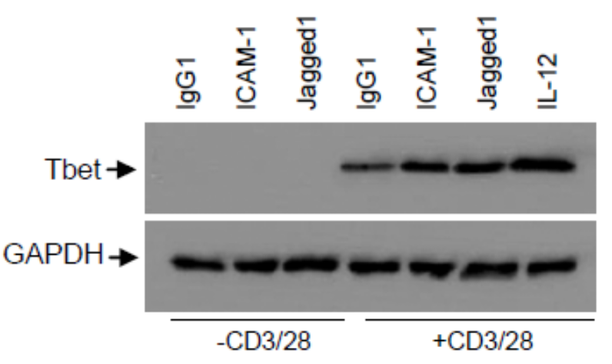
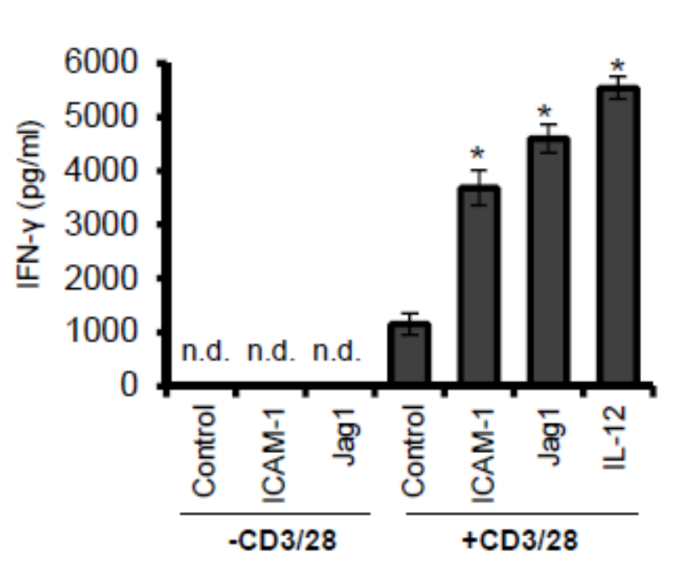
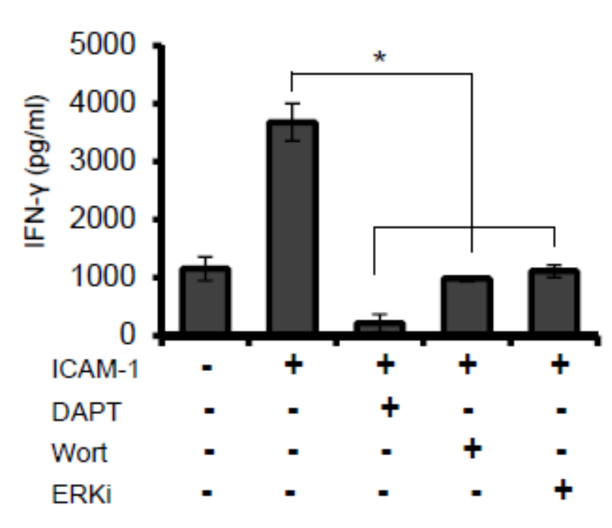
LFA-1/ICAM-1 favors Notch-dependent Th1 polarization
Unpublished data

Slide 11
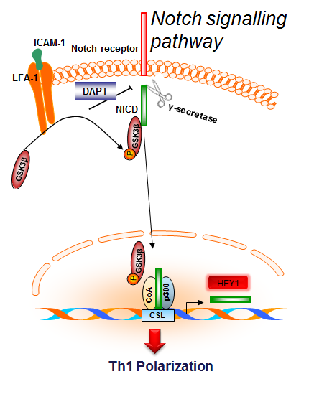
Notch Pathway summary

Slide 12
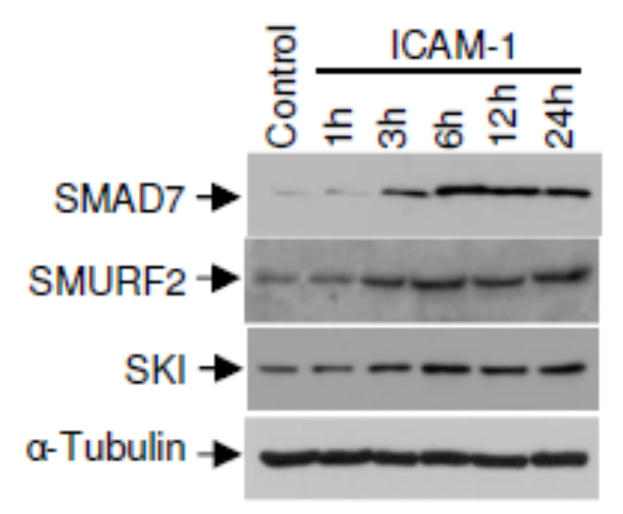
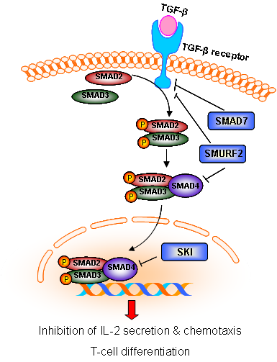
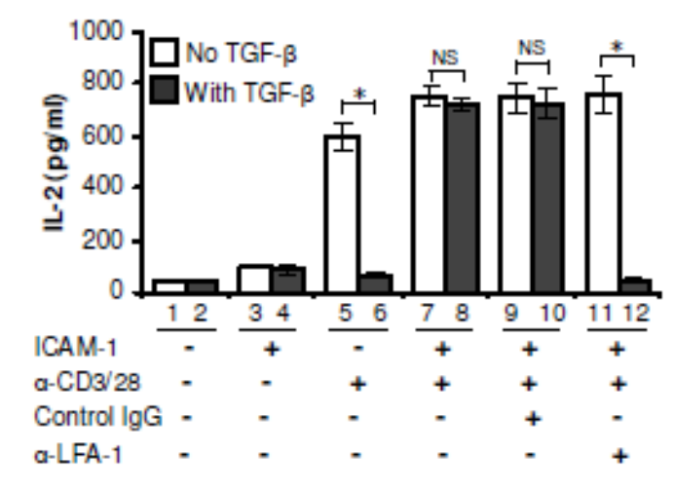
TGF-β pathway: LFA-1/ICAM-1 up-regulates TGF-β inhibitory molecules
Verma et al. (2012) J Biol Chem

Slide 13
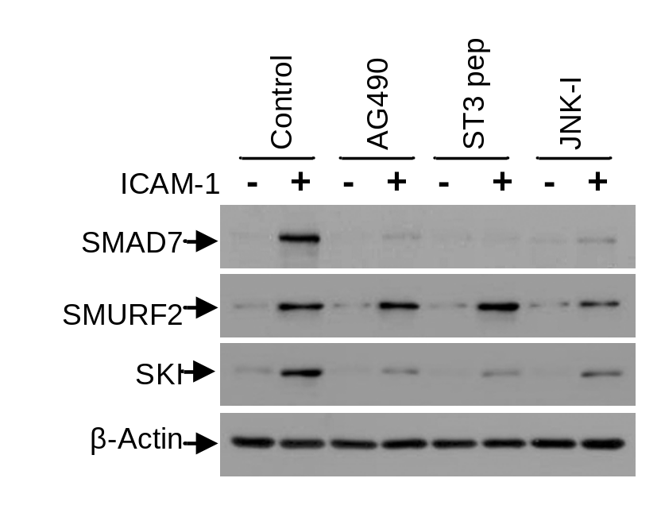
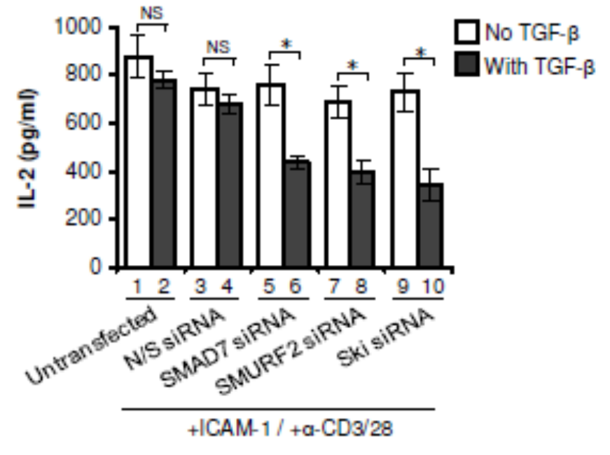
LFA-1/ICAM-1-induced TGF-β inhibitory pathway is dependent on STAT3 and/or JNK
Verma et al. (2012) J Biol Chem

Slide 14
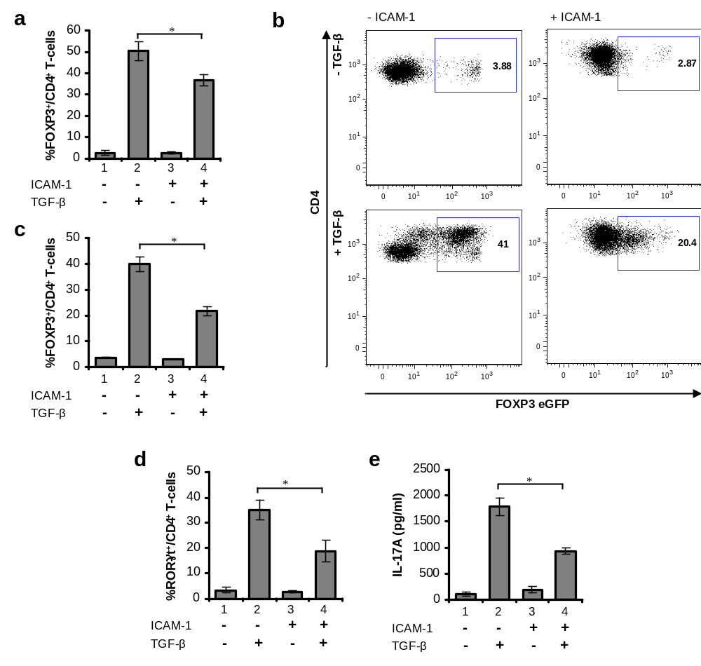
LFA-1 stimulated T-cells are refractory to iTreg or Th17 differentiation
Human
Mouse
iTreg
Mouse
Human
Human
Th17
Verma et al. (2012) J Biol Chem

Slide 15

Summary: LFA-1/ICAM-1 induced TGF-β refractoriness in T-cells
LFA-1/ICAM-1 signalling TGF-β signalling
ICAM-1
TGF-β
LFA-1
TGF-β receptor
SMAD3
SMAD2
P
SMAD2
SMAD7
P
SMAD3
STAT3
P
JNK
P
STAT3
P
SMURF2
P
SMAD2
SMAD4
SMAD3
P
SKI
P
P
P
c-Fos
SMAD2
STAT3
P
c-Jun
SMAD3
SMAD4
STAT3
P
P
AP-1
SMAD7
SKI
SMURF2
Inhibition of IL-2 secretion, Th17, iTreg
Unpublished illustration

Slide 16
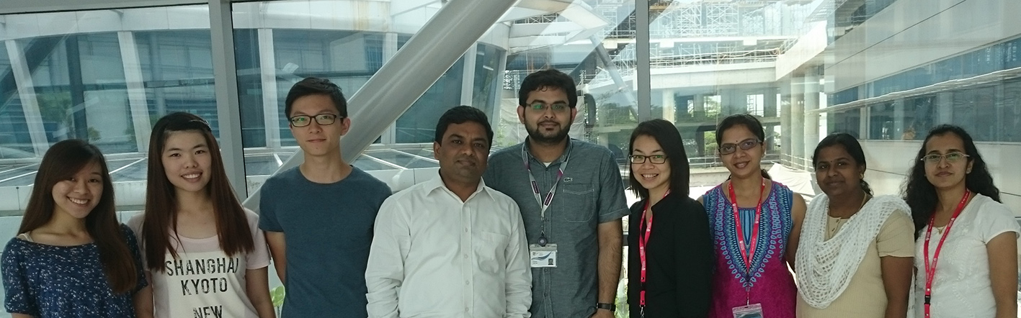












Laboratory members
Jianhui
Fazil
Madhavi
Amutha
Carey
Grace
Navin
Seow
Praseetha
Existing collaborations
Funding support
New collaborations

