Slide 1
Enzyme Engineering: An Innovative Way to Manage the Economics of Biosimilars
Nov 2014
Naveen Kulkarni, CEO

Slide 2
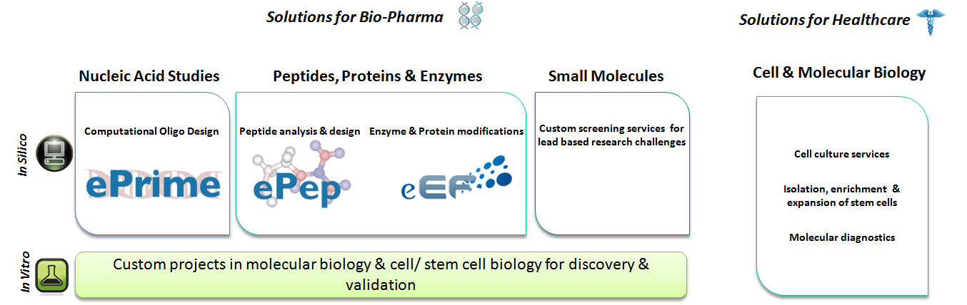
About Polyclone
Capability Snapshot

Slide 3
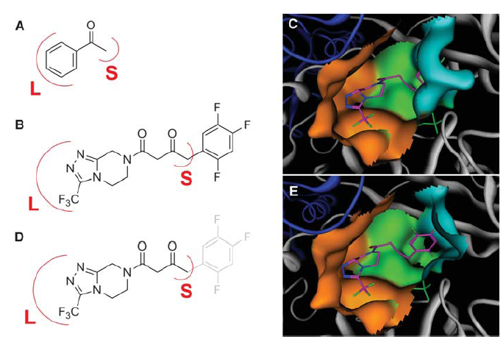
Need to engineer the enzyme
Transaminase
Engineered to produce Sitagliptin
The most common issue with the transamination reaction is the unfavourable reaction conditions
The enzymes also suffer from
low turnover numbers
post reaction processing issues
poor thermostability
low solvent tolerance
limited substrate range (substrates with a substituent no larger than a methyl group at the position adjacent to the ketone), hence low activity towards the desired substrate
27 mutations has given 10 to 13% increase in overall activity

Slide 4
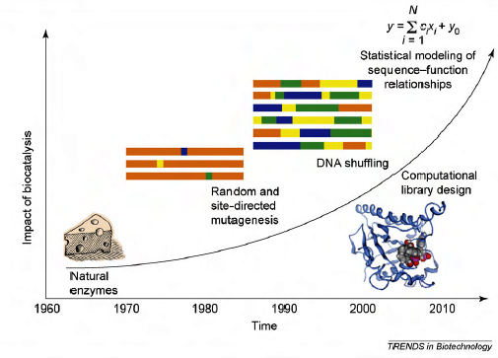
Different approaches for engineering biocatalysis/ Enzymes
Rational design
Directed evolution
The number of success stories in enzyme engineering using these approaches is far lesser than the failures encountered
  Silent substitutions
  Even, Major modifications lead to useless changes
Reports say that computational tools hasten the process of making better enzymes and provide molecular details for further development
Notes:
Dissimilar sequences that yield similar structural characteristics in comparison to wild type without any changes in the conformation.
Major changes lead to useless changes in the functional properties of an enzyme.

Slide 5
Screening and selection tools- in demand
The crucial step in enzyme engineering- Generating focused libraries
Computational techniques – to generate focused libraries
  Understanding of protein structure and function
  Mimicking the experimental process of library screening
But is there a technique that can accurately predict the kinetic properties of an enzyme considering factors like temperature, pH and the thermodynamics of the E-S reaction?
  Sequence based methods predict protein stability- generalized prediction and does not consider catalytic binding mode
  Docking considers catalytic binding on static structures, intermolecular energies shows no change if mutations are beyond the active site, no linear relationship
  Molecular dynamics can reveal different transition state of the E-S reaction- many post simulation analysis to interpret the difference, time consuming

Slide 6
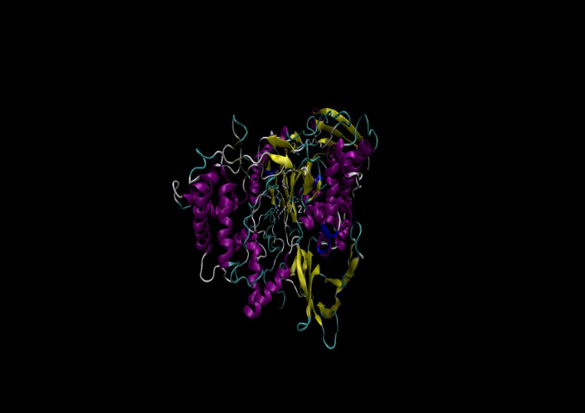
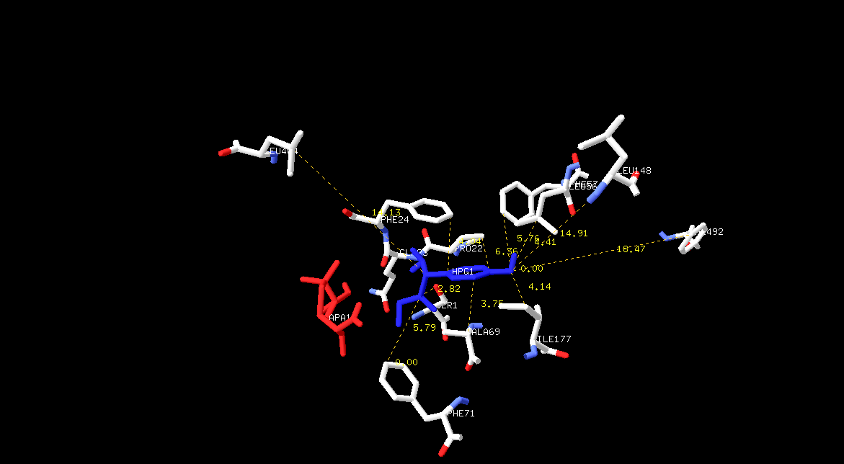
“Computational techniques”- fastest way to understand proteins/enzymes
PGA (E.coli)
Sequence similarity 90%
Active site is 100 % identical
XPGA
Hydrolysis 100%
Synthesis 25%
Hydrolysis 100%
Synthesis 50%
Simulation studies show clear change in the electrostatic potential of XPGA compared to PGA
The XPGA having a stronger positively charged active site.

Slide 7
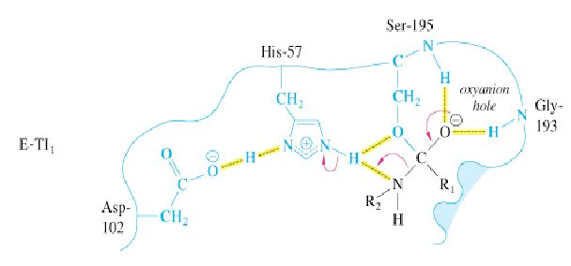
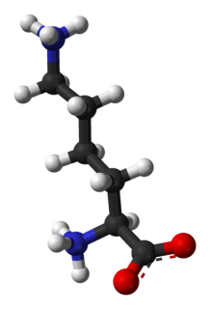
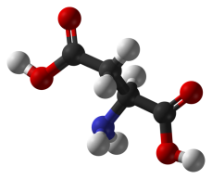
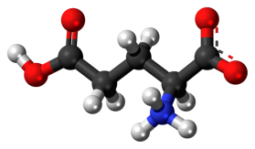
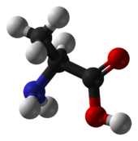
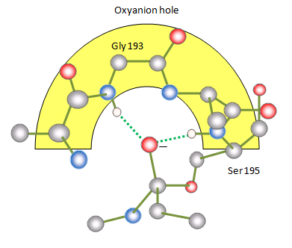
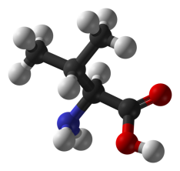
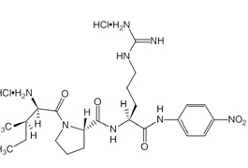
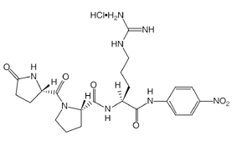
Enzyme of study-serine protease (Chymotrypsin)
Reported activity data of serine protease (Chymotrypsin)
position 193 | Substrates | Kcat values | Classification
A | S-2288 | 64.8 | moderate
D | S-2288 | 4.2 | low
E | S-2288 | 71.2 | moderate
K | S-2288 | 30 | low
V | S-2288 | 10 | low
G | S-2288 | 110.2 | high
A | S-2366 | 117 | high
D | S-2366 | 40.8 | low
E | S-2366 | 98 | high
K | S-2366 | 114.2 | high
V | S-2366 | 26.7 | low
G | S-2366 | 145 | very high
D
E
K
S-2288
(S-2366)
A
V
H-D-Ile-Pro-Arg-p-nitroanilide
pyroGlu-Pro-Arg-p-nitroanilide

Slide 8
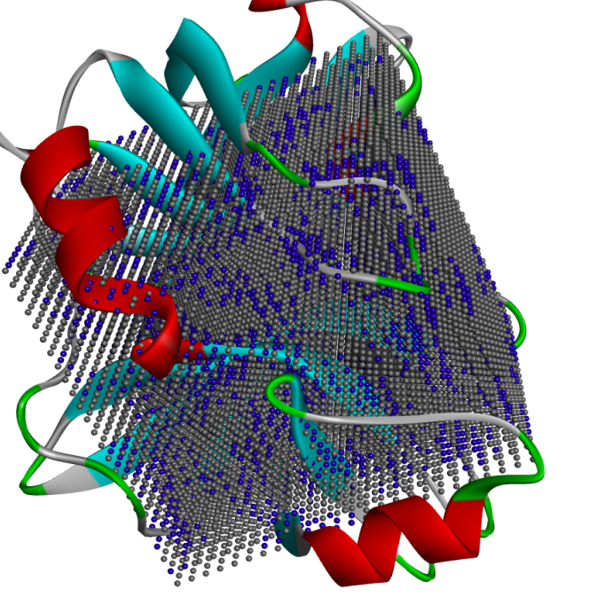
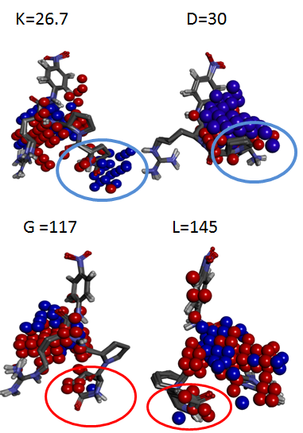
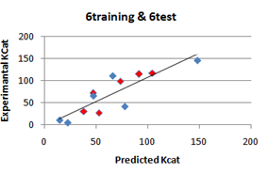
1.8 million data points were generated to select the relevant GCODs
Small spheres are GCODs
156,250 descriptors for each mutation
1,875,000 data points -overall for 12 E-S simulations
Predicted activity values correlated with the experimental values
Showed a specific interaction with GLY 218 and GLU 217
Blue spheres represent selected GCODs for generating QSAR model
Blue = training set
Red = test set

Slide 9
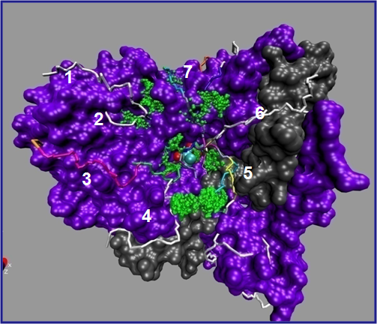

Enzyme engineering Framework - eEF
Path based Hotspot prediction
eEF is used to engineer enzymes
  against thermal & pH denaturation
  for increased activity on novel substrates
  to attain activity against a synthetic substrate
Predicts Hotspots and enzyme modifications for better activity
  The Hotspots are predicted in the catalytic site as well sites aiding catalysis which can be away from the active site
  Grid based energy landscape
  Impact on inter and intra domain
  Per residue energy profiling
Experiments conducted to predict Hotspots are carried out in different assay conditions like solvent, pH, temperature etc.
Grid Based Hotspot prediction

Slide 10
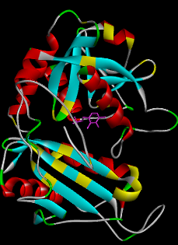
Screening mutations
Never misses a potential modification !
 | Number of modification sites |  |  |  |  |  |  |  |  |  |  |  |  |  |  |  |  |  | Total number of modified enzymes
 | 1 | 2 | 3 | 4 | 5 | 6 | 7 | 8 | 9 | 10 | 11 | 12 | 13 | 14 | 15 | 16 | 17 | 18
Number of substitutions at each site | 12 | 12 | 12 | 12 | 12 |  |  |  |  |  |  |  |  |  |  |  |  |  | 248832
 | 6 | 6 | 6 | 8 | 12 | 12 |  |  |  |  |  |  |  |  |  |  |  |  | 248832
 | 4 | 4 | 5 | 5 | 6 | 9 | 12 |  |  |  |  |  |  |  |  |  |  |  | 259200
 | 3 | 4 | 4 | 5 | 5 | 6 | 6 | 6 |  |  |  |  |  |  |  |  |  |  | 259200
 | 3 | 3 | 3 | 3 | 3 | 5 | 6 | 6 | 6 |  |  |  |  |  |  |  |  |  | 262440
 | 3 | 3 | 3 | 3 | 3 | 3 | 3 | 4 | 5 | 6 |  |  |  |  |  |  |  |  | 262440
 | 2 | 2 | 2 | 2 | 2 | 4 | 4 | 4 | 4 | 4 | 8 |  |  |  |  |  |  |  | 262144
 | 2 | 2 | 2 | 2 | 2 | 2 | 2 | 3 | 3 | 4 | 5 | 12 |  |  |  |  |  |  | 276480
 | 2 | 2 | 2 | 2 | 2 | 2 | 2 | 2 | 3 | 3 | 3 | 3 | 12 |  |  |  |  |  | 248832
 | 2 | 2 | 2 | 2 | 2 | 2 | 2 | 2 | 2 | 2 | 2 | 4 | 4 | 8 |  |  |  |  | 262144
 | 2 | 2 | 2 | 2 | 2 | 2 | 2 | 2 | 2 | 2 | 3 | 3 | 3 | 3 | 3 |  |  |  | 248832
 | 2 | 2 | 2 | 2 | 2 | 2 | 2 | 2 | 2 | 2 | 3 | 3 | 3 | 3 | 3 |  |  |  | 248832
 | 2 | 2 | 2 | 2 | 2 | 2 | 2 | 2 | 2 | 2 | 2 | 2 | 2 | 2 | 2 | 2 | 4 |  | 262144
 | 2 | 2 | 2 | 2 | 2 | 2 | 2 | 2 | 2 | 2 | 2 | 2 | 2 | 2 | 2 | 2 | 2 | 2 | 262144
Modified enzyme models
Substrates (proteins, DNA and Small molecules )
Intra-intermolecular energy based filter- transformed scoring functions
Energies calculated based on the domain movement analysis
Empirical and knowledge based screening
The structure of the Enzyme & substrate is flexible
S
E
+

Slide 11
  Engagement: Sponsor can monitor the output at any given point of the process
Input
In silico Enzyme-Substrate reaction
Output
Specify the requirement - Catalytic and physical properties for the enzyme of interest
E
Hotspot Identifier
  Molecular dynamics and 4D-QSAR studies
  Model 200,000 modifications
Intra-intermolecular energy based filter- transformed scoring functions
E
S
S
4. Predict catalytic and physical properties
Activation energy, Rate limiting steps, Kcat, Km etc. of the modifications
3. Transition path
Sampling, QM/MM and
steered MD at Specific the pH/ temperature etc.
E
P
77° C
E
8
67° C
P
7
57° C
+
6
Modified enzyme models
47° C
5
37° C
4
Substrates (proteins, DNA and Small molecules )
27° C
3
Temperature
pH
S
E
+
Modified X2 showing low activation energy
Energy
Modified X1
Wild

Slide 12
Protein engineering and biopharmaceutical market
Is Biobetter better than Biosimilar development?
Biobetters are proteins that are superior when compared to the innovative biologic, based on a molecular or chemical modification that may translate into an improvement over the reference protein product
In order to improve their clinical potential, second generation recombinants are being developed, each exhibiting improved efficacy and potency depending on their applications
  With growing incidences of cancer, autoimmune disorders and infectious diseases, spurt of new opportunities for growth of the market is expected by the end of this decade
  Factors that restrain new biologics development
    development costs
    stringent regulatory issues
    risk of failure
  Examples
  Sequence modification ,Glycosylation, Pegylation
  Interferon alpha(increased efficacy) , interleukin-2 (stable in solution)
Notes:
The latest generation of “biobetters” which are engineered to be more effective than branded biologics are hitting the market before biosimilars and could make development of the latter pointless, an expert has said.
Biobetters are enhanced or ‘better’ versions of biosimilars, or the innovator drugs.
The therapeutic molecule (from the innovator drug or biosimilar) is modified using platform technologies to create a biological product with superior characteristics. These could be greater efficacy, varied mode of delivery, reduced toxicity, longer product half-life, etc. Compared to biosimilars for the same indication, they offer significant treatment gains for patients.
Biobetters: engineered versions of prototype products to enhance PK or other product characteristics
Enhanced PK/PD: pegylation, hyperglycosylation
Enhanced substrate binding: site directed mutagenesis (eg enhanced fibrin specificity)
Enhanced cellular targeting : use of receptor specific ligands or glycoform engineering for improved uptake in target cells

Slide 13
Challenges that can be addressed
Increase half life
Decrease immunogenicity
Increase protease resistance
Increase solubility & stability
Increase catalytic activity of therapeutic enzymes

Slide 14
Requirements from sponsor
Clearly define the objectives of the study
3D structure of the enzyme of interest
Mode of binding and kinetic properties of the enzyme-substrate reaction
Structure of enzyme-substrate complex
Reported structure of enzyme complexed with other active substrates OR inhibitor/s
Specify process conditions of the reaction
Available literature study

Slide 15
Thank You ! info@polyclonebio.com

Slide 16
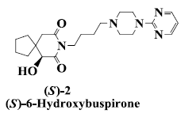
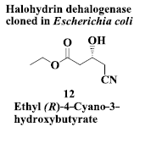
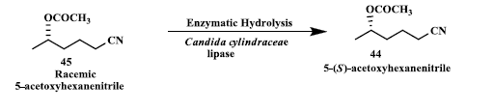
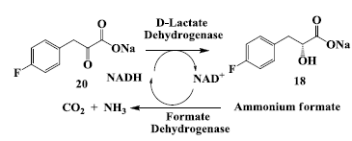
Enzymatic preparation of Drugs
Cholesterol lowering agent
Antianxiety drug :Reductase
Anti-Alzheimer’s drugs
Anticancer Drug: Enzymatic Preparation of (S)-2-Chloro-1-(3-Chlorophenyl)Ethanol
Rhinovirus protease inhibitor
Anticancer drug: Enzymatic preparation of C-13 paclitaxel side-chain synthon.

Slide 17
Advantage of using Transaminases for producing drugs
Antimigraine Drugs
Anti – diabetic drug
Requires low-cost substrates
Does not need an external cofactor to recycle the enzyme
High enantioselectivity and reaction rate
Ability to accept inexpensive amines, such as isopropylamine,as amino donors, in combination with their role in organic synthesis for the biocatalytic production of a wide variety of chiral amines and a-amino acid compounds of high enantiomeric excess

Slide 18
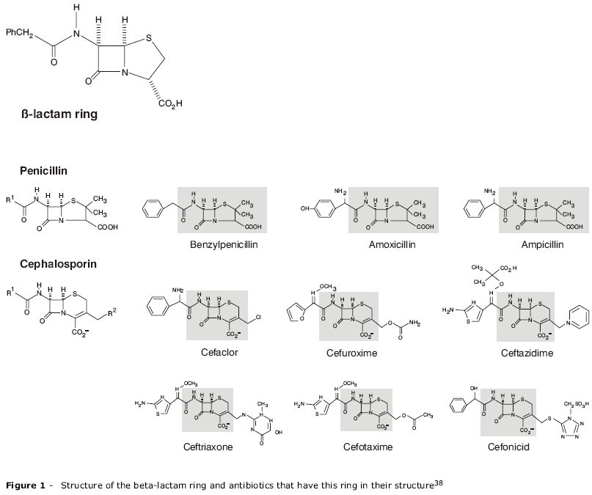
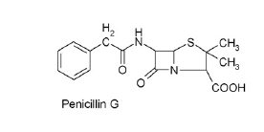
Engineering penicillin G acylase for producing semi -synthetic antibiotics

Slide 19
Computational tools in enzyme engineering
Multiple tools are used to address different parts of the problem. Ex: Tools like
  CC\PBSA,EGAD,FoldX,Hunter,I-Mutant2.0,Rsetta,Prethermut, pKD Server, PROPKA are used for thermal and pH stability
  Autodock, Gold, DOCK, Schrodinger for enzyme- substrate binding
  Gromacs, NAMD, Charmm for E-S simulation
Knowledge based tools use sequence level information to predict hotspots
Molecular modeling and dynamics are by far the most revealing techniques when it comes to studying the enzymatic reaction
Need for specific expertise to shift from one tool to other and move on to the next to make sense
Sequence based methods gives no information about the change in the catalytic binding modes and the thermodynamics of the reaction
Molecular modeling and dynamics are computationally too expensive and very often the results are not comprehensive
There is no such integrated tool in the market that can produce 1000’s of modifications and predict activation energy and rate limiting steps at different process conditions for the required biocatalysis

