Slide 1


Aloe-Vera leaf extract mediated synthesis of curcumin nanoparticles: Implications in the treatment of Type 2 diabetes in experimental wistar rat model
Presented By:
Naureen Fatima
Research Scholar
Department of Biochemistry
J.N. Medical College
Aligarh Muslim University
Aligarh (U.P.), India-202002.
Supervisor: Prof. Shagufta Moin
(Department of Biochemistry)
Co-Supervisor: Prof. Mohammad Owais
(Interdisciplinary Biotechnology Unit)

Slide 2

INTRODUCTION
Diabetes mellitus is a group of metabolic diseases characterized by hyperglycaemia resulting from defects in insulin secretion, insulin action, or both.
Chronic hyperglycaemia in diabetes is associated with long-term damage, dysfunction, and failure of various organs, especially the eyes, kidneys, nerves, heart, and blood vessels.
In addition to the primary defect in carbohydrate metabolism, defects in lipid metabolism are widespread, with elevations in plasma Free Fatty Acids and Triglycerides, and, in some circumstances, of ketones.

Slide 3
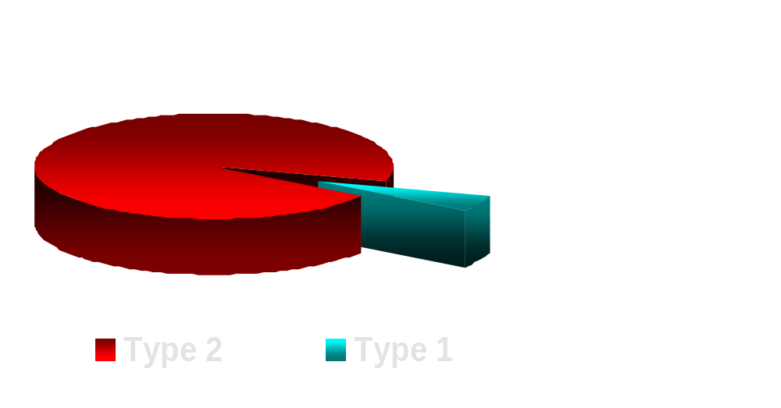
Diabetes Mellitus has been classified into two major categories
95%
5%

Slide 4
TYPE 2 DIABETES
Also called non-insulin dependent diabetes mellitus (NIDDM) or adult onset diabetes mellitus.
Usually begins as insulin resistance, a disorder in which the cells do not use insulin properly. As the need for insulin rises, the pancreas gradually loses its ability to produce insulin.
Associated with older age, obesity, family history of diabetes, impaired glucose metabolism, physical inactivity, and race/ethnicity.

Slide 5
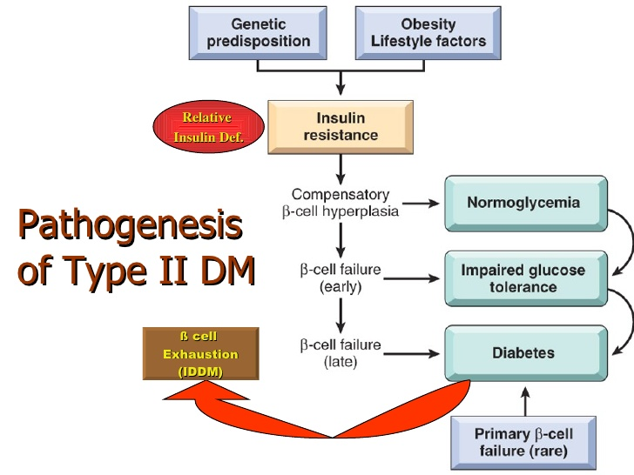

Slide 6
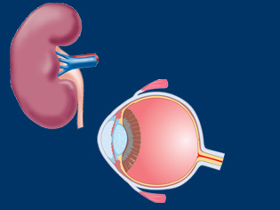
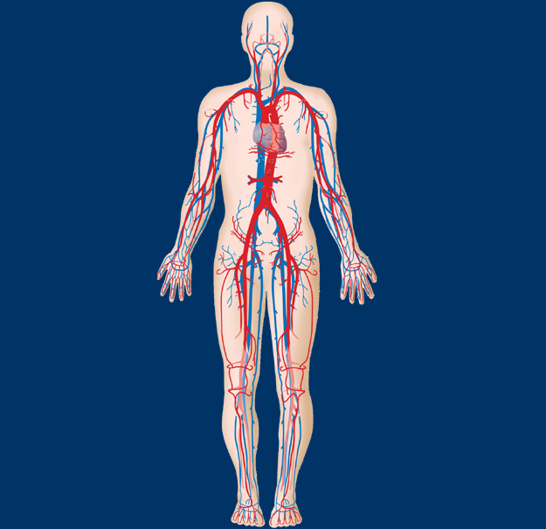
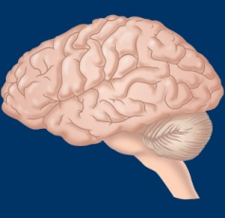
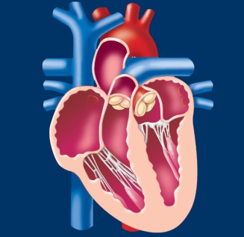
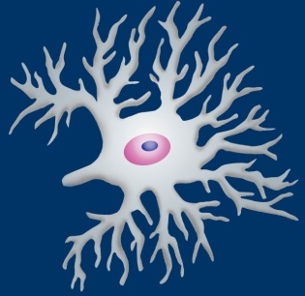
DIABETES IS ASSOCIATED WITH SERIOUS COMPLICATIONS
Stroke
Diabetic
Retinopathy
2- to 4-fold increase in
cardiovascular mortality and stroke
Leading cause
of blindness
in adults
Cardiovascular
Disease
8/10 individuals with diabetes die from CV events
Diabetic
Nephropathy
Diabetic
Neuropathy
Leading cause of
end-stage renal disease
Leading cause of
non-traumatic lower extremity amputations

Slide 7
Recently, many plants and their products have been gaining importance due to their imperative use in the synthesis of nanoparticles.
Curcumin, a highly potent bioactive component of Curcuma longa L. (turmeric) has been widely used in the prevention and treatment of various chronic diseases, such as cancer, cardiovascular diseases, metabolic disturbances and obesity.
In this study, we have developed a rapid and eco-friendly method for the synthesis of curcumin nanoparticles using leaf extracts of Aloe vera plant.

Slide 8
OBJECTIVES
To synthesize Aloe Vera leaf extract (ALVE) mediated curcumin nanoparticles for possible therapeutic effect in diabetes.
To study the ameliorative effect of CNPs on glycaemic status in streptozotocin-induced diabetic wistar rat model.
To study the effect of CNPs on the levels of oxidative stress biomarkers.
To assess the DNA damage in the liver, kidney and pancreas of diabetic wistar rats.

Slide 9

STUDY DESIGN
The study was conducted at the Department of Biochemistry, J.N. Medical College in collaboration with Interdisciplinary Biotechnology Unit, Aligarh Muslim University, Aligarh (India).
Approved by the Institutional Animal Ethical Committee.
Carried out on Streptozotocin-induced diabetic wistar rat model.
Curcumin Nanoparticles (CNPs) were synthesized using Aloe Vera leaf extract (ALVE).
Group design:
Group I Healthy Control
Group II Healthy Control treated with CNPs
Group III Diabetic
Group IV Diabetic treated with CNPs
Notes:
This the pilate study so we take 50 patients in each group
(ml/min per 1.73 m2). In stage 2 -Mildly reduced kidney function
Inclusion criteria Exclusion criteria
Normal blood sugar, BP, lipid profile Thyroid patients, obese
Hypertensive T1DM, CKD
S. Creatinine >1.0 T1DM, CKD with any other disease
E-GFR <90—60 exclusion

Slide 10

METHODS
Preparation of Aloe Vera leaf extract
Synthesis of nano-rod formulation using Aloe Vera leaf extract
Characterization of curcumin nanoparticles employing
  Scanning Microscopy
  Transmission Electron Microscopy
  FTIR Spectroscopy
Measurement of Fasting blood glucose, lipid peroxidation, protein carbonyl content and liver function markers.
Determining the DNA damage in all the groups using COMET assay.

Slide 11
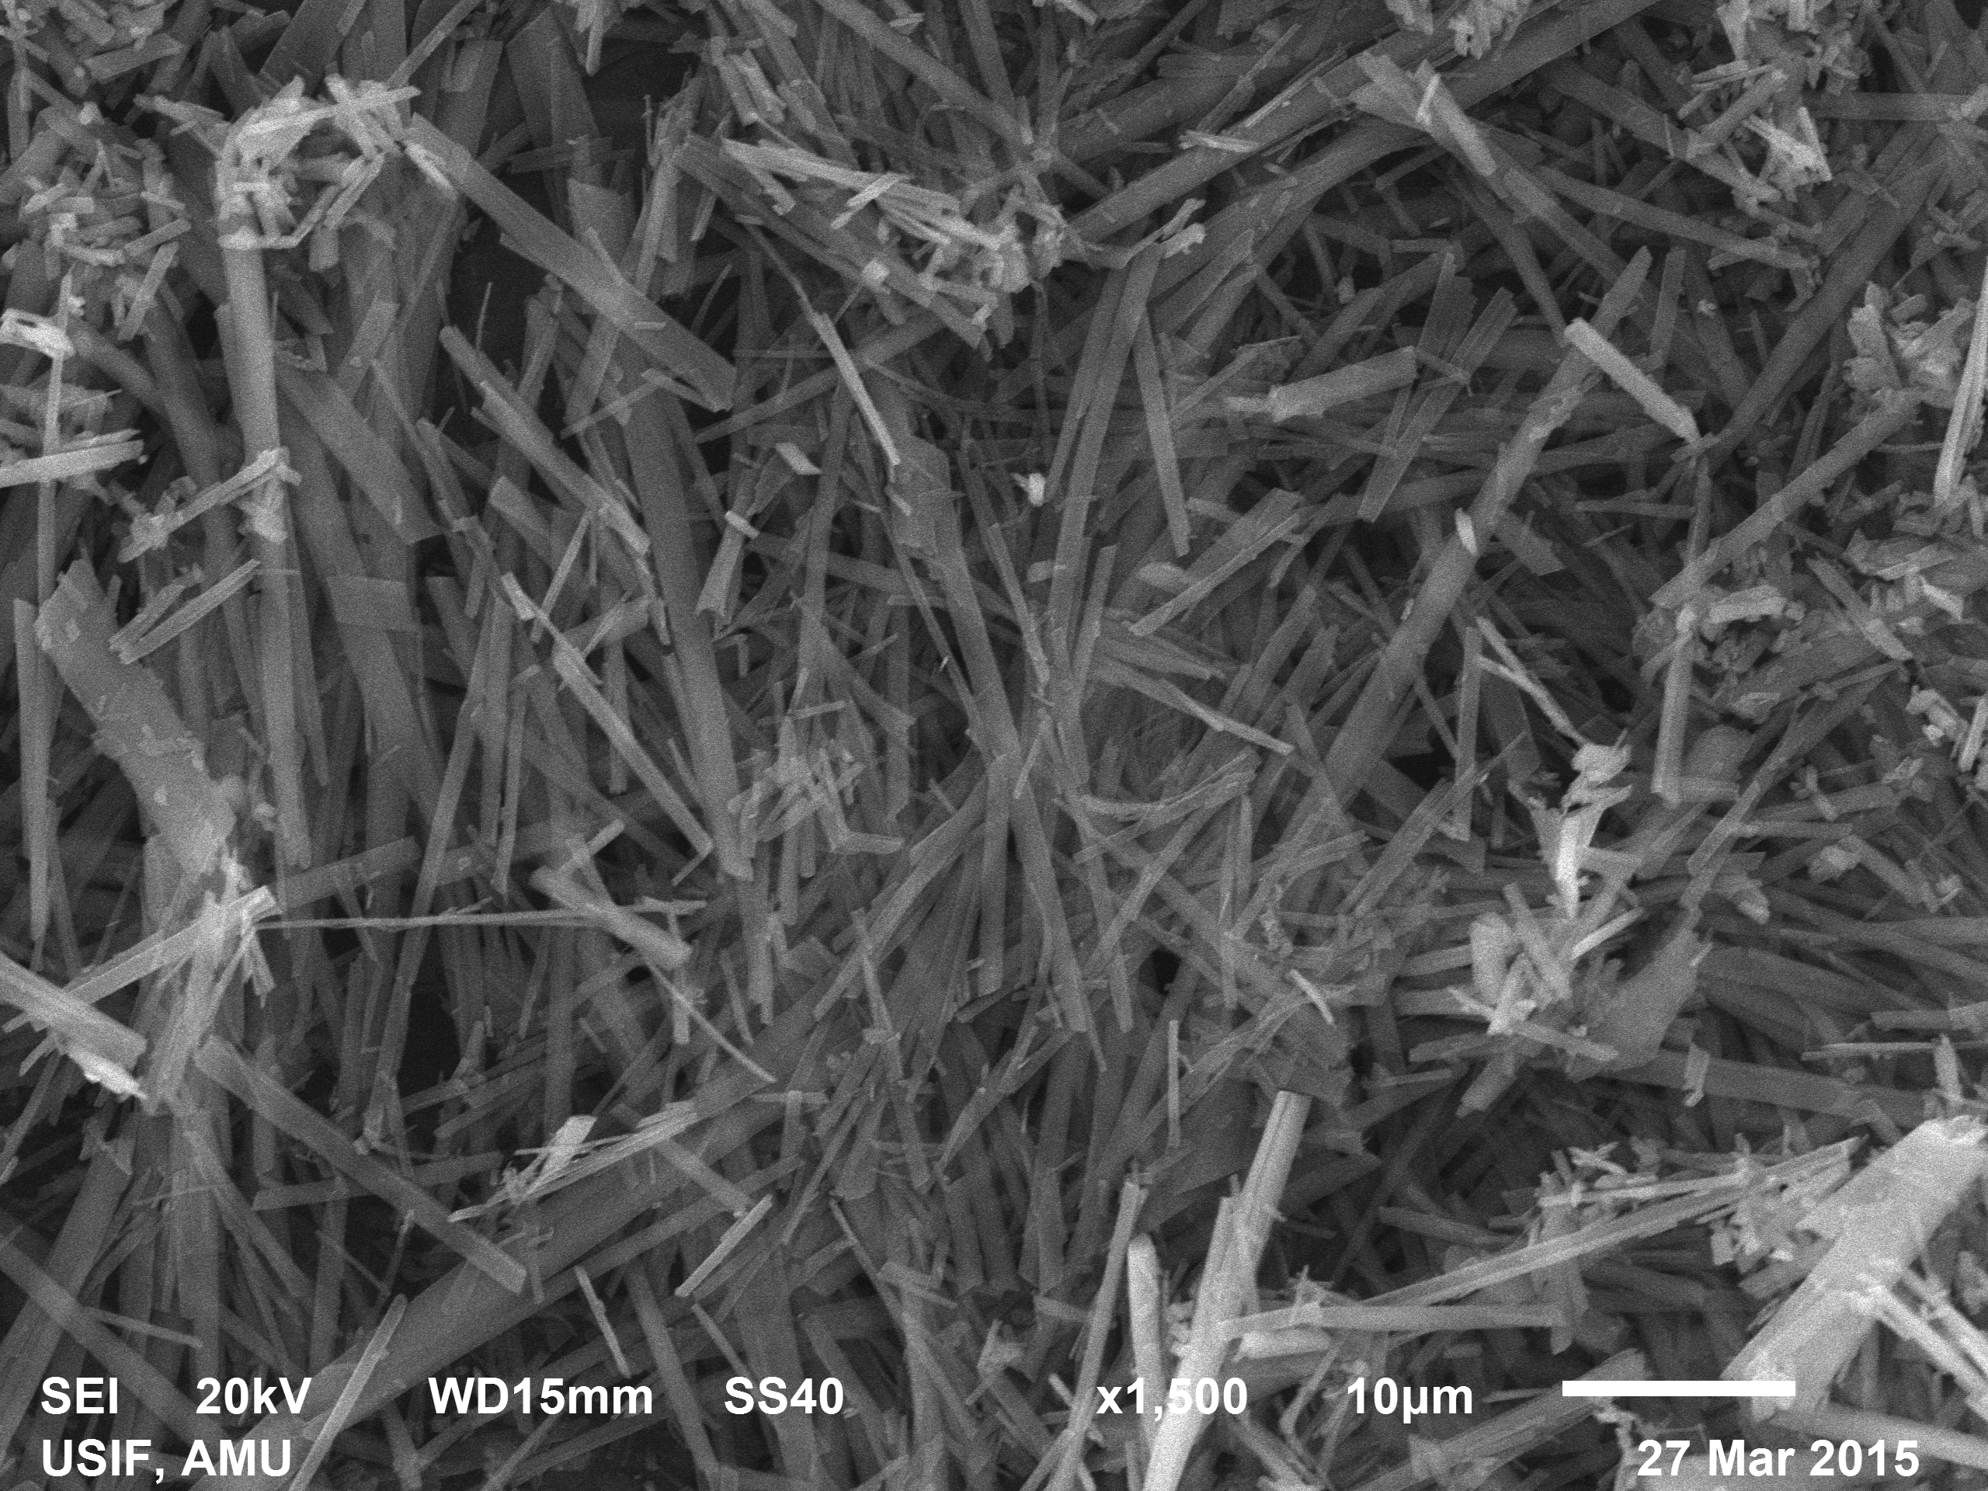
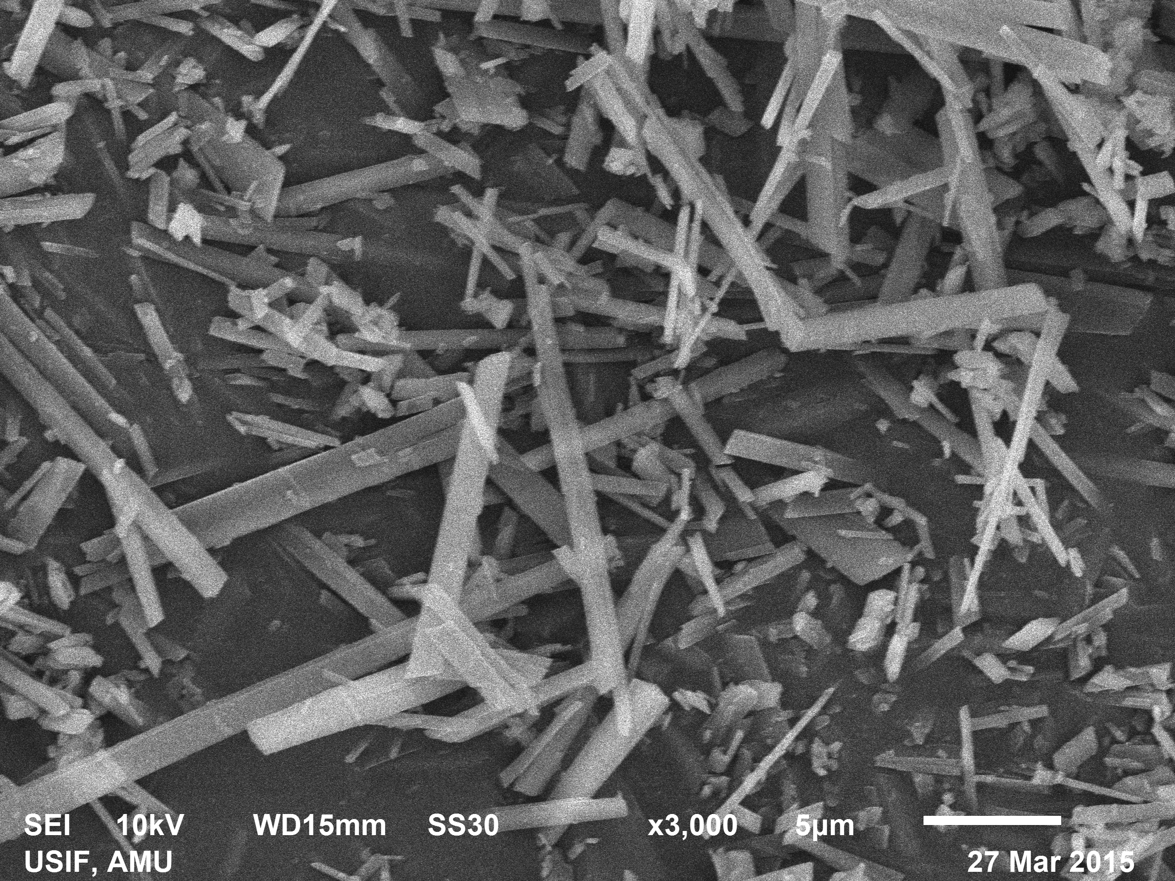
Scanning Electron Microscopy

Slide 12
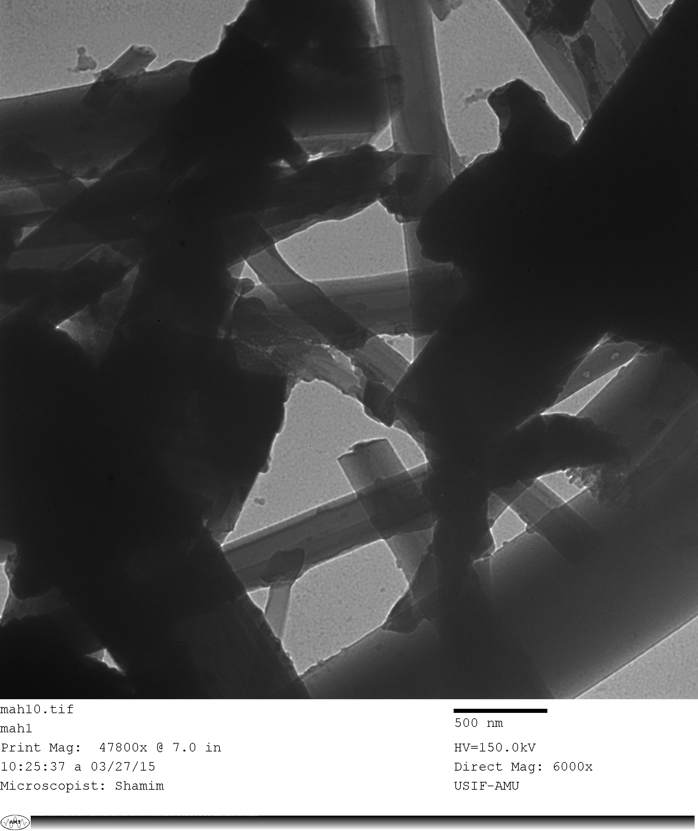
Transmission Electron Microscopy

Slide 13
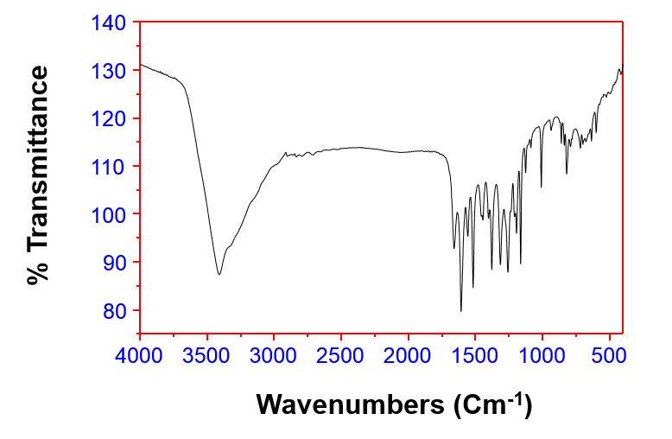
Fourier transform infrared spectroscopy

Slide 14
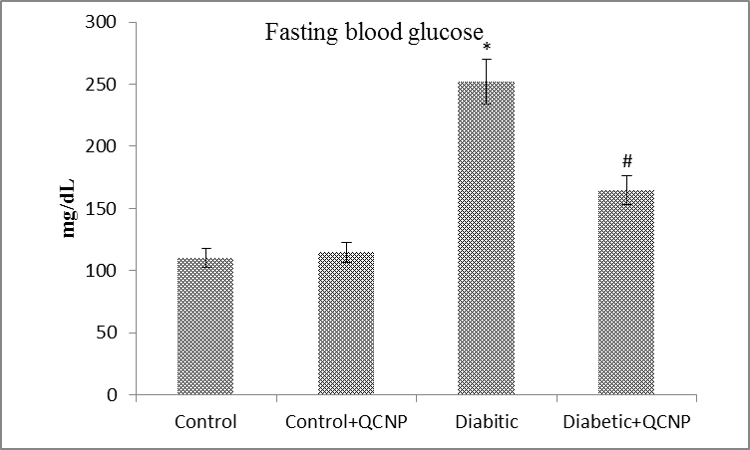
Fasting Blood Glucose Level
Healthy Control + CNPs Diabetic Diabetic + CNPs
Control

Slide 15
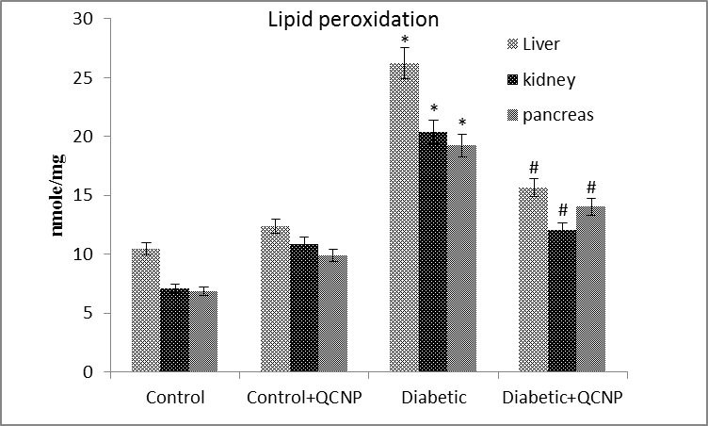
Lipid Peroxidation
Healthy Control + CNPs Diabetic Diabetic + CNPs
Control

Slide 16
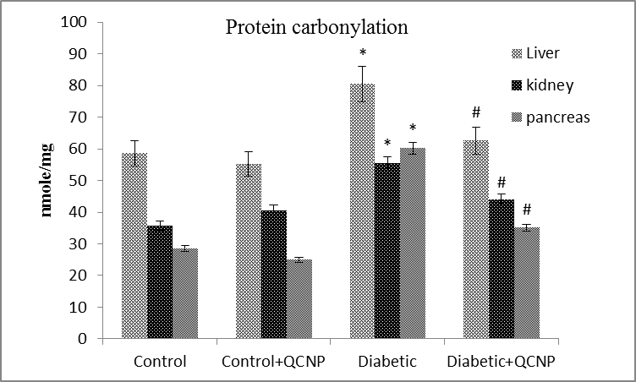
Protein Carbonyl Content
Healthy Control + CNPs Diabetic Diabetic + CNPs
Control

Slide 17
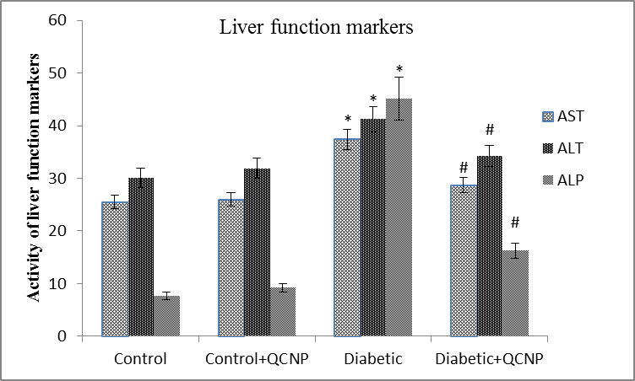
Liver Function Markers
Healthy Control + CNPs Diabetic Diabetic + CNPs
Control

Slide 18
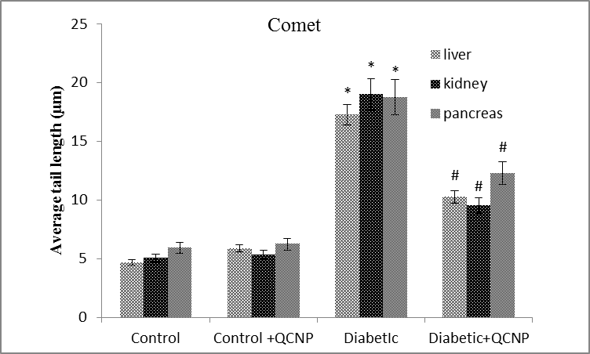
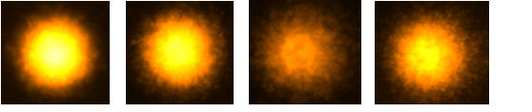
Comet Assay
Healthy Control + CNPs Diabetic Diabetic + CNPs
Control

Slide 19

CONCLUSION
Therapeutic efficacy of the AVLE synthesized CNPs were found better than that of free form of curcumin as well as with the AVLE alone.
CNPs were also found to be effective in ameliorating the increased levels of fasting blood glucose, lipid peroxidation, protein cabonylation and liver enzyme markers in STZ-induced diabetic rats.
CNPs showed inhibitory effect on the DNA damage in beta cells of pancreatic islets.
Polyphenol mediated green synthesis of CNPs with effective anti-diabetic potential may open new prospects for type 2 diabetes therapy.

Slide 20
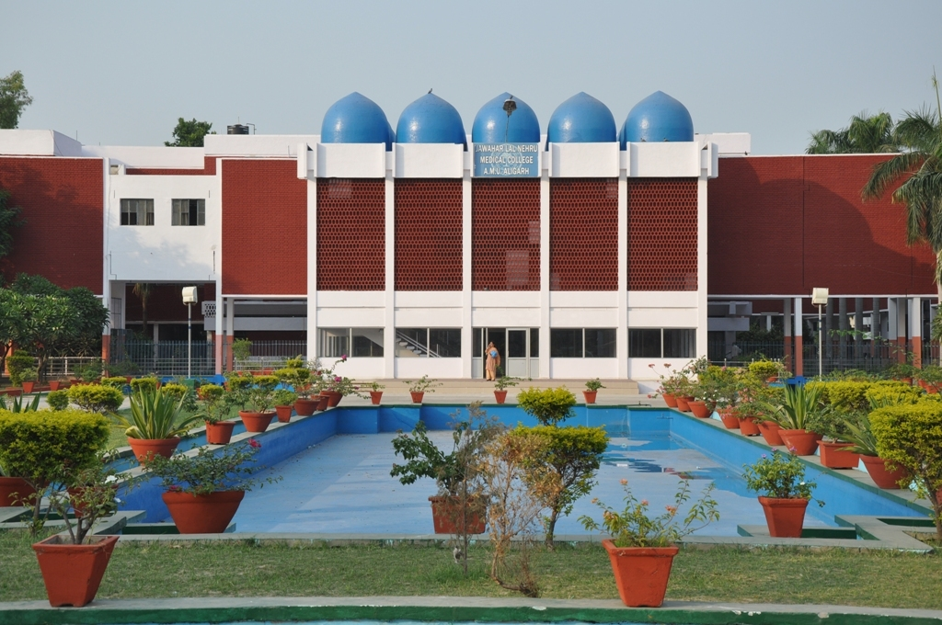
THANK YOU

