Slide 1



COMPARISON OF ROBOTIC VERSUS OPEN AND LAPAROSCOPIC DISTAL PANCREATECTOMY IN PANCREATIC NEUROENDOCRINE TUMOR
Nathania Sutandi¹, Mr. Stuart Robinson², Prof. Steven A. White²
¹Faculty of Medical Science, Newcastle University, ²Department of Hepatopancreato-biliary
Surgery, Freeman Hospital
9th International Conference on Endocrinology and Diabetes Summit, 13th-14th September 2017, Singapore

Slide 2





1. INTRODUCTION
2. OBJECTIVES
OUTLINE
3. METHODS
4. RESULT AND DISCUSSION
5. CONCLUSION

Slide 3

01
INTRODUCTION

Slide 4



PANCREATIC NEUROENDOCRINE TUMOR (PNET)
ODP (n=10)
LDP (n=14)
RADP (n=10)
P value
DEMOGRAPHICS
SUBTYPES
PATHOGENESIS
PNET can be broadly divided into 2 subcategories, which are functioning (hormone producing) or non-functioning tumors depending on which gut peptides they secrete
PNET occurs in 1-2% of pancreatic tumors, with the incidence of 2-3/100.000, mostly in the age group of 40-60 years old
Most of pNETs occur sporadically, however approximately 10% may be associated with multiple neoplasia type 1 (MEN 1)
INTRODUCTION

Slide 5



PANCREATIC NEUROENDOCRINE TUMOR (PNET)
ODP (n=10)
LDP (n=14)
RADP (n=10)
P value
CLINICAL PRESENTATION
DIAGNOSIS
TREATMENT
Symptoms in non-functioning tumor can be caused by the mechanical problem from the tumor growth, while in functioning tumor, the symptoms are related to the hormone overproduction
Diagnosis of pNETs can be established through endocrine testing (gut hormone profile), imaging (CT, MRI, US, PET, EUS, SRS), and histological evidence
Treatment for pNETs vary from surgery, medical therapy (based on tumor properties), systemic chemotherapy, or even surveillance
INTRODUCTION

Slide 6
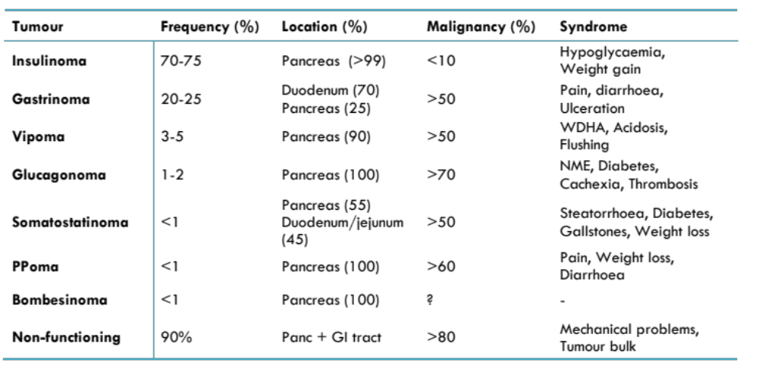
PANCREATIC NEUROENDOCRINE TUMOR (PNET)
ODP (n=10)
LDP (n=14)
RADP (n=10)
P value
Table 1. Clinical presentation of pNETs based on the subtypes
INTRODUCTION

Slide 7
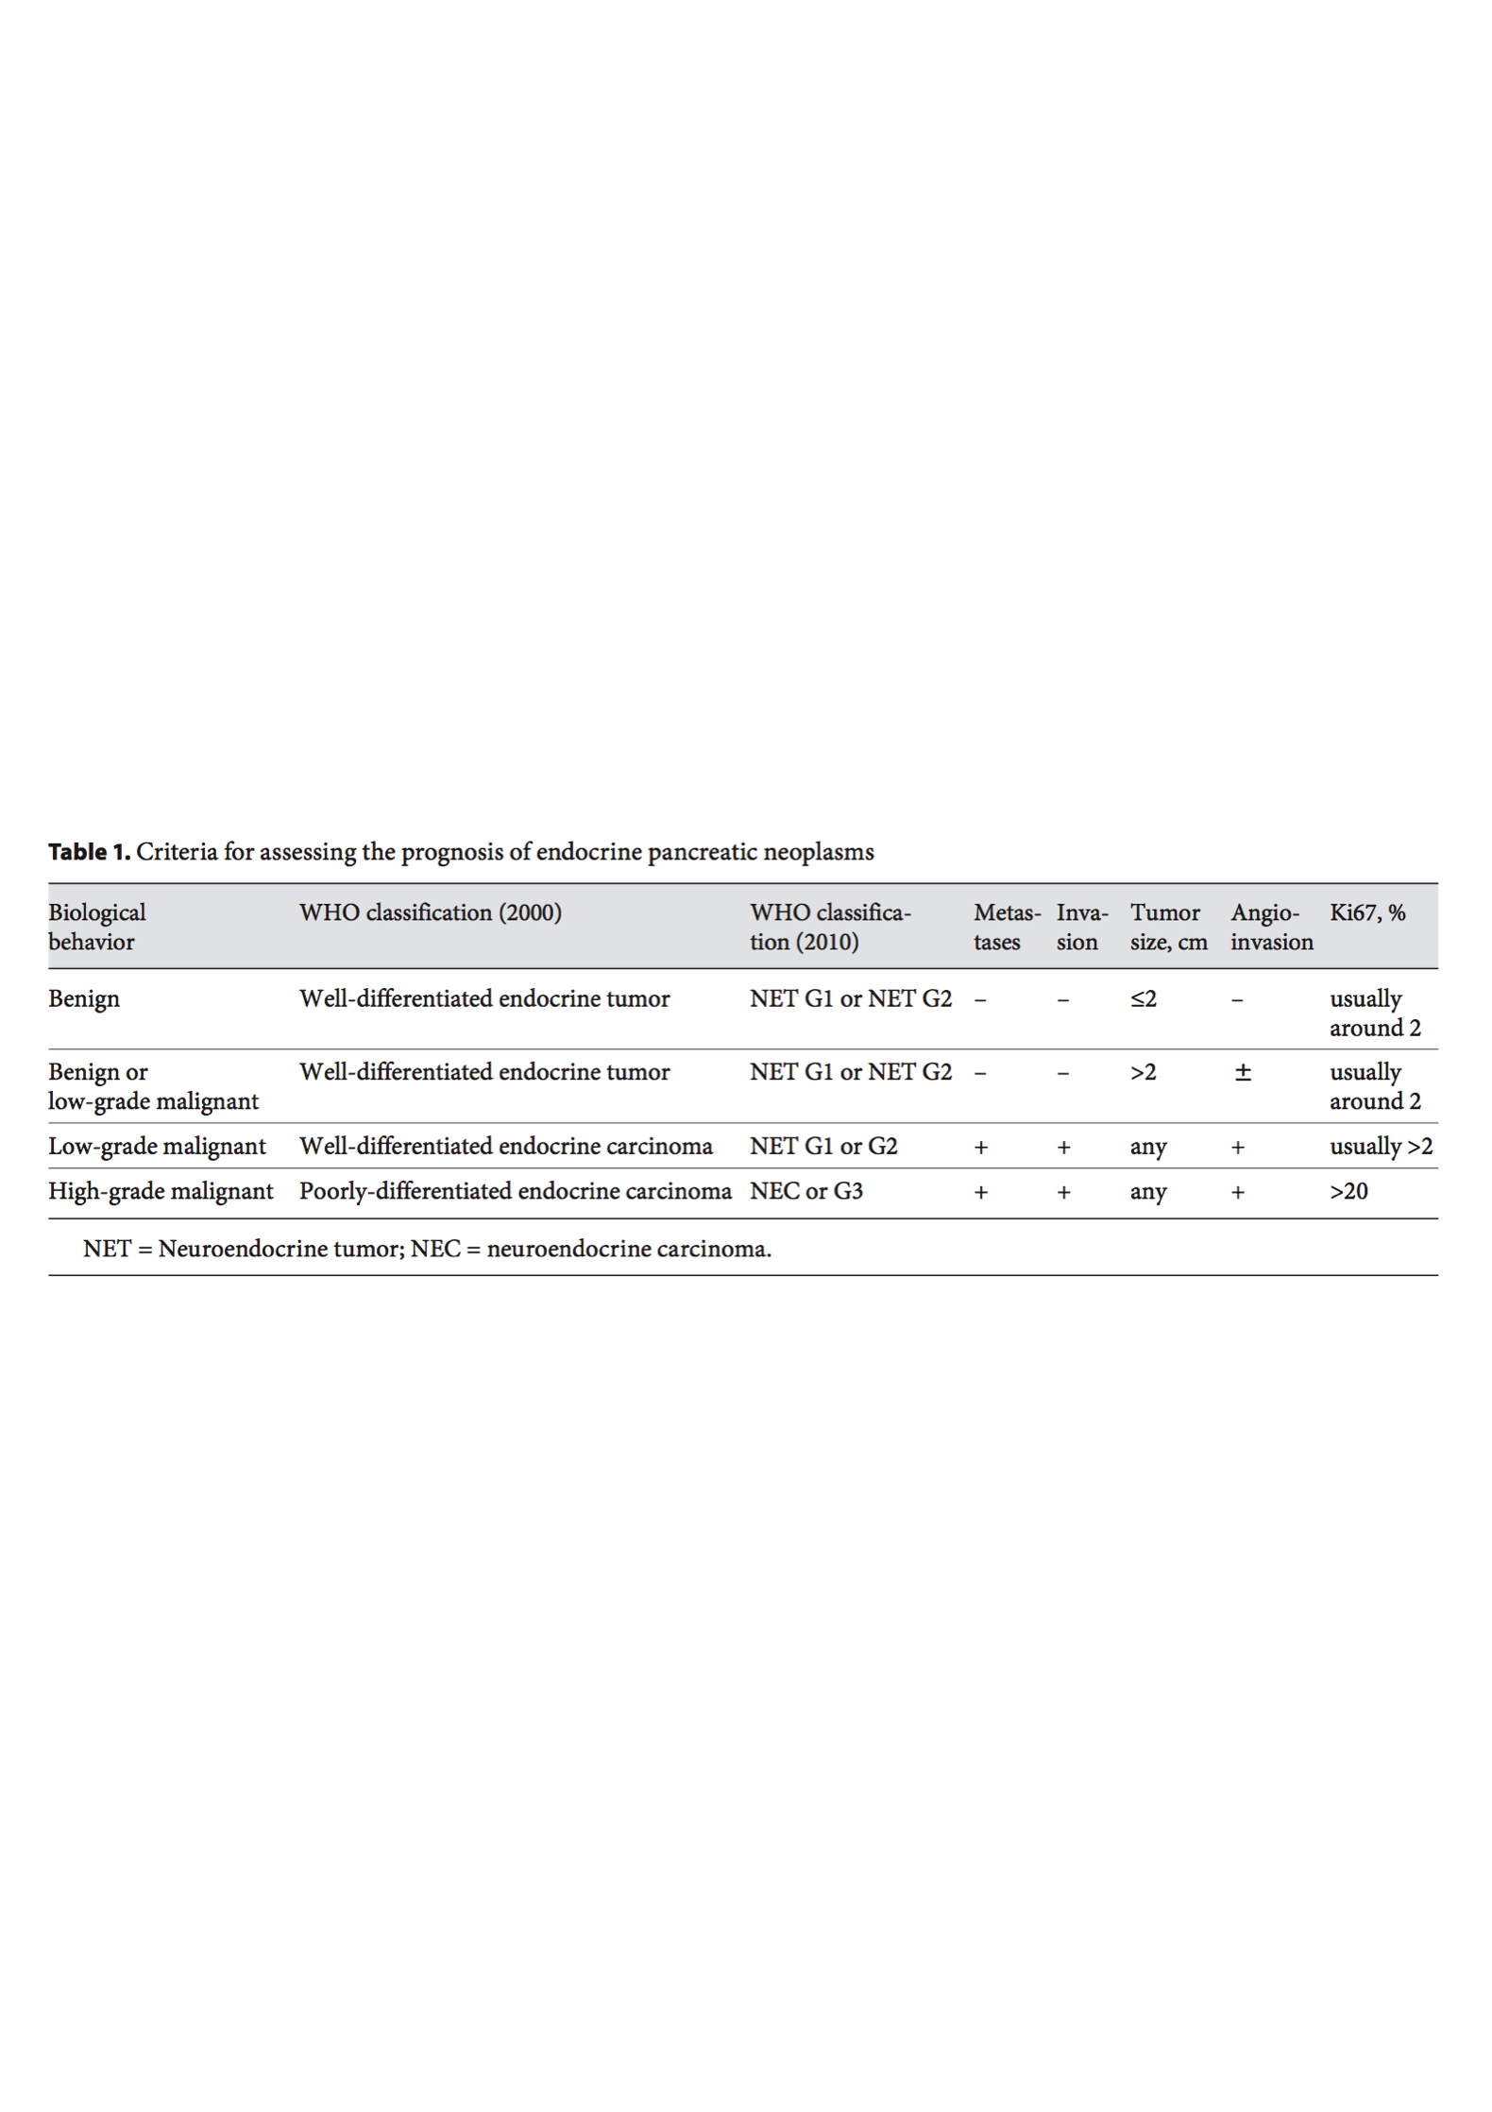
PANCREATIC NEUROENDOCRINE TUMOR (PNET)
ODP (n=10)
LDP (n=14)
RADP (n=10)
P value
Table 2. WHO Classification for pNETs
INTRODUCTION

Slide 8
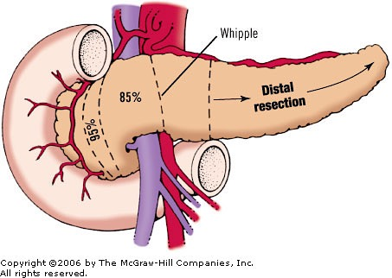



DISTAL PANCREATECTOMY
DEFINITION
INDICATION
PROCEDURE
COMPLICATION
Treatment of choice for benign and malignant lesions in the body/tail of the pancreas (NET, MCN, IPMN, Adenocarcinoma, chronic pancreatitis)
Can be done with/without splenectomy through open (ODP), laparoscopic (LDP), or robotic (RADP) approach
Removing the part of the pancreas extending to the left of the midline (not involving duodenum and distal bile duct)
Post-operative pancreatic fistula (POPF) remains the most common complication following distal pancreatectomy
Figure 1. Distal pancreatectomy illustration
INTRODUCTION

Slide 9









ROBOTIC SURGERY
Robotic surgery was claimed to be able to overcome the limitations of laparoscopic surgery
3 dimensional camera
7 degree freedom instrument
Tremor and scale
movement filter
Robotic system enhanced surgeon’s dexterity in many ways
Endo-wrist technology
Better ergonomics
INTRODUCTION

Slide 10
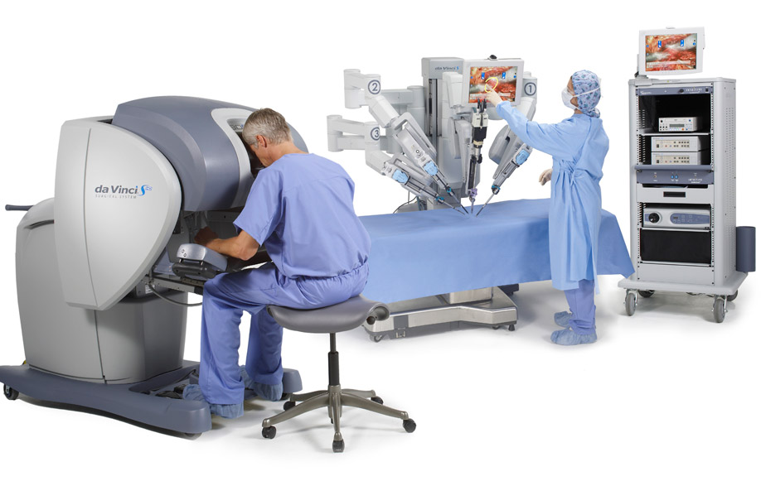
ODP (n=10)
LDP (n=14)
RADP (n=10)
P value
The da Vinci Surgical System :
Surgeon’s console
Patient cart
Vision cart
INTRODUCTION

Slide 11




BACKGROUND
ODP (n=10)
LDP (n=14)
RADP (n=10)
P value
The incidence of pNET has gradually increased over the last three decades
Most pNET is relatively small and solitary - well suited for surgical removal by minimally invasive approach
RADP is being used increasingly in specialized pancreatic surgery centers
No studies have reported the safety and feasibility of RADP in the management of pNET
INTRODUCTION

Slide 12
02
OBJECTIVES

Slide 13



To conduct the first study which compares the outcomes of RADP, LDP, and ODP in PNET
To assess the safety and feasibility of robotic distal pancreatectomy in PNET
To verify the theoretical advantages of RADP over LDP and ODP in the clinical practices
OBJECTIVES

Slide 14
03
METHODS

Slide 15



DESIGN & STUDY POPULATION
Patients undergoing ODP, LDP, RADP performed at HPB Surgery, Freeman Hospital (September 2007 - March 2017)
Decision on types of procedure was made in the MDT meeting
Inclusion criteria : patients undergoing distal pancreatectomy with or without splenectomy with the indication of pNET
STUDY
POPULATION
Follow-up was done through clinical examination, blood test, and imaging as needed
Exclusion criteria : patients who had another major procedure alongside the operation
METHODS

Slide 16




DATA COLLECTION
Patients’ medical records
(electronic databases and patients’ notes)
PATIENTS’ DEMOGRAPHIC
PATIENTS’ CLINICAL DATA
INTRA-OPERATIVE DATA
POST-OPERATIVE DATA
Age
Gender
BMI
ASA score
Size of lesion
Grade of lesion
Ki67%
Operative time
Preparation time (for robotics)
Estimated blood loss
Spleen preservation rate
Conversion rate
Oncological outcome
Total hospital stay
Length of ITU stay
30-days morbidity
Pancreatic fistula
Post-operative DM
30-days reoperation
30-days readmission
Recurrence
Analgesia at discharge
METHODS

Slide 17
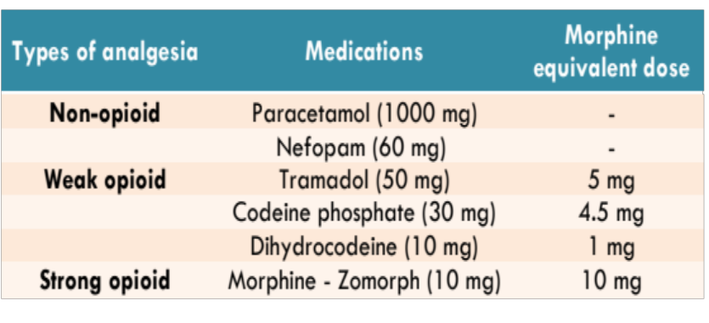
DEFINITIONS
Ki67 = Proliferation index for NET
CONVERSION = Change of operative procedure from laparoscopic or robotic to open (laparotomy)
OPERATIVE TIME = Time needed for the operation starting from the first incision until the skin closure
PREPARATION TIME = Set-up time of the robot in the robotic group
R0 RESECTION RATE = Complete excision of the tumor with the minimum clearance margin of 1 mm
MORBIDITY (30 DAYS) = Clavien-Dindo Classification of surgical complication
PANCREATIC FISTULA = ISGPF criteria
POST-OPERATIVE PAIN = Morphine equivalent doses from discharged analgesia x daily frequency
Table 3. Morphine equivalent doses
METHODS

Slide 18



STATISTICAL ANALYSIS
CATEGORICAL DATA
Reported in the form of frequency (percentage)
Assessed using Chi -square (X²) test
P Value of less than 0.05 is considered statistically significant
Reported in the form of mean ± SD or median (range)
Data normality was assessed by using Shapiro-Wilk test
Assessed using ANOVA or Kruskal-Wallis test
All patients were analyzed on an intention-to-treat basis
SPSS Software v.23.0
CONTINUOUS DATA
METHODS

Slide 19
04
RESULT & DISCUSSION

Slide 20
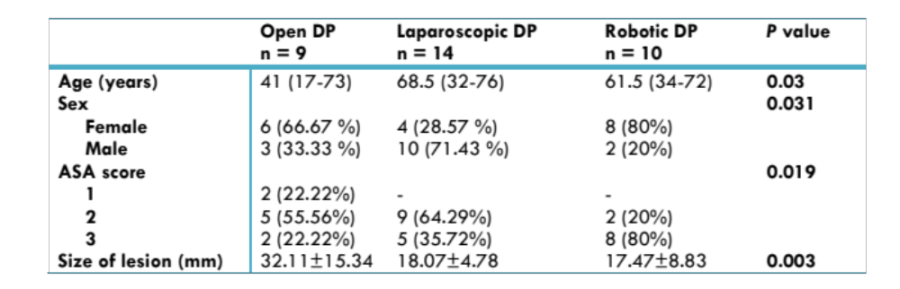
PATIENTS’ BASELINE CHARACTERISTICS
ODP (n=10)
LDP (n=14)
RADP (n=10)
P value
Table 4. Characteristic of patients undergoing distal pancreatic resection with pNET
Patients’ gender, grade of lesion, and Ki67% of the lesion were
similar between the three groups
RESULT

Slide 21
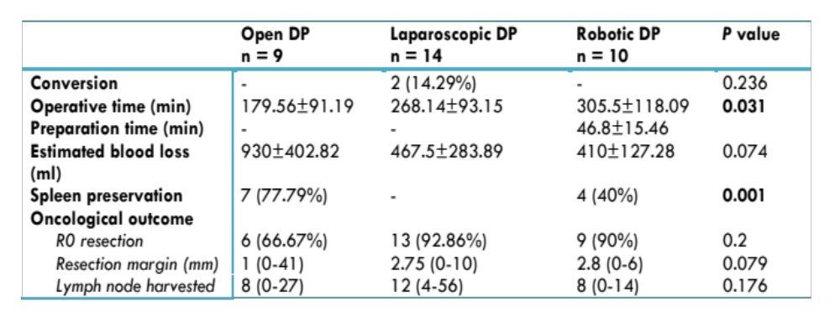
INTRA-OPERATIVE VARIABLES
Table 5. Intra-operative outcomes of patients undergoing distal pancreatic resection with pNET
RESULT

Slide 22
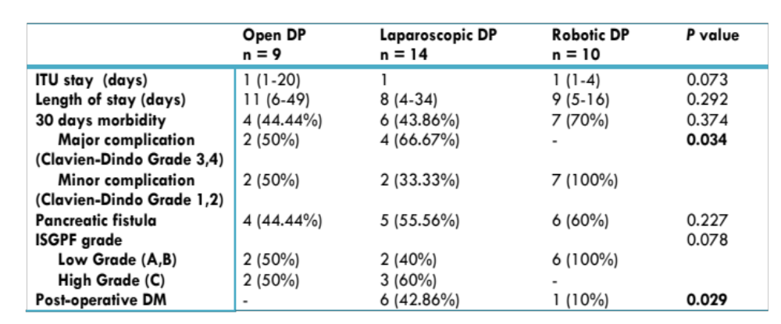
POST-OPERATIVE VARIABLES
Table 6of patients undergoing distal pancreatic resection with pNET
RESULT

Slide 23
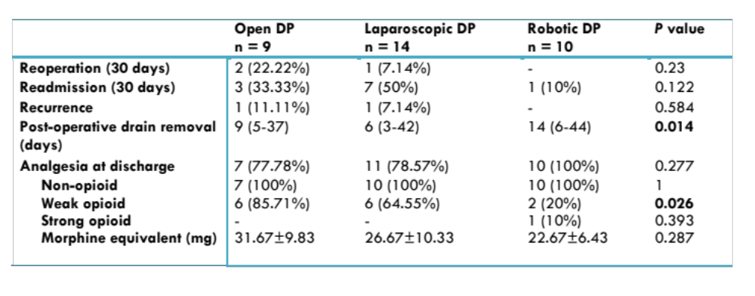

POST-OPERATIVE VARIABLES
Table 6b. Post-operative outcomes of patients undergoing distal pancreatic resection with pNET
Patients’ follow-up varied from 18(1-69) months
RESULT

Slide 24



BENEFITS OF ROBOTIC SURGERY
Less estimated blood loss
Better hemostasis, and control of splenic artery, portal and mesenteric blood vessels, and the other small vascular network located near the pancreas
Higher spleen preservation
  Palep et al : 3D visualization & motion tremor filter results in better accuracy in complex surgical task
Higher R0 resection rate
Surgeons claimed that this was resulted from the better ergonomics in RADP
DISCUSSION

Slide 25



Less major complication
Contributed to the technological advantages in the robotic system
Less post-op DM
Higher accuracy in robotic system, as well as the extent and location of the resection may affect the insulin secretion that play role in the occurrence of pancreatic diabetes
Less weak opioid prescribed
Less post-operative pain experienced by the patients
DISCUSSION

Slide 26


DISADVANTAGES OF ROBOTIC SURGERY
This may be related to the surgical learning curve, setup time, and the time required in adapting to a new technology and technique
Not calculated in our study
Kang et al – RADP vs LDP : 8304$ vs 3861$
With more experience, this can be quickly reduced,
Napoli et al - 10 cases, Shakir et al - 40 cases
Longer operative time
Possible higher cost
Butturini et al – RADP vs LDP : 10588$ vs 12986$ due to shorter hospital stay
DISCUSSION

Slide 27
05
CONCLUSION

Slide 28



Robotic distal pancreatectomy has unique advantages over laparoscopic and open approach in the management of pNET and should be considered where appropriate surgical expertise exists
Its safety and feasibility are comparable with the other two techniques as shown by the lower trend in blood loss, similar R0 resection rate, lower post-operative diabetes mellitus, lower high-grade complication, and lower high-grade fistula
The major disadvantages are the increased cost and operative time
CONCLUSION

Slide 29



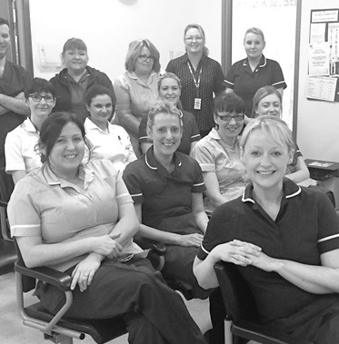
THANK YOU
ACKNOWLEDGEMENT :
Prof. Steven A. White, MB.ChB, PS, FRCS, MD
Consultant HPB and Transplant Surgeon Freeman Hospital, Newcastle, UK
Mr. Stuart M. Robinson, MB.ChB, PhD, MRCS, MD
Speciality Registrar General/HPB Surgery, Freeman Hospital, Newcastle, UK
HPB and Transplant Surgery Team Freeman Hospital, Newcastle, UK

