Slide 1
A fundamental understanding
of the microwave properties in commercial ceramic dielectrics
Nathan Newman
Materials Department, ASU
Students: Shengke Zhang, Justin Gonzales, Siddhesh Gajare, & Alex Devonport
Collaborators: Hasin Sahin (U. Antwerp) & Dinish Martien (Quantum Design)
Our approach: Use modern solid-state methods
Q1: Can solid state physics methods provide a fundamental understanding?
A1: Yes, electronic & phonon band theory predicts dielectric properties of interest
Q2: What causes microwave loss?
A2: Spin-losses- a surprising result!!!!!
  Q3: Can the materials properties that determine τ_{F} (i.e. α_{L}, τ_{µ} and τ_{ε}) be predicted
A3: Yes ☺

Slide 2
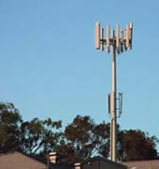
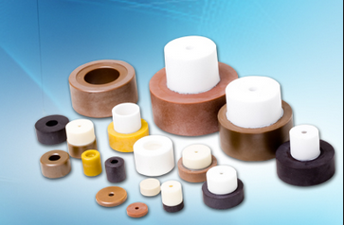
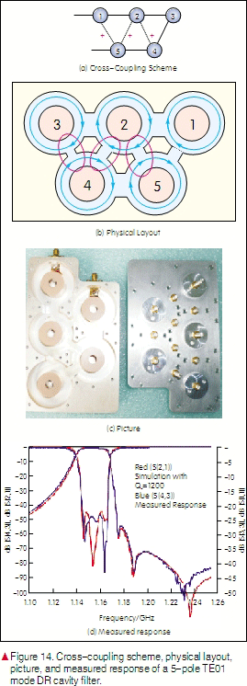
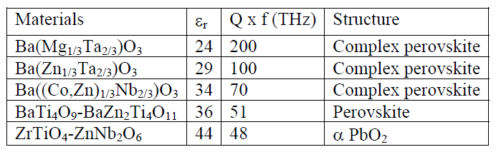
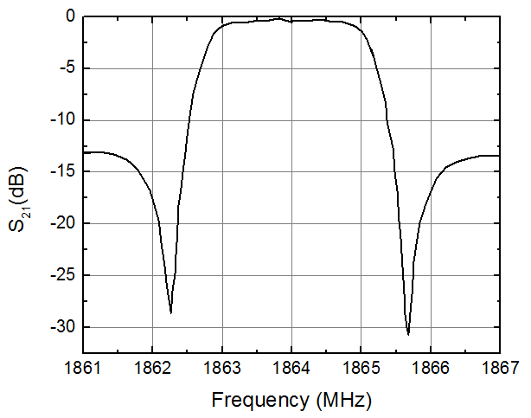
Cell phone base stations and their bandpass filters
Cell phone base station
Cell phone bandpass filter
Microwave dielectrics
Bandpass
filter
15 cm x 8 cm
www.trans-techinc.com
http://wwwen.zte.com.cn
Bandpass filter characteristics
Q @2 GHz
60,000
35,000
25,000
24,000

Slide 3
Motivation
Future wireless systems will
  handle voice, audio , video and other data simultaneously at very fast rates
  require simultaneous operation in bands from hundreds of MHz to tens of GHz
  Need multiband, broadband and narrowband functionality, power handling, dynamic range, selectivity
  Require simultaneous transmission & reception over multiple bands
To bridge gap between current technology & future needs requires miniaturization
  PATHS: Novel design and/or low-loss high-dielectric-constant materials

Slide 4
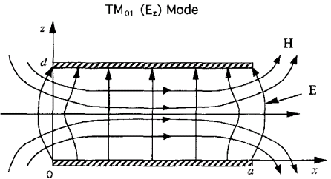
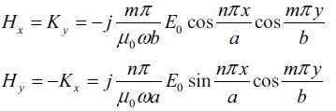

Microwave properties of Ba(Zn_{1/3}Ta_{2/3})O₃
for resonators and filters
E
^{λ}/₂

Slide 5
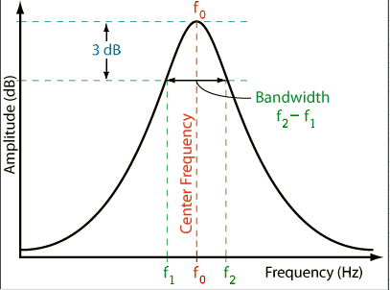
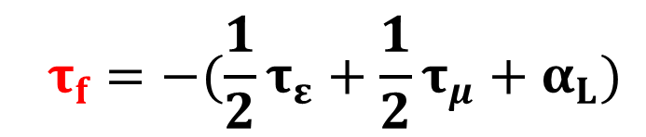
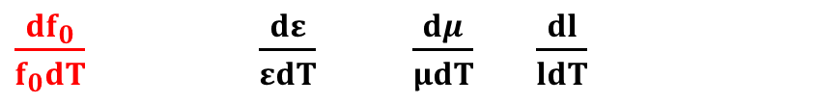

Critical Device Parameters for Resonators and Filters, Q & τ_{f}
A resonant peak
Goal: High Q-factor to improve filter performance
  Low insertion loss
  Sharp roll-off
f₀
Δf
=1/tan δ (loss tangent)
Q =
http://www.sengpielaudio.com/calculator-bandwidth.htm
Goal: Near-Zero Temperature Coefficient of Resonant Frequency (τ_{f} )
$$f_{0}=\frac{c}{2l\sqrt{εμ}}$$
$${ τ}_{f} =−(\frac{1}{2}τ_{ε}+\frac{1}{2}τ_{μ}+α_{L})$$
1st derivative
$\frac{df_{0}}{f_{0}dT} \frac{dε}{εdT}$ $\frac{dμ}{μdT} \frac{dl}{ldT}$
  Transition-metal additives are added to “tune” τ_{f}

Slide 6
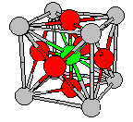
+2 +5
Perovskite Ba(Zn_{1/3}Ta_{2/3})O₃ (BZT)
ε of ~30
tan δ = ¹/_{Q} = ~2x10⁻⁵ @ 2 GHz
Devices w/ Q = ~55,000 (i.e. low-loss & sharp bandwidth)
Compact devices: (^{λ}/₂ =2 cm, rather than 4 cm with ε = 7.5)
Ba⁺² Zr⁺⁴ O₃⁻²
O²⁻
Ba²⁺
one Zn²⁺ and two Ta⁵⁺ results in average valence of
^{(1 x 2) + (2 x 5)} = 4
Compact devices: λ ∞ ε^{−½} at specific device frequency, ε=30
tan δ = ¹/_{Q} = ~1.6 x 10⁻⁵ @ 2 GHz, Q = ~60,000

Slide 7
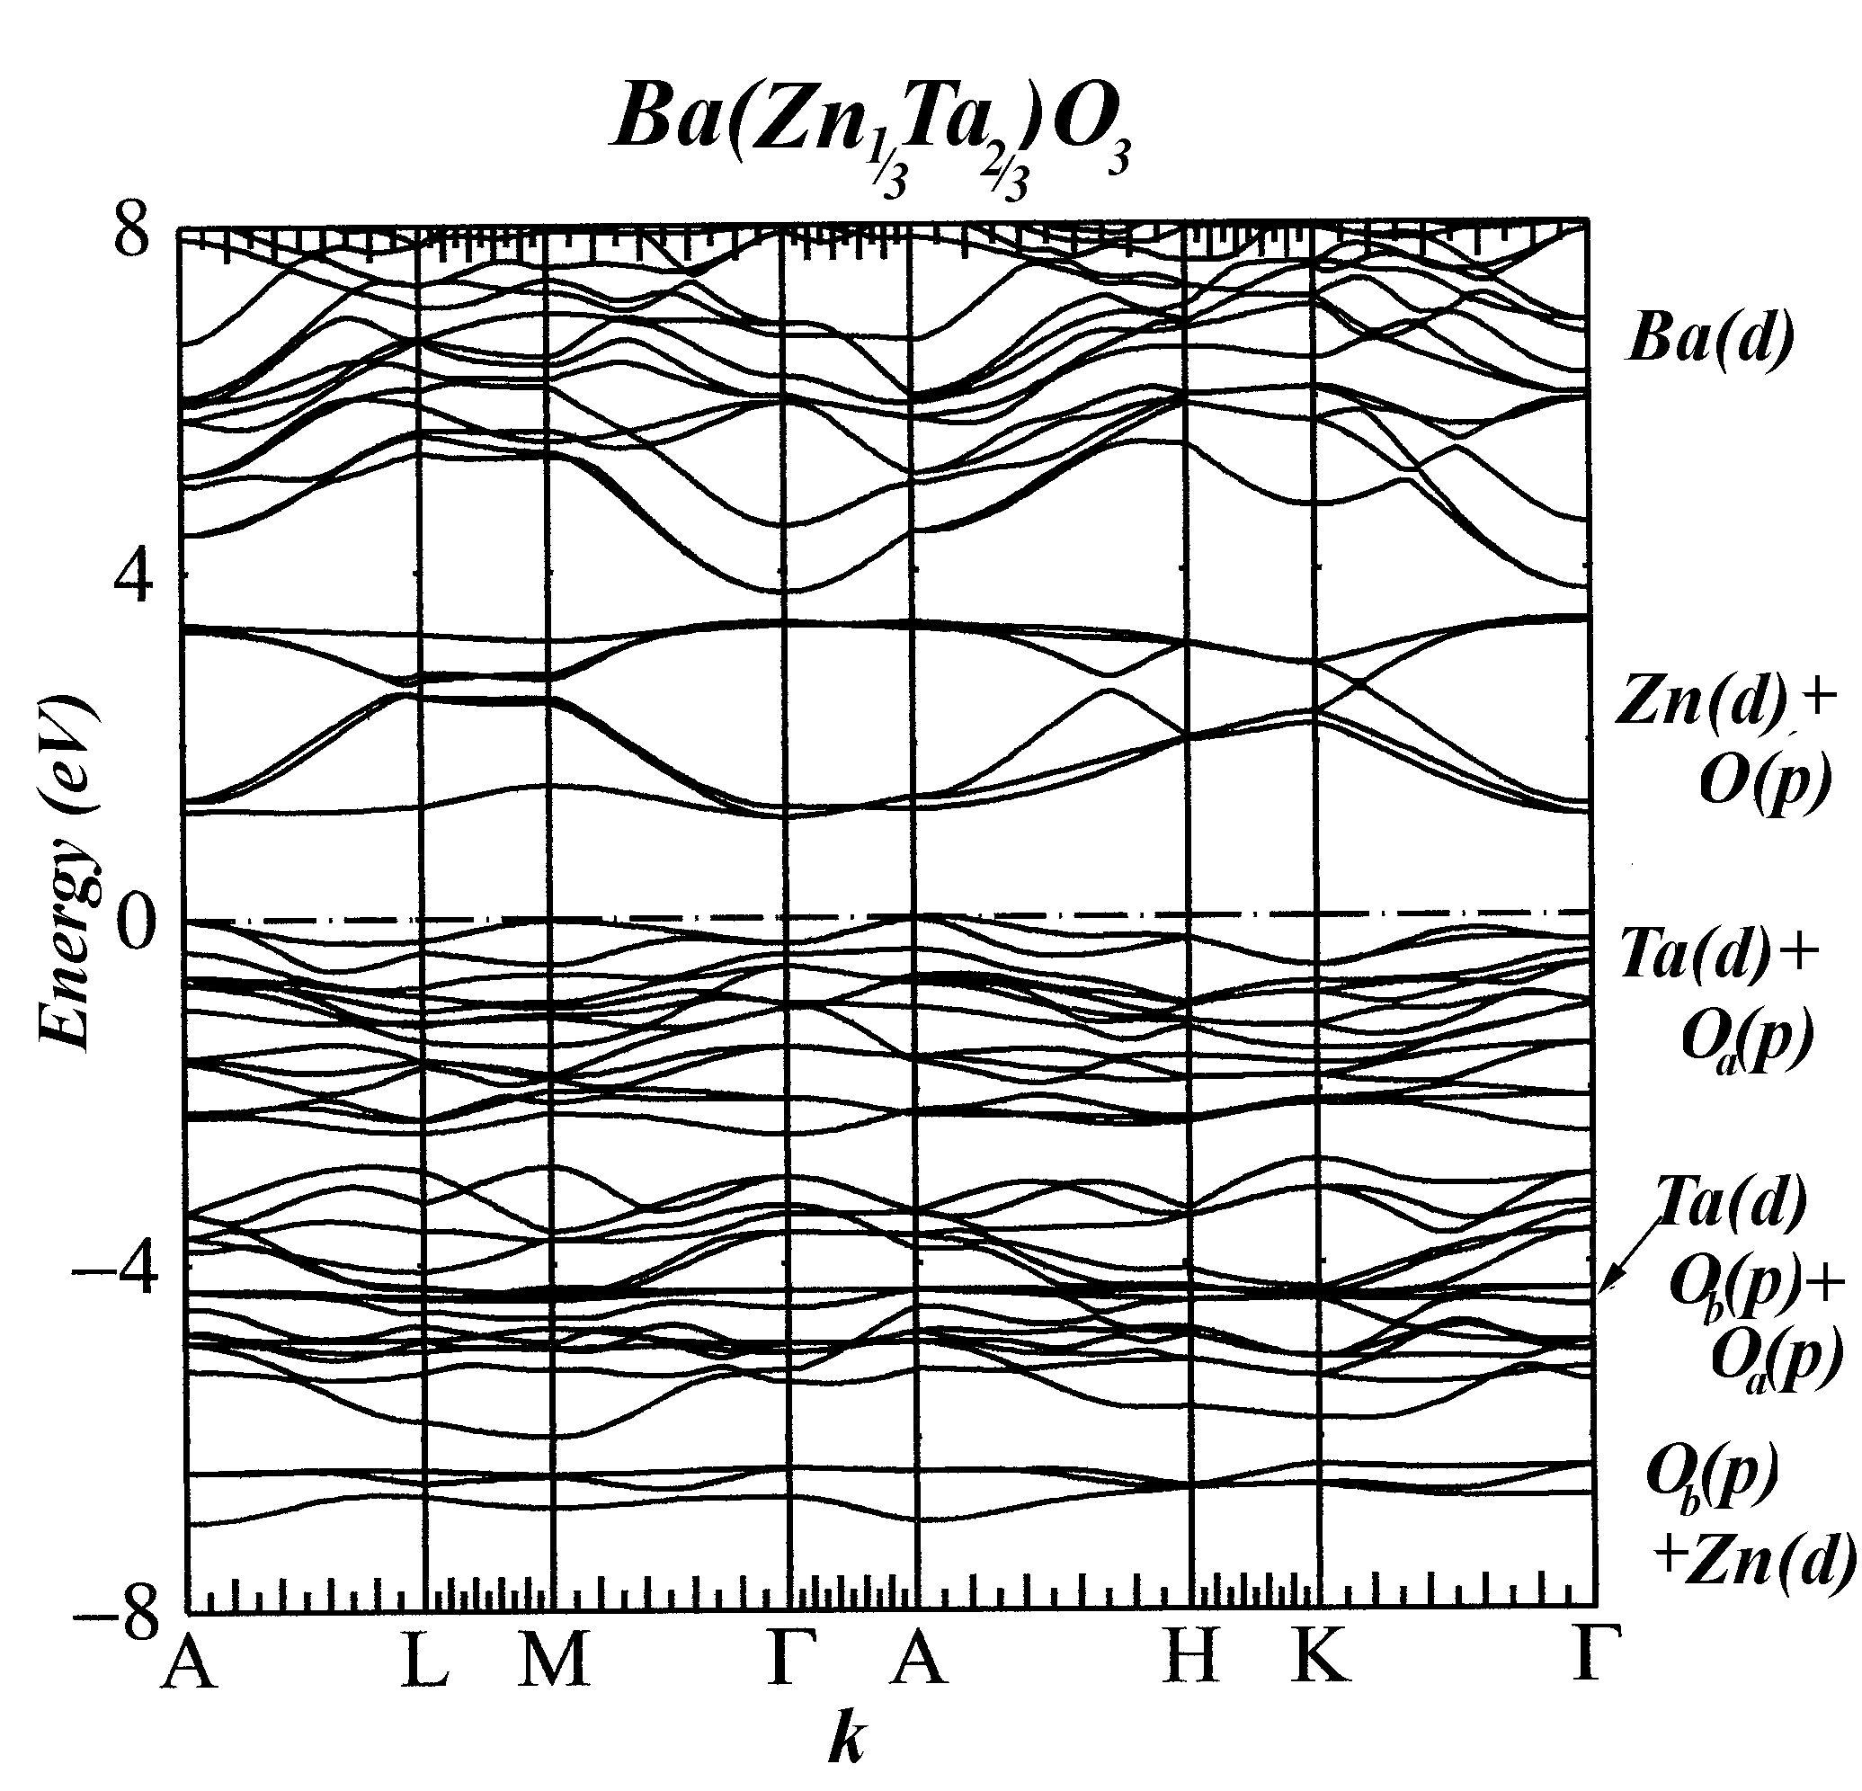
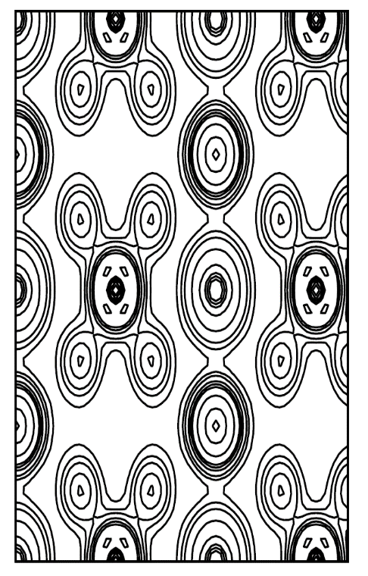
Ba(Zn_{1/3}Ta_{2/3})O₃ band structure
Band Structure shows d-electron “covalent” bonding - rigid & directional
This arises from charge transfer from
emptying out Ta-5d (lower conduction band) to filled Zn-3d (upper valence band) levels
angularly rigid bonds → ↓ anharmonicity phonon → ↓ microwave loss
Ba
O
Empty Ta (d)
O
Zn
Full Zn (d)

Slide 8

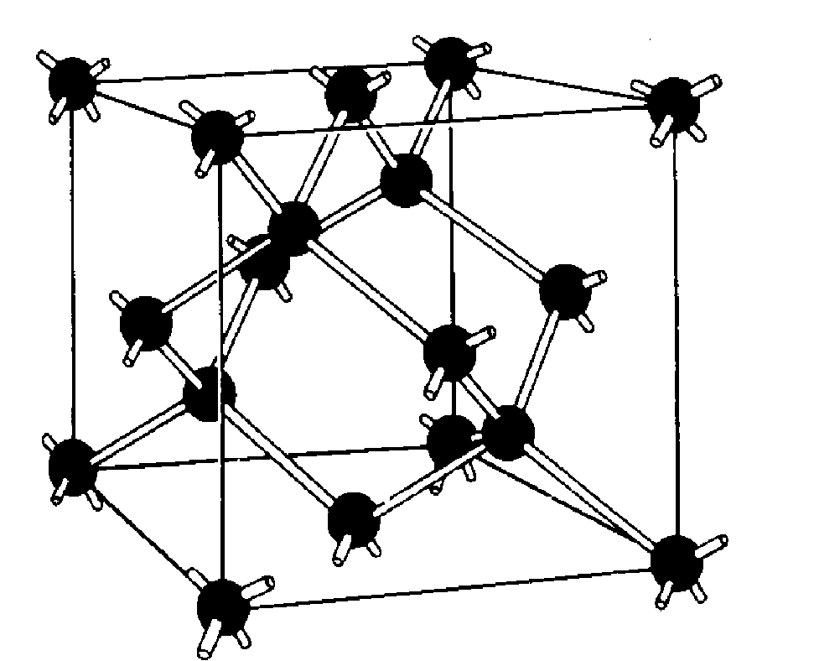

Non-directional ionic bonds
weak like ionic NaCl
Directional covalent bonds
strong like covalent diamond
Low melt temperatures
Weak angular rigidity,
with soft phonon modes
High microwave loss
High melt temperatures
Strong angular rigidity,
with rigid phonon modes
Low microwave loss

Slide 9
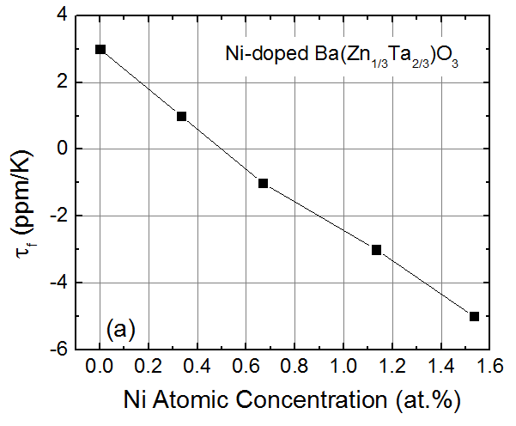
Transition-metal Additives are Commonly Added to “Tune” τ_{f} to Zero
Zr-doping minimizes anneal times to attain high Quality Factors (Q)
Ni-doping gives zero temp.-coefficient of resonant frequency
  offsets thermal expansion w/ T-dependence of ε
E
^{λ}/₂
τ_{f} = 0 ppm/K
T. Negas et al, Proceedings of the International Conference, Jackson, WY, July 17–20, 1990

Slide 10
Approach
We will vary the temperature &magnetic field to identify the loss mechanism in practical microwave dielectric materials
Intrinsic loss
  Anharmonic phonons
Extrinsic loss
  a) Electrical carrier conduction
  b) Softened anharmonic phonons from defects
  c) Electron paramagnetic “spin-flip” loss
  d) 2-level systems from electric dipoles precession
Prior to this work, no direct measurement!
No proof!

Slide 11
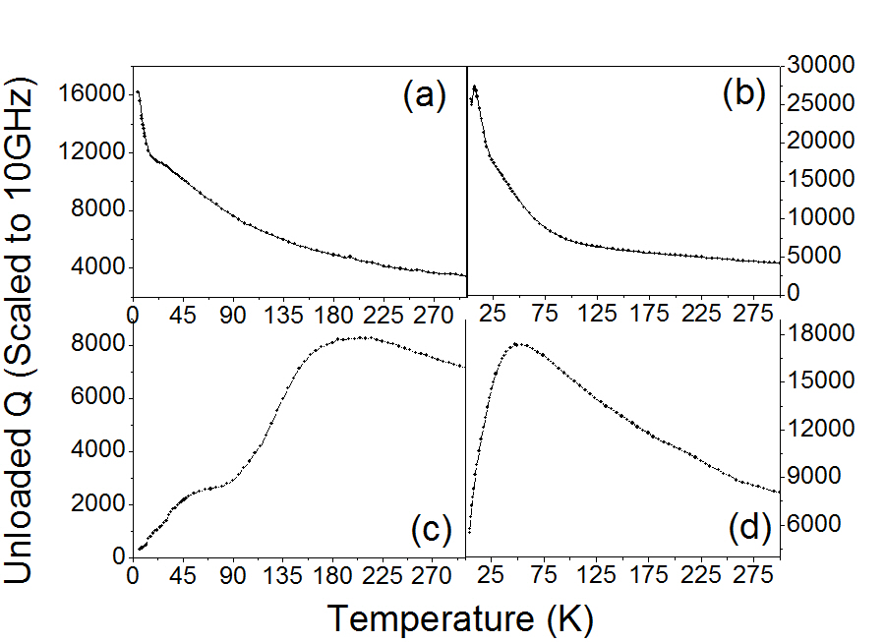
Temperature dependence of commercial materials
(from Trans-Tech Inc.)
Ba(Zn_{0.13}Co_{0.20}Nb_{2/3})O₃
Ba(Ni_{0.04}Zr_{0.03}Zn₀.₂₉Ta_{0.64})O₃
Decrease of Q at low temperature
General effect in commercial microwave dielectric materials!
Quality factor (scaled to 10 GhZ)

Slide 12
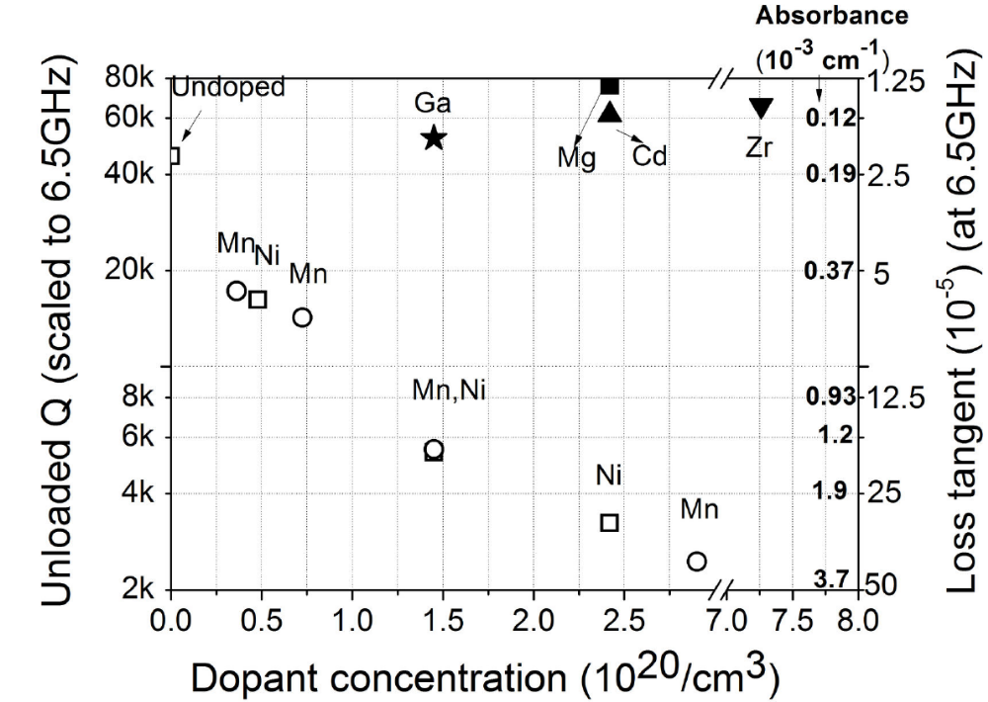
Unloaded Q factor of BZT doped w/ various impurities @ 4.2K
4.2K
“Magnetic” transition metal impurities influence loss
Spin mechanism involved; Not phonons or free carriers!

Slide 13
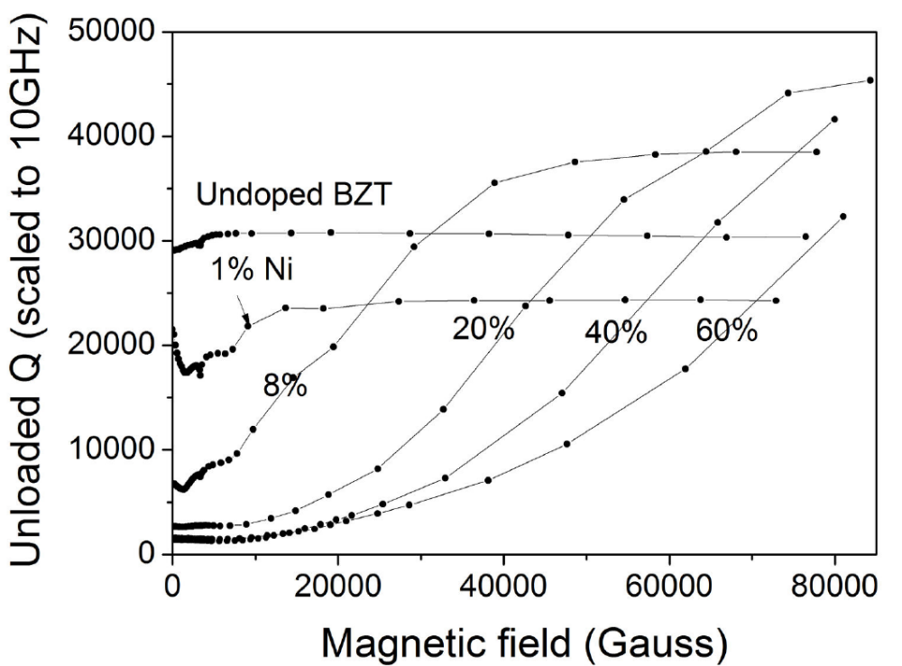
Magnetic-field dependence of Ni-doped samples at 4.2K
We can improve Q by orders of magnitude with applied field
Shows is spin related
Magnetic dependence: Rule out the possibility of phonon & free carrier conductive losses
Practical importance??
(% is fraction of Ni substitution on Zn-site, 15% corresponds to 1 atomic % Ni)
Commercial Ni-doping concentration is ~12%

Slide 14
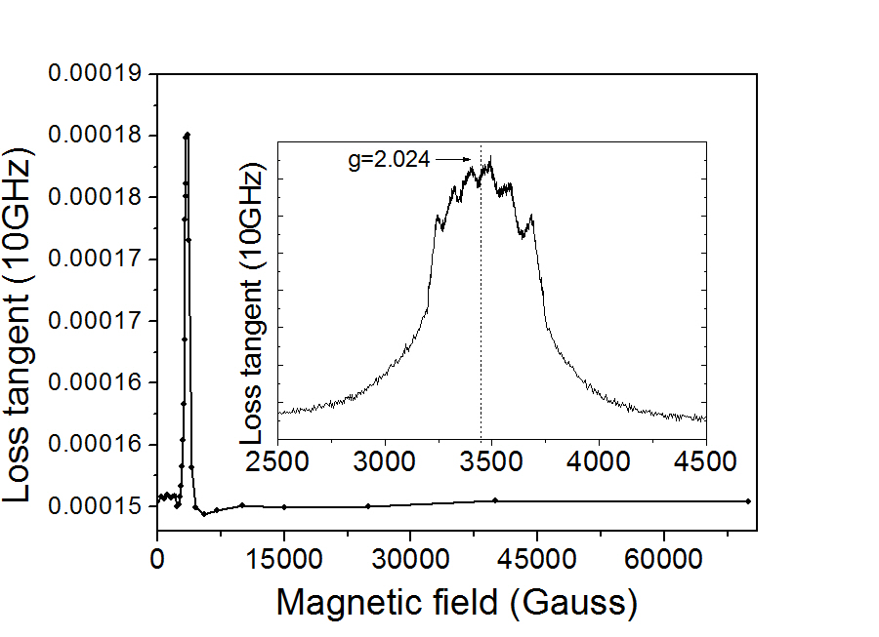

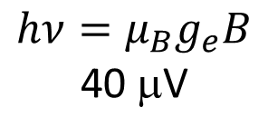

Electron Paramagnetic Resonance (EPR)
Zeeman
B
T=300K
$$ΔE$$
$$hν=μ_{B}g_{e}B$$
40 μV
Resonance
3400 G
$$Applied magnetic field$$
Applied Magnetic Field
E=μ_{B}gB
E=hν
3.8% Mn-doped BZT
6 peaks due to hyper fine structure
from I=⁵/₂ Mn nuclear spins
i.e. I = -⁵/₂, -³/₂, -½ , ½, ³/_{2,} ⁵/₂
Resonance
Microwave
photon
Zeeman

Slide 15
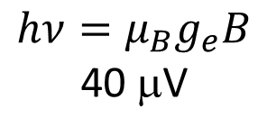
Electron Paramagnetic Resonance (EPR)
g=2.01
Zeeman
B
T=300K
$$ΔE$$
$$hν=μ_{B}g_{e}B$$
40 μV
Resonance
3400 G
$$Applied magnetic field$$
Applied Magnetic Field
E=μ_{B}gB
E=hν
3.8% Mn-doped BZT
6 peaks due to hyper fine structure
from I=⁵/₂ Mn nuclear spins
i.e. I = -⁵/₂, -³/₂, -½ , ½, ³/_{2,} ⁵/₂
Resonance
Microwave
photon
Zeeman

Slide 16
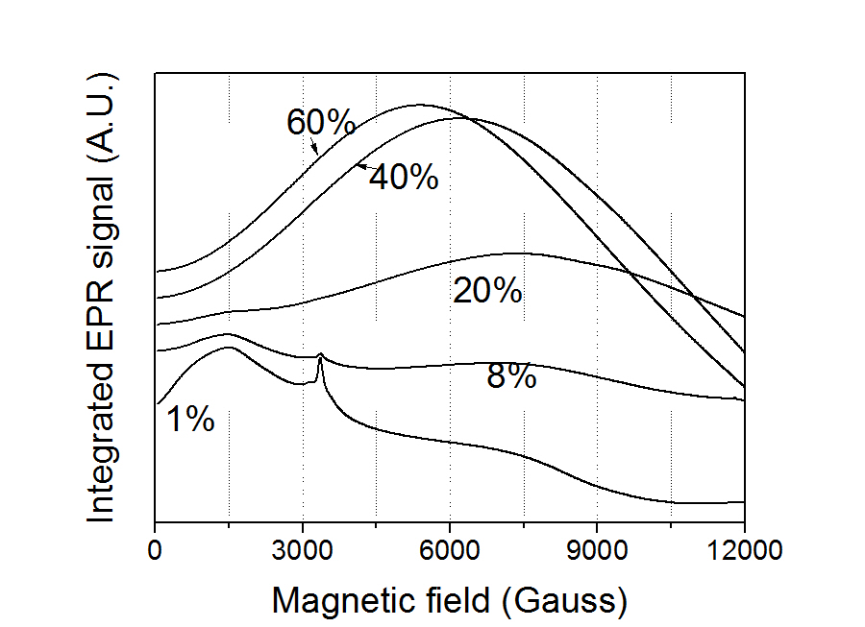
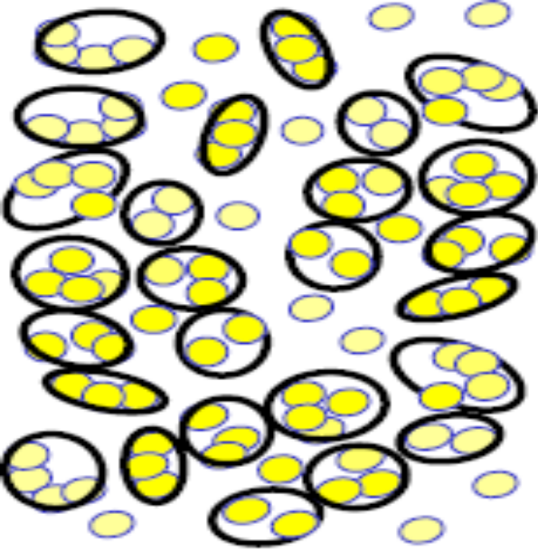
It is spin flips!
Identify as EPR spin-flip mechanism!
Plotting ¹/_{Q} (i.e. loss tangent ∞absorption)
Microwave-induced Spin flips in exchange-coupled clusters!
Loss tangent (1/Q)
B
Isolated defects

Slide 17
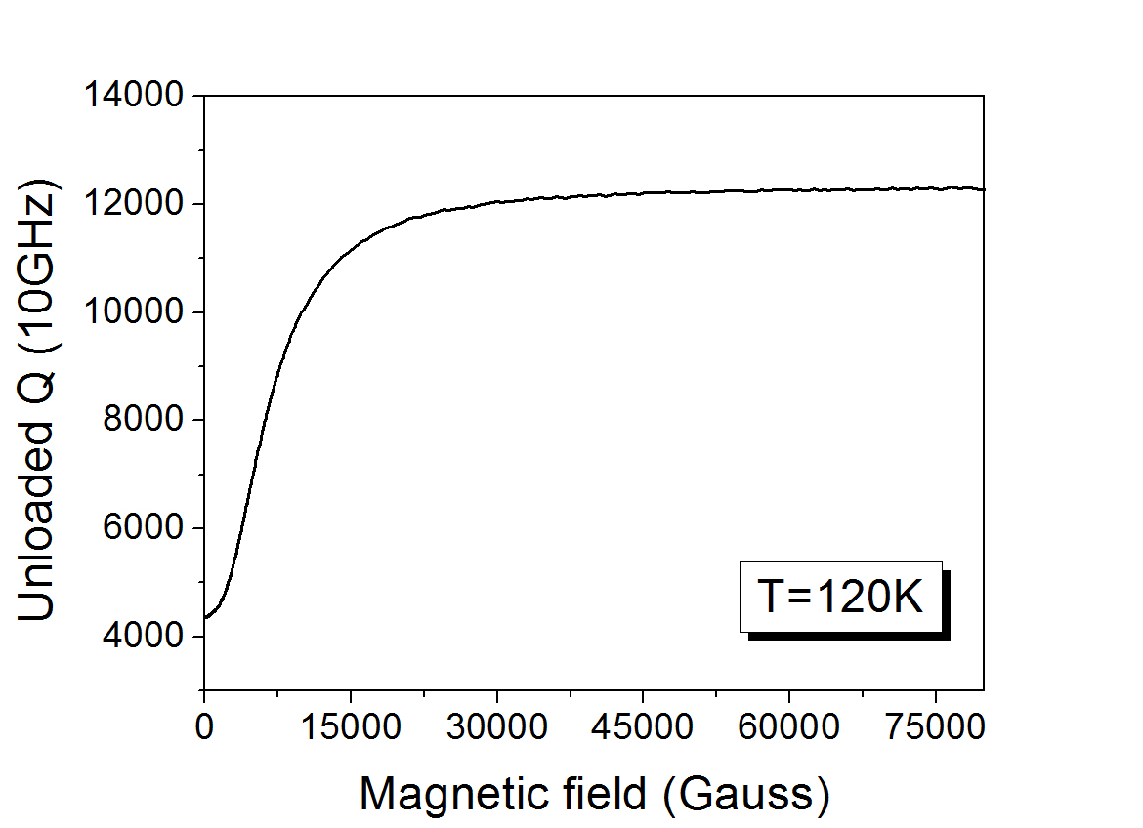
Best properties in a magnetic-field- so far
⇒ ALLOWS TUNING OF MICROWAVE PROPERTIES
Co-doped Ba(Zn_{1/3}Nb_{2/3})O₃

Slide 18
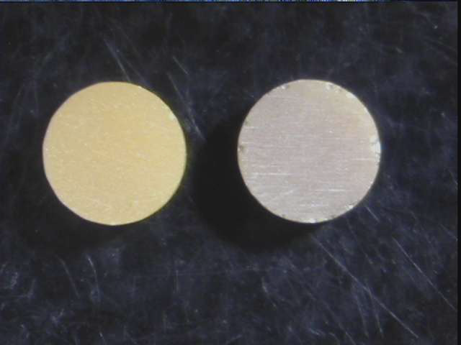
Degraded microwave properties at room temperature
Ba(Zn_{1/3}Ta_{2/3})O₃
Q>40,000
Q<15,000

Slide 19
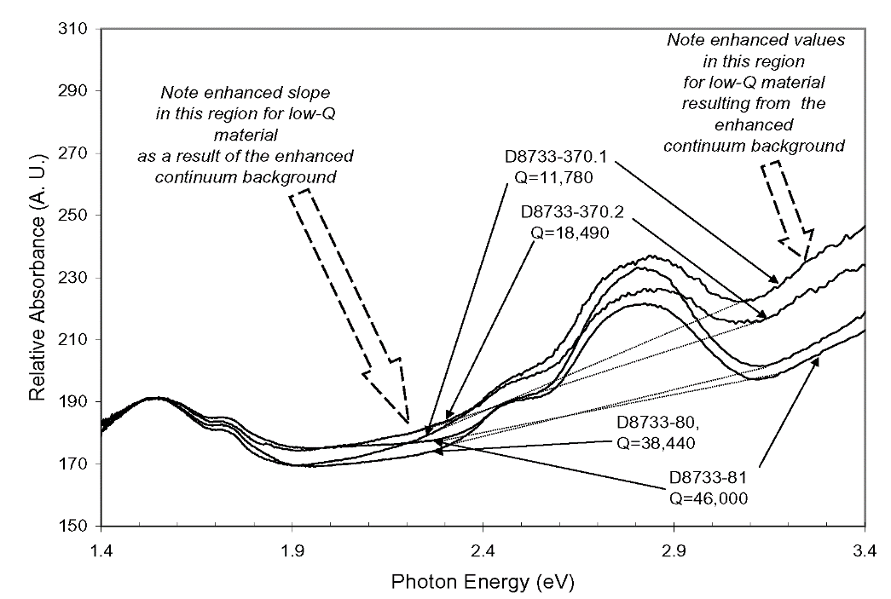
Ba(Zn_{1/3}Ta_{2/3})O₃
Q>40,000
Q<15,000
Color Centers!!!! High Q, yellow. Low Q, brown.
Ba(Zn_{1/3}Ta_{2/3})O₃
Photon energy (eV)
Optical measurements of Ba(Zn_{1/3}Ta_{2/3})O_{3.}
Enhanced background from optically active point defects for lower Q materials Correlates microwave loss to point defect concentrations.

Slide 20
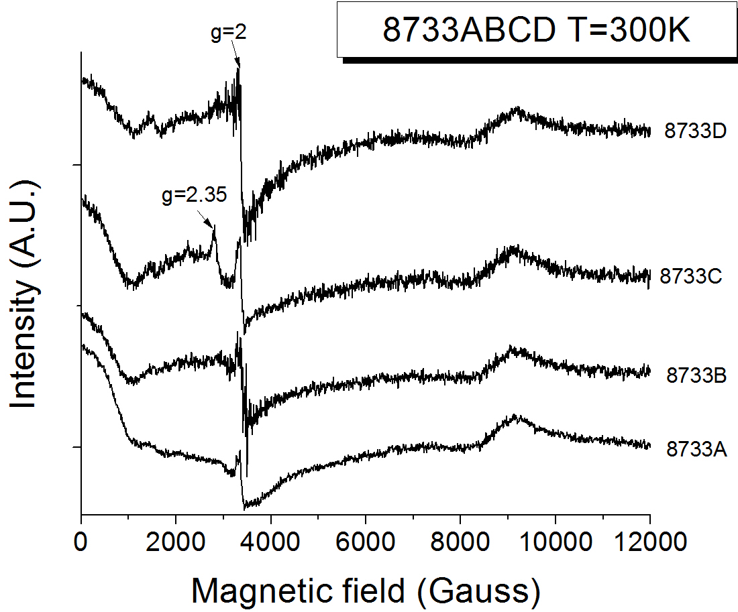
EPR finds free-carrier conduction loss peak (i.e. g=2)
correlates with Q at 300 K

Slide 21
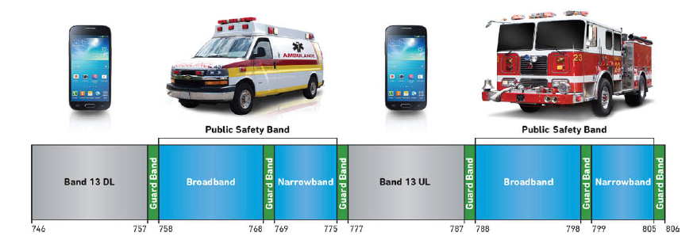
τ_{f} = - (α_{L} + ½ τ_{µ}+ ½ τ_{ε})
Why is Zero/Near-Zero τ_{f} So Important?
MHz
L. Miller, RF filters applications for dummies, a Wiley brand, 2015
We will independently determine τ_{f}, α_{L}, τ_{µ} and τ_{ε}
Use of experiment and simulation will be used to understand the fundamental mechanism for each factor!

Slide 22
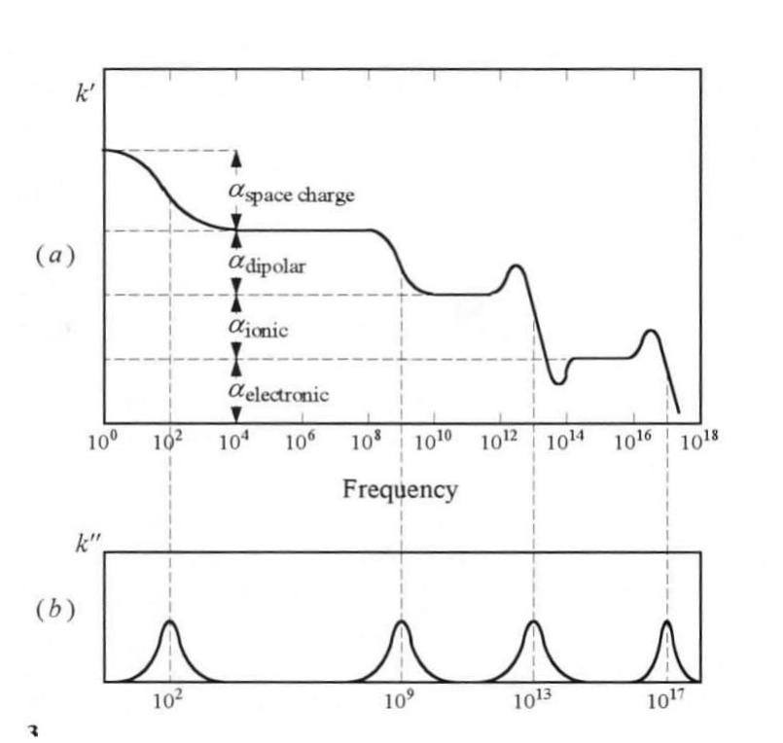
Kramers-Kronig (KK) of complex dielectric constant
-indicates that a change in ε is associated with a loss mechanism
40 μV 30 mV 1 eV
ε
α_{microwave loss}
\
Loss tangent
Microwave phonon electronic
loss absorption transitions

Slide 23
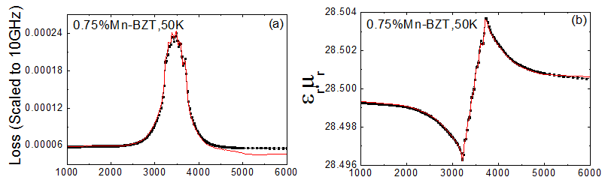
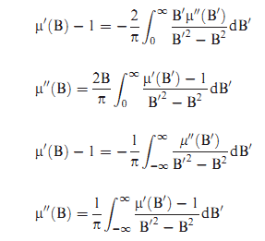

If there are EPR losses, then there are also changes to the magnetic permeability (μ_{r})!
0.05 at.% Mn-BZT, 50K
0.05 at.%
Mn-BZT, 50K
Red line: KK transformed
Black dots: Measurement
Red line: KK transformed
Black dots: Measurement
g=2.0
Magnetic field (Gauss)
Magnetic field (Gauss)
KK equations:
$$f_{0}=\frac{c}{2l\sqrt{μ_{r}ε_{r}}}$$
μ_{r}(B) = μ_{r}’(B) - jμ_{r}’’(B)
Loss tangent=μ_{r}’’(B)/μ _{r}’(B)
11

Slide 24
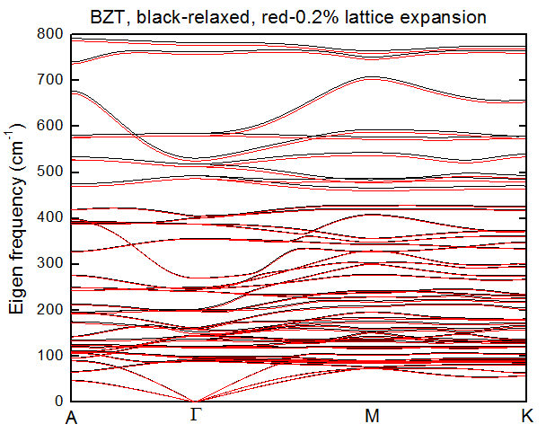
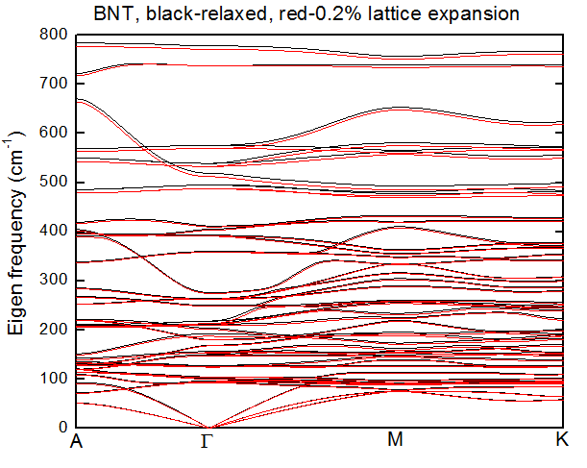
Phonon Dispersion Curves from
Density Functional Theory Calculations
Ba(Zn_{1/3}Ta_{2/3})O₃
Ba(Ni_{1/3}Ta_{2/3})O₃
Black is for 0 K and Red is for 300 K, a 0.2% expanded lattice

Slide 25
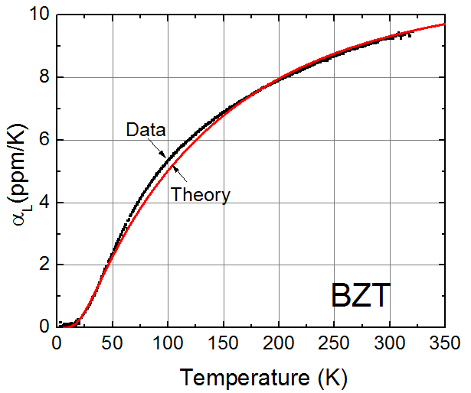
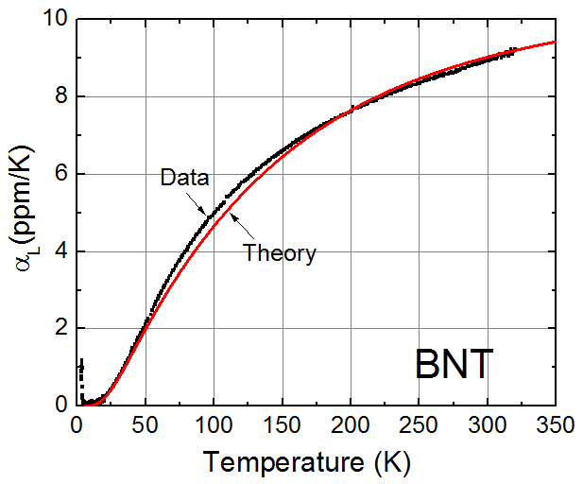
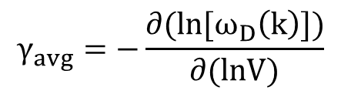
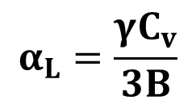
Thermal expansion coefficient measurement with dilatometer
Good agreement between experimental results and Density Functional Calculations!
$$α_{L}=\frac{γC_{v}}{3B}$$
 | Avg. Gruneisen parameter (γ) | Bulk Modulus (B) (GPa)
BZT | 4.11 | 359 GPa
BNT | 2.57 | 235 GPa
$$γ_{avg}=−\frac{∂(ln⁡[ω_{D}\left(k\right)])}{∂(lnV)}$$

Slide 26
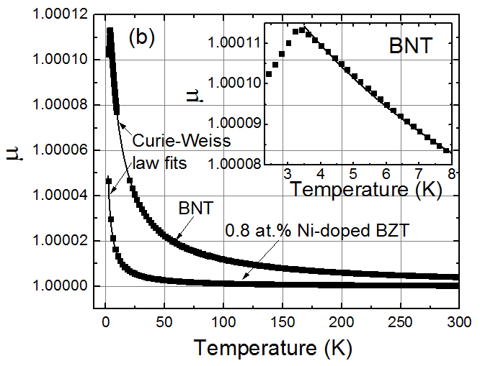
Measurements of Temperature Dependence of Magnetic Permeability (τ_{µ})
T_{Neel}=3.3K
µ of BNT (3.3 – 300 K) and 0.8 at.% Ni-BZT accurately fit by Curie-Weiss law
T_{Neel} = 3.3 K is observed.

Slide 27
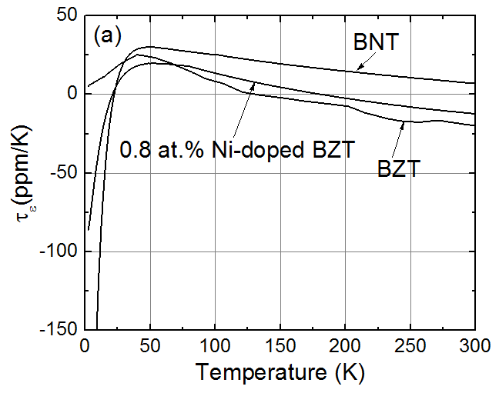
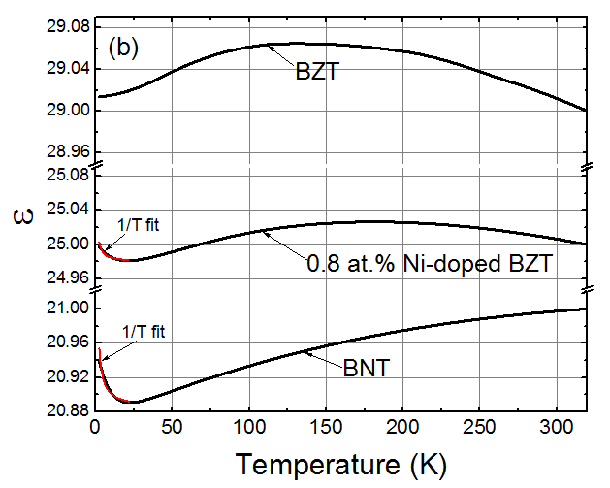
Inferred Temperature Dependence of
Dielectric Constant (τ_{ε})
ε is the integration of τ_{ε}
τ_{ε} = - (2 τ_{f} + 2 α_{L} + τ_{µ})
At low T, τ_{ε} scales with the Ni concentration.
Surprisingly, ε can be fit with equation, Constant/T + ε∞ at low T, resulting from the paraelectric defects.

Slide 28
Summary
Transition metal impurities dominate loss tangent at cryogenic temperature in high performance microwave dielectrics
  From resonant spin excitations of unpaired transition metal d-electrons in exchange-coupled clusters
The room temperature loss is tentatively associated with electrical conduction, even in commercially produced material
We are exploring the potential to use magnetic fields to improve Q and tune the microwave performance
First principle electron and phonon band structure calculations can be used to understand relevant properties of interest to the microwave dielectric community
  including ε, τ_{f}, α_{L}, τ_{µ} and τ_{ε}
  additional work is needed to predict anharmonic phonon loss in complex dielectrics (Wu and Ceder, 2001)
Microwave loss in the high performance dielectric Ba(Zn_{1/3}Ta_{2/3})O₃ at 4.2K, Phys. Rev. Letters 109, 257601 (2012)
Dominance of paramagnetic loss in microwave dielectric s at cryogenic temperatures Appl. Phys. Lett. 101, 252901 (2012)
Main source of loss in Ba(Zn_{1/3}Ta_{2/3})O₃ and Ba(Zn_{1/3}Nb_{2/3})O₃ at low temperatures J. Am. Ceram. Soc. (2015)

Slide 29
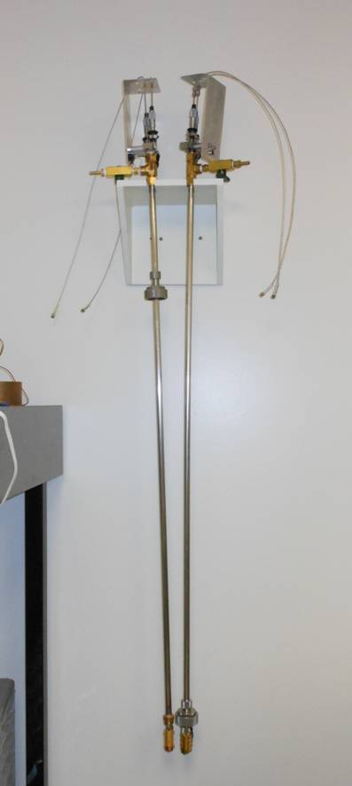
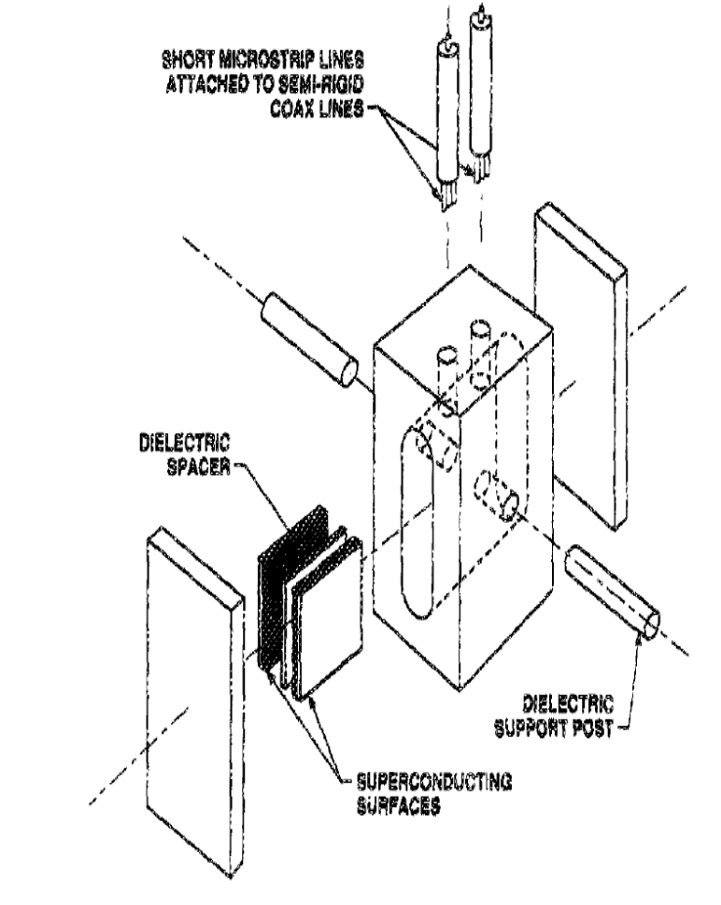
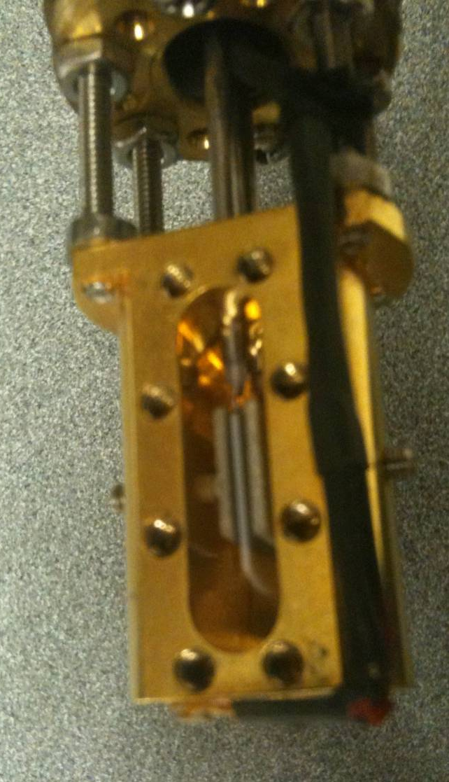
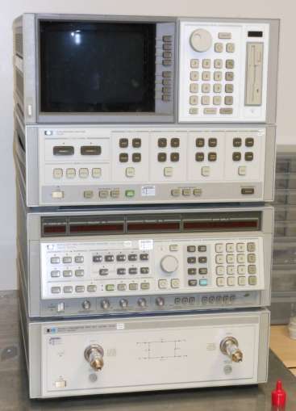
Microwave dipping probe measurement system
1 cm
HP 8510
Dip into 2-400 K 0-9 T Dewar
Schematic
Picture
Parallel plate & dielectric cavity

Slide 30
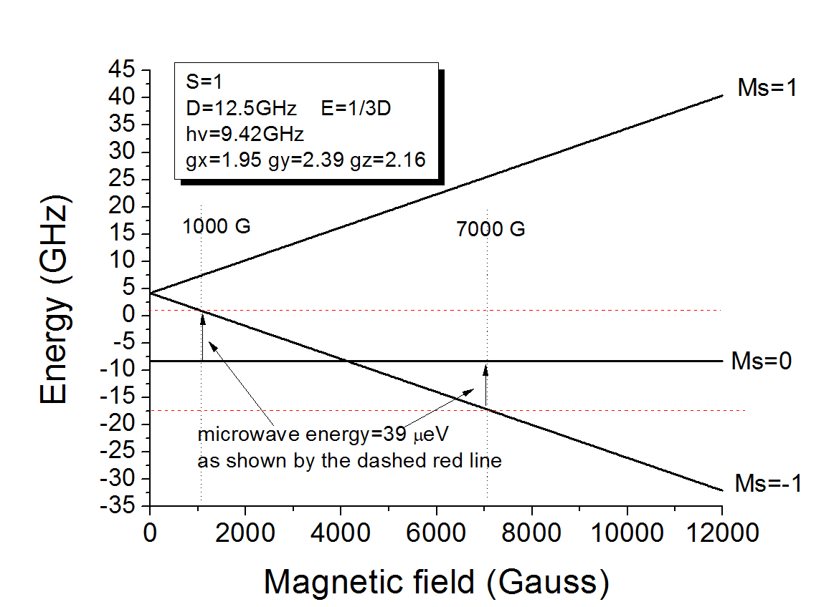
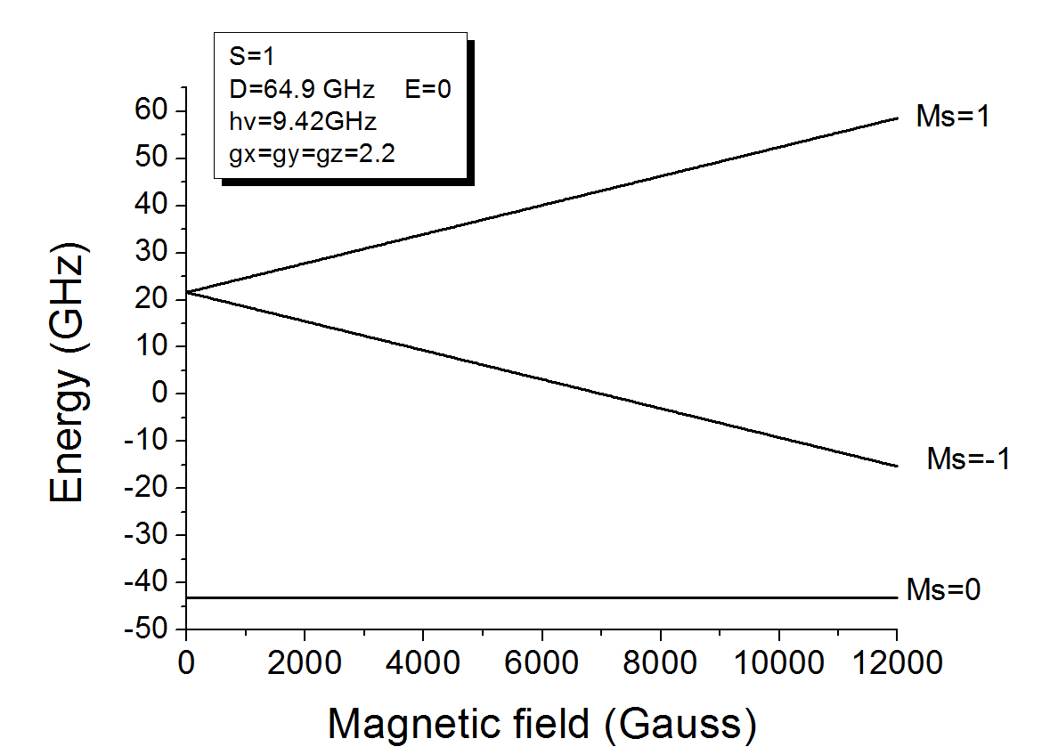
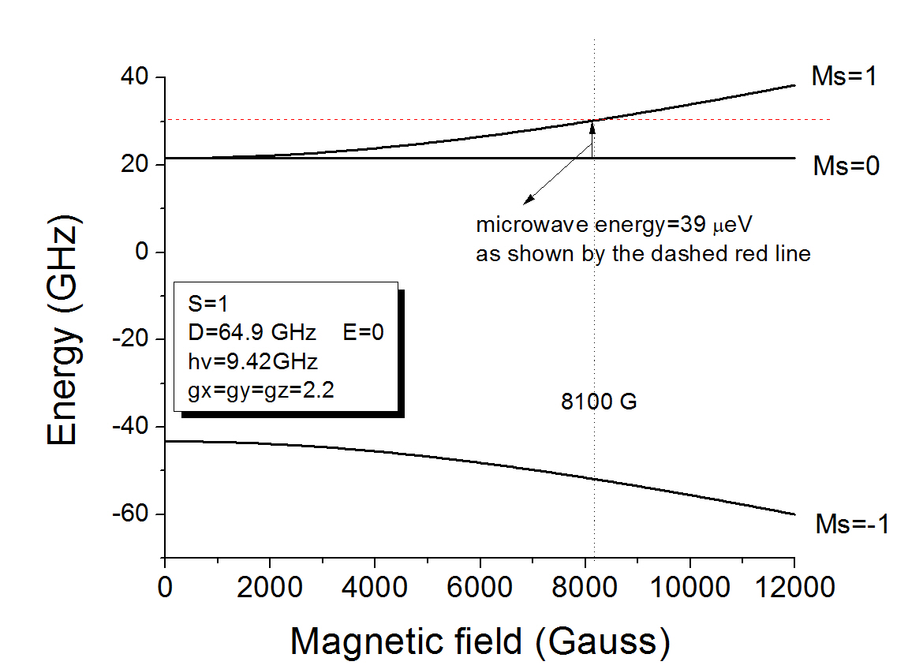
8% Ni Species 1
8% Ni Species 2
B || to z axis
B || to z axis
(no transition in this range)
B ┴ to z plane
H=μ_{B}gB•S+1/2J(S(S+1)-2s(s+1))+D(S_{z}²-1/3S(S+1))
Zeeman
Exchange interaction
Zero field splitting
Nate Newman Materials Program
Pictures from Bruker website

Slide 31
