Slide 1
Conference Series LLC Conferences
Conference Series LLC is a pioneer and leading science event organizer, which publishes around 500 open access journals and conducts over 500 Medical, Clinical, Engineering, Life Sciences, Pharma scientific conferences all over the globe annually with the support of more than 1000 scientific associations and 30,000 editorial board members and 3.5 million followers to its credit.
Conference Series LLC has organized 500 conferences, workshops and national symposiums across the major cities including San Francisco, Las Vegas, San Antonio, Omaha, Orlando, Raleigh, Santa Clara, Chicago, Philadelphia, Baltimore, United Kingdom, Valencia, Dubai, Beijing, Hyderabad, Bengaluru and Mumbai.

Slide 2
Investigation of Efavirenz discontinuation in multi-ethnic populations of HIV positive individuals by genetic analysis.
Nathan W Cummins, MD
Assistant Professor of Medicine
Consultant in Infectious Diseases
Mayo Clinic Rochester, USA
7th Pharmacovigilance & Pharmaceutical Industry
August 22, 2016
Vienna, Austria

Slide 3
Disclosures
Speaker’s Commercial Interest/Off-Label Use:
No disclosures
Objectives
Recognize the potential benefits of pharmacogenetics to improve safety of approved HIV medications.
Define barriers to translation of potential pharmacogenetic tests for antiretroviral medications.

Slide 4
Globally, 34.0 million people living with HIV in 2011
Including 3.3 million children less than 15 years
2.5 millions new infections (including 330 000 children);
22% less than in 2001
1.7 million people died of AIDS in 2011
Each day almost 7,000 people newly infected
Each day 3,950 more people on antiretroviral therapy
http://www.who.int/hiv/en/

Slide 5
Adults and children estimated to be living with HIV  2011
Western &
Central Europe
900 000
[830 000 – 1.0 million]
Eastern Europe
& Central Asia
1.4 million
[1.1 million – 1.8 million]
North America
1.4 million
[1.1 million – 2.0 million]
East Asia
830 000
[590 000 – 1.2 million]
Middle East & North Africa
300 000
[250 000 – 360 000]
Caribbean
230 000
[200 000 – 250 000]
South & South-East Asia
4.0 million
[3.1 million – 5.2 million]
Latin America
1.4 million
[1.1 million – 1.7 million]
Sub-Saharan Africa
23.5 million
[22.1 million – 24.8 million]
Oceania
53 000
[47 000 – 60 000]
Total: 34.0 million [31.4 million – 35.9 million]
http://www.who.int/hiv/en/

Slide 6
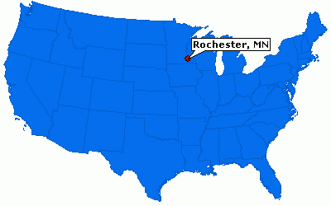
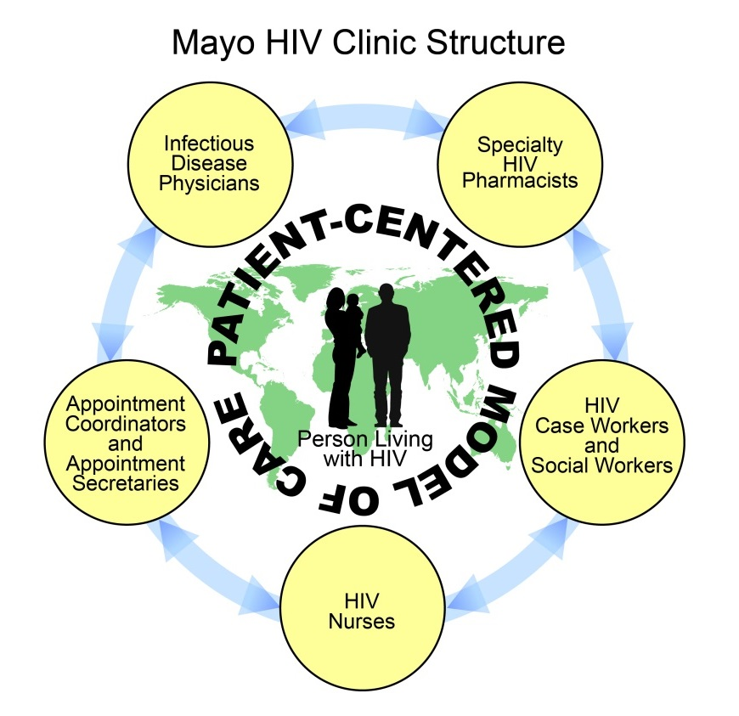
HIV in Minnesota, USA
Low prevalence in MN
7.2 new infections per 100000 persons in 2011 (highest among ND/SD/WI/IA)
Mayo HIV Clinic
  Established in 1996
  Has cared for >1400 patients, including >500 current continuity patients
Cummins NW et al . World J Virol 2016 May 12; 5(2): 63-67 ISSN 2220-3249 (online)

Slide 7
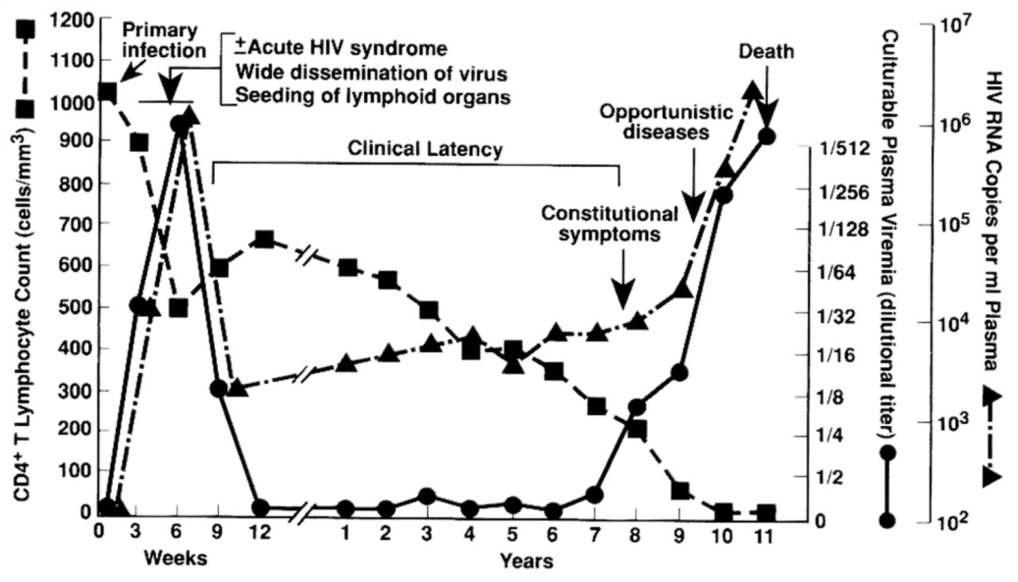
From: Immunopathogenic Mechanisms of HIV Infection
Ann Intern Med. 1996;124(7):654-663. doi:10.7326/0003-4819-124-7-199604010-00006
Figure Legend:
Typical course of human immunodeficiency virus (HIV) infection.The New England Journal of MedicineThe complex, multifactorial, multiphasic, and overlapping factors of the immunopathogenic mechanisms of HIV disease are shown. Throughout the course of HIV infection, virus replicates and immunodeficiency progresses steadily, despite the absence of observed disease during the so-called clinical latency period. Immune activation and cytokine secretion vary among HIV-infected persons, sometimes increasing dramatically as disease progresses. Immune activation and cytokine secretion play a major role in pathogenesis. Adapted from reference 2 by permission of . Pantaleo et al. 1993; 328:327-35.
Date of download:
7/2/2013
Copyright © The American College of Physicians.
All rights reserved.

Slide 8
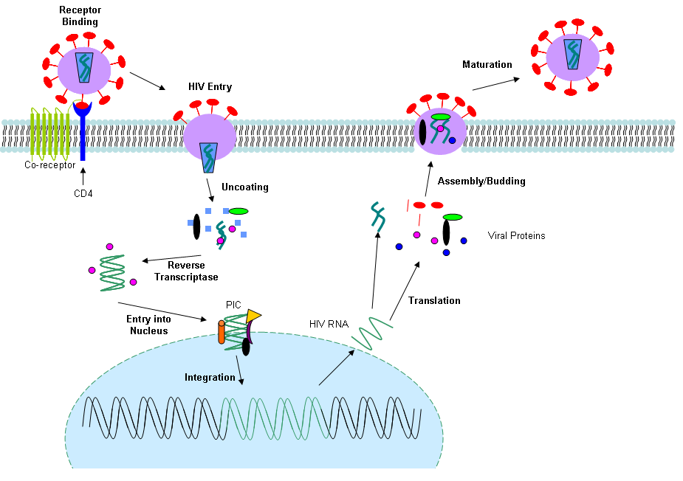
Entry Inhibitors
Maraviroc
Enfuvirtide
RT Inhibitors
NRTIs (7)
NNRTIs (5)
Protease Inhibitors
(9)
Integrase Inhibitors (3)
Latency

Slide 9
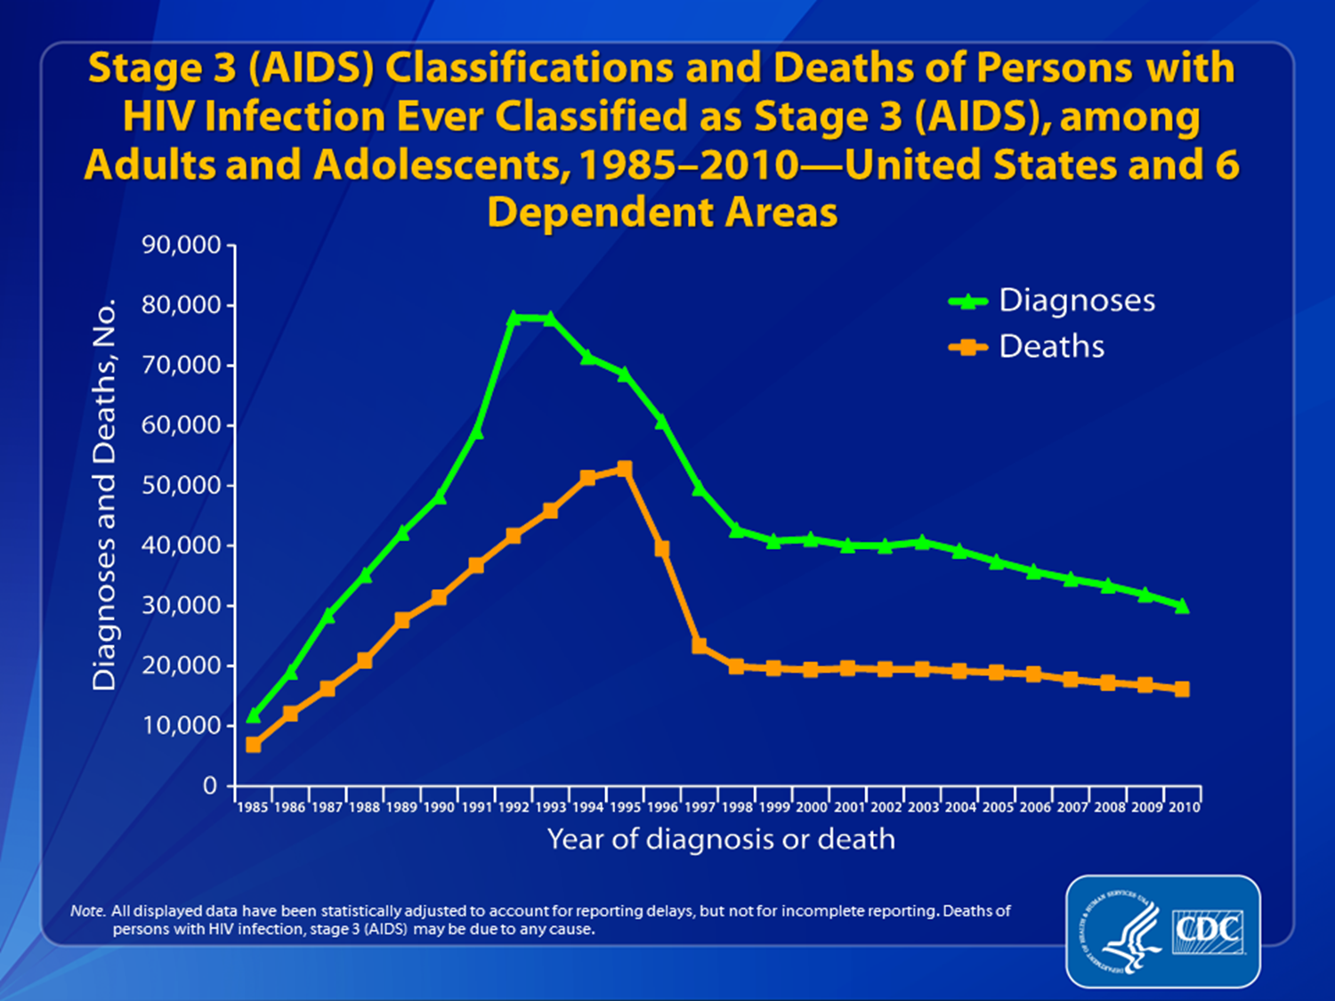

Slide 10
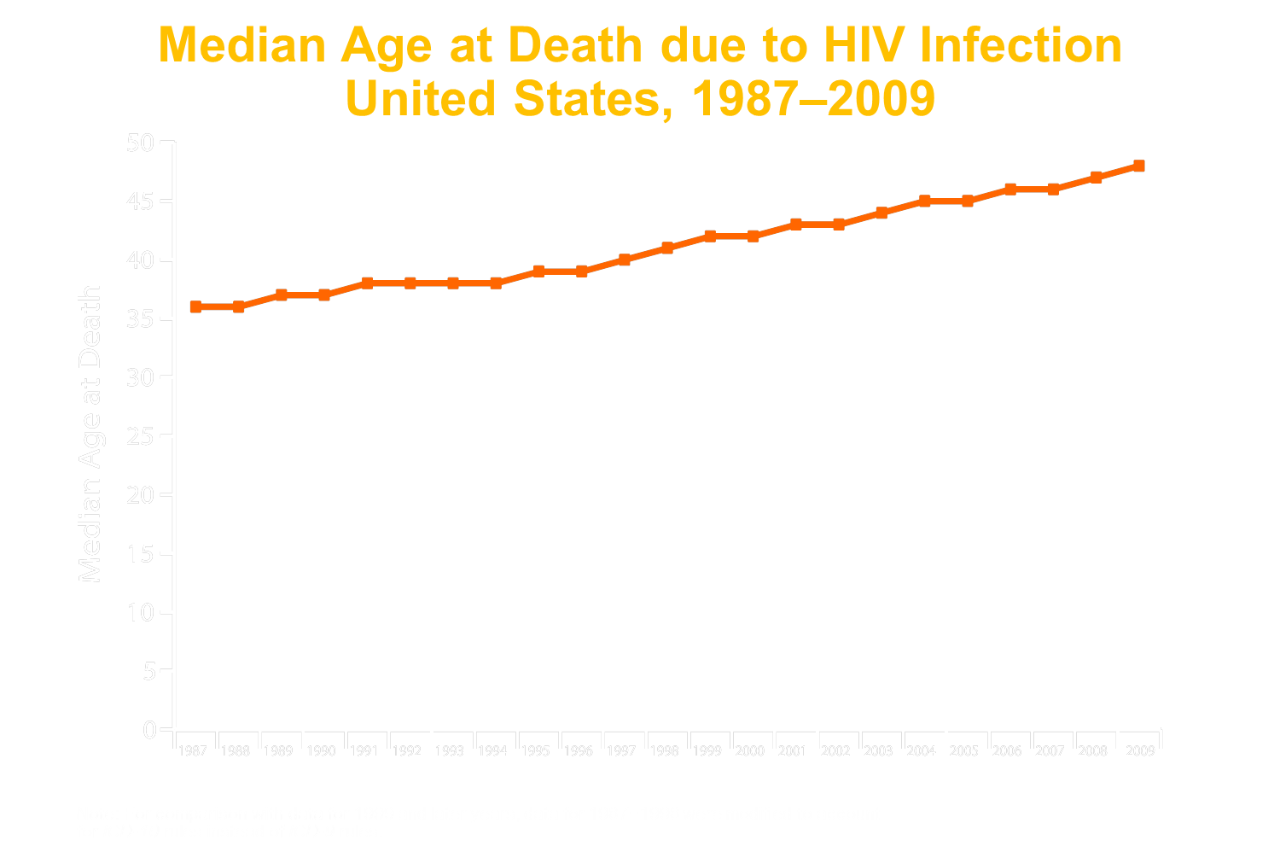

Slide 11
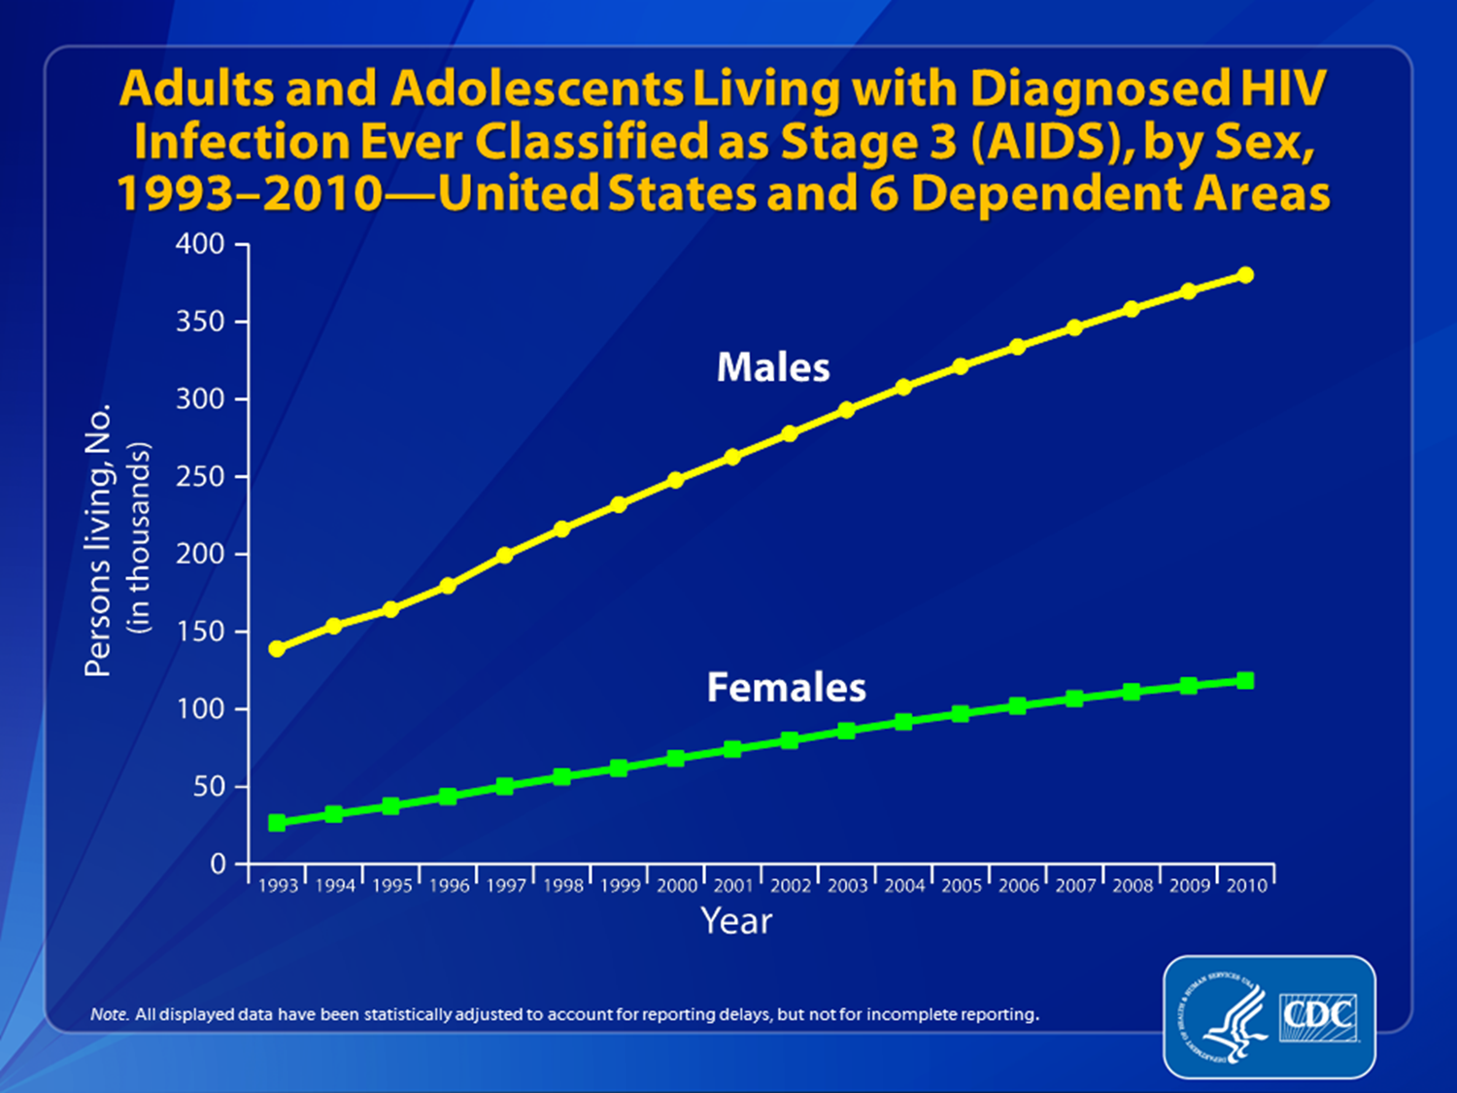

Slide 12
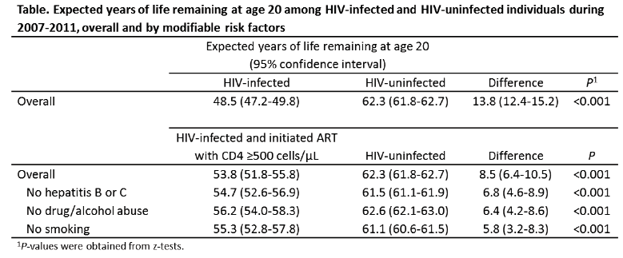
PLHIV on treatment can have a nearly, but not completely, normal life expectancy.
Marcus et al. J Acquir Immune Defic Syndr. 2016 Mar 29; CROI abstract #54.

Slide 13
Expanding role of cART
DHHS and IAS guidelines recommend cART for all HIV-infected persons regardless of CD4 T cell count.
Recently published WHO guidelines recommend cART for all HIV-infected persons with
  CD4 T cells of 500 cells/mm3 or less for adults, adolescents and older children
  Or with active tuberculosis (TB) disease who are living with HIV; people with both HIV and hepatitis B virus (HBV) infection with severe chronic liver disease; HIV-positive partners in serodiscordant couples; pregnant and breastfeeding women and children younger than five years of age, all regardless of CD4 T cell count.
  26 million people eligible (9.7 million currently on therapy)

Slide 14

Persons Living with Diagnosed or Undiagnosed HIV Infection
HIV Care Continuum Outcomes, 2012 — United States and Puerto Rico
72%* | 72%* | 60%* | Mayo Clinic
National HIV Surveillance System,: Estimated number of persons aged ≥13 years living with diagnosed or undiagnosed HIV infection (prevalence) in the United States at the end of 2012. The estimated number of persons with diagnosed HIV infection was calculated as part of the overall prevalence estimate.
Medical Monitoring Project: Estimated number of persons aged ≥18 years who received HIV medical care during January to April of 2012, were prescribed ART, or whose most recent VL in the previous year was undetectable or <200 copies/mL—United States and Puerto Rico.
www.cdc.gov

Slide 15
Barriers to lifelong viral suppression on ART
cART complicated by frequent side effects
  Symptomatic
  Laboratory abnormalities
  Metabolic
  Mild → Severe
  Frequently lead to ART discontinuation or change
    INSIGHT trials ~26%
    ~20% discontinue efavirenz/tenofovir/
    emtricitabine within 12 months Scourfield AIDS. 2012 Mar 23.

Slide 16
Adverse Drug Effects
Class | Class-wide ADEs | Select Drug Specific ADEs
Entry Inhibitors | N/A | Injection site rxs (T20)
NRTIs | GI intolerance Fat redistribution Lactic acidosis Hepatic steatosis Anemia | Hypersensitivity (ABC) MI (ABC) Pancreatitis (DDI, D4T) Peripheral Neuropathy (DDI, D4T) Renal Dysfunction (TDF) Myopathy (AZT)
NNRTIs | Rash Hepatotoxicity Dyslipidemia | CNS symptoms (EFV) Stevens-Johnson Syndrome (NVP)
Integrase Inhibitors | GI intolerance Headache | Rhabdomyolysis (RAL)
Protease Inhibitors | GI intolerance Dyslipidemia Insulin resistance Fat redistribution QT prolongation Hepatotoxicity | Indirect hyperbilirubinemia (ATV) Nephrolithiasis (ATV, IDV)

Slide 17
Current ART Selection Paradigm
Viral Factors
Resistance Testing
  Genotype
  Phenotype
Prior treatment Hx
Co-receptor Tropism
Environmental
Guidelines
Comparative Effectiveness Studies
Access
Cost
Patient Specific
Allergies
Comorbidities
Pregnancy
Drug interactions
Preference for anticipated side effects
Pill burden
Likelihood of compliance

Slide 18

Innovative solutions
Critical need for more informed antiretroviral regimen selection that
  1) decreases the chances of treatment discontinuation or change by minimizing the risk of ADEs, and
  2) is individualized for the patient.
Pharmacogenomics to decrease adverse drug effects
  “Right drug, right patient, right time”

Slide 19
Precedence – HLA-B*5701
Abacavir is associated with a rare severe and sometimes fatal hypersensitivity reaction
  Fever, malaise, GI effects, rash, respiratory distress, hepatitis and renal dysfunction
Strongly associated with HLA-B*5701
RCTs demonstrated that pre-testing for HLA-B*5701 effectively prevents ABC HSR
Cost effective
Recommended in US and IAS guidelines

Slide 20
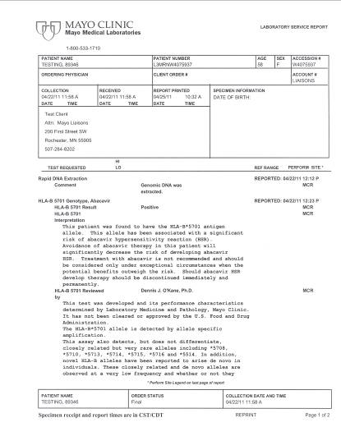
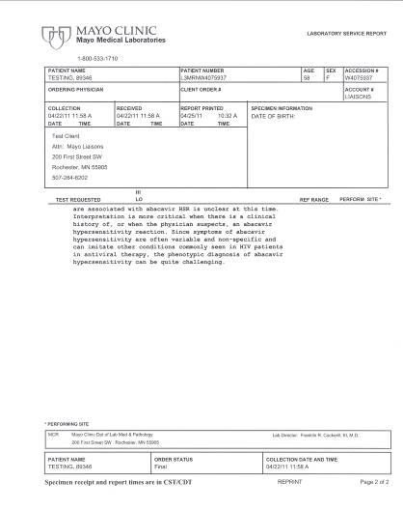

Slide 21
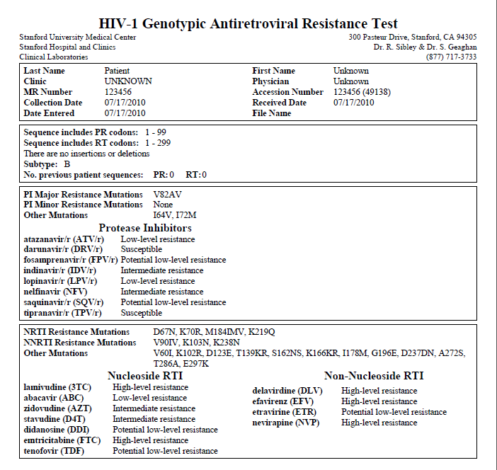
Viral genotype testing for ART resistance is standard of care
http://clinicalvirology.stanford.edu/UNKNOWN_AVRT.pdf

Slide 22
Pharmacogenomics in HIV
Observational studies
Mostly retrospective
Candidate-gene or GWAS approaches
Often not validated
Few clinical trials
Scarce functional studies

Slide 23
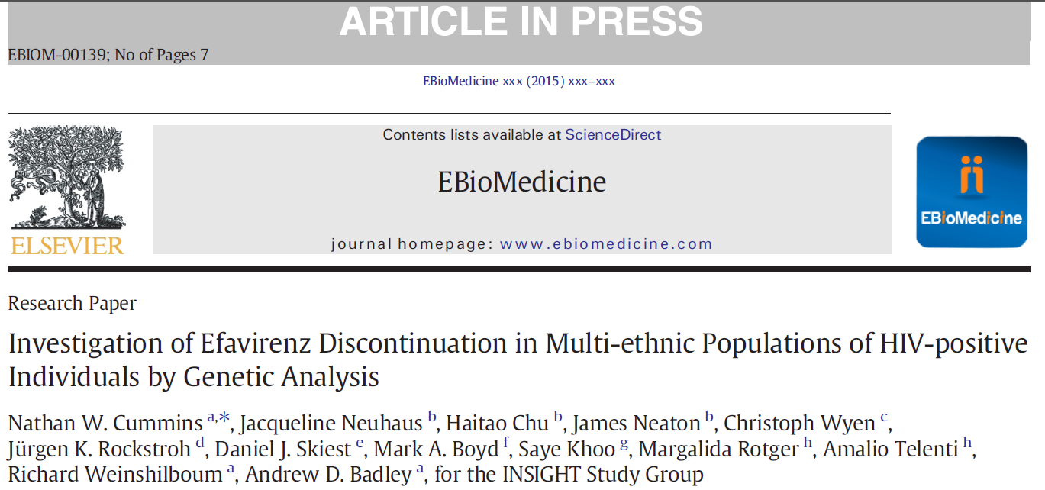
http://dx.doi.org/10.1016/j.ebiom.2015.05.012

Slide 24
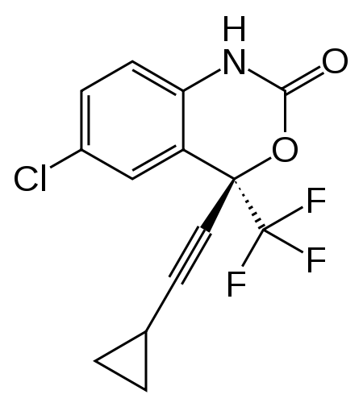
Efavirenz (EFV)
FDA approved in 1998
Preferred first line agent
Co-formulated in one-pill once-a-day cART in 2006
Reached a large market share (~85%), and will soon be coming off-patent
CNS Adverse Effects of EFV well described
  Dizziness, Lightheadedness, Nightmares, Disengagement, Impaired concentration, Agitation, Depression, Psychosis, Suicidal ideation
Premature discontinuation and lack of adherence is common
  K103N mutation – cross resistance to other NNRTIs

Slide 25
Efavirenz and Suicidality: The importance of pharmacovigilance
Study type | Efavirenz-associated risk | Reference
Meta-analysis of 4 ACTG RCTs | Suicidality HR 2.28 [95% CI, 1.27 to 4.10]; P = 0.006). Attempted or completed suicide HR 2.58 [CI, 0.94 to 7.06]; P = 0.065 | Mollan et al. Ann Intern Med. 2014 Jul 1;161(1):1-10
Retrospective analysis of D:A:D data | No association with EFV and suicide as cause of death | Smith et al. J Int AIDS Soc. 2014 Nov 2;17(4 Suppl 3):19512
US Medicaid and commercial claims data analysis | No association with EFV and suicidality as diagnosis Adjusted HR: commercial, 1.029 (0.636-1.665); Medicaid, 0.902 (0.617-1.319). | Nkhoma et al. Medicine (Baltimore). 2016 Jan;95(3):e2480
Analysis of START trial data | Suicidal behavior HR for EFV versus ART-naïve controls was 4.16 (p=0.02) HR for non-EFV regimens versus ART-naïve controls was 1.04 (p=0.93) (p=0.05 for difference in HRs). | Arenas-Pinto et al. International AIDS Society July 2016 Abstract: THAB0202

Slide 26
Pharmacogenetics of EFV
In a study of 821 participants in three ACTG studies,
  SNPs in CYP2B6 and CYP3A4, which metabolize EFV, were associated with serious CNS adverse effects. Ribaudo. The Journal of Infectious Diseases. 2010 (202):717-722.
In another study of 577 participants from the Swiss HIV Cohort,
  A Genetic Risk Score composed of SNPs in CYP2A6, CYP2B6 and CYP3A4
  Highly predictive of discontinuation of ART regimens containing EFV because of serious CNS events
    HR 3.1 (95% CI: 1.4-7.3)
    Lubomirov and Telenti. The Journal of Infectious Diseases. 2011 (203):246-257.

Slide 27
Hypothesis
PG testing for EFV-associated neurotoxicity will decrease the incidence of ADEs, and therefore increase medication adherence and effectiveness.
  To determine if PG testing for EFV associated toxicities is predictive of discontinuation of EFV with-in one year of treatment initiation in HIV-infected patients.
  Study Design: Pharmacogenetic profiling of cryopreserved DNA samples collected prospectively in three prospective, multicenter INSIGHT clinical trials.

Slide 28
Subjects:
1134 HIV-infected patients from INSIGHT trials
  SMART (Strategies for Management of Anti-Retroviral Therapy)
  ESPRIT (Evaluation of Subcutaneous Proleukin® in a Randomized International Trial)
  FIRST (Flexible Initial Retrovirus Suppressive Therapies)
Inclusion Criteria
  1) Informed consent,
  2) DNA samples available for testing,
  3) 12 months of follow up data concerning antiretroviral therapy compliance, duration, changes, side effects and adverse drug events,
  4) did not discontinue or change antiretroviral regimens due to primary treatment failure or development of viral resistance.

Slide 29
SMART VS Group with DNA available and
On ART and no history of EFV or ATV or
ART naïve
N=830
ESPRIT Control Group with DNA available and
No history of EFV or ATV
N = 963
FIRST with DNA available
N = 545
Did not switch to EFV or ATV
N=473
Did not start or switch to EFV or NVP
N=107
Did not start EFV or NVP or switch to EFV or ATV
N=589
N=241
N=490
N=438
< 12 mo. follow-up on EFV, NVP, or ATV
N=55
<12 mo. follow-up on EFV or ATV
N=5
<12 mo. follow-up on EFV or NVP
N=173
N=186
N=485
N=265
Insufficient DNA sample
N=79
Insufficient DNA sample
N=54
Insufficient DNA sample
N=45
N=107
N=431
N=220
N=758 total included in analysis

Slide 30
PG Testing using Illumina Platform
Primary SNPs
  SNPs in CYP2A6, CYP2B6 and CYP3A4 associated with EFV ADEs and discontinuation
Secondary SNPs (future analyses)
  Vitamin D deficiency
  Low Bone Mineral Density
  Dyslipidemia
  Apoptosis Regulatory Genes

Slide 31
Primary SNPs
Gene | SNP
CYP2A6: | rs28399433
CYP2B6: | rs28399499
CYP2B6: | rs35303484
CYP2B6: | rs35979566
CYP2B6: | rs3745274
CYP3A4: | rs4646437

Slide 32
“EFV Risk Score”
Score 1 (reference score): participants are homozygous for the reference allele in all 3 genes
Score 2: participants are homozygous for the reference allele for the main pathway (CYP2B6), and they have 1 to 4 LOF/DOF alleles in the accessory pathways (CYP2A6 and CYP3A4)
Score 3: participants have 1 LOF/DOF allele for CYP2B6 but they do not have any LOF/DOF allele in the accessory pathways (CYP2A6 and CYP3A4)
Score 4: participants have 1 LOF/DOF allele for CYP2B6 and they have 1 to 4 LOF/DOF alleles in the accessory pathways (CYP2A6 and CYP3A4)
Score 5: participants have 2 LOF/DOF allele for CYP2B6 but they do not have any LOF/DOF allele in the accessory pathways (CYP2A6 and CYP3A4)
Score 6: participants have 2 LOF/DOF allele for CYP2B6 and they have 1 to 4 LOF/DOF alleles in the accessory pathways (CYP2A6 and CYP3A4)
LOF - Loss of Function; DOF – Decrease of Function

Slide 33
Baseline characteristics of participants by genetic risk score (INSIGHT)
Characteristic | Score 1-5 | Score 6 | OR (95% CI) Score 6 vs 1-5ª | OR (95% CI) Score 6 vs 1-5^{b}
No. | 718 | 40
Age in years (median, IQR; OR per 10 year increase) | 40 (34, 45) | 37 (34, 41) | 0.8 (0.5, 1.1) | 0.8 (0.5, 1.1)
Female (%) | 21.3 | 47.5 | 3.3 (1.7, 6.4) | 2.1 (1.0, 4.3)
Black race (%) | 22.1 | 65.0 | 5.5 (2.6, 12.0) | 4.5 (1.9, 10.5)
CD4 T cell count in cells/mm³ (median, IQR; OR per 100 cell increase) | 414 (280, 571) | 312 (136, 520) | 0.9 (0.8, 1.1) | 1.0 (0.8, 1.1)
HIV RNA (% < 500 copies/) | 44.3 | 22.5 | 0.6 (0.2, 1.4) | 0.7 (0.3, 1.9)
BMI kg/m² (median, IQR; OR per 5 kg/m² increase) | 24.0 (21.8, 26.4) | 23.9 (22.0, 27.7) | 1.1 (0.8, 1.6) | 1.0 (0.7, 1.3)
Hepatitis B or C co-infection (%) | 13.1 | 10.0 | 1.1 (0.4, 3.4) | 1.1 (0.4, 3.6)
ªunadjusted, stratified by study
^{b}adjusted for age, gender, race, CD4 T cell count, HIV RNA, BMI, and hepatitis co-infection and stratified by study

Slide 34
Primary Outcome
The proportion of patients who discontinue or change the antiretroviral regimen within 12 months after initiation
  Compared between patients with or without the individual risk alleles, using Cox proportional hazards regression models
  Adjustment for Confounding variables

Slide 35
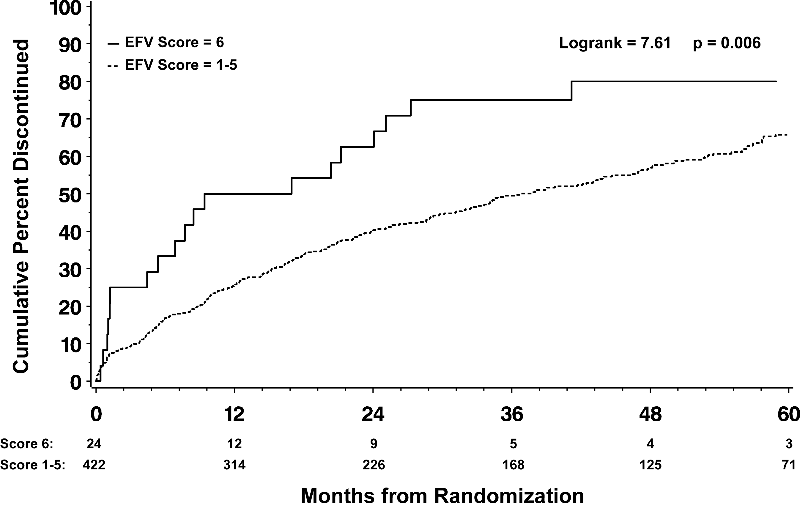
Time to Discontinuation of EFV

Slide 36
Results
Patient Group | Adjusted* HR (95% CI) for discontinuation of ART, Score 6 vs 1-5 | P value
ART naïve who started EFV (N=131) | 2.2 (1.0, 4.9) Adjusted HR 3.1 (95% CI: 1.4-7.3) from the Luborimov paper | 0.05
ART experienced who switched to EFV (N=315) | 1.7 (0.9, 3.1) | 0.10
All who started EFV (N=446) | 1.9 (1.2, 3.1) | 0.008
ART naïve who started NVP (N=80) | 1.5 (0.6, 3.7) | 0.35
ART experienced who switched to ATV (N=232) | 0.5 (0.1, 4.0) | 0.55
*Adjusted for age, gender, race, CD4+, log10 HIV RNA, BMI, and hepatitis co-infection and stratified by study

Slide 37
Baseline characteristics of participants by genetic risk score (Swiss Cohort)
Characteristic | Score 1-5 | Score 6 | OR (95% CI) Score 6 vs 1-5ª | OR (95% CI) Score 6 vs 1-5^{b}
No. | 259 | 13
Age in years (median, IQR; OR per 10 year increase) | 39 (34, 47) | 36 (32, 42) | 0.7 (0.4, 1.3) | 1.2 (0.6, 2.5)
Female (%) | 25.5 | 61.5 | 4.7 (1.5, 14.8) | 1.8 (0.5, 6.8)
Black race (%) | 14.7 | 76.9 | 19.4 (5.1, 73.7) | 17.5 (3.6, 84.4)
CD4 T cell count in cells/mm³ (median, IQR; OR per 100 cell increase) | 207 (119, 269) | 204 (152, 248) | 0.9 (0.6, 1.4) | 0.9 (0.4, 1.7)
HIV RNA (log₁₀ copies/ml) | 4.9 (4.4, 5.4) | 4.6 (4.4, 4.9) | 0.8 (0.4, 1.5) | 0.8 (0.3, 2.0)
BMI kg/m² (median, IQR; OR per 5 kg/m² increase) | 22.6 (20.9, 24.6) | 23.0 (21.4, 25.3) | 1.0 (0.5, 2.2) | 0.9 (0.4, 2.3)
Hepatitis B or C co-infection (%) | 45.6 | 53.8 | 1.4 (0.5, 4.3) | 0.9 (0.3, 3.1)
ªunadjusted, stratified by study
^{b}adjusted for age, gender, race, CD4 T cell count, HIV RNA, BMI, and hepatitis co-infection and stratified by study

Slide 38
Pooled analysis with Swiss Cohort
Genetic Risk Score | N (%) who discontinued within first year: INSIGHT | N (%) who discontinued within first year: Swiss Cohort | Unadjusted* OR (95% CI) for discontinuation in first year, vs. score of 6 | P value | Adjusted** OR (95% CI) for discontinuation in first year, vs. score of 6 | P value
Score 1 | 31 (28.4) | 22 (30.6) | 0.38 (0.19, 0.79) | 0.009 | 0.41 (0.18, 0.90) | 0.03
Score 2 | 30 (28.6) | 16 (28.6) | 0.38 (0.18, 0.79) | 0.01 | 0.36 (0.17, 0.77) | 0.009
Score 3 | 16 (18.4) | 14 (21.9) | 0.23 (0.11, 0.49) | <0.001 | 0.24 (0.10, 0.54) | <0.001
Score 4 | 29 (27.6) | 19 (35.2) | 0.41 (0.20, 0.85) | 0.02 | 0.39 (0.18, 0.82) | 0.01
Score 5 | 2 (12.5) | 3 (23.1) | 0.19 (0.06, 0.60) | 0.005 | 0.20 (0.06, 0.65) | 0.008
Score 6 | 12 (50.0) | 7 (53.8) | 1.0 | -- | 1.0 | --
Total | 120 (26.9) | 81 (29.8)
*Adjusted for age, gender, race, CD4+, log10 HIV RNA, BMI, and hepatitis co-infection and stratified by study

Slide 39
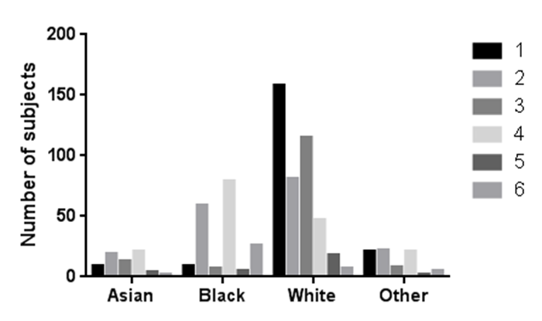
EFV Risk Score distribution differed by race

Slide 40
Analysis by Population and Study Stratification
Genetic Risk Score | Race | Total Number | Unadjusted* OR (95% CI) for discontinuation in first year, vs. score of 6 | P value | Adjusted** OR (95% CI) for discontinuation in first year, vs. score of 6 | P value
Score 6 vs. score 1-5 | Black | 166 | 1.71 (0.72, 4.08) | 0.23 | 1.89 (0.75, 4.78) | 0.18
Score 6 vs. score 1-5 | Non-black | 552 | 5.59 (1.66, 18.8) | 0.006 | 5.27 (1.54, 18.0) | 0.008
*Stratified by study
**Adjusted for age, gender, CD4 T cell count, HIV RNA, BMI, and hepatitis co-infection and stratified by study

Slide 41
Planned Next Steps
Pilot and feasibility RCT of PG testing prior to initiating EFV based regimen in the Mayo Clinic HIV clinic
Definitive Multicenter RCT
Development of a “Patient Genotype” for risk of ADEs from multiple ART drugs/ classes akin to viral genotype for ART susceptibility.

Slide 42
So what happened?
FDC Trade Name | Components | FDA Approval | Comments
Complera® | RPV/FTC/TDF | 2011 | VL<100,000 Fewer drug interactions Fewer CNS AEs
Stribild® | EVG/COBI/FTC/TDF | 2012 | Improved tolerability Different but significant Drug interactions
Triumeq® | DTG/ABC/3TC | 2014 | HLA-B*5701 testing required Fewer drug interactions Improved tolerability

Slide 43
Comparative Efficacy
Comparator | Efficacy Difference | Additional notes
RPV/FTC/TDF *ECHO and THRIVE | Week 96 (77% overall response rate in both groups) | ⬆ Virologic failure (VL>100K) ⬇ discontinuation due to AEs
EVG/COBI/FTC/TDF *GS-US-236-0102 Study | Week 96 (84% vs 82%, difference +2.7%, 95% CI: -2.9% to 8.3%) | Discontinuation due to AEs (5% vs 7%) Cost-effectiveness ratio of $166,287/QALY gained
DTG/ABC/3TC *SINGLE | Week 48 (88% vs. 81%, P=0.003) | Discontinuation due to AEs (2% vs 10%) Cost-effectiveness ratio of $482,717/QALY gained
Nelson et al HIV Clin Trials 2013; Zolona et al.JAIDS 2013; Juday et al Clinicoecon Outcomes Res 2013; Walmsley et al NEJM 2013; Peng etal J Int AIDS Soc 2014

Slide 44
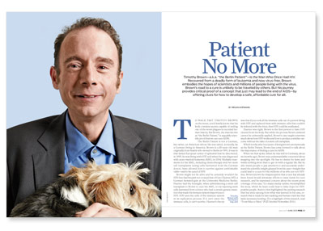
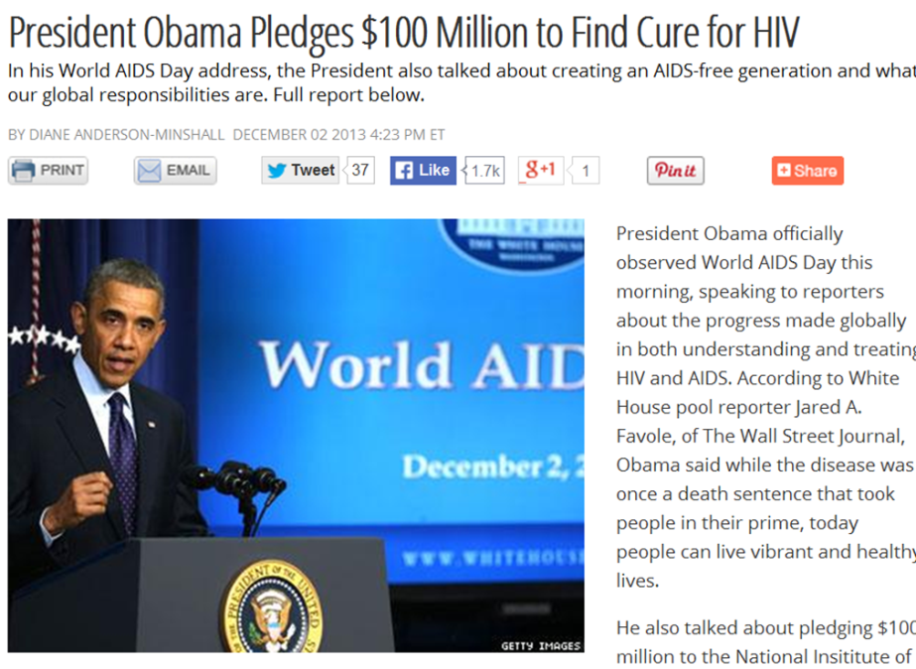
N of 1
CURE
CURE
CURE

Slide 45
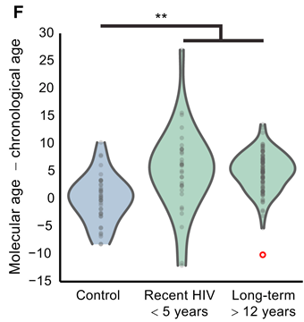
So why cure HIV?
Life expectancy not fully normalized (-14 years)
Accelerated aging phenotype
  Metabolic and CV complications
  Age-related malignancies
  Cognitive decline
  Frailty
Life long medications
  Cost; toxicities
End the pandemic quicker than with preventative efforts alone?
Molecular Cell 2016 62, 157-168DOI: (10.1016/j.molcel.2016.03.019)
Deeks. Annu Rev Med 2011

Slide 46
Current status of HIV cure
Can occur (Berlin patient)
Lots of ideas
Many under early stage clinical development
Significant hurdles
  Latent viral reservoir
  Incremental risk/benefit ratio
  Regulatory

Slide 47
Curative strategies
Gene therapy
Vaccination /
immune based Rx
Reactivation
Low accessibility
Oncogenic potential?
Genotype specific?
Toxicity concerns
Curative vs preventative
May not work alone
May require multiple Rx
Low cost, high accessibility
“To reach individuals living with HIV around the world, a curative regimen must be effective, simple, safe, and scalable,” Anthony Fauci.

Slide 48
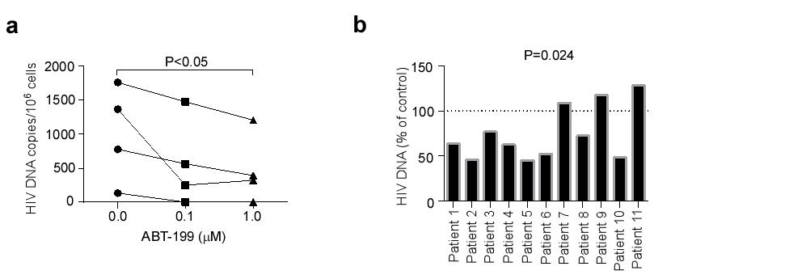
Venetocalx (ABT-199), a selective Bcl-2 inhibitor reduces HIV DNA in ex vivo reactivated primary CD4 T cells from HIV infected persons.
αCD3/αCD28
Primary CD4 T cells from HIV infected patients on ART
DMSO vehicle
TDF/RAL
16hrs
72hrs
TDF/RAL
ABT-199

Slide 49
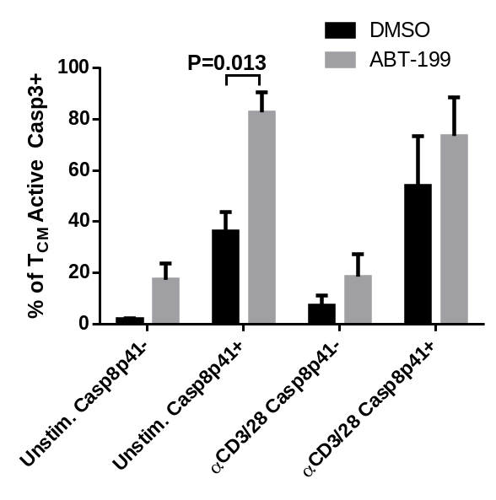
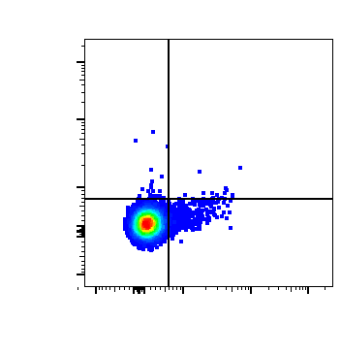
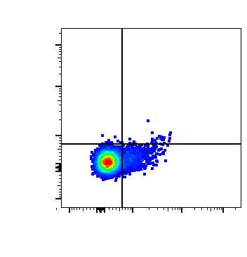
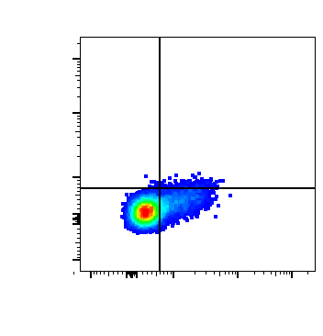
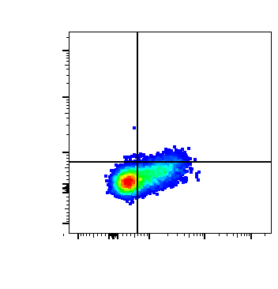
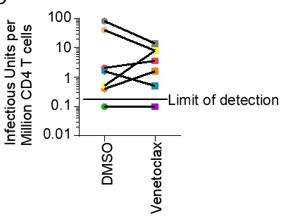
Venetoclax increases apoptosis in Casp8p41+ T_{CM} ex vivo and decreases replication virus in some patients’ cells.
DMSO
ABT-199
0.10
0.09
0.09
0.19
Unstimulated
98.7
1.15
94.9
4.82
0.08
1.01
0.09
3.00
αCD3/CD28
Casp8p41
83.8
15.1
62.2
34.7
Active Caspase3

Slide 50
Opportunities and Challenges for Pharmacogenetics in HIV
Newer ARTs are safer in RCTs
  Pharmacovigilance for identifying rare, unforeseen ADEs
  Pharmacogenetic analyses for predictors
Implementation in resource-poor settings using older ARTs
  Decreasing costs of genetic testing; POC testing
Technology/ data expanding faster than ability to study
  Whole genome/exome data
  Adequately powered studies
  Functional studies
Expanding role of ART; Treatment as prevention
Potential variability in responses/ ADEs in future HIV curative interventions

Slide 51
Acknowledgments
INSIGHT Steering Committee
Richard Weinshilboum
Andrew Badley
Jim Neaton, Jacquie Neuhaus, Haitao Chu
Amalio Telenti, Margalida Rotger and the Swiss HIV Cohort Study
Writing Group Members (Christoph Wyen, Jürgen Rockstroh, Daniel J. Skiest, Mark Boyd, Saye Khoo).
Mayo Clinic Advanced Genomics Technology Center (AGTC)
  David Rider, Abhinita Lnu
Mayo Clinic Center for Individualized Medicine
  Richard Weinshilboum
Mayo Clinic Center for Translational Science Acitivities
  KL2 program, Small Grants program
NIH/NIAID

Slide 52

Questions & Discussion

Slide 53
Let us meet again..
We welcome you to our future conferences of Conference Series LLC
through
9th International Conference and Exhibition on Pharmacovigilance
July 17-19, 2017 Munich, Germany
http://pharmacovigilance.pharmaceuticalconferences.com/

