Slide 1


3D Dilemma of This Century
Natalie Rasgon, MD, PhD
Professor
Department of Psychiatry and Behavioral Sciences Department of Obstetrics and Gynecology
Director, Center for Neuroscience in Women’s Health
Stanford University School of Medicine
Stanford, California

Slide 2









Overview
Diabetes^{1,2}
Dementia³
Depression^{4,}
5
Global prevalence
4.6 billion
47.5 million
350 million
Disability
19th disease to cause maximum disability (YLL)
12th most burdensome disease in the US
2.53% of all global DALYs
Cost
$612.2 billion
$604 billion year
$2.5 trillion

Slide 3

Insulin Resistance
(IR)
Affective Disorders (ad)
Dementia/ Alzheimer’s Disease (AD)
Impaired glucose
utilization
Increased insulin levels
Increased glucose levels
Serotonin
NMDA/Glutamate
Cortisol
Acetylcholine

Slide 4
Insulin Resistance (IR)
A condition in which tissue responsiveness to the
normal action of insulin is impaired
It is a major risk factor for DM, CVD, and mood disorders
May or may not be a consequence of weight gain
NCEP ATP III. Circulation 2002; 106: 3143; Rasgon & Jarvik. J Gerontol A Biol Sci Med Sci 2004; 59: 178-183; Rasgon et al. 2002

Slide 5














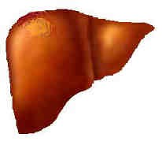

Underlying Mechanisms: Obesity and
Insulin Resistance
Skeletal Muscle
Glucose Utilization
Lipolytically active abdominal adipose tissue
Adipose Tissue
Inhibition of Lipolysis
FFA
Insulin Action
Adipose Tissue
Liver
Glucose Output
Hyperglycemia and Dyslipidemia
Steinberg HO, Baron AD. Diabetologia. 2002;45:623-634; Caballero AE. Obesity Res. 2003;11:1278-1289; Reaven GM. Diabetes. 1988;37:1595-1607

Slide 6

Clinical Conditions Associated with Insulin
Resistance
Obesity
Dyslipidemia
Atheroschlerosis
Diabetes Mellitus
Insulin
Resistance
Hypertension
Depression
Endothelial
Dysfunction
Syndrome X
Microalbuminuria
Polycystic Ovary Syndrome
NCEP ATP III. Circulation 2002; 106: 3143; Rasgon & Jarvik. J Gerontol A Biol Sci Med Sci 2004; 59: 178-183; Rasgon et al. 2002

Slide 7
Insulin Resistance in CNS
High prevalence of depression in patients with primary IR
Non-diabetic patients with major depression often have
IR, even after remission of depressive symptomatology
IR results in
  Reduced insulin transport into the brain
  CNS glucose deprivation leads to impairment in brain function
    Depression
    Cognitive decline
    Detrimental affects on behavior that influence
quality of glycemic control

Slide 8
Insulin Resistance and Cognition
Majority of previous studies relating IR and cognition conducted with
elderly individuals
  Increasing age is a major confounder in this association
  IR generally worsens with increasing age in the elderly
  Age-related cognitive changes heterogeneous across older adults
    May be harder to detect specific effects due to IR
    Global, rather than specific, deficits in relation to metabolic dysfunction
IR may exist in younger adults even with normal BMI
  BMI may not be a sensitive measure for younger adults with depression
High BMI over time
  Independent predictor of cognitive decline with advancing age

Slide 9
Cognition in Depression, IR, and AD
Metabolic changes in crucial brain regions in patients with AD
Insulin resistance
Inadequate glucose utilization
Clinical evidence: Affective disorders more common in persons with diabetes than in nondiabetic persons
Neurochemical evidence: Reduced serotonergic activity and
hyperactivity of the HPA axis
Neuroimaging evidence: Reduced cerebral glucose
utilization in the limbic area
Rasgon, N., & Jarvik, L. (2004). Insulin resistance, affective disorders, and Alzheimer's disease: review and hypothesis. The Journals of Gerontology Series A: Biological Sciences and Medical Sciences, 59(2), M178-M183. Chicago

Slide 10

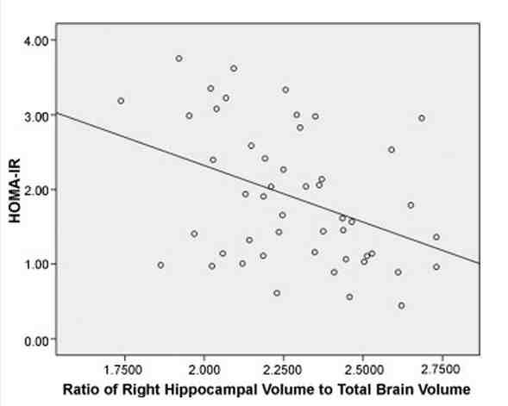
Insulin Resistance and Decreased
Hippocampal Volume
Women at risk for AD: Multiple regression analysis using raw right hippocampal volume as the dependent variable and total brain volume as an independent variable in addition to HOMA-IR.
Significant main effect of HOMA-IR on right hippocampal volume (t =
−2.768, p = .008).
Rasgon, N. L., Kenna, H. A., Wroolie, T. E., Kelley, R., Silverman, D., Brooks, J., ... & Reiss, A. (2011). Insulin resistance and hippocampal volume in women at risk for Alzheimer's disease. Neurobiology of aging, 32(11), 1942-1948. Chicago.

Slide 11
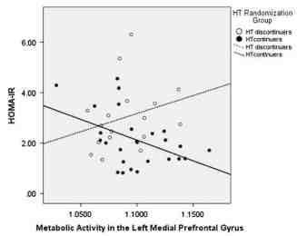
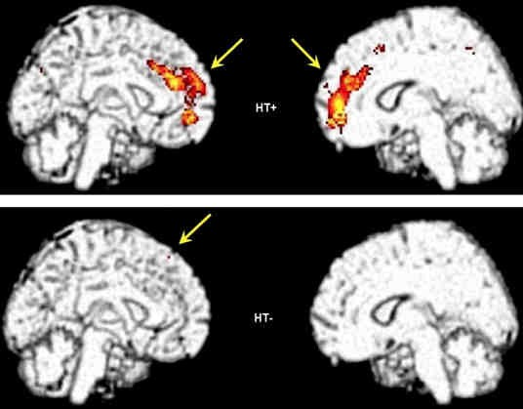
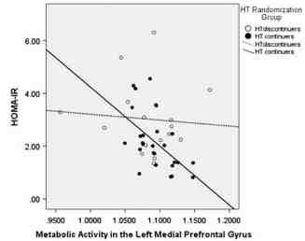
Insulin Resistance and Prefrontal Gyrus
Metabolism
HOMA-IR and metabolic activity in the medial prefrontal gyrus within HT continuers (HT+) and discontinuers (HT−).
Rasgon, N. L., Kenna, H. A., Wroolie, T. E., Williams, K. E., DeMuth, B. N., & Silverman, D. H. (2014). Insulin resistance and medial prefrontal gyrus metabolism in women receiving hormone therapy. Psychiatry Research: Neuroimaging, 223(1), 28-36.

Slide 12

Association between insulin resistance and
cognition in patients with depressive disorders
Demographics Methods
Subjects
  Non-diabetic adults (N=39)
  Men and women aged 19- 71
  BMI < 40 kg/m2
  History of MDD currently
not in a mood episode
  Cognitively intact (MMSE score>28)
Procedures
  Insulin suppression test for steady state plasma glucose
  Cognitive testing
 | Total Sample (N=39) |  | < 45 years (N=14) |  | > 45 years (N=25)
 | Mean | SD | Mean | SD | Mean | SD | t | p
Age | 48.41 | 13.38 | 33.79 | 8.22 | 56.60 | 7.23 | -9.00 | <.001
(range) | (19-71) |  | (19-44) |  | (45-71)
Education | 16.56 | 2.35 | 16.00 | 2.29 | 16.88 | 2.37 | -1.13 | .27
(range) | (12-23) |  | (12-20) |  | (12-23) |  |  | (ns)
HDRS-21 | 9.36 | 4.63 | 12.07 | 4.18 | 7.84 | 4.21 | 3.02 | .01
(range) | (1-20) |  | (5-20) |  | (1-16)
Age of MDD | 26.71 | 14.55 | 19.69 | 6.66 | 30.86 | 16.40 | -2.83 | .01
onset | (10-68) |  | (10-32) |  | (12-68)
SSPG | 140.64 | 69.67 | 161.46 | 68.12 | 128.87 | 69.21 | 1.37 | .18
(range) | (52- |  | (65-304) |  | (52-323) |  |  | (ns)
 | 323)
BMI | 27.68 | 5.50 | 30.32 | 7.09 | 26.20 | 3.79 | 2.02 | .06
(range) | (19.6- |  | (19.6-39.3) |  | (20.4-38.6) |  |  | (ns)
 | 49.2)
FSIQ | 122.55 | 10.22 | 117.36 | 11.33 | 125.14 | 8.77 | -2.18 | .04
(range) | (98- |  | (98-138) |  | (109-142)
 | 142)
Wroolie, T. E., Kenna, H. A., Singh, M. K., & Rasgon, N. L. J Psychiatr Res. 2014; 60, 65-72.

Slide 13
Analyses
Multiple linear regressions
  Model 1: Age, education, SSPG, and any significantly
associated predictors
  Model 2: Age, education, BMI, and any significantly
associated predictors
  Post hoc analyses within dichotomized age groups (<45 and >45 years)
Wroolie, T. E., Kenna, H. A., Singh, M. K., & Rasgon, N. L. J Psychiatr Res. 2014; 60, 65-

Slide 14
IR vs. BMI Effects on Cognition:
Whole Group
Model 1: not significant
  SSPG level was not significantly associated with performance on any cognitive variables
• Model 2: (F(3,30)=4.562, p<.05)
  Higher BMI was associated with worse dominant hand fine motor ability(t=-2.21, p=.04)
  Higher age (t=-3.23, p<.01) and lower level of educational attainment (t=-2.21, p=.04) also associated with worse dominant hand fine motor ability
Wroolie, T. E., Kenna, H. A., Singh, M. K., & Rasgon, N. L. J Psychiatr Res. 2014; 60, 65-

Slide 15

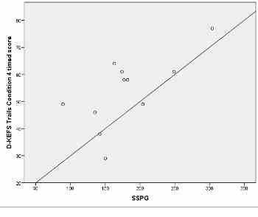
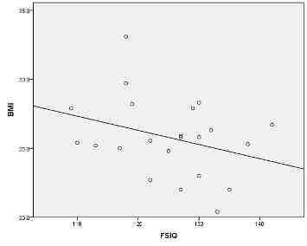
IR vs. BMI Effects on Cognition:
Age-related
Cognition in subjects < 45 years Cognition in subjects > 45 years
• Model 1: (F(3,7)=8.26, p<.05)
Model 1: not significant
– Higher SSPG associated with worse (cognitive flexibility; (t=4.24, p=.004)*
– SSPG was not significantly associated with
any cognitive variables
Model 2: not significant
• Model 2: (F(3,18)=7.60, p<.01)
– BMI not significantly associated with any cognitive variables
– Higher BMI was significantly associated with lower FSIQ
*significant with Bonferroni correction
Wroolie, T. E., Kenna, H. A., Singh, M. K., & Rasgon, N. L. J Psychiatr Res. 2014; 60, 65-

Slide 16
Conclusion
Differential cognitive effects of IR and BMI are
age-specific
Higher IR associated with executive function
deficits in younger adults
  Similar to what is seen in adolescents with Metabolic Syndrome
Higher BMI associated with global decline in
older adults
  Similar to what is seen in older adults with DM2
Wroolie, T. E., Kenna, H. A., Singh, M. K., & Rasgon, N. L. J Psychiatr Res. 2014; 60, 65-

Slide 17


Telomeres and Biological Aging
Telomeres shorten over time
Accelerated shortening due to inflammation & oxidative stress
Emerging index of biological age
Short TL predicts subsequent morbidity and mortality
Social and psychological factors (chronic perceived stress, pessimism, social disadvantage) are associated with short TL
Blackburn, Nature 1981; Epel, PNAS 2004; O’Donovan, BBI 2009; Steptoe, BBI 2011

Slide 18
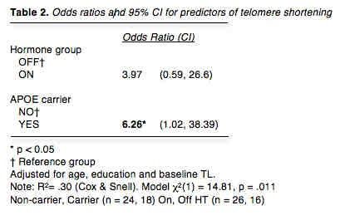
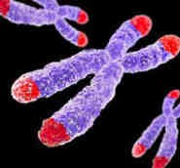
Genetic Risk Factor & Cell Aging
APOE-e4 is a major genetic risk factor for Alzheimer’s
disease and early mortality
Prospective study, APOE-e4 carriers had 6x greater odds of TL shortening
High-functioning, healthy mid-life women with the e4 allele bear markers of cellular aging
Jacobs, Epel, Blackburn et al. Under review, PNAS

Slide 19

TL Correlated with Hippocampal Volume
N = 47, p = 0.029

Slide 20






Breaking Through the Vicious Cycle:
Pharmacological Disruption
Dementia
Diabetes
Depression
Insulin- sensitizing agents

Slide 21
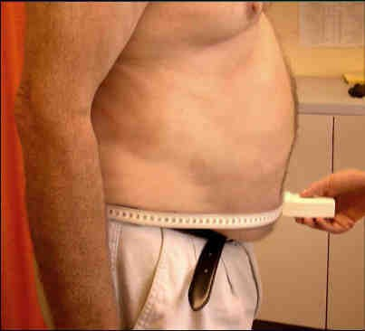
Identifying Patients Who Are at Risk for Insulin
Resistance
Abdominal obesity
  WC: men, >40 inches; women,
>35 inches
Elevated triglycerides
– >149 mg/dL
Decreased HDL
  Men: <40 mg/dL; women: <50 mg/dL
Elevated blood pressure
– >129/>84 mm Hg
Increased fasting glucose
– >99

Slide 22
Breaking Through the Vicious Cycle:
Pharmacological Disruption
Improve diet
Exercise
Decrease obesity

Slide 23


Future Directions: Primary Prevention
Pharmacological
Optimal treatment of depression
Early diagnosis and management of metabolic dysfunction
Aggressive treatment of diabetes
Non-pharmacological
Stress reduction and
management
Exercise
Ketogenic diet

Slide 24
Key Points
Alzheimer's disease (AD) frequently occurs with diabetes, CAD, and depression, which may contribute to the development of AD and other dementias
Insulin resistance may be a link between mood disorders, vascular disease, and dementia
Patients with diabetes, CAD, or depression are at risk for dementia and their cognitive performance should be monitored; these conditions should be treated to improve patient health and reduce the risk of dementia
After dementia has been identified, it should be managed with the appropriate lifestyle modifications and treatments

Slide 25
References
1.
2.
IDF Diabetes Atlas. Rep. no. 6. International Diabetes Foundation, 2014. Web. 28 July 2015.
Bhutani, J., & Bhutani, S. (2014). Worldwide burden of diabetes. Indian journal of endocrinology and metabolism, 18(6), 868.
"10 Facts on Dementia." WHO. World Health Organization, Mar. 2015. Web. 29 July 2015.
Insel, T. (2011, September 28). Director's Blog: The Global Cost of Mental Illness. Retrieved July 29, 2015.
Murray CJ et al. Disability-adjusted life years (DALYs) for 291 diseases and injuries in 21 regions, 1990-2010: a systematic analysis for the Global Burden of Disease Study 2010. Lancet,380(9859): 2197-223, 2012.
Steinberg HO, Baron AD. Diabetologia. 2002;45:623-634; Caballero AE. Obesity Res. 2003;11:1278-1289; Reaven GM.
Diabetes. 1988;37:1595-1607
Rasgon, N., & Jarvik, L. (2004). Insulin resistance, affective disorders, and Alzheimer's disease: review and hypothesis. The Journals of Gerontology Series A: Biological Sciences and Medical Sciences, 59(2), M178-M183. Chicago
NCEP ATP III. Circulation 2002; 106: 3143; Rasgon & Jarvik. J Gerontol A Biol Sci Med Sci 2004; 59: 178-183; Rasgon et al.
2002
Rasgon, N. L., Kenna, H. A., Wroolie, T. E., Kelley, R., Silverman, D., Brooks, J., ... & Reiss, A. (2011). Insulin resistance and hippocampal volume in women at risk for Alzheimer's disease. Neurobiology of aging, 32(11), 1942-1948. Chicago.
Rasgon, N. L., Kenna, H. A., Wroolie, T. E., Williams, K. E., DeMuth, B. N., & Silverman, D. H. (2014). Insulin resistance and medial prefrontal gyrus metabolism in women receiving hormone therapy. Psychiatry Research: Neuroimaging, 223(1), 28-36.
Wroolie, T. E., Kenna, H. A., Singh, M. K., & Rasgon, N. L. J Psychiatr Res. 2014; 60, 65-72.
Von Zglinicki, T., Serra, V., Lorenz, M., Saretzki, G., Lenzen-Gro&bgr, R., Ge&bgr, R., ... & Steinhagen-Thiessen, E. (2000). Short telomeres in patients with vascular dementia: an indicator of low antioxidative capacity and a possible risk factor?. Laboratory investigation, 80(11), 1739-1747. Chicago.
Rasgon, N. L., Kenna, H. A., Reynolds‐May, M. F., Stemmle, P. G., Vemuri, M., Marsh, W., ... & Ketter, T. A. (2010). Metabolic dysfunction in women with bipolar disorder: the potential influence of family history of type 2 diabetes mellitus. Bipolar disorders, 12(5), 504-513.
3.
4.
5.
6.
7.
8.
9.
10.
11.
12.
13.

Slide 26

















Natalie L. Rasgon, M.D., Ph.D.
Katherine E. Williams, M.D.
Laraine T. Zappert, Ph.D.
Tonita E. Wroolie, Ph.D.
Thalia Robakis, M.D., Ph.D.
Stanford Center for Neuroscience
in Women’s Health
Danielle Balzafiore, M.S., M.A.
Kaitlyn Young
Kathleen Watson, M.S., Ph.D.
Sarah Borish
Abigail Kramer
Chelsea Tobin
April Alcantara
Maile T. Jones
Siena Roat-Shumway

