Slide 1
The regentime technique in stem cell therapy
A gate to immortality
Presenter: Nassim Halim Abi Chahine MD, Neurosurgeon
ACE Cells Lab. Ltd, UK

Slide 2
A technique of how to transform blank cells,
into organ specific progenitor stem cells

Slide 3
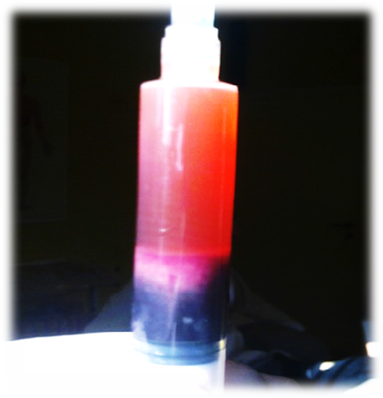
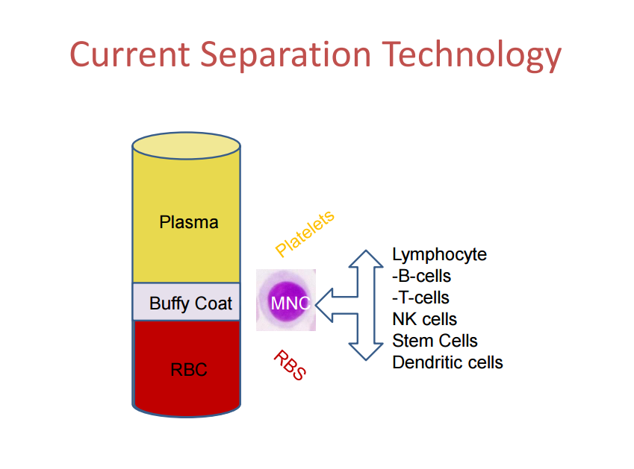
Regentime
Based on Transplantation of
Differentiated Autologous Adult Bone Marrow derived Mononuclear Progenitor Stem Cells after in vivo and in vitro proliferation
Notes:
The Regentime® procedure can be summarized with the following description:

Slide 4
MSC Mesenchymal stem cells
MACs Multipotent Adult Stem Cells
MPCs Mesodermal Progenitor Stem Cells
MAPCs Multipotent Adult Progenitor Cells
VSELs Very Small Embryonic-like Stem Cells
MIAMI Marrow Isolated Adult Lineage Inducible Cells

Slide 5

Anunusual mixture of cells and factors interact in a very complex way to produce the cell pathology and clinically manifests as
Multiple Sclerosis

Slide 6
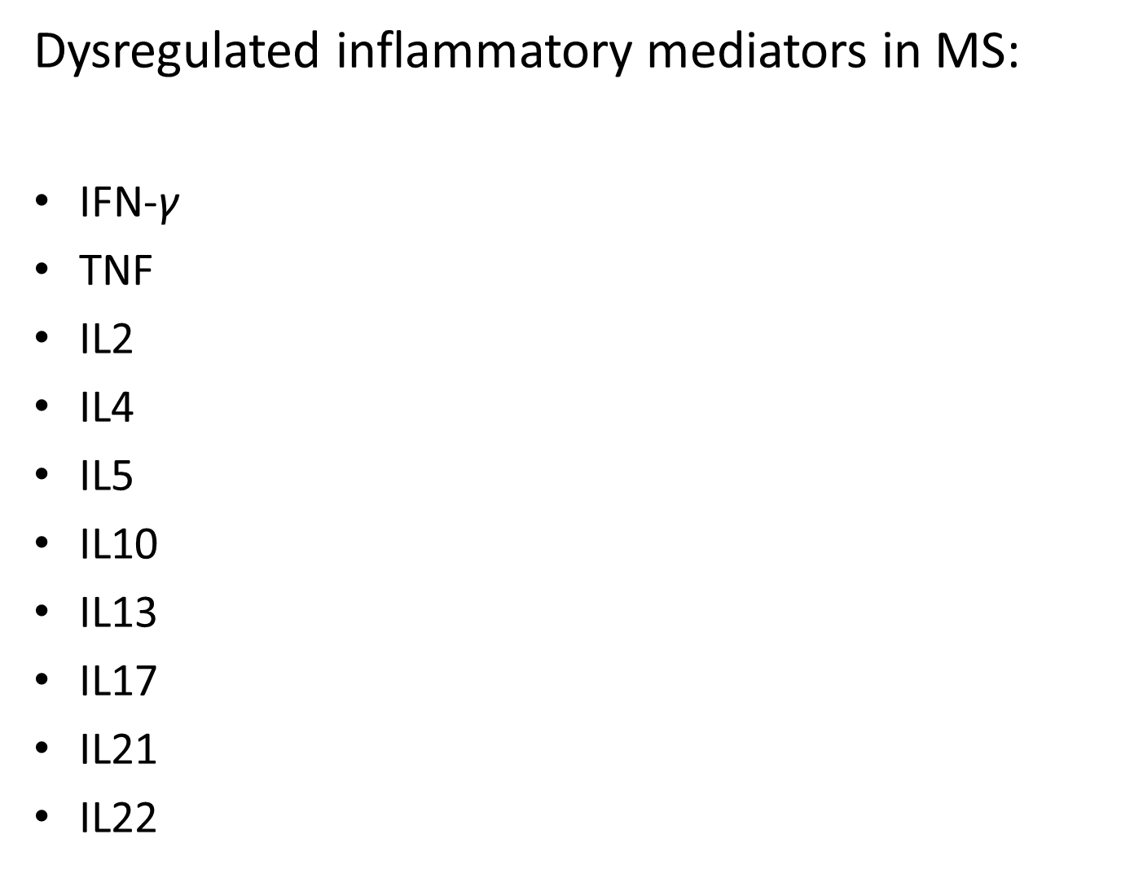
The immune inflammatory cells involved in the pathobiology of MS include the:
T-helper 1
T-helper 2
T-reg cells
Th17 cells
NK cells
Macrophages
B-lymphocytes
Plasma cells

Slide 7
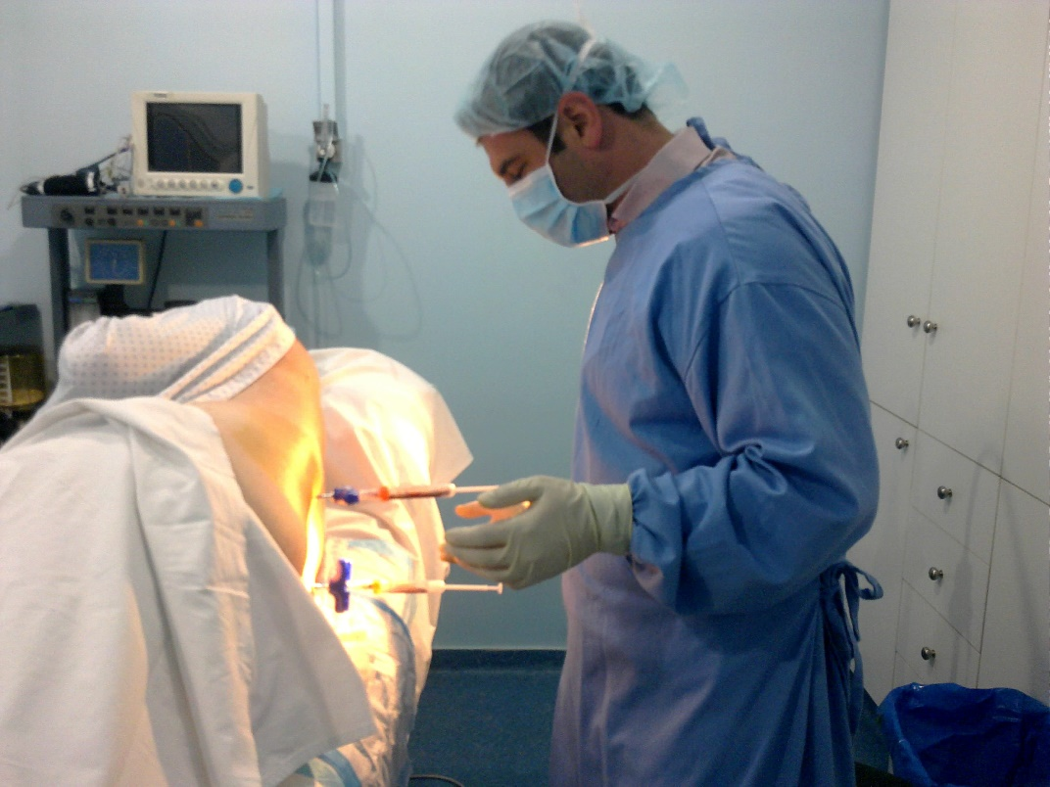
Regentime® a method combining the proliferation, harvest and culture of MNC in complete disintegrated-organ-specific-cells

Slide 8
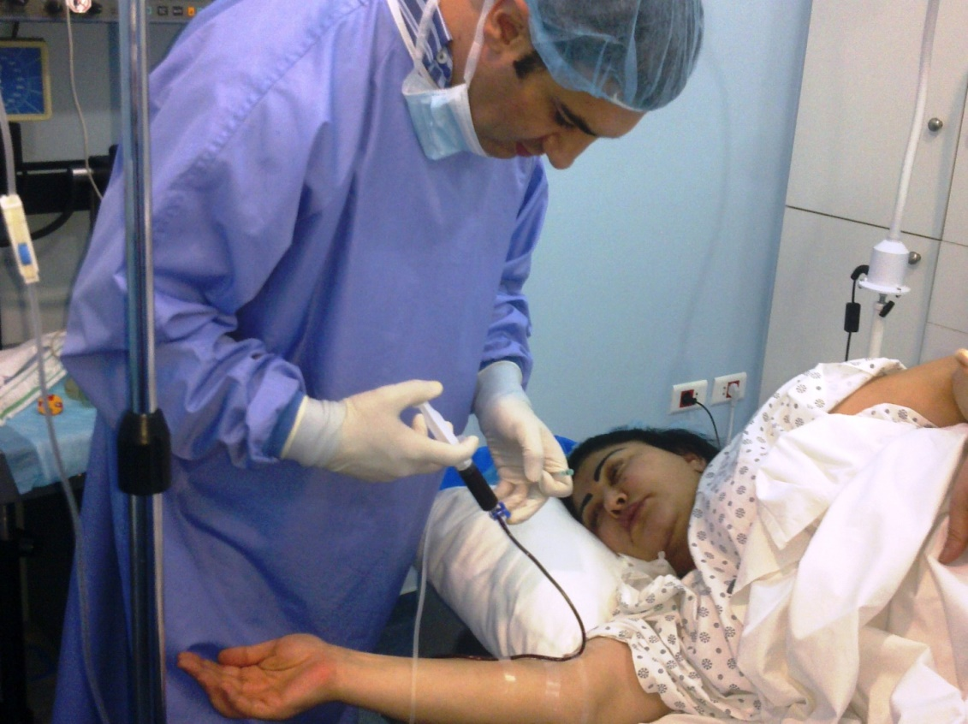
These Progenitor Cells were applied in situ in the harmed organ show to be superior to ordinary human mesenchymal stem cell based therapies

Slide 9
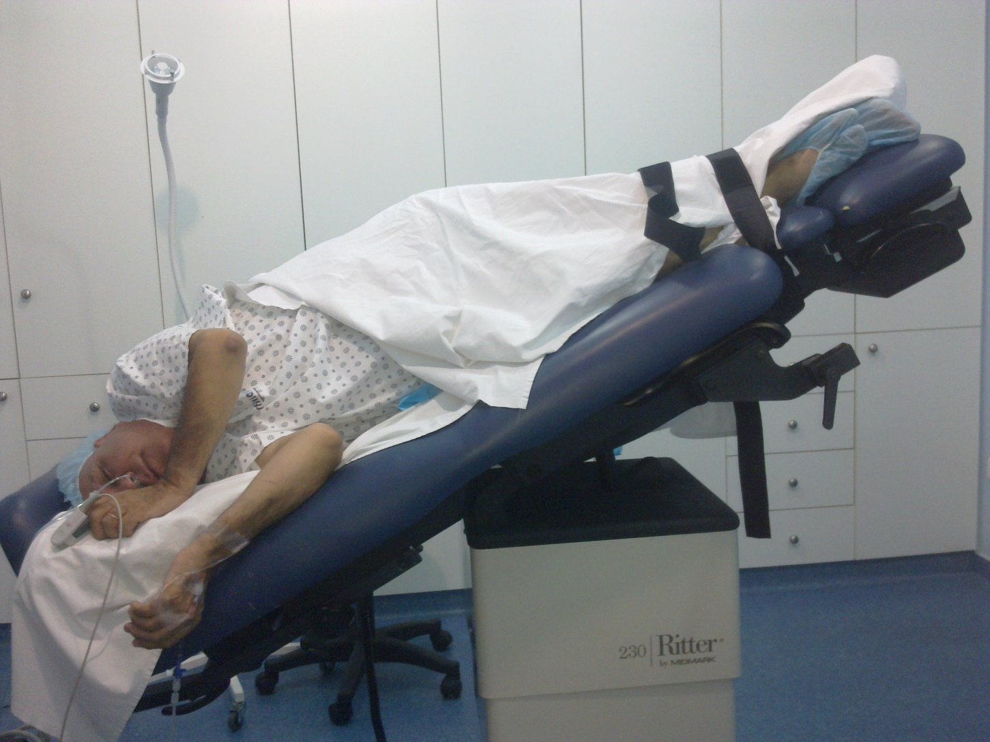

Slide 10
Procedure or Protocol?
Materials and Methods

Slide 11
Materials
Filgrastim G-CSF, Granulocyte-colony stimulating factor
Human adult autologous bone marrow aspirates
ACE-Product (Alaa Cell Extract)

Slide 12
Methods
1. The pre-lab stage
2. The bone marrow collection stage
3. The laboratory stage
4. The transplantation stage
5. The post-transplantation stage

Slide 13

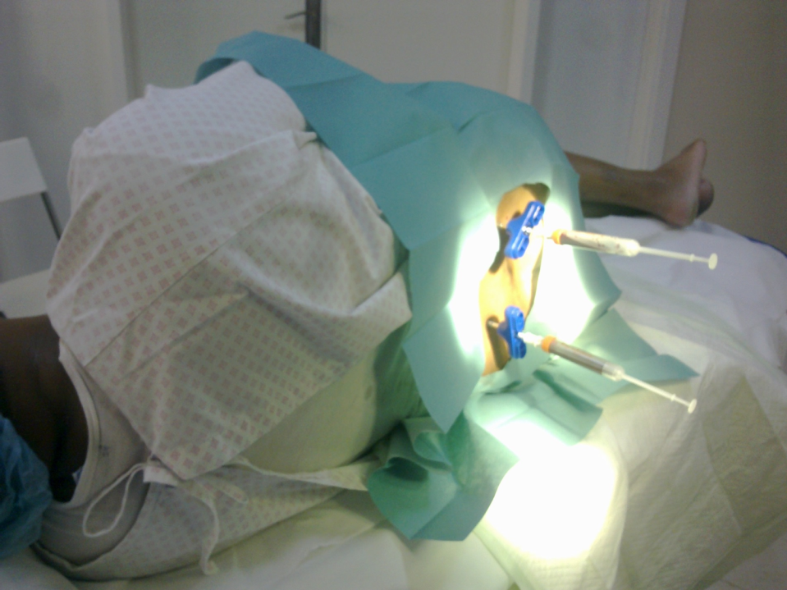
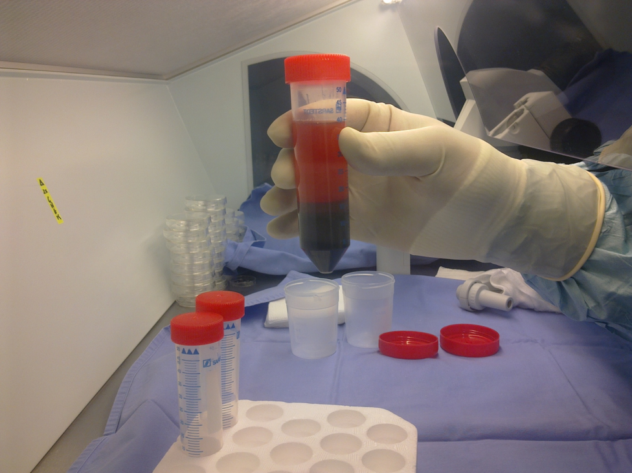
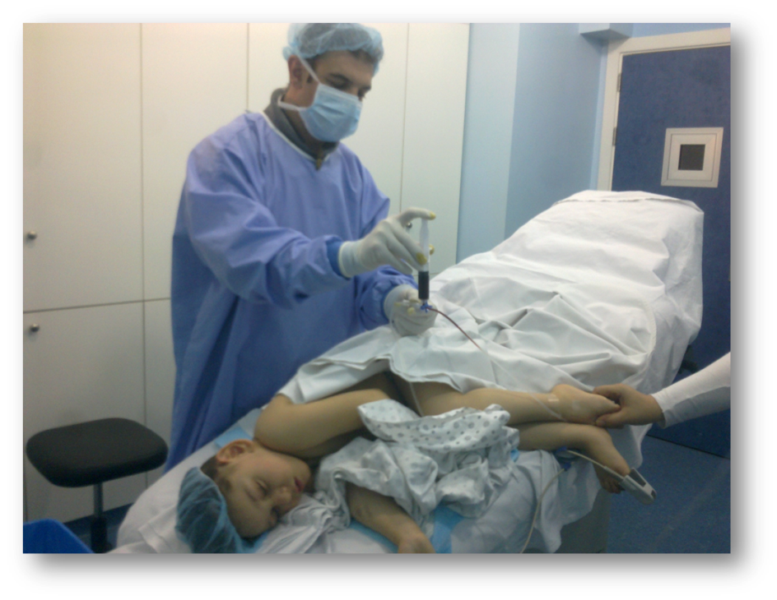

Slide 14
Exosomal and Lisosomal peptides

Slide 15
The Peptides of the organelles showed to be the cause behind the activation of endogenous progenitor cells.

Slide 16
In a trial to create organ specific stem cells from autologous human source, Regentime® succeeded to create progenitor stem cells

Slide 17
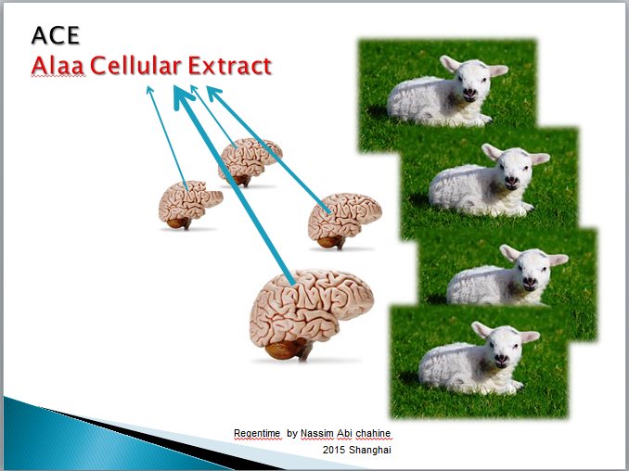

Slide 18
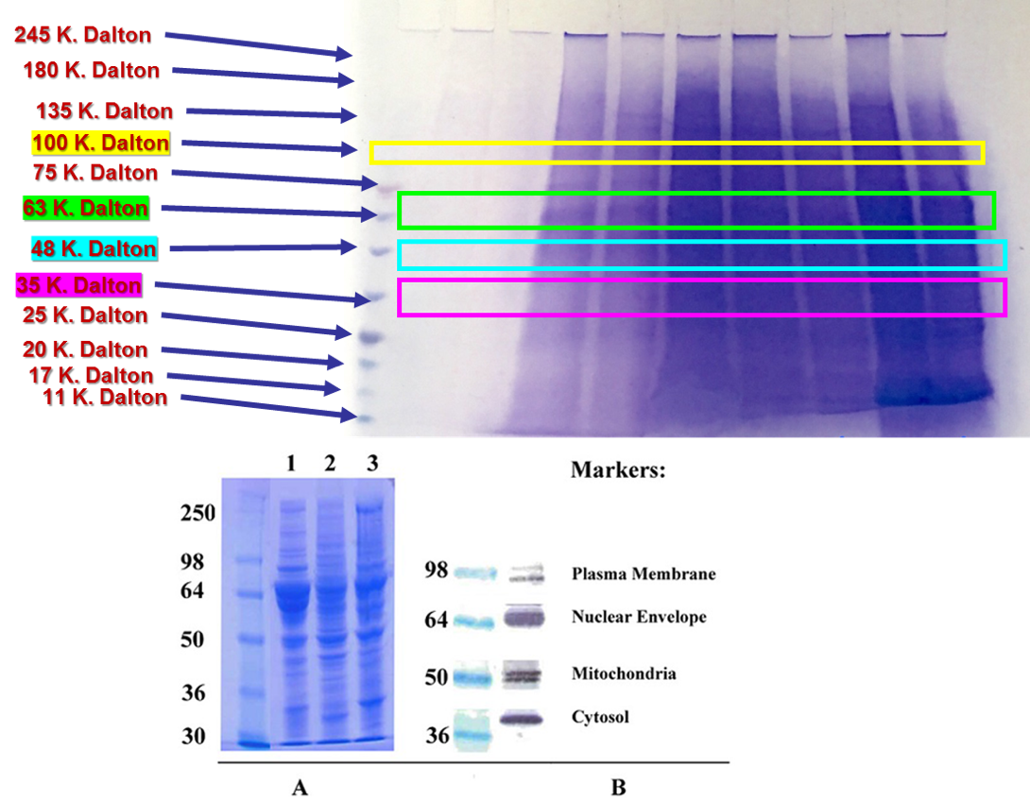

Slide 19
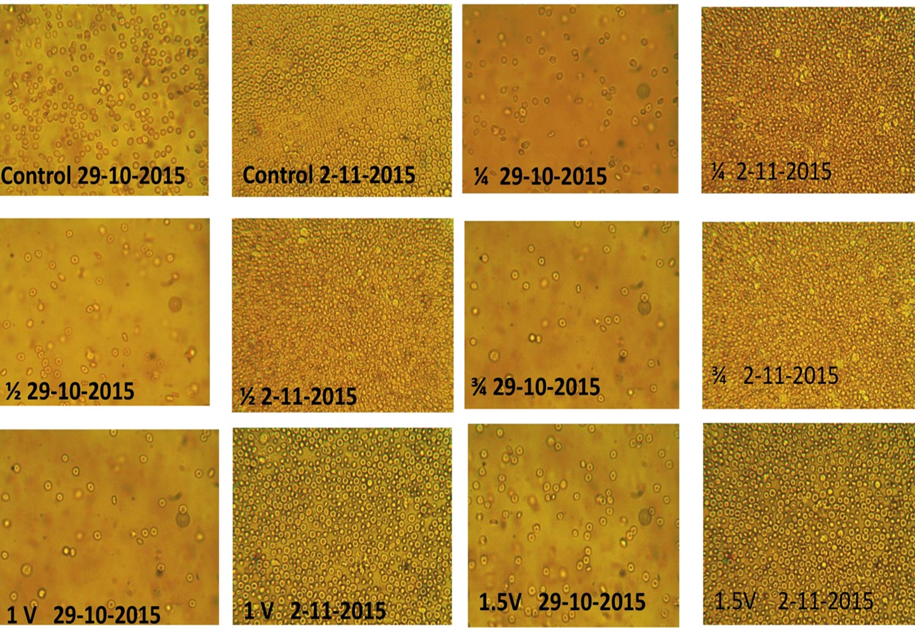

Slide 20
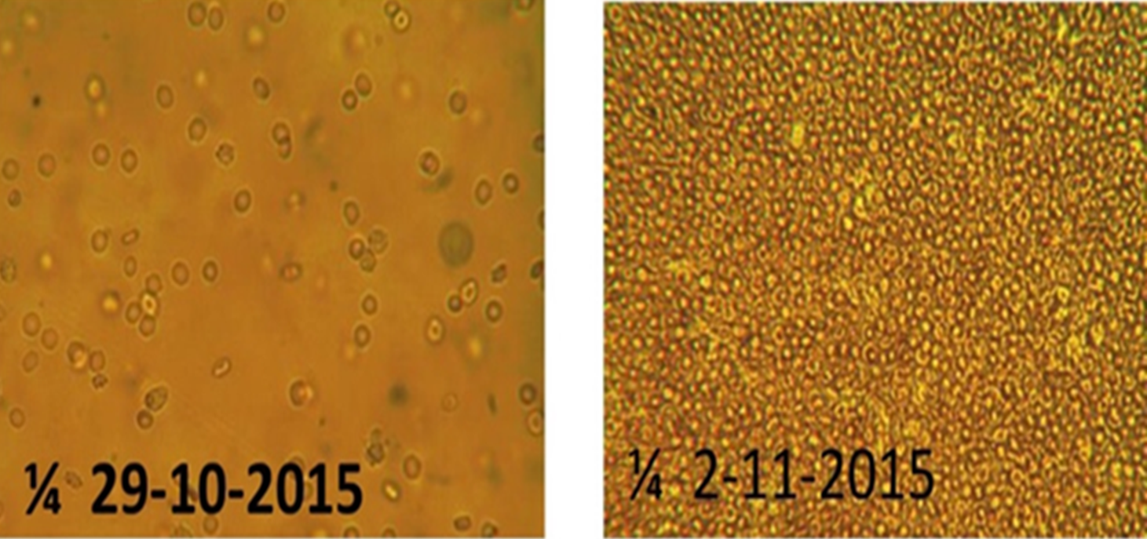

Slide 21
The 5 Challenges in ACE production:
1- The time factor
2- The nature of organ
3- The added chemicals
4- Qualification and quantification (temperature)
5- Protein specific characteristics (N-terminal ac)
Notes:
Ad 4- Temperature and denaturation

Slide 22
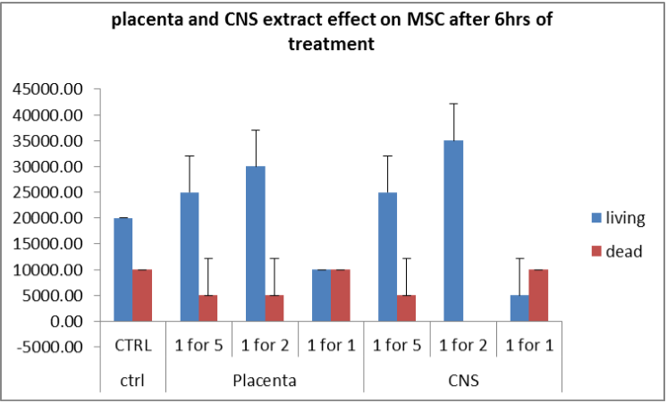

Slide 23
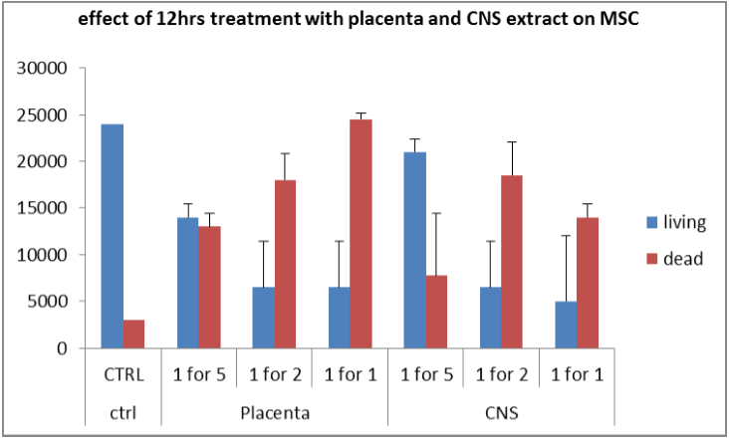

Slide 24
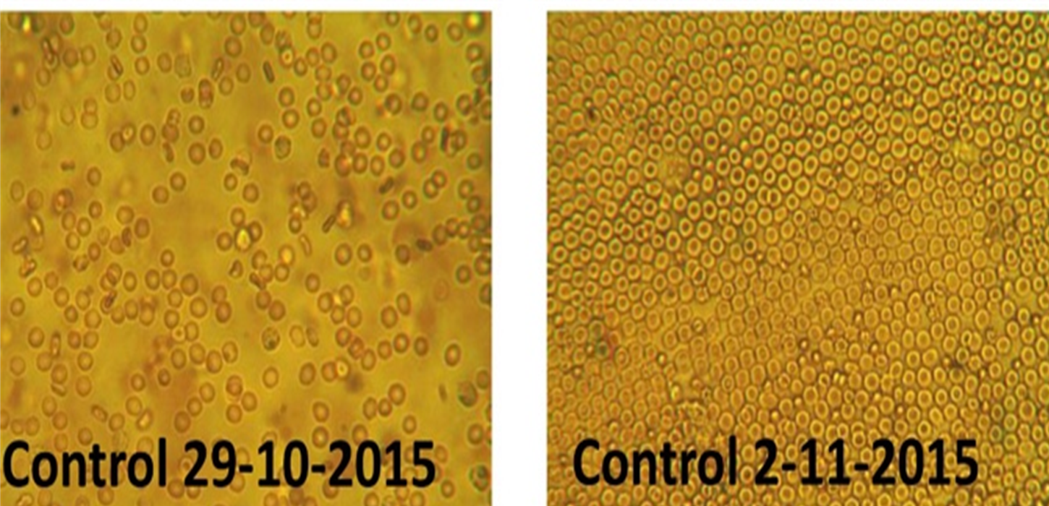
Morphological changes denote that cells are completely transformed and changes in shape and pattern of stain of the nuclei prove the transformation.

Slide 25
Heart, liver, brain, kidney, pancreas and many other progenitor stem cells were reengineered and all transformations were detected

Slide 26
Another plus with ACE

Slide 27
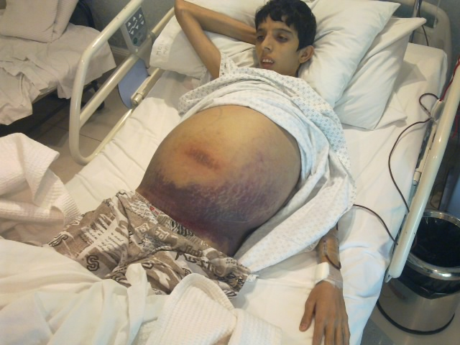

Slide 28
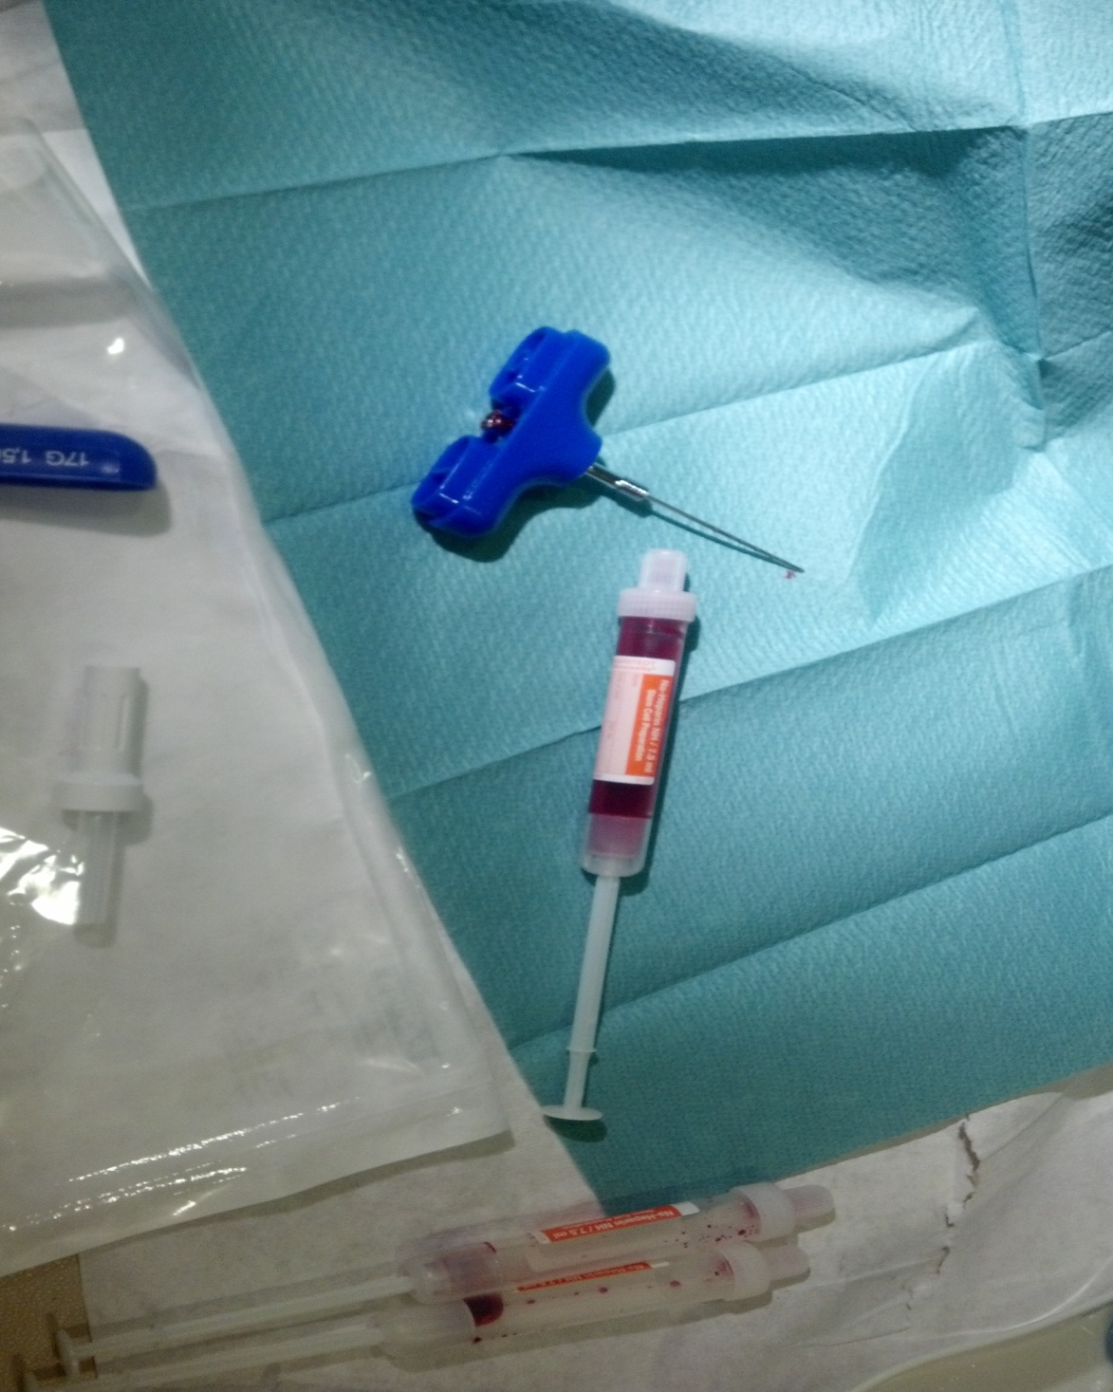

Slide 29
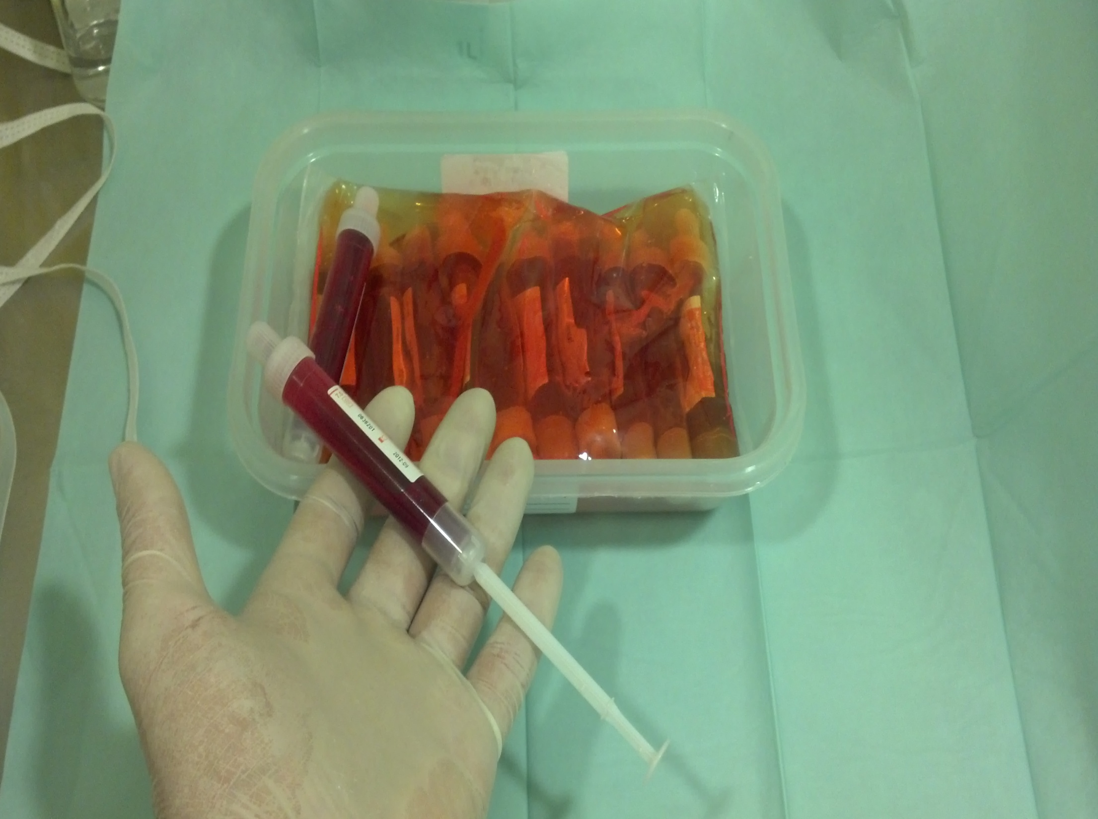

Slide 30
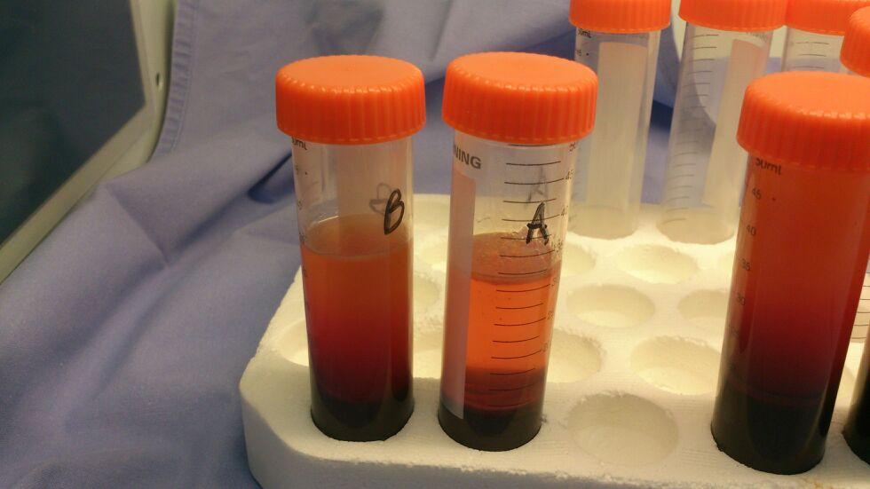

Slide 31
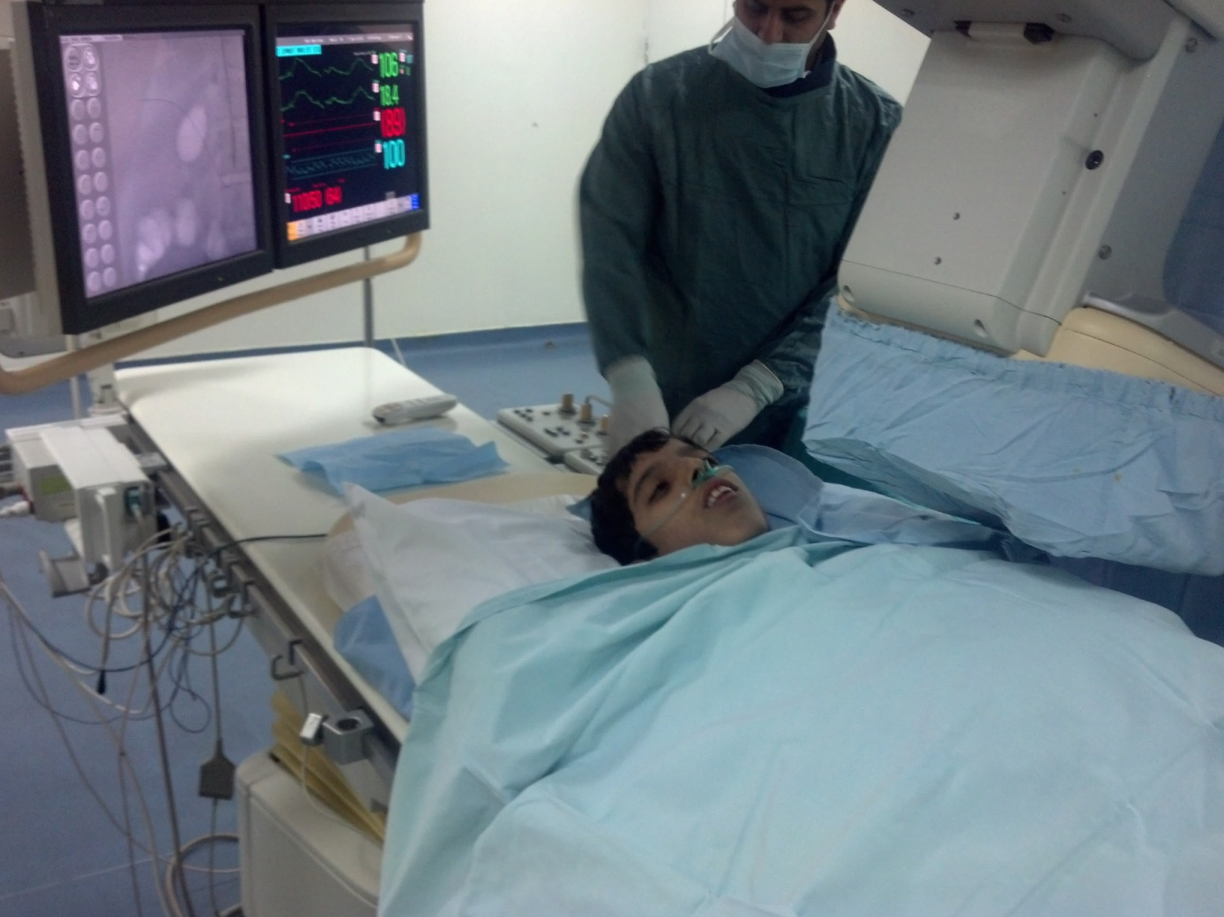

Slide 32


Slide 33
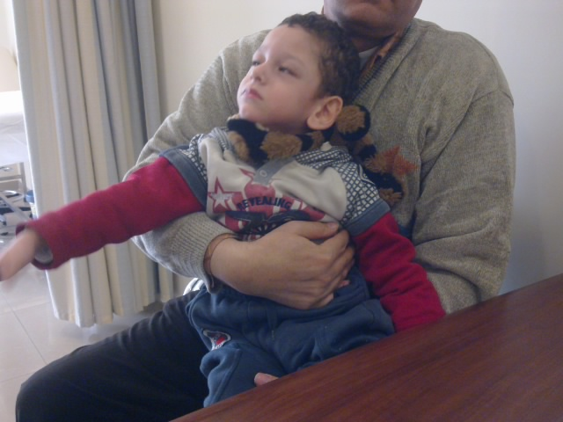

Slide 34
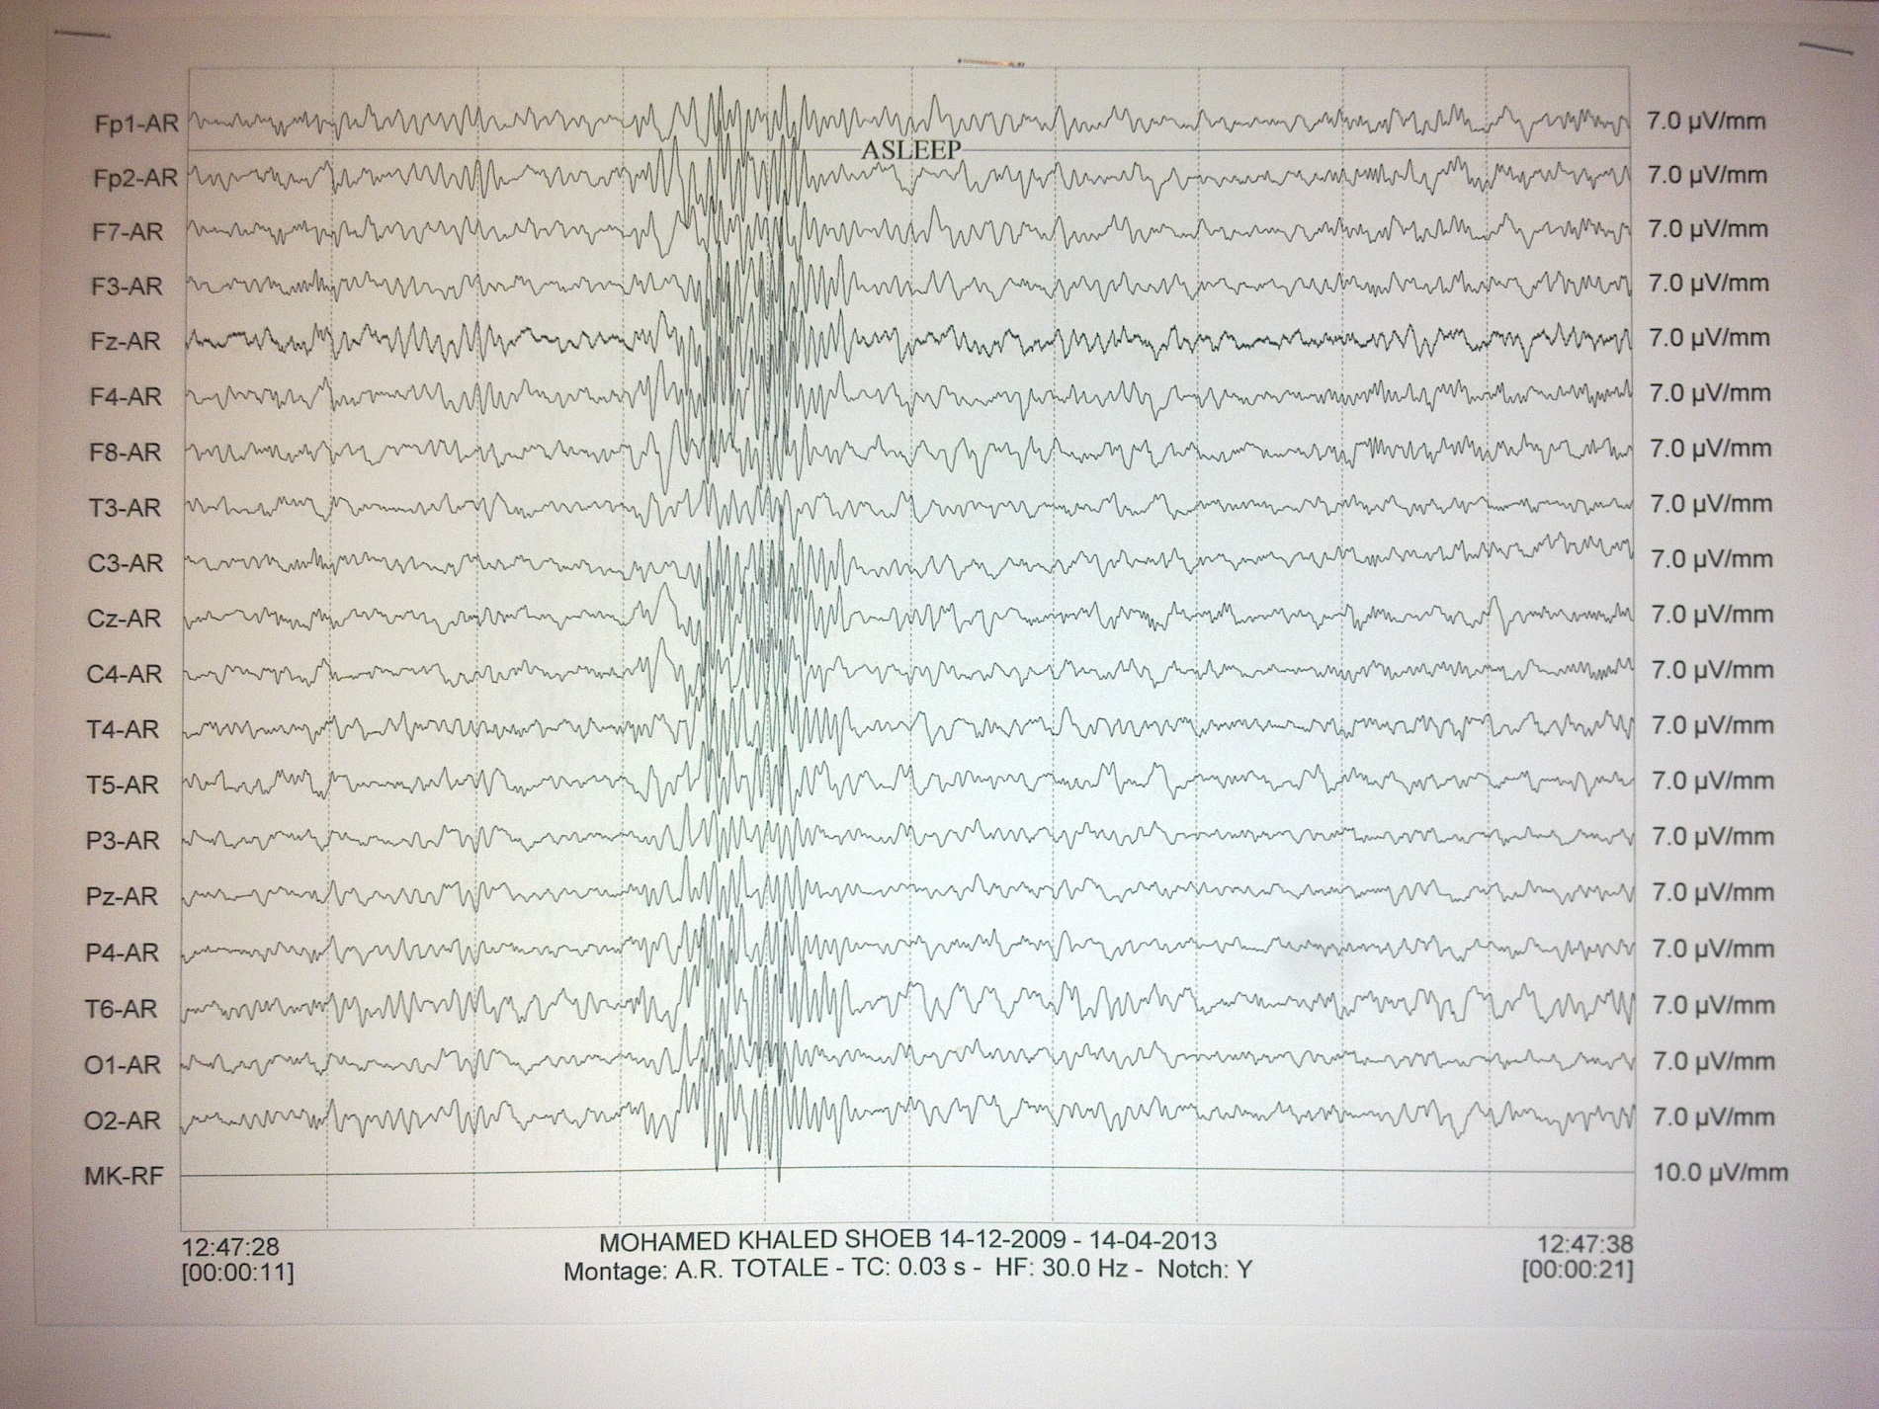

Slide 35
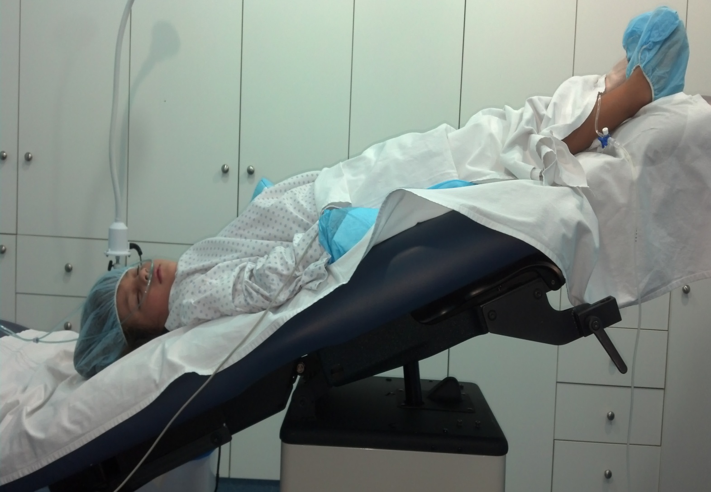

Slide 36
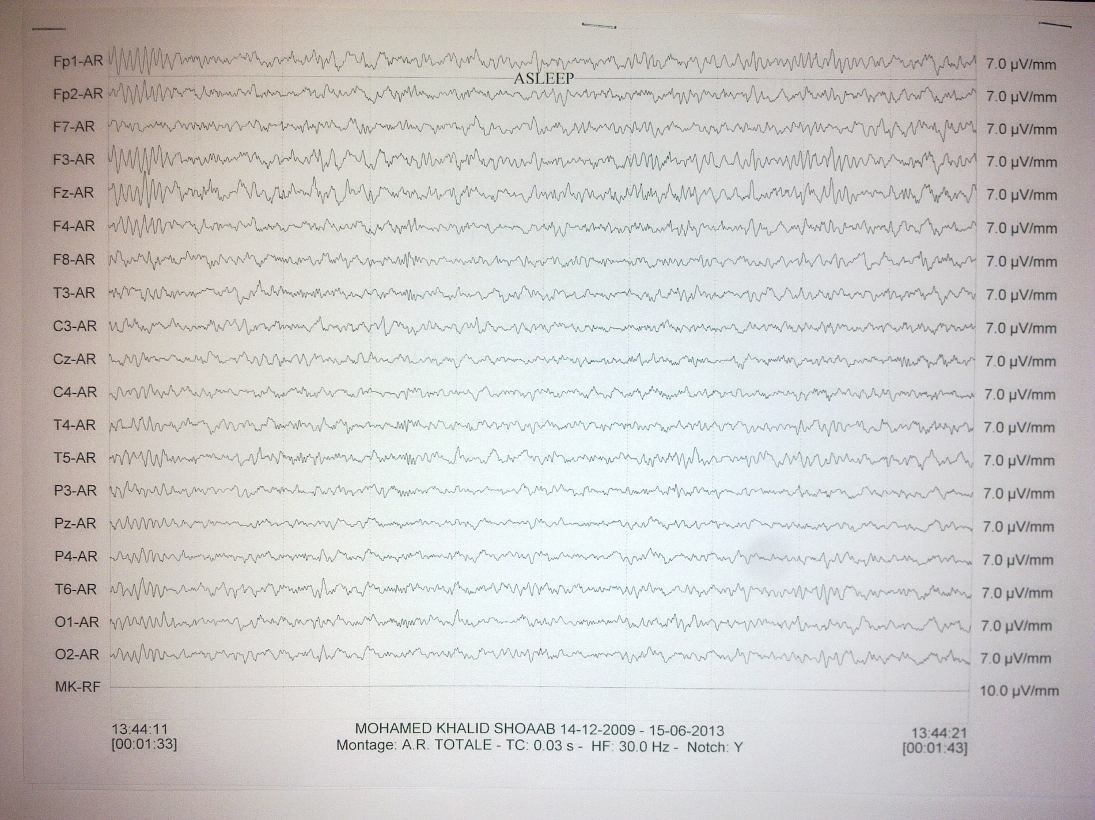

Slide 37
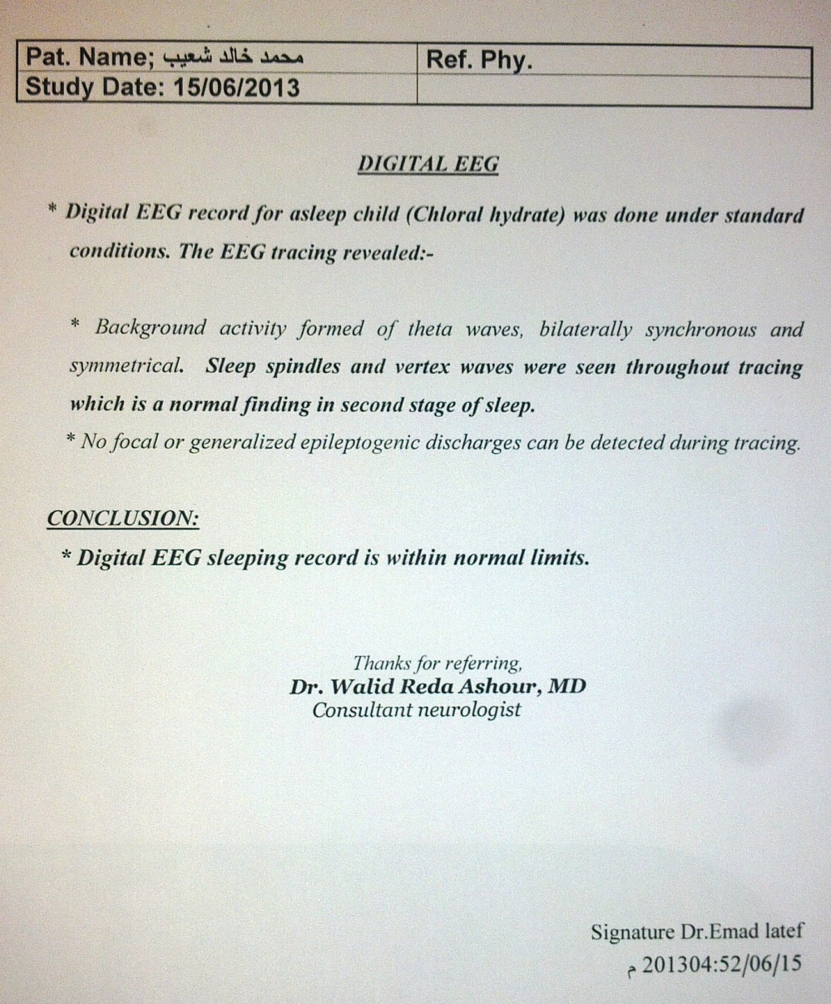
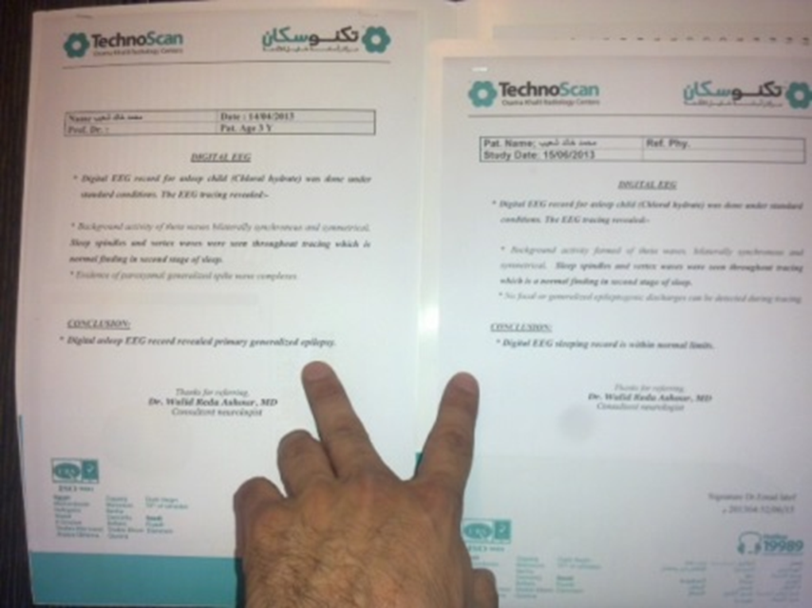

Slide 38
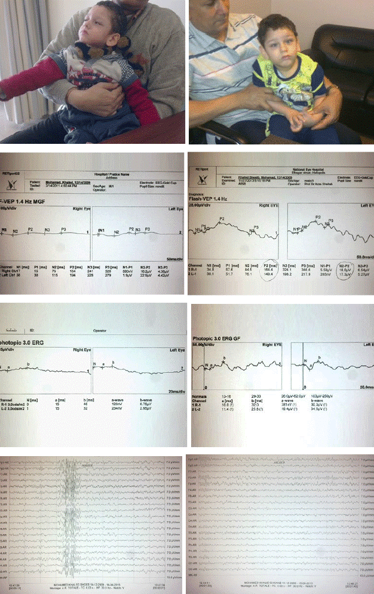

Slide 39
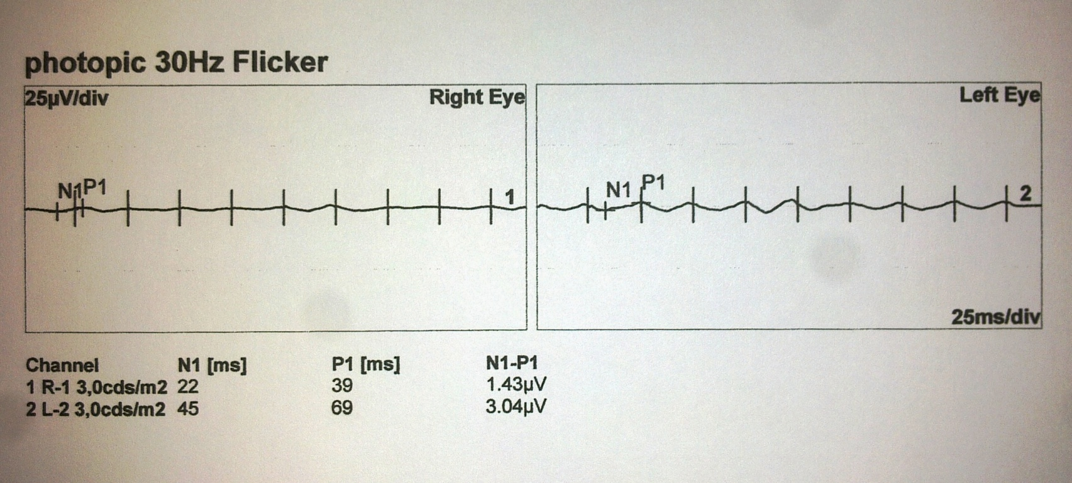
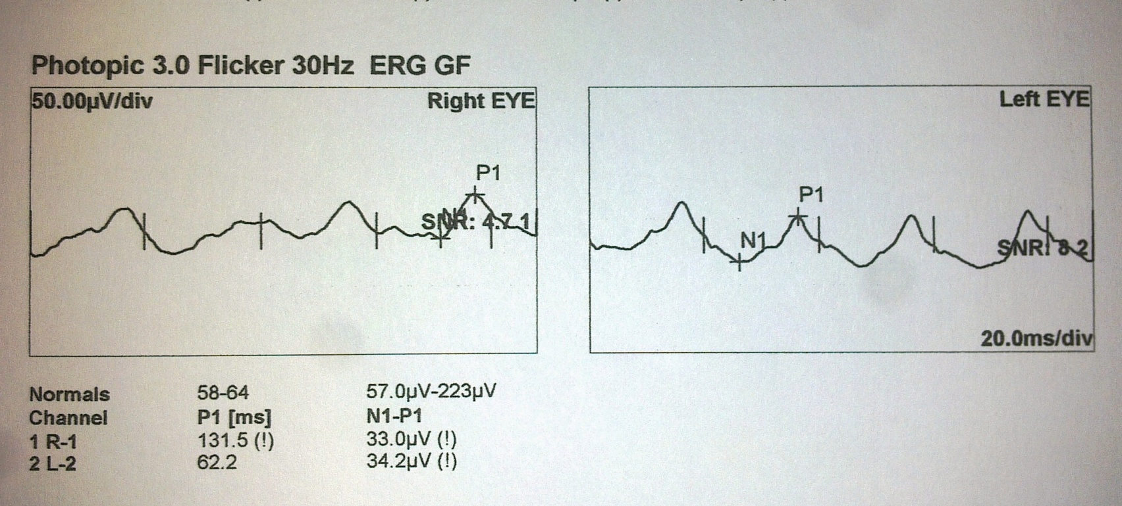

Slide 40
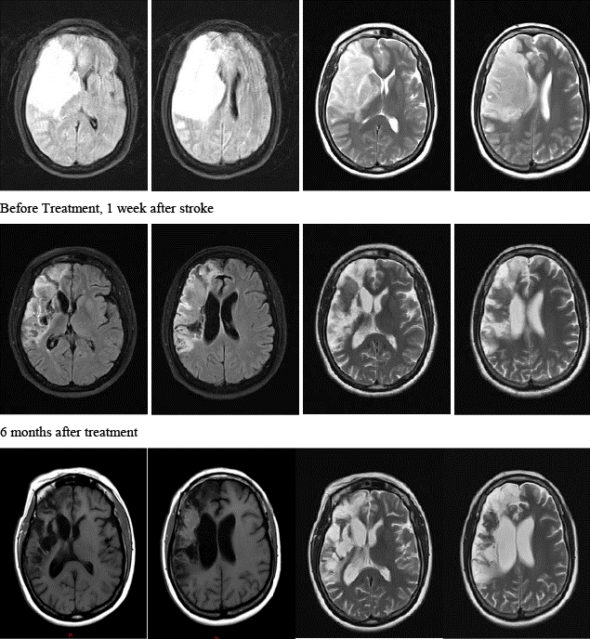

Slide 41
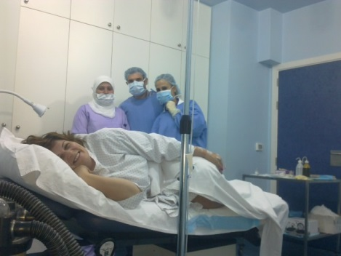
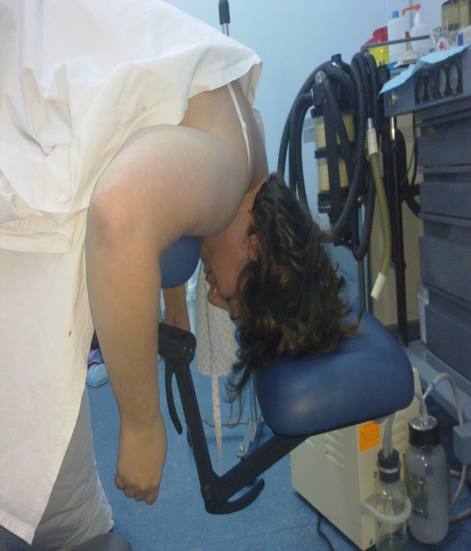

Slide 42
Regentime® procedure is equivalent to a final protocol, belonging to stem cells reengineering and application, with its high safety measures.
It approach the clinical therapy

Slide 43
.
Time is the golden factor for regeneration

