Slide 1












A DIFFERENT CLINICAL PERSPECTIVE FOR THE
DIAGNOSIS OF WHITE MATTER DISORDERS
MYELINATION DEFECTS
–
LEUKODYSTROPHIES
- LEUKOENCEPHALOPA- THIES
NASSER NADIM
Senior Pediatrician, Clalit Health Organization

Slide 2


A case report
❖ Mais was referred at the age of three months, due to
“Inability to control the movements of her head”
❖ maybe early to decide if it is abnormal?

Slide 3

case report cont..
Her physical examination at 5 months age showed:
A head was hanging down, and moved by gravity. Rapid eye oscillating movements -(nystagmus).
Her percentile showed that her head circumference had declined.

Slide 4
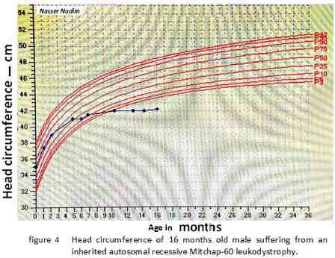
case report cont..
The Neuro-ophthalmologist wrote at sixteen months of age :
There is no cherry red spot,
No Dysmorfism,
No social smile,
Eyes did not follow an object,
Head circumference was 41 cm.,
Head-lag & axial hypotonia,
no bulbar signs.
Spastic paraplegia of limbs.
Deep tendon reflexes were alert”.

Slide 5



case report cont..
Genetic consultation:
No specific diagnosis. metabolic disease is suspected.

Slide 6
case report cont..
three major clinical markers are at our hands:
The uncontrolled head movements and head lag
nystagmus
BERA test revealed a sensori-neural deafness

Slide 7
case report cont..
In the coming months , the physical examination revealed:
Loss of sight,
failing to swallow and to thrive- PEG feeding
Chronic bronchitis dominated her coming visits.
To be continued

Slide 8

Conclusions from the case report
Primary infantile motor developmental delay or hypotonia is a serious sign,
A chaos of non-systematic, non-directive symptoms and signs

Slide 9



Goals
1- A NEW PERSPECTIVE for easy access to children with developmental retardation
2- The logic behind the chronology of
clinical symptoms of leukodystrophies.

Slide 10

MRI when and why

Slide 11
Quick diagnosis
Chips of DNA, CMA ?

Slide 12



The logic behind myelin disorders
LDs have gradual clinical course

Slide 13
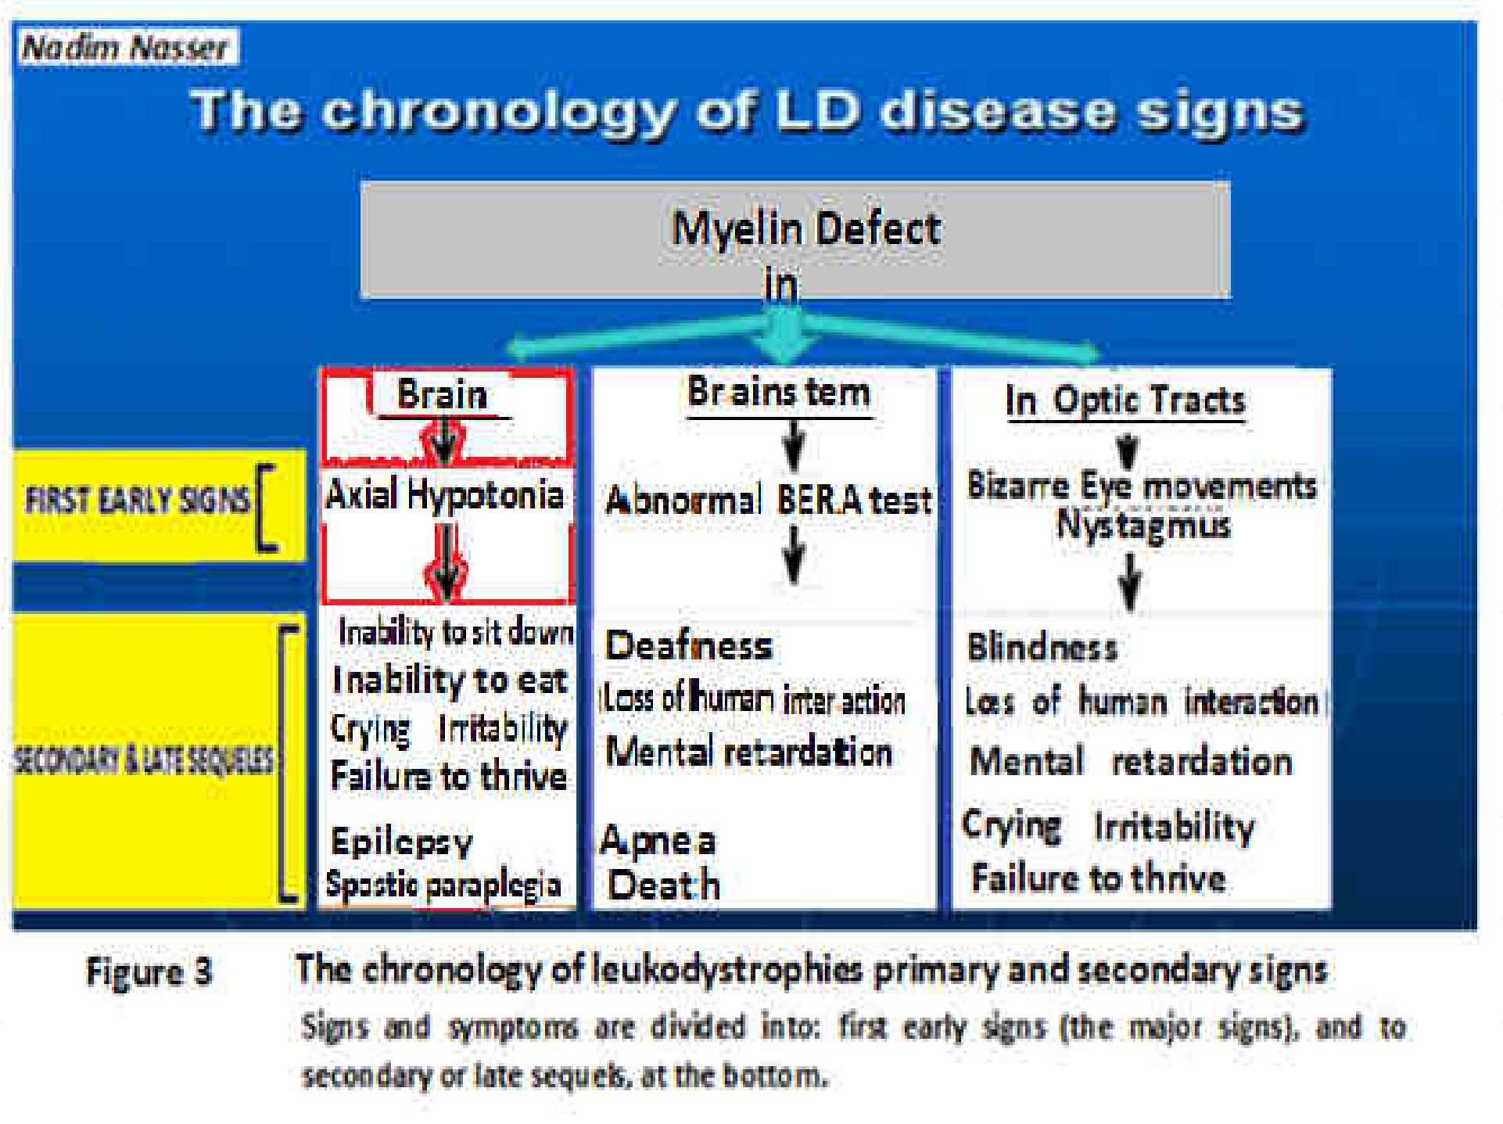

Slide 14
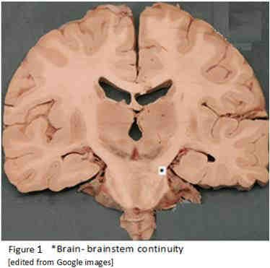
THE WIDE DISTRIBUTION OF WHITE MATTER IN THE CENTRAL NERVOUS SYSTEM

Slide 15
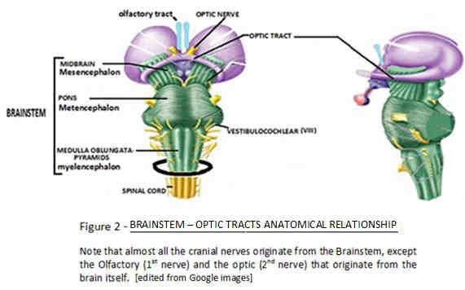

Slide 16
Has the infant a white matter disorder?

Slide 17
Figure1: A flowchart for the differential diagnosis of primary truncal hypotonia
An infant with primary
truncal hypotonia
2 1
Major signs:
Consult Ophthalmo- Neurologist
Check tendon reflexes
Tremor
Staccato speech
& order BERA Test
Nystagmus
Hyperreflexia
Normal
Areflexia
Abnormal BERA test
Minor signs:
Normal retina, decreased head circumference etc...
Investigate for other
Upper Neuron
injury
L.M.N. dis.:
metabolic dis.
Genetic consultation for: Spinal Muscular
*Gray matter
3
*White matter
Atrophy
Order
MRI & Genetic consultation: Leukodystrophy

Slide 18


case report cont..
MAIS
PRESENTED
MAJOR SIGNS:
TRUNCAL (AXIAL) HYPOTONIA,
NYSTAGMUS
ABNORMAL BRAINSTEM AUDIOMETRY
LATER:
SOCIAL DEPRIVATION
IRRITABILITY, FTT…

Slide 19


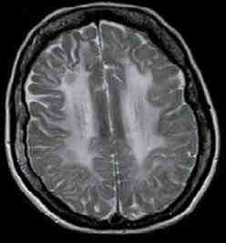
case report cont.. MRI results
the brain MRI was
done at 13 months old

Slide 20


Case report cont..
Mais has a leuko-dystrophy:
The mutation is D29G (by Magen Daniella group).
Name of disease: "Mitchap-60" leukodystrophy
All the patients who had this disease presented the three major signs!

Slide 21


Apples that fell into my lap
HEAD LAG nystagmus Abnormal BERA test
HEAG-LAG
NYSTAGMUS
ABNORMAL BERA TEST

Slide 22



The new perspective - THE TRIAD
Those three apples actually are the three major signs of the MAIS-NADIM NASSER TRIAD.
They originate from three different brain structures:
sub-cortex
Optic tracts
& Brainstem
✓ They are the most frequent features in all our group of patients.

Slide 23
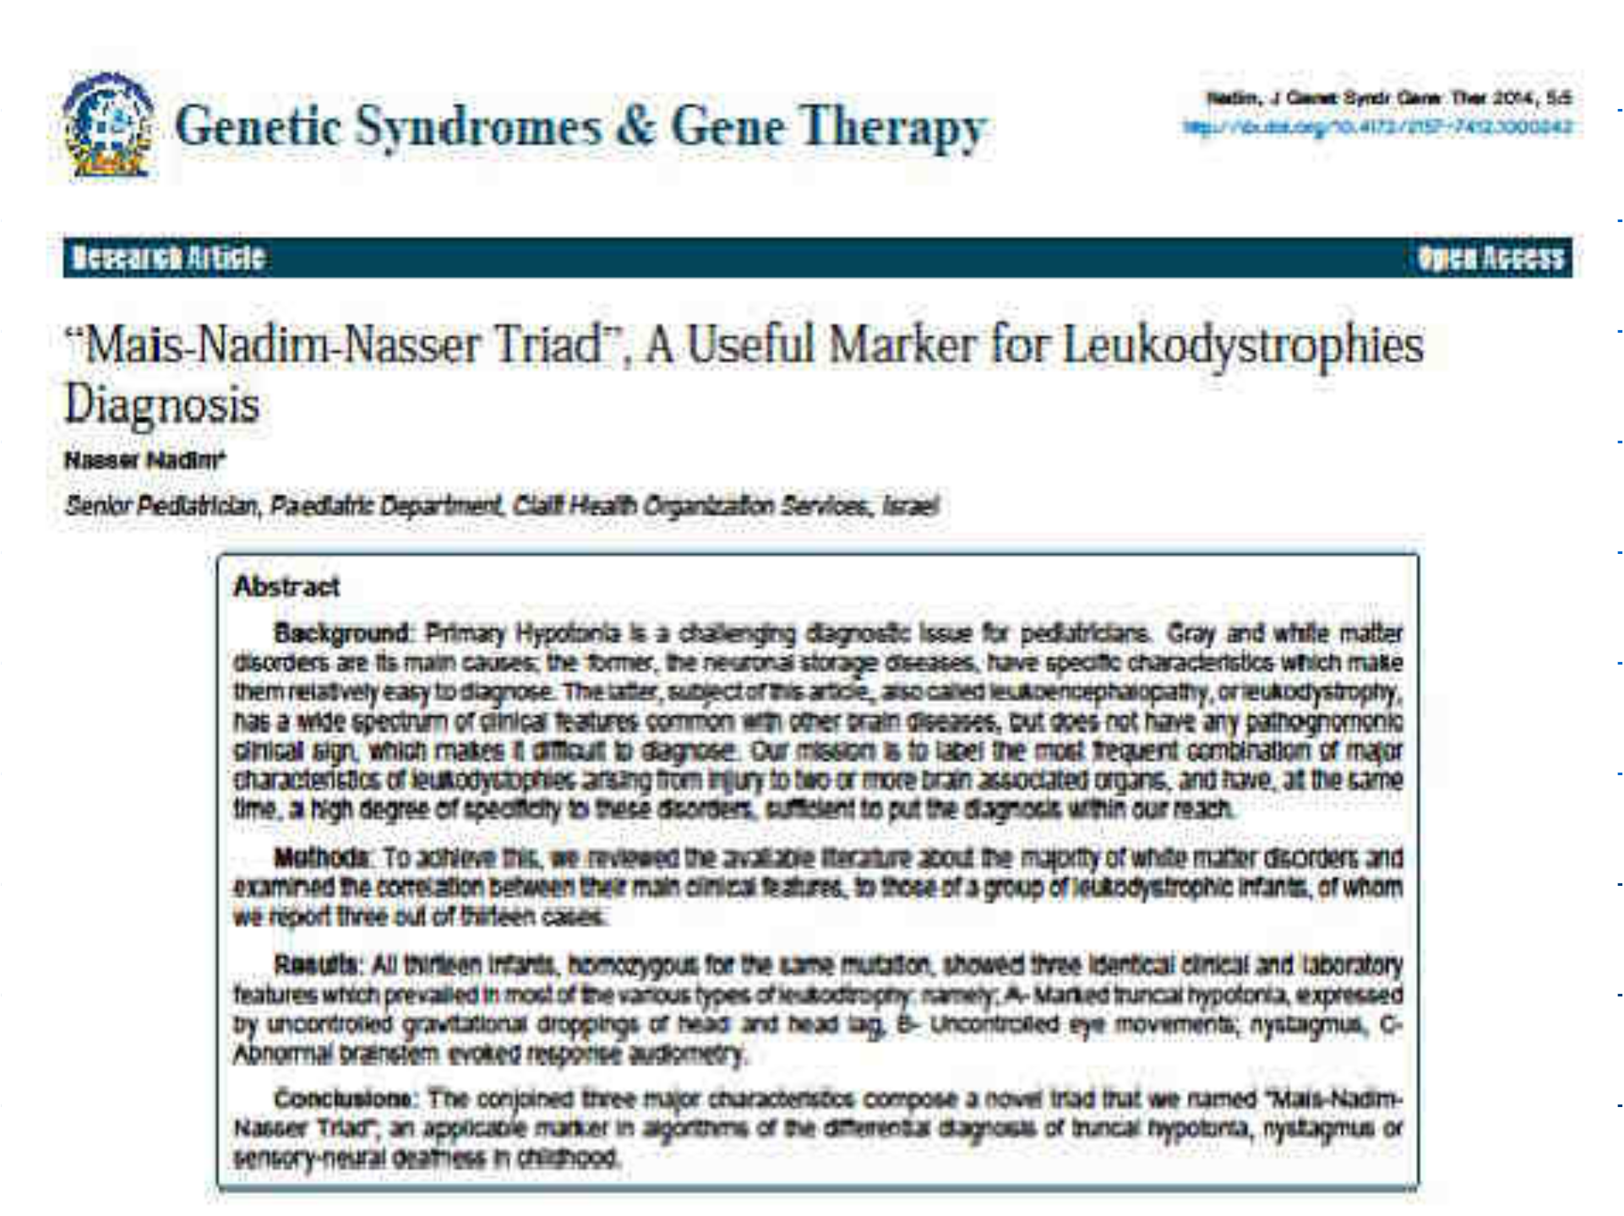









Primary Hypotonia

Slide 24
Buddha (500 B.C.)
I never see what has been done;
I only see what remains to be done.

