Slide 1
Dietary Fat, Serum Cholesterol and Cardiovascular Disease
By
Dr Nas Al-Jafari
Family Medicine Consultant

Slide 2
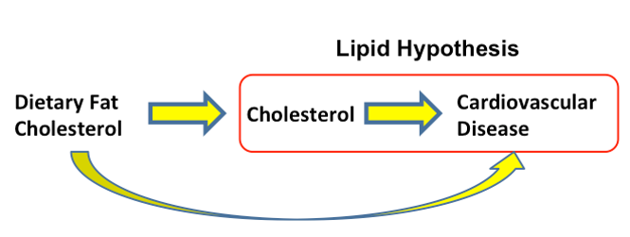
Diet-Heart Hypothesis

Slide 3
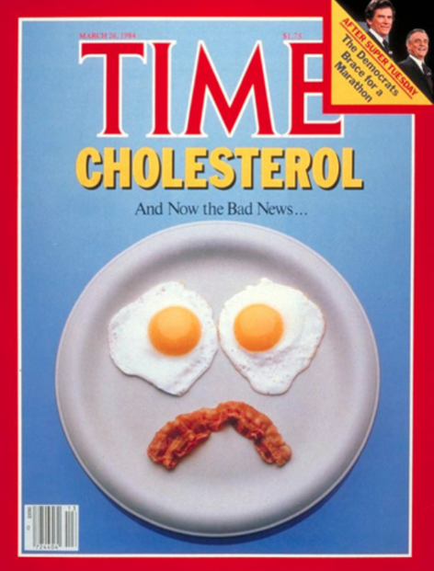
1984

Slide 4
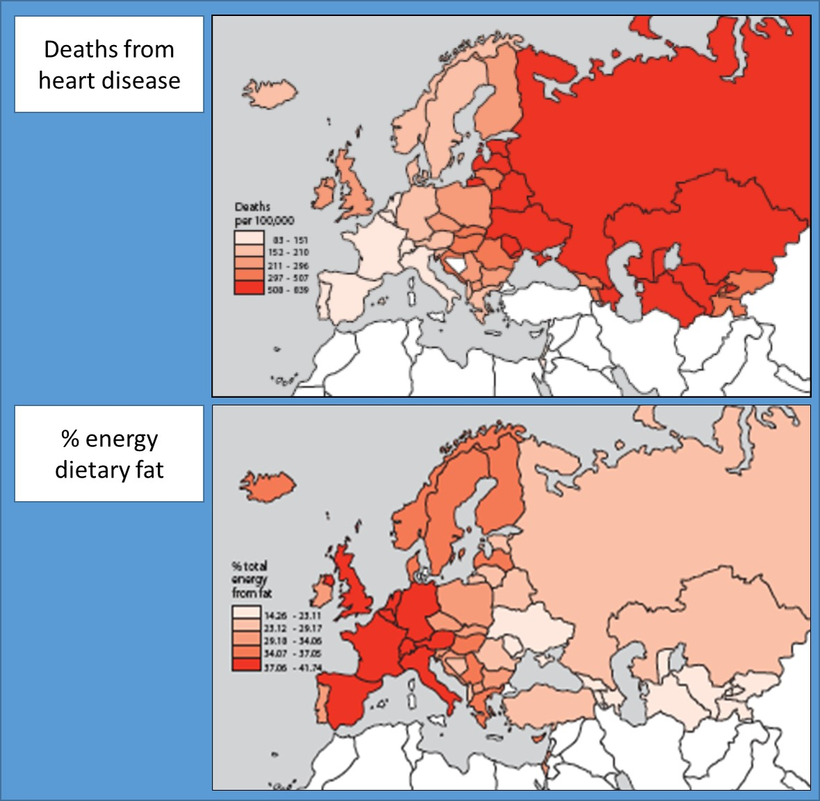
European Cardiovascular Disease Statistics 2008 edition. Allenadar S et al

Slide 5
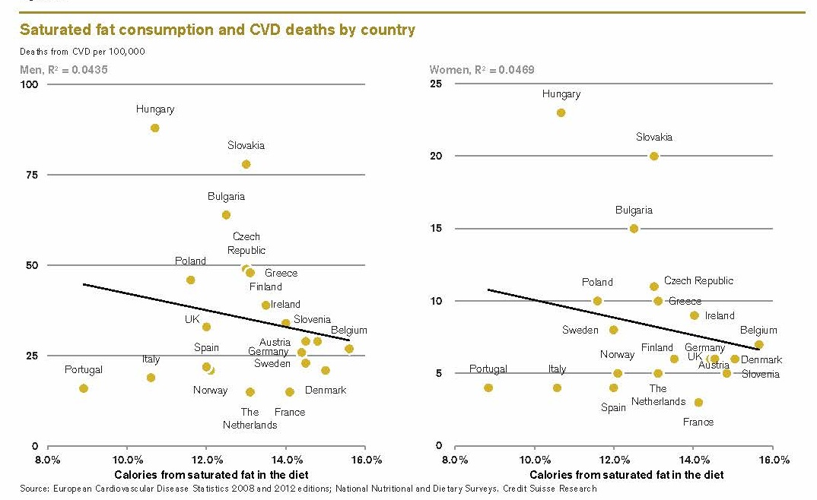

Slide 6
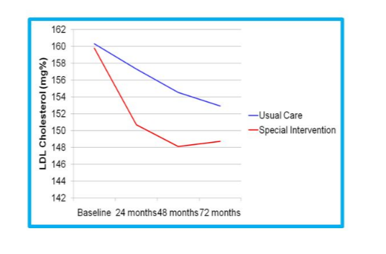
MRFIT
The MRFIT trial evaluated 12,866 high-risk middle-aged men who were randomly assigned either to a special intervention program consisting of stepped-care treatment for high blood pressure, counseling for cigarette smoking, and dietary advice for lowering blood cholesterol levels, or to their usual sources of health care in the community. LDL-C was significantly lowered in the special intervention group compared to the “usual care” group. However, during a follow-up of seven years there were no significant difference in total death rates between the groups and no differences in the number of deaths from heart disease.
Multiple risk factor intervention trial. Risk factor changes and mortality results. Multiple Risk Factor Intervention Trial Research Group. JAMA 1982 Sep 24;248(12):1465-77

Slide 7
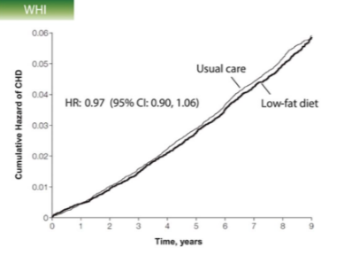
Women’s Health Initiative (WHI)
The largest controlled intervention trial on diet and heart disease to date, the Women’s Health Initiative randomly assigned more than 48 thousand women, 50 – 79 years old, to a low-fat intervention or a comparison group. LDL-C was significantly lowered in the intervention group compared to the comparison group. Nonetheless, after six years of follow-up there were no differences between the groups in the incidence of coronary heart disease and stroke.
Low-fat dietary pattern and risk of cardiovascular disease: the Women's Health Initiative Randomized Controlled Dietary Modification Trial. JAMA. 2006 Feb 8;295(6):655-66.

Slide 8

Conclusions
The results of these two large trials strongly indicate that lifestyle measures aimed at lowering LDL-C do not improve survival or reduce mortality from coronary heart disease.

Slide 9
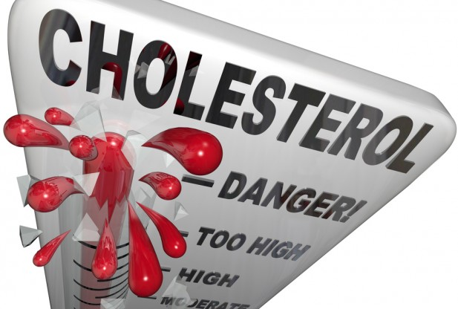
Cholesterol: Surrogate Marker for CVD?
A reduction in saturated fats is recommended to reduce cholesterol levels, and carbohydrates are placed at the bottom of the food pyramid, mainly because they tend to lower cholesterol levels. Public health authorities have recommended that 60 percent of daily calories should come from carbohydrates.

Slide 10
Prospective Urban Rural Epidemiological (PURE) study
The habitual food intake of 145,275 participants in 19 high, middle and low-income countries.
Higher carbohydrate intake was associated with lower TC and LDL-C but also with lower HDL-C and ApoA levels, leading to higher TC/HDL-C and ApoB/ApoA ratios and higher TGs.
A higher intake of SFAs was associated with higher LDL-C and lower TG levels. Higher MUFA intake was associated with lower TC, LDL-C, and higher ApoA. Higher PUFA intake was associated with lower TC and LDL-C and paradoxically higher ApoB level.
Iso-caloric replacements of carbohydrates with SFAs increased TC by 3%, LDL-C by 5% and HDL-C by 1% and decreased TG by 5%. Replacement of carbohydrates with MUFA led to a 2% decrease in LDL-C, 3% decrease in TC/HDL-C ratio, and 1% decrease in ApoB/ApoA ratio. Replacing carbohydrates with PUFAs was associated with little change in lipid markers.
The authors concluded that higher carbohydrate intake has the most adverse impact on lipid profiles and replacing it with saturated fat improved HDL-C and TG and replacing it with MUFAs improved TC/HDL-C and ApoB/ApoA.
The Prospective Urban Rural Epidemiology (PURE) study: examining the impact of societal influences on chronic non-communicable diseases in low-, middle-, and high-income countries. Teo K et Al. Am Heart J. 2009 Jul;158(1):1-7.e1. doi: 10.1016/j.ahj.2009.04.019.

Slide 11
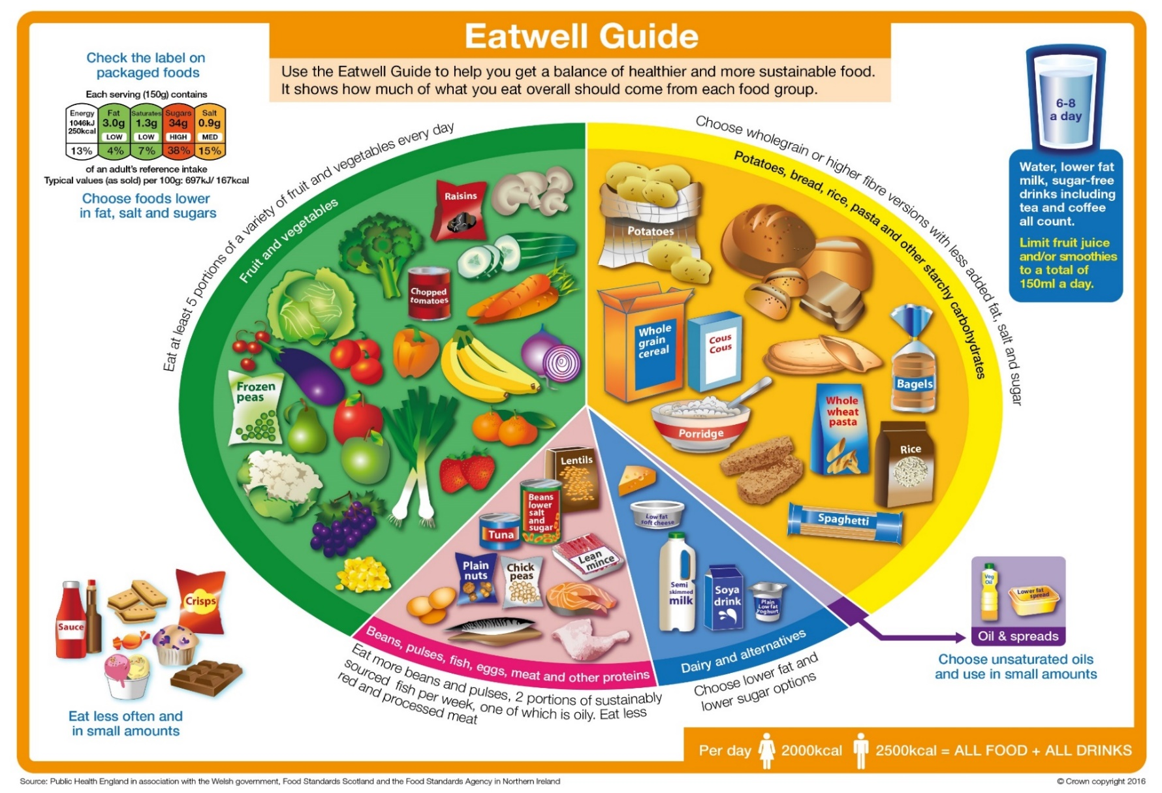

Slide 12

US Academy of Nutrition and Dietetics

Slide 13
Is High Cholesterol an Issue?

Slide 14
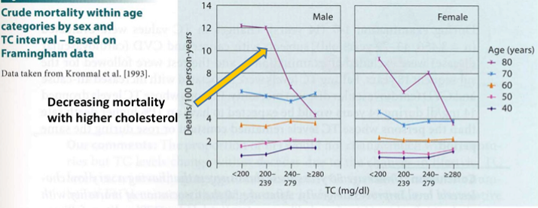
Cholesterol and Age
Total Serum Cholesterol levels and mortality risk as a function of age. A report based on the Framingham Data. Arch Intern Med. 1993 May 10; 153(9): 1065-73 Kronmal RA

Slide 15
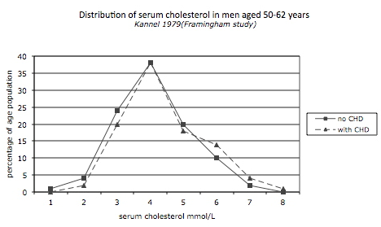
J-Shaped Curve
The studies a correlation between cholesterol levels and overall death rate in young and middle-aged people but not among the elderly. However, the mortality curve appears J-shaped which means that those with the lowest cholesterol levels have increased mortality.
When it comes to total mortality, some data indicate that optimal levels of serum cholesterol may be between 210 and 230 mg/dl (5.4 and 5.9 mmol/l).
Although high LDL-C may be associated with increased risk of heart disease, low levels are associated with increased risk of death. Among elderly individuals there appears to be an inverse relationship between cholesterol levels and mortality, indicating that high cholesterol levels are protective or reflect better health.
Cholesterol and mortality. 30 years of follow-up from the Framingham study. JAMA. 1987 Apr 24;257(16):2176-80. Anderson KM, Castelli WP, Levy D.

Slide 16
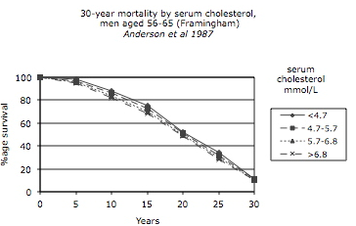
Framingham Data
If we look at the survival curves. As we might expect only 10% of men aged 50–65 surveyed for 30 years. However the important thing is that the blood levels of cholesterol had no influence whatsoever on survival.
Cholesterol and mortality. 30 years of follow-up from the Framingham study. JAMA. 1987 Apr 24;257(16):2176-80. Anderson KM, Castelli WP, Levy D.

Slide 17
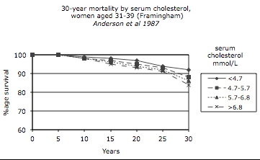
Are women the same as men?
A Norwegian study found an inverse relationship between cholesterol levels and mortality among women, for whom (according to the authors) moderately elevated cholesterol (by current standards) may prove to be not only harmless but even beneficial.
Furthermore, the relationship between cholesterol levels and disease may be different for men and women
National Cholesterol Education Program (NCEP) Expert Panel on Detection, Evaluation, and Treatment of High Blood Cholesterol in Adults (Adult Treatment Panel III). Expert Panel on Detection, Evaluation, and Treatment of High Blood Cholesterol in Adults. JAMA. 2001;285(19):2486-2497. doi:10.1001/jama.285.19.2486

Slide 18
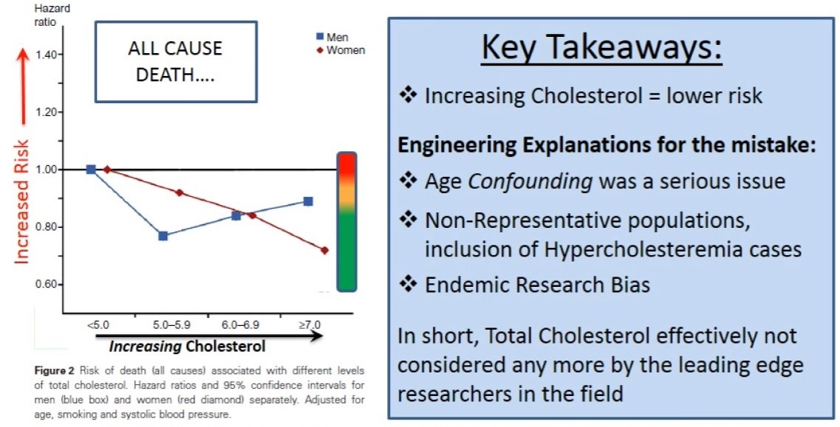
Total Cholesterol as a predictive Factor?
Is the use of cholesterol in mortality risk algorithms in clinical guidelines valid? Ten years prospective data from the Norwegian HUNT 2 study (>58,000 participants). Halfdan Petursson MD, Johann A. Sigurdsson MD

Slide 19
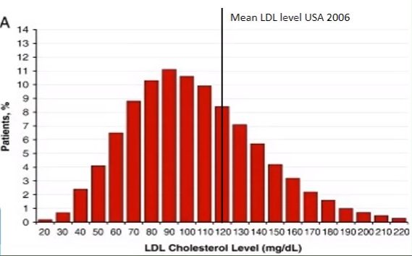
LDL as a predictor of CV Events
- Of 231,986 hospitalizations from 541 hospitals, admission lipid levels were documented in 136.95 (59.0%)
- Mean LDL levels were 104.9mg/dl (LDL 2.6mmol/l)
Am Heart J 2009; 157: 111-7.e2

Slide 20
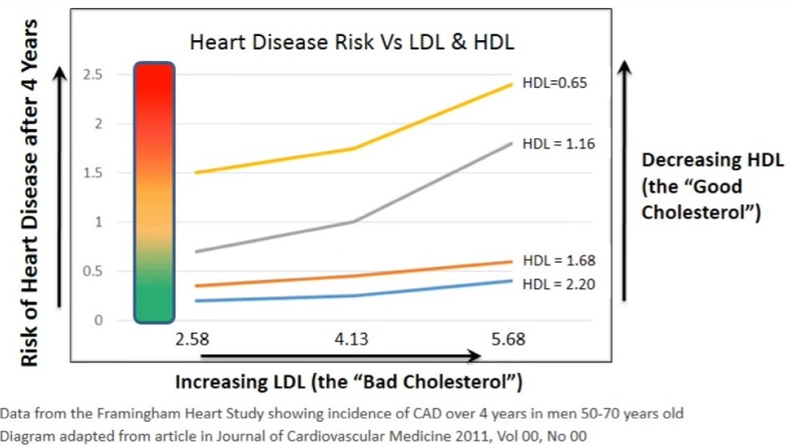
LDL/HDL Ratio

Slide 21
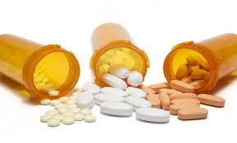
STATINS

Slide 22
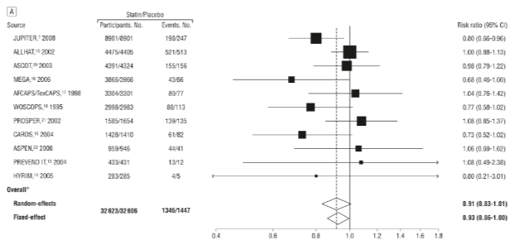
Statins in Primary Prevention
Approximately 65 thousand patients were included in the primary prevention trials, 65 percent were men and 35 percent were women. Taken together, all-cause mortality rate was 11.4 per one thousand person years among people on placebo and 10.7 per one thousand patient years on people on statins. This difference is not statistically significant. Furthermore, there was no relationship between the amount of reduction of LDL-cholesterol and all-cause mortality
This literature-based meta-analysis did not find evidence for the benefit of statin therapy on all-cause mortality in a high-risk primary prevention set-up.
Statins and all-cause mortality in high-risk primary prevention: a meta-analysis of 11 randomized controlled trials involving 65,229 participants.
Arch Intern Med. 2010 Jun 28;170(12):1024-31. doi: 10.1001/archinternmed.2010.182.

Slide 23

Everyone over 40 yrs should be on Statins?
Statin Drugs Given for 5 Years for Heart Disease Prevention (Without Known Heart Disease)
www.thennt.com

Slide 24
The Lancet
Among relatively low risk individuals, it has been estimated that for every 1 mmol/L reduction in LDL-cholesterol there is an absolute reduction in major vascular events of about 11 per 1000 over 5 years.
What does this really mean?
Let’s say that I am a low risk patient and my LDL-cholesterol is 143 mg/dl ( 3.7 mmol/L ).
My LDL-C goes down to 104 mg/dl (2.7 mmol/L) while I’m taking the drug. This treatment is going to make it one percent less likely for me to have a coronary event or a stroke during those five years, compared to if I do not take the drug. Not very impressive indeed.
One has to wonder whether this proposed benefit outweighs the risk of treatment. If there is doubt, we should not treat.
Primum non nocere; first do no harm
The effects of lowering LDL cholesterol with statin therapy in people at low risk of vascular disease: meta-analysis of individual data from 27 randomised trials. The Lancet 17 May 2012

Slide 25
Statin targets: Conflict of interest?
“When the National Cholesterol Education Program lowered the optimal cholesterol levels in 2004, eight of the nine people on the panel had financial ties to the pharmaceutical industry, most of them to the manufacturers of cholesterol-lowering drugs who would subsequently reap immediate benefits from these same recommendations”
The Great Cholesterol Myth By Jonny Bowden, Stephen Sinatra, Deirdre Rawlings

Slide 26
Several studies have addressed the efficacy of statin drugs compared with placebo among patients with documented cardiovascular disease.
The three largest trials:
- 4S (Scandinavian Simvastatin Survival Study),
- LIPID (Long-Term Intervention with Pravastatin in Ischemic heart Disease study)
- HPS (Heart Protection Study)
All-cause mortality was significantly lower among patients receiving statin therapy compared with placebo. The absolute reduction in all-cause mortality was 4 percent, 3.1 percent and 1.8 percent in the three trials respectively.
Secondly, however, it has not been proven that statin drugs reduce mortality among healthy people with increased risk of heart disease - except for
- Individuals with diabetes
- Familial hypercholesterolemia
Efficacy of cholesterol-lowering therapy in 18,686 people with diabetes in 14 randomised trials of statins: a meta-analysis. The Lancet 2008, 371(9607):117-125

Slide 27

NNT for Secondary prevention
Statins given for 5 years for Heart Disease Prevention (People with known Heart Disease)
www.thennt.com

Slide 28
Improve-It
Further lowering of LDL cholesterol by adding ezetimibe to statin therapy in patients with coronary artery disease will improve outcome. A total of 18,144 high-risk patients. The average LDL cholesterol at baseline was 95 mg/dL (2.5 mmol/L)
Composite endpoint of cardiovascular death, nonfatal myocardial infarction, rehospitalization for unstable angina, coronary revascularization, or stroke.
Primary endpoint events occurred in 34.7% of the control group versus 32.7% of the treatment group. (2% absolute risk reduction). This means that 50 patients would need to be treated for seven years to prevent one event.
There was no difference between the groups in overall death rate, or death rate from cardiovascular disease, As expected, LDL cholesterol was significantly lowered in the treatment arm; median levels were 69.9 mg/dL (1.8 mmol/L) in the control group versus 53.2 mg/dL (1.4 mmol/L) in the treatment group.
High risk group, the lowering of LDL cholesterol did not significantly affect mortality.
98 percent of the patients didn’t benefit from treatment.
Ezetimibe Added to Statin Therapy after Acute Coronary Syndromes. Christopher P et al. N Engl J Med 2015; 372:2387-2397

Slide 29
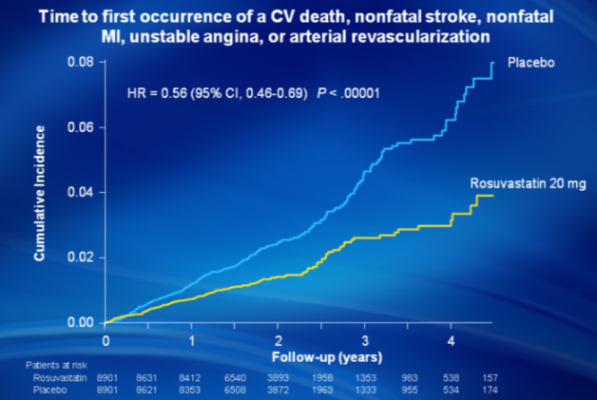
The Jupiter Trial
The Jupiter trial suggested that treatment with statins may have beneficial effects among people with relatively low levels of LDL cholesterol. The individuals who participated in this trial all had elevated levels of hs-CRP which is a marker of inflammation.
Rosuvastatin to Prevent Vascular Events in Men and Women with Elevated C-Reactive Protein
Paul M Ridker et al N Engl J Med 2008; 359:2195-2207

Slide 30
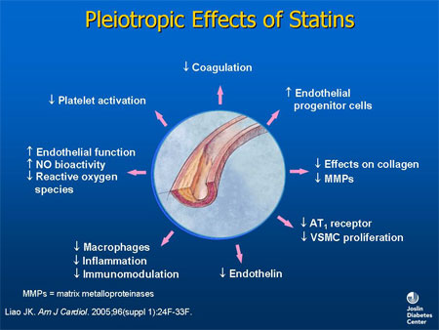
Pleiotropic Effects
Statins are potent inhibitors of cholesterol biosynthesis. However, the overall benefits observed with statins appear to be greater than what might be expected from changes in lipid levels alone, suggesting effects beyond cholesterol lowering.
Recent studies indicate that some of the cholesterol-independent or “pleiotropic” effects of statins involve improving endothelial function, enhancing the stability of atherosclerotic plaques, decreasing oxidative stress and inflammation, and inhibiting blood clotting mechanisms.
Pleiotropic effects of statins. Annu Rev Pharmacol Toxicol 2005;45:89-118.
Liao JK, Laufs U

Slide 31
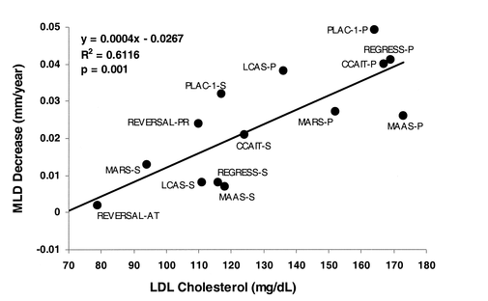
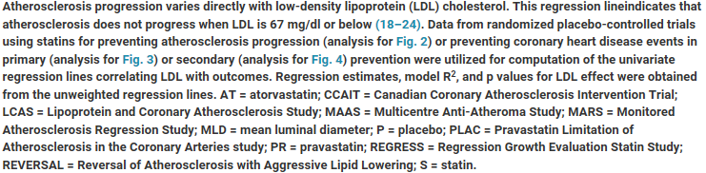
Threshold for Atherosclerosis
Randomized trial data suggest atherosclerosis progression and coronary heart disease events are minimized when LDL is lowered to <70 mg/dl (1.8 mmol/L). No major safety concerns have surfaced in studies that lowered LDL to the range of 50 to 70 mg/dl.
Optimal low-density lipoprotein is 50 to 70 mg/dl. Lower is better and physiologically normal.
J O'Keefe. Journal of the American College of Cardiology. Volume 43, Issue 11, June 2004

Slide 32
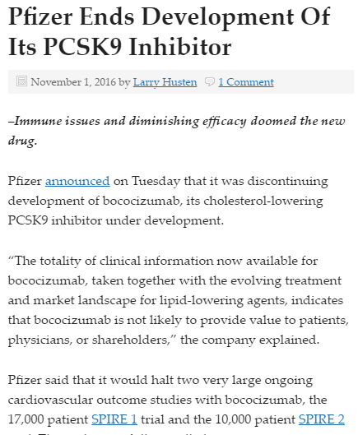
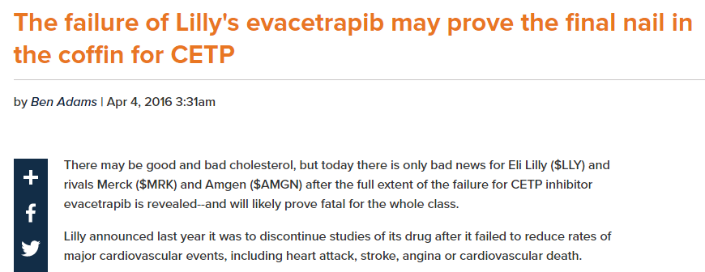
PCSK9 Inhibitors
Heart attacks have been shown to be uncommon in humans with very low plasma levels of LDL cholesterol due to a sequence variation in the PCSK9 gene.

Slide 33
FOURIER Trial
Evolocumab (Repatha) reduced the primary and secondary composite end points by 15% and 20% respectively. However, the absolute risk reduction was modest, at 1.5% for both. The authors estimate that 74 patients would need to be treated with evolocumab for 2 years to prevent one cardiovascular death, myocardial infarction or stroke.
Evolocumab did not reduce cardiovascular death rate or death from any cause.
The benefits of evolocumab were restricted to the reduction of the risk of stroke by 0.4%, myocardial infarction by 1.2%, and coronary revascularization by 1.5%
Evolocumab and Clinical Outcomes in Patients with Cardiovascular Disease. Marc S. Sabatine et al. March 17, 2017DOI: 10.1056/NEJMoa1615664

Slide 34
Cost-Benefit
Evolocumab is estimated to cost approximately $14,350 per patient for a one-year supply in the United States, or approximately $1200 per month.
The estimated cost of treating 74 patients (the number needed to treat (NNT)) for two years with evolocumab is $2,123,800. That would be the cost of preventing one event (cardiovascular death, myocardial infarction or stroke) over a period of two years.
Does anybody doubt that the juice ain’t worth the squeeze?

Slide 35

THANK YOU

