Slide 2
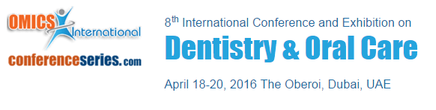

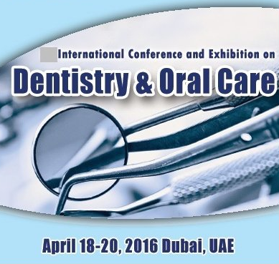
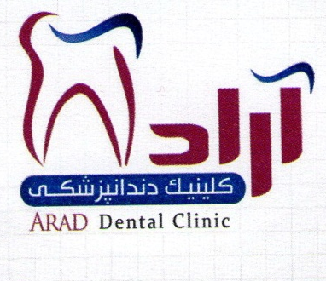
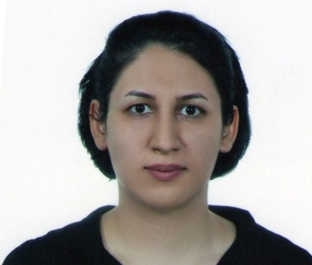
The supportive oral measures preceding radiation therapy in patients diagnosed with nasopharyngeal carcinoma
Narges Mirjalili

Slide 3



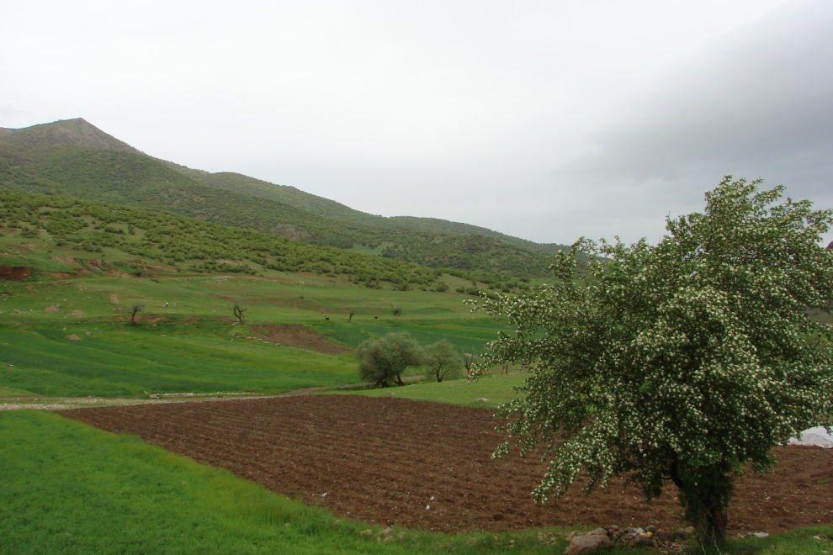




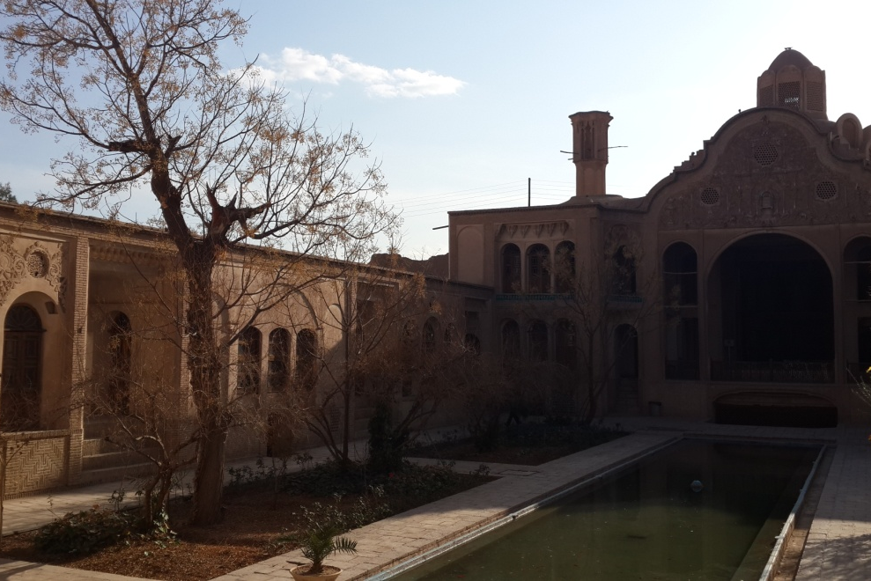


Slide 4
How this lecture is organized
1-3
The significant role of oral care givers among patients with nasopharyngeal carcinoma
Why we need simple and cheap preventive oral cares
4-6
Reviewing the most prominent adverse effects of head and neck radiation therapy
Brief overview of effective preventive measures
7
Going through a short list of relatively cost-effective preventive measures
Reminding their positive influence

Slide 5
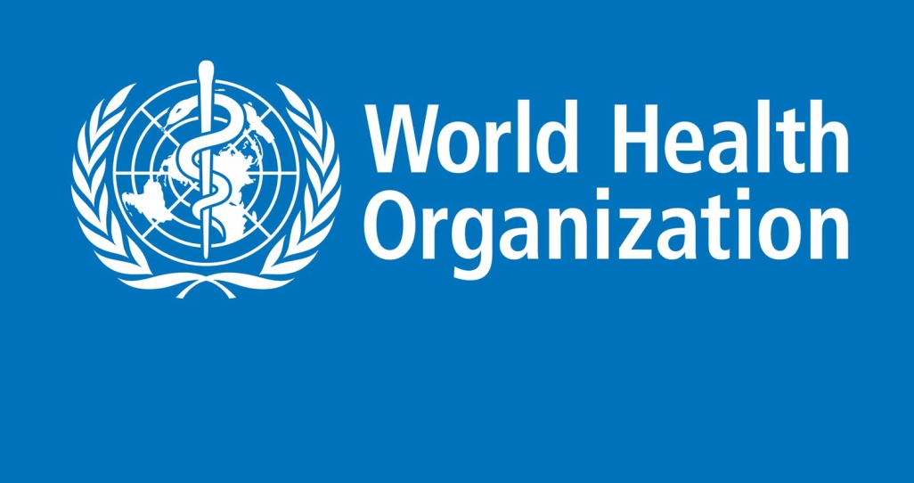

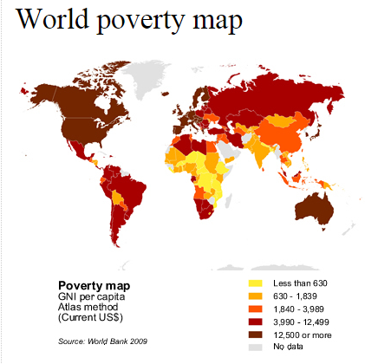

Epidemiology
The number of new cases is expected to rise by about 70% over the next 2 decades. (Report on 2012)
More than 60% of world’s total new annual cases occur in Africa, Asia and Central and South America.
These regions account for 70% of the world’s cancer deaths.
NPC represents about 0.7% of the global cancer burden
Notes:
So, we have a reasonably high chance of having patients who has undergone radiation therapy involving head and neck region. The most notable example is NPC

Slide 6
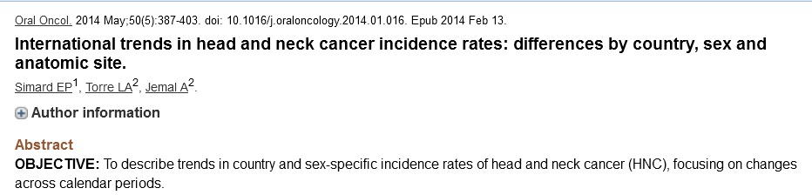
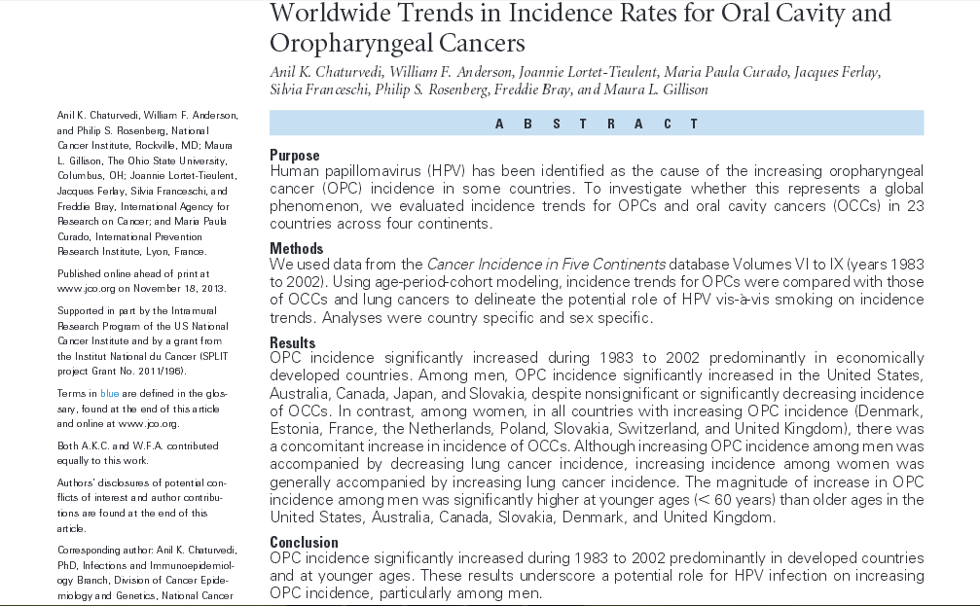

HPV
NPC
Notes:
Systematic reviews – 2013 , 2014.

Slide 7
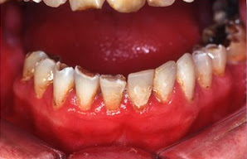
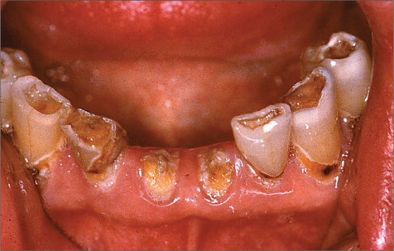
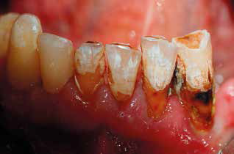
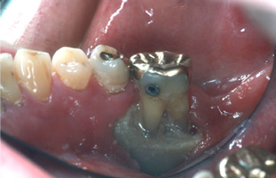
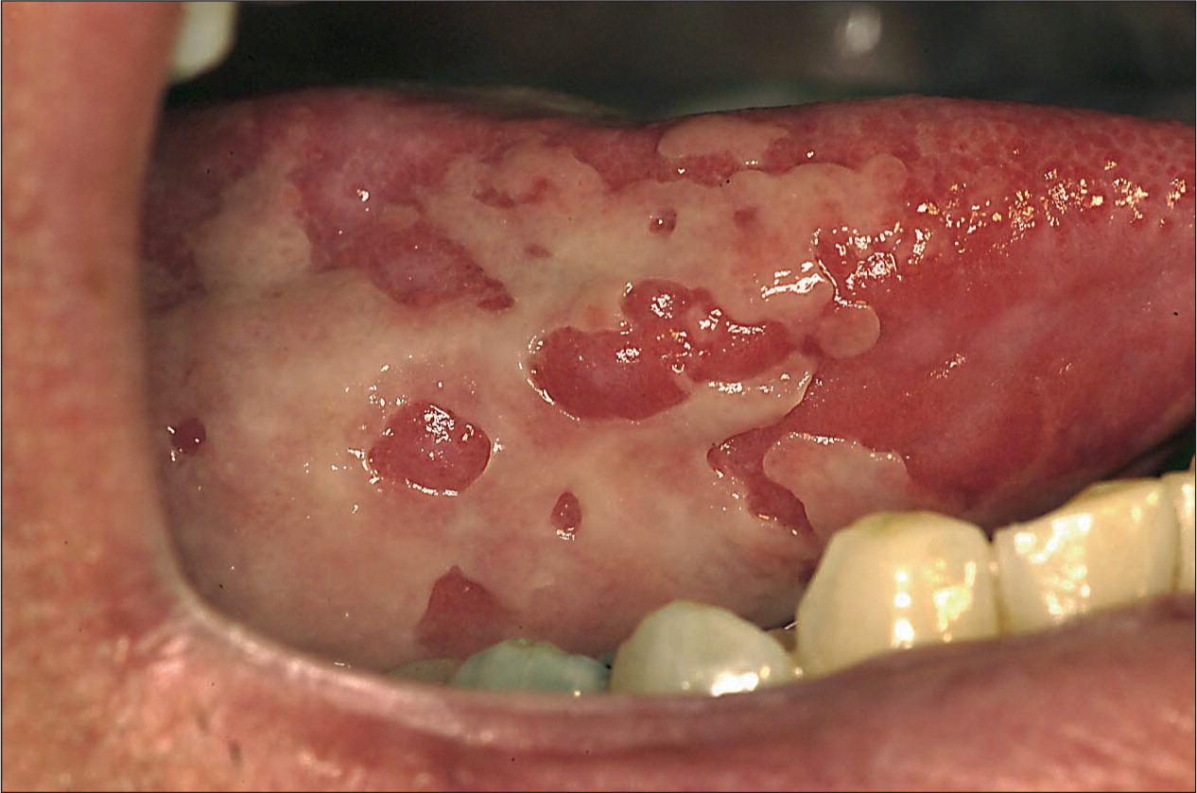
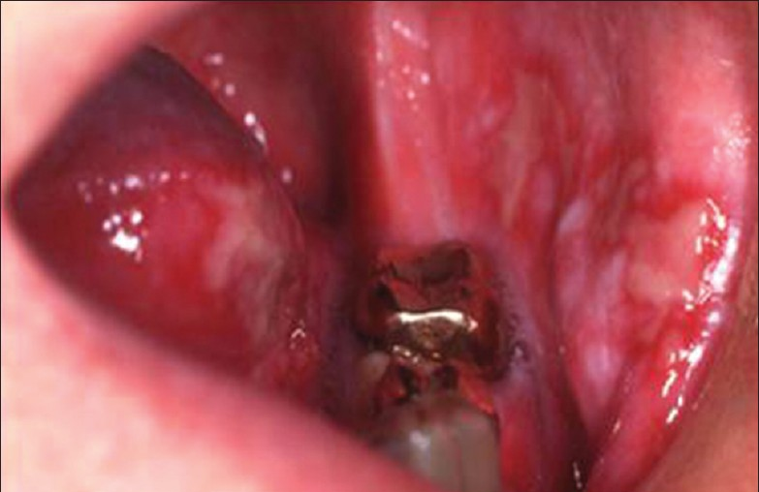
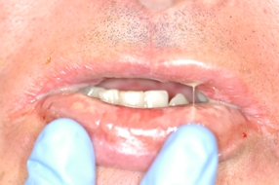

Slide 8


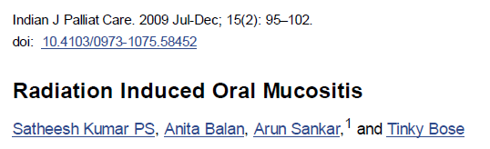
Mucositis
Intensive oral care protocol decreased risk of oral mucositis.
Benzydamine oral rinse is recommended as preventive agent in patients receiving
moderate-dose radiation therapy.
One of the prime limiting factors of radiation for advanced head and neck carcinoma.
Patients who develop clinically significant salivary hypofunction may experience increased discomfort from oral mucositis.
Notes:
Imbalance between cell death and regeneration
The incidence
of oral mucositis was especially high in patients: (i) With primary tumors in the oral cavity, oropharynx, or
nasopharynx; (ii) who also received concomitant chemotherapy; (iii) who received a total dose over 5,000
cGy; and (iv) who were treated with altered fractionation radiation schedules.

Slide 9
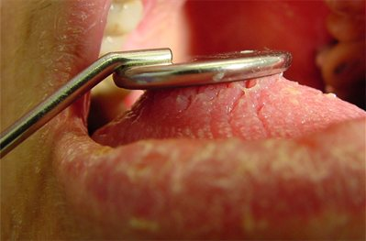
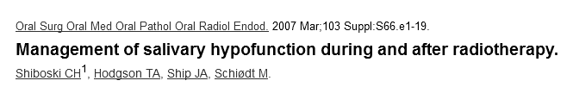
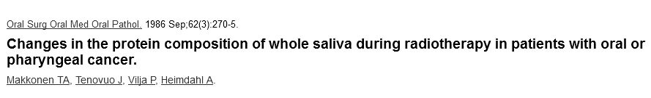
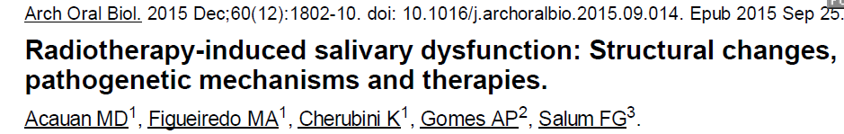
IMRT & Parotid sparing
Radioprotective agents (Amifostine)
Expensive
Contraversial results
Serious adverse events (eg.: hypotension and GI disturbances)
Sialogogue premedication
positive effect on salivary flow but not lasting
Salivary gland surgical transfer
Hallmarks :
Acinar atrophy
Chronic inflammation
The most significant long-term complication of radiotherapy in the head and neck region
Hyposalivation
Notes:
Despite advanced radiation methods, such as intensity modulated radiation therapy: IMRT, and the use of protective drugs, such as Amifostine,
In humans, there can be a subjective modest improvement in xerostomic symptoms after a few months despite a decreasing salivary flow rate, suggesting adaptation
Importantly, the subjective symptom of xerostomia may not always correlate with salivary flow rates.
A systematic on 20006 review and meta-analysis was recently published concluded amifostine is effective in preventing acute and late xerostomia.
Since the meta-analysis (4 trials), 3 further trials examining the effect of amifostine failed to support the meta-analysis results

Slide 10
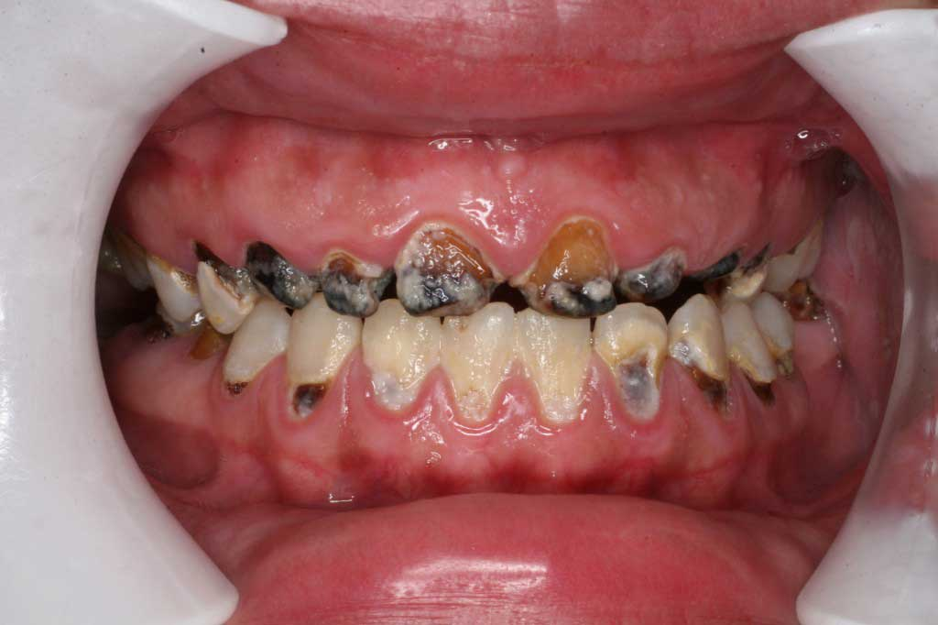
It results from:
A shift in oral microflora
Reduced oral clearance
Changes in saliva composition
Nutritional changes
Neglecting oral hygiene
A late effect, usually with a rapid onset and quick progress
Characterized by the absence of acute pain
Considerations:
Risk of osteoradionecrosis
Niche for secondary seeds
Impaired nutrition
Topical Fluoride preparations
Radiation-induced caries as the late effect of radiation therapy in the head and neck region
Katarzyna Dobroś, Justyna Hajto-Bryk, Małgorzata Wróblewska, Joanna Zarzecka . Contemp Oncol (Pozn) 2015; 19 (5)
Radiation induced caries
Notes:
Aiming to maintain a good nutritional status without the need for enteral nutrition, physicians, and nutritionists
commonly recommend diet changes that include sticky, soft, non-detergent, carbohydrate-rich foods.
However, these, along with a higher frequency of intake, will contribute to the onset of caries.1,3,24
In addition, acute RT side effects, such as mucositis, also contribute to changes in the composition and
frequency of food intake
During and immediately after the radiotherapy, patients often report increased sensitivity to thermal and chemical stimuli (sweet, sour foods), which is associated with the lack of a protective layer of saliva and inflammation of the oral
mucosa. Mucositis results in increased susceptibility to injury. Additional pain associated with tooth brushing often
causes the patients to become negligent with regard to routine oral hygiene. Trismus and general malaise are also
believed to be factors compromising oral hygiene [10, 14].
Qualitative: (decreased buffer capacity, immunoprotein)
Clinically, three different patterns have been identified. The most common pattern (Type 1) affects the cervical aspect of the teeth and extends along the cementoenamel junction. A circumferential injury develops and crown amputation often occurs (Figure 1A).
The second pattern (Type 2) presents with areas of demineralization on all dental surfaces. Generalized erosions and worn occlusal and incisal surfaces are not uncommon (Figure 1B).
The third and least common pattern (Type 3) presents as color changes in the dentin. The crown becomes dark brown/black and occlusal and incisal wear may be seen (Figure 1C). The same individual can present with more than one pattern. Importantly, even teeth located outside the RT field are at risk.
The early response, resulting in atrophy of the secretory cells without inflammation might be due to radiation-induced apoptosis. In contrast, the
late response with inflammation could be a result of radiation-induced necrosis.
Xerostomia, with secondary symptoms of increased dental caries, difficulty in chewing, swallowing and speaking, and an increased incidence of oral candidiasis, can have a significant effect on the quality of life.

Slide 11
Ideal Preventive Protocol
Eliminating all sources of infection & reducing the CFU
IMRT
Eliminating all sources of infection & reducing the CFU
Compromised Preventive Protocol
Amifostine
Hydration & saliva stimulation
(start before and continue through, if possible)
Pilocarpine
In-office fluoride
(before radiation)
Neutral fluoride preparation
Fluoride mouth wash , switch to Xylitol mouthwash

Slide 12
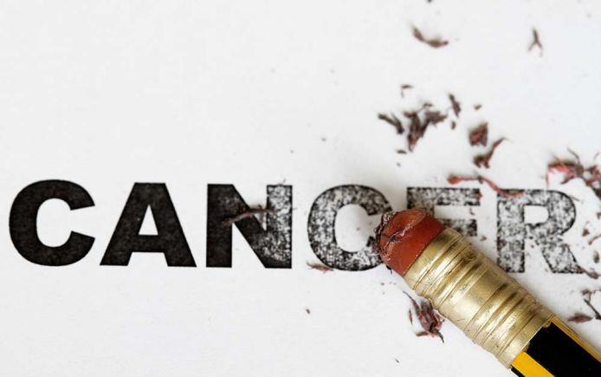

Thanks for your attention ☺

