Slide 1
About OMICS Group
OMICS Group International is an amalgamation of Open Access publications and worldwide international science conferences and events. Established in the year 2007 with the sole aim of making the information on Sciences and technology ‘Open Access’, OMICS Group publishes 400 online open access scholarly journals in all aspects of Science, Engineering, Management and Technology journals. OMICS Group has been instrumental in taking the knowledge on Science & technology to the doorsteps of ordinary men and women. Research Scholars, Students, Libraries, Educational Institutions, Research centers and the industry are main stakeholders that benefitted greatly from this knowledge dissemination. OMICS Group also organizes 300 International conferences annually across the globe, where knowledge transfer takes place through debates, round table discussions, poster presentations, workshops, symposia and exhibitions.

Slide 2
About OMICS Group Conferences
OMICS Group International is a pioneer and leading science event organizer, which publishes around 400 open access journals and conducts over 300 Medical, Clinical, Engineering, Life Sciences, Phrama scientific conferences all over the globe annually with the support of more than 1000 scientific associations and 30,000 editorial board members and 3.5 million followers to its credit.
OMICS Group has organized 500 conferences, workshops and national symposiums across the major cities including San Francisco, Las Vegas, San Antonio, Omaha, Orlando, Raleigh, Santa Clara, Chicago, Philadelphia, Baltimore, United Kingdom, Valencia, Dubai, Beijing, Hyderabad, Bengaluru and Mumbai.

Slide 3

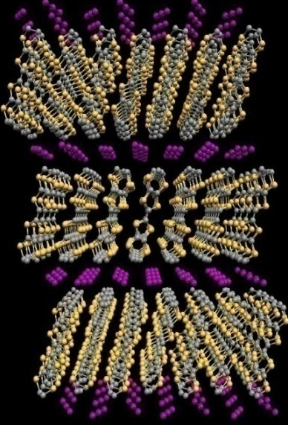
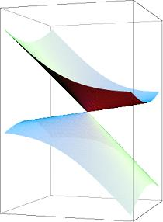
Materials Science-2014 Oct. 6. 2014
Quantum Hall effect
in
multilayered massless Dirac fermion systems
Toho Univ., N. Tajima
α-(BEDT-TTF)₂I₃ (p>1.5 GPa)
Dirac fermion system
carriers (holes) doping
Quantum transport phenomena
SdH & QHE

Slide 4



Toho Univ.
:T. Ozawa, T. Yamauchi, Y. Nishio and K. Kajita
RIKEN
:Y. Kawasugi and R. Kato
IMS
:M. Suda and H. M. Yamamoto

Slide 5
Outline
1. Introduction
2. holes-doping: SdH and QHE
3. Conclusions

Slide 6
Outline
1. Introduction
2. holes-doping: SdH and QHE
3. Conclusions

Slide 7
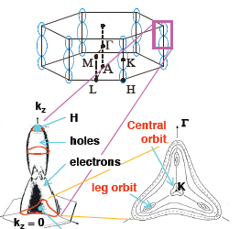
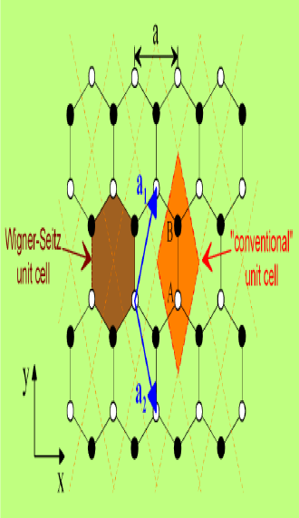
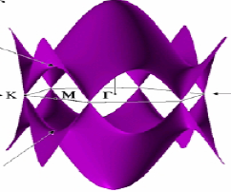
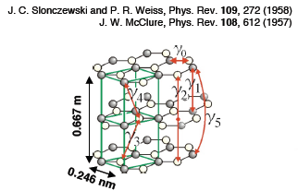
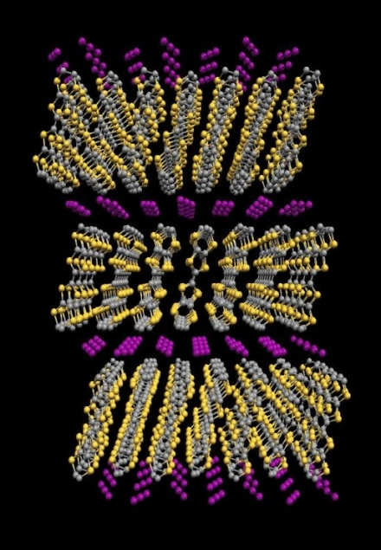
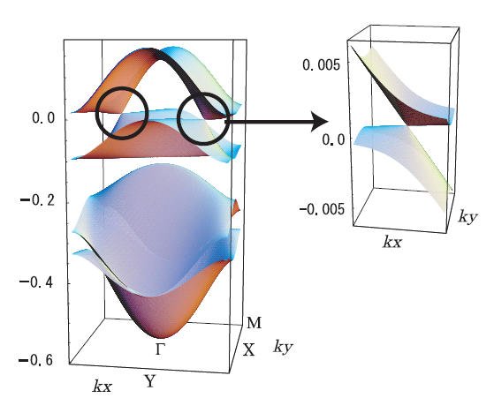
1. Introduction： α-(BEDT-TTF)₂I₃
Graphene: monolayer of graphite
P.R. Wallace, Phys. Rev. 71, 622 (1947)
graphite
K. S. Novoselov et al., Nature 438(2005)197.
Y. Zhang et al., Nature 438(2005)201.
α-(BEDT-TTF)₂I₃
(p>1.5GPa)
First bulk zero-gap material
Katayama, et al.,

Slide 8
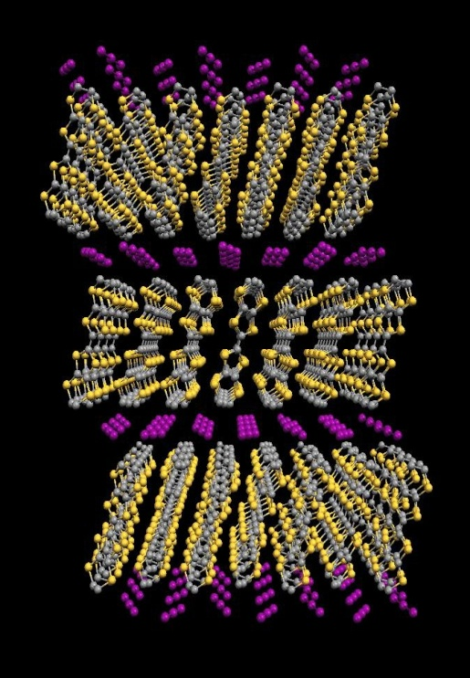
1. Introduction： α-(BEDT-TTF)₂I₃
K.Bender, et al., Mol. Cryst. liq. Cryst., 108 (1984) 359
BEDT-TTF
[ ₂ ]⁽⁺⁾ I₃⁽⁻⁾
e
2D-system
Conductive layer (BEDT-TTF)
Insulating layer (I₃)
Conductive layer (BEDT-TTF)
Insulating layer (I₃)
c
b
Conductive layer (BEDT-TTF)
o
a

Slide 9
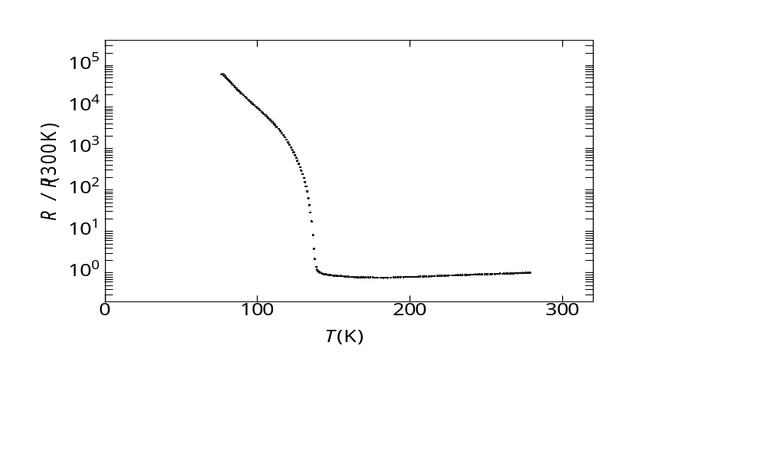
1. Introduction： α-(BEDT-TTF)₂I₃
135K
T > 135K
+1e
0
+0.5e
+0.5e
a
a
o
b
b
T < 135K
o
Charge disproportionation
H.Kino and H.Fukuyama (Theory) J. Phys. Soc. Jpn. 64(1995)1877.
H.Seo (Theory) J. Phys. Soc. Jpn. 69(2000)805.
Y.Takano, et.al. (NMR) J. Physics and Chemistry. Solid 62(2001) 393.
R.Wojciechowski, et.al. (Raman) Phys.Rev.B 67(2003) 224105.

Slide 10
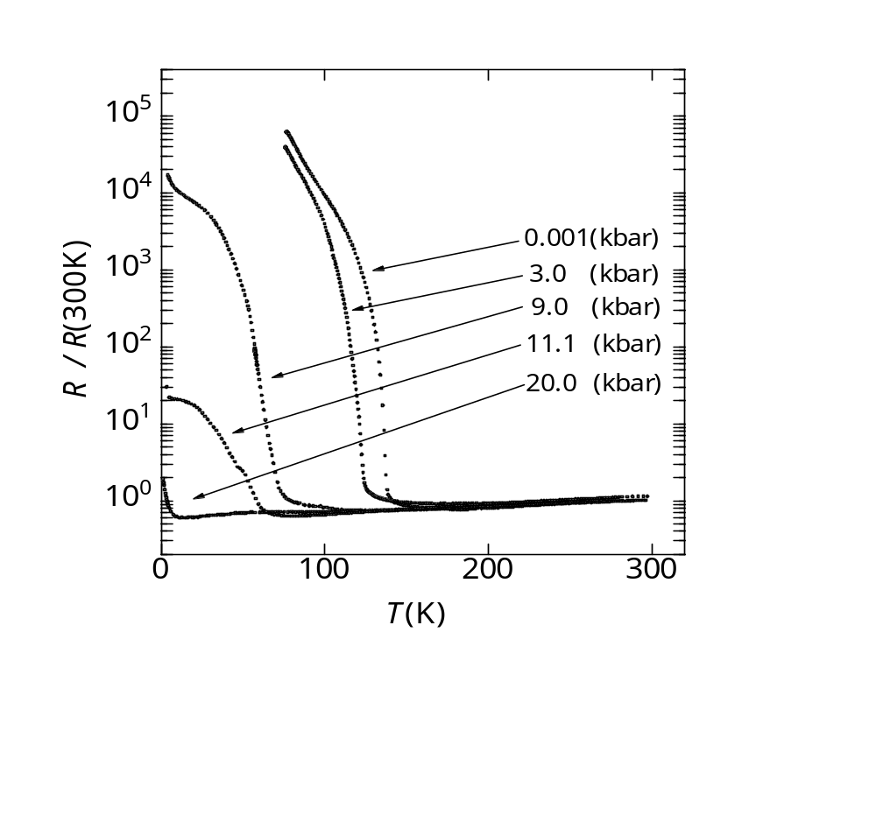
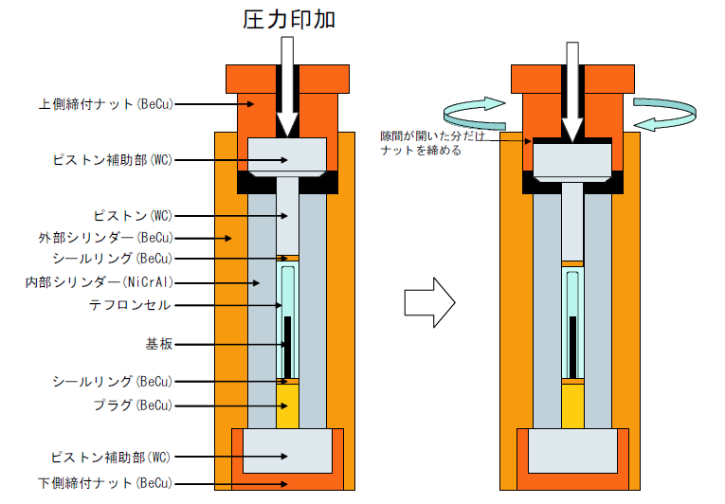
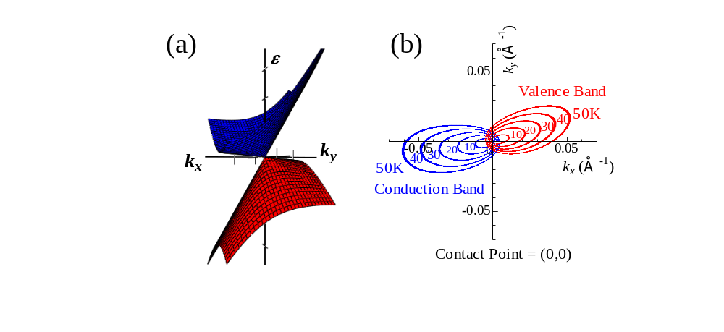
1. Introduction： α-(BEDT-TTF)₂I₃
Teflon
Pressure medium: Oil
Sample
※1kbar=0.1GPa= 10,000 atm
Zero-gap system: Dirac fermion

Slide 11
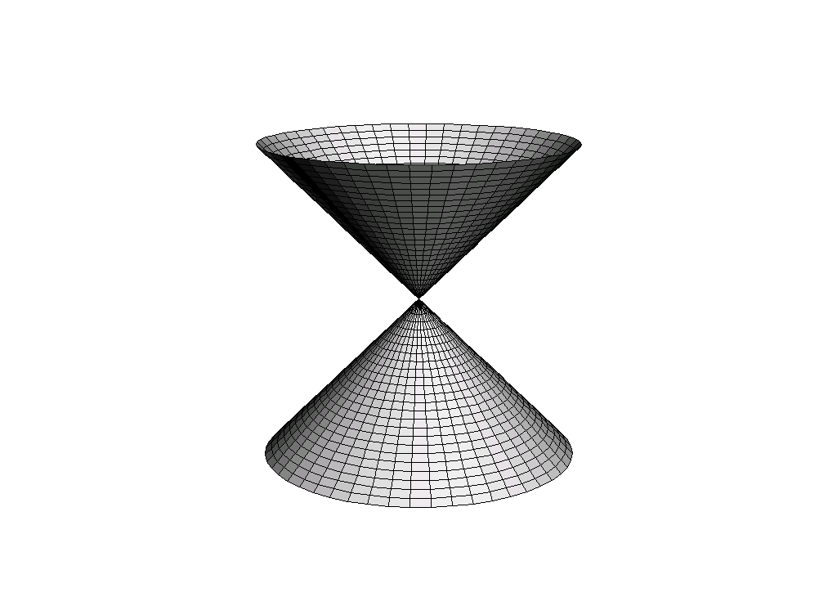



1. Introduction： α-(BEDT-TTF)₂I₃
What is interesting?
What is important?
Dirac point
$$E$$
(contact point)
$$k_{x}$$
$$k_{y}$$
Dirac cone
:normal-e
m*=0
: massless Dirac electrons
(relativistic electrons)

Slide 12

1. Introduction： Characteristic transport
Sheet resistance: $R_{s}\sim h/e^{2}$
・Toho Univ. & RIKEN
Carrier density: $n=\int{DfdE}∝v_{F}^{−2}T^{2}$
・Toho Univ. & RIKEN
Anomalous $σ_{xy}$ due to inter-band effects of B
・Toho Univ. & RIKEN
・A. Kobayashi, et al
peculiar magnetotransport
・Toho Univ. & RIKEN

Slide 13
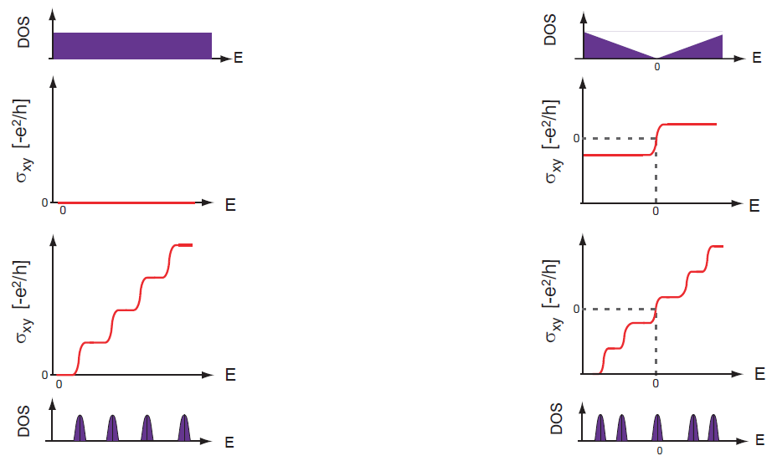


1. Introduction： Landau level
Conventional conductor
Zero-gap structure
B
B
$$∆=\sqrt{2eℏv_{\text{F}}^{2}B}(\sqrt{|n|}−\sqrt{|n−1|})$$
$$∆=ℏωC$$

Slide 14
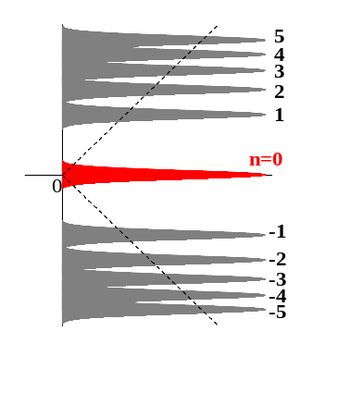
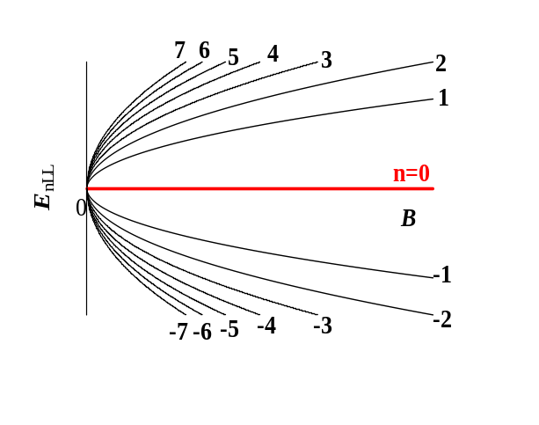
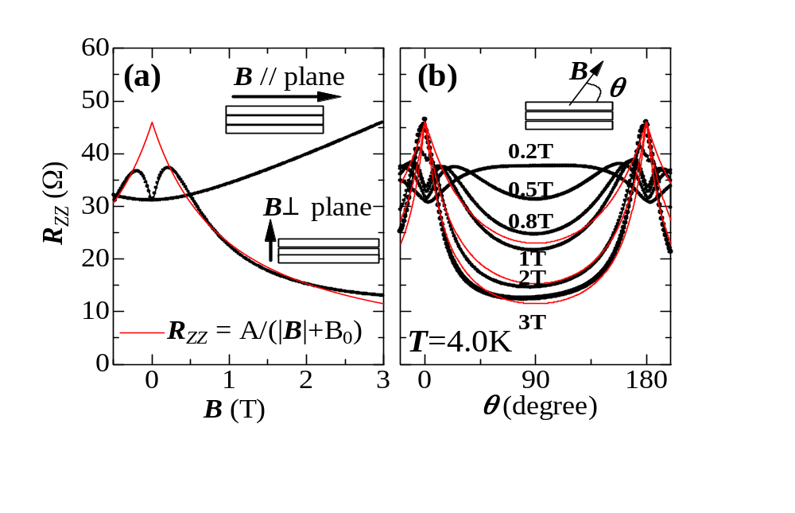
1. Introduction： Zero-mode
1) E_{1LL}»k_{B}T, → quantum limit
Osada formula
(T. Osada, JPSJ 77 (2008) 084711)
2) Degeneracy of zero mode
：n_{0LL}(B) =B/2φ₀ , φ₀ =h/e
B
3) σ_{zz} ∝ n_{0LL} ∝B
ρ_{zz}
ρ_{zz} ∝ 1/B
N. T, et al., PRL, 102, 176403 (2009).

Slide 15
Outline
1. Introduction
2. holes-doping: SdH and QHE
3. Conclusions

Slide 16
2. holes-doping： Other Landau level
Can we inject the carriers into the sample?
Undoped state
E
E
E
E_{F}
h
e
DOS
DOS
DOS
E_{F}
E_{F}
B=0
B=0
B
B=0
B
B=0
B

Slide 17
2. holes-doping：
Can we inject the carriers into the sample?
Yes → Breakthrough
Undoped state
E
E
E
E_{F}
h
e
DOS
DOS
DOS
E_{F}
E_{F}
B=0
B=0
B
B=0
B
B=0
B

Slide 18
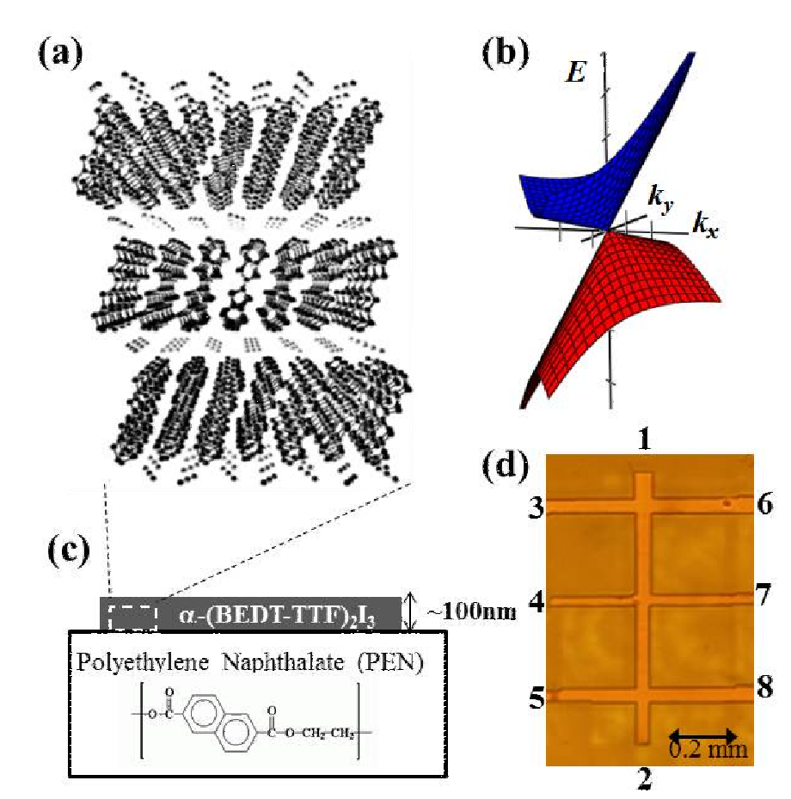
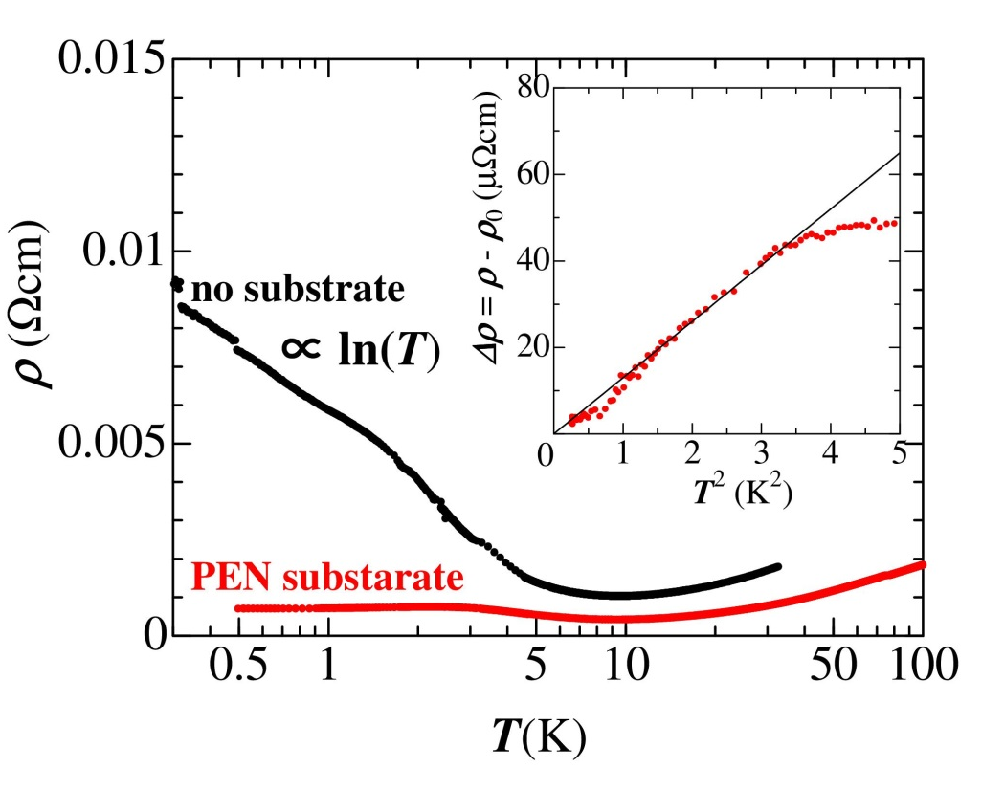


2. holes-doping: resistivity
N. T, et al., PRB, 88, 075315 (2013).
1. PEN is slightly charged in negative.
Fermi-liquid sate
$$ρ∝T^{2}$$
2. $n\sim {10}^{8} {cm}^{−2}/layer$ at low-T

Slide 19
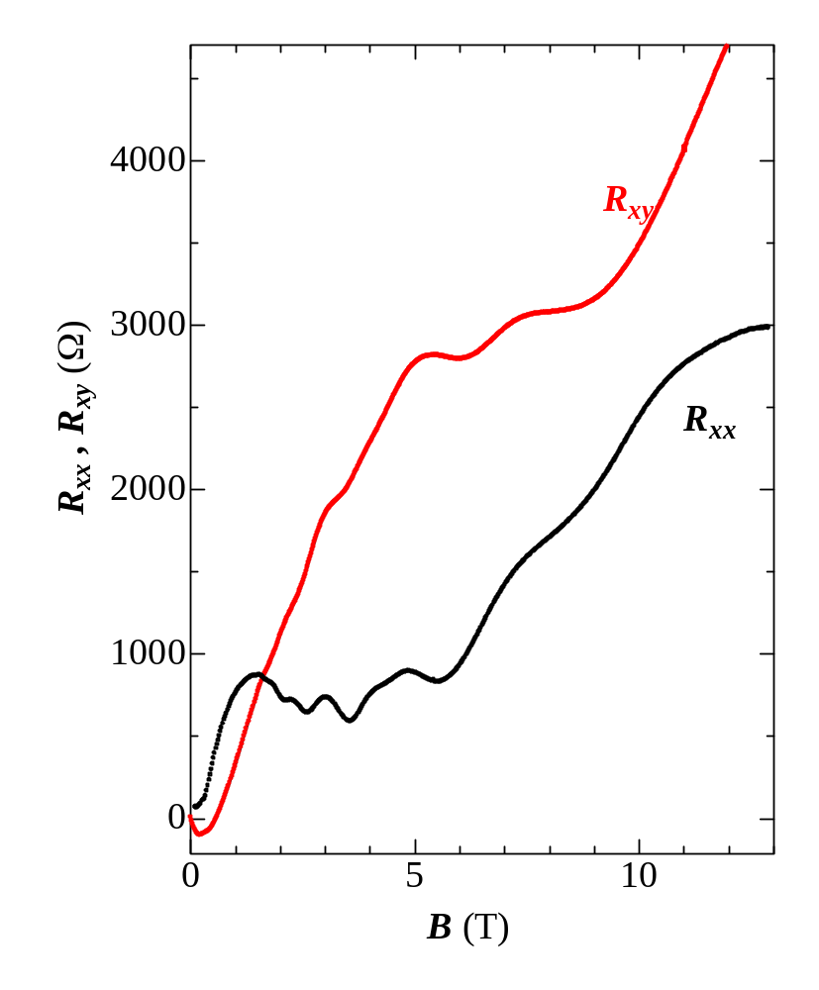
2. holes-doping: SdH & QHE
N. T, et al., PRB, 88, 075315 (2013).
hole-doping
1. PEN is slightly charged in negative.
2. $n\sim {10}^{8} {cm}^{−2}/layer$ at low-T

Slide 20
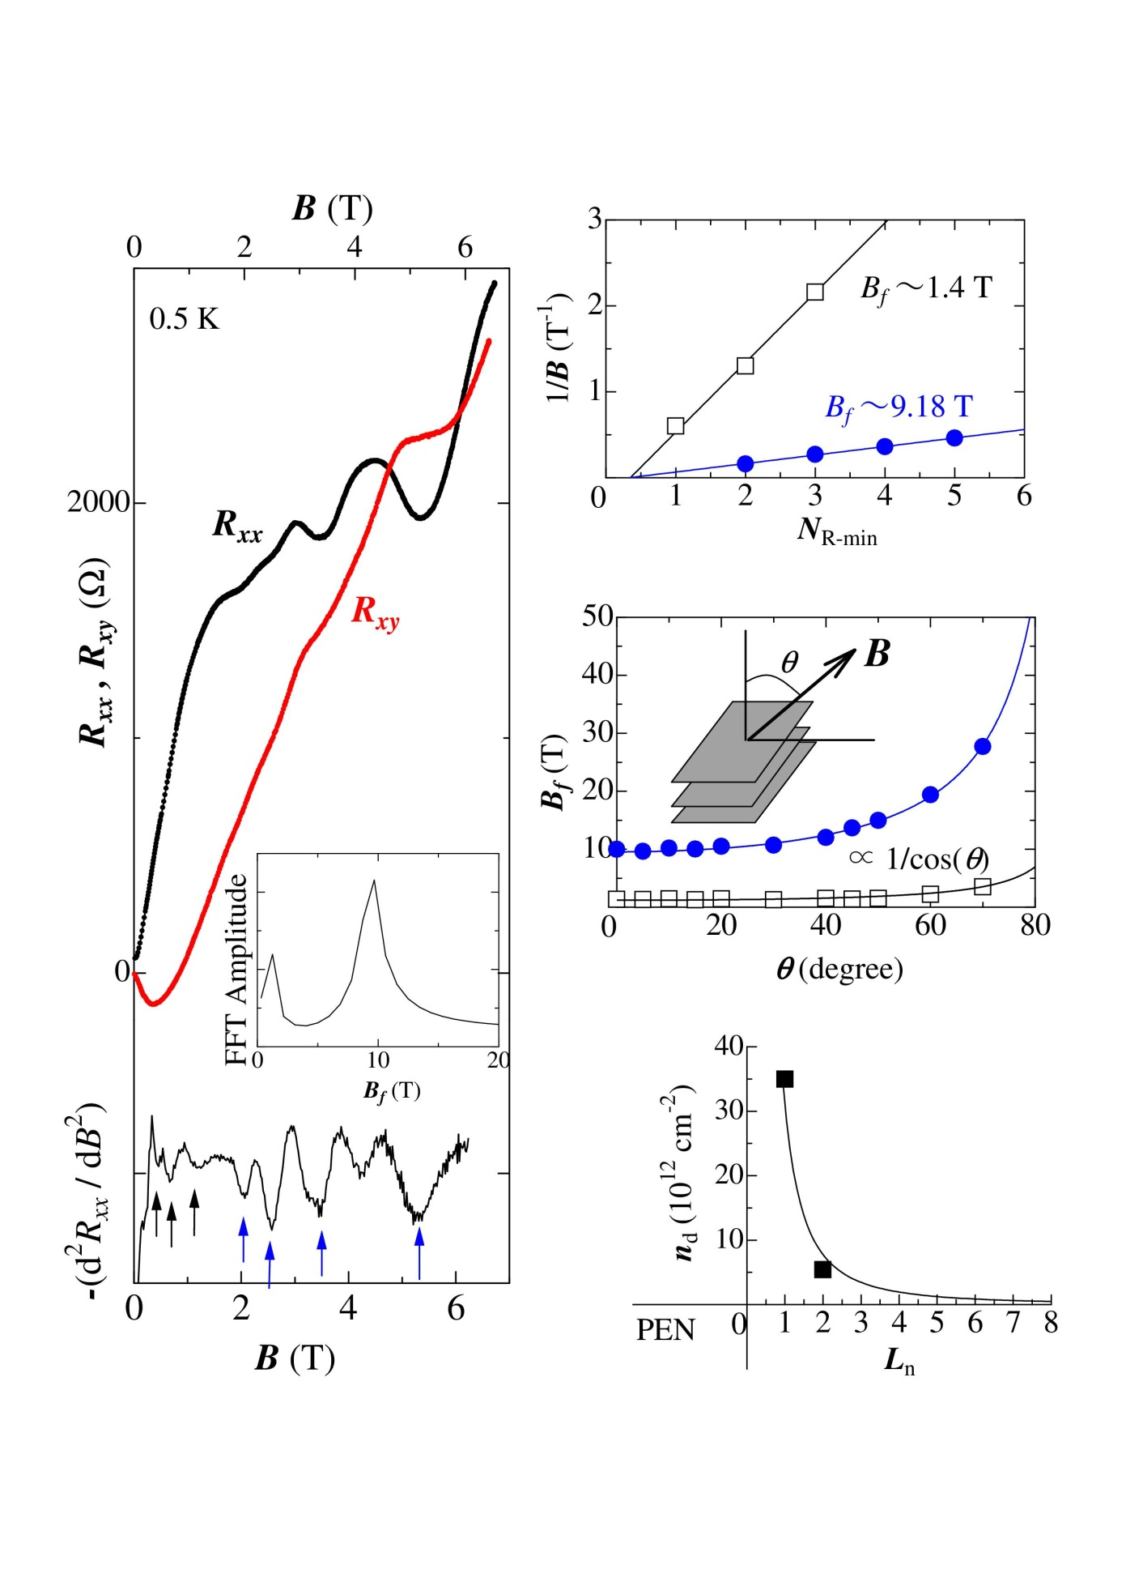
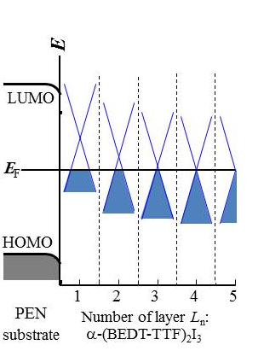




3. Results： SdH & QHE
N. T, et al., PRB, 88, 075315 (2013).
$$∆R_{xx}=A(B)\cos\left[2π(\frac{B_{0}}{B}+\frac{1}{2}+γ)\right]$$
$γ=0$: normal -e
$γ=1/2$: Dirac -e
Energy diagram
$$n_{d}∝B_{f}$$

Slide 21
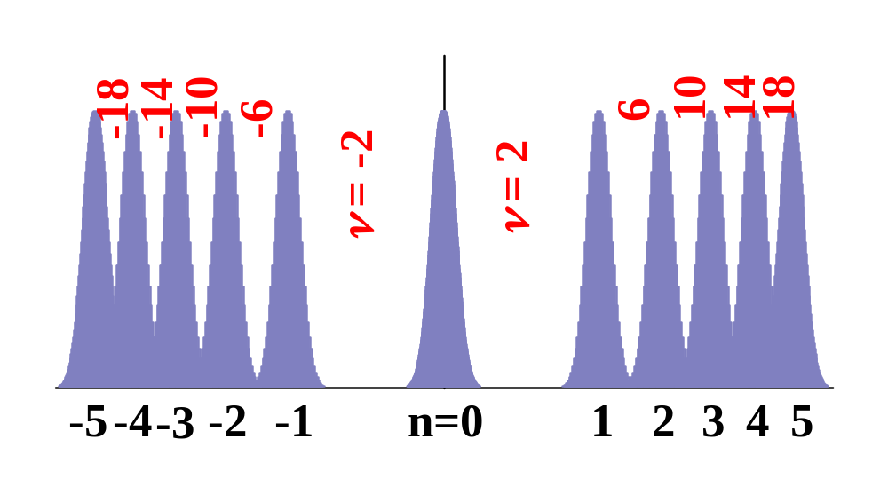



2. holes-doping
N. T, et al., PRB, 88, 075315 (2013).
QHE in 2D Dirac system
$$R_{xy}^{−1}=νe^{2}/h$$
$$ν=±4(n+1/2)$$
$$|ν|=2, 6, 10, 14, 18,⋯$$

Slide 22
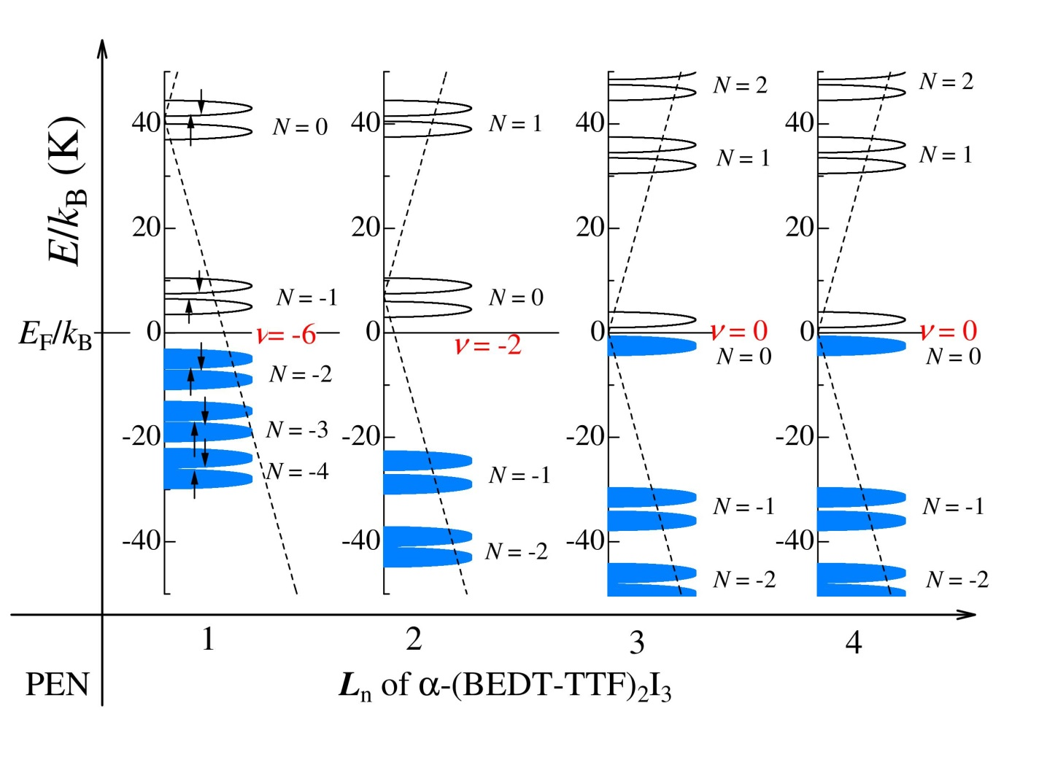
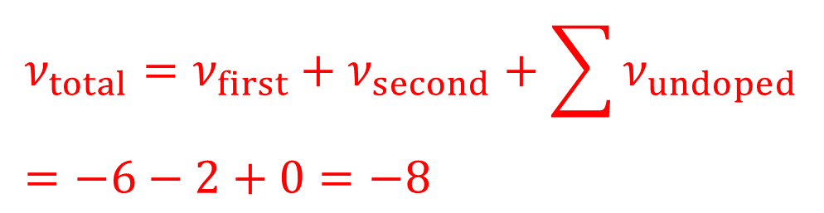
2. holes-doping: QHE at 5.5 T
N. T, et al., PRB, 88, 075315 (2013).
$$ν_{total}=ν_{first}+ν_{second}+\sum{ν_{undoped}}=−6−2+0=−8$$

Slide 23


2. holes-doping: QHE at 5.5 T
N. T, et al., PRB, 88, 075315 (2013).
Thickness dependence of conductivity
✔ QHE around 5.5 T
At $L_{n}→2, ν_{total}=−8$
✔ Undoped layer
$$σ_{xx}\sim 0.07e^{2}/h, σ_{xy}\sim 0.008e^{2}/h$$

Slide 24

3. Conclusions
Crystals on PEN
holes doping
Fermi liquid state
First observation of SdH & QHE
Direct evidence of Dirac system

Slide 25
Let Us Meet Again
We welcome you all to our future conferences of OMICS Group International
Please Visit:
http://materialsscience.conferenceseries.com/
Contact us at
materialsscience.conference@omicsgroup.us
materialsscience@omicsgroup.com

