Slide 1


Differential Expression of SOCS1/SOCS3 Ratios in Virus-Infected Macrophage Cell Lines
Nancy J. Bigley, Ph.D.
Microbiology and Immunology Program, and Department of Neuroscience, Cell Biology, and Physiology ,College of Science and Mathematics and Boonshoft School of Medicine, Wright State University, Dayton, Ohio
2014

Slide 2
We previously noted that murine keratinocyte cell lines (HEL-301 7 PAM-212) PRODUCED large amounts of SOCS1 mRNA and protein following infection with HSV-1 or treatment with interferon-gamma (IFN-γ). In contrast, murine fibroblasts (l929) exhibited minimal increase in SOCS1 levels when treated with IFN-γ following infection with HSV-1 (Frey et al. 2009).
An antiviral state was induced in fibroblasts but not in keratinocytes. This resistance of keratinocytes to IFN-γ corresponded to the hyperinduction of SOCS1 in these cells.
The goal of the present study was to determine the effects of HSV-1 infection on morphology, CD14-CD86 expression, cell viability, and SOCS protein levels in polarized M1 and M2 macrophage cell lines (J774A.1 and RAW 264.7) during the first 24 hour of infection. For comparison we examined these responses against the monocyte-macrophage trophic Dengue virus (DENV2) in the RAW 264.7).

Slide 3
Viruses
Herpes Simplex Virus-1 strain Syn 17+ (HSV-1) initially obtained from Dr. Nancy Sawtell, Children’s Hospital Medical Center, Cincinnati, OH was propagated on confluent monolayers of Vero cells. After 4-5 days post infection or when CPE was evident, the cells were spun down, supernatant was aliquoted and stored at -80⁰C. Virus was quantified by infecting Vero cell monolayers with different dilutions of virus and plaque forming units were counted to calculate volume required for 0.1 multiplicity of infection (MOI).
Dengue Virus DENV serotype 2 (DENV-2) was provided by Dr. Eric M. Vela, Battelle Memorial Institute Research Center. DENV2 was propagated on Vero 76 cells. Brieﬂy, Vero 76 cells grown in 100 mm petri dishes to a conﬂuence of approximately 85% at 37 °C, were infected with DENV-2 for 5-6 days or until CPE was evident. Cells were then scraped and centrifuged at 1500 rpm to eliminate cell debris. The supernatant fluid was aliquoted and stored at −80°C until use. Dengue virus titers were determined by plaque assay on conﬂuent monolayers of Vero 76 cells grown in 6-well plates
Murine Macrophage Cell Lines
264.7 (ATCC TIB-71) and J774A.1 (TIB-67) cells lines were obtained from the American Type Culture Collection (ATCC) Manassas, VA.

Slide 4
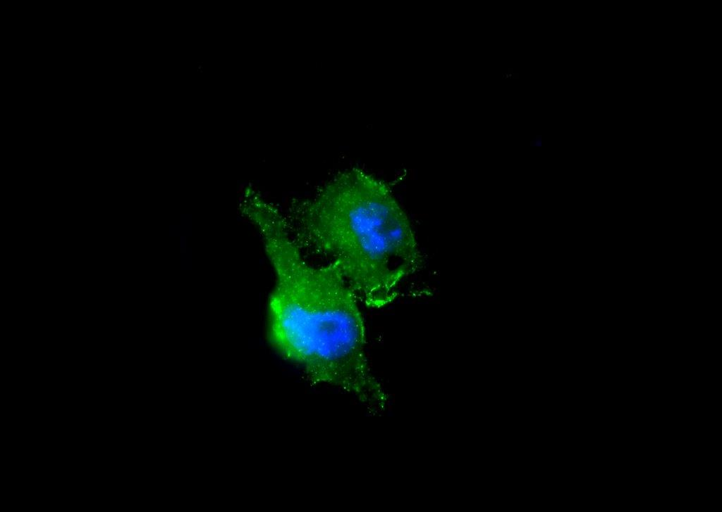
DENV2 infection of RAW 264.7 macrophages at 3 days post infection

Slide 5
Macrophage Polarization Treatment
CD86
SOCS1
M0
SOCS3
No treatment
20 ng/mL IL-4 for 12-24 hours
LPS (100 ng/mL)
IFN-γ (20 ng/mL)
for 12-24 hours
M1
M2

Slide 6
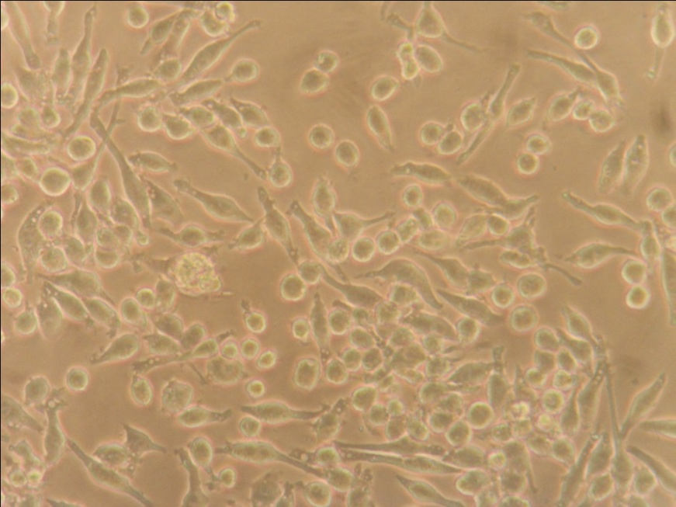
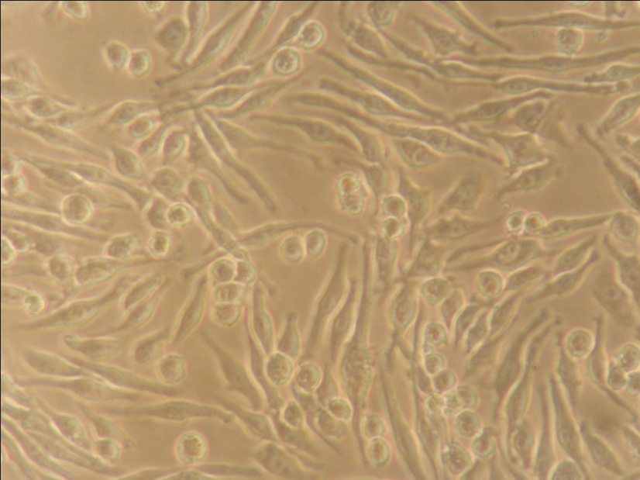
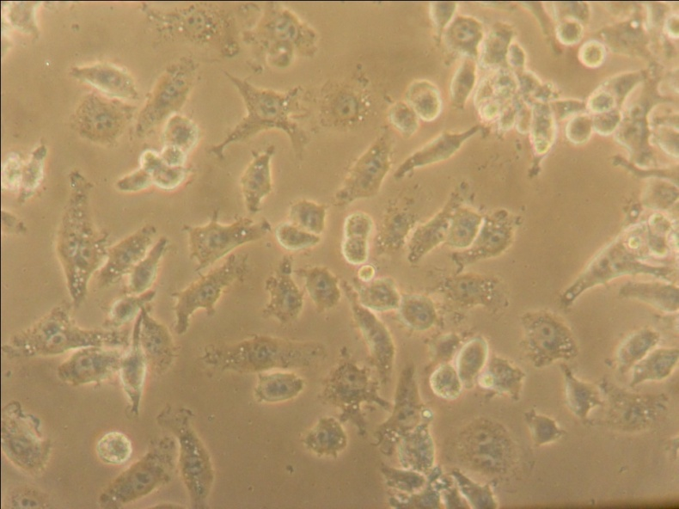
LPS & IFN-γ
IL-4
J774A.1 Macrophages at 24 hours after polarization

Slide 7
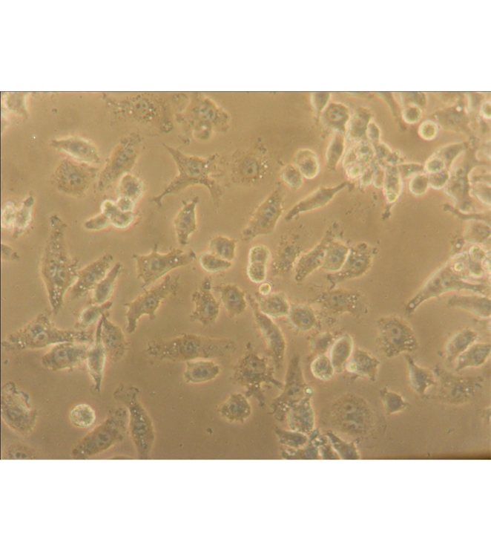
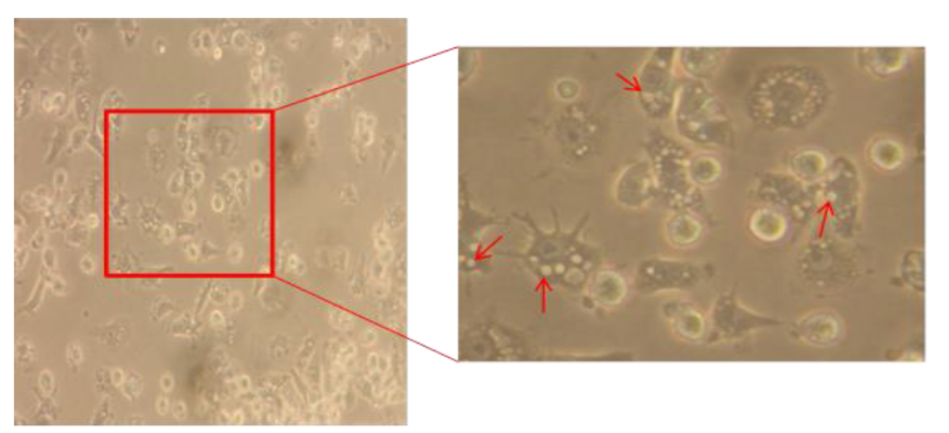
M1 J774A.1
M1 RAW 264.7
Vacuolated M1 Macrophages

Slide 8
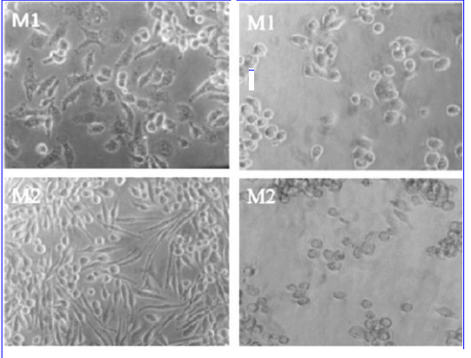
J774A.1 Macrophages
Uninfected HSV-1-infected

Slide 9
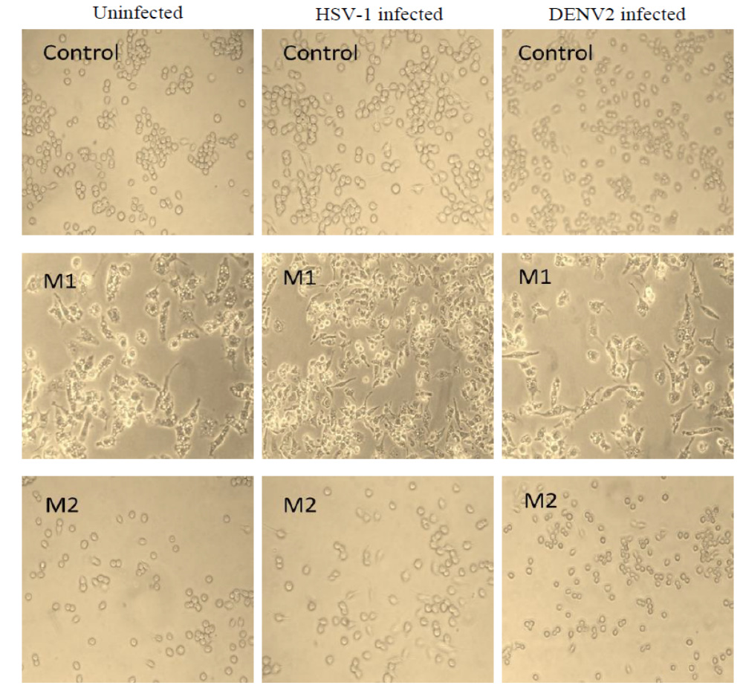
RAW 264.7 Macrophages

Slide 10
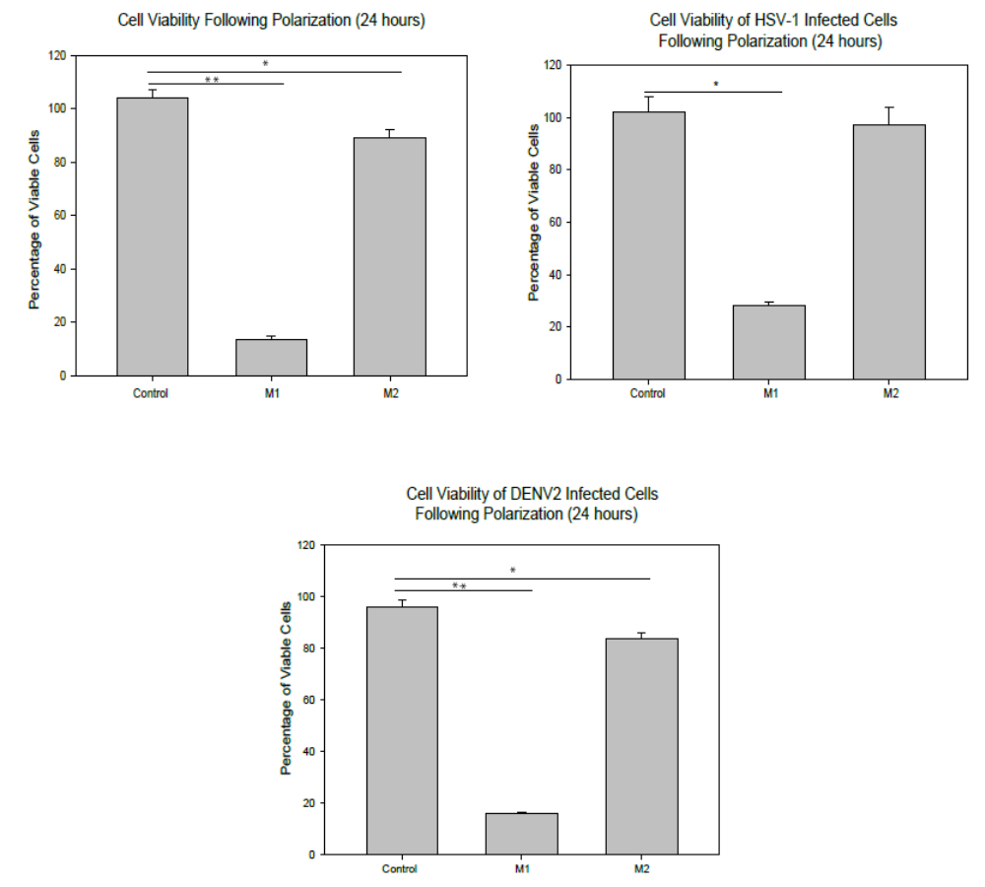
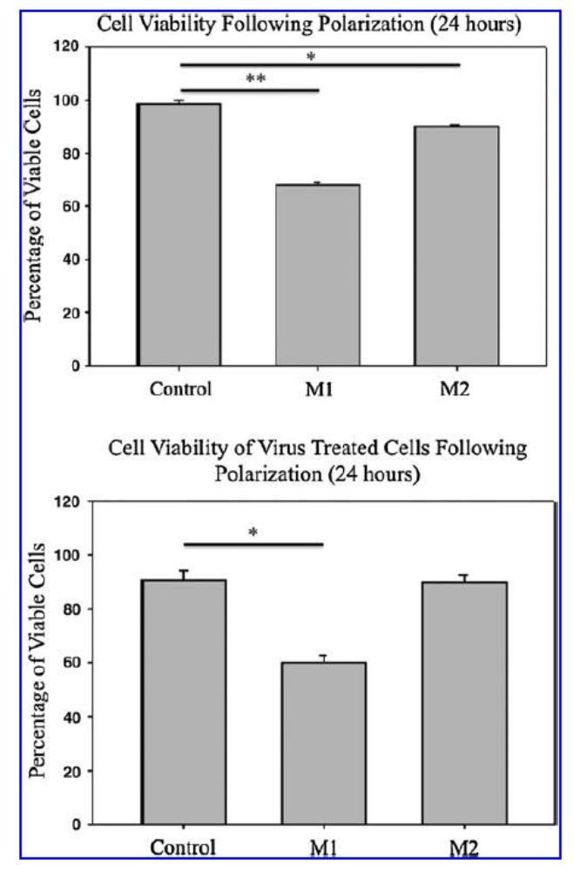
J774A.1 Macrophages
RAW264.7 Macrophages

Slide 11
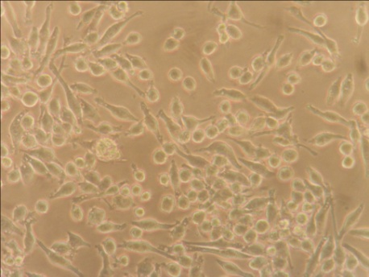
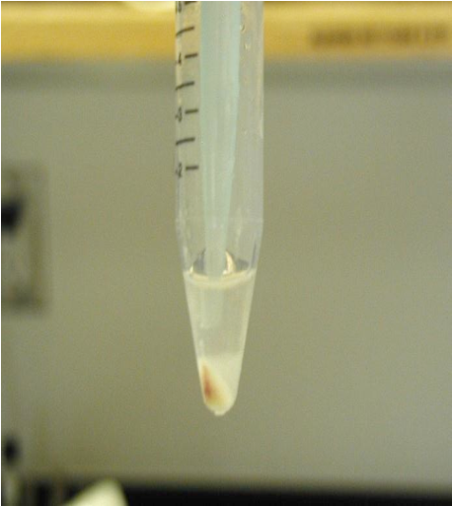
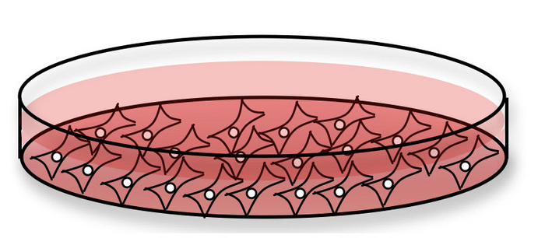
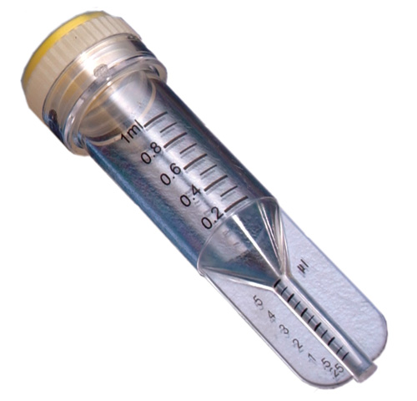
Virus Treatment of Macrophages
2.
1.
In order to accurately determine cell number and calculate MOI accurately:
Cells were released from culture plate using a non-enzymatic dissociation reagent
Cell count was taken using a TPP PCV cell counting tube, making it possible to calculate MOI accurately
Release cells/centrifuge
Count
4.
3.
Add virus (0.1 MOI)/cytokines

Slide 12
Monocyte/Macrophage Markers | Scavenger Receptors | Membrane Glycoprotein
CD14- LPS receptors | CD206 macrophage mannose receptor (MMR) | CD200R- expressed mainly on monocytes and neutrophils. Interaction between CD200R and CD200 limit and suppress macrophage-induced inflammatory damage.
CD80 (B7.1) co-receptor on antigen –presenting cells (APCs) | CD163- hemoglobin-haptoglobin receptor; expressed on both monocytes and macrophages
CD86 (B7.2) co-receptor on APSs

Slide 13
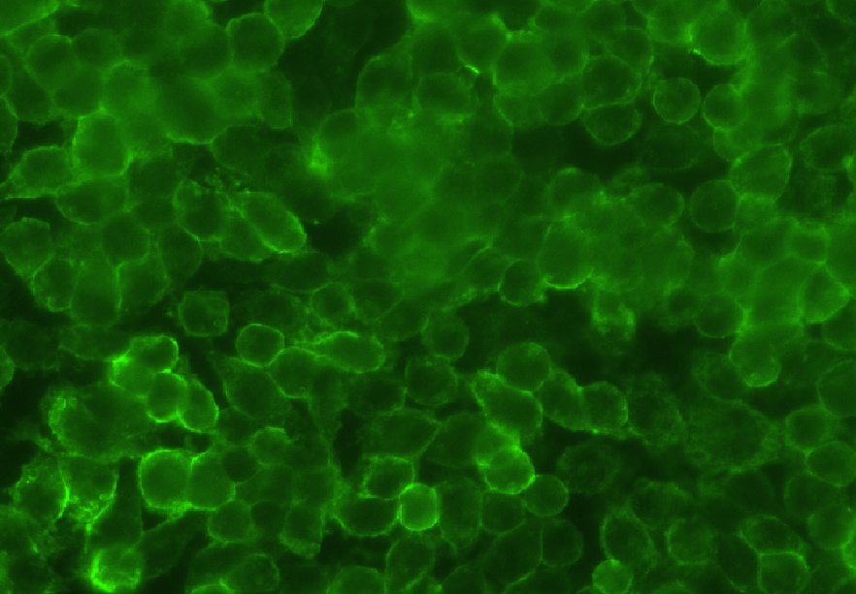
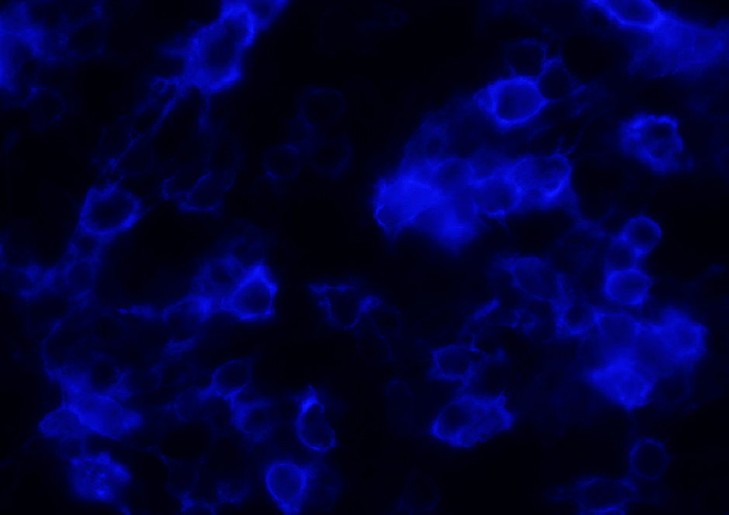
J774.1 macrophages polarized to M1 phenotype
Stained with FITC-labeled anti- mouse CD14
Stained with brilliant violet 421 -labeled anti-mouse CD86

Slide 14
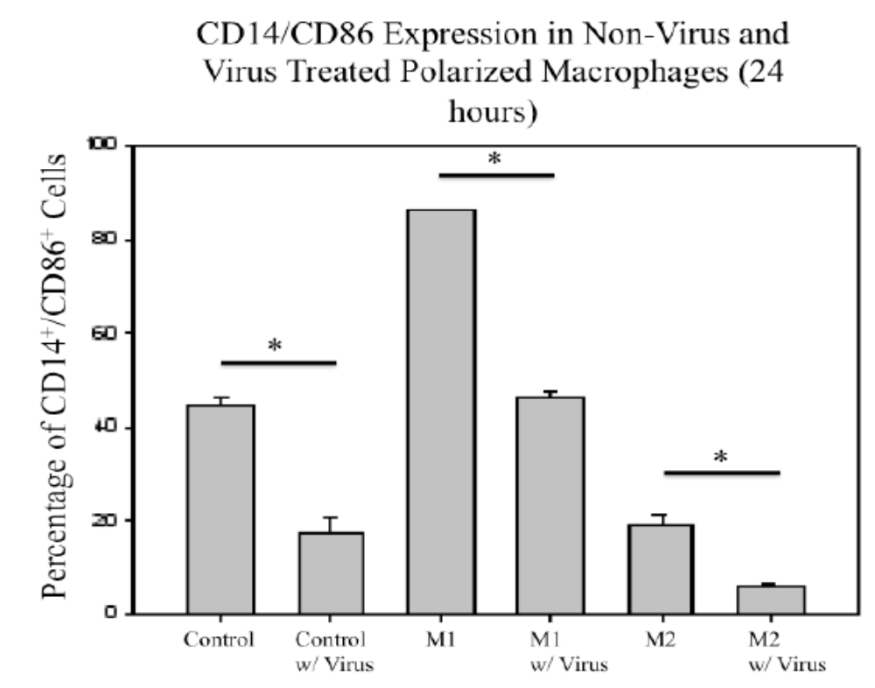
J774a.1 Murine Macrophages

Slide 15
Jaguin and colleagues recently used monocytes purified from the buffy coats of human peripheral blood cells to characterize phenotypic and genomic markers.
generated macrophages from these primary human cells by treatment with M-CSF
polarized them using the same inducers as used in the present study, LPS and IFN-γ to induce M1 phenotype and IL-4 to induce the M2 phenotype
the cell membrane marker unique to M1 cells was CD80 (B7.1)
CD200R expression was unique to the M2 polarized human macrophages
As did we using M1 and M2 polarized murine macrophage cell lines (data not shown), they found that the mannose receptor CD 206 did not distinguish between M1 and M2 phenotypes of human macrophages.

Slide 16
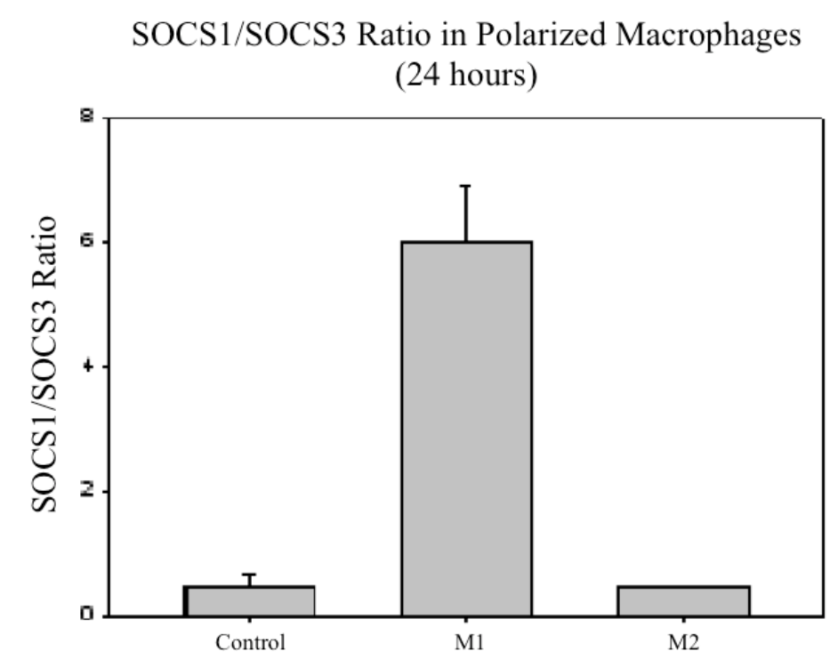
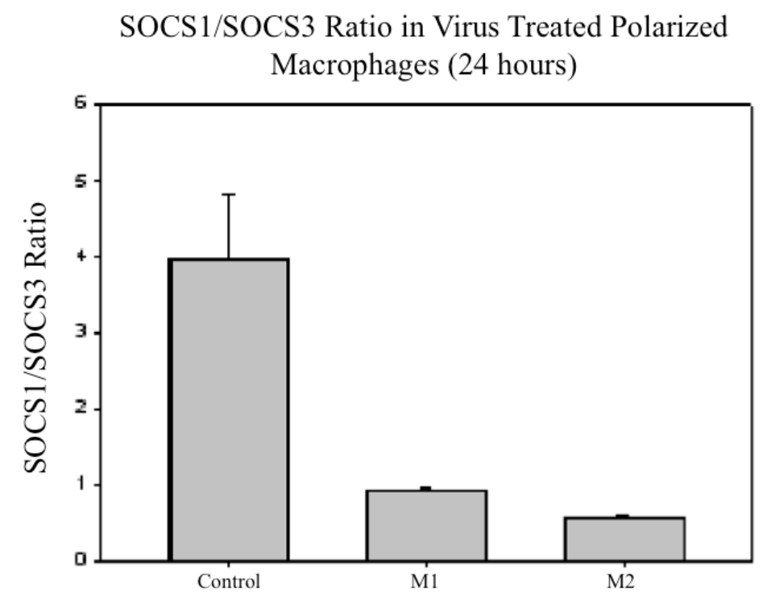
Flow cytometry summary of SOCS1 and SOCS3 expression by uninfected and infected J774A.1 macrophage subpopulations
Left Panel. Note Uninfected cells at 24 h after polarization. M1 cells expressed higher levels of SOCS1 than SOCS3 with a SOC1/SOCS3 ratio of 7:1.
Right Panel. Virus-infected M1 cells expressed a SOCS1/SOCS3 ratio of 1:1 while M2-infected cells exhibited a SOCS1/SOCS3 ratio of 1:2

Slide 17
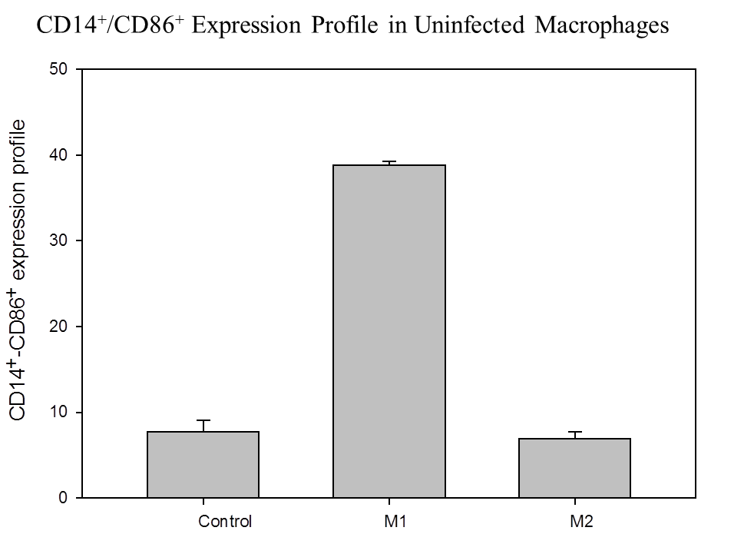
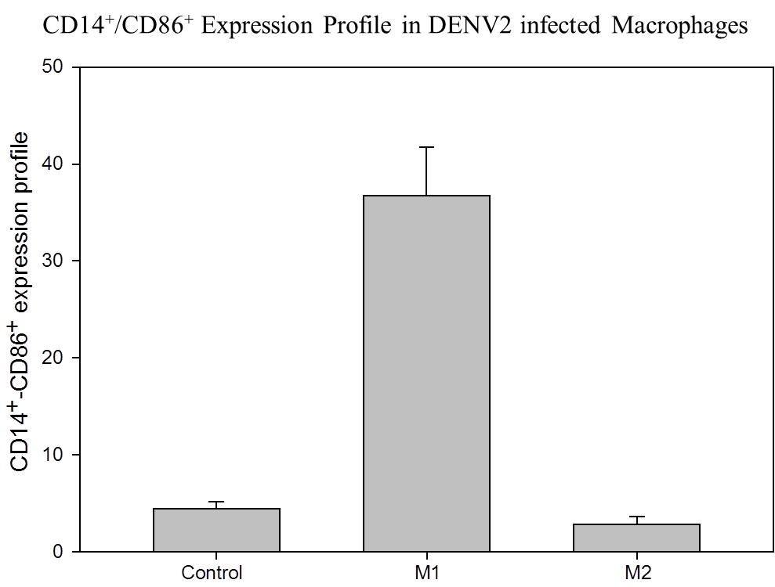
CD14/CD86 EXPRESSION IN RAW 264.7 Murine Macrophages

Slide 18
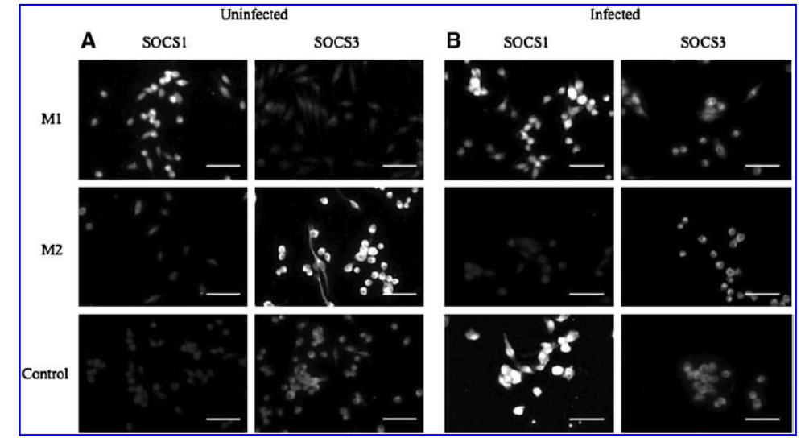

Slide 19
Ratios determined by Flow cytometry (J774a.1) and Western Blot (RAW 267.4)
 | J774.A | RAW 264.7
 | Ratio | Ratio
M0 | 1:2 | 1:2
M0-HSV-1 | 1:2 | 1:2
M1* | 7:1 | 1:3
M1-HSV-1 | 1:1 | 1:1
M2 | 1:2 | 1:2
M2-HSV-1 | 1:2 | 1:2
* Difference because of cell line or detection method,. Western Blot detects denatured antigenic fragments ; Flow cytometry detects native protein conformation. SOCS1:SOCS3 ratios in all DENV2-infected cells was 1:1.

Slide 20
Summation of Observations
HSV-1 infection led to morphological differences in all 3 experimental groups
HSV-1 infection decreased CD14/CD86 expression in all 3 experimental groups
M1 macrophages did not show an up regulation of SOCS1 following virus challenge, however, SOCS3 levels were increased
HSV-1-infected unpolarized (M0) J774A.1 cells exhibited significant increases in expression levels of native SOCS1

Slide 21
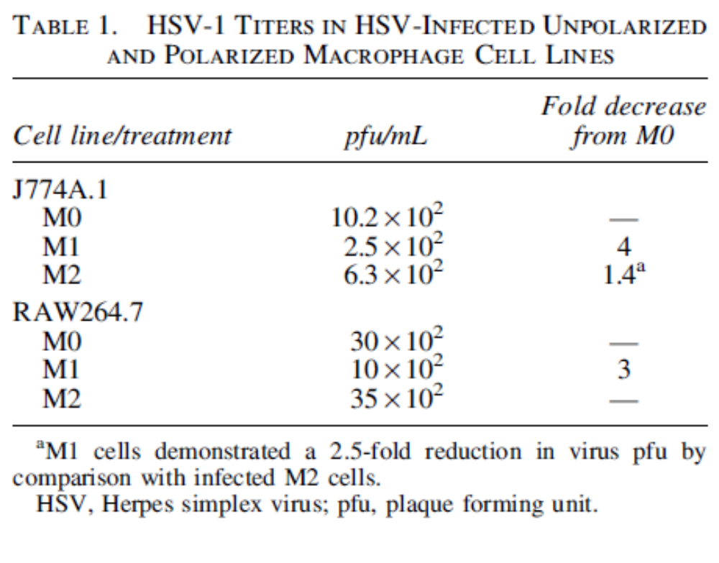
At 24 h after infection, M0 control and M2 cells showed greater virus yield than did the M1 cells, presumably reflecting the loss of viable M1 cells.

Slide 22
Does up regulation of SOCS3 expression in HSV-1-infected M1 macrophages over that seen in uninfected M1 cells reflect the effects of M1 polarization or suggest the cell’s attempt to counteract effects of proinflammatory molecules?
Qasimi and colleagues showed that different domains of SOCS3 protein are used to mediate interleukin-10 (IL-10) inhibition of TNF-α and nitric oxide production by this same macrophage cell line (Qasimi and others 2006). In this same macrophage cell line (J774A.1) , Il-10 was responsible for the anti-inflammatory response to Borrelia burgdorferi (Dennis and others 2006).
SOCS1/SOCS3 expression levels appeared relatively unchanged in virus-infected M2 macrophages when compared to their uninfected counterparts, suggesting microenvironment signals such as IL-4 play a greater role in SOCS expression levels than does HSV-1 infection.
We then hypothesized that the HSV-1-infected J774A.1 M1 macrophages were attempting to counteract the effects of inflammatory molecules induced by polarization.

Slide 23
Google Image
Structural domains of SOCS molecules
Note that only SOCS1 contains a nuclear localization sequence (NLS)

Slide 24
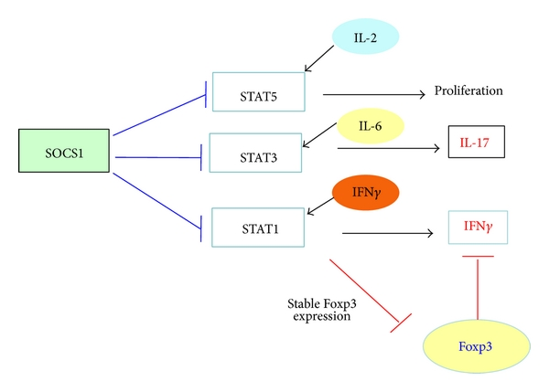
Overview of SOCS1 inhibition of cytokine-induced STATs

Slide 25
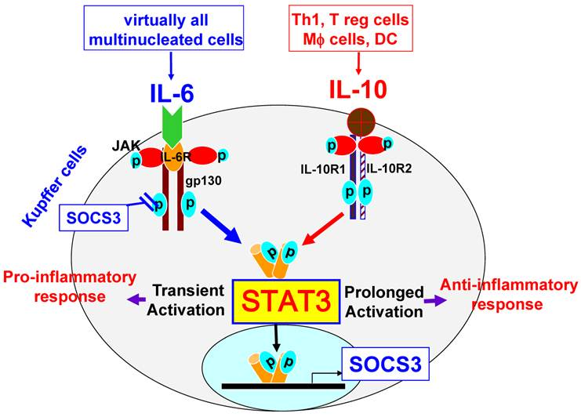
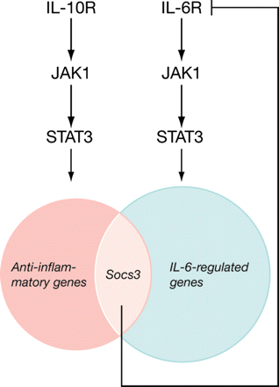
Pro-inflammatory and anti-inflammatory effects of SOCS3

Slide 26
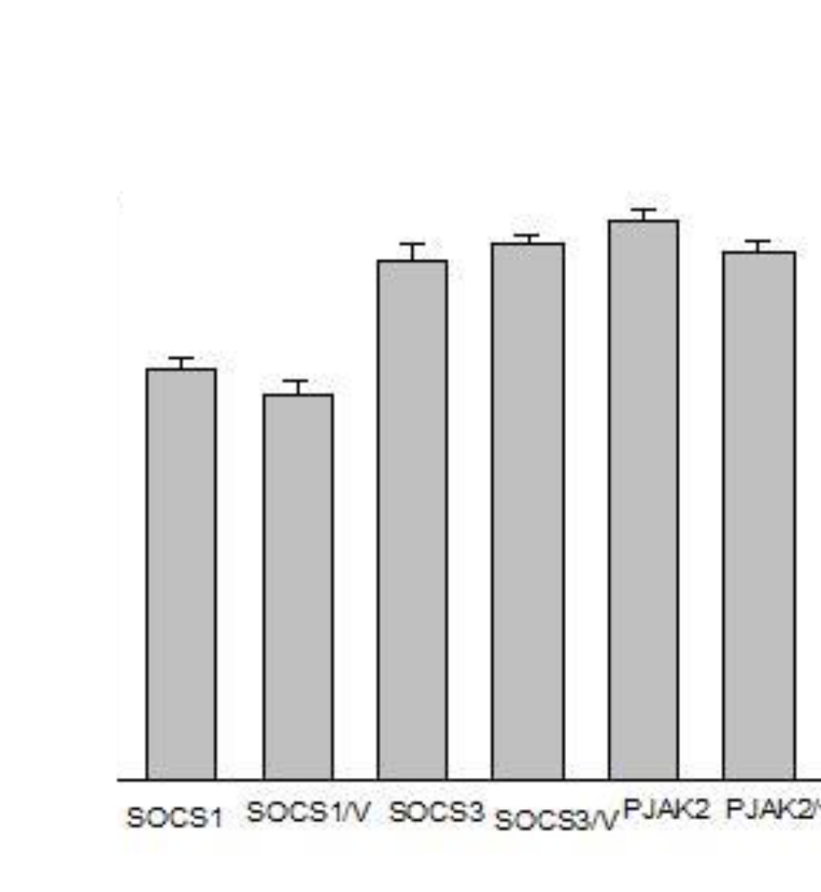
p<0.001 when the SOCS1 groups were compared with the SOCS3 and pJAK2 groups
LPS (100 ng/ml)
IFN-γ (20 ng/ml)
0.1 MOI HSV-1
SOCS3 peptide or SOCS1 Inhibitor
Incubate 24 hours
Effects of SOCS1 and SOCS3 peptide mimetics and SOCS1 inhibitor (pJAK2) on polarized M1 J774A.1 macrophages.

Slide 27
Jo et al. (2005) used a recombinant cell-penetrating form of SOCS3 (CP-SCS3) to protect mice (C3H/HeJ) from the lethal effects of SEB and LPS by reducing production of inflammatory cytokines and attenuating apoptosis and hemorrhagic necrosis .
Within 2 hours after injection, CP-SOCS3 was distributed In multiple organs and persisted for at least 8 hours
The membrane-translocating motif (MTM) was composed of 12 amino acids from a hydrophobic signal sequence form fibroblast growth factor 4. The MTM was attached to either the N- terminal or C-terminal of SOCS3. Only these forms were capable of penetrating RAW cells.
Based on these observations, we tested whether the SOCS3 peptide mimetic could modify the cytotoxicity of the M1 polarization treatment or virus infection.
The peptide mimetics in this present study were provided by Dr. H.M. Johnson and his colleagues , University of Florida at Gainesville. These peptides contain an addition of a
lipophilic group (palmitoyl-lysine) to the N terminus of the synthetic peptide which provides them with the ability to penetrate cells.

Slide 28
SOCS3 Peptide Mimetic protects macrophages (RAW 264.7) from the lytic effect of HSV-1 and from the lytic effect of M1 polarization
P>0.03
P<0.03
P>0.03
SOC3 peptide (35μM/ml) or TC medium for 30 minutes prior to
LPS (100 ng/ml)
IFN-γ (20 ng/ml)
0.1 MOI HSV-1
Incubate 24 hours
Cell Viabilities of RAW 264.7 macrophages 24 hours after M1 polarization

Slide 29
CONCLUSIONS
S0CS3 peptide mimetic and the S0CS1 inhibitor (pJAK2) increased the viability of polarized M1 cells over SOCS1-treated M1 J 774A.1 macrophages similar to the observations in comparable cell groups infected with HSV-1 (p<0.001)
Prediction: The anti-inflammatory effect in these cells will be characterized by increased levels of IL-10
SOCS1 peptide mimetic decreases the viability of polarized M1 cells and HSV-1-infected M1 J774A.1 macrophages (p<0.001)
Prediction: The inflammatory effect in these cells will be characterized by increased levels of TNF-α.
SOCS3 Peptide Mimetic protects macrophages (RAW 264.7) from the lytic effect of HSV-1 and from the lytic effect of M1 polarization
These characterization are in progress at present.

Slide 30
Significance
Benefits of SOCS3 Peptide Mimetic
Neuro inflammation- already shown in microglial cells by Benveniste’s group (Qin et al, 2012).
Anti-inflammatory effects in inflammatory diseases including viral diseases such as Dengue fever and autoimmune tissue destruction.
Benefits of SOCS1 Peptide Mimetic
Convert the M2-type macrophage in solid tumors to an inflammatory M1 phenotype

Slide 31
References
Ahmed C M, Dabelic R, Waiboci L W, et al. 2009. SOCS-1 mimetics protect mice against lethal poxvirus infection: Identification of a novel endogenous antiviral system. J Virol 83:1402-1415.
Frey K.G., Ahmed C.H.I., Dabelic R., et al. 2009. HSV-1-induced SOCS-1 expression in keratinocytes: Use of a SOCS-1 antagonist to block a novel mechanism of viral immune evasion. J Immunol 183: 1253-1262.
Nowoslawski Akhtar L., and Benveniste E.N. 2011. Viral Exploitation of Host SOCS Protein Functions. J Virol 85: 1912-1921.
Qin H., Yeh, W-I., De Sarno, P., et al. 2012a. Signal transducer and activator of transcription-3/suppressor of cytokine signaling-3 (STAT3/SOCS3) axis in myeloid cells regulates neuroinflammation. Proc Natl Acad Sci U S A 109 (13) 5004-5009.
Qin H., Holdbrooks A.T., Liu Y., et al. 2012b. SOCS3 deficiency promotes M1 macrophage polarization and inflammation. J Immunol 189: 3439-3448.
Bigley NJ. 2014. Complexity of Interferon-γ Interactions with HSV-1. Frontiers in Immunology/Immunotherapies and Vaccines. Feb 2014/vol 5/article 15.
Reichard AC, Cheemarla NR, Bigley NJ. SOCS1/3 Expression Levels in HSV-1-Infected, Cytokine-Polarized and -Unpolarized Macrophages. J Interferon Cytokine Res. 2014 Jun 23. [Epub ahead of print]
Jaguin M., Houlbert N., Fardel O., et al. 2013. Polarization profiles of human M-CSF-generated macrophages and comparison of M1 markers in classically activated macrophages from GM-CSF and MS origin. Cell Immunol 281:51-61.

Slide 32
Qasimi P., Ming-Lum A., Ghanipour A., et al. 2006. Divergent mechanisms utilized by SOCS3 to mediate interleukin-10 inhibition of tumor necrosis factor α and nitric oxide production by macrophages. J Biol Chem 281:6316-6324.
Dennis V.A,. Jefferson A., Singh S.R., et al. 2006.Interleulin-10 anti-inflammatory response to Borrelia burgdorferi, the agent of Lyme Disease: a possible role for suppressor of cytokine signaling 1 and 3. Infect. Immun.. 74;5780-5789.
Jo D., Danya l., Collins R.D., Hawiger J. 2005, intracellular protein therapy with SOCS3 inhibits inflammation and apoptosis. Nature Med. 11:892-898.

Slide 33
Acknowledgements
Graduate Students
Adam C. Reichard
Nagarjuna Reddy Cheemarla
Sarah Al Sharif
Hind Albershi
Kelley J. Williams
University of Florida Colleagues contributing the SOCS peptides and inhibitor
Drs. Howard M. Johnson, Chulbul M.I. Ahmed, and Joseph Larkin
Dr. Barbara E. Hull, Director of the Microbiology and Immunology Program, Wright State University

