Slide 1
Production of polyhydroxybutyrate (PHB) from wheat bran through enzymatic hydrolysis and fermentation
Annamalai.N and Sivakumar.N
Department of Biology
College of Science
Sultan Qaboos University, Oman

Slide 2
Outline
Polyhydroxybutyrate
Need of the study
Use of Feedstock for PHB production
Bottlenecks
Methodology
Results and discussions
Conclusions

Slide 3
Polyhydroxyalkanoates (PHA)
Polyhydroxyalkanoates (PHAs) - biodegradable polyesters-synthesized and accumulated - unbalanced growth medium
PHAs – Thermoplastic – Similar to physical properties as polyethylene or polypropylene
PHAs - ecofriendly alternatives to petrol-based polymers

Slide 4
Polyhydroxybutyrate (PHB)
PHB - most common type of PHA
PHB - properties such as stiffness, brittleness, high degree of crystallinity, and high melting point (175ºC) - comparable to conventional plastics
Poly-3-hydroxybutyrate [P(3HB)] and its copolymers

Slide 5
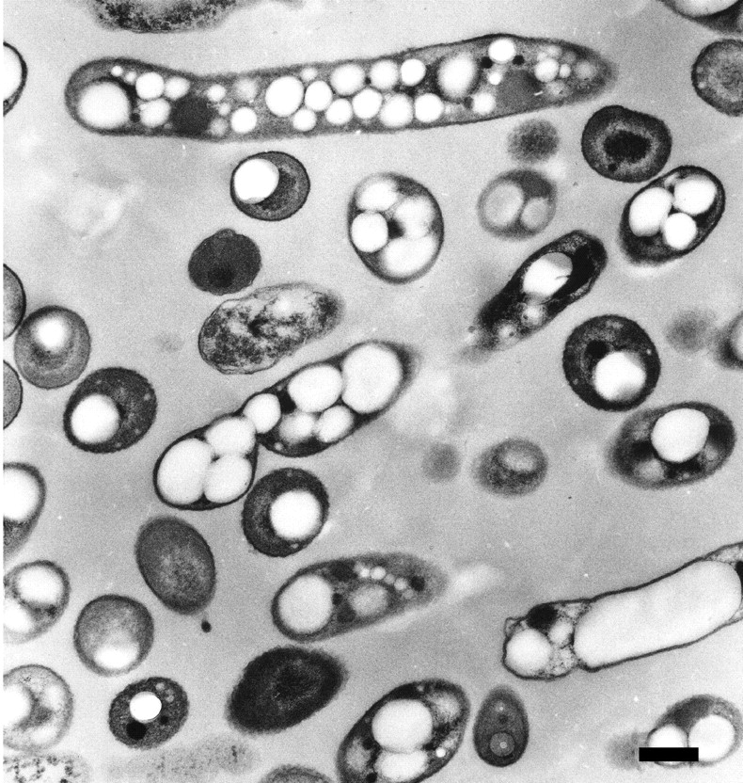
Polyhydroxybutyrate (PHB)
Inclusion bodies – accounts 90% of the dry cell mass
Biodegradable to water and carbon dioxide
Bio-based plastics - petroleum prices and plastic pollution
http://jb.asm.org/content/187/11/3814.full
Wautersia eutropha H16

Slide 6
Need of the study
Cost of sugars - major limiting factor for the commercial success of PHB
45% of production cost - for raw materials
70-80% of the total expense - carbon source
Need of suitable renewable and inexpensive carbon sources

Slide 7
Use of Feedstock for PHB production
Increasing global demand for sustainable resources
Cellulosic biomass - agricultural residues - potential inexpensive renewable feedstock
Lignocellulosic biomass into sugars - potential carbon resources for PHB production

Slide 8
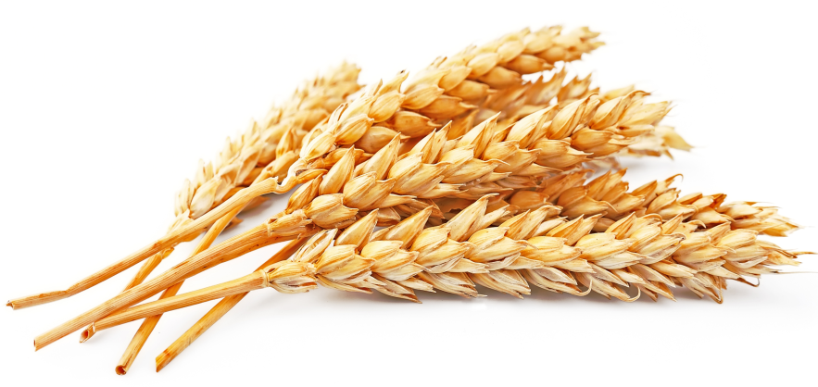
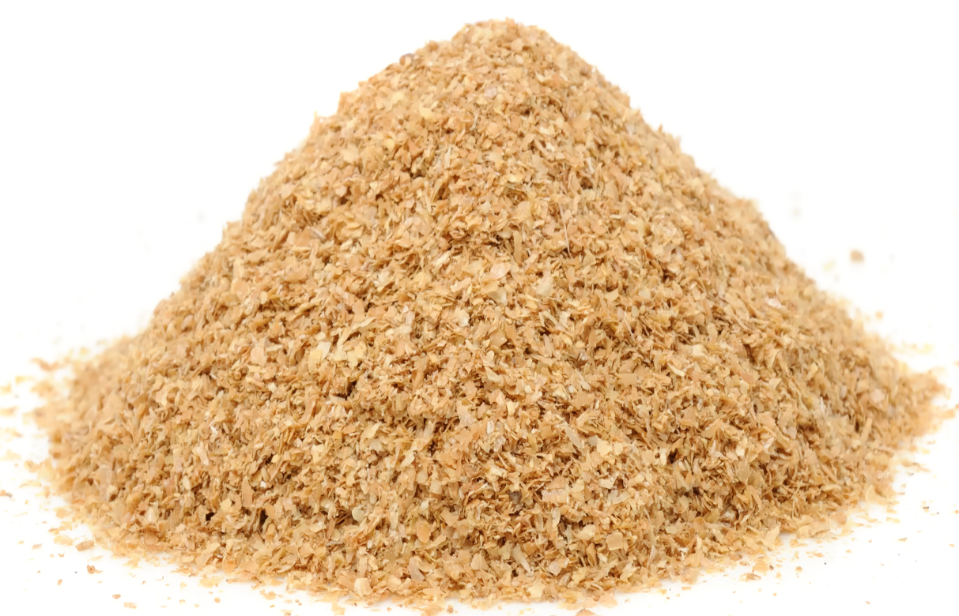
Use of Feedstock for PHB production
Wheat is a major global commodity
Generates huge quantity of wheat bran as a waste
Underutilized
www.wisegeek.com

Slide 9
Use of Feedstock for PHB production
Consists of cellulose, arabinoxylans and β- (1,3)/ β- (1,4)- glucan, starch, protein and lignin
Potential to serve as a low-cost feedstock - as renewable energy

Slide 10
Bottlenecks
Efficient hydrolysis of cellulose to glucose
  recalcitrant composite structure of lignin, hemicellulose and cellulose
Enzymatic saccharification
Efficiency and effectiveness
  feedstock characteristics
  pretreatment methods
  hydrolysis conditions

Slide 11
Aims
Pretreatment of wheat bran
Enzymatic hydrolysis of wheat bran into fermentable sugars and further production of PHB using Ralstonia eutropha

Slide 12
Methodology
Wheat bran (WB) - destarched by the method of Zhou et al., (2010)
Destarched WB + 1% NaOH [1:10 (w/v)] autoclaved at 121ºC for 30 min
Centrifugation - residue - washed thrice with distilled water - dried at 50ºC - used for further enzymatic hydrolysis

Slide 13
Analytical Methods
Moisture content - NREL/TP-510-42621 (Sluiter et al., 2008a)
Ash contents- NREL/TP-510-42622 (Sluiter et al., 2008b)
The structural carbohydrates-NREL/TP-510-42618 method (Sluiter et al., 2012)

Slide 14
Analytical Methods
The cellulose and hemicellulose content was analyzed by HPLC (Shimadzu; LC10AD)
Sugars (glucose and xylose) were quantified by external calibration with standards
The acid soluble and insoluble lignin - NREL/TP-510-42618 (Sluiter et al., 2012).

Slide 15
Enzymatic Hydrolysis of Pretreated Wheat Bran
Enzymes used
Cellulase from Trichoderma reesei (37 FPU/g)
β - glucosidase from Aspergillus niger (50 CBU/g )

Slide 16
Enzymatic Hydrolysis of Pretreated Wheat Bran
Pretreated wheat bran in 50 mM citrate buffer (pH 4.8) [10% (w/v)]
Incubated at 50ºC and 150 rpm for 96 h
Samples were withdrawn at regular interval of 12 h
Centrifuged at 10,000 xg for 10 min and the supernatant was subjected to sugar analysis in HPLC.
The percentage of hydrolysis were calculated based on the amount of glucan (cellulose) and xylan (xylose) present in the initial substrates and sugars released by hydrolysis

Slide 17
Production of PHB
Wheat bran - after enzymatic hydrolysis – centrifuged – supernatant – pH 6.8
2.4 - KH₂PO₄; 2.5 - Na₂HPO₄; 0.5 - MgSO₄; 0.1- Ferric ammonium citrate and 4.5 - NH₂SO₄ (g/L) were added to the supernatant (C/N – 20:1) and filter sterilized (0.2µm)
Seeded with 1% inoculum (R. eutropha precultured in a nutrient medium) and incubated at 150 rpm for 96 h at 30ºC

Slide 18
Production of PHB
Cell growth at 600 nm, Cell dry weight (DCW)
Extraction of PHB
Harvested cells
6% sodium hypochlorite and chloroform
37ºC at 300 rpm for 2 h
Cellular debris removed and concentrated
PHB polymer precipitated with chilled methanol (1:9)
Separated and dried in vacuum at room temperature

Slide 19
Results and discussion
Table 1. Composition of untreated and pretreated wheat bran
Raw material | Cellulose, as glucose (%) | Hemicellulose, as xylose (%) | Lignin (%)
Untreated | 32.43 ± 0.34 | 26.34 ± 0.25 | 20.15 ± 0.28
Pretreated | 54.84 ± 0.57 | 20.25 ± 0.66 | 08.93 ± 0.40

Slide 20
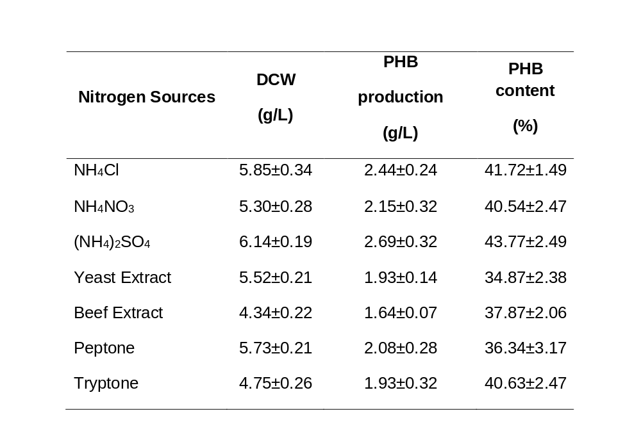
Results and discussion
Table 2. Effect of various nitrogen sources on cell growth (DCW),
PHB production (g//L) and PHB content (%) of R. eutropha

Slide 21
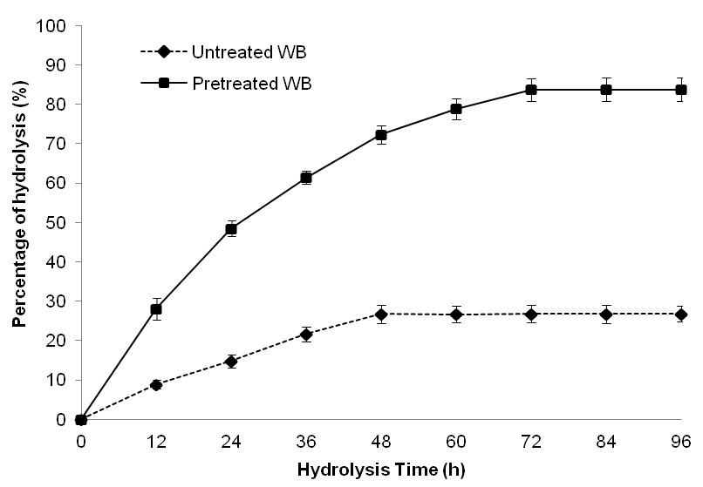
Results and discussion
Fig. 1. Percentage hydrolysis of untreated and pretreated wheat bran

Slide 22
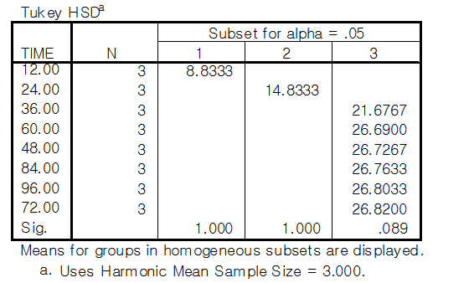
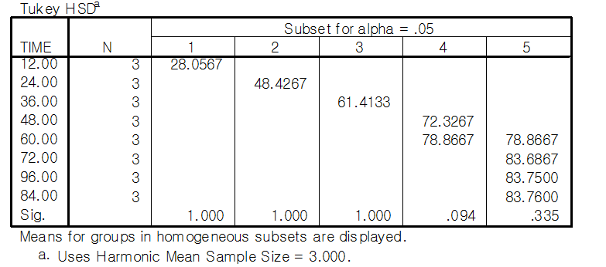
Results and discussion
Table 3. Tukey Post Hoc analysis of hydrolysis of untreated and
pretreated wheat bran

Slide 23
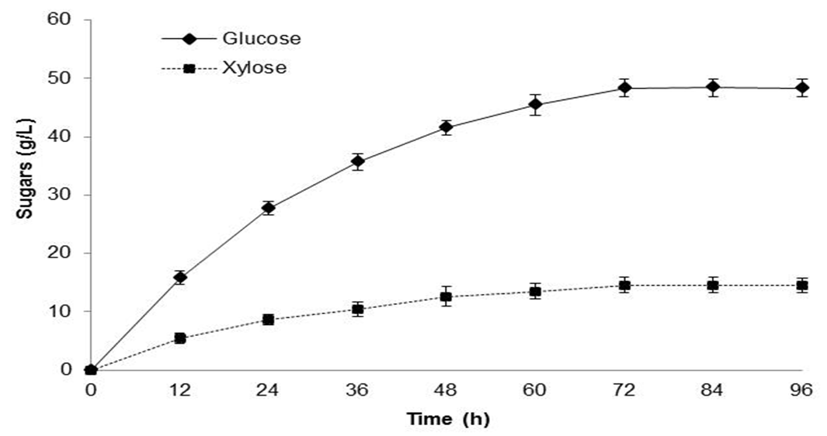
Results and discussion
Fig. 2. Sugars such as glucose and xylose from wheat bran through
enzymatic hydrolysis by cellulase of T. reesei

Slide 24
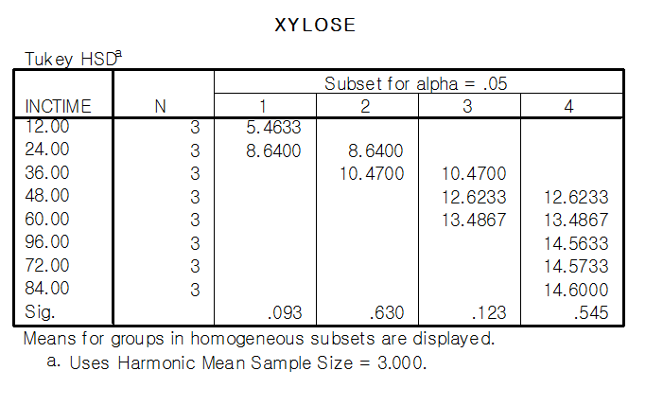
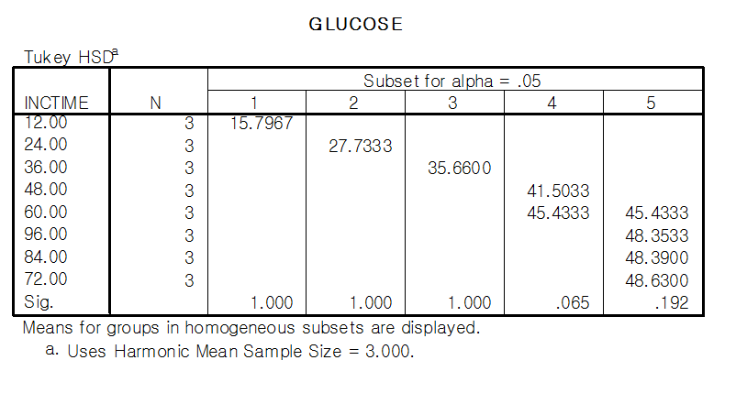
Results and discussion
Table 4. Tukey Post Hoc analysis of xylose and glucose released from
pretreated wheat bran

Slide 25
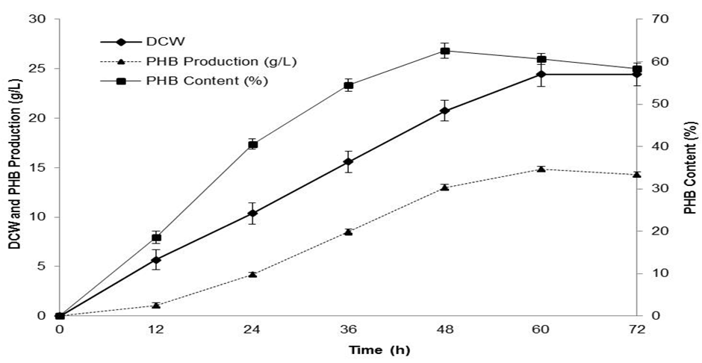
Results and discussion
Fig. 3. DCW, PHB production and PHB content produced from enzymatic hydrolysis of pretreated wheat bran using R. eutropha

Slide 26
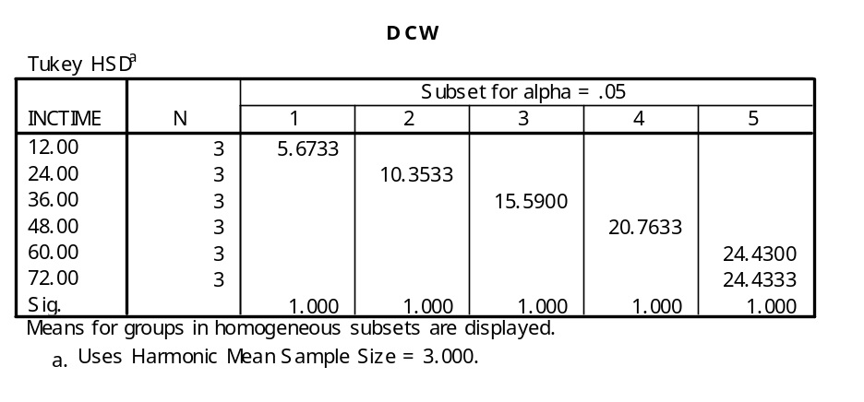
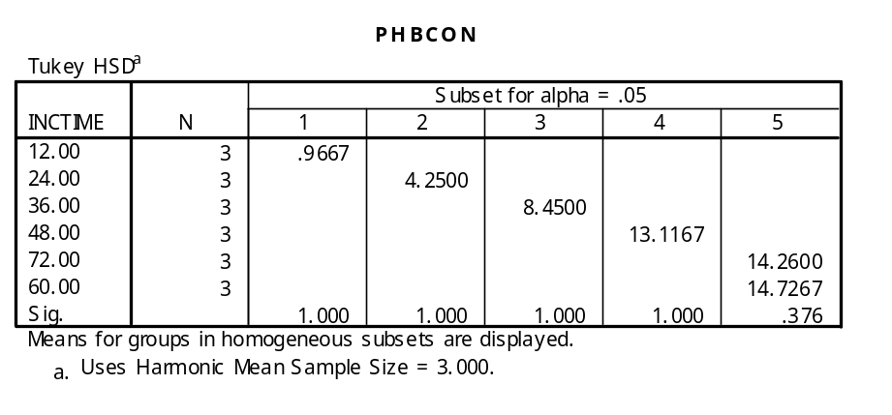
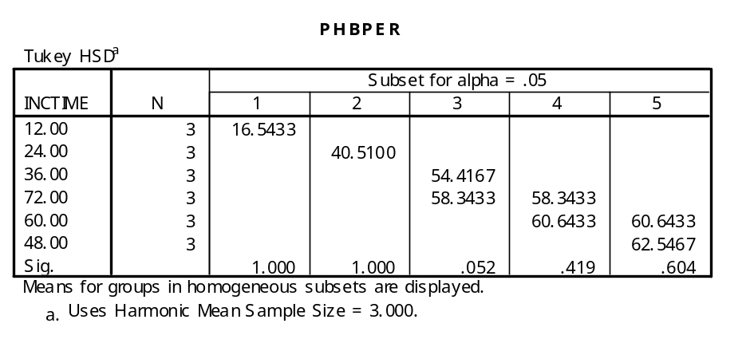
Results and discussion
Table.5 Tukey Post Hoc analysis of DCW, PHB production and PHB content

Slide 27
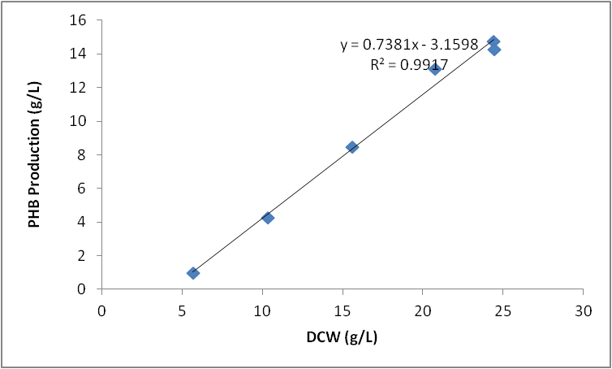
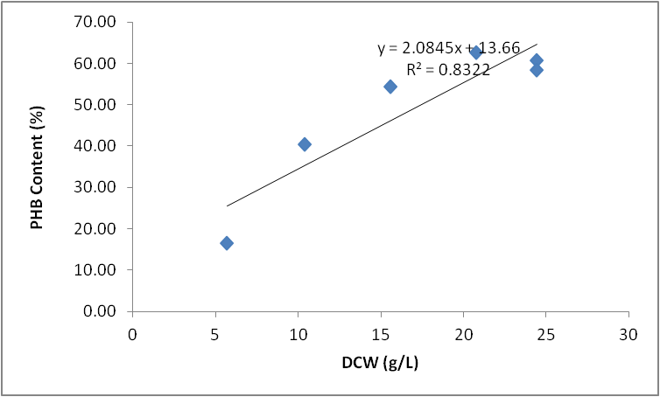
Results and discussion
Fig. 4. Regression analysis of a) DCW and PHB production and
b) DCW and PHB content

Slide 28
Results and discussion
The results suggested that the yield of PHB was 0.330 g/g where 48 g/L of glucose obtained from pretreated wheat bran
  higher than the yield (0.267 g/g for 45 g/L sugar) of B. megaterium using OPEFB hydrolysate (Zhang et al., 2013) and
  lower (0.39 g/g) than xylose utilizing bacterium B. cepacia IPT 048PHB utilizing sugarcane bagasse (Silva et al., 2004)
  The PHB content of R. eutropha (62%) in the present study was comparable with the earlier studies on utilizing lignocellulosic biomass (Yu and Stahl, 2008; Silva et al., 2007).

Slide 29
Conclusions
Alkaline pretreatment increases the exposure of cellulose in the wheat bran
Detoxification may not be required
High correlation exist between DCW and PHB production
Wheat bran could be a potential carbon source for polyhydroxybutyrate production by R. eutropha
Could reduce the production cost besides reducing the disposal problem of these substrates

Slide 30
References
Sluiter A, Hames B, Ruiz R, Scarlata C, Sluiter J, Templeton D, Crocker D. 2008. Determination of Structural Carbohydrates and Lignin in Biomass. Golden, CO: National Renewable Energy Laboratory.
Sluiter JB, Ruiz RO, Scarlata CJ, Sluiter AD, Templeton DW. 2010. Compositional analysis of lignocellulosic feedstocks. 1. Review and description of methods. J Agric Food Chem 58(16):90439053.
Sluiter A, Hames B, Ruiz R, Scarlata C, Sluiter J, Templeton D (2008a) Determination of sugars, byproducts and degradation products in liquid fraction process samples (LAP). NREL, Golden, CO.
Sluiter A, Hames B, Ruiz R, Scarlata C, Sluiter J, Templeton D, Crocker D (2008b) Determination of structural carbohydrates and lignin in biomass (LAP). NREL, Golden, CO.
Zhang Y, Sun W, Wang H, Geng A. Polyhydroxybutyrate production from oil palm empty fruit bunch using Bacillus megaterium R11. Bioresour Technol. 2013;147:307–14. doi: 10.1016/j.biortech.2013.08.029.
Silva LF1, Taciro MK, Michelin Ramos ME, Carter JM, Pradella JG, Gomez JG. Poly-3-hydroxybutyrate (P3HB) production by bacteria from xylose, glucose and sugarcane bagasse hydrolysate. J Ind Microbiol Biotechnol. 2004 Jul;31(6):245-54.
Yu J., Stahl H. Microbial utilization and biopolyester synthesis of bagasse hydrolysates. Bioresour Technol. 2008;99:8042–8048.

Slide 31



