Slide 1
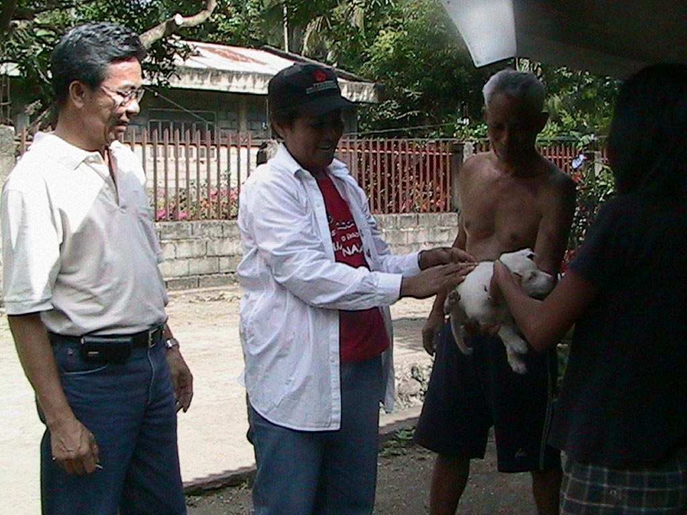

Slide 2
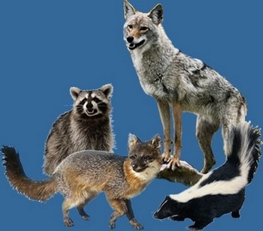
A study of certain sociodemographic factors among patients with dog bite in Community Health Centre, Mulky, Dakshina Kannada District, INDIA
Dr N UDAYA KIRAN
Professor and Head, Department of Community Medicine,
K S HEGDE MEDICAL ACADEMY, Nitte University, MANGALORE (INDIA)

Slide 3
Introduction
Rabies an archaic zoonotic disease
Described in the ancient Indian Scripture, the Atharvaveda
Major public health problem even today (Deshmukh, 2004).
10th biggest cause of death due to infectious diseases GLOBALLY
50,000 - 60,000 deaths annually
Majority in tropical developing countries (Haupt, 1999)

Slide 4
Introduction
36% of these deaths occur in India
2.74 rabies cases per 100,000 people per year,
Deaths projected as 20,565 annually³.

Slide 5
OBJECTIVE OF THE STUDY
To estimate the number of dog bite cases coming for vaccine
To study their compliance
To throw light upon the requirements needed
To study the difficulties in vaccination

Slide 6
METHODOLOGY
Type of study: Longitudinal study
Study duration: November 2015 to April 2016
Study population: Patients receiving anti rabies vaccine
Data collection: Pre-tested, structured questionnaire
Data analysis: SPSS software

Slide 7
METHODOLOGY
INCLUSION CRITERIA
All the dog bite patients receiving anti rabies vaccine in the OPD during study period
Who are willing to participate in the study .
EXCLUSION CRITERIA
Patients who are severely sick and not able to respond
Patients who were last for follow up

Slide 8
RESULTS
Table 1 Sociodemographic distribution of study Population (N=235)
Age group (in years) | Number | Percentage
Less than 10 | 20 | 8.51
11-20 | 36 | 15.31
21-30 | 54 | 22.97
31-40 | 45 | 19.14
41-50 | 34 | 14.46
More than 50 | 46 | 19.57
Sex
Male | 135 | 57.44
Female | 100 | 42.56
Religion
Hindu | 211 | 89.78
Muslim | 14 | 5.95
Christian | 10 | 4.25
Socioeconomic Status
APL(Above Poverty line) | 94 | 40.00
BPL(Below Poverty line) | 141 | 60.00

Slide 9
RESULTS
Table 2.Nature of wounds in the Study Subjects (N=235)
Site of Dog Bite | Number | Percentage
Leg | 105 | 44.68
Hand | 109 | 46.38
Others | 21 | 8.9
Severity of the wound
Category I | 34 | 14.46
Category II | 132 | 56.17
Category III | 69 | 29.36
Cleaning of the Wound
Yes | 221 | 94.04
No | 14 | 5.96
Cleaning Agent (N=221)
Water | 68 | 30.76
Water with soap | 138 | 62.44
Other | 15 | 15.06

Slide 10
RESULTS
Table 3:-Vaccine Coverage of the study subjects (N=235)
Time Interval | Number | Percentage
Same day of dog bite | 158 | 67.23
Previous day | 49 | 20.85
>2day | 28 | 11.91
Referred by Whom
Self | 162 | 68.93
Private hospital | 32 | 13.61
PHC | 41 | 17.44
Number of Doses received
1 | 34 | 14.46
2 | 36 | 15.31
3 | 44 | 18.72
4 | 40 | 17.02
5 | 81 | 34.46

Slide 11
RESULTS
Study subjects were 235 and all of them were bitten by dogs
Over a period of 6 months
22.97% were in the 21-30 years age group
19.14% were in the 31-40 years age group
19.57% were more than 50 years of age.
57.44% were males and 42.56% were females.
211 (89.7%) subjects belongs Hindu religion followed by Muslims.
Majority of the study subjects belongs to BPL Family (60%)

Slide 12
RESULTS
44.68% of the bites were on the legs
46.38% were bitten on the hands
8.9% were bitten on the body and the rest in multiple sites.
14.46% - Category 1
56.17% Category 2
29.36% Category 3
94.04% of the victims cleaned the wound

Slide 13
RESULTS
67.23% subjects approached the hospital on the same day of dog bite
20.85% came on the next day
11.91% came to the hospital after 2 days.
68.93% came to this hospital of their own
31% referred by private hospital and PHC.
34.46% received all 5 doses of vaccination
18.72% received 3 doses
17.02% received 4 doses

Slide 14
Discussion
Majority of the dog bite victims were males 57.44%.
66% of those bitten were below 40 years
Studies have reported a similar profile ^{4, 5}.
Varied results for completion of anti-rabies regimen (40 % t0 50%)⁶
Retrospective studies in India dogs were the biting animals
Majority of the victims were males and unvaccinated
10% of the victims were partially immunized ⁷

Slide 15
CONCLUSION
People are aware of the necessity to approach a health facility following dog bite
The method of cleaning needs to be studied
They are keen to start the vaccination
They are not motivated to complete the full course
There is a need to create awareness regarding adherence to treatment
Strong IEC programme should be implemented

Slide 16
REFERENCES
Deshmukh RA. Rabies. Pune (India): Yogaksema Department of Virology, Haffkine Institute; 2004.
Haupt W. Rabies- risk of exposure and current trends in prevention of human cases. Vaccine.1999; 17:1742-9.
Rozario Menezes. Rabies in India, MD, CMAJ • February 26, 2008 • 178(5)
Aghahowa SE, Ogbevoen RN. Incidence of dog bite and anti-rabies vaccine utilization in the, University of Benin Teaching Hospital, Benin City, Nigeria: A 12-year assessment. Vaccine. 2010 Jul 5; 28(30):4847-50.
Clinical and epidemiological features of human rabies cases in the Philippines: a review from 1987 to2006. Into J Infect Dis. 2011 Jul; 15(7):e495-9.

Slide 17
REFERENCES
6.Sudarshan MK, Mahendra BJ, Madhusudana SN, AshwoathNarayana DH, Rahman A, Rao NS, XMeslinF, Lobo D, Ravikumar K, Gangaboraiah. An epidemiological study of animal bites in India: results of a WHO sponsored national multi-centric rabies survey. J Commun Dis. 2006 Mar; 38(1):32-9.
7.Sudarshan MK, Madhusudana SN, Mahendra BJ, Rao NS, AshwathNarayana DH, Abdul Rahman S,Meslin F-, Lobo D, Ravikumar K, Gangaboraiah. Assessing the burden of human rabies in India: results of a national multi-center epidemiological survey. Int J Infect Dis. 2007Jan;11(1):29-35.

