Slide 1


World Congress and Expo on Applied Microbiology August 18-20, 2015 Frankfurt, Germany
ALKANNA ORIENTALIS (L.) BOISS. plant callus cultures as novel source with antibacterial activity
Dr. Naira Sahakyan

Slide 2
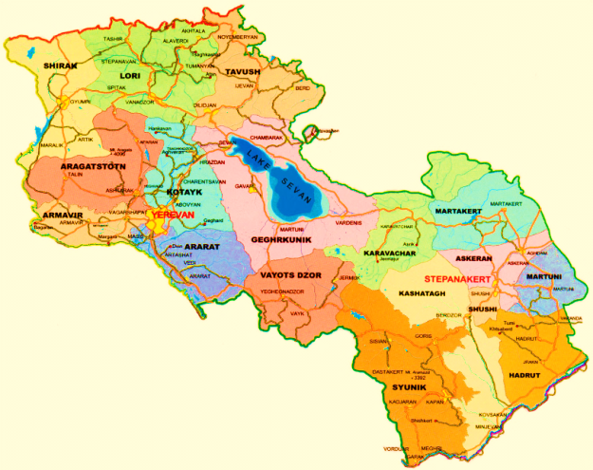
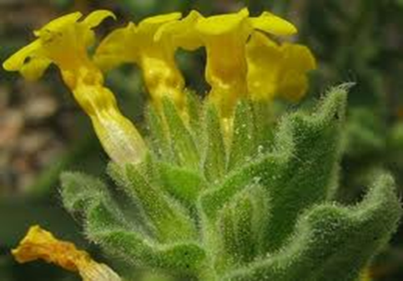
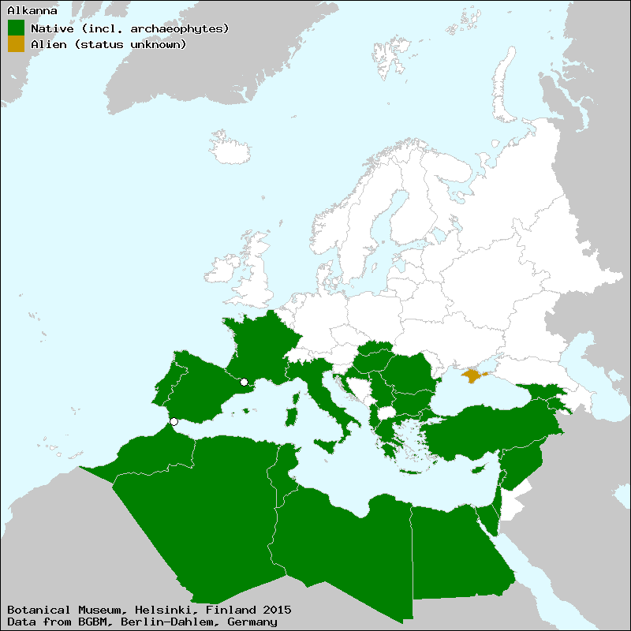
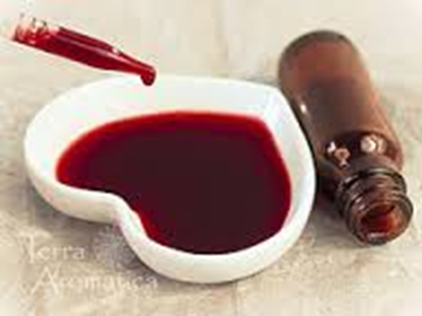
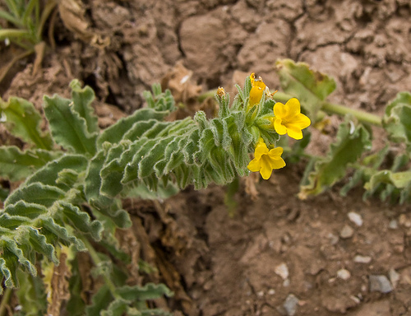
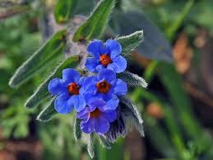
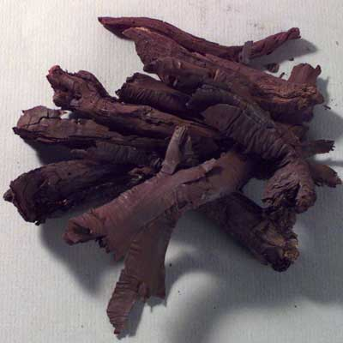
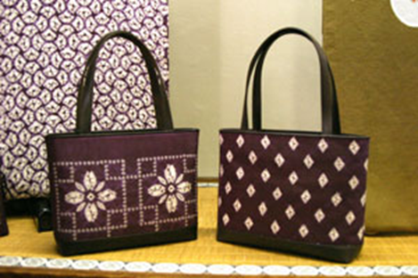
Alkanna orientalis
Alkanna malatyana
Alkanna tinktoria
http://ww2.bgbm.org/EuroPlusMed/PTaxonDetail.asp?NameId=109422&PTRefFk=7100000
Biodiversity Assessment for Armenia (2000) USAID Contract number:LAG-I-009900014-00
E. Vitek, G. Fayvush, K. Tamanyan, B. Gemeinholzer (2010) New taxa of Gundelia (Compositae) from Armenia. Ann- Naturhist. Mus. Wien, B 111: 85-99

Slide 3
STUDIED SIDES
In recent years preparations based on biologically active compounds of plant origin possessing antimicrobial and antiviral activity, have been widely used for the treatment of various infectious diseases. (Abdallah EM (2011) Plants: an alternative source for antimicrobials. J Appl Pharm Aci 1(1):16-20.)
Some biologically active compounds of different plants including Alkanna sp. (Boraginaceae) possess detoxifying properties by means of inactivating the microbe toxins and have antioxidant and cytotoxic effects. (Bame et al., (2013) Sarothrin from Alkanna orientalis is an antimicrobial agent and efflux pump inhibitor. Planta Med 79(5):327–329).
Alkanna sp. produce naphtoquinones, known to have antimicrobial and cytotoxic activities. Pigment shikonin ((±)-5,8-dihydroxy-2-(1-hydroxy-4-methyl-3-pentenyl)-1,4-naphthoquinone) and its esters are the widely studied class of these substances which are used in medicine, cosmetics and food industry, and they are commercially very important. (Chen et al., (2001) Shikonin, a component of antiinflammatory Chinese herbal medicine, selectively blocks chemokine binding to CC chemokine receptor-1. Int Immunopharmacol 1:229–23; Chen et al.,(2003) Shikonin, a component of Chinese herbal medicine, inhibits chemokine receptor function and suppresses human immunodeficiency virus type 1. Antimicrob Agents Chemother 47(9):2810–2816).
Plant origin quinones may suppress the activity of electron transport systems of many microorganisms and ATP production (Dadi et al., (2009) Inhibition of ATPase activity of Escherichia coli ATPsynthase by polyphenols. Int J Biol Macromol 45(1):72-79.)
Sarothrin from A. orientalis as an antimicrobial agent can inhibit efflux pumps activity of Staphylococcus aureus (Bame et al., (2013)Sarothrin from Alkanna orientalis is an antimicrobial agent and efflux pump inhibitor. Planta Med 79(5):327-329.
There is a little information concerning isolated cultures of Boraginaceae family plants, bu isolated culture of A.orientalis as a source of naphthoquinones has not been examined yet (Malik et al., (2014) Biotechnological approaches to the production of shikonins: a critical review with recent updates. Critical review with recent updates. Crit Rev Biotechnol. Doi:10.3109/07388551.2014.961003.)
Therefore, obtaining of isolated cultures of A. orientalis, developing conditions for their cultivation, as well as maintenance of a stable growth and active metabolism are of considerable interest to develop new cell lines possessing the ability to accumulate naphthoquinones

Slide 4
THE AIM OF THE PRESENT WORK
• Obtaining of A. orientalis isolated cultures
• Developing conditions for their cultivation
• Maintenance of a stable growth and active metabolism
• Investigation antimicrobial activity of A. orientalis extracts by revealing of responsible mechanisms

Slide 5

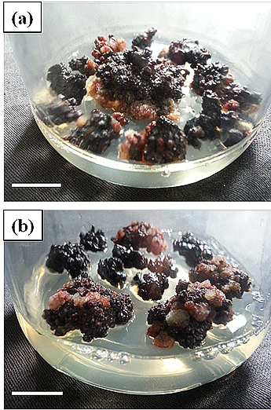
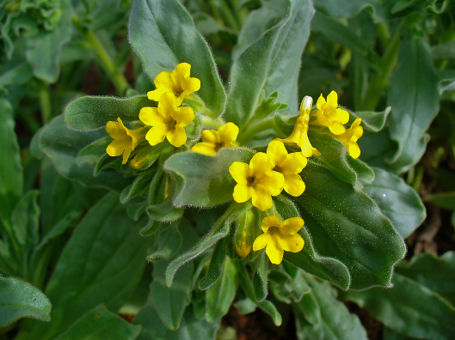
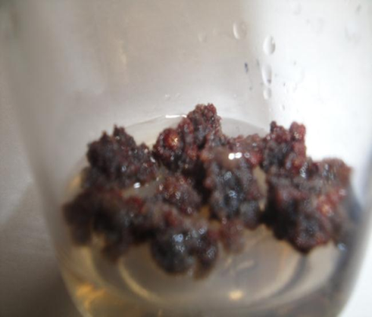
Isolation of A. orientalis cultures
A. orientalis
A. orientalis callus culture on MS control (N1) medium
A. orientalis callus culture on (a) N2 and (b) N3 media
Murashige T, Skoog F (1962) A revised medium for rapid growth and bio assays with tobacco tissue culture. Physiol Plantarum 15(3):473-479
Petrosyan MT, Shcherbakova Y, Sahakyan NZ, Vardanyan Z, Poladyan A, Popov YG and Trchounian A. Alkanna orientalis (L.) Boiss. plant isolated cultures and antimicrobial activity of their extracts: phenomenon, dependence on different factors and effects on some membrane associated properties of bacteria. Plant Cell Tiss Organ Cult 2015:online

Slide 6
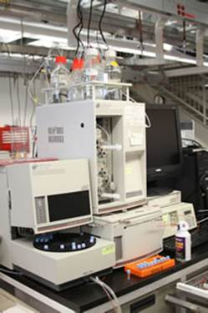
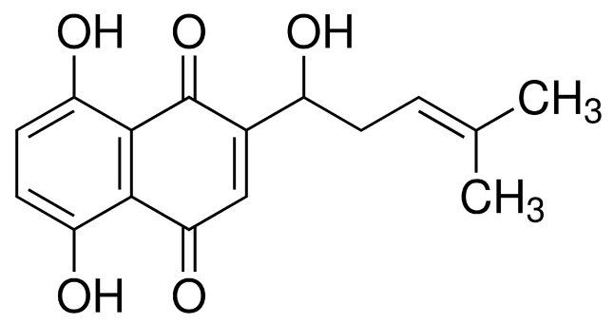
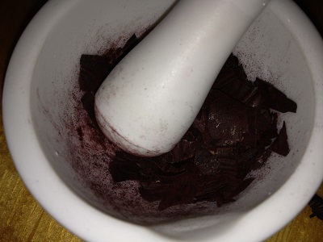
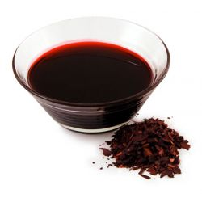
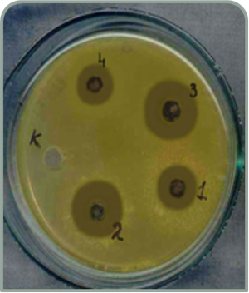
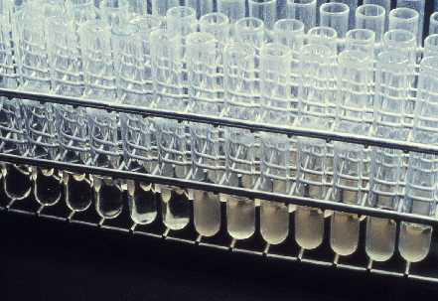
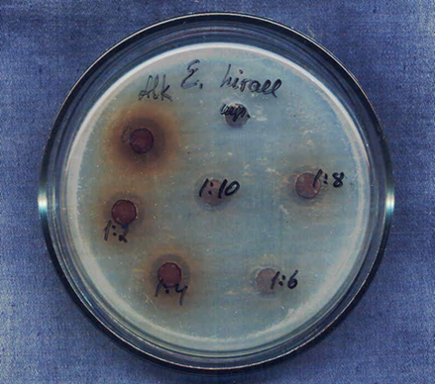
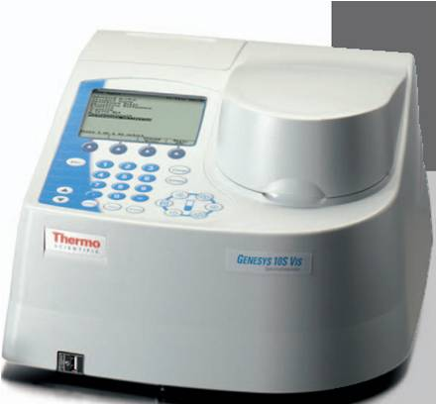
Determination of naphthoquinones (shikonin)
Extract preparation
Determination of extract antimicrobial activity
Patel et al., (2014) Performance Standards for Antimicrobial Susceptibility Testing; Twenty-Fourth Informational Supplement. M100-S24. 34(1), p 226

Slide 7
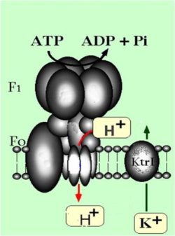
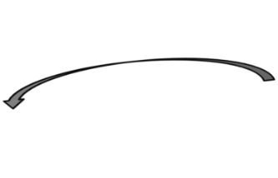
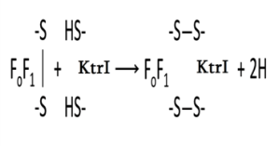

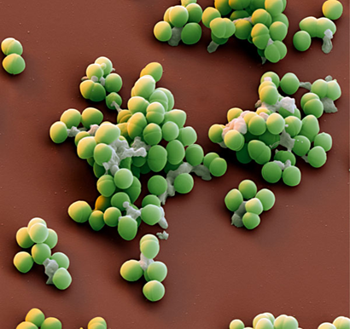
Investigation of some membrane-associated properties of E. hirae under the influence of A.orientalis intact plant and isolated culture extracts
F₀F₁ ATPase
Determination of ion fluxes across the cell membrane
Membrane vesicle
Determination of accessible thiol-groups number
Determination of ATPase activity
E. hirae
Poladyan A, Trchounian A (2006) The increase in the number of accessible SH groups in the Enterococcal membrane vesicles by ATP and nicotinamide adenine dinucleotides. Curr Microbiol 52(4):300-304.
Poladyan A, Trchounian A (2011) Transport of protons and potassium ions through the membranes of bacteria Enterococcus hirae dependent on ATP and nicotinamide adenine dinucleotides. Biophysics 56(4):668-671

Slide 8
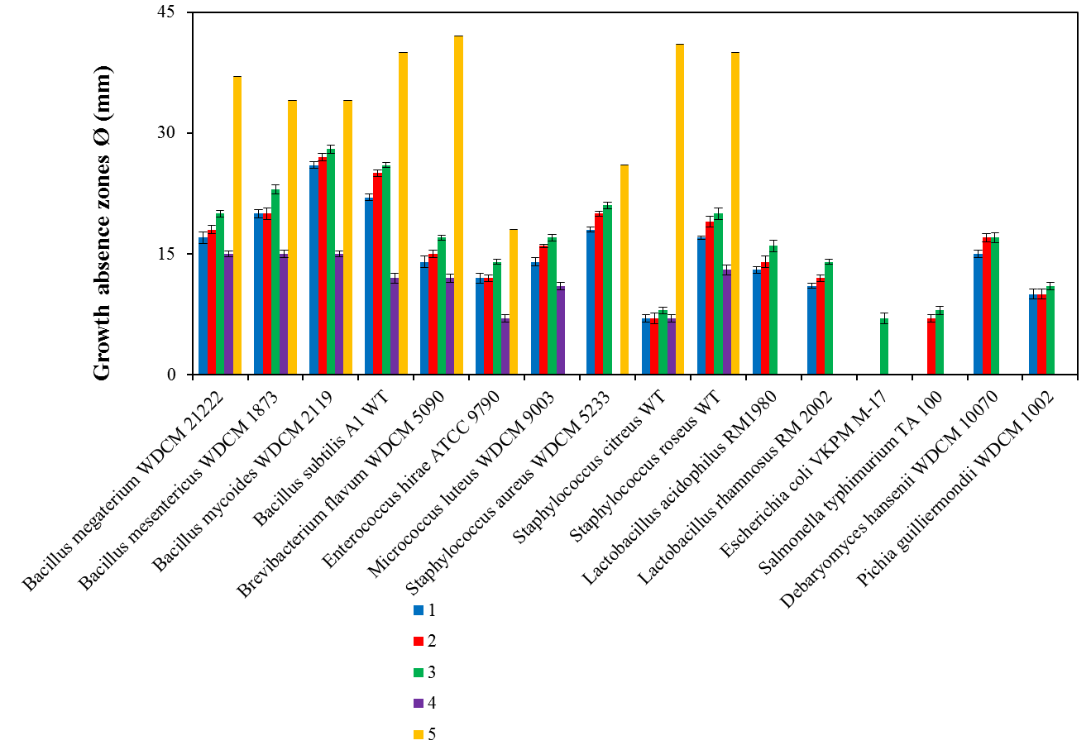
Sizes of the test microorganism’s growth absence zones under the influence of A. orientalis callus tissues and intact plant extracts
callus tissue extracts growing on medium N1 (control)
callus tissue extracts growing on medium N2
callus tissue extracts growing on medium N3
Intact plant root extracts
positive control (ampicillin 50 lg/mL)

Slide 9
Minimal inhibitory concentrations of A. orientalis callus tissues extracts, shikonin and ampicillin against some microorganisms
Test microorganisms | MIC (μg/mL)
 | A.orientalis extract | Positive controls
 |  | shikonin | Ampicillin
B.megateriumWDCM 2122² | 125 | 15.625 | 12.5
B. mesentericus WDCM 1873 | 125 | 15.625 | 12.5
B.Mycoides WDCM2119 | 125 | 15.625 | 12.5
B. Subtilis A1 WT | 125 | 15.625 | 12.5
Br.flavum WDCM 5090 | 250 | 31.25 | 12.5
E. hirae ATCC 9790 | 250 | 31.25 | 12.5
M.luteus WDCM 9003 | 250 | 31.25 | NT²
St.aureusWDCM 5233 | 125 | 15.625 | 12.5
St.citreusWT | 500 | 62.5 | 25
St. roseusWT | 125 | 15.625 | 12.5
E. coli VKPM M-17 | 500 | 62.5 | 25
S.typhimurium TA 100 | 750 | 125 | NT
D.hansenii WDCM 10070 | 250 | 31.25 | NT
P. guilliermondii WDCM 1002 | 500 | 62.5 | NT
NT not tested

Slide 10
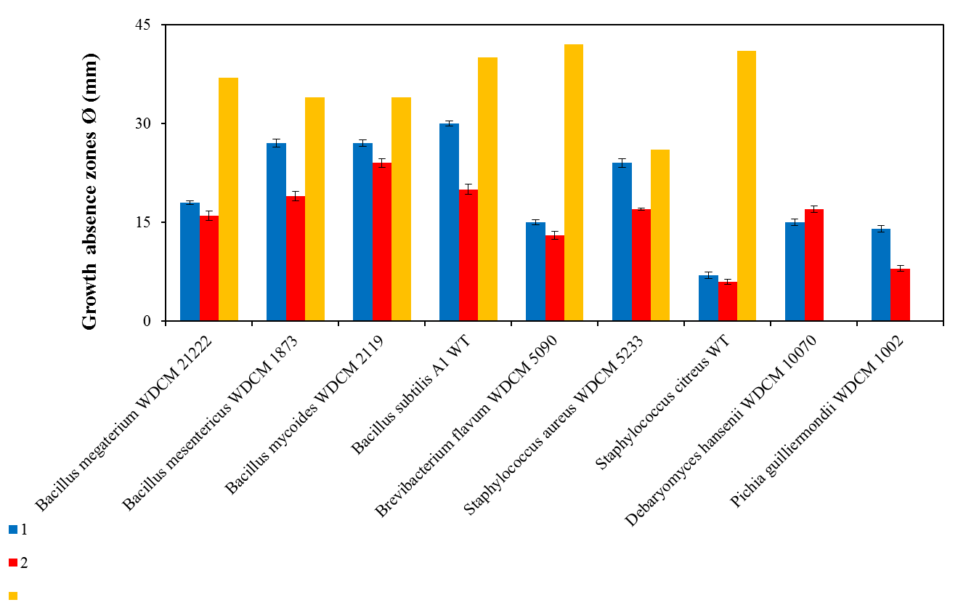
Influence of A.orientalis isolated culture cultivation period on its antibacterial activity
A.orientalis callus culture of 60th sub-cultivation
A.orientalis callus culture of 145th sub-cultivation
Positive control (Ampicillin)
P<0.05

Slide 11
H⁺/K⁺ exchange fluxes by E. hirae ATCC9790 in the presence of A. orientalis intact root and callus tissues extracts
Glucose (0.2 %) was added into the assay medium before bacteria. Control was without extracts supplementation. Ion fluxes calculated per 10¹⁰ cells/mL. DCCD-sensitivef luxes are the differences between fluxes in parallel experiments in the absence and presence of 0.2 mM DCCD. For p, *control is the sample without any additions; ** control is the sample where only intact root extract was added in appropriate quantities; *** control is the sample where only callus tissue extract was added in appropriate quantities.

Slide 12
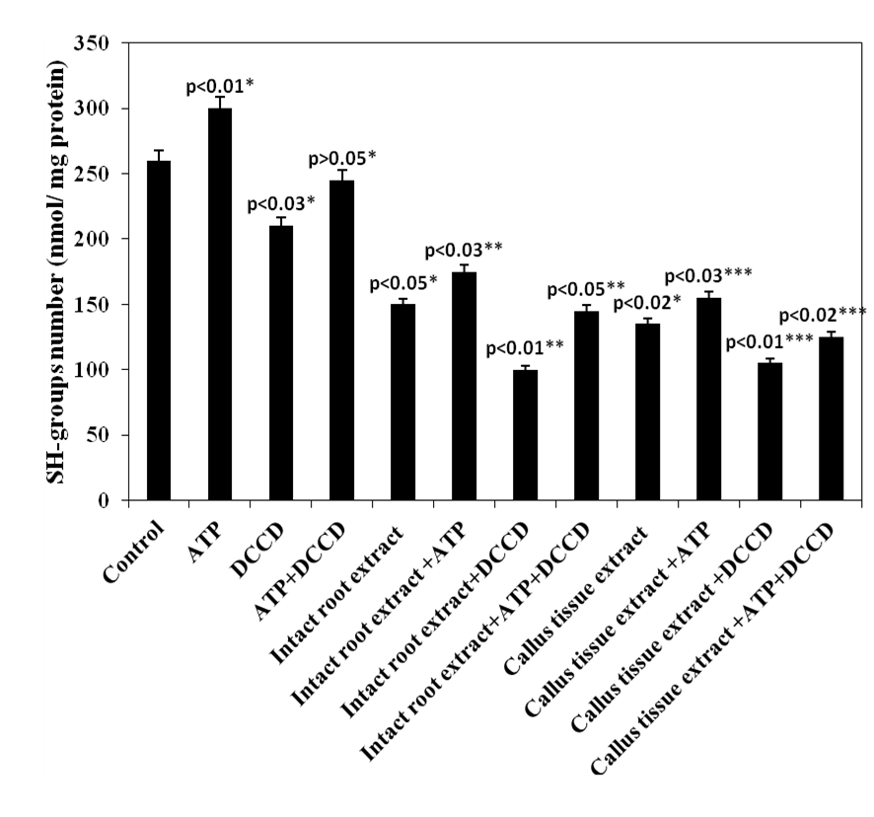
The changes in the number of accessible SH-groups of E. hirae ATCC9790 membrane vesicles in the presence of A. orientalis intact root and callus tissue extracts. 3 mM ATP and 0.2 mM DCCD were added into the medium when indicated

Slide 13
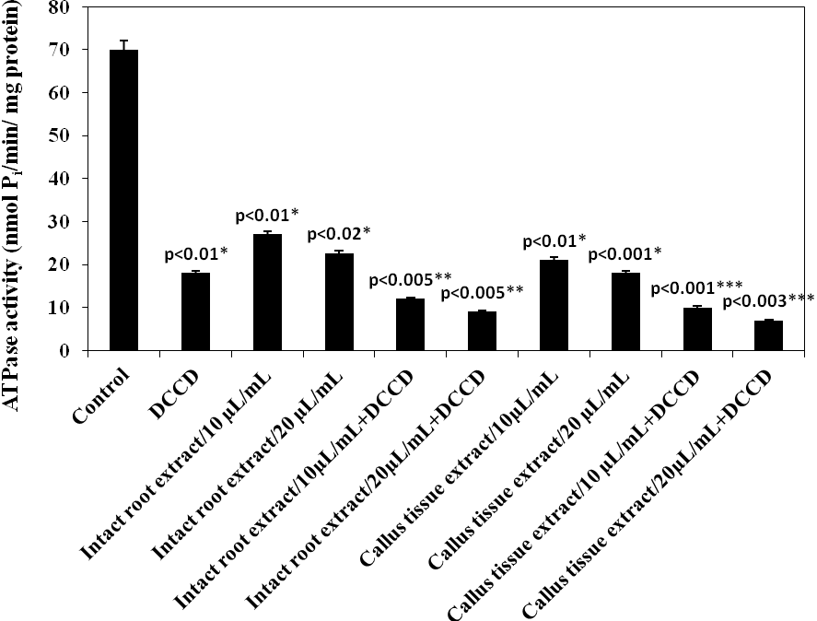
The changes in ATPase activity of E. hirae ATCC9790 membrane vesicles in the presence of A. orientalis intact root and callus tissue extracts. 0.2 mM DCCD was present in the assay medium when mentioned

Slide 14
Acknowledgement
Prof. A.H. Trchounian
Dr. M.T. Petrosyan
Dr. Anna Poladyan
The work was supported by the Basic research support by State Committee on Science, Ministry of Education and Science of Armenia (#10-3/9)

Slide 15
Thank you for your attention!

