Slide 1
Listeria monocytogenes risk in poultry meat and usage of bacteriophages as a biocontrol agent
Naim Deniz AYAZ
Kirikkale University Faculty of Veterinary Medicine, Department of Food Hygiene and Technology, Kirikkale, TURKEY

Slide 2
Foodborne pathogens and infections
Foodborne and waterborne pathogens kill an estimated 2 million people annually (WHO, 2014)
31 known agents of foodborne disease caused 48 million illnesses, 128,000 hospitalization, 3,000 deaths per year in USA (Scallan, 2011).
Costs the US economy $152 billion to $1.4 trillion per year (Scharff, 2010)

Slide 3
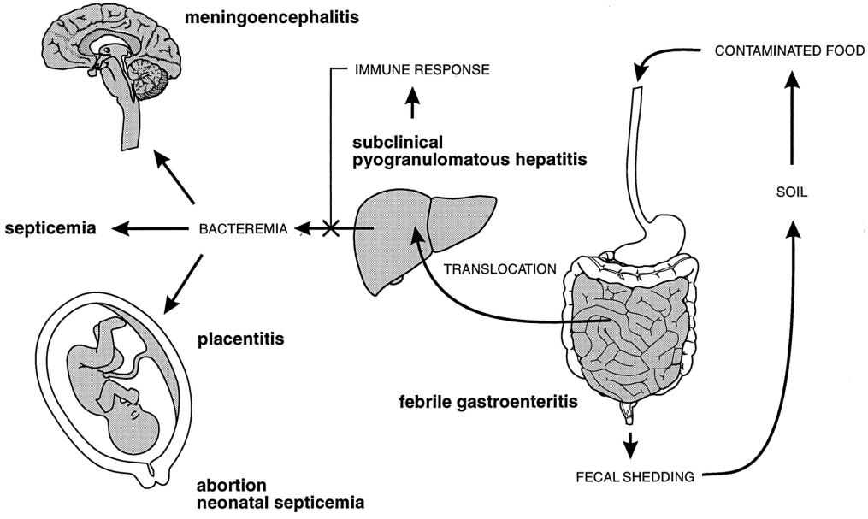
Listeria monocytogenes
L. monoctogenes is a zoonotic food-borne bacteria
Leads to a variety serious infections in humans such as
  encephalitis,
  meningitis,
  abortion
  septicemia,
  those suffering with listeriosis occurs in approximately 30% mortality.
Epidemiologic studies have revealed that a significant proportion of cases of listeriosis caused by contaminated foods

Slide 4
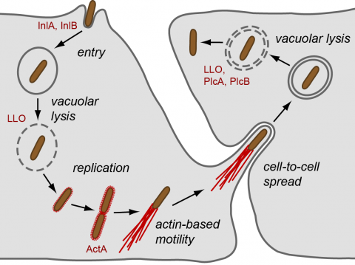
13 known serotypes, approximately 95% of the isolates from the food and 98% of the clinical isolates belong to 1/2a, 1/2b, 1/2c and 4b serotypes.
Most L. monocytogenes strains can cause high morbidity and mortality depending on their virulence, however some strains don’t cause any infections in mammals due to absence of their virulence factors.
L. monocytogenes provides its pathogenicity with virulence factors such as hlyA, actA, inlA, inlB, inlC, inlJ, plcA, plcB genes and vip, fbpA and fri
The presence of these genes is just as important as the expression levels that play an important role on its pathogenicity.

Slide 5
Who are in risk?
At least 90% of people who get Listeria infections are in a higher risk group. Healthy children and adults occasionally get infected with Listeria, but they rarely become seriously ill.
Pregnant women: About one in seven (14%) cases of Listeria infection occurs during pregnancy. Infection during pregnancy can cause fetal loss (miscarriage or stillbirth), preterm labor, and illness or death in newborn infants.
  Pregnant women are about 10 times more likely than the general population to get Listeria infection.
  Pregnant Hispanic women are about 24 times more likely than the general population to get Listeria infection.
Older adults: More than half (58%) of Listeria infections occur among adults 65 and older.
  Adults 65 years and older are about 4 times more likely than the general population to get Listeria infection.
People with weakened immune systems: such as cancer and immunosuppresive therapy (i.e., steroids, chemotherapy, radiation), liver or kidney disease, diabetes, alcoholism, and HIV/AIDS.

Slide 6
Some outbreaks caused by Lm
Country | Year | Food | Serotype | Affected person | Deaths
USA | 1998 | turkey deli meat | 4b | 108 | 18
Finland | 1998 | salmon trout | 1/2a | 5 | 0
Finland | 1998-1999 | butter | 3a | 25 | 24
USA | 1998-1999 | frankfurters | 4b | 108 | 18
France | 1999-2000 | meat | 4b | 10 | 10
France | 1999-2000 | pork tongue in jelly | 4b | 26 | 7
USA | 2000 | turkey deli meat | 1/2a | 30 | 7
USA | 2001 | sliced turkey meat | 1/2a | 16 | 0
USA | 2002 | delicatessen turkey meat | 4b | 54 | 11
USA | 2003 | Mexican style cheese | 4b | 12 | 2
Canada | 2008 | meat product |  | 57 | 22
USA | 2011 | cantaloupe | 1/2a, 1/2b | 147 | 33
USA | 2013 |  |  | 124 | 24
USA | 2014 | ice cream |  | 8 | 5

Slide 7
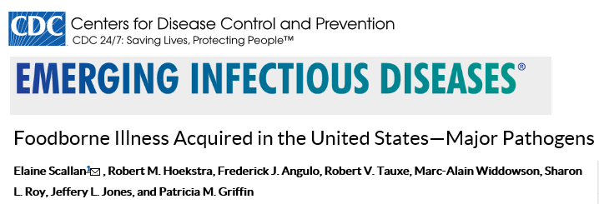
Incidence of listeriosis
CDC estimates that approximately 1600 illnesses and 260 deaths due to listeriosis occur annually in the USA.
In 2013, the average annual incidence of listeriosis in the United States was 0.26 cases per 100,000 individuals

Slide 8
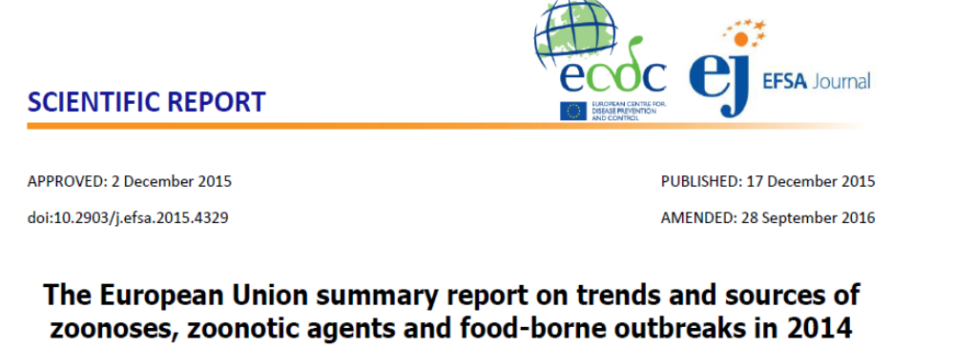
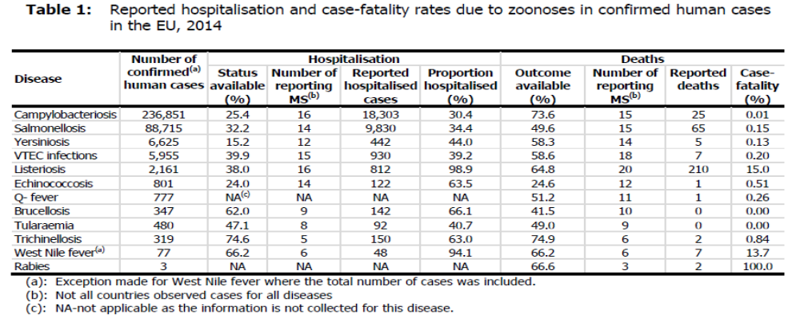

Slide 9
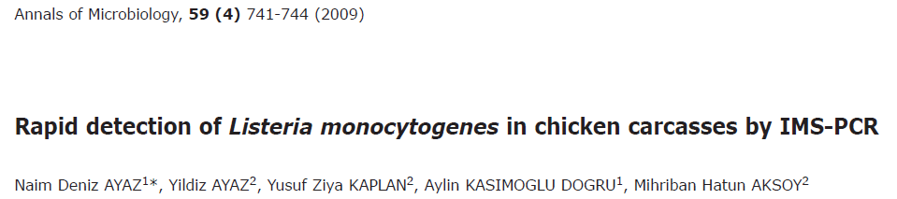
Poultry meat as a vehicle of Lm
240 chicken carcass samples from 7 different brands within a year period
İmmunoPCR method
Half Fraser Broth (30°C, 20-24 h) → Fraser Broth (37°C, 20-24 h) → IMS → PCR (hlyA).
Findings
3 day analysis
49/240 positivity (% 20,4) (L. monocytogenes +)
L. monocytogenes prevalance spring 5,8%; summer 6,3%; fall 4,2% and winter 4,2%

Slide 10
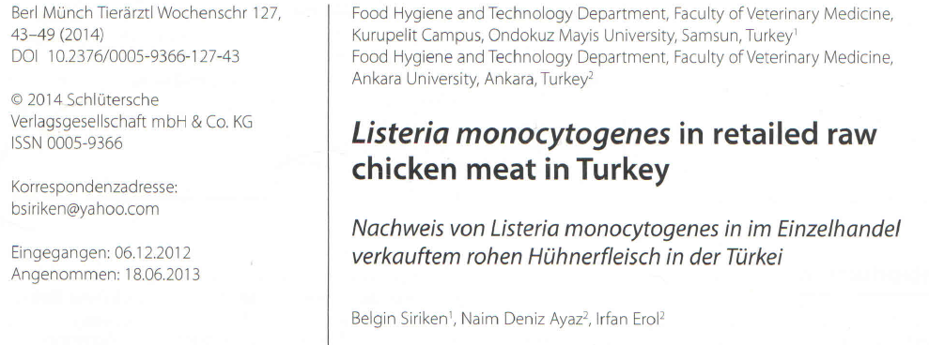
34/116 chicken meat (% 29,3) L. monocytogenes +
carcass 22%; cubic meat parts 34,8%
All 51 L. monocytogenes 1/2a (or 3a)
72,5% resistant to atleast one antibiotic
17,8% streptomycin, 13,7% tetracycline, 11,8% ampicillin, 7,8% vancomycin and 2% gentamicin

Slide 11
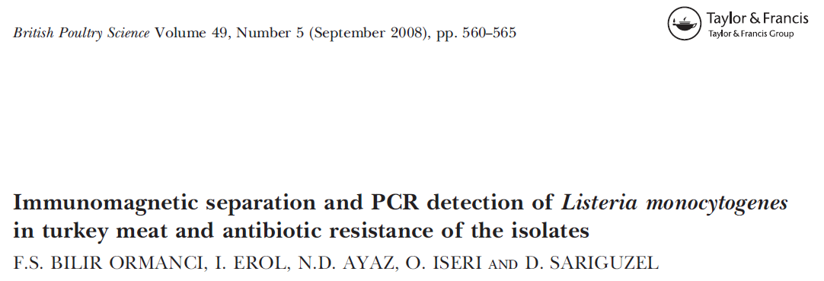
23/180 turkey meat (12,7%) L. monocytogenes +
Cubic meat parts 16,6%; breast meat 11,6% and leg 10,0%.
IMS based culture (22) ; conventional culture (15)
82,6% penicillin and 73,9% ampicillin resistance
%34,7’si eritromisine ve streptomisine intermediate resistance
Gentamycin, tetracycline, chloramphenicol and vancomycin susceptible

Slide 12
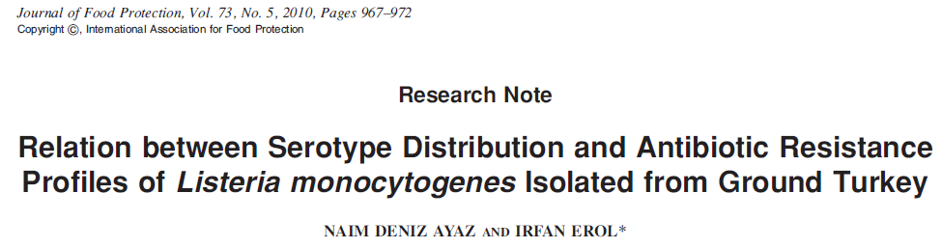
44,9% (35) serotype 1/2a (3a), 37,2% (29) 4b (4d or 4e), 9% (7) 1/2b (3b) and 9% (7) 1/2c (3c)
Summer and fall serotype 1/2a, winter 4b
63/78 (80,8%) penicillin G and 53 (67,9%) ampicillin resistance
İ
66,7% (52/78) penicillin G and ampicillin MDR
41,0% (32), 17,9% (14), 10,3% (8) and 7,7% (6); erythromycin, streptomycin, cephalothin and kanamycin intermediate resistance, respectively.

Slide 13
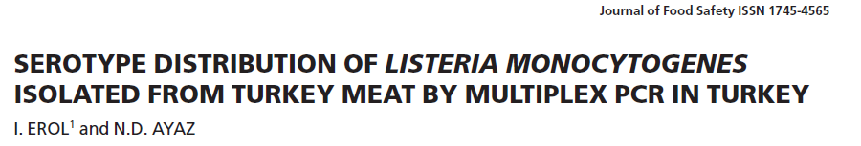
51,4% (19) serotype 4b (4d, 4e), 27,0% (10) 1/2a (3a) and 21,6% (8) 1/2b (3b)
4b dominant serotype
Summer 1/2a and 4b,
Winter 4b
Cubic meat parts and legs serotype 4b, breast meat 1/2a

Slide 14
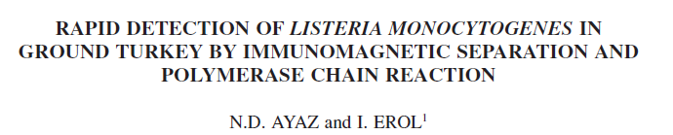
64/180 turkey ground meat (% 35,5) Listeria spp. positive
17,7% (32) L. monocytogenes,
13,3% (24) L. innocua, 3,8% (7) L. İvanovii, 2,7% (5) L. seeligeri
4 samples L. monocytogenes and L. innocua +
Winter16, summer 13 samples L. monocytogenes +

Slide 15
Regulation
According to the commission regulation of the European Union (EU; European Commission 2005), the concentration of L. monocytogenes should be kept below 100 cfu/g in food products and be absent in 25-g samples of RTE food products that can support the growth of the bacteria or is intended for infants or special medical purposes.
Regulations in Canada, New Zealand, and Australia also differentiate between RTE food products that can support the growth of L. monocytogenes (absent in 25-g sample) and other food products (<100 cfu/g)
In Turkey zero tolerance (0/25 g)

Slide 16
CONTROL METHODS
FDA recommendations for washing and handling food.
  Rinse raw produce, such as fruits and vegetables, thoroughly under running tap water before eating, cutting, or cooking. Even if the produce will be peeled, it should still be washed first.
  Scrub firm produce, such as melons and cucumbers, with a clean produce brush.
  Dry the produce with a clean cloth or paper towel.
  Separate uncooked meats and poultry from vegetables, cooked foods, and ready-to-eat foods.
Keep your kitchen and environment cleaner and safer.
  Wash hands, knives, countertops, and cutting boards after handling and preparing uncooked foods.
  Be aware that Listeria monocytogenes can grow in foods in the refrigerator. Use an appliance thermometer, such as a refrigerator thermometer, to check the temperature inside your refrigerator. The refrigerator should be 40°F or lower and the freezer 0°F or lower.
  Clean up all spills in your refrigerator right away–especially juices from hot dog and lunch meat packages, raw meat, and raw poultry.
  Clean the inside walls and shelves of your refrigerator with hot water and liquid soap, then rinse.
Cook meat and poultry thoroughly.
  Thoroughly cook raw food from animal sources, such as beef, pork, or poultry to a safe internal temperature. For a list of recommended temperatures for meat and poultry
Store foods safely.
Choose safer foods.

Slide 17
Treatments
Sanitation
Thermal treatment
Chemical preservatives
Radiation
Low temperature
Drying and etc.

Slide 18
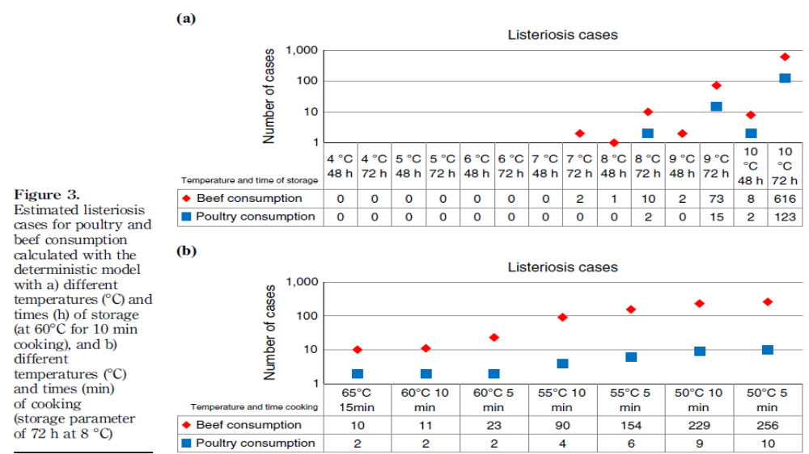
Foerster et al., 2015

Slide 19
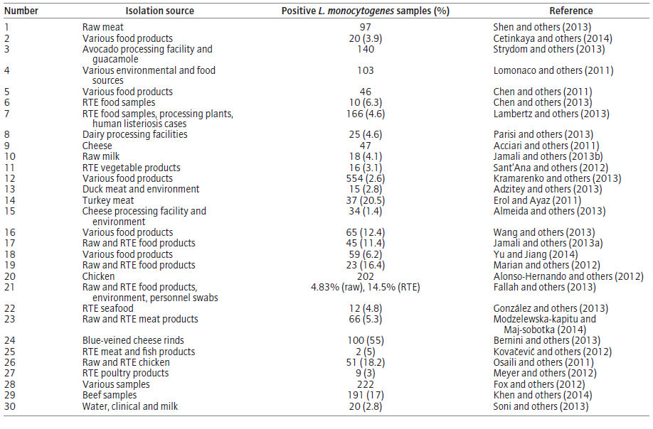

Slide 20
Additional methods are needed to control these bacteria
In the past two decades, numerous measures were introduced by both industry and regulatory agencies to combat Listeria.
As industry and consumers continue to raise the bar in their continuous pursuit of higher food safety standards, occasionally new technologies emerge, providing new opportunities for food processors for cost-savings, flavor improvement, a cleaner label and safer products.
Phage technology is one of these true innovations.

Slide 21
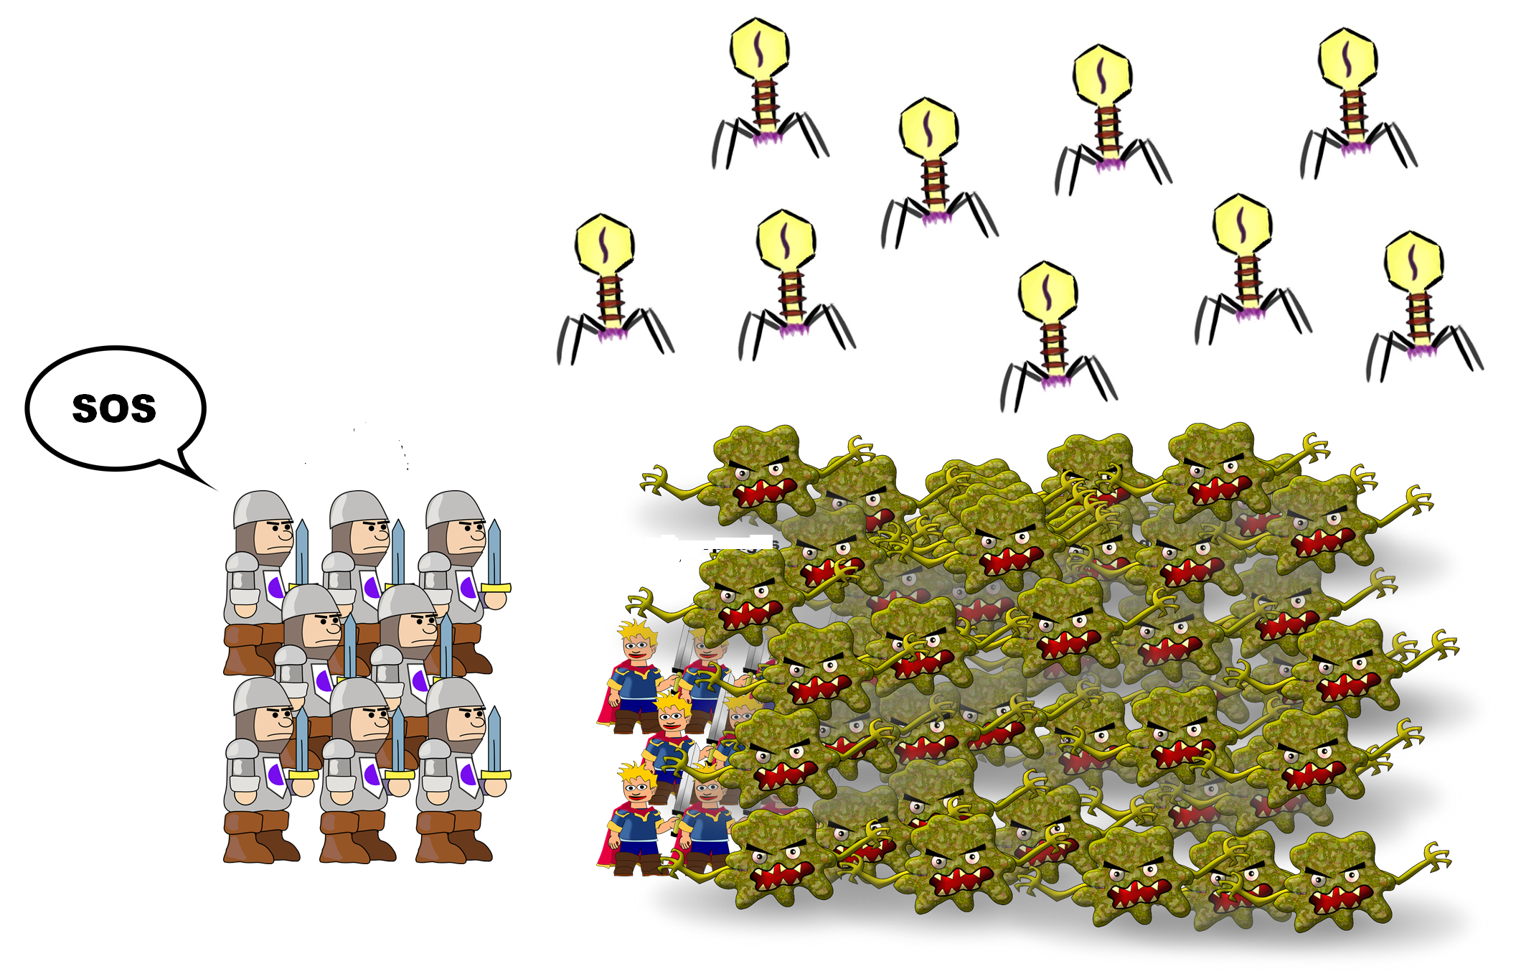
Bacteriophages
My enemy’s enemy is my friend
Bacteriophages, the viruses of bacteria, can act as natural antimicrobials against food pathogens in the food industry
These phages infect specific bacteria and use the genomic material of the bacteria to produce new phages, ultimately destroying the bacterial cell.
In addition to the systems like HACCP and GMP for food safety from farm to table, the use of specific virulent bacteriophages for L. monocytogenes in order to reduce L. monocytogenes load in foods of animal origin before, during and after slaughter processes emerges as an another method.
Usage of specific virulent bacteriophages to L. monocytogenes as a biocontrol and decontamination agent of L. monocytogenes in foods, don’t cause any side effects in humans.

Slide 22
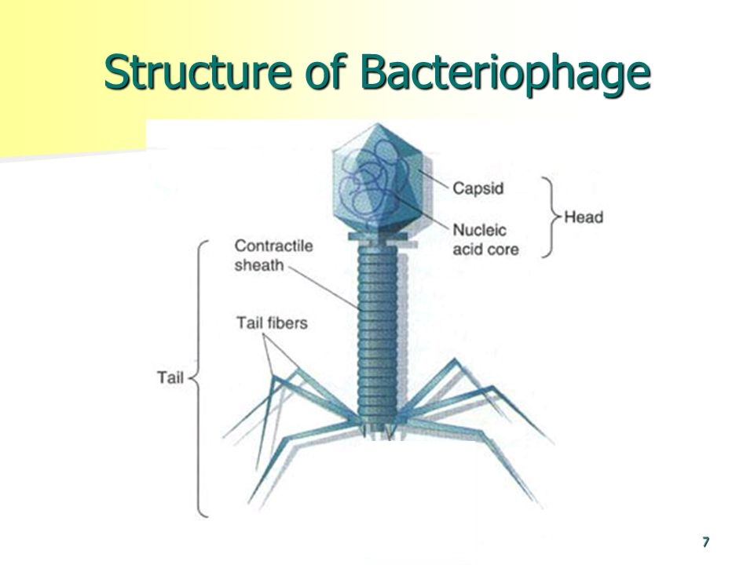

Slide 23
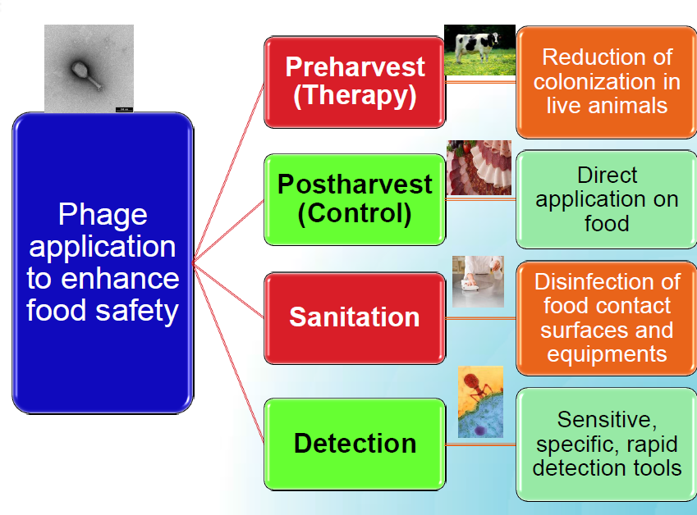
Usage of phages

Slide 24
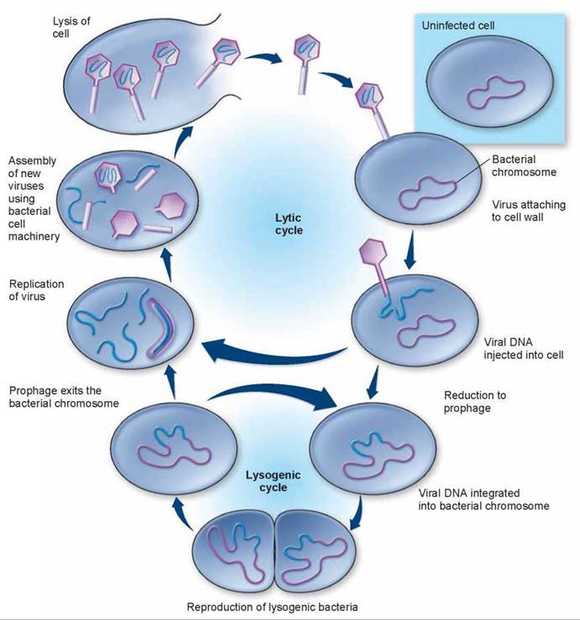
Bacteriophage life cycle

Slide 25
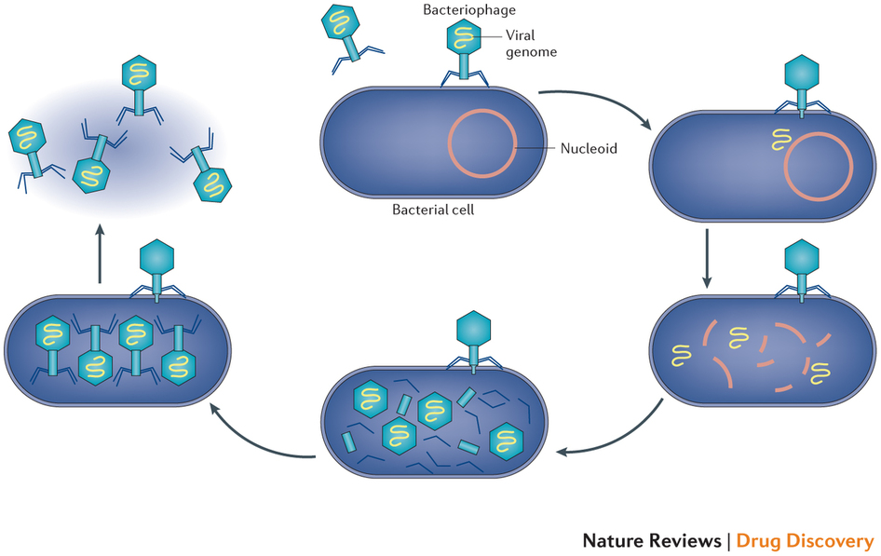
Kinetics of phage infection
min. Attachment of bacteriopage to a susceptible cell
1 min. Inject DNA into cell
1-7 min. Transcribe and translate early genes
    block bacterial DNA synthesis and degrade host chromosomal DNA
    block transcription of host mRNAs
    block translation of host proteins
    small amounts of early proteins produced (catalytic functions)
    transcription from single phage genome
7-15 min. Replication of phage DNA
10-20 min. Translation of phage late proteins (structural)
    transcribed from new phage DNA (many copies of template)
    need large amounts of these proteins to build new virions
18-25 min. Assembly of new phage particles (end of eclipse period)
25 min. Lysis of host cell and release of progeny (end of latent period)

Slide 26
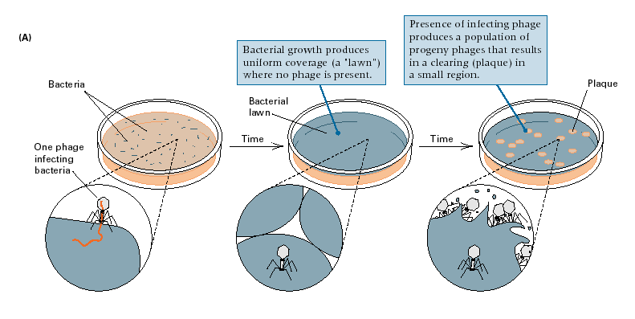
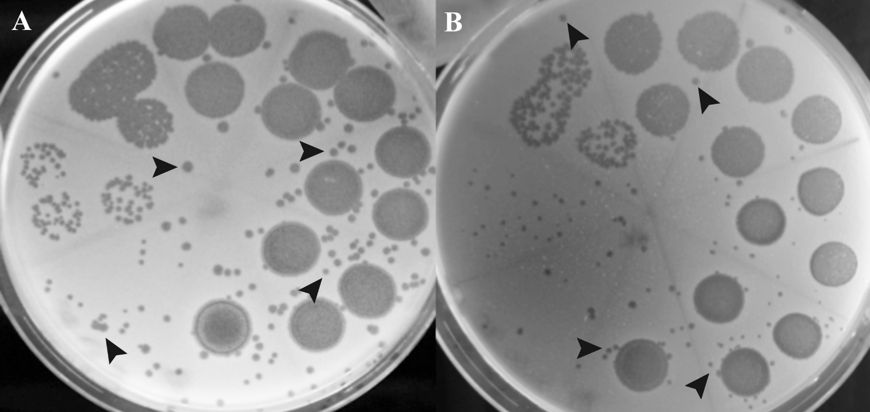
Plaque formation
Plaques are clear zones formed in a lawn of cells due to lysis by phage.
At a low multiplicity of infection (MOI) a cell is infected with a single phage and lysed, releasing progeny phage which can diffuse to neighboring cells and infect them, lysing these cells then infecting the neighboring cells and lysing them, etc,
It ultimately results in a circular area of cell lysis in a turbid lawn of cells.
Dynamic process

Slide 27
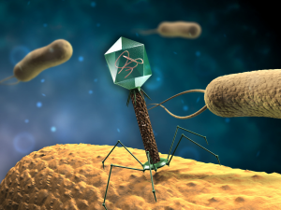
Bacteriophage as a biocontrol agent
It should be;
Broad host range
Low BIM (Bacteriophage insensitive mutant)
Strong lytic
Propagated easily to high titre
Stable

Slide 28
Advantages
high specificity to target their host determined by bacterial cell wall receptors,
leaving untouched the remaining microbiota, a property that favors phages over other antimicrobials that can cause microbiota collateral damage;
self-replication and self-limiting, meaning that low or single dosages will multiply as long as there is still a host threshold present, multiplying their overall antimicrobialimpact
as bacteria develop phage defense mechanisms for their survival, phages continuously adapt to these altered host systems
low inherent toxicity, since they consist mostly of nucleic acids and proteins
phages are relatively cheap and easy to isolate and propagate but may become time consuming when considering the development of a highly virulent, broad-spectrum, and nontransducing phage
they can generally withstand food processing environmental stresses (including food physiochemical conditions)
they have proved to have prolonged shelf life
Phages are readily abundant in foods and have been isolated from a wide variety of raw products (e.g., beef, chicken), processed food (e.g., pies, biscuit dough, and roast turkey), fermented products (e.g., cheese, yoghurt) and seafood (e.g., mussels and oysters).

Slide 29
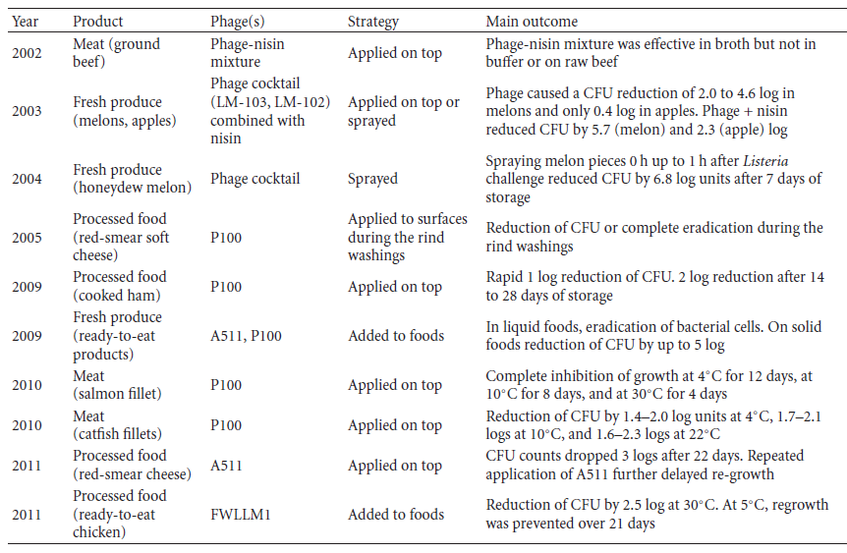
Biocontrol of Lm by phages
Nonetheless, even without complete eradication and different testing methods, bacteriophage treatment has a significant influence on L. monocytogenes in food products.

Slide 30

Conclusion
Bacteriopages are;
Specific
Effective
Environmental friendly agents to control foodborne pathogens in foods.
Not only to enhance food safety but also for phage theraphy in humans and animals.

Slide 31
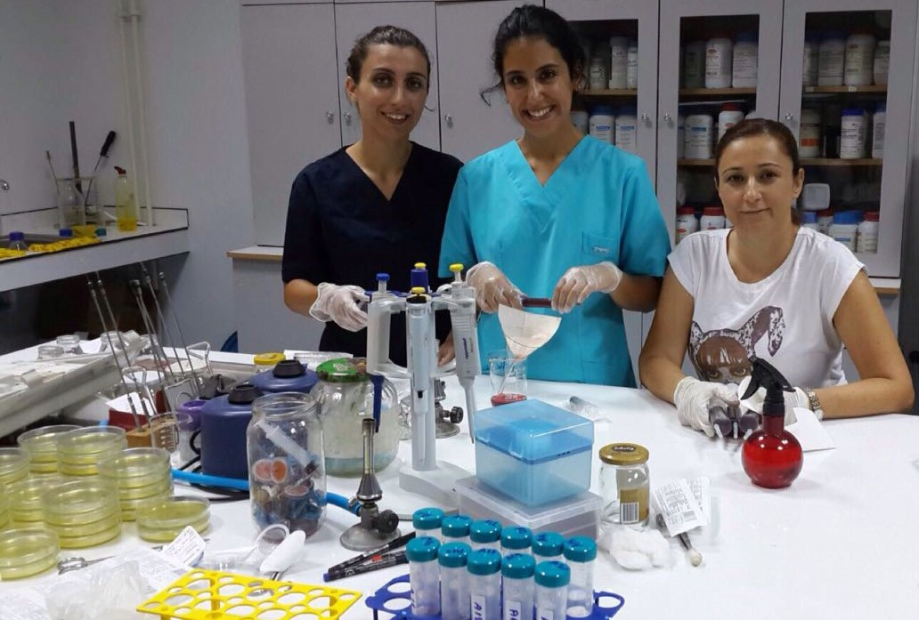
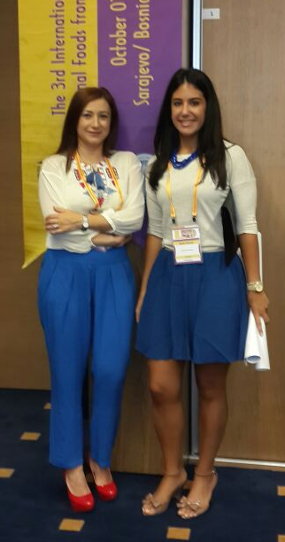
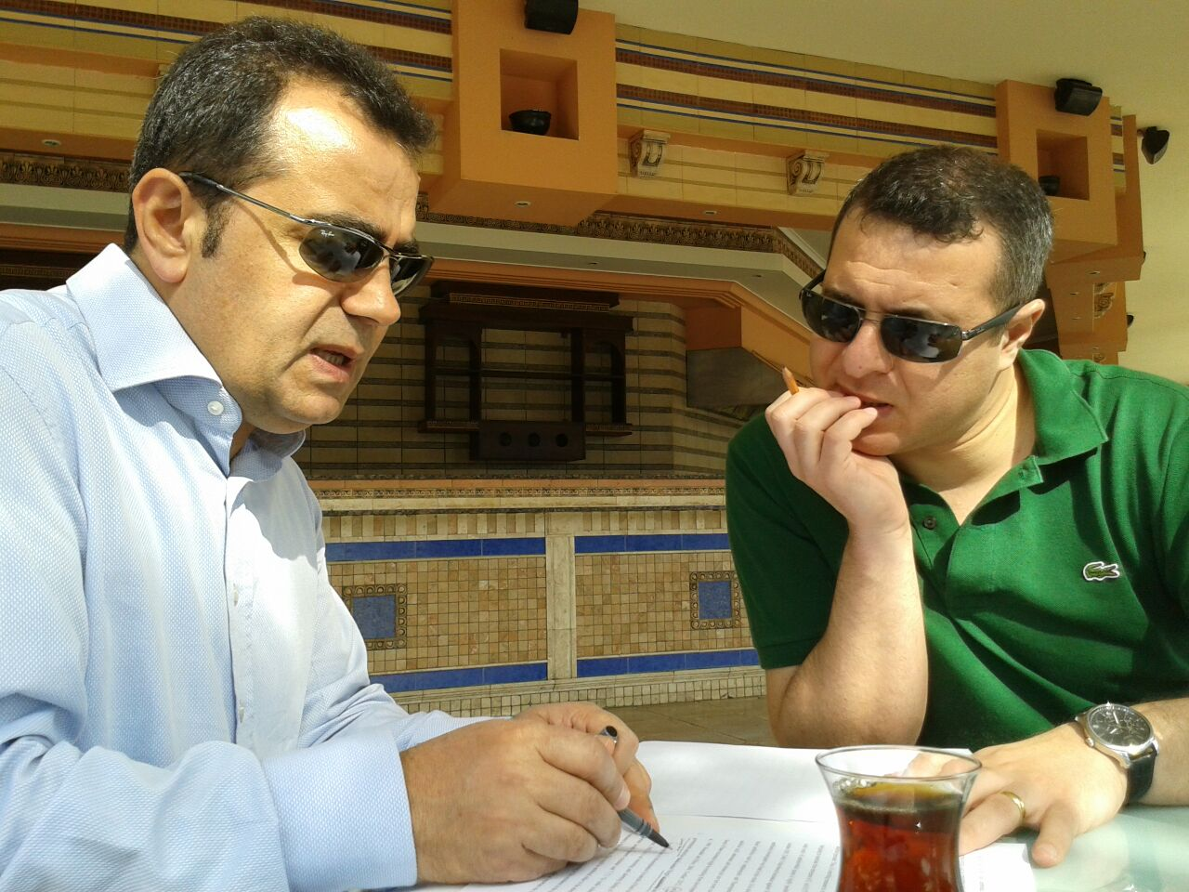
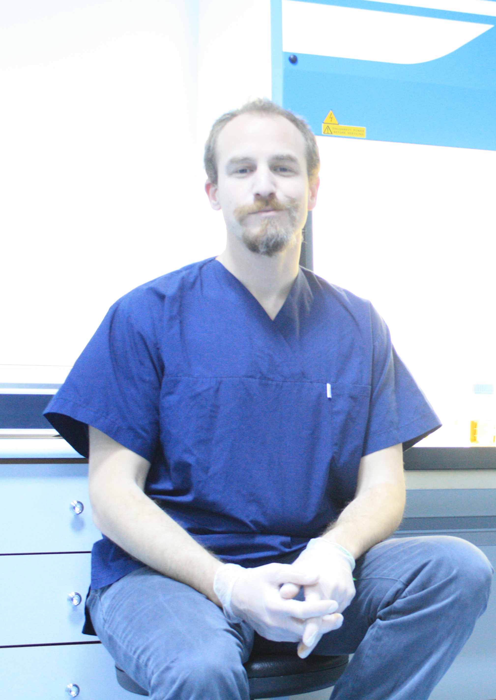
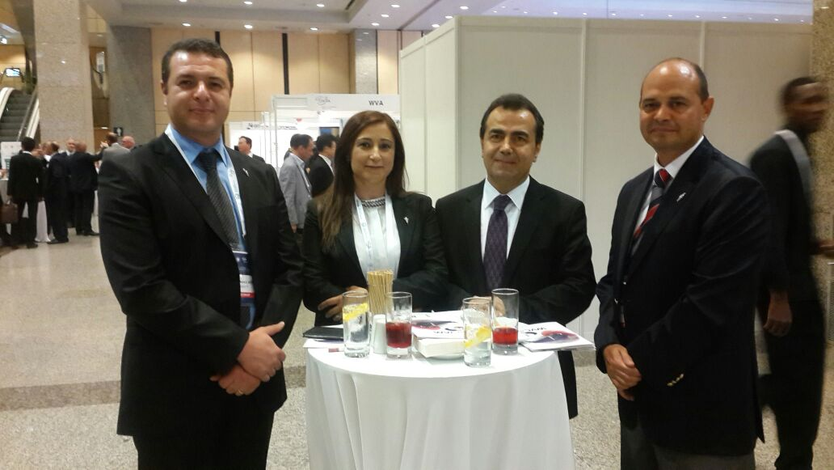
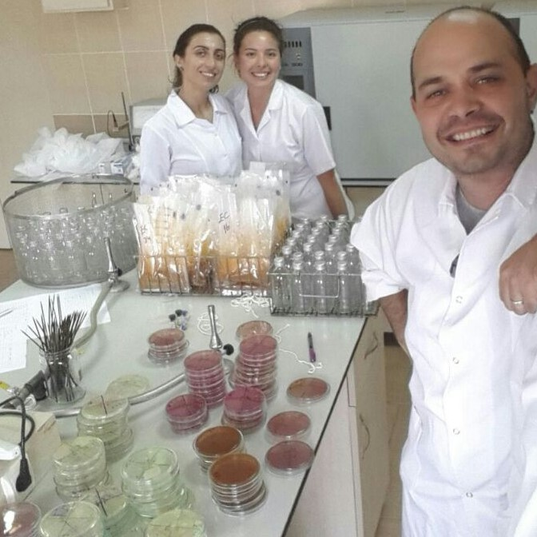
acknowledgement
Working on food microbiology since 2003.
16 projects
38 scientific papers
39 conference presentations
1 book chapter
1 award
Unfortunately administrative tasks…

