Slide 1


Comparative study of enzymatic and chemical denaturation of wheat gluten and their cellulosic nanocomposites
By
Nahla A. El-Wakil
Cellulose & Paper Dept.
National Research Center
Cairo, Egypt
Recycling Expo-2015

Slide 2
Protein-Based nanocomposites for Food Packaging
Academy of Scientific Research and Technology, Egypt & Campus France
Recycling Expo-2015
International Project (Imhotep) (2013/2015)

Slide 3
Objective
The purpose is to examine the role of nanocellulose (CNC and MFC) as a reinforcing agent on the chemically and enzymatically denatured wheat gluten films.
Recycling Expo-2015

Slide 4
Introduction
Recycling Expo-2015

Slide 5
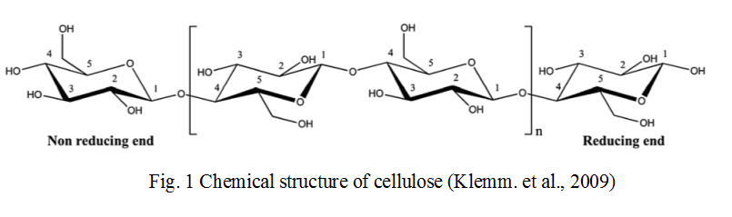
Cellulose
Recycling Expo-2015

Slide 6
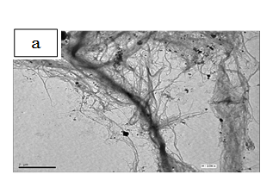
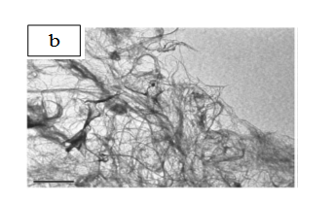
Nanocellulose
Recycling Expo-2015
Microfibrillated cellulose
TEM of nanofibers isolated from rice straw (a) and bagasse (b) (Hassan et al., 2010 & 2012)

Slide 7
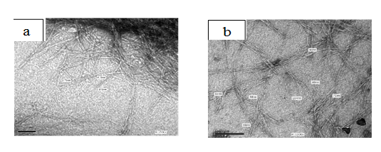
Cellulose nanocrystals
Recycling Expo-2015
The nanostructure of (a) bagasse and rice straw (b) (Hassan et al., 2009)

Slide 8
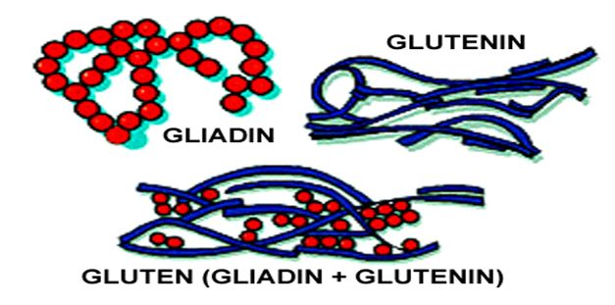
Wheat gluten
Recycling Expo-2015
The structure of wheat gluten

Slide 9
Recycling Expo-2015
Denaturation of protein
Heat denaturation
Chemical denaturation
Enzymatic denaturation

Slide 10
Recycling Expo-2015
Chemical denaturation of wheat gluten
Development of wheat gluten/nanocellulose/titanium dioxidenanocomposites for active food packaging. Nahla A. El-Wakil, Enas A. Hassan, Ragab E. Abou-Zeid, Alain Dufresne. Carbohydrate Polymers 124(2015) 337–346.

Slide 11
Charcterization
Recycling Expo-2015
Scanning electron microscopy (SEM)
Water sensitivity
Contact angle
Water vapor uptake (WVU)
Water vapor permeability (WVP)
Mechanical testing
    Tensile strength and Young’s modulus
Antimicrobial activity

Slide 12
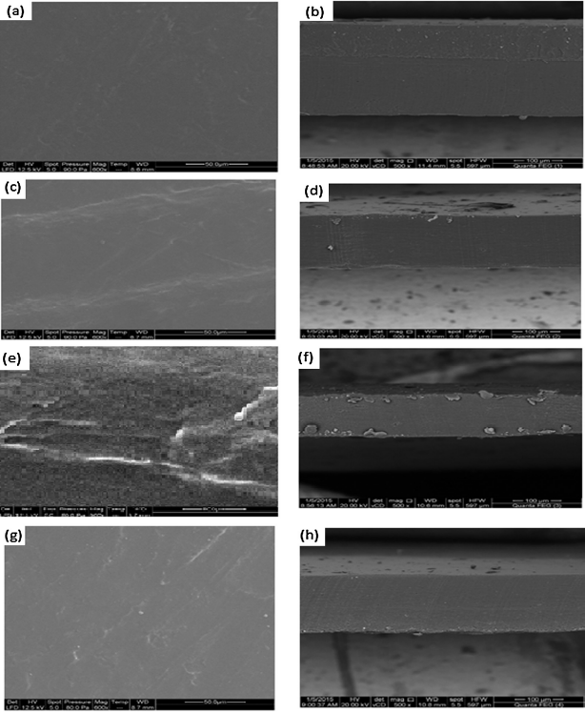
Recycling Expo-2015
Scanning electron microscopy (SEM)
SEM micrographs of surfaces and cross sections of neat WG (a and b), WG/CNC 7.5% (c and d), WG/CNC 12.5% (e and f) and WG/CNC 7.5%/0.6%TiO2(g and h).

Slide 13

Recycling Expo-2015
Contact angle
Contact angle of WG, WG / CNC and WG/CNC/ TiO₂
WG/CNC |  | WG/CNC 7.5%/TiO2
Sample | Contact angle | Sample | Contact angle
WG | 45.10 ± 1.18 | WG/CNC 7.5% | 64.04 ± 2.84
2.5% CNC | 58.88 ± 0.74 | 0.2% TiO2 | 67.10 ± 0.11
5% CNC | 62.00 ± 0.38 | 0.4% TiO2 | 68.86 ± 0.41
7.5% CNC | 64.04 ± 2.84 | 0.6%TiO2 | 74.63 ± 0.66
10% CNC | 75.19 ± 0.25 | 0.8% TiO2 | 85.6 ± 2.31
12.5% CNC | 78.48 ± 1.18 | 1.0% TiO2 | 89.70 ± 0.14

Slide 14
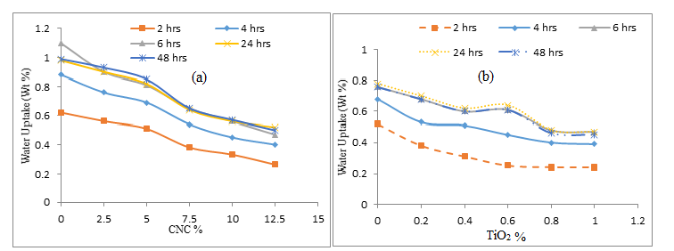
Recycling Expo-2015
Water vapor uptake test (WVU)
Dependence of WVU on CNC content (a) and TiO₂ content (b).

Slide 15
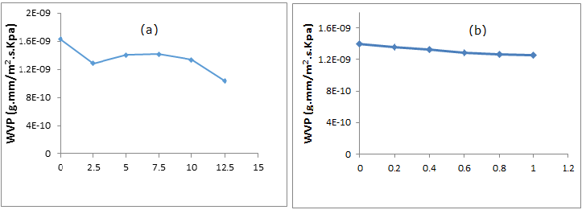
Recycling Expo-2015
Water vapor permeability (WVP)
Dependence of WVP on CNC content (a) and TiO₂ content (b).

Slide 16
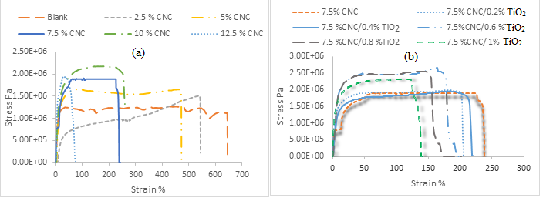
Mechanical testing
Recycling Expo-2015
Typical stress-strain curves obtained from tensile tests for neat WG and WG filled with CNC (a) and WG with 7.5% CNC filled with TiO₂ (b).

Slide 17
Recycling Expo-2015
Antimicrobial activity
The colony-forming units (CFU/ml) and the reduction % of surviving number of the tested bacteria of the coated paper with and without TiO₂ nanoparticles
 |  |  | S. aureus |  |  |  |  |  |  | E. coli
 |  |  |  |  |  | Time of UVA light exposure (h)
 | 1/2 |  | 1 |  | 2 |  |  | 1/2 |  | 1 |  | 2
Sample | CFU/ml | R (%) | CFU/ml | R (%) | CFU/ml |  | R (%) | CFU/ml | R (%) | CFU/ml | R (%) | CFU/ml | R (%)
Blank | 2.4×10⁵ | - | 3.7×10⁵ | - | 3.1×10⁵ |  | - | 3.2×10⁵ | - | 6.0×10⁵ | - | 6.6×10⁵ | -
I layer | 1.0×105 | 58.3 | 8.0×10⁴ | 78.4 | 0 |  | 100 | 2.5×10⁵ | 21.9 | 2.9×10⁵ | 51.7 | 1.0×10⁵ | 84.9
II layers | 3.7×10⁴ | 84.6 | 1.0×10⁴ | 97.3 | 0 |  | 100 | 1.9×10⁵ | 40.6 | 1.0×10⁵ | 83.8 | 3.0×10⁴ | 95.5
III layers | 2.9×10⁴ | 87.9 | 3.0×10³ | 98.2 | 0 |  | 100 | 1.5×10⁵ | 53.1 | 6.0×10⁴ | 90.0 | 1.0×10⁴ | 98.5

Slide 18
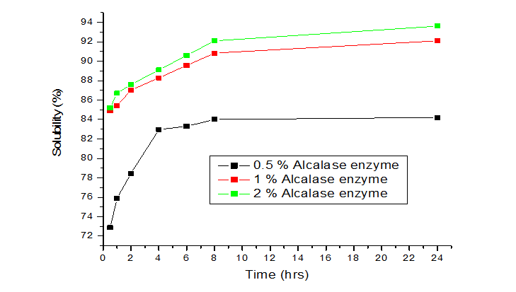
Recycling Expo-2015
Enzymatic denaturation of wheat gluten (EWG)
Effect of time on solubility of wheat gluten obtained with different percent of Alcalase enzyme

Slide 19
Recycling Expo-2015
Mechanical testing
Tensile strength of WG/MFC and EWG/MFC films

Slide 20
Water vapor permeability (WVP)
Recycling Expo-2015
WVP of WG/MFC and EWG/MFC films

Slide 21
Contact angle measurment
Recycling Expo-2015
Contact angle of EWG/MFC films
WG/MFC
Sample | Contact angle
5 % MFC 10 % MFC 15 % MFC 20 % MFC 25 % MFC 30 % MFC | 30.85 34.77 38.22 39.33 40.5 38.4

Slide 22
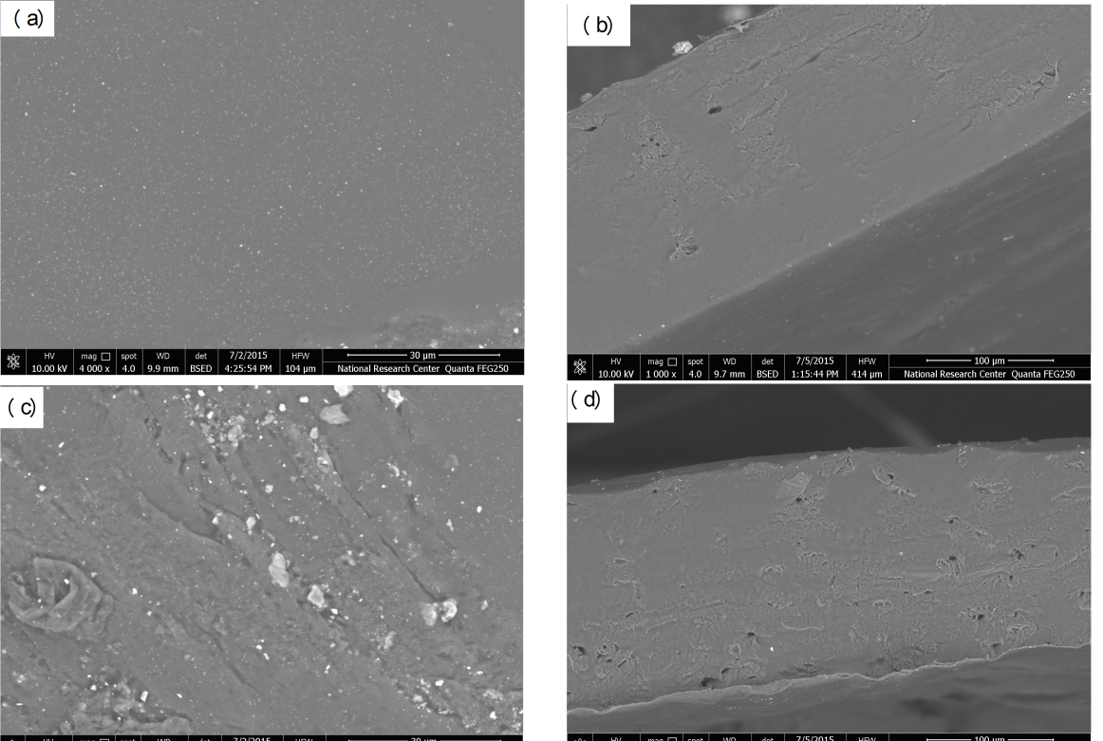
Scanning electrone microscopy
Recycling Expo-2015
SEM micrographs of EWG/20% MFC (a and b) and EWG/30% MFC (c and d) surface and cross section.

Slide 23
Conclusion
Recycling Expo-2015
Filling of chemically and enzymatically denatured wheat gluten with MFC enhanced the mechanical and barrier properties of the prepared nanocomposites. However, this enhancement is significant in case of chemical denaturation specially for MFC content > 15%.
Attempts to develop thermoplastic films from wheat gluten to replace synthetic polymer based films need more extensive studies to achieve the target

Slide 24
Acknowledgement
Recycling Expo-2015
I would to acknowledge my colleagues:
Dr. Enas A. Hassan assistant prof. and Dr. Ragab Abou-Zeid Researcher.
The authors acknowledge the Academy of Scientific Research and Technology, Egypt (National Research Center) & Scientific sector of the French institute of Egypt (Grenoble Institute of Technology, Pagora, Grenoble , France) for their financial support.

Slide 25

Recycling Expo-2015

