Slide 1
Dietary adequacy of Egyptian children with autism
Presented by
Dr. Nagwa Abdel Meguid
Prof. of Human Genetics and special Needs, NRC,Egypt
Head of the CONEM Egypt Child Brain Research Group
Council for Nutritional and Environmental Medicine (Norway)
UNESCO/ L’Oreal Laureate

Slide 2
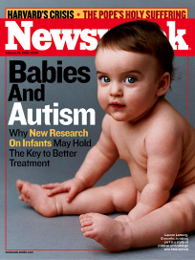
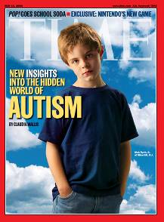
Autism
Problems with socialization
Problems with communication
Unusual behaviors

Slide 3
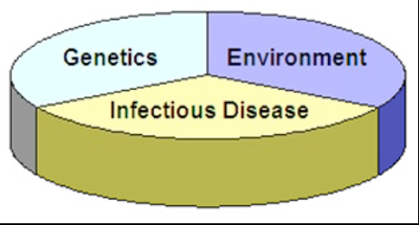
Autism is Multifactorial in nature:
genetic components, infectious components and environmental components. While the relative contribution of each of these components may differ from one individual to the next
Each of these components does play a role for all of us. A certain threshold or body burden needs to be met for each of these factors in order for multifactorial disease to occur.

Slide 4

By the end of 7 months
Smile back at another person
Respond to sound with sounds
Enjoy social play
Red Flags
No big smiles or other warm, joyful expressions
No back-and-forth sharing of sounds, smiles, or other facial expressions by nine months or thereafter

Slide 5

By the end of 1year
Use simple gestures
Imitate actions in their play
Respond when told “no”
Red Flags
No back-and-forth gestures, such as pointing, or waving bye
Not answering to one’s name when called
No babbling – mama, dada, papa

Slide 6

By the end of 18 months
Do simple pretend play
Point to interesting objects
Use several single words unprompted
Red Flags
No single words by 18 months
No simple pretend play

Slide 7

By the end of 2 years
(24 months)
Use 2- to 4-word phrases
Follow simple instructions
Become more interested in other children
Point to object or picture when named
Red Flags
No two-word meaningful phrases (without imitating or repeating)
Lack of interest in other children

Slide 8
Autism is still poorly understood, a number of
environmental, anthropological, neurobiological and genetic factors have been related to the pathophysiology of ASD, even the impact of oxidative stress response related to the environment and nutrition intake.

Slide 9
To determine the associated risk factors in Egypt, we studied pedigree charts, degree of consanguinity of parents and family history of similarly affected infants or children. Males were more affected than females. Only 30% of the mothers received

Slide 10
Antenatal care only, 15% received multivitamins and folic acid during pregnancy. This high-lights the importance of measures for health promotion and disease prevention
In child bearing-age women should pay special attention to prenatal care and childbirth which can influence neonatal indicators and prevention of birth defects.

Slide 11
Consanguinity Rate Among Arabs

Slide 12
Increase in consanguinity rates over time among some Arab countries

Slide 13
Decrease in consanguinity rates over time among some Arab countries

Slide 14
Future breakthroughs will profit greatly from the application of evidence-based approaches to therapy. In this regard, studies of monogenic ASD have much to offer with regard to detailed characterization of a subset of ASD.

Slide 15
Although most studies have shown that individuals with autism have selective eating habits and their dietary intake is often below the recommended panels of daily amounts, so they
may be at risk for vitamin and mineral insufficiency.

Slide 16
Subjects with autism are now recognized as belonging to a complex multifactorial pathology, where neurological patterns and severity are related to an etiology involving interactions between genes, environment, diet, and gender

Slide 17
The present study aimed at comparing dietary regimens and habits of normally developing apparently healthy children with a pediatric population of individuals affected by autistic disorder.

Slide 18
A total of 80 children with autistic disorder and 80 apparently healthy, normally developing pediatric individuals were enrolled in this work.

Slide 19
Specialized dietitian got food frequency questionnaire from parents of all participants.
The parents of each subject were requested to provide three days food diary of their children for
two weekdays and one weekend (covering the consumption over 24 h on each of the three days).

Slide 20
Individual food intake was calculated and analyzed using Computer Aided Nutritional Analysis Program, the food composition
(National Nutrition Institute, Cairo, Egypt).

Slide 21
Serum magnesium (Mg), iron (Fe), and calcium (Ca) were measured by colorimetric methods using quantitative colorimetric BioAssay Systems kits
Serum vitamin B12, folic acid, and vitamin B6 were measured by enzyme-linked immunosorbent assay (ELISA) using DRG kits

Slide 22
Results
Plotting on the Egyptian sex-specific anthropometric growth (auximetric) chart, absolute weights as well as weight-related for age classes, were significantly higher in cases than healthy controls.
No differences between groups were observed in regard to total kilocalories (kcal), carbohydrates, and fat intake.

Slide 23
A total of 23.8% of children with autistic disorder vs. 11.3% in the healthy control group had a nutrient intake with features below the (RDA) of protein.
Children with autistic disorder showed low dietary intake of micronutrients; calcium (Ca), magnesium (Mg), iron (Fe), andselenium(Se) also they had significantly high intake of potassium (K) and vitamin C compared to healthy controls.

Slide 24

Serum Mg, Fe, Ca, folate and vitamin B12
in children with autistic disorder were significantly low compared with healthy children.

Slide 25
These results confirmed that different
nutritional inadequacy was observed in Egyptian children with autistic disorder.

Slide 26

Interventions for Autism
Any intervention for Autism needs to bear in mind three very important factors
that will affect outcome:
(1) Autism is Heterogeneous.
(2) Autism is often accompanied by co-morbidities.
e.g. epilepsy, ADHD, anxiety-related problems
(3) Age and environment may play a role.

Slide 27
Could diet
affect Autism?

Slide 28
Screening of the nutritional status of Autism children for nutrient adequacy to reduce these deficiencies by dietary means or by administering appropriate vitamin and mineral supplements.

Slide 29


Diet & health are linked:
not just another
“casual” relationship!

Slide 30
Mean and the standard deviation (Mean ± SD) for 80 children with autistic disorder and 80 controls
Variable | Cases Mean ± SD | Control Mean ±SD | P Value
Kilocalories (Kcal/d) | 1116.2 ± 271.6 | 1136.5 ± 269.4 | 0.317
Protein (gm/d) | 36.6 ± 10.3 | 39.7 ± 8.7 | 0.021
Fat (gm/d) | 43.2 ± 12.8 | 45.0 ± 11.1 | 0.233
Fibers (gm/d) | 1.4 ± 0.4 | 0.715 ± 0.2 | 0.001
Carbohydrates (gm/d) | 145.3 ± 22.3 | 143.0 ± 32.4 | 0.303
Protein energy ratio status | 13.6 ± 4.4 | 14.2 ± 2.9 | 0.309
Carbohydrate energy ratio status | 52.8 ± 9.7 | 51.5 ± 8.5 | 0.343
Fat energy ratio status | 33.6 ± 9.6 | 34.4 ± 7.8 | 0.576

Slide 31
Variable | Cases Mean ± SD | Control Mean ± SD | P Value
Vitamin A (mg/d) | 159.6 ± 30.9 | 161.8 ± 46.7 | 0.359
Vitamin B1 (mg/d) | 0.27 ± 0.08 | 0.28 ± 0.07 | 0.27
Vitamin B2 (mg/d) | 0.47 ± 0.12 | 0.5 ± 0.13 | 0.052
Vitamin B6 (mg/d) | 0.91 ± 0.16 | 0.6 ± 0.15 | 0.001
Folic acid (mg/d) | 197.75 ± 34.22 | 269.48 ± 20.90 | 0.001
Vitamin B12 (mg/d) | 0.39 ± 0.12 | 0.85 ± 0.15 | 0.001
Vitamin C (mg/d) | 23.2 ± 6.8 | 17.7 ± 4.7 | 0.001

Slide 32
Variable | Cases Mean ±SD | Control Mean ±SD | P Value
Calcium (mg/d) | 468.113 ±109.6 | 817.258±114.6 | 0.001
Iron (mg/d) | 8.821 ± 2.6 | 14.421 ± 2.3 | 0.001
Phosphorus (mg/d) | 468.2± 119.9 | 469.7± 122.7 | 0.467
Magnesium (mg/d) | 85.63± 22.39 | 150.98 ± 26.02 | 0.001
Zinc (mg/d) | 4.6± 1.4 | 4.8± 1.3 | 0.185
Selenium (mg/d) | 7.3± 2.0 | 8.3± 2.3 | 0.004

Slide 33

Feeding problems in children with ASD
Food Selectivity + Food refusal + Obsessive eating patterns >Concern for nutritional deficits and possible imbalances

Slide 34
HOW DO I GET MY KID
TO EAT THIS STUFF?
we need to eat a LOT of vegetables to get enough carbohydrate calories for a balanced diet. Our strategy was to control the plate, and insist on “First peas, then steak” for example. So we would alternate bites, for the entire meal.

Slide 35
Conclusions
Nutritional inadequacies were observed in children with autistic disorder. So nutritional status of children with autism should regularly be screened for nutrient adequacy to reduce these deficiencies by dietary means or by administering appropriate vitamin and mineral supplements
Exclusion diets may be helpful in ameliorating some of the core and/or secondary symptoms of Autism for some people.
The present study lends further support to properly designed individualized nutritional therapy which may relieve autistic symptoms and the occurrence of gastrointestinal disorders

Slide 36
Conclusions
Finally,
Evidence for the use of diet as good as most other interventions (specialised education/behavioural plans).
Parents and caregivers should, therefore, be aware of the benefits of nutritional therapy, especially in developing countries.

Slide 37
Collaborators
Prof Dr. Geir Bjørklund :
Council for Nutritional and Environmental
Medicine NORWAY
Prof Dr. Salvatore Chirumbolo:
Department of Neurological and Movement
Science, University of Verona, Italy
Prof Dr. Eman Sultan:
Department of Clinical Nutrition, National Nutrition
Institute, Cairo, Egypt

Slide 38
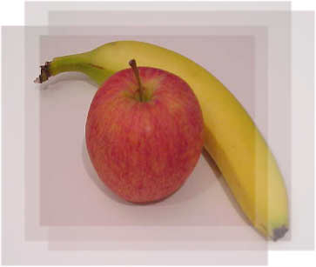
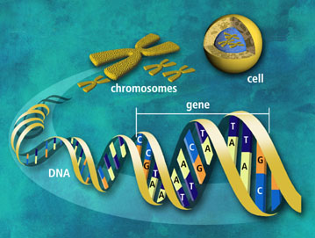
Thank You

