Slide 1

Comparison of Treatment Efficiency of Intravenous and Intrasplenic injection of the BM-derived mesenchymal stem cell in CCL4-induced liver fibrosis in Rat.

Slide 2

Assistant Professor
Dr.Naglaa Kamal Idriss
,
MMBCH,MSc,PhD
Medical Biochemistry and Molecular Biology, Faculty
of Medicine, Assiut University, Egypt
PhD at Birmingham university
& postdoctoral research fellow at medical school
Experimental and clinical science , general University Hospital of Southampton
member of ISSCR,ESC,ACC

Slide 3
Introduction
Liver fibrosis is a progressive disease that includes disorder of normal hepatic tissue structural design and extreme accumulation of extracellular matrix in response to chronic injury.

Slide 4
The aim of this study was to estimate the treatment effects of rat (BM-MSCs) on rat liver fibrosis induced by CCL4.
Intrasplenic and intravenous transplantations were examined to evaluate the effects of different injection routes on the liver fibrosis model at 12 weeks after transplantation

Slide 5
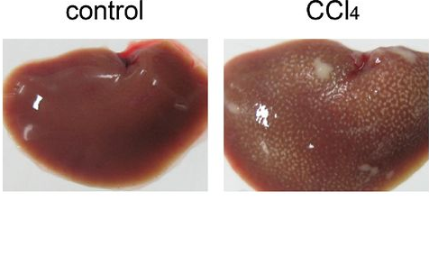
Induction of Liver Fibrosis
Liver fibrosis will be induced by subcutaneous injection of carbon tetrachloride (CCl₄) .The injection was given twice weekly for 6 weeks.

Slide 6
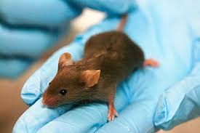
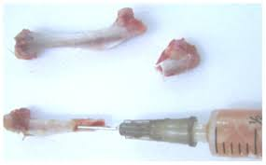
All animal experiments received approval from the institutional animal care committee

Slide 7
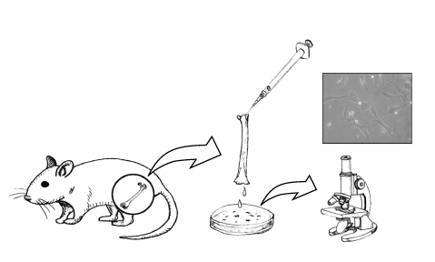
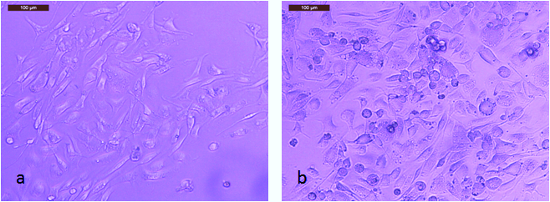
Rats were divided into the following groups:
Group 1 (Control group): 6 rats received 0.2 ml/100 g body weight of castor oil twice weekly for 6 weeks.
Group 2 (CCl4 group): 6 rats received 0.2 ml/100 g body weight.

Slide 8
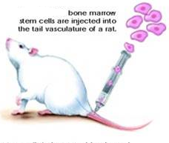
Group 3: (CCl4/BM-MSCs group): 6 rats received CCl4 as previous. The rats were infused with 10⁷ BM-MSCs/rat IV (through tail vain) and scarified after 3 months

Slide 9

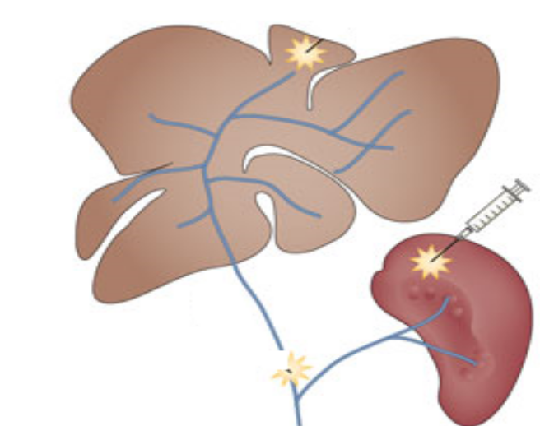
Group 4 (CCl4/BM-MSCs group): 10 rats received CCl4 as previous and followed by injection of 10⁷BM-MSCs intrasplenic.

Slide 10
Serum Biochemical Assessment
Blood sample was driven from rats at 4, 8 and 12 weeks. ALT and albumin were assessed.
Histopathological Examination
By staining liver tissues with hematoxylin and eosin (H&E) and Masson Trichrome for evaluation of fibrosis.

Slide 11
At 4, 8 and 12 weeks from stopping CCl4 and administration of stem cells, venous blood was collected from the retro-orbital vein to assess serum albumin and alanine transaminase (ALT).
All rats were sacrificed with CO2 narcosis, and the liver tissue was harvested for histopathological examination and real time PCR analysis

Slide 12

Rat BM-MSCs at one week of culture (a),
rat BM-MSCs at two weeks of culture (80-90% confluent) (b).

Slide 13

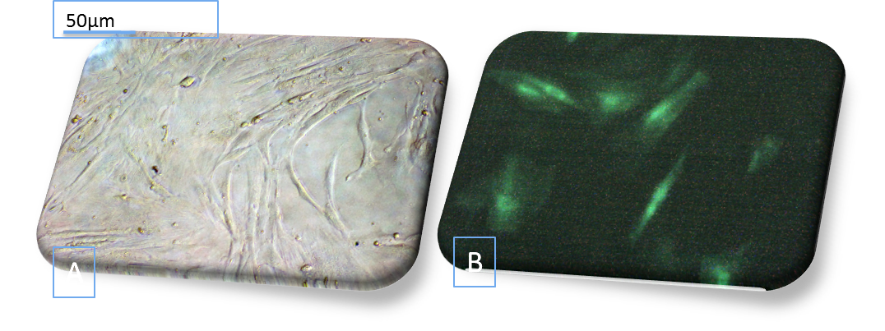
Fig (2): Showed in vitro culture of BM/MSCs
A: BMSCs at two weeks of culture (80-90% confluent)
B: Labeling of BMSCs with GFP fluorescent dye (in vitro)

Slide 14
Table (1): Primers used for qRT-PCR after total RNA extracted and reverse transcribed into cDNA and amplified using SYBERGREEN
Target gene | Primer sequence: 5`- 3`
IL-6 | Forward: CCACTTCACAAGTCGGAGGCTTA Reverse: GTGCATCATCGCTGTTCATACAATC
IL-1β | Forward: GCTGTGGCAGCTACCTATGTCTTG Reverse: AGGTCGTCATCATCCCACGAG
CK-18 | Forward: GGACCTCAGCAAGATCATGGC Reverse: CCACGATCTTACGGGTAGTTG
INF-γ | Forward: AGGCCATCAGCAACAACATAAGTG Reverse: GACAGCTTTGTGCTGGATCTGTG
HGF | Forward: TGGTGTTTCACAAGCAATCCAGA Reverse: CCGTTGCAGGTCATGCATTC
GAPDH | Forward : CACCCTGTTGCTGTAGCCATATTC Reverse: GACATCAAGAAGGTGGTGAAGCAG

Slide 15
human SIRT-1(silent information regulator-1)( Antifibrotic biomarkerby Western blot):
ELISA:
Connective tissue growth factor (pg/ml) was assessed in tissue homogenate of all the studied groups using ELISA kit

Slide 16
Isolation and Culture of BM-MSCs
BM cells were flushed from tibia and fibula of rat bones with (PBS) containing 2 mM EDTA. Over 15 ml Ficoll-Paque, 35 ml of the diluted sample was carefully layered, centrifuged for 35 minutes and the upper layer was aspirated leaving undisturbed mononuclear cell (MNC) layer at the interphase. This MNC layer was aspirated, washed twice in PBS containing 2 mM EDTA and centrifuged.

Slide 17
Labeling Stem Cells with GFP:Cells were centrifuged, washed twice in serum free medium, pelleted and suspended in nucleofector solutions. A final concentration of 4-5x 10⁵ cells/100 μl nucleofector solutions was applied.
Labeled cells were injected intravenously in rat with CCL4-induced liver fibrosis. After 12 weeks, liver tissue was examined with a fluorescence microscope (Leica, Germany) to detect and trace the cells stained with GFP.

Slide 18
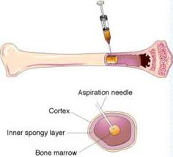
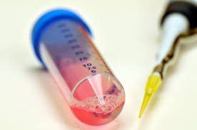
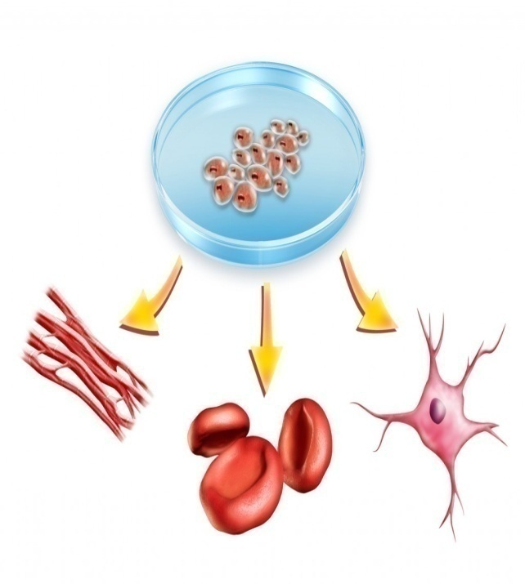
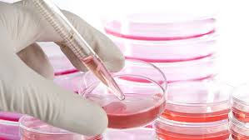

Slide 19
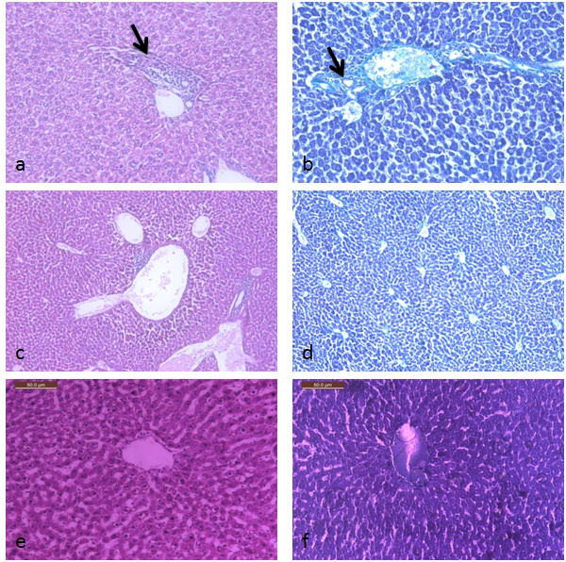
Histopathological examination of liver tissue showed that stem cells have a significant anti-fibrotic effect as evidenced by decreasing liver collagen compared to the CCl₄ group.
Mild focal portal fibrosis was detected in the CCl₄ model (black arrow)
Normal liver was evidenced with no fibrosis after BM-MSCs injection l c- H&E x40 and d- Masson Trichrome x40.
Normal liver was assessed showed no fibrosis CD34⁺ injection in CCl₄ model e- H&E x200 and f- Masson Trichrome x200.

Slide 20

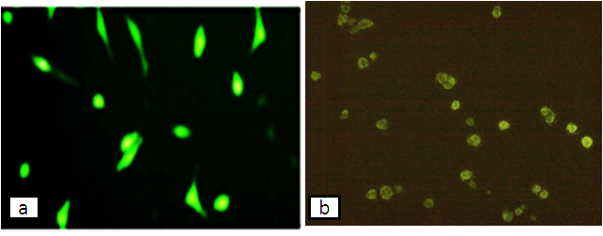
Labeling of BM-MSCs with GFP (in vitro) (a), homing of the injected labeled mesenchymal stem cells by GFP in the rat liver (in vivo) (b).

Slide 21
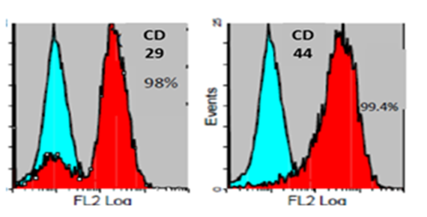
FLOW CYTOMTERIC analysis expressed higher levels of CD29⁺ (A) and CD 44⁺ (B) to confirm BM-MSCs isolation.

Slide 22
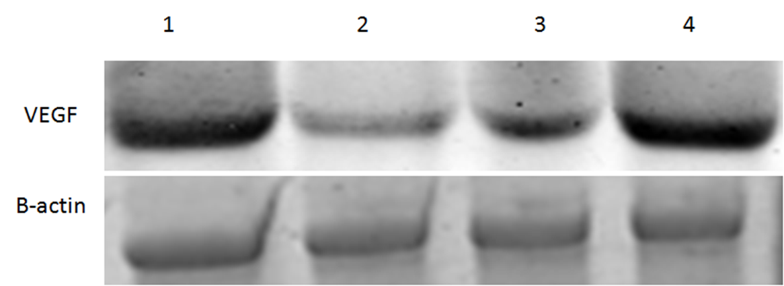
The scanning densitometry results of VEGF versus β-actin protein expression in 1: Control group, 2: CCL4 group, 3: CCL4/MSCs IV and 4: CCL4/MSCs intrasplenic

Slide 23
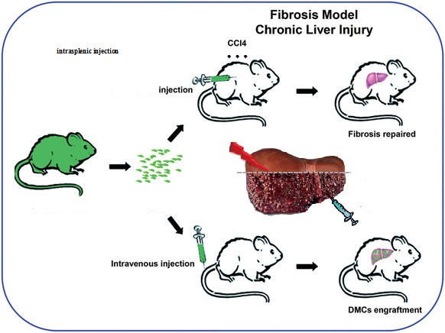

Slide 24
Conclusion
There were no differences in treatment effects between intravenous and intrasplenic administrations.
The IV injection group had significantly different
(p < 0.05) serum Connective tissue growth factor levels compared with the intrasplenic injection group. However, liver serum markers and liver histology classification of both groups showed no differences.

Slide 25
BM-MSC transfusion via a peripheral vein is a potential method for liver fibrosis treatment In consideration of safety, we suggest transfusion of bone marrow-derived mesenchymal stem cells via a peripheral vein as a potential method for liver fibrosis treatment in the aging process.

Slide 26
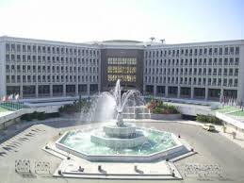
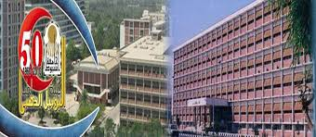
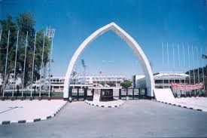
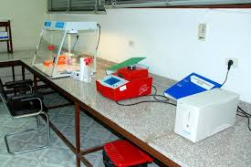
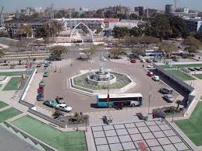

Slide 27


Because of their prospective for differentiation into hepatocytes as well as their immunomodulatory characteristics, MSCs are encouraging therapeutic agents for the therapy of acute liver fibrosis.
However, there are still several complications including conflicting data regarding MSCs engraftment in the
liver and their long-term effectiveness, potential risk of malignant transformation, and unwanted mesenchymal extractions differentiation in vivo.

