Slide 1
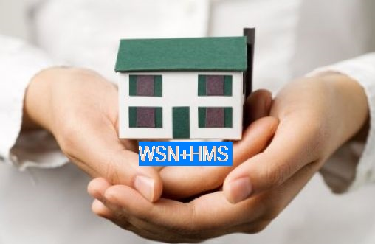
Ambient Assisted Living (AAL) setup to determine the wellness of a person living alone in their own home
Dr. N. K. Suryadevara
Senior Member IEEE
Professor and Head-Computer Science & Engineering
Geethanjali College of Engineering & Technology
Hyderabad-India

Slide 2

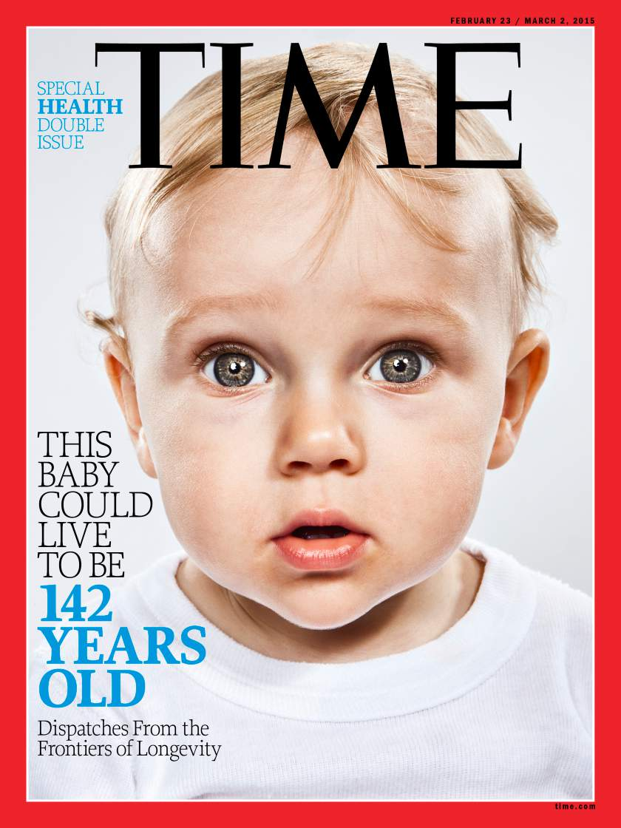
Good News
It’s not just hype
New Science could lead to very long lives
This Baby Will Live to Be 120. National Geographic May 2013
This Baby Could Live to Be 142 (TIME) March 2015

Slide 3
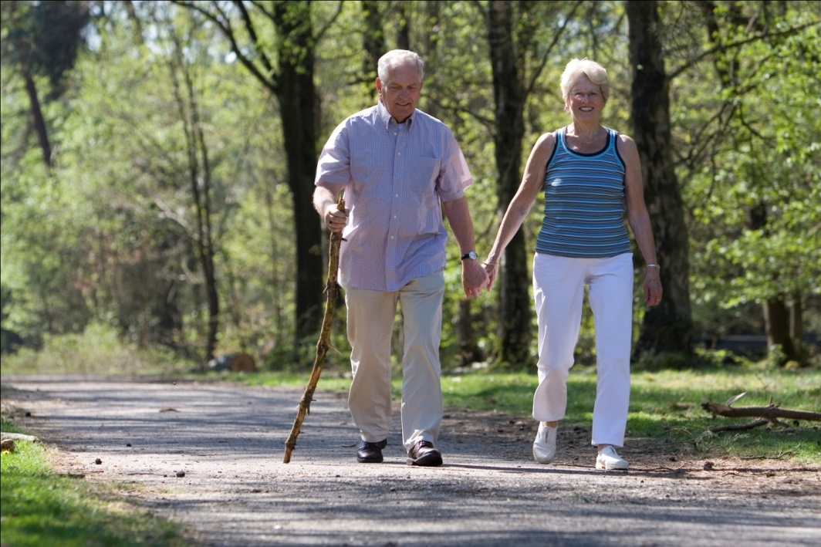
Importance of Research
Old Population %
Year
Notes:
An Aging World-Report::Within next decade “elderly people will be more than children”;
Elderly people are estimated to rise by 2050 to 19.3% worldwide;
By 2061, 1 in 4 NZ’s will be age 65 or older;
the life expectancy is projected to grow for individuals ;

Slide 4
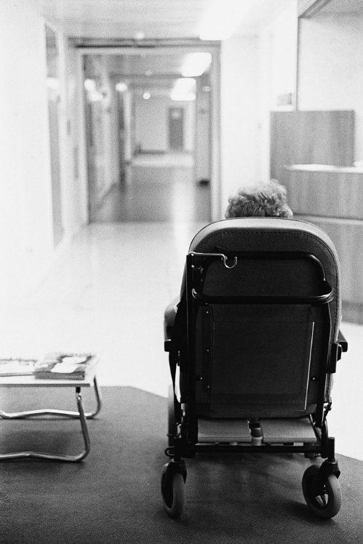
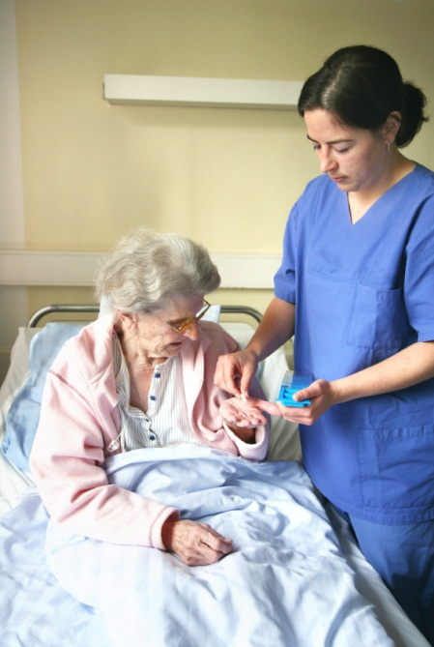
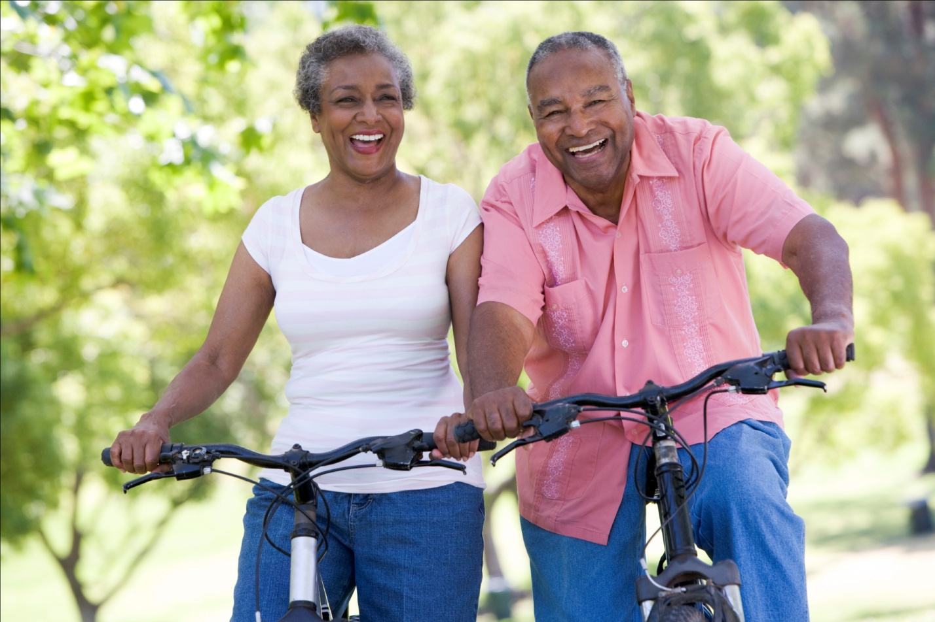
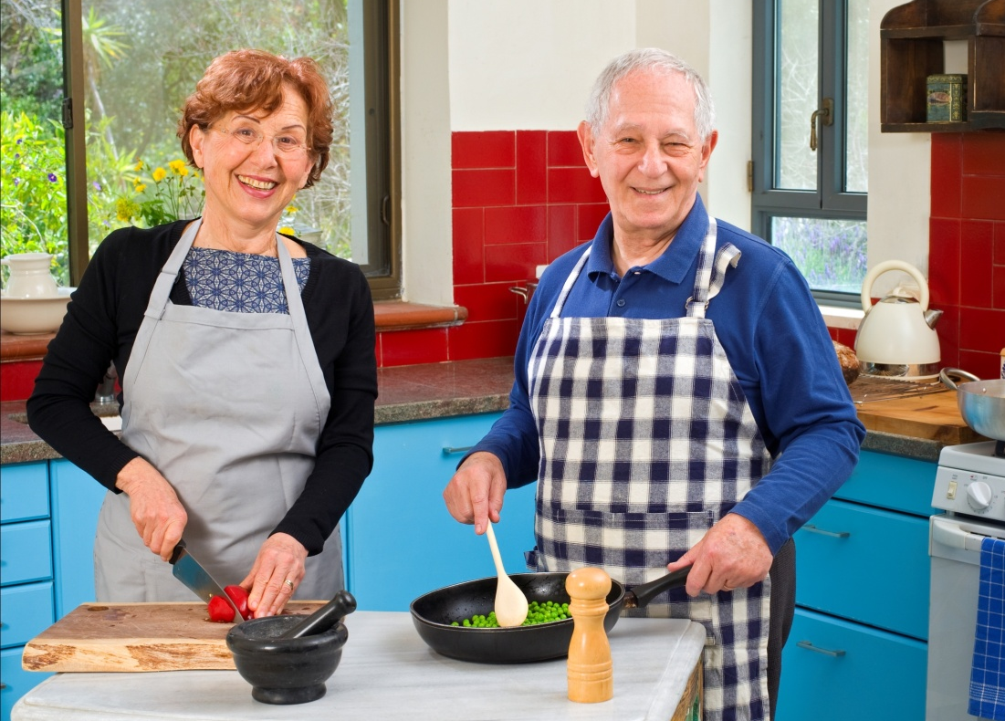
Independent Life
?
Notes:
The elderly population who spend most of their time at home is growing rapidly;
The health center environments rarely provide inhabitants with substantial physical home setting environments;
Our ageing population expects that this better longevity will help them to lead an independent and quality life in their own home;

Slide 5
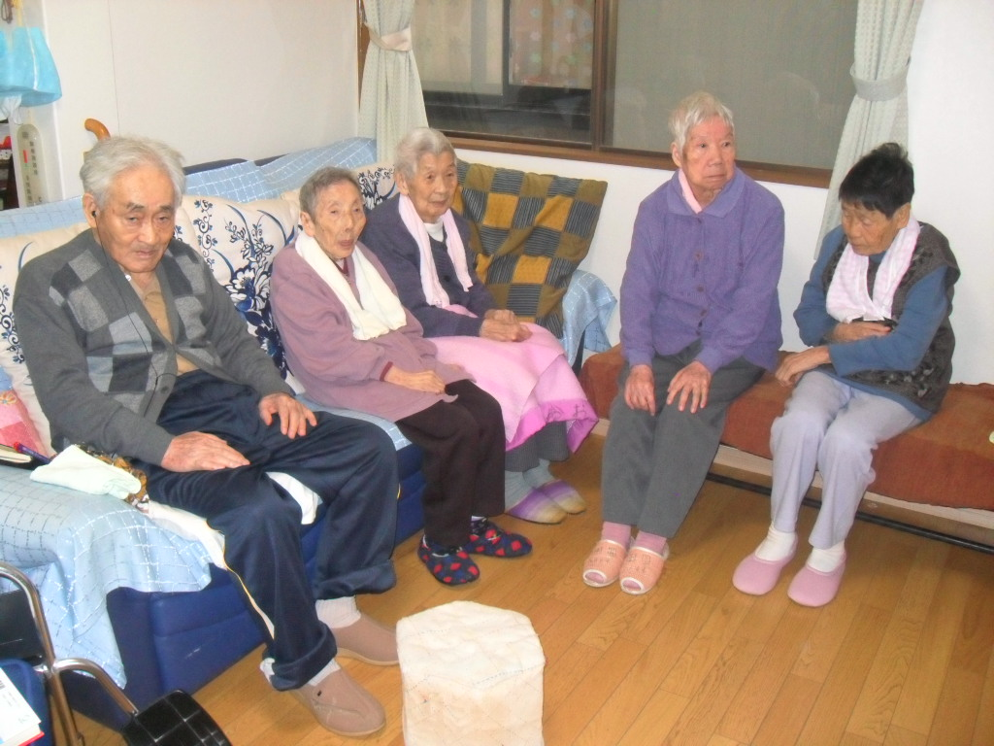
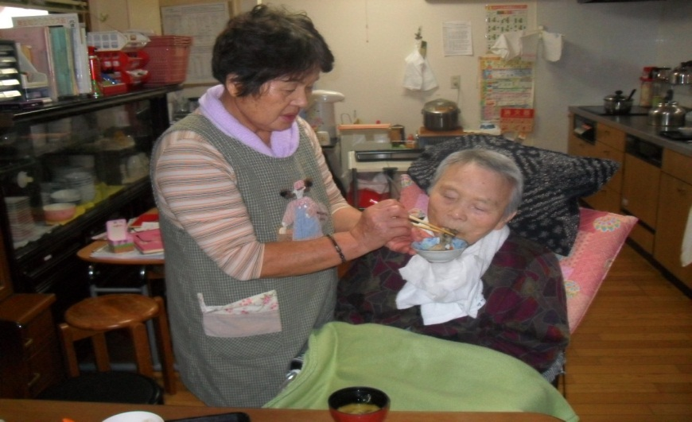
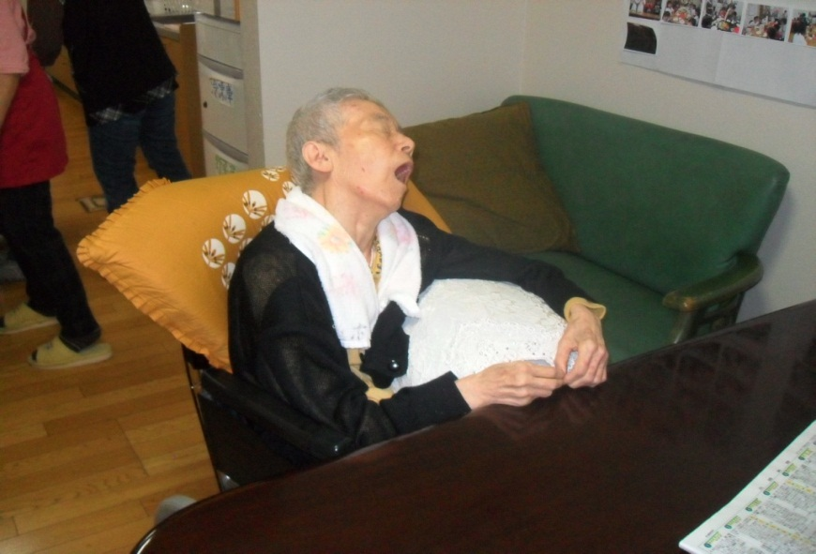
Need Assistance…….
Notes:
main concerns are the increased cost of providing healthcare services and the sustainability of the services

Slide 6
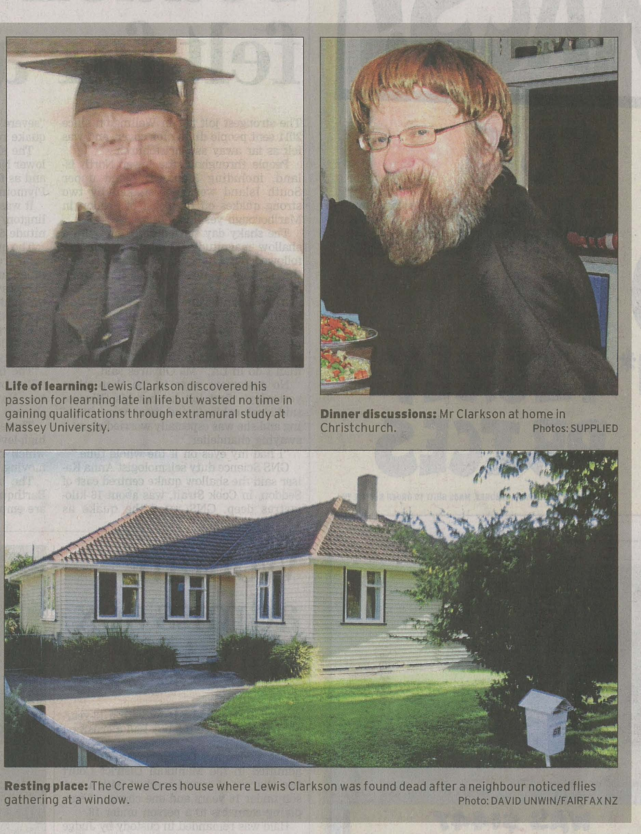
How does someone die alone in their home without anyone realising?

Slide 7
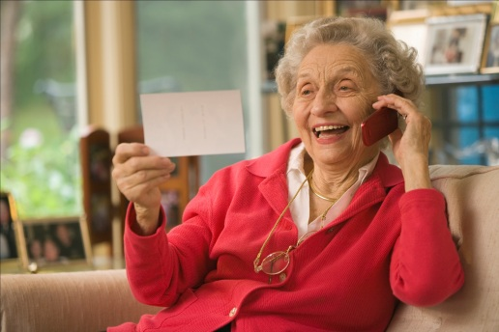
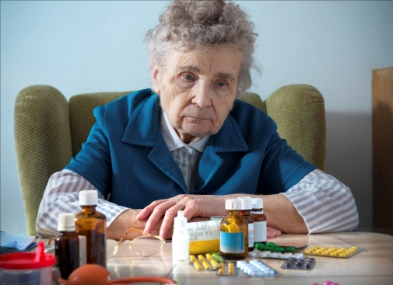
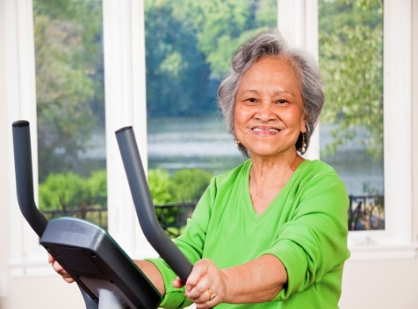
Their Needs
Help with
Activities of Daily Living (ADL)
Health Monitoring
Reducing the burden from Caregiver
Notes:
health information exchange has changed and millions now look online for apt health information;
Today’s online users are not only “people in poor health who want to get healthy, but also healthy people who want to remain healthy;
to assist the elderly with their health information in real-time, Pervasive Sensor Networks (PSN) were deployed in home environments to prompt appropriate actions when irregular ADL events were happening;
the development of intelligent systems to recognize elderly Activities of Daily Living (ADL),health monitoring, etc.,

Slide 8
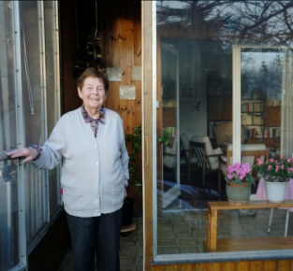
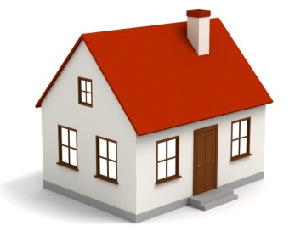


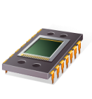
Smart Home Monitoring System
Ambient Assisted Living Setup
Perceptions (sensors)
Environment
Smart Home
Actions (controllers)
Notes:
wide range of research on smart homes is carried out world-wide;
Sensors integrated into everyday objects;
Knowledge acquisition about the inhabitant;
AAL technology is emerging as a vital role in improving the quality of life for the general public;
sensing technologies can be deployed at feasible points in a home and assess the inhabitant in the vicinity of the situation;
The “Ubiquitous Monitoring” systems might be more readily adopted by the elderly if the monitoring systems were designed and developed as a custom-made tool;
the camera or vision based system has a very low acceptability among the inhabitants especially among the elderly;
there is a need for low-cost and sustainable arrangement of healthcare;

Slide 9
My Research
Activities of
Daily Living
Provide Assistance/Advise
Monitoring
Unobtrusive
Health
Wellness
Informatics
Physiological
Determination
Monitoring
System
Wearable and
Non-Wearable
Non
-
Invasive
-
Environmental
Monitoring
Notes:
It was also observed that inhabitants do not like to make alterations to their houses for investigation purposes
Functional blocks of the health informatics system

Slide 10
Health Informatics System collects more data
Plenty of Data Collection methods/tools
More resources are required for Analyzing the data
Proper Information can be gained from the analysis
(translation) of data
Important indications for proper decision-making
Notify policy development
Our Solution:
Web-based reporting tool to analyze and infer right decisions

Slide 11
My Research
AAL Services
(Energy Consumption)
(Human Physiological)
Recognition of Human ADL’s
Human Wellness Determination
β_{1,} β₂
Domestic Objects usage Trend through
Time Series Data Mining
Smart Home Monitoring System
Remote Interoperability
Sensors Data Acquisition
Internet
Data Base
Health Care Provider/
Relatives/
Tele-Care Services
WSN

Slide 12
Better Solution-Technologies
Instrumentation
Sensing Objects
Wireless
Communication
Information Processing

Slide 13
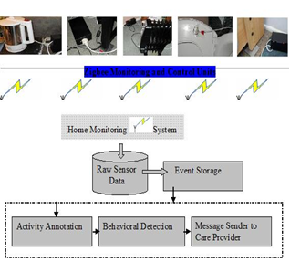
Sensors Integrated with Everyday Objects

Slide 14
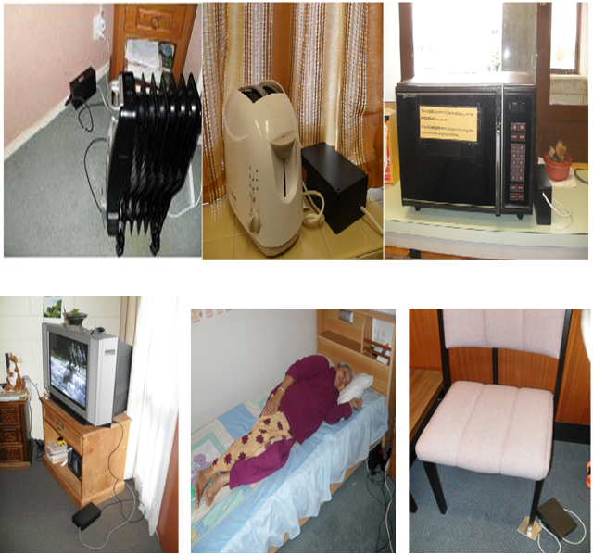
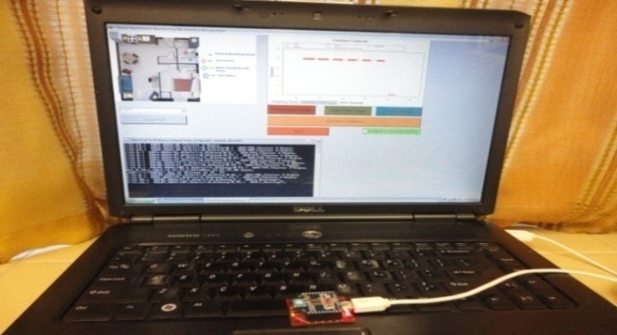
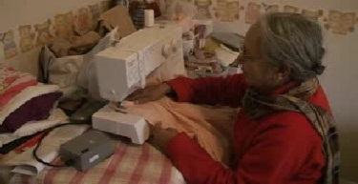
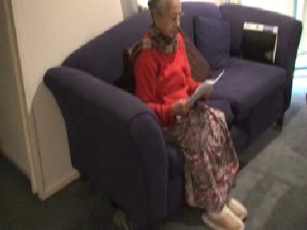
Sensing Units-HMS

Slide 15
Monitoring Basic ADL
ADL α Household Appliance Usage
Preparation of Food (Breakfast,Lunch,Dinner)
Sleeping
Toileting, Self Grooming
Dinning
Relax
Watching TV(while sitting on Couch)
Microwave, Water Kettle, Toaster or (any other item used regularly in Kitchen)
Room Heater
Television/Radio
Bed, Couch, Chair, Toilet
Any other appliance used as habitual
Passive Infra Red(PIR) Sensors: Mobility(Movements monitoring)
N.K.Suryadevara, S. C. Mukhopadhyay, R. Wang, R.K. Rayudu, “Forecasting the behavior of an elderly using wireless sensors data in a smart home”, Elsevier: Engineering Applications of Artificial Intelligence, Available online 12 September 2013, ISSN 0952-1976, http://dx.doi.org/10.1016/j.engappai.2013.08.004.

Slide 16
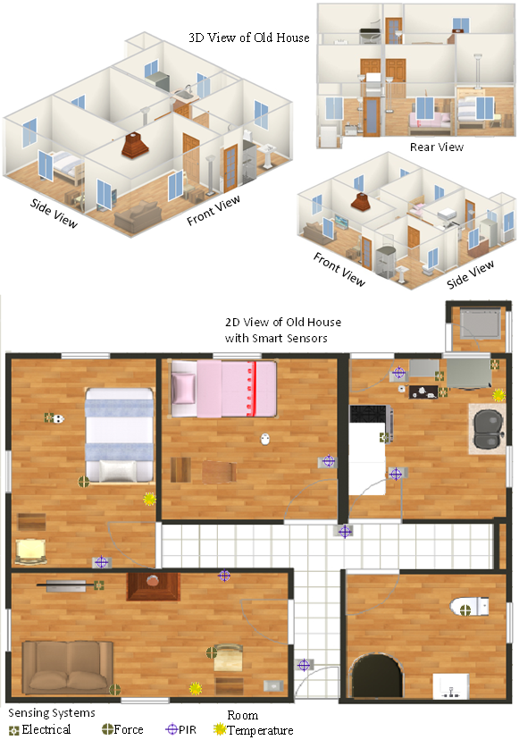
Smart Sensor Deployment Layout

Slide 17
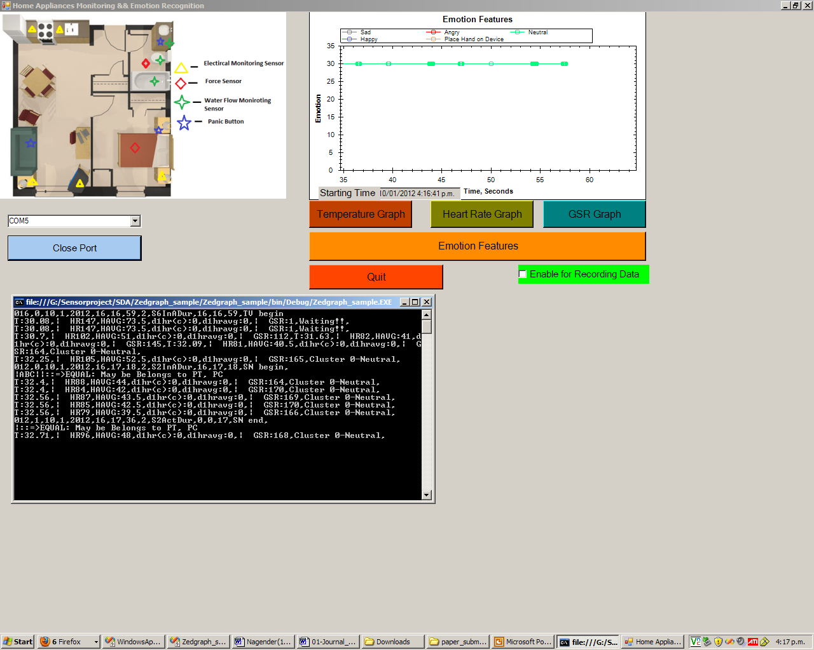
Human Emotion and ADL recognitions
Quazi, M.T.; Mukhopadhyay, S.C.; Suryadevara N.K.; Huang, Y.M. “Towards the smart sensors based human emotion recognition”, Proceedings of IEEE International Conference Instrumentation and Measurement Technology (I2MTC)-Austria-2012,Page(s):2365 – 2370, . ISBN: 9781457717710

Slide 18
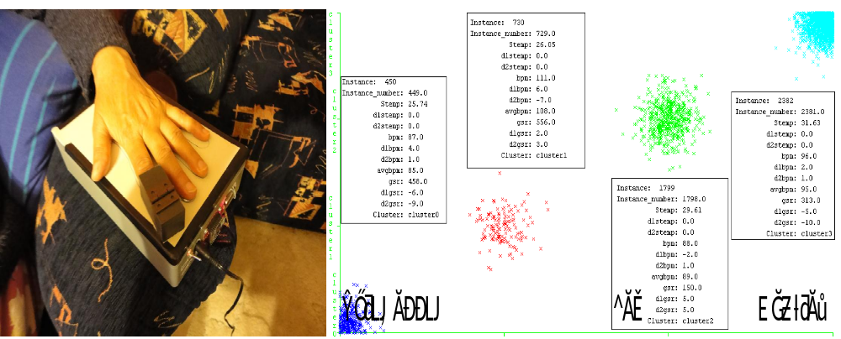
Human Emotional State Recognition Unit
Quazi, M.T.; Mukhopadhyay, S.C.; Suryadevara N.K.; Huang, Y.M. “Towards the smart sensors based human emotion recognition”, Proceedings of IEEE International Conference Instrumentation and Measurement Technology (I2MTC)-Austria-2012,Page(s):2365 – 2370, . ISBN: 9781457717710

Slide 19
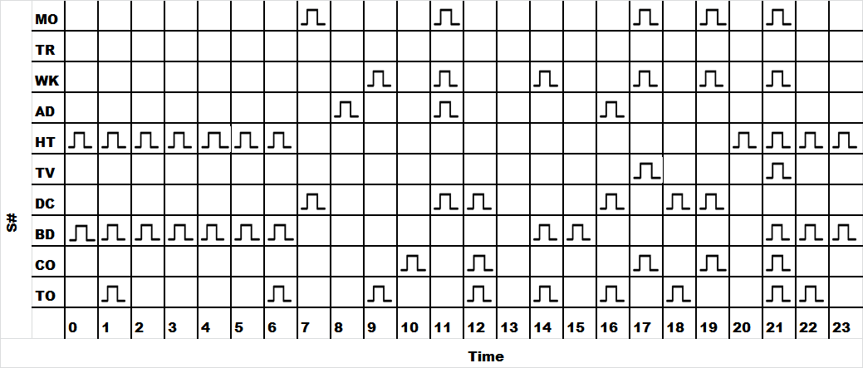
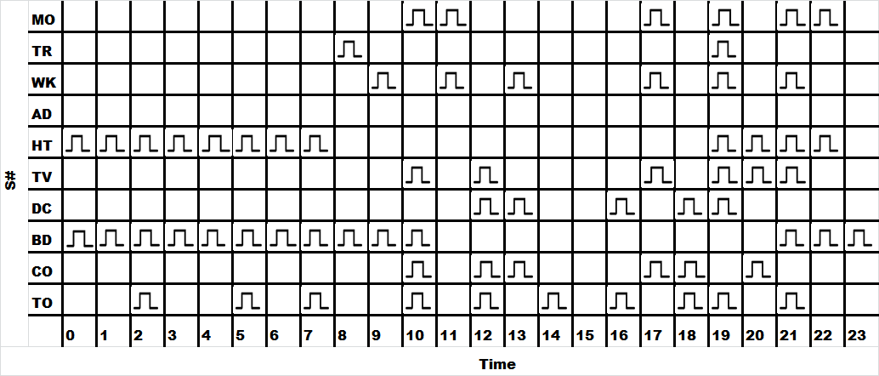
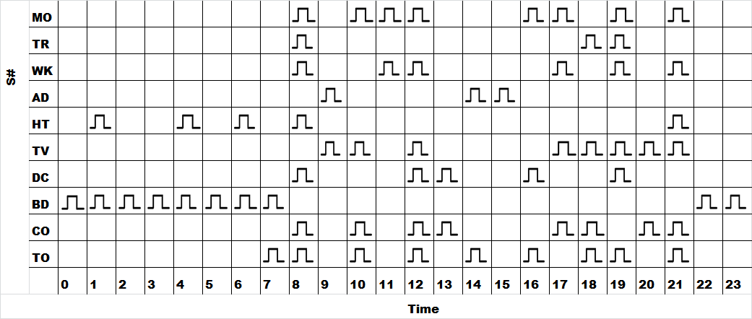
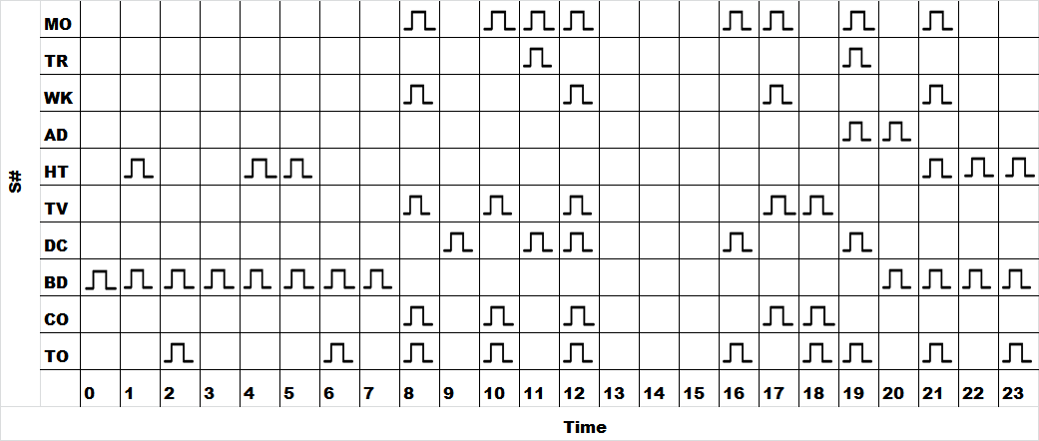
Sensor activity status
Subject #1
Subject #2
Subject #3
Subject #4
Suryadevara N.K, Mukhopadhyay S.C, “Wireless Sensor Network based Home Monitoring System for Wellness Determination of Elderly”, IEEE Sensors Journal-2012, Vol: 12 Issue: 6, Page(s): 1965 – 1972

Slide 20
Domestic objects are used at regular time intervals in the day to day life
Usage durations and the frequency of use are varied
“Human behaviours in constant contexts recur, because the processing that initiates and controls their performance becomes automatic”
“Frequency of past behaviour reflects the habit strength and has a direct effect on future performance”

Slide 21
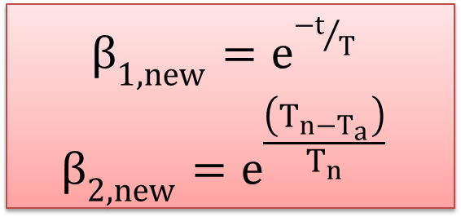
Wellness Determination
β_{(1,old)} = (1- t / T)
β_{(2,old)} = 1+(1- t_{a} / T_{n})
Sensor Event
Level-0
C Context Recognition
Level-1
ADL Recognition
Level-2
${β_{1,new}=e}^{{−t}/T}$
$${β_{2,new}=e}^{\frac{\left(T_{n−T_{a}}\right)}{T_{n}}}$$
Notes:
β1’ inactive usages of household appliances, indicating the status of inactivity of daily living, ii) ‘β2’, excess usages of household appliances, indicating abnormal activity of daily living conditions, and iii) ‘τ’- the trend in usage of household appliances indicating the conduct of ADL;
The collection of longitudinal data will help the healthcare providers to know the past behavior of elderly

Slide 22
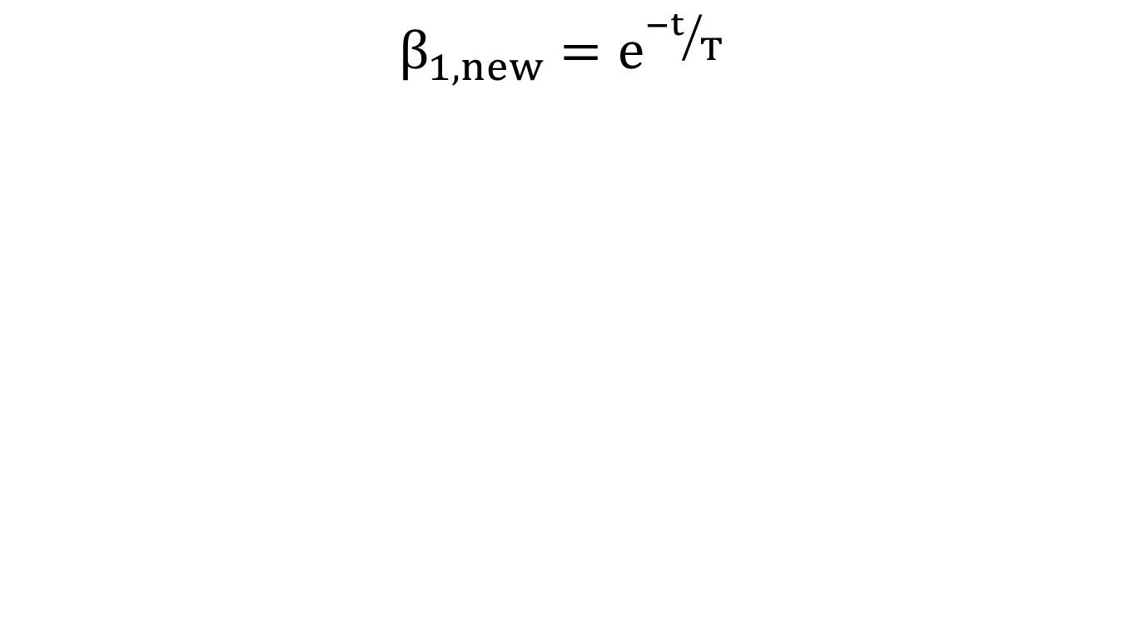
Improved Wellness Function (β_{1, new})
${β_{1,new}=e}^{{−t}/T}$
Suryadevara N.K, Mukhopadhyay S.C, “Determining Wellness through an Ambient Assisted Living Environment,” IEEE Intelligent Systems-May 2014,Page(s):30-37, ISSN:1541-1672

Slide 23
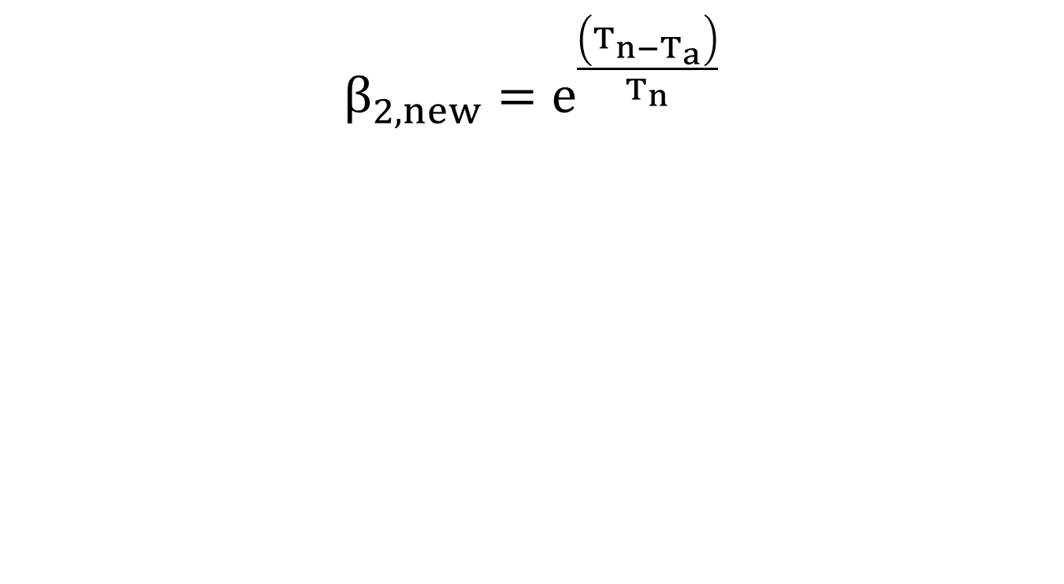
Improved Wellness Function (β_{2, new}):
${β_{2,new}=e}^{\frac{\left(T_{n−T_{a}}\right)}{T_{n}}}$
Suryadevara N.K, Mukhopadhyay S.C, “Determining Wellness through an Ambient Assisted Living Environment,” IEEE Intelligent Systems-May 2014,Page(s):30-37, ISSN:1541-1672

Slide 24
Behaviour Detection
Regular or Irregular
Sensor Activity Pattern
Forecasting
Wellness Indices
To Minimize “False Alarms”
N.K.Suryadevara, S. C. Mukhopadhyay, R. Wang, R.K. Rayudu, Forecasting the behavior of an elderly using wireless sensors data in a smart home, Elsevier: Engineering Applications of Artificial Intelligence, Available online 12 September 2013, ISSN 0952-1976, http://dx.doi.org/10.1016/j.engappai.2013.08.004.

Slide 25
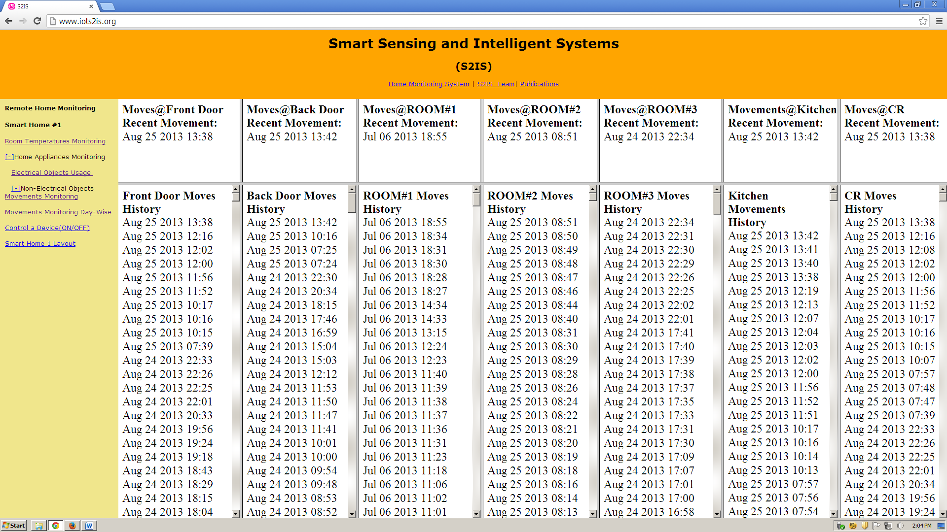
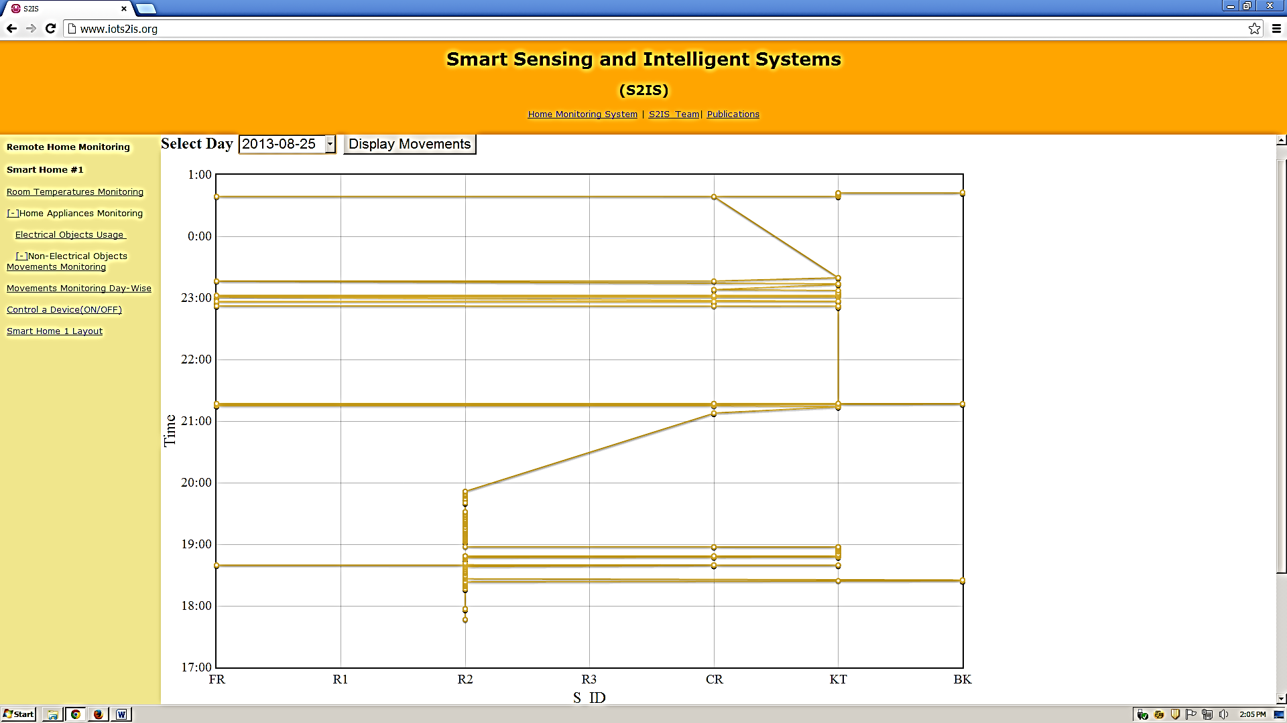
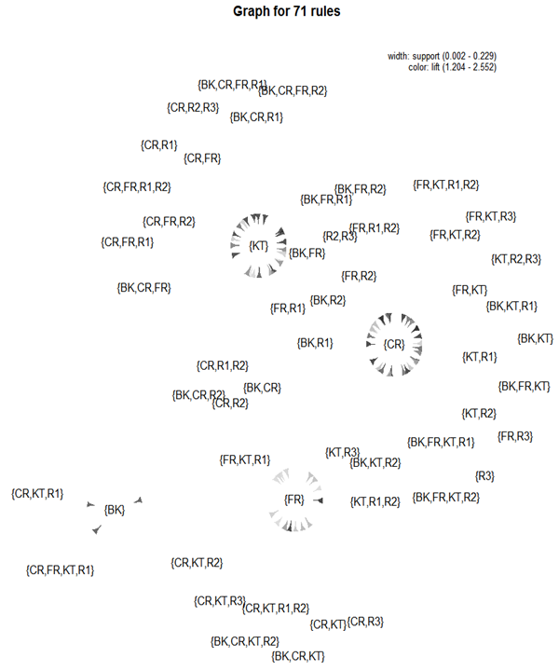
Tracking System

Slide 26
Wellness Determination
N.K.Suryadevara, S. C. Mukhopadhyay, R. Wang, R.K. Rayudu, Forecasting the behavior of an elderly using wireless sensors data in a smart home, Elsevier: Engineering Applications of Artificial Intelligence, Available online 12 September 2013, ISSN 0952-1976, http://dx.doi.org/10.1016/j.engappai.2013.08.004.

Slide 27
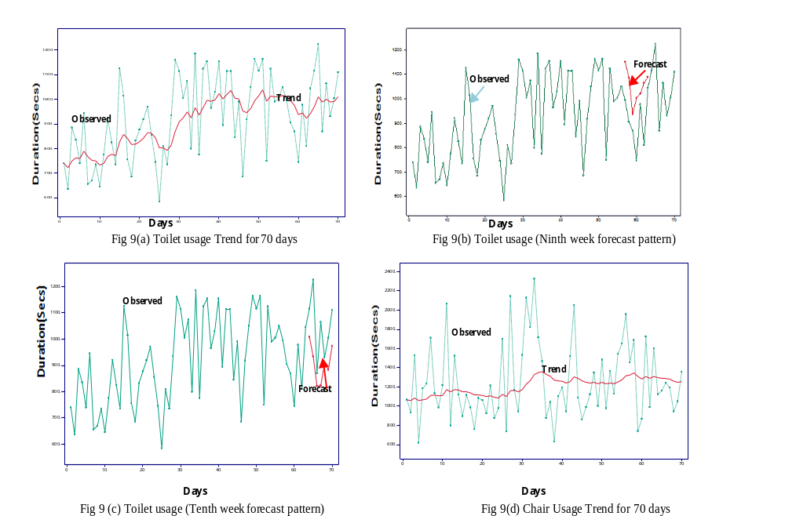
N.K.Suryadevara, S. C. Mukhopadhyay, R. Wang, R.K. Rayudu, Forecasting the behavior of an elderly using wireless sensors data in a smart home, Elsevier: Engineering Applications of Artificial Intelligence, Available online 12 September 2013, ISSN 0952-1976, http://dx.doi.org/10.1016/j.engappai.2013.08.004.

Slide 28
Sensor Activity Pattern
Discovering Interesting Patterns in Data
Cluster of Similar Instances
Perform Classification of New Data based on Training Data
Associations
Sequential Patterns/Rules
(Finding inherent regularities in data)
With Time Constraints
Top-K Sequential Rule Mining
(Redundant/Non-Redundant)

Slide 29
Conclusion
WSN Assisted Intelligent Integrated Healthcare Platform for Wellbeing and Independent Living
The healthcare platform consists of
Appliances Monitoring Unit
Physiological parameters monitoring unit
Human Posture and Position Detection Unit
Human Emotion Recognition Unit
Automatic Medicine Dispenser Unit
Power Management Unit
Robust Supervisory Control Unit
Safety Box Unit

Slide 30
A WSN Assisted and Embedded Processing based smart home to care elderly people.
The integrated system is able to support people who wish to live independently.
The developed system is robust and is possible to develop at a low cost due to indigenous development.
The technology assisted home will alert the caregiver in advance about the trend of the health status, so that necessary precaution can be taken.

Slide 31
Thank you
suryadevara99@gmail.com

