Slide 1


Clinical Presentations of HHV-6 Infection in Infants and Children in Kuwait: A
Retrospective Study
Dr Nada Madi
Assistant Professor
Microbiology Department
Faculty of Medicine
Kuwait University
Kuwait
Notes:
1

Slide 2

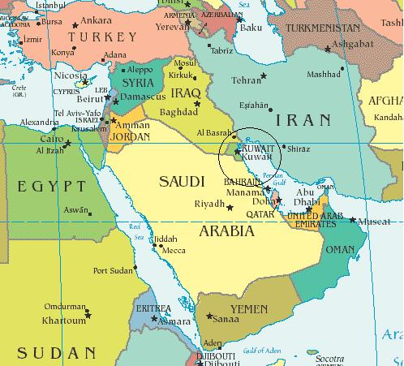




Slide 3
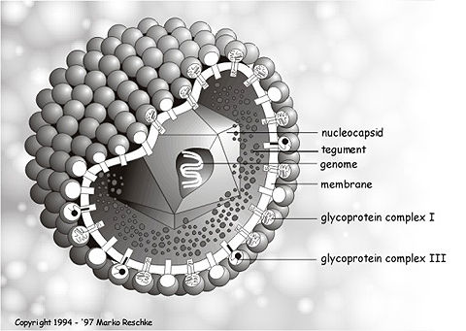
HHV-6 Properties
Order: Herpesvirales
Family: Herpesviridae
Subfamily: Betaherpesvirinae
Genus: Roseolovirus
Two distinct species: HHV-6A and HHV-6 B.
HHV-6B causes the childhood illness roseola infantum, whereas HHV-6A has been isolated mainly in immunocompromised hosts
HHV-6 is now recognized as a T-cell lymphotropic virus with high affinity for CD4 lymphocytes
Notes:
HHV-6 was initially characterized as a human B-lymphotropic virus, but it soon appeared that it was essentially a T-lymphotropic virus, and it acquired its definite name
Finally, based on both biological properties and genetic analyses, HHV-6 was officially classified as a member of the Herpesvirales
Those isolates and the HHV-6 isolates obtained subsequently were stratified into two well-defined, non-overlapping groups differing by specific genetic changes and phenotypic properties. These two groups were designated variants A and B (HHV-6A and HHV-6B) of the unique HHV-6 species
The photo is for electronon micrograph of extracellular , mature , enveloped HHV-6 budding from a cell

Slide 4
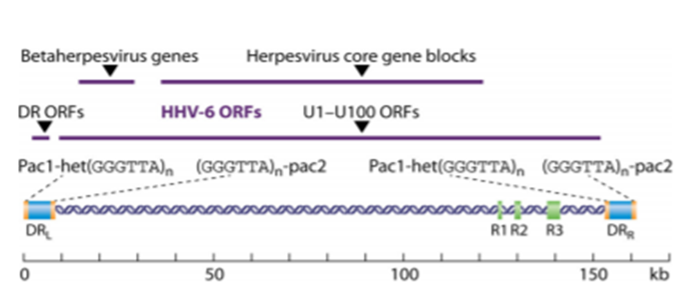
Genome and Genetic Variability
Linear ds DNA, 163-170 kb
2 well-defined variants: HHV-6A
and B share an overall nucleotide sequence identity of approximately 90%
Genetic polymorphism:
Immediate early region I (IEI)
Glycoproteins B (gB) and glycoproteins H (gH)
U94 product
The differences affect the binding of viral proteins to their cellular targets alter cell tropism interactions with the microenvironment host immune responses pathogenesis
Notes:
FIG 1 Schematic representation of the HHV-6 genome. The genome is represented as a double-stranded DNA containing specific elements which are described in the text. The repeat elements, shown as green and blue boxes, include the identical terminal repeat sequences DRL and DRR, the internal repeat arrays R1, R2, and R3, and the stretches containing repeat hexanucleotide sequences [(GGGTTA)n] within the DR regions. Purple straight lines indicate the positions of the different sets of ORFs.
Those isolates and the HHV-6 isolates obtained subsequently were stratified into two well-defined, nonoverlapping groups differing by specific genetic changes and phenotypic properties. These two groups were designated variants A and B (HHV-6A and HHV-6B) of the unique HHV-6 species
The genetic variability of HHV-6 DNA is limited, with the nucleotide identity among all published sequences exceeding 90% as a whole
HHV-6A and HHV-6B DNAs exhibit clear specific differences which are scattered throughout the genome and permit their easy recognition, without any ambiguity.

Slide 5

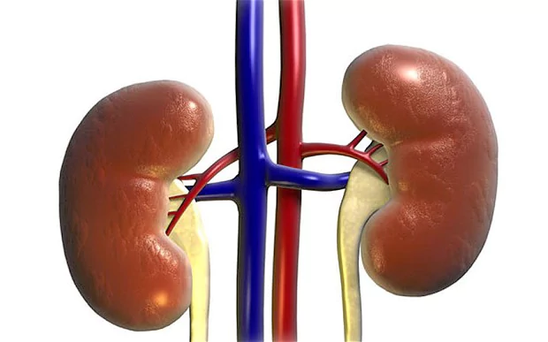
Latency and Reactivation
HHV-6 genome has the capacity of to be maintained in a nuclear latent form or to drive a low-level productive infection in some cells while inducing a fully lytic infection in other cells.
Latency sites: brain, tonsils, salivary glands, kidneys, liver, lymph nodes, endothelial cells, monocytes/macrophages, bone marrow progenitors and CNS cells.
The U94 gene play a major role in the establishment and maintenance of intracellular latency.
Reactivation: transcription of IE genes in the IE1 and IE2 regions following the transactivation effect of cellular and/or viral factors whose nature is still unknown.
Reactivation results in the induction of a replication cycle and eventually cytopathic effect
Notes:
Like other human herpesviruses, HHV-6 persists indefinitely in its host and is capable of reactivation, meaning the active production of detectable mature virions in some body compartments following a phase of apparently complete clearance.
As for HCMV, the host tissue range of HHV-6 in vivo appears to be broader than might be expected from in vitro studies and includes the brain, tonsils, salivary glands, kidneys, liver, lymph nodes, endothelial cells, and monocytes/macrophages
The latter cell types are suspected to be preferential sites for virus latency, in parallel with bone marrow progenitors and central nervous system (CNS) cells
The viral gene U94, which is expressed during latent infection, is assumed to play a major role in the establishment and maintenance of intracellular latency.
This reactivation process results in the induction of a replication cycle and the possible appearance of a cytopathic effect.

Slide 6
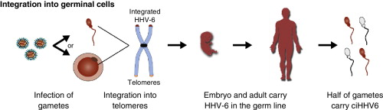
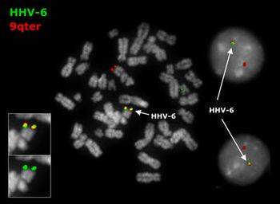
Chromosomal Integration (ciHHV-6)
HHV-6 is able to persist in latent state by naturally integrating into regions of the host's chromosome
Chromosomally integrated HHV-6” (ciHHV-6) is an inherited condition in which the complete HHV-6 genome is integrated into the telomere of every chromosome resulting in individuals harboring the integrated virus in their germ line and transmitting it to their offspring
This phenomenon occurs in 0.2 to 1% of the general population in developed countries and is often causes high levels of viral DNA in host serum and plasma (Pellett 2012)
ciHHV-6 might lead directly to reactivation, as reflected by the production of viral transcripts, proteins, and even transmissible virions
It is unique feature among human herpesviruses and raises numerous novel questions regarding both pathophysiology and diagnosis.
Notes:
HHV-6 is unique among human herpesviruses in that it is able to persist in latent state by naturally integrating into regions of the host's chromosome
This phenomenon was further reported to be present in human cells in vivo, including cells which can be transmitted as germinal cells to offspring and hematopoietic stem cells transferred to a transplant recipient
. Although there is no in vivo evidence for that assumption, it must be kept in mind knowing that HHV-6 has the ability to infect sperm cells
The integrated virus can excise itself from the chromosome and activate under certain circumstances, such as immune deficiency
Chromosomally integrated HHV-6 individuals will always have a very high viral load in whole blood testing—generally over 1 million copies per ml — but testing on plasma will be low or below the level of detection unless the individual is acutely ill

Slide 7

Epidemiology of HHV-6 Infection
HHV-6A and HHV-6B are ubiquitous viruses that are detected in all human populations around the world.
Seroprevalence is almost 100% in Europe and is close to 100% in the rest of the world—with certain exceptions, such as Morocco, which has 20% seroprevalence.
Primary HHV-6 infection is acquired between 6 months and 2 years of age
Congenital infection following intrauterine transmission has been reported for about 1% of children (Aubin JT et al., 1992)
Congenital infection is mainly linked with ciHHV-6 in mothers (Tesini BL et al., 2014)
Virus transmission is by saliva, and transmission through organ transplantation has been described infrequently, blood transfusion and breast feeding have never been reported to be origins of primary infections
Primary HHV-6B infection occurs first, in many cases associated with clinical symptoms, whereas HHV-6A is acquired later, through asymptomatic infection
Notes:
Primary infection can also happen later, in adults, as reported in a few cases
To date, a clear view of the respective temporality of HHV-6A and HHV-6B infections is missing. It is generally believed that in the majority of countries, primary HHV-6B infection occurs first, in many cases associated with clinical symptoms, whereas HHV-6A is acquired later, through asymptomatic infection
Ultimately, the concomitant detection of HHV-6A and HHV-6B in blood or tissues from adults indicates that the two viruses chronically infect many, if not most, individuals

Slide 8
Clinical Impacts of HHV-6 Infections
Primary Infection
Stage of HHV-6 infection | Disease or symptom
Primary infection (congenital) | Abnormalities at birth and during immediate postnatal period (H) CNS developmental defects (H)
Primary infection (postnatal) | Exanthema subitum (roseola infantum, sixth disease) (C) Fever, seizures (C) Mild gastrointestinal and respiratory tract symptoms (C) Thrombocytopenia, infectious mononucleosis-like syndrome (C) Hepatitis, gastroenteritis, colitis (C) Meningoencephalitis and encephalitis (C) Hemophagocytic syndrome (H) Temporal lobe epilepsy (H)
Account for 10 to 20% of febrile illnesses while mostly are asymptomatic
The rate of exanthema subitum is higher in Japan than in the United States, the responsible variant was HHV-6B in most cases (Descamps V et al., 2014)
A nationwide survey in Japan showed an unexpectedly poor prognosis for exanthema subitum-associated encephalitis (Yoshikawa T et al., 2009)
Fatal cases of encephalopathy following acute HHV-6 infection were reported for two children with underlying genetic mitochondrial disorders (Al-Zubeidi D et al., 2014)
Congenital HHV-6 infection following primary infection during pregnancy has been found to occur in about 1% of children .
ciHHV-6 was found to be the predominant context associated with congenital HHV-6 infection (Hall CB et al., 2008)
Notes:
Clinical syndromes consistently (C) or hypothetically (H) associated with HHV-6 infections
HHV-6 primary infections cause acute febrile diseases in young children of 6 months to 3 years of age, with the most emblematic one being exanthema subitum (also known as roseola infantum or sixth disease)
less typical combinations of fever, seizures, skin rash, and gastrointestinal and respiratory tract symptoms have been reported, with most of them leading to a quick, favorable outcome (
As a whole, HHV-6 primary infections account for 10 to 20% of febrile illnesses at this age, and the majority of these infections are associated with clinical symptoms, in disagreement with the previous assumption that the majority of these infections are asymptomatic
For still unknown reasons, the clinical symptoms might differ slightly according to country: the rate of exanthema subitum associated with primary infection seems to be higher in Japan than in the United States (153). As mentioned above, the responsible variant was found to be HHV-6B in most cases. Primary infections with HHV-6A have been reported much less frequently, and it is generally assumed that HHV-6A is acquired after HHV-6B, through an asymptomatic infection. However, symptomatic primary infections with HHV-6A have been described for children in the United States as well as in sub-Saharan Africa
Infrequently, primary infection is associated with a more severe disease, such as hepatitis, including fulminant forms in some cases, thrombocytopenia, infectious mononucleosis-like syndrome, hemophagocytic syndrome, gastroenteritis, colitis, or myocarditis
Neurological complications include meningoencephalitis and encephalitis, which represent ultimate stages of CNS involvement during primary infection and whose outcomes remain uncertain
Congenital infection results from either the germ line transmission of ciHHV-6 (i.e., congenital ciHHV-6) or transplacental passage of the virus following endogenous reactivation (or putative exogenous reinfection) in the mother.
The question of active virus replication has been more difficult to address in considering cases of mesial temporal lobe epilepsy which have been related to HHV-6B in children: there was no evidence of systemic viral infection, but high levels of HHV-6 DNA were detected in the hippocampal regions following temporal lobectomy, suggesting an active local multiplication of the virus, possibly focused in astrocytes

Slide 9
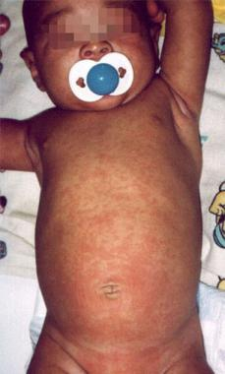
Exanthema subitum (roseola infantum, sixth disease)
Notes:
9-month-old infant boy presented with 1-day history of high-grade fever and irritability.

Slide 10
Clinical Impacts of HHV-6 Infections
Reactivations
Stage of HHV-6 infection | Disease or symptom
Reactivation (and possible reinfection) | Fever (C) Rash (C) Thrombocytopenia, leukopenia, anemia, bone marrow suppression (C) Hepatitis (C) Encephalitis, neurocognitive dysfunction (C) Retinitis (C) Pneumonitis (C) Drug-induced hypersensitivity syndrome (C) Gastroenteritis, colitis (H) Temporal lobe epilepsy (H) Allograft rejection (H) Graft-versus-host disease (H) Thrombotic microangiopathy (H) Higher incidence and severity of infections with HCMV, fungi, and other opportunistic pathogens (H)
HHV-6 reactivations in transplant recipients occur in a minority of patients but are involved in a wide spectrum of syndromes
Reactivation occurs in 33-48% of patients undergoing hematopoietic stem-cell transplantation result in life-threatening illness concerning the CNS and/or bone marrow, two well-known sites of HHV-6 latency
Encephalitis develops in only a small proportion of patients and the majority of cases are due to HHV-6B
In renal transplant recipients, the spectrum of clinical manifestations is limited, whereas hepatitis, pneumonitis, bone marrow suppression, and encephalitis have been reported for liver, lung, and heart transplant patients
The capability of HHV-6 to accelerate the progression to AIDS remains controversial, reports showed cases of encephalitis, pneumonitis, and retinitis (Lusso P et al., 1994)
Notes:
Some symptoms may be considered nonspecific, such as fever, rash, and transiently decreased numbers of circulating blood cells belonging to the granulocyte/macrophage, erythroid, and megakaryocytic lineages (Table 2)
In contrast, subacute limbic encephalitis and delayed engraftment are now recognized as typical opportunistic diseases due to HHV-6 reactivation in HSCT recipients
These patients, particularly those receiving allogeneic transplants, are at high risk of developing a reactivation within the first 4 weeks after cell transfer and, subsequently, suffering a lifethreatening illness concerning the CNS and/or bone marrow, two well-known sites of HHV-6 latency
In renal transplant recipients, the spectrum of clinical manifestations seems limited, whereas hepatitis, pneumonitis, bone marrow suppression, and encephalitis have been reported for liver, lung, and heart transplant patients
Other clinical conditions associated with HHV-6 reactivation in this population include hepatitis, idiopathic pneumonitis, bone-marrow suppression, encephalitis, fever and rash, graft versus host disease (GVHD), and delayed engraftment. Although reactivation of HHV-6 accounts for most infections, transmissions of HHV-6 with the donor allograft, solid organ, or hematopoietic stem cell have also been reported.

Slide 11
Clinical Impacts of HHV-6 Infections
Chronic Infections
The chronic clinical manifestations that can be related to the persistence of HHV-6 in the body is challenging to proof.
The demonstration of HHV-6 as the cause of diseases are extremely difficult
HHV-6 is one of the most serious infectious trigger candidate of multiple sclerosis, on the basis of immunological, virological, and experimental data (Yao K et al., 2010)
Recent study suggested the putative role of HHV-6A infection in Hashimoto’s thyroiditis as s environmental triggers (Caselli E et al., 2012)
HHV-6 can cause myocarditis and subsequent chronic cardiomyopathy from frequent detection of the virus in heart muscle biopsy specimens (Ablashi DV et al., 210)
Hypothetical role of HHV-6 in the pathogenesis and progression of angioimmunoblastic T cell lymphoma is supported by a higher detection frequency and load of HHV-6 DNA in tumor tissue than those in other lymphomas (Zhou Y et al., 2007)
Notes:
Numerous challenges arise in considering the chronic clinical manifestations that can be related either directly or indirectly to the persistence of HHV-6 in the body, apart from or independent of clear-cut episodes of active viral infection.
In addition, the current limitations of investigational tools concern the interpretation of results regarding viral loads, transcripts, and immune markers, as well as the low level of viral expression during latent infection, the existence of two HHV-6 species, and the lack of relevant animal models
The role of HHV-6 as a possible trigger for multiple sclerosis (MS), an inflammatory demyelinating disease of the CNS, has been debated for a long time
. However, to date, no definite proof of this causative role has been provided (184). Such a proof would open the way to novel MS therapies based on specific antiviral effectors.
The virus was detected more frequently in thyroid cells of patients suffering from Hashimoto’s thyroiditis than in those of control patients, such as patients with Graves’ disease or multinodular goiter.

Slide 12
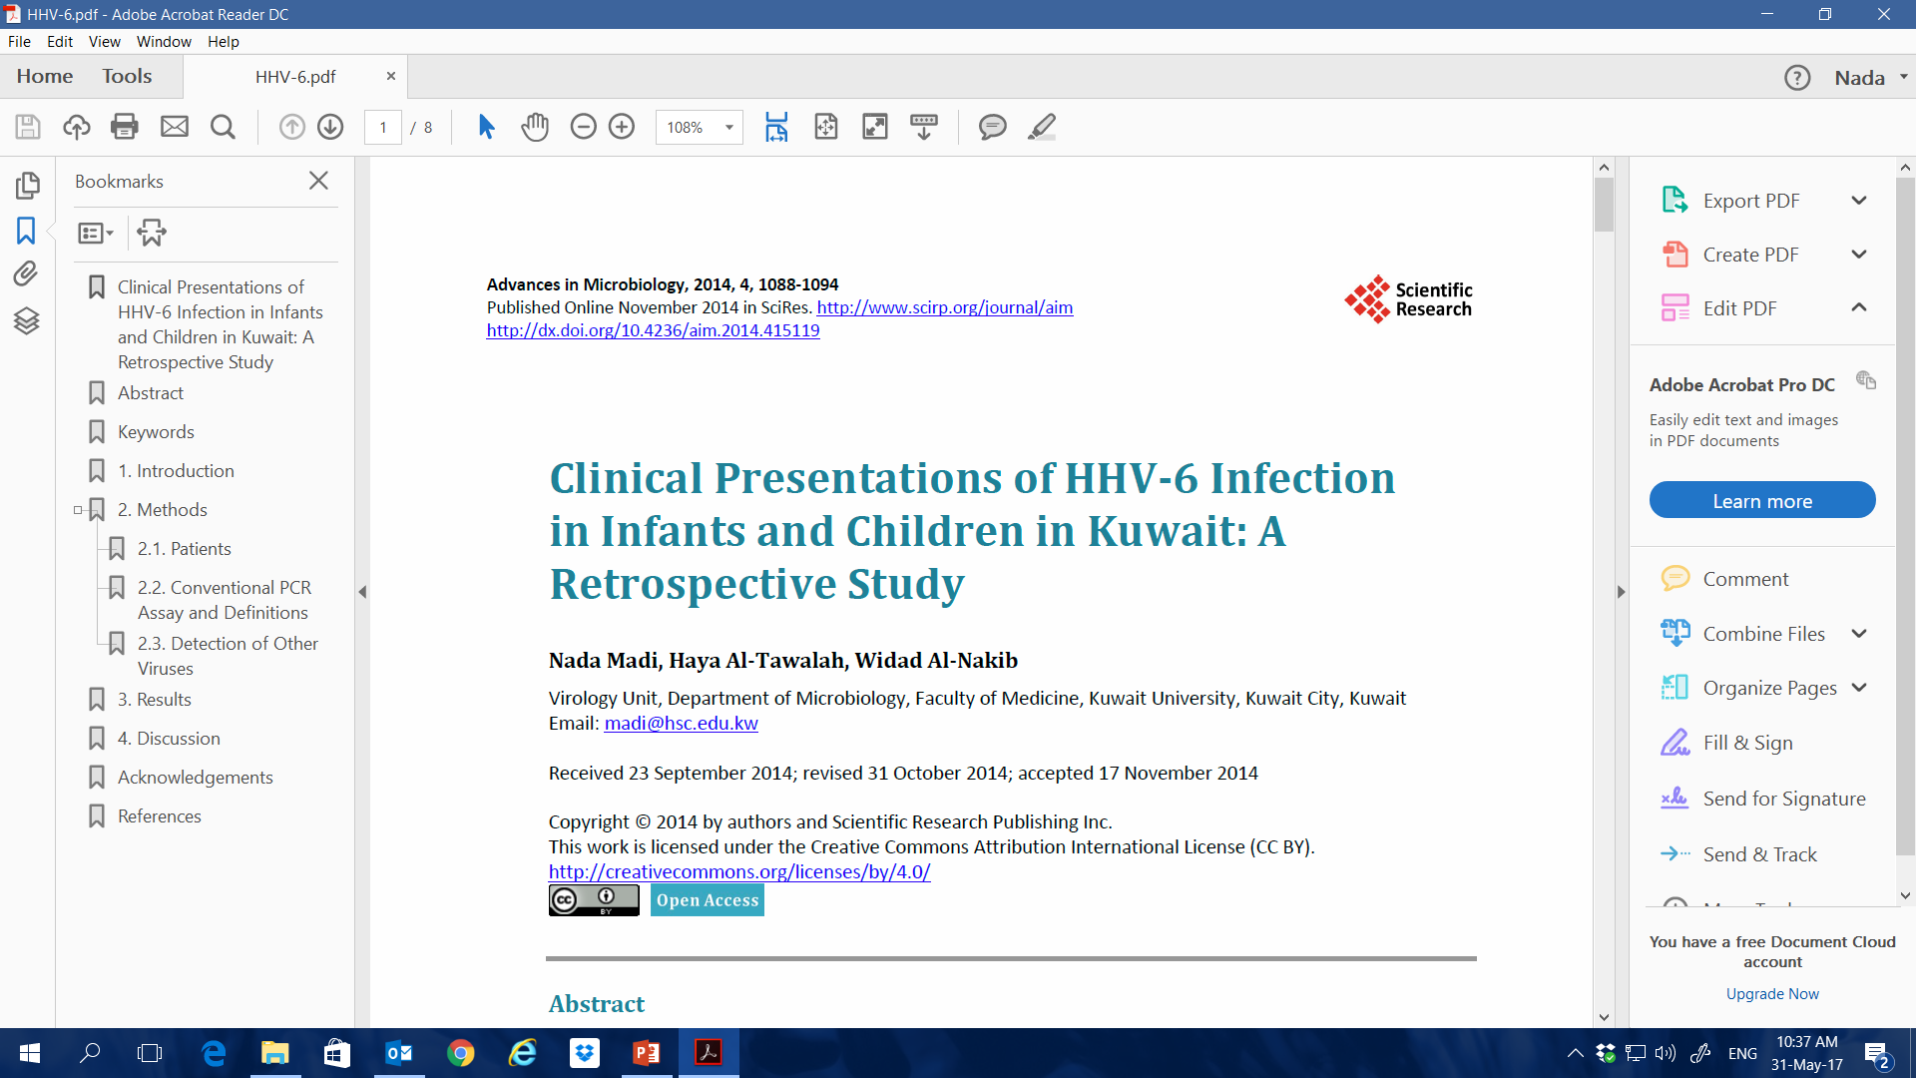

Slide 13
Clinical Presentations of HHV-6 Infection in Infants and Children in Kuwait: A Retrospective Study
Clinical manifestations of human herpesvirus 6 (HHV-6) have not been clearly defined, and the role of HHV-6 in human disease among infants and children in Kuwait remains to be fully elucidated
The study describes the clinical manifestations and syndromes associated with HHV-6 infection among infants and children in Kuwait.
A retrospective study covering the period between 2008 and 2014 was conducted on infants and children aged from 1 month to 5 years (n= 449) presented with symptoms suggestive HHV-6 infection such as fever, roseola, and seizures.
Blood and CSF samples from infants and children who presented with symptoms suggestive HHV-6 infection were subjected to nested PCR test for HHV-6.
Detection of IgM antibodies to Epstein Bar virus (EBV), Parvovirus B19, and adenovirus in blood was performed by ELISA.
Enteroviruse RNA was detected by conventional PCR, CMV and HSV DNA were detected by Real-Time PCR in blood.
Notes:
No published data on the spectrum of signs and symptoms developed as a result of HHV-6 infection in infants and children in Kuwait. Therefore, this study describes the clinical manifestations and syndromes associated with HHV-6 infection among infants and children in Kuwait.

Slide 14
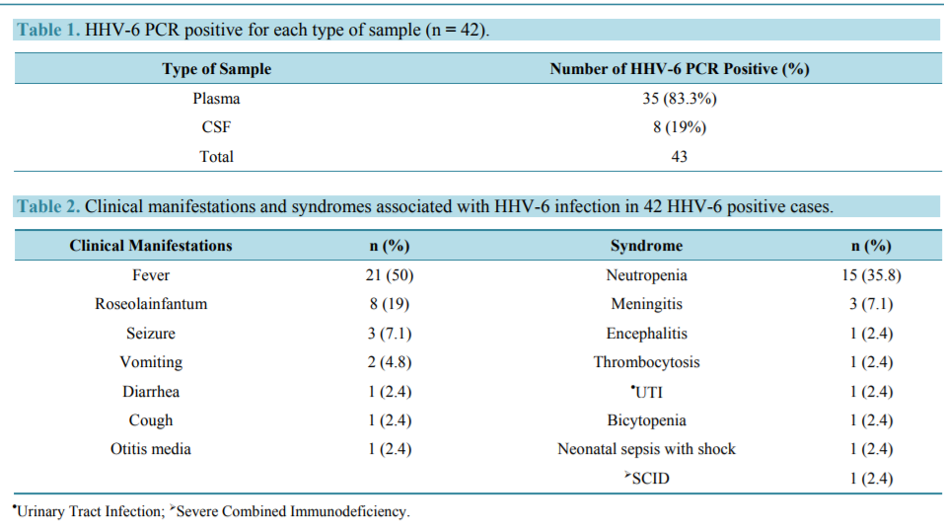
Clinical Presentations of HHV-6 Infection in Infants and Children in Kuwait: A Retrospective Study
9.3% (n = 42) of infants and children were positive for HHV-6
One child had bone marrow transplantation with severe combined immunodeficiency syndrome (SCID) with MHC class II deficiency and graft versus host disease, the presenting symptoms was rash.
Notes:
Among the 42 cases, the breakdown of positive HHV-6 DNA PCR results according to the sources of samples was as follows: 35 (83.3%) were positive in plasma and 8 (19%) were positive in CSF
According to the definition of active infection (positive plasma PCR test), 83.3% had active infection. On the other hand, 8 patients (19%) were PCR positive in CSF only
Only one patient was positive in both CSF and plasma samples. However, one patient was CSF positive and plasma negative, which suggest that this patient had latent infection
The clinical manifestations and syndromes of the 42 HHV-6 positive infants and children are presented in
Fever was the most prominent finding, presented in 50% (n = 21) of the HHV-6 cases. Roseolainfantum presented in 19% (n = 8) of the cases. The rash was maculopapular and most frequently generalized, involving face, trunk, and limbs
In addition, Diarrhea, cough, otitis media, (2.4% each) were less frequently seen in the HHV-6 cases
Fifteen children (35.8%) had neutropenia at the time of hospitalization. Another three children (7.1%) had meningitis. Encephalitis, thrombocytopenia, urinary tract infection (UTI), Bicytopenia, neonatal sepsis with shock, were seen in 2.4%.
We found one child aged two years and 6 months who had undergone bone marrow transplant had SCID with MHC class II deficiency and graft-versus-host disease (GVHD). This child had only severe rash and was positive for HHV-6 in plasma. Unfortunately, it was difficult to define clearly whether this infection was primary or reactivation of latent infection since information on antibody seroconversion test was not available

Slide 15
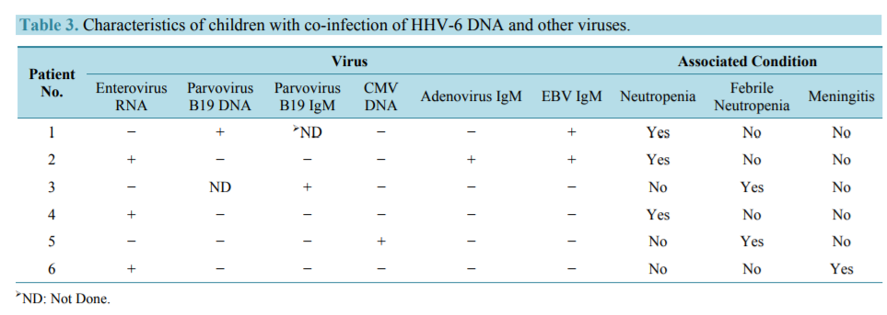
Clinical Presentations of HHV-6 Infection in Infants and Children in Kuwait: A Retrospective Study
3 children were positive for Enterovirus RNA, 2 children were positive for Parvovirus B19 positive, 2 children were positive for EBV, 1 child was positive for adenovirus and another one was positive for CMV.
Notes:
The relationship between the presence of HHV-6 DNA and other viruses was also examined. Six children showed HHV-6 co-infection with other viruses

Slide 16
Conclusion
The study in Kuwait provides important information about the clinical outcome of HHV-6 infection among infants and children.
Fever is the main clinical manifestation of HHV-6 infection
Neutropenia is highly associated with HHV-6 infection among infants and children
Encephalitis and meningitis are linked to HHV-6 infection in immunocompetent children, which indicate that the virus can result in different neurological complications
Our results also suggest that HHV-6 may trigger the manifestations of GVHD
Our results are in agreement with other study: neutropenia in previously healthy children in Kuwait was caused by infections in 55% of cases: HHV-6, 30%; Enterovirus, 23%; Influenza A H1N1, 13%; Parvovirus, 10%; EBV, 10%; UTI by Eshcherichia coli, 7%; Adenovirus, 7%of (Hussain et al.,2012)

Slide 17

Pending Questions and Perspectives
Decoding the Clinical Impact of Chromosomal Integration
ciHHV-6 raises numerous theoretical clinical concerns related to virus reactivation, dysregulation of immune responses, and instability of the cell genome
If proven, these phenomena might significantly alter the frequencies of inflammatory, autoimmune, or drug-induced hypersensitivity diseases in ciHHV-6 subjects
Also, they might modify the rate of side effects and the overall prognosis of transplantation and transfusion for patients receiving ciHHV-6 blood cells or organs
There is a need of retrospective studies in order to determine whether ciHHV-6 is significantly more frequent in some diseases.
Also, prospective studies of cohorts of ciHHV-6 individuals will analyze the occurrences of particular illnesses compared to those for cohorts of control subjects.

Slide 18

Pending Questions and Perspectives
Differential Pathogenic Roles of HHV-6A and HHV-6B
HHV-6A and HHV-6B are now defined as distinct virus species
Their epidemiologies are suspected to differ from each other regarding the time of virus acquisition in life, their role in HHV-6 primary infection according to geographic region, their distribution in human tissues, and their modes of human-to-human transmission
Major questions refer to disease associations
Some studies showed increased severity of HHV-6A over HHV-6B, particularly in acute and chronic CNS diseases suspected to be linked with HHV-6 infection
It is essential to make a clear distinction between both species in all research projects regarding HHV-6 epidemiology and pathogenicity, it will help in defining specific diagnostic and treatment strategies on a more relevant basis

Slide 19
Take Home Message
HHV-6 is a widespread betaherpesvirus which is now encompasses two different species: HHV-6A and HHV- 6B.
HHV-6 herpesviruses, induces a lifelong latent infection in humans.
ciHHV-6 is foind in about 1% of the general population. This may be a confusing factor for the diagnosis of active viral infection.
Many active HHV-6 infections, corresponding to primary infections, reactivations, or exogenous reinfections, are asymptomatic. However, the virus may be the cause of serious diseases, particularly in immunocompromised individuals.
The formal demonstration of the causative role of HHV-6 in many acute and chronic human diseases is difficult due to the ubiquitous nature of the virus, chronicity of infection, existence of two distinct species, and some time due to limitations of current investigational tools
There are still numerous pending questions about HHV-6 which should stimulate future research works on the pathophysiology, diagnosis, and therapy of this amazing human virus

Slide 20

Thank You

