Slide 1
Applications of Nano- and Femto-technology in Medicine and Pharmacy

Slide 2
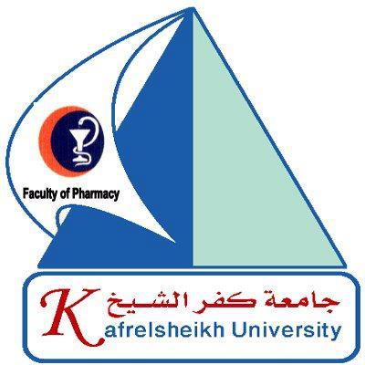

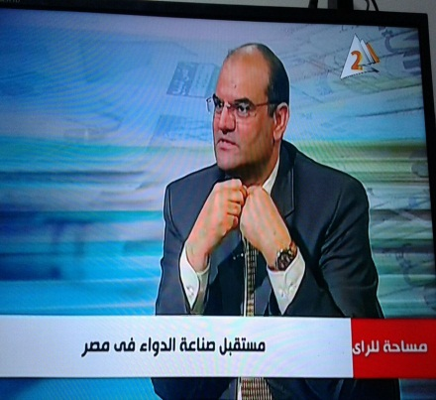
Nabil Mohie Abdel-Hamid
Ex-Dean and Prof of Cancer Biology
( Biochemistry Department)
in
Pharmacy College, Kafrelsheikh University, Egypt
nabilmohie@yahoo.com
Presented
By

Slide 3
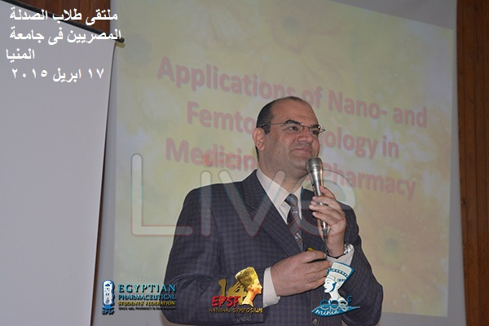
Lectures stories

Slide 4
Contents
Background.
Definitions of Nanomedicine and Nanopharmacy.
Nano and Femto economics.
Objectives.
Benefits of Nano and Femto World.
Current Applications.
Future Disciplines.

Slide 5
Background
Human health and disease have faced frequent obstacles, that constitute a barrier to discover diseases in a pre-observable state, or to have the facility to treat the disease in a very specific, efficient, targeted way avoiding other healthy environments.

Slide 6
Nanomedicine: It`s defined as the repair, construction and control of human biological systems using devices built upon nanotechnology standards.
Nanopharmacy: It is the use of nanoscales in drug manufacturing, solubility, dosage forms, administration , bioavailability and biodistributions.

Slide 7
Nano and Femto economics
Nanomedicine is a huge industry.
Sales reached 6.8 billion dollars in 2004. USA and European Union are investing billions of dollars and plan to invest more in the future.

Slide 8
Objectives
Globally, scientists work on finding new accurate modalities to set down, think and execute critical tasks within the living cells, then get out, as if being in a minute voyage to solve a threatening problem.

Slide 9
In this voyage, either they could study an ancient uncovered disease or solve a non previously resolved problem.
Human health seems to be a fascinating interest to make a great race and competition among scientists to introduce a gift to the humanity each single second.

Slide 10
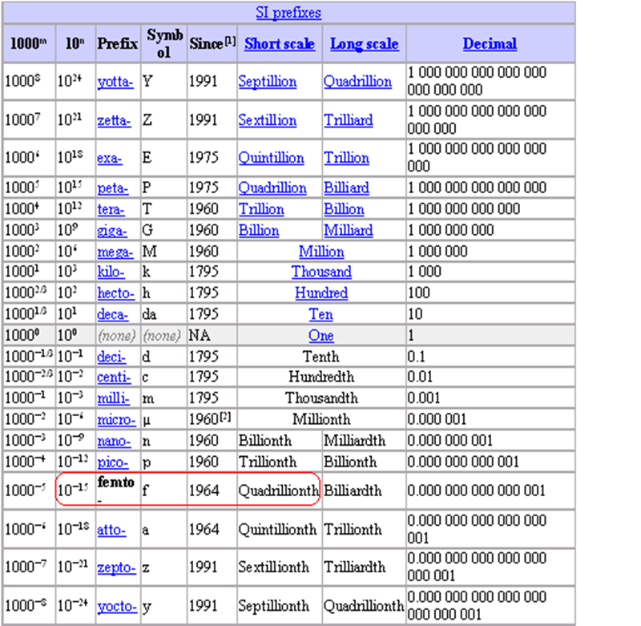
Mathematically

Slide 11
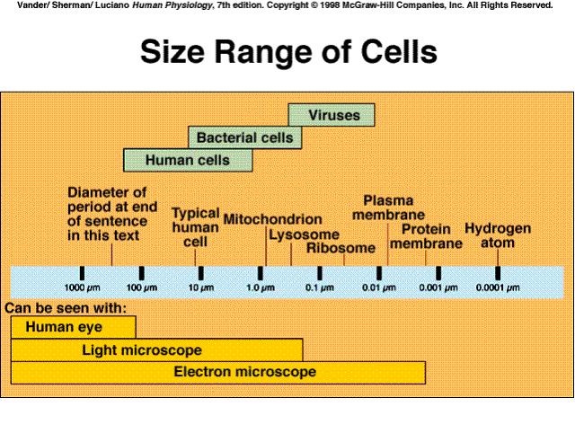
Human cell size is: 9 µm = 9X10⁻⁶m
= 9000 nm
N.B: Division by 10

Slide 12
Cellular pores and distances
Actually, there is no pores in cell membrane in sense of small holes as we could imagine. These pores are integral transmembrane proteins, or, an arrangement of several proteins. It allows them to create passive or active passages through cell wall.
Nuclear pore diameter is around: 9 nm.
The distance between the nucleus and cell membrane is around : 200 nm.

Slide 13
Benefits of Nano and Femto World
At the nano and femto level, materials begin to demonstrate entirely new chemical and physical properties and can be stronger, lighter and highly soluble. The invention of such techniques and devices opened a new era in medical and pharmaceutical applications.

Slide 14
Current Applications
Relevant applications were reported in surgery (femtolaser), cancer diagnosis, biodetection of disease markers, molecular imaging, implant technology, tissue engineering, devices for drug, protein, gene and radionuclide delivery.

Slide 15
I: Cancer Management Examples
1- Currently, cancer management in a very specific targeted manner could be achieved using nano gold particles, which were delivered to tumor cells, with least side effects.
Abdel-Hamid, NM, Bastawy, M A and Nagy, MA (2012): Golden Forms of Nano - Sized Anticancer Drugs . Archives in Cancer Res, 1(1) :1-13.

Slide 16
By irradiating the area of the tumor with an infrared laser, which passes through flesh without heating it, the gold is heated sufficiently to cause death to the cancer cells.
Although still in preclinical phases, it seems quite promising.

Slide 17
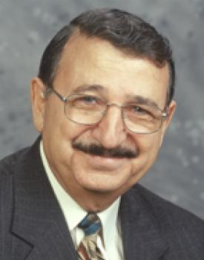
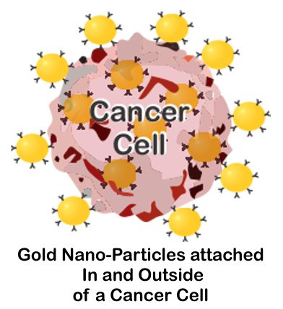
Prof Moustafa El-Sayed: 1 g Gold treats One thousand Cancer Patient, he said.

Slide 18
2- As well as, other metal particles, like nanovehicles for boron delivery to tumor cells, still in preclinical phases, but seems quite promising.

Slide 19
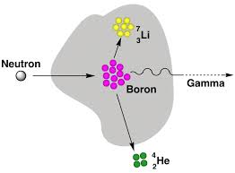
Boron Neutron Capture Therapy

Slide 20
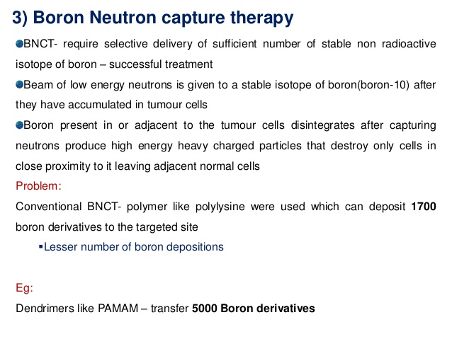

Slide 21
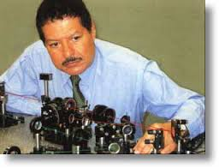
II-Inspective!
Diagnostic !
One of the scientific achievements using femtosecond lasers was taking pictures of chemical reactions while they take place, Ahmed Zewail (1999).
Psychology of Molecules.

Slide 22
IV- Drug Targeting
Positively-charged gold nanoparticles were found to enter the kidneys .
Negatively-charged gold nanoparticles remained in the liver and spleen.
The nanoshells can be targeted to bond to cancerous cells by conjugating antibodies or peptides to the nanoshell surface.

Slide 23
V- Femtolaser vision corrections
Using femtosecond lasers demonstrated how an ultrafast single twist around a chemical bond in the retinal molecule is responsible for initiating the complex bio-molecular response eventually giving rise to a vision stimuli in the brain.
For the well-adapted eye (night vision) the sensitivity to individual light particles (photons) is extremely high, primarily because of the ultrafast initial twist.

Slide 24
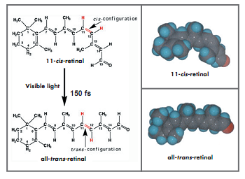
Cis to all trans retinol

Slide 25
VI- Femtosecond Laser Neurosurgery
Ultra-short pulse laser perform extremely precise surgery and cut nano-sized structures of nerve cells.
Conventional lasers heat the area, then cut it, but this increases the risk for tissue damage.
The advantage of “nanoscissors” is ability to cut cell organelles without harming surrounding tissue. The technique uses a series of low-energy femtosecond near-infrared laser pulses.

Slide 26
VII-Thermotherapy and Photo-thermal ablation therapy using nanoshells
Thermotherapy is hyperthermia and thermal ablation therapy. It is based on fact that tumor cells are more sensitive to temperature increase than normal tissue cells (50°C -70 °C).
Photo-thermal ablation therapy using silica nanoshells: Nanoshells are layered, spherical nanoparticles consisting of a dielectric silica (SiO2) core coated with a thin metal shell.

Slide 27
These ceramic-based nanoparticles have a diameter of 100-200 nm and the coating is 10 nm thick. It is a controllable silica core and the thickness of the gold shell. Gold usually absorbs light from visible to UV part of electromagnetic spectrum, which can burn cancer tissue.

Slide 28
Tissue ablation is destruction of diseased (pathologic) tissue with aim to cure a disease.
One way to achieve this is thermal ablation, by either cooling or heating to temperatures lethal to cells (below -40 °C or above 50 °C).
Different physical principles for heating and cooling tissue, as radiofrequency (RF) electric current, microwaves, laser, ultrasound, and cryogenic cooling or cryogenic freezing.

Slide 29
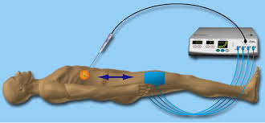
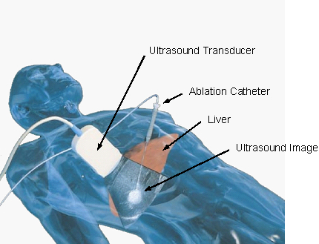
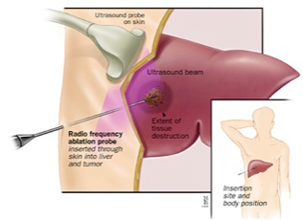
Classical Thermotherapy and Radiofrequency

Slide 30
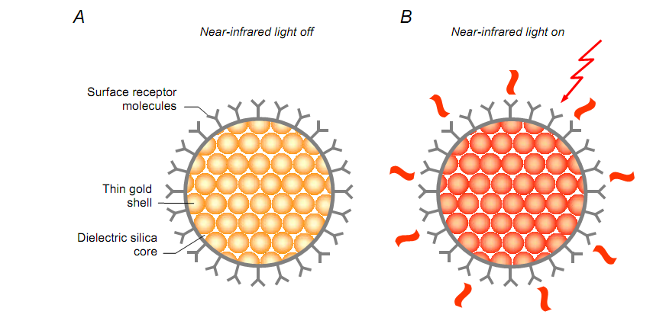
Photo-thermal ablation therapy using gold-coated silica nanoshells. Surface receptor molecules, e.g. antibodies, used for targeting (A). Once accumulated inside a tumor, near- infrared light is used to activate the gold nanoparticles. The gold nanoparticles absorb near- infrared light turning it into heat which is lethal to cancer cells (B).

Slide 31
VIII- NanoChemotherapy of cancer
Nano-structured polymer capsules could be used to deliver chemotherapy directly to tumors, leaving adjacent tissue intact. The concept of the capsule is basically a templating core (~1 µm in diameter), which contains drug particles, surrounded by multi- layered polymer spheres with embedded light-absorbing gold nanoparticles (~6 nm in diameter). A lipid bilayer and tumor-specific antibodies form an outer layer.

Slide 32
If injected into bloodstream, nano- capsules concentrate inside tumors, a low-energy pulse from a near-infrared laser is applied. A 10-nanosecond laser pulse is brief enough to heat the gold nanoparticles which swell up to 50 nm in diameter.
The pulse is very short, damage the contents of nano- capsules, will melt the gold, rupture polymer spheres and nano- capsules subsequently release their contents.

Slide 33
In clinical use the laser could be targeted through the skin, or be beamed inside the body via an endoscope. The infrared energy (100 mJ/cm²) needed for the rupture of the nano-structured capsules is well within safety limits.

Slide 34
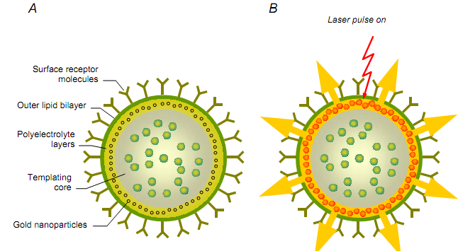
Optically addressable nano- structured capsule for controlled delivery. A core content is covered with a seven layer polyelectrolyte shell (A). The outer part of the capsule contains additional lipid bilayers with surface receptor molecules. Light-absorbing gold nanoparticles are embedded in polyelectrolyte layers. A short laser pulse heats the gold nanoparticles which swell in diameter causing rupture of the polymer capsule (B).

Slide 35
Future Disciplines
Nanopharmacy: In the future, drugs are planned to be packed into nanoscopic plastic spheres which can be inhaled and new type of porous polymer particles for releasing drugs in an environment resembling lungs for respiratory diseases, also, robotics are planned for cell and tissue repair, no specific ceiling is known.

Slide 36
Surgery: Blood leaks caused during re-stitching the arteries that cut during a kidney or heart transplant. The flesh welder could weld the artery perfectly.
Nanoparticles of cadmium selenide glows when exposed to ultraviolet light. When injected, they seep into cancer tissues. The surgeon can see the glowing tumor and use it as a guide for more accurate tumor removal.

Slide 37

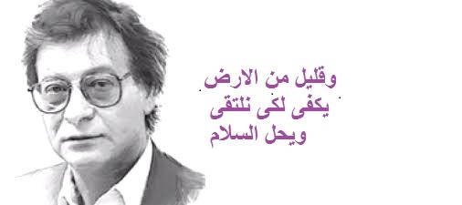
Thanks

